Slide 1
The Age of Mental Wellness
Mental Wellness Category – Just How Big Is It? (size of the problem/opportunity)
Science & Business (how we can solve it)
Current & Future Trends (where it is going)

Slide 2






Americans' Mental Health Ratings
Sink to New Low (Dec 7, 2020 – GALLUP)
Each year since 2001, Gallup has asked Americans as part of its November Health and Healthcare survey to say whether their own mental or emotional wellbeing is excellent, good, only fair, or poor.
Those rating their mental health as “excellent” or “good” has historically ranged from 81% to 89% - until this year's 76%.
Americans' latest assessment of mental health is worse than it has been at any point in the last two decades
    Excellent (34%) / Good (42%) / Fair (18%) / Poor (5%)

Slide 3
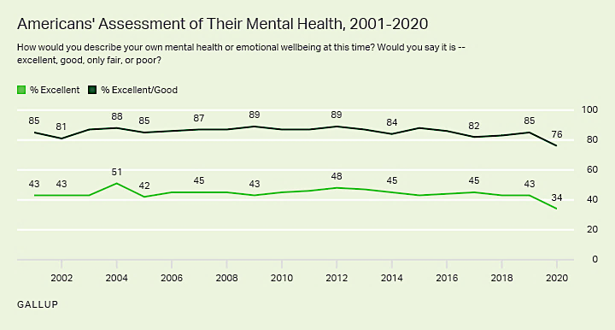

Slide 5
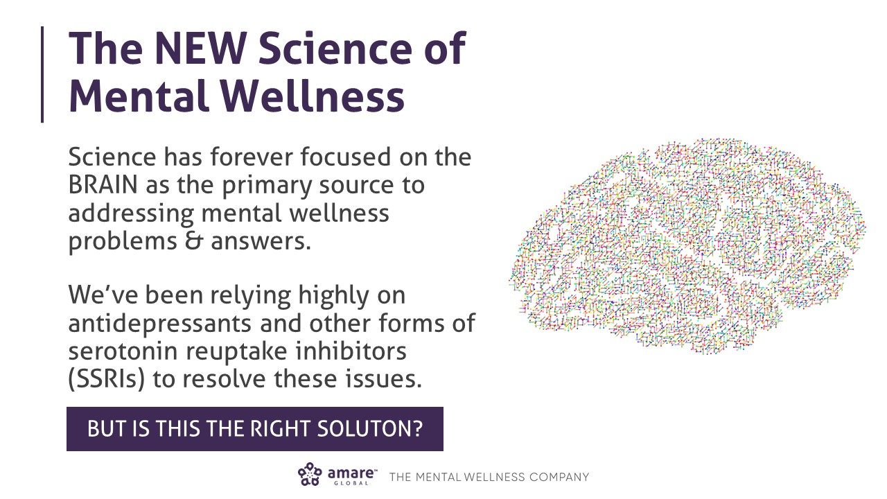

Slide 6




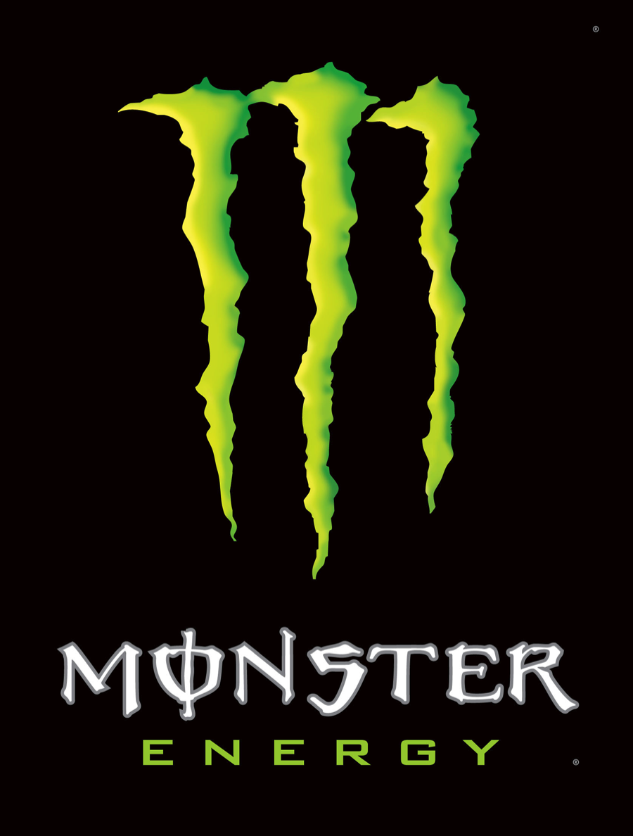










$100B+

Slide 7
The Mental Wellness Continuum
How you feel is not just in your head — it’s also in your gut and heart.
You can now DO something NATURALLY to improve your mental wellness.
WHERE ARE YOU ON THE MENTAL WELLNESS CONTINUUM?
1
2
3
4
5
6
7
8
9
10
“Struggling”
“Typical”
“Flourishing”
Depression
Anxiety
Diabetes
Obesity
Heart Disease
Autoimmune
Arthritis
Fibromyalgia
CFS
Dementia
ADD / ADHD
Alzheimer’s
Fatigue
Tension
Sad
Brain Fog
Headaches
Acne
Eczema
Congestion
URTIs
Joint Pain
Muscle Pain
Bloated
Chubby
Energetic
Calmness
Happy
Sharp
Creative
Clear Skin
Rarely Sick
Flexible
Lean
Strong
Resilient
RED
ORANGE
YELLOW
GREEN
BLUE
INDIGO
VIOLET
Notes:
Wherever you are today on the mental wellness continuum, you can ”move to the right”

Slide 8
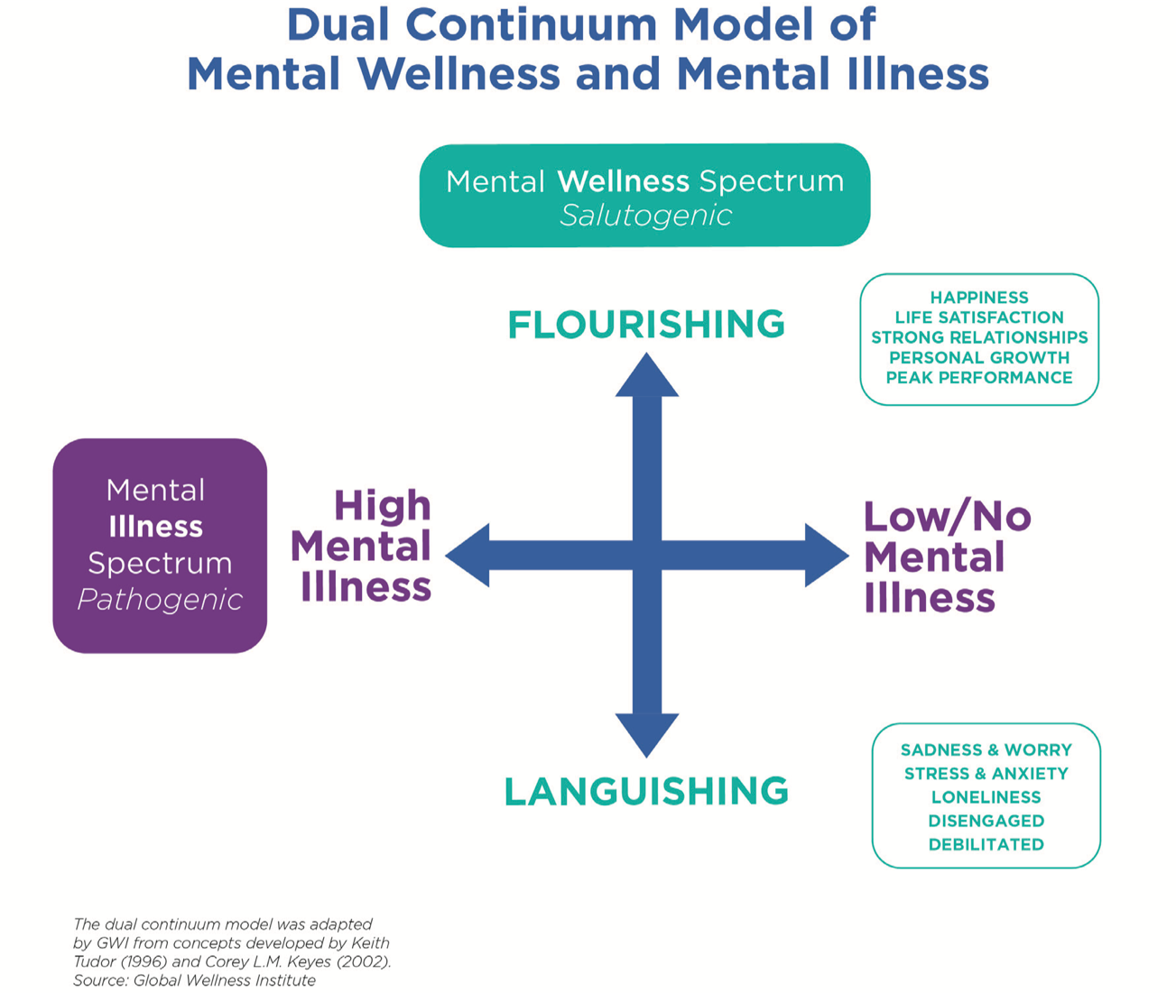

Slide 9

Peak Performance & Mental Wellness
“It’s OKAY to not be OKAY”
Mental Wellness is different from Mental Illness
Mental Fitness is the best version of ourselves
Our “Best Life” rests on a Mental Wellness foundation

Slide 10
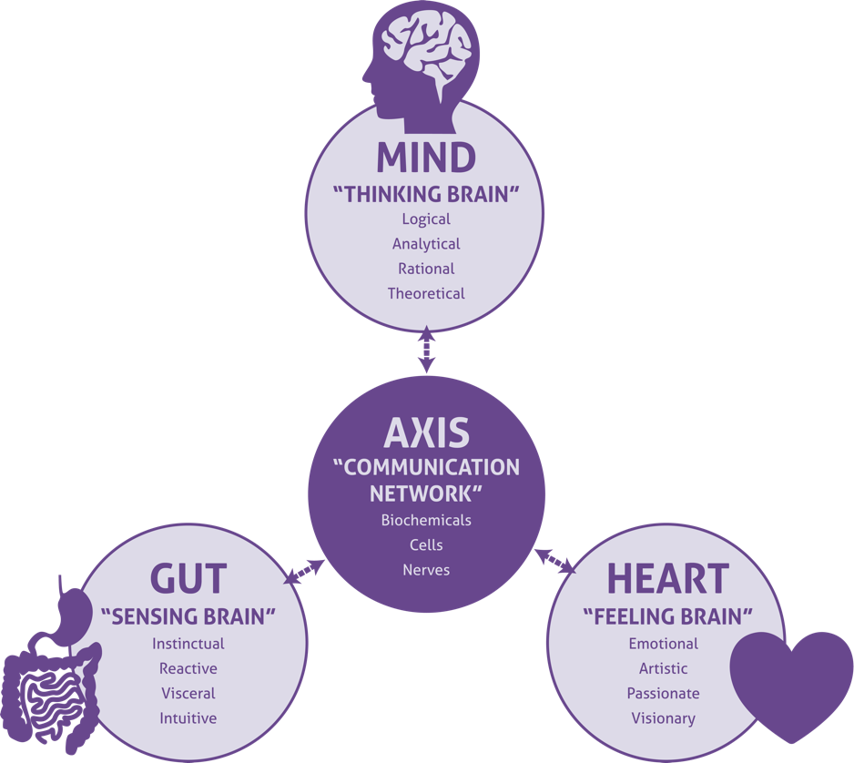
Problem – Old science = how you feel is not just in your head
What if you could harness the new science (gut-heart-brain-axis)

Slide 11
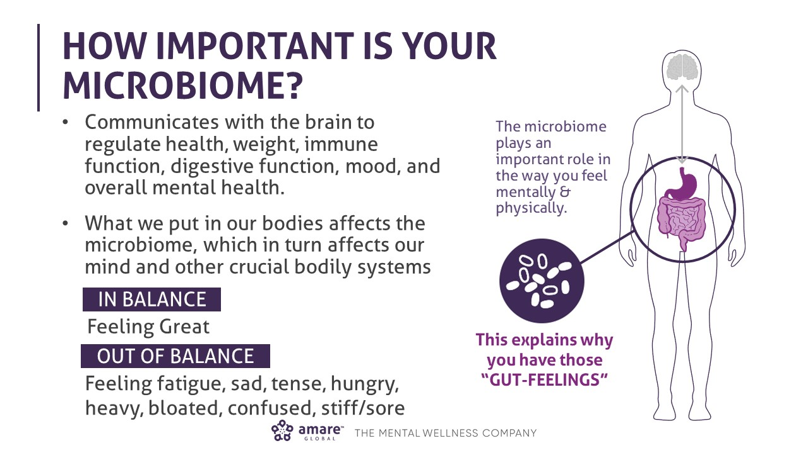

Slide 12
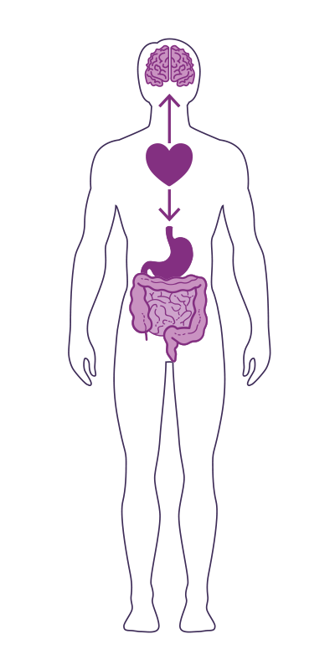
The GUT-HEART-BRAIN-AXIS
Studies have now shown that the heart is the body’s third brain, containing approximately 40,000 neurons that can sense, feel, learn, and remember.
Similar to the gut-brain-axis, the heart and brain are also closely connected via the heart-brain-axis.
The heart sends messages to the brain about what it needs, how the body feels and more.
Nervous system (brain)
Cardiovascular system (heart)
Immune system (axis)
Gastrointestinal system (gut)
Endocannabinoid & Endocrine systems (ECS)

Slide 13
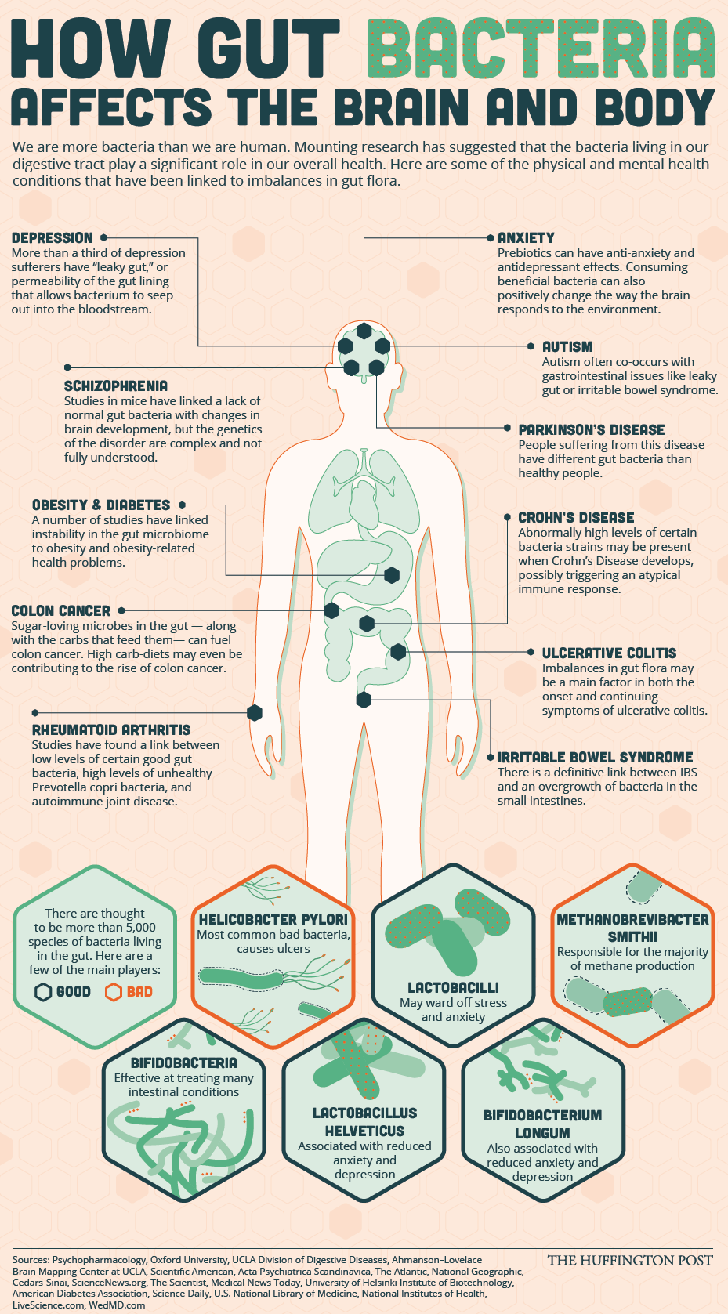

Slide 14
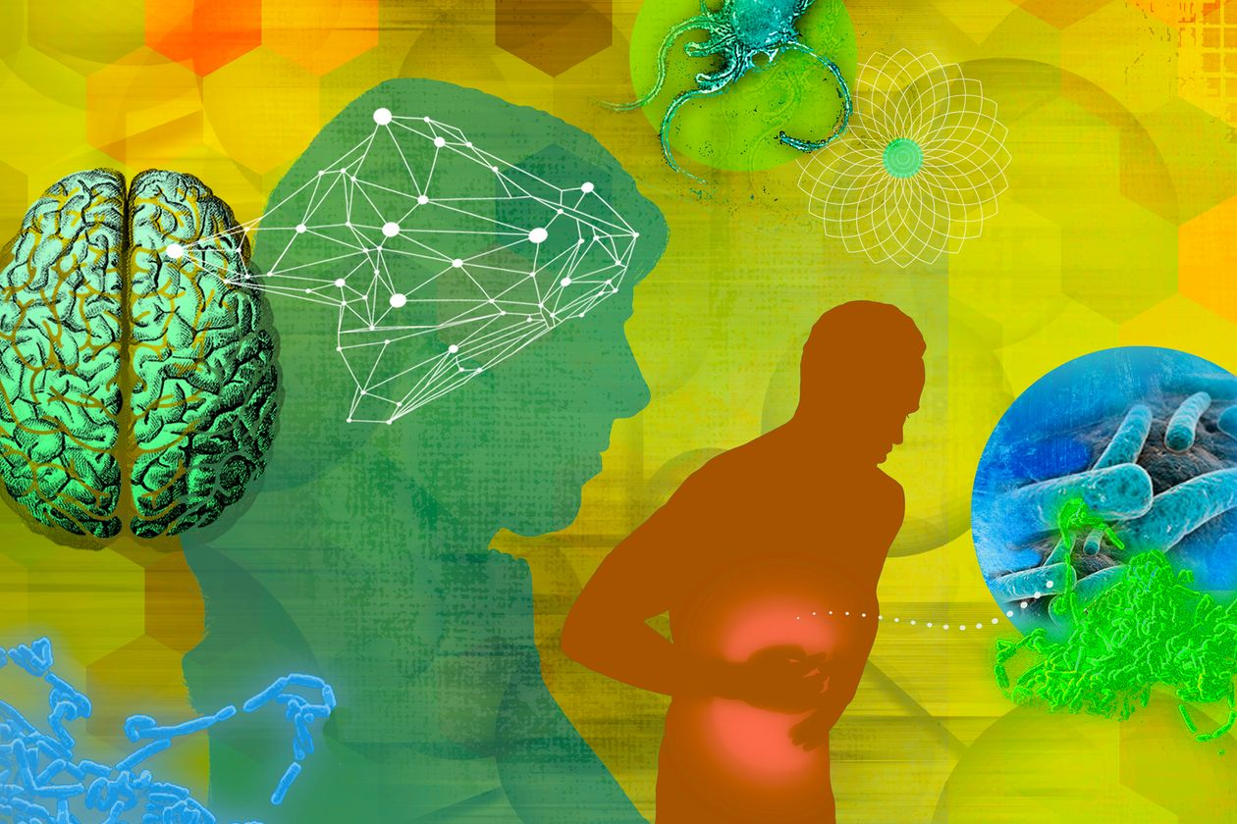
Feeling Depressed? Bacteria in Your Gut May Be to Blame
New studies point to the trillions of organisms in the human microbiome as playing an unexpectedly huge role in our well-being
Wall Street Journal
Dec 21, 2020
https://www.wsj.com/articles/depression-bacteria-in-your-gut-may-have-caused-itor-made-you-healthier-11608565953

Slide 15
the microbial menagerie living in our digestive tract may help regulate brain function, including mental health.
linking our feelings of stress, anxiety and severe depression to disturbances among hundreds of microbe species living in our gut that some researchers have started calling the psychobiome.
bacteria in the gut appear to produce some of the same substances used by doctors to treat depression and may naturally play a role in maintaining our emotional balance.
indiscriminate use of antibiotics and other sanitation measures eliminated the harm that bacteria cause at the expense of the protection they can provide
These microbes appear especially adaptable to changes in the environment, diet and the biochemistry of emotion.
disorders including depression, bipolar disorder, schizophrenia and autism-spectrum disorder have significant disruptions in the composition of their gut microbiome.
Some common gut bacteria, for example, help generate neurotransmitters such as serotonin, which affects neural activity related to mood and memory.
(GABA) to relieve anxiety and improve mood.
by targeting microbes in the gut, we can have behavioral effects that are going to have impact on overall well-being.

Slide 16
NEXT BIG THING

Slide 17


Science!

Slide 18

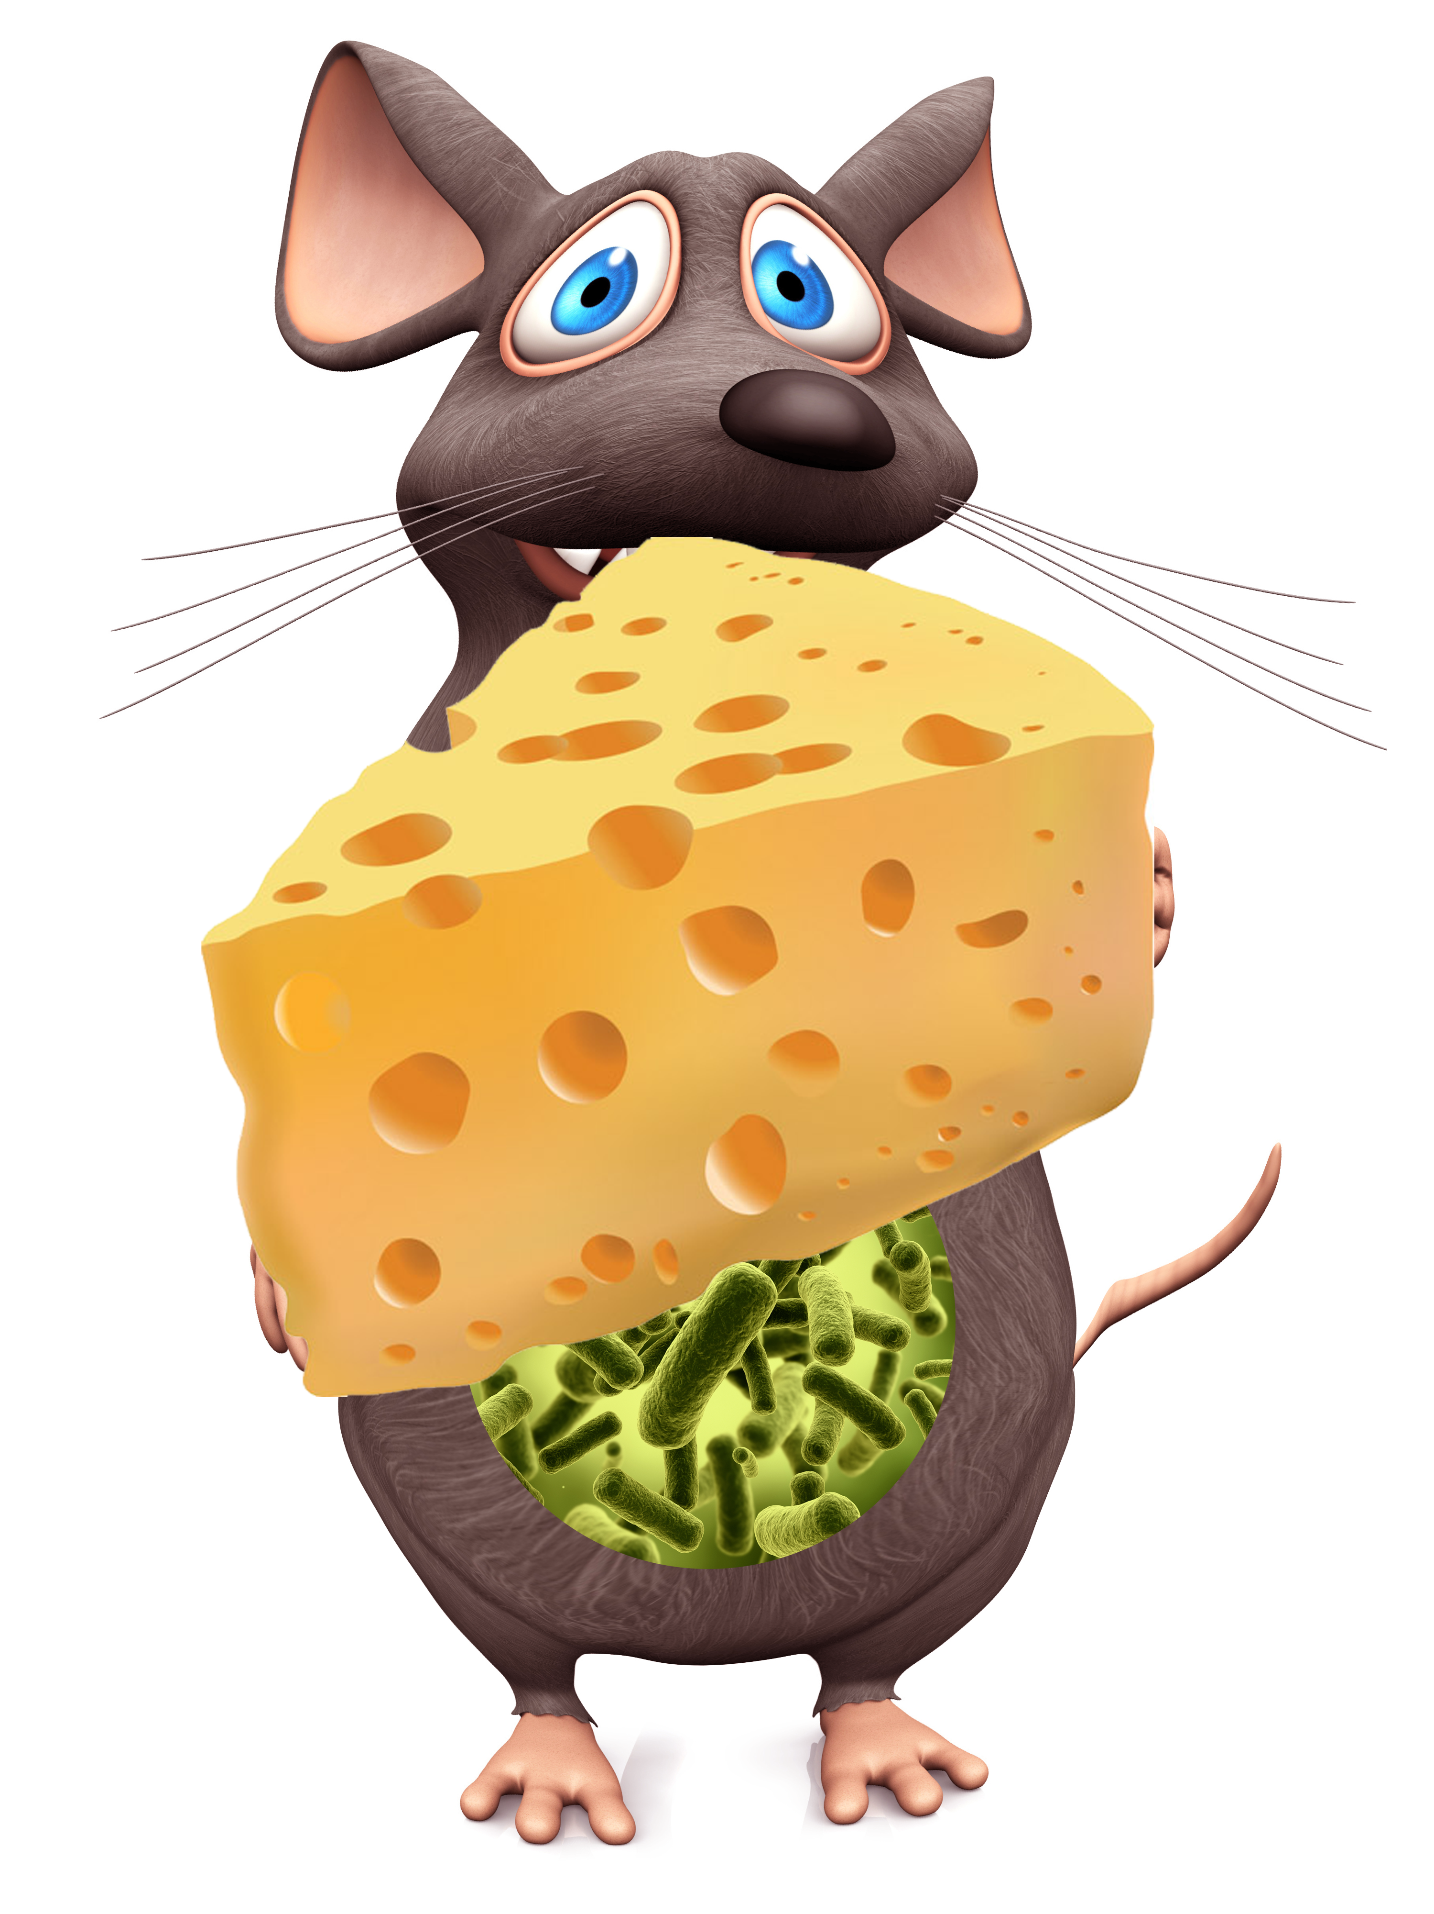

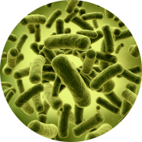
Obese
Overeating
Lean
Obese
Overeating
Obesogenic microbiota
Germ-free
Obesogenic microbiota

Slide 19



Timid
“Introvert”
Outgoing
“Extrovert”
Timid
“Introvert”
Normal gut microbes
Germ-free
Transplanted

Slide 20
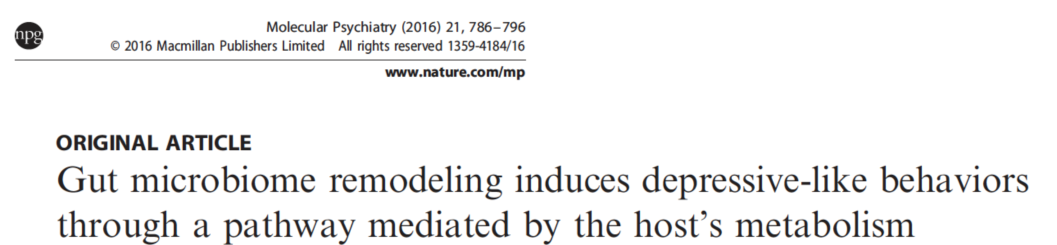
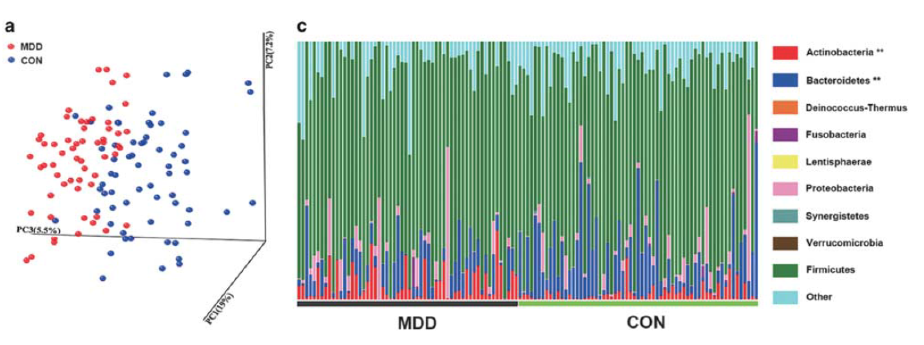
Depression
Zheng P et al, 2016

Slide 21
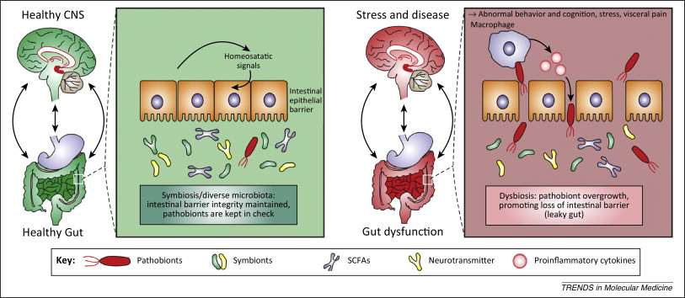

Slide 22

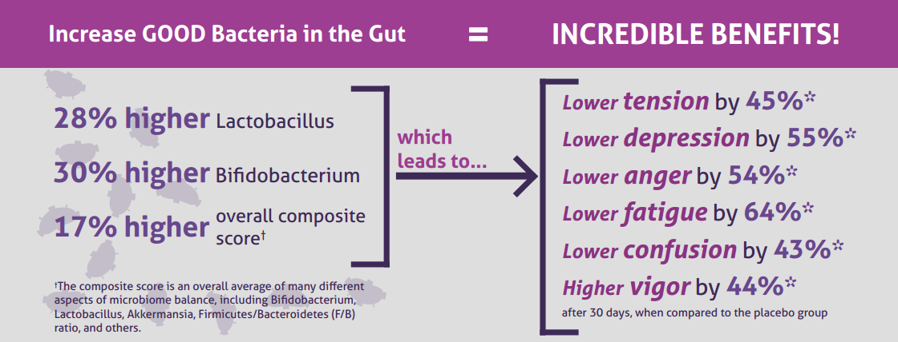
CLINICAL STUDY
The Amare FundaMentals Pack has been clinically proven to:

Slide 23
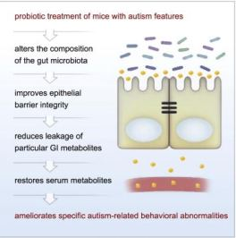

Slide 24
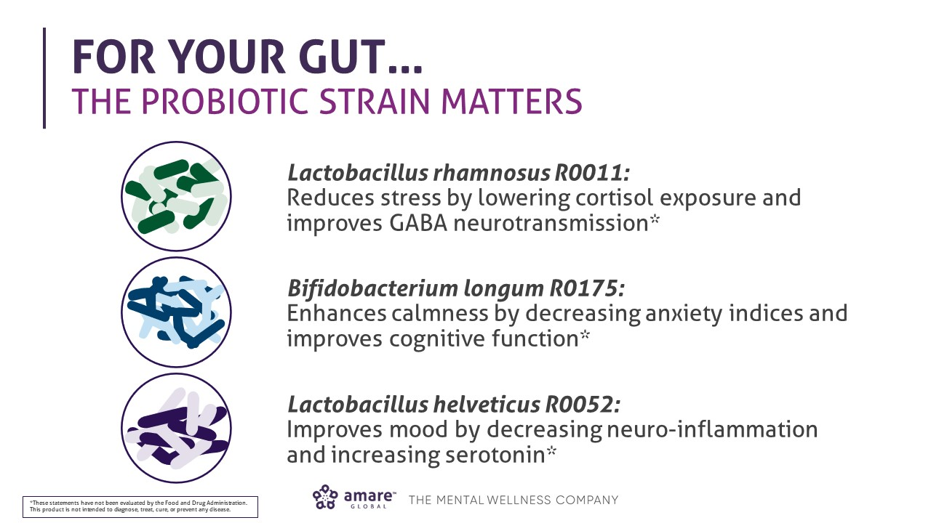

Slide 26
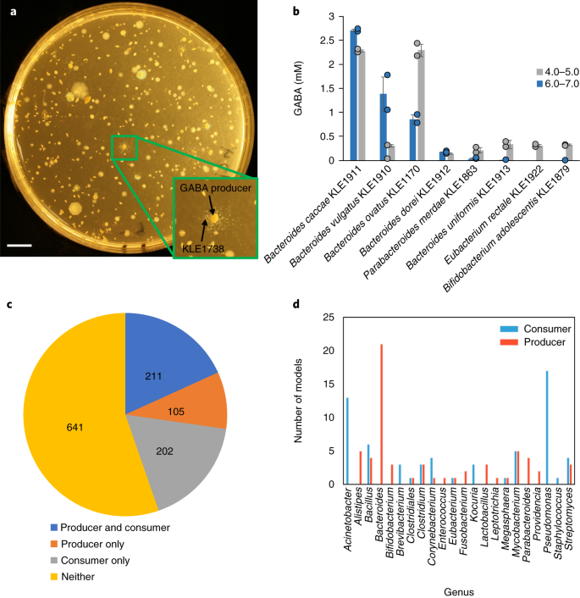
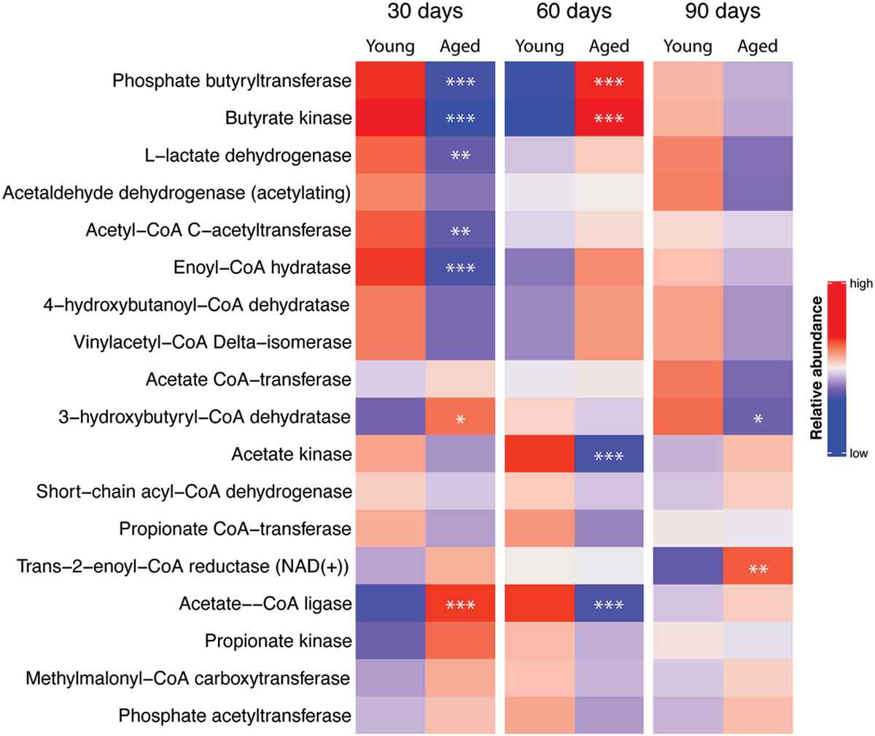
Bacteroidetes/GABA
SCFAs/Butyrate
Bacteroidetes = more GABA = modulate stress, metabolism, mood, sleep, IBS…
-our studies show +6% in Bacteroidetes
With aging/stress = gut microbiome is altered, SCFA production is decreased, and mental/physical performance is impaired
-our studies show +89% in SCFA production capacity (butyrate kinase)
Change your gut – change your brain – change your body – change your future!
Notes:
Bacteroidetes producers = more GABA = modulate stress, mood, sleep, IBS (+6%)
With aging = gut microbiome is altered, SCFA production is decreased, and cognitive performance is impaired (+89%)
Future is NOW!
Change your gut – change your brain – change your body – change your future!

Slide 27
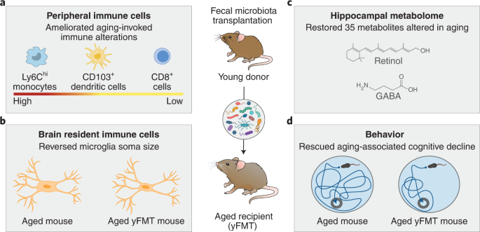

Slide 28

Where do supplements fit?
Stress/Sleep Management
Exercise
Nutrition
Supplements
Evaluation
Supplements
Exercise
Nutrition
Sleep
Evaluation/Environment/Exposure
Motivation and Energy to Exercise?
Appetite and Craving Modulation?
Relaxation and Recovery?

Slide 29
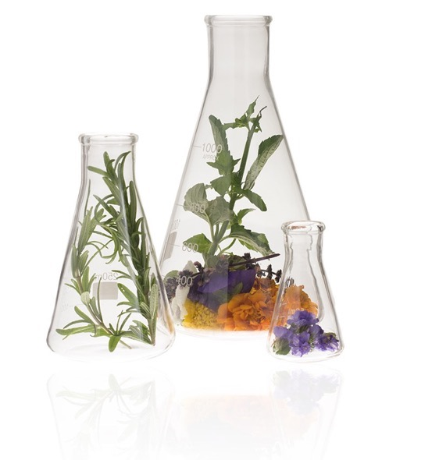
Amare Science & Quality
ANCIENT WISDOM
MODERN INNOVATION
ANALYTICAL VERIFICATION
RESEARCH PROVEN
ETHICAL SOURCING
from the ancient practices of traditional Chinese medicine (TCM), Ayurveda, and other TMS
using psycho-neuro-immunology, microbiome, & Gut-Heart-Brain-Axis research to create proprietary patented formulas
of our safe, pure, potent and traceable all-natural, standardized active compounds from around the globe
branded ingredients, claims substantiation and peer-reviewed clinical studies that prove our products work
of exotic ingredients through our global supply chain of sustainability-focused partners

Slide 30
Peer-Reviewed Scientific Presentations
(related to FundaMentals)
  American College of Nutrition = November 2017, Alexandria VA
  (“Outstanding Research” Award)
  Experimental Biology = April 2018, San Diego, CA
  American College of Sports Medicine = May 2018, Minneapolis, MN
  Mental Health America – Fit for the Future Conference = June 2018, Washington DC
  Microbiome Movement – Gut Brain Axis = November 2018, Boston, MA
  American Mental Wellness Awareness Association = November 2018, Hershey, PA
  NAMI Professional Education Day (National Alliance for Mental Illness) =
  February 2019, Honolulu, HI
  International Society of Nutritional Psychiatry Research (INSPR) =
  November 2019, London, UK

Slide 31
Peer-Reviewed Scientific Presentations
(related to product as noted)
(Kid’s Mood+) = Targeted Dietary Supplementation Improves Mental
Performance in Children
  Experimental Biology / American Physiological Society (April 2020, San Diego, CA)
(B3 Body, MentaHeart, Kid’s Mood+) = The Brain-Body-Biome – How Mental Wellness Drives a Multi-Faceted Impact on Physical Health
  HealCon (Keynote) - complementary medicine conference – (Newport Beach CA, May 2020)
(MentaHeart) = Optimization of Heart-Brain-Axis Signaling
Improves Mental and Physical Performance
  American College of Sports Medicine (May 2020, San Francisco, CA)
(B3 Body) = Dual Role of Gut-Brain-Axis Modulation in Obesity and Depression
  Functional Food Center - 28th Annual Conference on Functional and Healthy Foods for Longevity (San Diego, CA Aug 2020)

Slide 32
Peer-Reviewed Scientific Publications
(Journal articles - related to product as noted)
FundaMentals:
Effect of Coordinated Probiotic/Prebiotic/Phytobiotic Supplementation on Microbiome Balance and Psychological Mood State in Healthy Stressed Adults. Functional Foods in Health & Disease Journal. Vol 9, No 4 (2019)
MentaHeart:
Effect of Astaxanthin Supplementation on Cardiorespiratory Function in Runners”. EC Nutrition 11.6 (2017): 253-259.
Astaxanthin Supplementation Reduces Depression and Fatigue in Healthy Subjects”. EC Nutrition 14.3 (2019): 239-246.
Effect of Astaxanthin Supplementation on Psychophysiological Heart-Brain Axis Dynamics in Healthy Subjects. Functional Foods in Health & Disease Journal. Vol 9, No 8 (2019)
B3 Body:
Modulation of Gut-Brain-Axis Improves Microbiome, Metabolism, and Mood. Functional Foods in Health & Disease Journal. 2020; 10(1): 37-54.

Slide 33
Patent Applications
NUTRITIONAL SUPPLEMENTS AFFECTING GUT-BRAIN-AXIS BALANCE AND MENTAL WELLNESS (GBX Proprietary Blend) (FundaMentals; MentaBiotics; MentaFocus; Energy+; VitaGBX; Kid’s VitaGBX)
NUTRITIONAL SUPPLEMENTS AFFECTING MOOD STATE AND SLEEP QUALITY (Sleep+)
NUTRITIONAL SUPPLEMENTS AND METHODS OF SUPPLEMENTATION AFFECTING THE ENDOCANNABINOID SYSTEM (HempGBX+)
NUTRITIONAL SUPPLEMENTS AND METHODS OF NUTRITIONAL SUPPLEMENTATION AFFECTING HEART/BRAIN AXIS (MentaHeart)
NUTRITIONAL SUPPLEMENTS AND METHODS OF NUTRITIONAL SUPPLEMENTATION AFFECTING MOOD AND FOCUS IN CHILDREN (Kid’s Mood+)
NUTRITIONAL SUPPLEMENTS AND METHODS OF NUTRITIONAL SUPPLEMENTATION AFFECTING MENTAL WELLNESS AND/OR MOOD (OmMega)
NUTRITIONAL SUPPLEMENTS AND METHODS OF NUTRITIONAL SUPPLEMENTATION AFFECTING MICROBIOME METABOLISM (B3 Body)

Slide 34
Awards!
2018 — NutraAward (Best New Finished Product): Fundamentals Pack
2018 — Botanical of the Year (Finalist): Mood+
2018 — Startup of the Year (Finalist): Amare Global
2019 — Probiotic of the Year (Finalist): Kids FundaMentals
2019 – Startup of the Year (Finalist): Amare Global
2022 – Product of the Year (Finalist): Edge
2022 – Probiotic of the Year (Finalist): GBX Fit

Slide 35


Slide 36
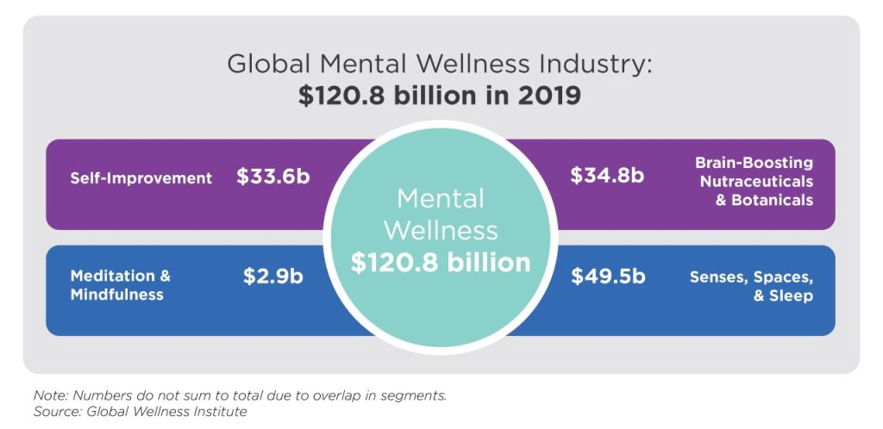
Mental wellness is a dynamic process of moving from languishing, to resilience, to flourishing…

Slide 39






Slide 44


NEXT BIG THING

Slide 45
Thank You!

