Slide 1






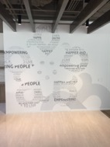
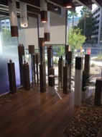
Vision: Leading the mental wellness revolution.
Mission: To create a holistic mental wellness platform that
connects a purpose-driven community of passionate people.
Headquarters located in Irvine, California

Slide 2



Love yourself first
and everything else
falls into place
“to love”

Slide 3



Your Amare Team
Hiep Tran
CEO & Founder
CORPORATE TIMELINE
Idea was Born the Summer of 2016
Formulation began in January of 2017
Pre-Launch (with products) in September of 2017
Official LAUNCH in January of 2018
First Annual Event held in September of 2018
-

Slide 4




.
START UP COMPANY
UNIQUE PRODUCTS
Our vision
is to lead
the global mental wellness revolution
TIMING
TIMING
TIMING
SOCIAL SHIFT
MASSIVE NEED
NEW ERA SCIENCE
TIMING MATTERS!

Slide 5
THE THREE THINGS YOU SHOULD KNOW ABOUT
MENTAL WELLNESS
How you feel is not just in your head – it’s also in your gut.
Our “second brain” includes the Microbiome and plays a major role in mental wellness.
You can now DO something NATURALLY to improve your mental wellness.
WHERE ARE YOU ON THE MENTAL WELLNESS CONTINUUM? (Circle your current number)
1
2
3
4
5
6
7
8
9
10
DISEASE STATUS
“TYPICAL”
OPTIMIZED
Depression
Anxiety
Diabetes
Obesity
Heart Disease
Autoimmune
Arthritis
Fibromyalgia
CFS
Dementia
ADD / ADHD
Alzheimer’s
Fatigue
Tension
Sad
Brain Fog
Headaches
Acne
Eczema
Congestion
URTI’s
Joint Pain
Muscle Pain
Bloated
Chubby
Energetic
Calmness
Happy
Sharp
Creative
Clear Skin
Rarely Sick
Flexible
Lean
Strong
Resilient
RED
ORANGE
YELLOW
GREEN
BLUE
INDIGO
VIOLET

Slide 6
Dr. Shawn Talbott
Amare’s Chief Science Officer
PhD, CNS, LDN, FACSM, FAIS, FACN
20+ years of experience developing nutritional products
Fellow of the American College of Nutrition, the American College of Sports Medicine, and the American Institute of Stress
Author of two academic textbooks, an award-winning documentary film, and several best-selling books that have been translated into multiple languages.
Featured guest on The Dr. Oz Show, Ask Dr. Nandi, The TED stage and the White House
Served as a nutrition educator for elite-level athletes
Diplomate of the International Olympic Committee’s (IOC) Sports Nutrition program
ShawnTalbott.com / Amare.com

Slide 7

GRIM REALITY
MASSIVE NEED
Americans spend over $100 billion annually on “feel better” products, from painkillers and anti-depressants to alternative and complementary therapies
Nearly 100 million Americans suffer from occasional aches and pains – and is one of the most common reasons that people look to complementary and alternative medicine (CAM) for non-pharmaceutical options
Globally, more than 350 million people are affected by feelings of depression each year
More than 80% of the nation’s 20 million college students feel “exhausted and overwhelmed by stress” - and more than one-third feel “depressed” to the point of dysfunction
Notes:
Shawn’s verbiage:
Americans spend over $100 billion annually on “feel better” products, from painkillers and anti-depressants to alternative and complementary therapies
Nearly 100 million Americans suffer from occasional aches and pains – and is one of the most common reasons that people look to complementary and alternative medicine (CAM) for non-pharmaceutical options
Globally, more than 350 million people are affected by feelings of depression each year
Nearly 90% of adolescents struggle with feelings of depression and anxiety before the age of 18
Globally, more than 800,000 people die by suicide every year – around one person every 40 seconds. In the United States, more than 40,000 Americans commit suicide each year – that’s more than 100 suicides per day
Every year, more than 24 million people, some as young as 12 years old, receive treatment for illicit drug or alcohol abuse
Approximately 1 in 5 new mothers in the U.S. have postpartum depression each year
The World Health Organization calls stress “the health epidemic of the 21st century” with more than 350 million people affected around the world
More than 80% of the nation’s 20 million college students feel “exhausted and overwhelmed by stress” - and more than one-third feel “depressed” to the point of dysfunction
SOURCES:
Grim Reality Statistics
Americans spend over $100 billion annually on “feel better” products, from painkillers and anti-depressants to alternative and complementary therapies
Centers for Disease Control and Prevention (CDC) https://www.cdc.gov/nchs/data/hus/hus13.pdf;
Journal of the American Medical Association (JAMA) Trends in Prescription Drug Use Among Adults in the United States From 1999-2012 http://jamanetwork.com/journals/jama/fullarticle/2467552; National Survey on Drug Use and Health https://nsduhweb.rti.org/respweb/homepage.cfm; National Center for Complementary and Integrative Medicine (NCCIM) https://nccih.nih.gov/news/press/cost-spending-06222016
Nearly 100 million Americans suffer from occasional aches and pains – and is one of the most common reasons that people look to complementary and alternative medicine (CAM) for non-pharmaceutical options
National Institutes of Health (NIH), National Center for Complementary and Integrative Medicine (NCCIM), National Health Interview Survey (NHIS) https://nccih.nih.gov/news/press/08112015; Washington Post https://www.washingtonpost.com/news/to-your-health/wp/2015/08/11/nih-more-than-1-in-10-american-adults-experience-chronic-pain/?utm_term=.4dd603a1f016
Globally, more than 350 million people are affected by feelings of depression each year
National Institute for Mental Health (NIMH) https://www.nimh.nih.gov/health/publications/depression/index.shtml; Healthline http://www.healthline.com/health/depression/facts-statistics-infographic; National Alliance on Mental Illness (NAMI) https://www.nami.org
Nearly 90% of adolescents struggle with feelings of depression and anxiety before the age of 18
Depression in Children and Teens, WebMD http://www.webmd.com/depression/tc/depression-in-childhood-and-adolescence-topic-overview#1; National Institute of Mental Health (NIMH) https://www.nimh.nih.gov/health/statistics/prevalence/any-disorder-among-children.shtml
Globally, more than 800,000 people die by suicide every year – around one person every 40 seconds. In the United States, more than 40,000 Americans commit suicide each year – that’s more than 100 suicides per day.
Centers for Disease Control & Prevention, National Center for Health Statistics, Increase in Suicide in the United States, 1999–2014, NCHS Data Brief No. 241, April 2016; New York Times https://www.nytimes.com/2016/04/22/health/us-suicide-rate-surges-to-a-30-year-high.html?_r=0; World Health Organization (WHO) http://www.who.int/mediacentre/news/releases/2014/suicide-prevention-report/en/
Every year, more than 24 million people, some as young as 12 years old, receive treatment for illicit drug or alcohol abuse
National Institutes of Health (NIH); National Institute on Drug Abuse (NIDA) https://www.drugabuse.gov/related-topics/trends-statistics; Substance Abuse and Mental Health Services Administration’s (SAMHSA’s) National Survey on Drug Use and Health https://www.drugabuse.gov/publications/drugfacts/treatment-statistics
Approximately 1 in 5 new mothers in the U.S. have postpartum depression each year
Centers for Disease Control and Prevention https://www.cdc.gov/reproductivehealth/depression/index.htm; Postpartum Progress http://postpartumprogress.org/the-facts-about-postpartum-depression/; American Psychological Association (APA) http://www.apa.org/pi/women/resources/reports/postpartum-depression.aspx
The World Health Organization calls stress “the health epidemic of the 21st century” with more than 350 million people affected around the world
World Health Organization (WHO) http://www.who.int/mediacentre/factsheets/fs369/en/; http://www.who.int/mediacentre/factsheets/fs396/en/; Business News Daily http://www.businessnewsdaily.com/2267-workplace-stress-health-epidemic-perventable-employee-assistance-programs.html; Stress: Concepts, Cognition, Emotion, and Behavior http://scitechconnect.elsevier.com/stress-health-epidemic-21st-century/; WHO World Mental Health http://www.who.int/mental_health/world-mental-health-day/2016/en/
More than 80% of the nation’s 20 million college students feel “exhausted and overwhelmed by stress” - and more than one-third feel “depressed” to the point of dysfunction
American College Health Association http://www.acha.org/ACHA/Resources/Topics/MentalHealth.aspx; American Psychological Association (APA) http://www.apa.org/monitor/2014/09/cover-pressure.aspx;

Slide 8
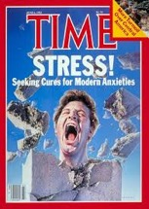


.
MASSIVE NEED
The World Health Organization calls Stress “the health epidemic of the 21st century” with more than 350 million people affected around the world.
Mental Wellness is becoming
“the national conversation”
Notes:
Shawn’s verbiage:
Americans spend over $100 billion annually on “feel better” products, from painkillers and anti-depressants to alternative and complementary therapies
Nearly 100 million Americans suffer from occasional aches and pains – and is one of the most common reasons that people look to complementary and alternative medicine (CAM) for non-pharmaceutical options
Globally, more than 350 million people are affected by feelings of depression each year
Nearly 90% of adolescents struggle with feelings of depression and anxiety before the age of 18
Globally, more than 800,000 people die by suicide every year – around one person every 40 seconds. In the United States, more than 40,000 Americans commit suicide each year – that’s more than 100 suicides per day
Every year, more than 24 million people, some as young as 12 years old, receive treatment for illicit drug or alcohol abuse
Approximately 1 in 5 new mothers in the U.S. have postpartum depression each year
The World Health Organization calls stress “the health epidemic of the 21st century” with more than 350 million people affected around the world
More than 80% of the nation’s 20 million college students feel “exhausted and overwhelmed by stress” - and more than one-third feel “depressed” to the point of dysfunction
SOURCES:
Grim Reality Statistics
Americans spend over $100 billion annually on “feel better” products, from painkillers and anti-depressants to alternative and complementary therapies
Centers for Disease Control and Prevention (CDC) https://www.cdc.gov/nchs/data/hus/hus13.pdf;
Journal of the American Medical Association (JAMA) Trends in Prescription Drug Use Among Adults in the United States From 1999-2012 http://jamanetwork.com/journals/jama/fullarticle/2467552; National Survey on Drug Use and Health https://nsduhweb.rti.org/respweb/homepage.cfm; National Center for Complementary and Integrative Medicine (NCCIM) https://nccih.nih.gov/news/press/cost-spending-06222016
Nearly 100 million Americans suffer from occasional aches and pains – and is one of the most common reasons that people look to complementary and alternative medicine (CAM) for non-pharmaceutical options
National Institutes of Health (NIH), National Center for Complementary and Integrative Medicine (NCCIM), National Health Interview Survey (NHIS) https://nccih.nih.gov/news/press/08112015; Washington Post https://www.washingtonpost.com/news/to-your-health/wp/2015/08/11/nih-more-than-1-in-10-american-adults-experience-chronic-pain/?utm_term=.4dd603a1f016
Globally, more than 350 million people are affected by feelings of depression each year
National Institute for Mental Health (NIMH) https://www.nimh.nih.gov/health/publications/depression/index.shtml; Healthline http://www.healthline.com/health/depression/facts-statistics-infographic; National Alliance on Mental Illness (NAMI) https://www.nami.org
Nearly 90% of adolescents struggle with feelings of depression and anxiety before the age of 18
Depression in Children and Teens, WebMD http://www.webmd.com/depression/tc/depression-in-childhood-and-adolescence-topic-overview#1; National Institute of Mental Health (NIMH) https://www.nimh.nih.gov/health/statistics/prevalence/any-disorder-among-children.shtml
Globally, more than 800,000 people die by suicide every year – around one person every 40 seconds. In the United States, more than 40,000 Americans commit suicide each year – that’s more than 100 suicides per day.
Centers for Disease Control & Prevention, National Center for Health Statistics, Increase in Suicide in the United States, 1999–2014, NCHS Data Brief No. 241, April 2016; New York Times https://www.nytimes.com/2016/04/22/health/us-suicide-rate-surges-to-a-30-year-high.html?_r=0; World Health Organization (WHO) http://www.who.int/mediacentre/news/releases/2014/suicide-prevention-report/en/
Every year, more than 24 million people, some as young as 12 years old, receive treatment for illicit drug or alcohol abuse
National Institutes of Health (NIH); National Institute on Drug Abuse (NIDA) https://www.drugabuse.gov/related-topics/trends-statistics; Substance Abuse and Mental Health Services Administration’s (SAMHSA’s) National Survey on Drug Use and Health https://www.drugabuse.gov/publications/drugfacts/treatment-statistics
Approximately 1 in 5 new mothers in the U.S. have postpartum depression each year
Centers for Disease Control and Prevention https://www.cdc.gov/reproductivehealth/depression/index.htm; Postpartum Progress http://postpartumprogress.org/the-facts-about-postpartum-depression/; American Psychological Association (APA) http://www.apa.org/pi/women/resources/reports/postpartum-depression.aspx
The World Health Organization calls stress “the health epidemic of the 21st century” with more than 350 million people affected around the world
World Health Organization (WHO) http://www.who.int/mediacentre/factsheets/fs369/en/; http://www.who.int/mediacentre/factsheets/fs396/en/; Business News Daily http://www.businessnewsdaily.com/2267-workplace-stress-health-epidemic-perventable-employee-assistance-programs.html; Stress: Concepts, Cognition, Emotion, and Behavior http://scitechconnect.elsevier.com/stress-health-epidemic-21st-century/; WHO World Mental Health http://www.who.int/mental_health/world-mental-health-day/2016/en/
More than 80% of the nation’s 20 million college students feel “exhausted and overwhelmed by stress” - and more than one-third feel “depressed” to the point of dysfunction
American College Health Association http://www.acha.org/ACHA/Resources/Topics/MentalHealth.aspx; American Psychological Association (APA) http://www.apa.org/monitor/2014/09/cover-pressure.aspx;

Slide 9















MASSIVE NEED
$100B+

Slide 10




Cultural Change Around Mental Wellness
SOCIAL SHIFT

Slide 11
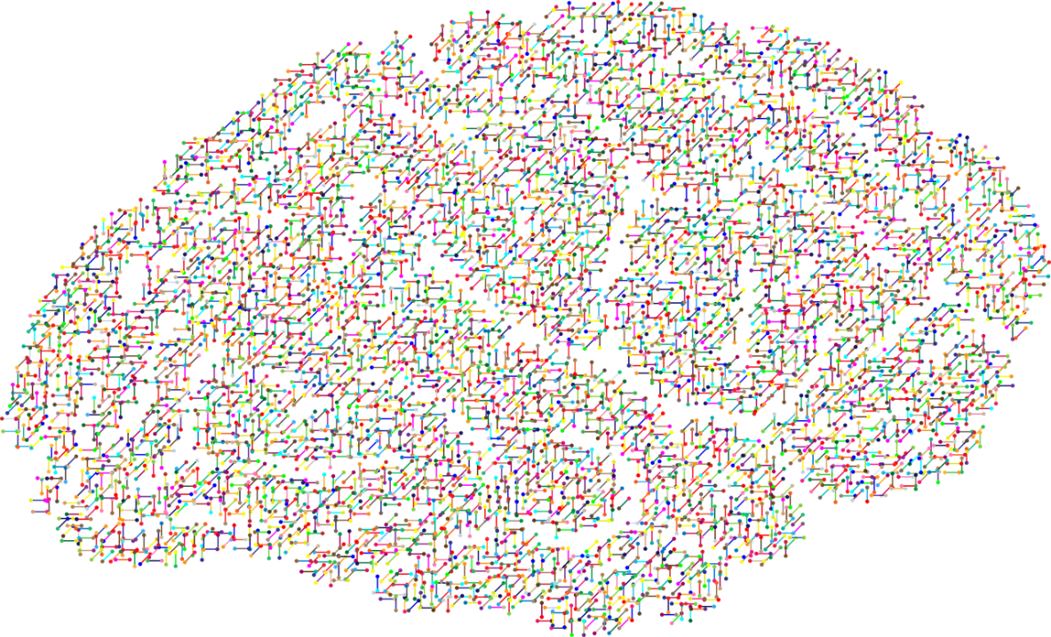
The NEW Science of
Mental Wellness
NEW ERA SCIENCE
Science has forever focused on the BRAIN as the primary source to addressing mental wellness problems & answers.
We’ve been relying highly on antidepressants and other forms of serotonin reuptake inhibitors (SSRIs) to resolve these issues.
BUT IS THIS THE RIGHT SOLUTON?

Slide 12
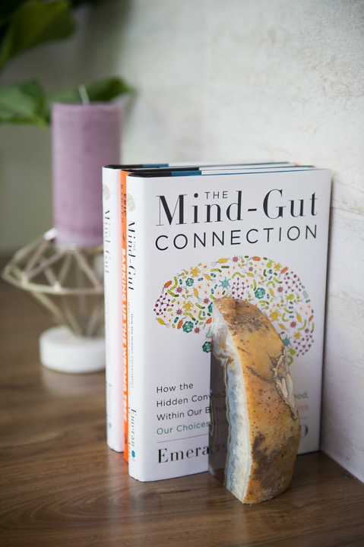
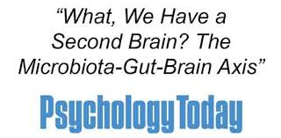
RECENT SCIENTIFIC
DISCOVERIES
NEW ERA SCIENCE
Science now tells us that we actually have a SECOND BRAIN!
There has been a massive scientific shift towards the MICROBIOME, also known as our gut and second brain, as being the source to addressing mental wellness issues.

Slide 13
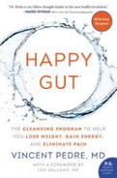
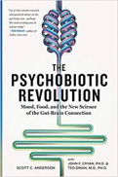

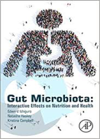
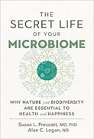
RECENT SCIENTIFIC
DISCOVERIES
NEW ERA SCIENCE
The Gut Microbiome solution is
another “national conversation”

Slide 14
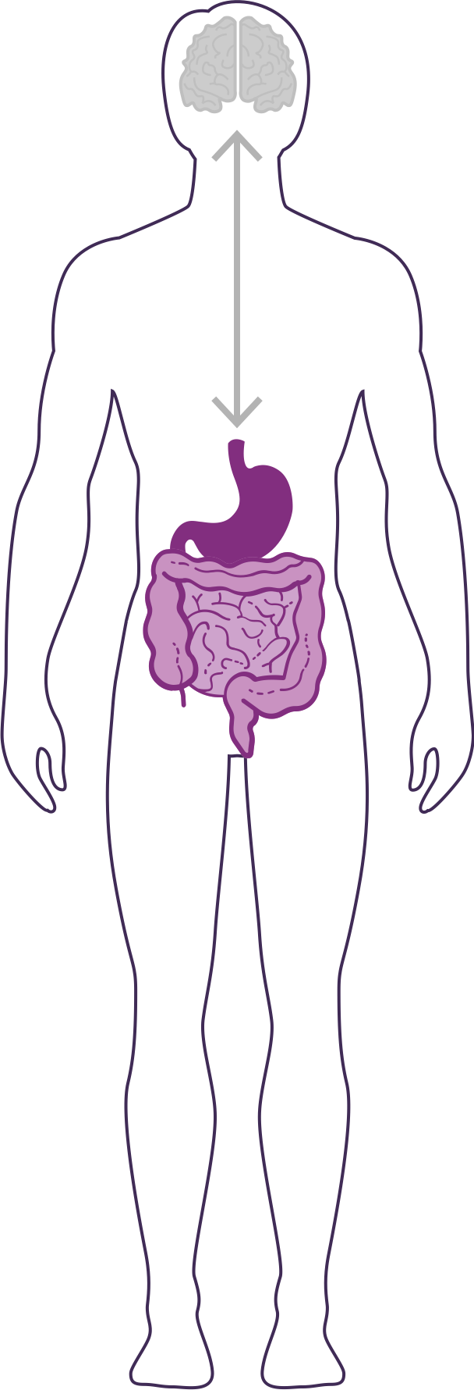
DID YOU KNOW?
NEW ERA SCIENCE
90% of the cells in your body are non-human
  Human genes = ~23,000
  Bacterial genes= ~20 million
  (~1,000x MORE than human genes)
The microbiome is an ecological community of trillions of bacteria living symbiotically in/on our body
  “2nd Brain” = 3-4 lbs (approximately the same size as our 1st brain)
YOUR GUT IS CONSIDERED YOUR SECOND BRAIN

Slide 15
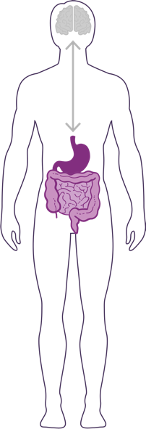
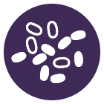
HOW IMPORTANT IS YOUR
MICROBIOME?
Communicates with the brain to regulate health, weight, immune function, digestive function, mood, and overall mental health.
What we put in our bodies affects the microbiome, which in turn affects our mind and other crucial bodily systems
The microbiome plays an important role in the way you feel mentally & physically.
IN BALANCE
NEW ERA SCIENCE
Feeling Great
This explains why you have those “GUT-FEELINGS”
OUT OF BALANCE
Feeling fatigue, sad, tense, hungry, heavy, bloated, confused, stiff/sore

Slide 16
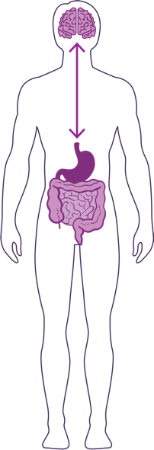
HOW DO YOUR “TWO BRAINS”
COMMUNICATE?
Our “two brains” communicate through a highly extensive network, known as the gut-brain axis (GBX).
NEW ERA SCIENCE
NETWORK CONSISTS OF:
“wires” – nerves
“chemicals” – neurotransmitters/hormones
“cells” – immune system
The GBX connects our
nervous system (brain)
immune system (axis)
and gastrointestinal system (gut)
with a vast array of cellular and biochemical messengers throughout the entire body, which include the microbiome, hormones, cytokines, and neurotransmitters.

Slide 17
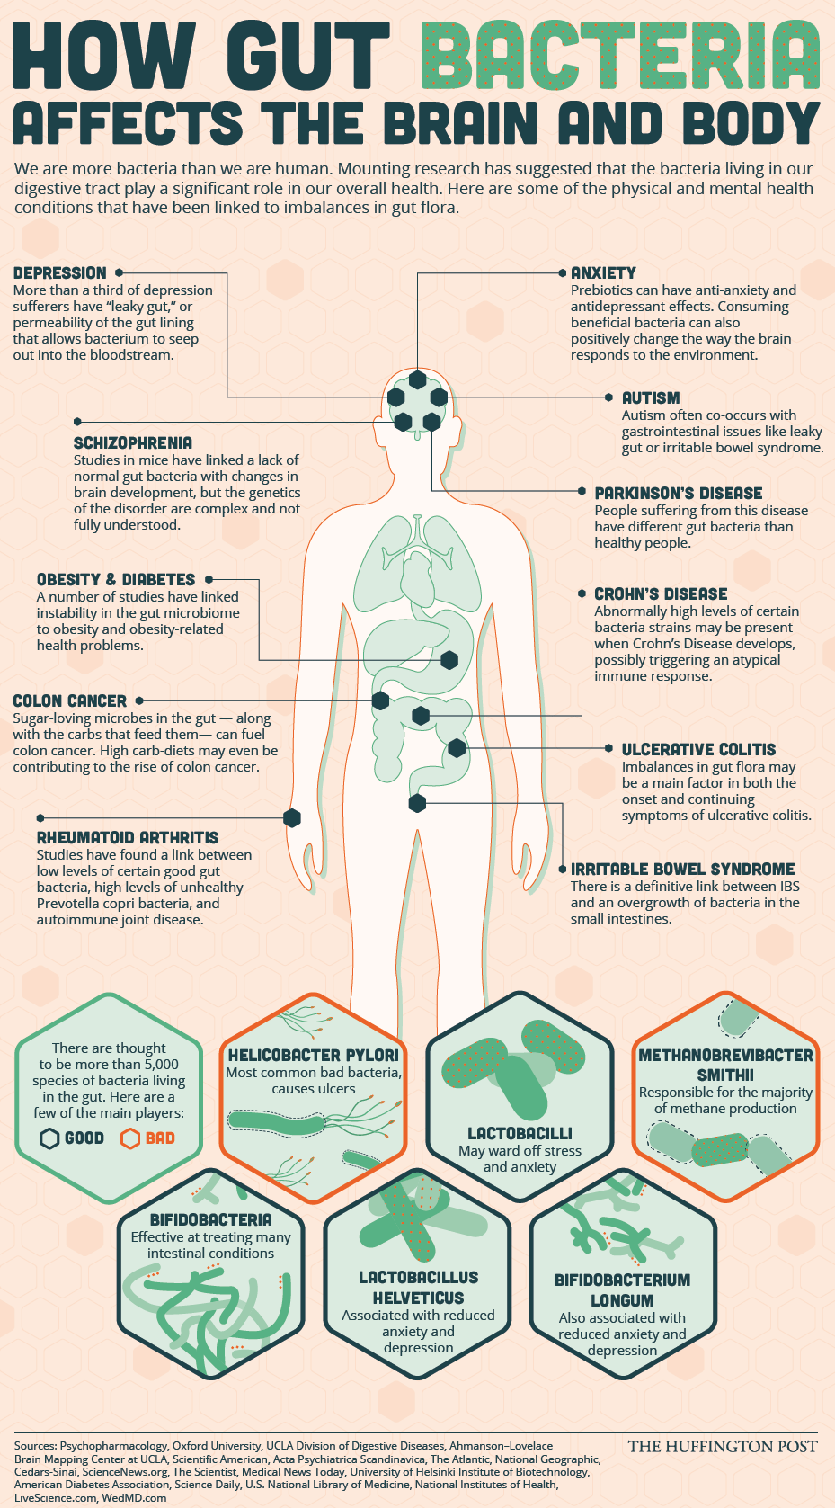

Slide 18
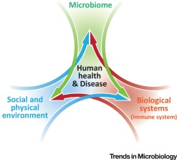
Biome
Body
Brain

Slide 19
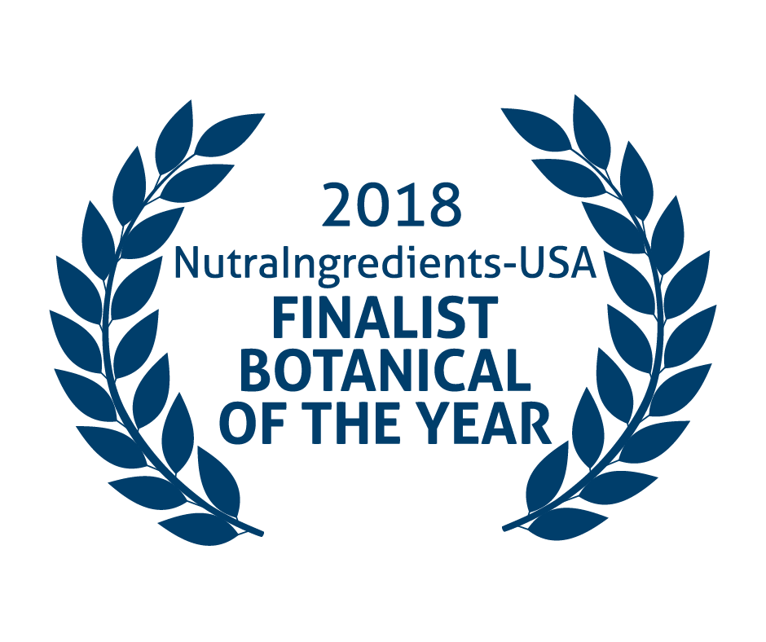
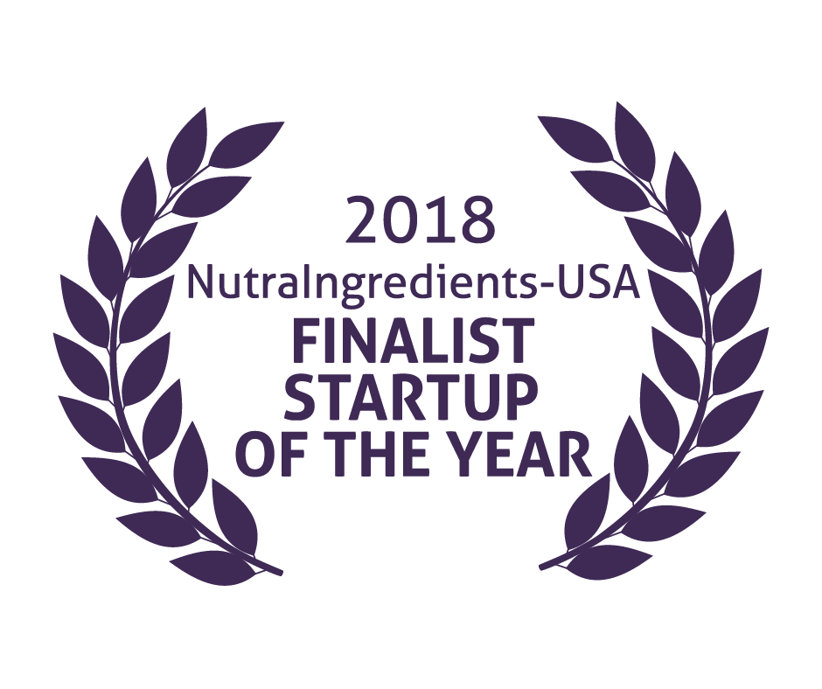
Mood+
Amare Global

Slide 20
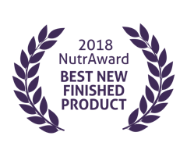
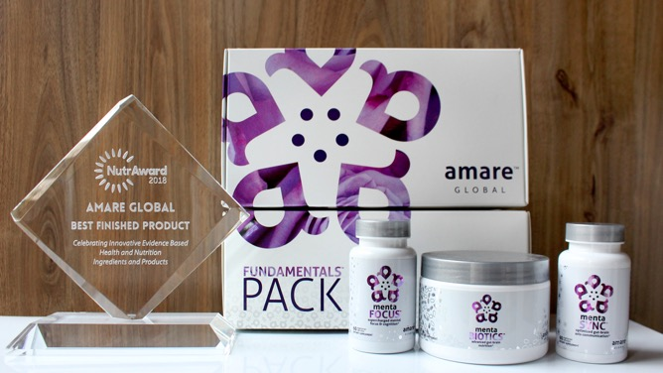
World’s First Award-Winning
Gut-Brain Axis Nutrition System!
The NutrAward recognizes companies that are investing in rigorous and measurable scientific studies to prove the efficacy of their proprietary ingredients or technologies.
Submissions are judged on their merit in the following areas:
Viable product
Emerging Category
Creative product concept
Distinct health application
Unique packaging
Matchless marketing

Slide 21

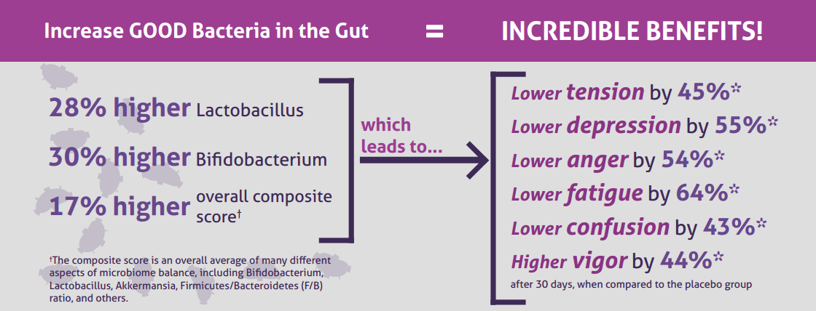
CLINICAL STUDY
The Amare FundaMentals Pack has been clinically proven to:

Slide 22
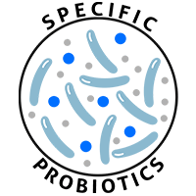
MENTABIOTICS SUGAR FREE
MW3™ Probiotic Proprietary Blend
™
Our blend contains unique and specific probiotic strains targeted to enhance overall mental wellness.*
MW3 Probiotic Strains:
Lactobacillus rhamnosus R0011 — Reduces stress by lowering cortisol exposure and improves GABA neurotransmission*
Bifidobacterium longum R0175 — Enhances calmness by decreasing anxiety indices and improves cognitive function*
Lactobacillus helveticus R0052 — Improves mood by decreasing neuro-inflammation and increasing serotonin*
*These statements have not been evaluated by the Food and Drug Administration. This product is not intended to diagnose, treat, cure, or prevent any disease.

Slide 23
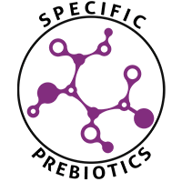
MENTABIOTICS SUGAR FREE
MW3™ Prebiotic Proprietary Blend
™
Our MW3 Prebiotic Proprietary Blend provides optimal gut support by feeding the specific mental wellness probiotic strains found in our MW3 Probiotic Proprietary Blend.*
MW3 Prebiotic Fibers:
IsoFiber™ (Iso-Malto-Oligosaccharides) — Contains a combination of naturally occurring prebiotic plant fibers that are clinically shown to improve the growth of specific probiotic strains featured in Kids FundaMentals™ and now MentaBiotics™ Sugar Free!
Bimuno® (Galacto-Oligo-Saccharides) — Resets and increases friendly gut bacteria, maintains immune health, controls inflammation in the body and supports microbiome balance. Is highly effective and a natural way of increasing preferred bacteria in the gut. Plays an important role in feeding Bifidobacteria probiotic strains.*
SunFiber® (Galactomannan Fiber) — Helps improve the growth and vitality of beneficial bacteria, including Bifidobacteria and Lactobacillus.*
*These statements have not been evaluated by the Food and Drug Administration. This product is not intended to diagnose, treat, cure, or prevent any disease.

Slide 24
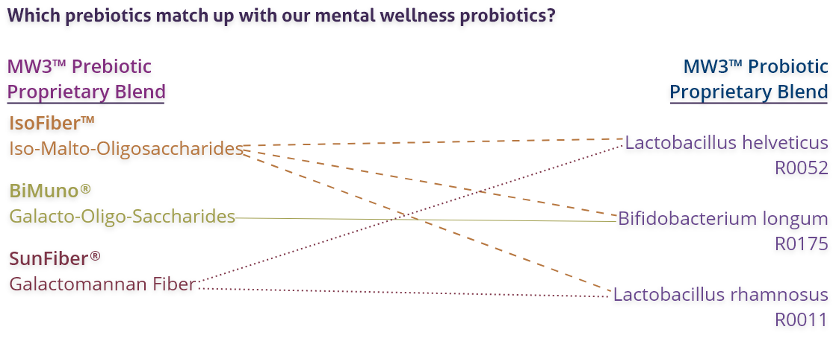
MENTABIOTICS SUGAR FREE
MW3™ Prebiotic/Probiotic Proprietary Blend
™
*These statements have not been evaluated by the Food and Drug Administration. This product is not intended to diagnose, treat, cure, or prevent any disease.

Slide 25
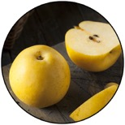

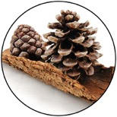
GBX+ Proprietary Blend…
Patent Pending and Exclusive to Amare
Applephenon: Asian Apple Fruit extract
Supports gut health, immune function, & inflammatory balance*
Enovita: French Grape Seed extract
Enhances blood flow, cardiovascular tone, & cellular defenses*
Enzogenol: New Zealand Pine Bark extract
Improves neurotransmitter balance, mental focus, & psychological vigor*
*These statements have not been evaluated by the Food and Drug Administration. This product is not intended to diagnose, treat, cure, or prevent any disease.
Notes:
Shawn: Slide: For Your Gut...: The Probiotic Strain Matters pg.26 -- Part of the reason why this product is so effective, is because we've looked at the research to guide our formulation. One of the very important ways that weve done that is the probiotic strains that we have chosen have already been specifically evaluated for their effects on different mental wellness parameters. This is very important distinction as you go out to talk to people about these products, that probiotics are hot right now, its one of the very important health trends that’s going on. But, the benefits of a probiotic are very very strain dependent. If I just said to you, "Everyone go out and buy some probiotics", and you went to the grocery store to look for probiotics, that would be like me saying, "Go out and get some vitamins." You wouldn’t know what vitamin I was talking about. Did he mean vitamin D or A? Or did he mean Vitamin C or B? All these vitamins do all different things inside the body, its exactly the same with these probiotic strains. So you can see the benefits here, Lactobacillus rhamnosus R0011, that tells us that specific strain does this, it lowers cortisol exposure which is a stress hormone. It increases a neurotransmitter called GABA which is associated with relaxing. Bifidobacterium longum R0175 reduces anxiety and improves cognitive function. Lactobacillus helveticus R0052 decreases neuroinflammation and increases serotonin, so its going to help you with your mood. You know, those benefits are specific to those strains, not to probiotics in general. In our separate probiotic formula, we have different strains that are more associated with more general wellness benefits, diarrhea, constipation, gastro intestinal function, immune system function, inflammation in a different way than your getting here with neural inflammation. In the future, we'll be selecting probiotic strains that are good for the heart-brain axis that is going to compound some of the benefits that we are seeing with this gut-brain axis. It’s a very very exciting area of science, but it’s also very strain-dependent.
There are over 10,000 different species of bacteria in our gut, but there are millions of strains comprising billions of bacteria overall.
Amare’s strains of bacteria are unique and have specific functions around mental wellness.

Slide 26
Portions of Data Presented at:
American College of Nutrition
  November 2017 – Alexandria VA (“Outstanding Research” Award)
Experimental Biology
  April 2018 – San Diego, CA
American College of Sports Medicine
  May 2018 – Minneapolis, MN
Mental Health America – Fit for the Future Conference
  June 2018 – Washington DC
Microbiome Movement – Gut Brain Axis
  November 2018 – Boston, MA
American Mental Wellness Awareness Association
  November 2018 – Hershey, PA
Medical, Nutrition, Biochemistry, Molecular Biology, Physiology, Psychology, Counselors, Policy…

Slide 27


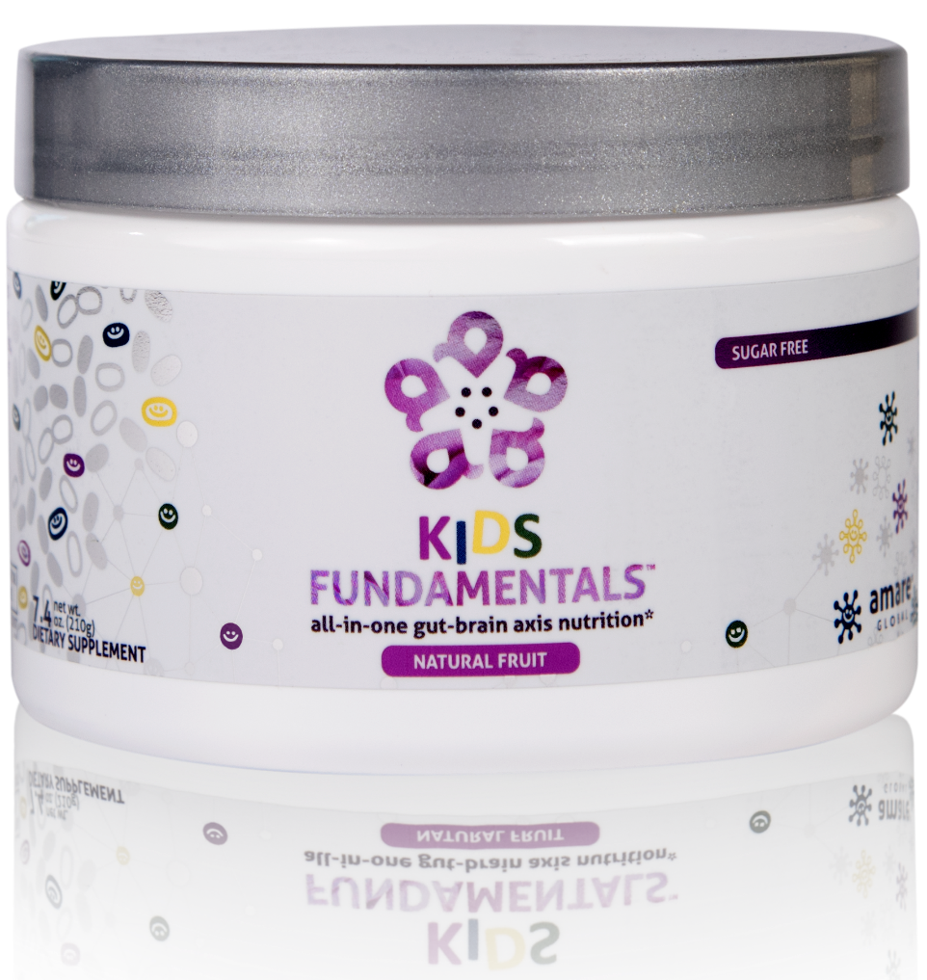
INGREDIENTS SHOWN TO IMPROVE MENTAL WELLNESS*
SUPPORTS ENTIRE GUT-BRAIN AXIS*
EASY-TO-DIGEST FORMULA
all-in-one gut-brain axis nutrition for kids & teens*
Kids FundaMentals™ is an all-in-one product that supports the entire gut-brain axis (GBX) of growing kids and teens. Featuring nutrients scientifically shown to improve mental wellness, this easy-to-digest formula is perfect for kids and teens of all ages.*
*These statements have not been evaluated by the Food and Drug Administration. This product is not intended to diagnose, treat, cure, or prevent any disease.
Notes:
Add callouts

Slide 28
Why is Fundamentals Different?
World’s 1st comprehensive/holistic GBX System
  Addresses each level of GBX balance
  Microbiome modulation
  Gut integrity
  Immune priming
  Inflammatory balance
  Neurotransmitter signaling
Specific probiotic strains for depression/anxiety/stress
Specific prebiotics fibers for stress/resilience
Patent-pending phytonutrients for GBX support
Scientifically-supported formula
  6 peer-reviewed presentations

Slide 29
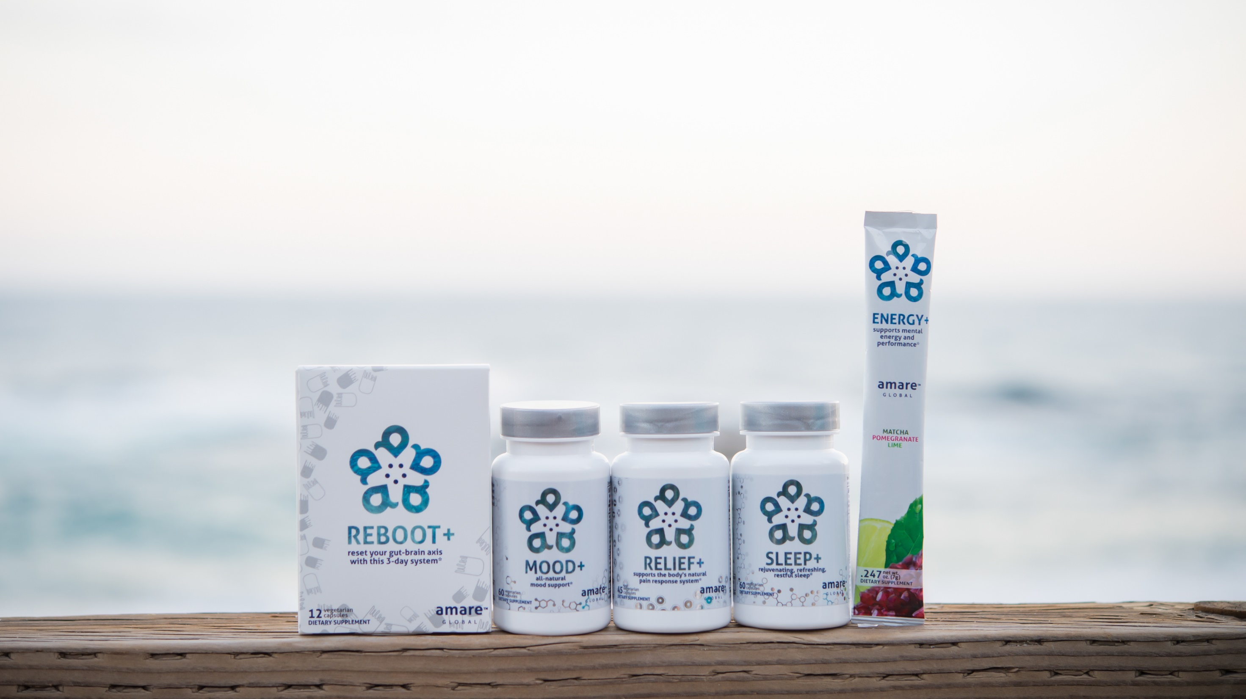

All-Natural Support Solutions for Energy, Mood, Pain, and Sleep*
MENTATHERAPEUTICS
™
*These statements have not been evaluated by the Food and Drug Administration. This product is not intended to diagnose, treat, cure, or prevent any disease.

Slide 30
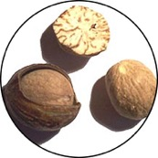

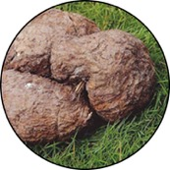
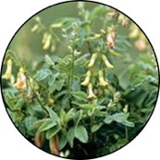
Why is Reboot+ Different?
Worldwide exclusive on Sebatin
  Patented blend of Poria/Myristica/Astragalus
  Improves liver detoxification
Anti-inflammatory
Antioxidant
Hepatoprotective
Poria
lanostane triterpene acids
Panchyman (1,3-β-D-glucan)
Inhibition of iNOS & TNF-α production
Myristica
Phenylpropanoids
Induction of glutathion
S-transferase
Astragalus
Saponins & Polysacharin
Increase tissue SOD and GSH
Free radical scavenging
*These statements have not been evaluated by the Food and Drug Administration. This product is not intended to diagnose, treat, cure, or prevent any disease.

Slide 31
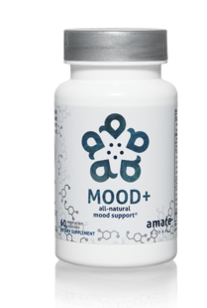

Why is Mood+ Different?
Finalist for Botanical of the Year
Most comprehensive herbal blend for mood support
  Venetron (Rafuma) – Depression
  Zembrin (Kanna) – Stress Resilience
  Sensoril (Ashwagandha) – Tension
  Relora (Magnolia) - Anxiety
MOOD ELEVATING
PROMOTES RELAXATION
TENSION REDUCING

Slide 32
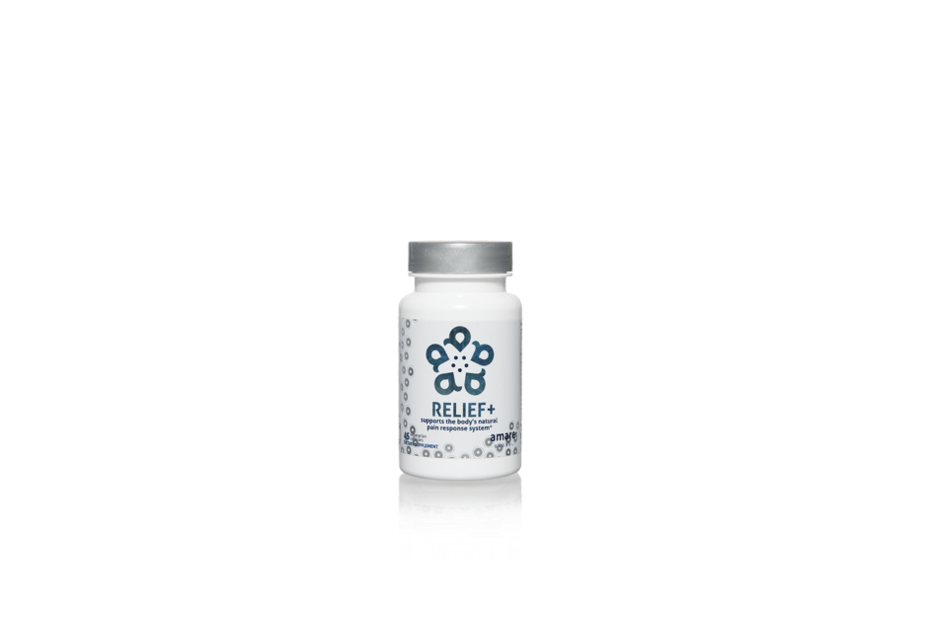
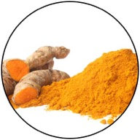
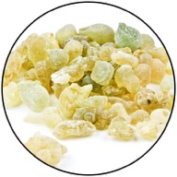
Why is Relief+ Different?
Worldwide exclusive on Meriva/Casperome combination
  Fast-acting Meriva (30x-better-absorbed turmeric)
    Blocks the inflammation/pain NOW
  Long-lasting Casperome (30x-better-absorbed boswellia)
    Inhibits the inflammation/pain LATER

Slide 33
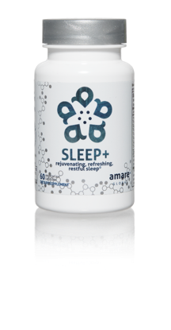
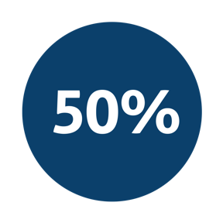
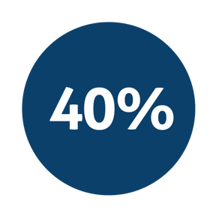

Why is Sleep+ Different?
Worldwide exclusive on patented corn-grass extract
  Research-supported Maizinol (30x potency corn grass)
  Improves Serotonin signaling (depression/anxiety)
  Improves Melatonin signaling (sleep quality)
    40% more time in Deep Sleep (body recovery)
    40% more time in REM Sleep (brain rejuvenation)
Improvement in sleep efficiency*
Improvement in sleep quality*
Fall asleep faster by 33% and wake up fewer times each night by 30%*

Slide 34
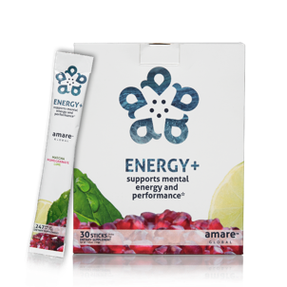
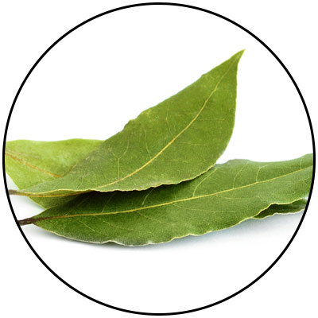
Why is Energy+ Different?
Patent-pending GBX proprietary blend
3-tiered energy
  Physical Energy (motivation)
  Mental Energy (focus)
  Mental Awareness
  (presence/connectedness/engagement)
Guayusa
Amazonian Awareness Enhancer

Slide 35
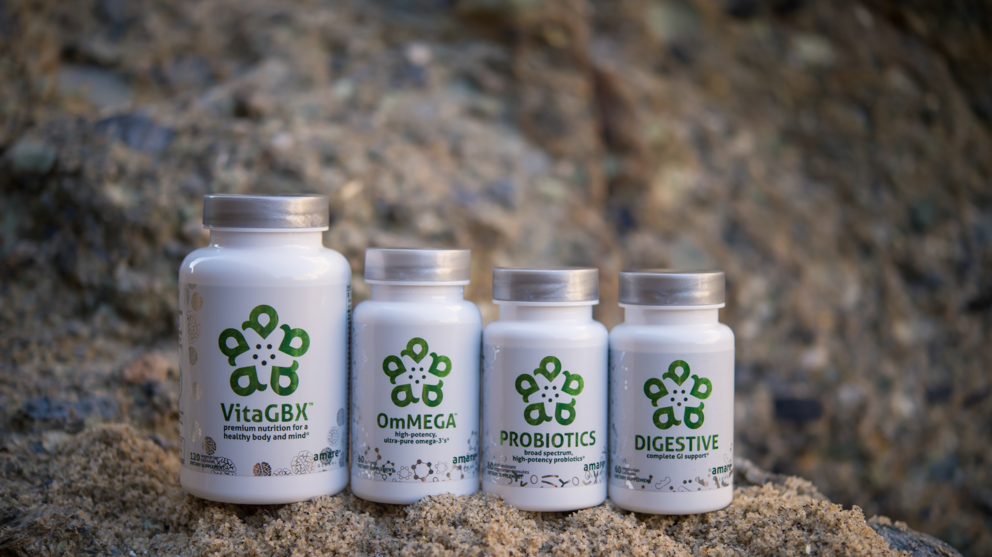
Pure & Potent Daily Essential Nutrients*
MENTAESSENTIALS
™
*These statements have not been evaluated by the Food and Drug Administration. This product is not intended to diagnose, treat, cure, or prevent any disease.

Slide 36
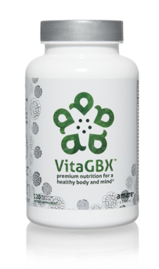
Why is VitaGBX Different?
Patent-pending GBX proprietary blend
Bioavailable forms of vitamins/minerals/phytonutrients
Nourishes Body & Mind
Modulates numerous CDRs (cellular-defense responses)
  Nrf2 (antioxidant)
  NfKb (inflammation)
  SIRT (cellular aging)
  MTOR (metabolism)
  HSP (autophagy = cellular cleanup)

Slide 37


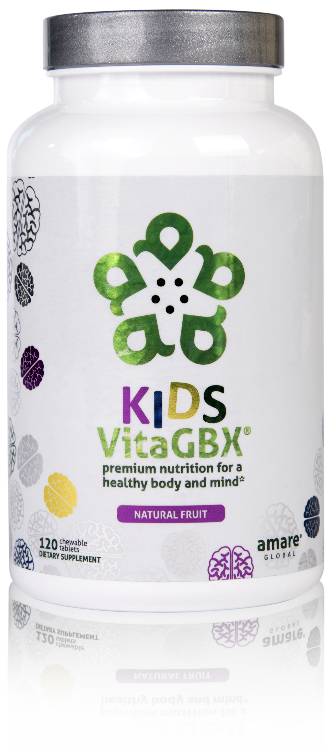
CONTAINS BENEFICIAL VITAMINS AND MINERALS
CONTAINS MORE THAN 50 NUTRIENTS*
PERFECT FOR KIDS AND TEENS OF ALL AGES*
premium nutrition for a healthy body and mind*
Kids VitaGBX® is a comprehensive multivitamin for kids and teens that combines more than 50 vitamins, minerals, amino acids, and phytonutrients. Packed with pure nutrients kids need as they grow and develop, our easy-to-digest chewable tablets feature both our Bright Mind Proprietary Blend (for mind support) and Amare GBX+ Proprietary Blend (for gut-brain axis support) to empower a well-balanced body and mind. Features a delicious, fruity flavor — perfect for kids and teens of all ages.*
*These statements have not been evaluated by the Food and Drug Administration. This product is not intended to diagnose, treat, cure, or prevent any disease.

Slide 38
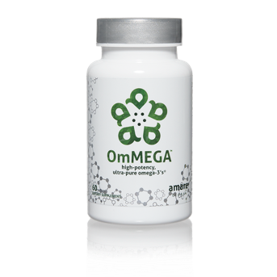

Why is OmMega Different?
High-potency/purity fish oil
70% omega-3 extract
  Typical = 30% omega-3
SUPPORTS COGNITIVE HEALTH
HIGH-POTENCY
EPA + DHA
MERCURY FREE
FISH OIL

Slide 39
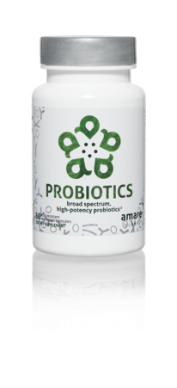
Why is Probiotics Different?
Bifidobacterium bifidum (Bb-06)
Maintains microflora balance by producing lactic acid and acetic acid to compete with “bad” bacteria (Staph. aureus, E. coli, Camplylobacter jejuni, etc).
Bifidobacterium longum (Bl-05)
Highly resistant to low pH and bile salts and is well-suited to the intestinal environment to help reduce inflammation. Helps reduce gastrointestinal discomfort caused by stress.
Lactobacillus acidophilus (La-14)
Ferments carbohydrates to lactic acid, which competes with “bad” bacteria for adhesion spaces on the intestinal mucosa. Increases mineral bioavailability (incl copper, magnesium, calcium, and manganese).
Lactobacillus casei (LC-11)
Wide range of benefits for improved digestion, reduced cholesterol, modulation of inflammation/allergies.
Lactobacillus rhamnosus (Lr-32)
Promotes general GI health and function – especially beneficial to prevent/treat occasional diarrhea and constipation after probiotic treatment.

Slide 40
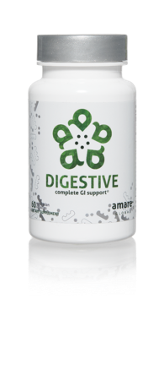
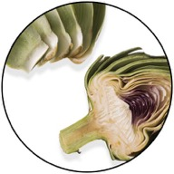
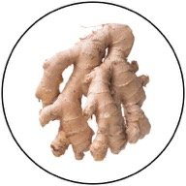
Why is Digestive Different?
Digestive enzymes work on all macronutrients
  Carbs/Fats/Proteins
Digestive enzymes work in all parts of GI tract
  Upper (stomach) / Middle (small intestine) / Lower (colon)
Patented digestive performance blend (ProDigest)
  Motility enhancer – moves food thru GI tract at proper speed
  Improves GI pH – restores “environment” healthy microbiome
A comprehensive blend of digestive enzymes to support the process of digestion in the upper, middle, and lower gastrointestinal system.*

Slide 41
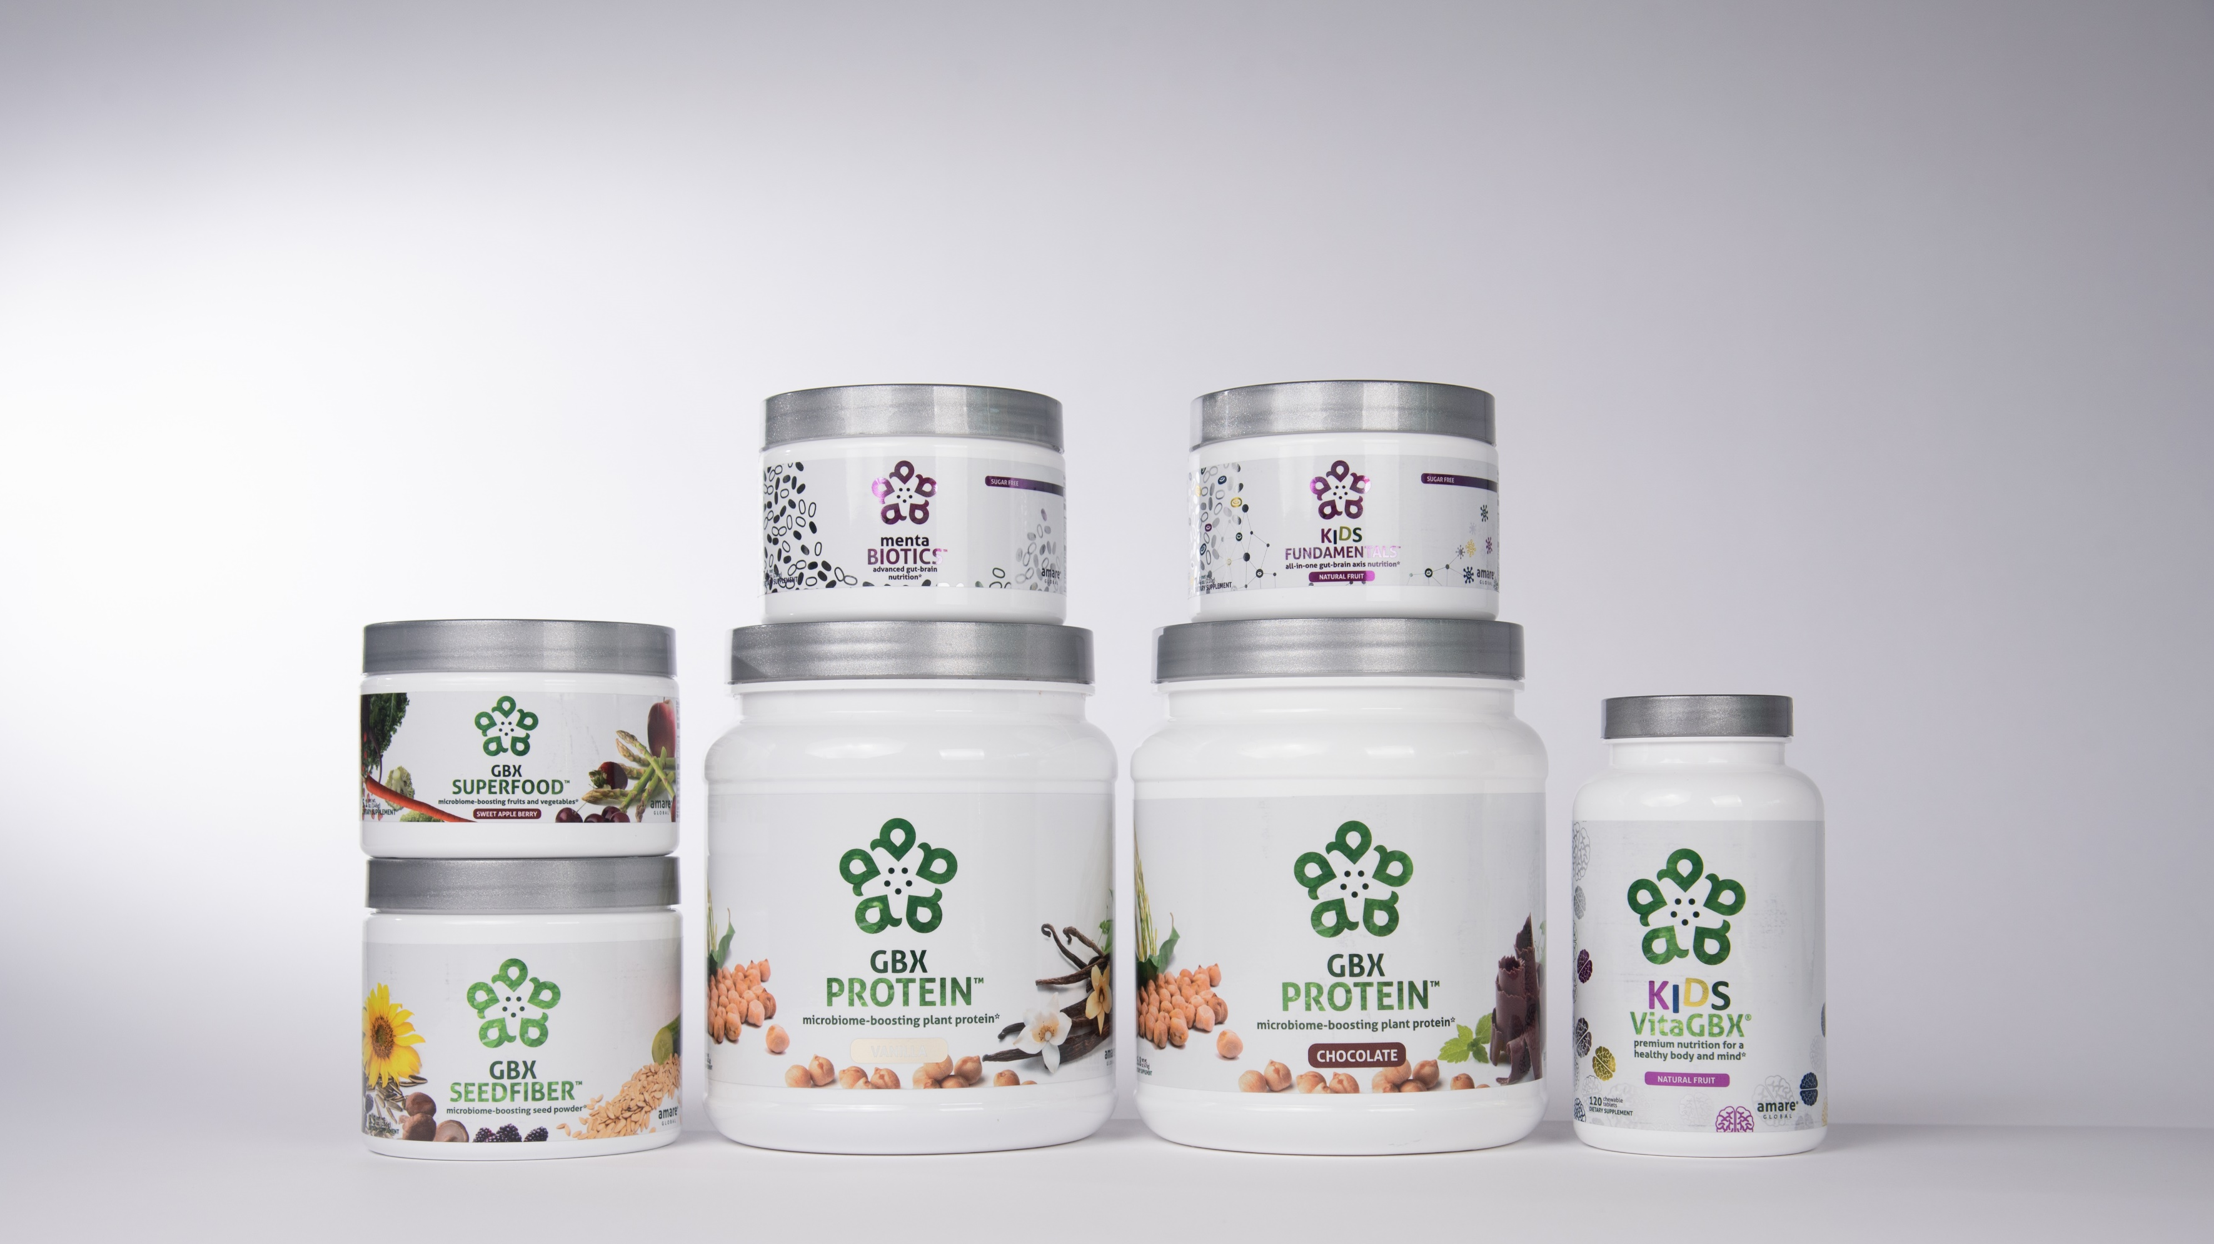

INTRODUCING NEW AMARE PRODUCTS

Slide 42







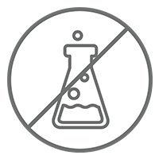
Microbiome-Boosting Nutrition*
GBX FOODS
™
Vegan /
All Natural*
Non-GMO and Gluten Free*
Sugar Free*
Soy and Dairy Free*
No Preservatives, Artificial Colors, Flavors and Sweeteners*
*These statements have not been evaluated by the Food and Drug Administration. This product is not intended to diagnose, treat, cure, or prevent any disease.

Slide 43



HELPS CONTROL APPETITE AND SUPPORTS MUSCLE MASS*
17 GRAMS OF ULTRA-PURE, PLANT-BASED PROTEIN*
NOURISHES GOOD GUT BACTERIA*
microbiome-boosting plant protein*
GBX Protein™ delivers 17 grams of pure plant protein. This unique chickpea, brown rice, and pea protein blend nourishes good bacteria in the gut and improves microbiome balance, while controlling appetite and supporting muscle mass. Fully-loaded with only functional ingredients, this potent formula supports the gut microbiome, helping fuel a healthy lifestyle.*
*These statements have not been evaluated by the Food and Drug Administration. This product is not intended to diagnose, treat, cure, or prevent any disease.

Slide 44




Why is GBX Protein Different?
Chickpea protein (Artesa)
  Small/uniform particle size = creamy mouthfeel
  Essential AA profile = muscle maintenance
  Oligosaccharides = microbiome nourishment
Improves
microbiome balance*
Helps control appetite*
Increases
energy*

Slide 45


NUTRIENTS EQUIVALENT TO 3 SERVINGS OF FRUITS AND VEGETABLES*
NOURISHES GOOD GUT BACTERIA*
PROVIDES CELLULAR ANTI-STRESS BENEFITS*
microbiome-boosting fruits and vegetables*
GBX SuperFood™ provides the phytonutrient equivalent of three servings of fruits and vegetables per scoop. This phytobiotic-rich blend delivers cellular level anti-stress benefits and helps protect cells from a variety of different stressors, helping the brain and gut run at peak efficiency.*
*These statements have not been evaluated by the Food and Drug Administration. This product is not intended to diagnose, treat, cure, or prevent any disease.

Slide 46










Why is GBX Superfood Different?
3-servings of fruits/vegetables
Nourishes microbiome (Isofiber)
Improves gut integrity
Increases heat shock proteins (cellular protection)
Stimulates autophagy (cellular cleanup)
Induces stress resilience and reduces tension (feel it)
Beet Root
Carrot
Spirulina
Spinach
Strawberry
Kale
Asparagus
Broccoli
Pomegranate
Tart Cherry

Slide 47


NEXT-GENERATION APPROACH TO OPTIMIZING GUT-BRAIN AXIS*
CONTAINS NATURAL MICROBIOME-BOOSTING FIBERS*
HELPS MANAGE FEELINGS OF STRESS, TENSION AND ANXIETY*
microbiome-boosting seed powder*
GBX SeedFiber™ is the next-generation approach to optimizing the gut-brain axis. This phytobiotic-rich formula contains seeds as sources of natural microbiome-boosting fibers, helping you feel fuller, longer. Featuring a cultured mushroom mycelia extract to support microRNA signaling between the microbiome and central nervous system, this unique blend helps manage feelings of stress, tension and anxiety.*
*These statements have not been evaluated by the Food and Drug Administration. This product is not intended to diagnose, treat, cure, or prevent any disease.

Slide 48
Why is GBX SeedFiber Different?
Delivers fiber/phytonutrients (cold-pressed seed hulls)
Nourishes microbiome
Improves gut integrity
Stimulates microRNA signaling (gene expression)
Enhances anti-anxiety signaling (feel it)

Slide 49



BODY.
BRAIN.
BIOME.
BODY. BRAIN. BIOME.
A fit body begins with mental wellness, and the key to a healthy brain is the gut microbiome. Body. Brain. Biome. Project b3. The holistic solution to a healthier well-being.
*These statements have not been evaluated by the Food and Drug Administration. This product is not intended to diagnose, treat, cure, or prevent any disease.

Slide 50

Project b³: BODY. BRAIN. BIOME.
Amare FundaMentals Pack (1), VitaGBX (1), GBX Protein (2), GBX SeedFiber (1), GBX SuperFood (1)

Slide 51




S.E.N.S.E. Program
Follow this step-by-step approach called S.E.N.S.E., which includes effective techniques and tips to create a healthier, happier you.
S – Supplementation
E – Exercise
N – Nutrition
S – Stress Management
E – Evaluation

Slide 52
Eight-Week Survey Results
95% of people experienced an increase in their level of understanding about proper supplementation, exercise, nutrition, and sleep.
87% of individuals stated that Project b3 has helped improve mood, reduce stress, and/or increase motivation.
85% of people said the program was easy to incorporate into their daily routine
85% of people noticed an improvement in their physical health, fitness, and overall wellness.
4 out of 5 people said that Project b3 helped them control food cravings and reduce stress eating and that they feel better and better as time passed with Project b3 (better at week 4 than week 2; better at week 8 than week 4)
9 out of 10 people report after 8 weeks on Project b3 that they plan to continue with the products and program.

Slide 53
THE THREE THINGS YOU SHOULD KNOW ABOUT
MENTAL WELLNESS
How you feel is not just in your head — it’s also in your gut.
Our “second brain” includes the microbiome and plays a major role in mental wellness.
You can now DO something NATURALLY to improve your mental wellness.
WHERE ARE YOU ON THE MENTAL WELLNESS CONTINUUM? (Circle your current number)
1
2
3
4
5
6
7
8
9
10
DISEASE STATUS
“TYPICAL”
OPTIMIZED
Depression
Anxiety
Diabetes
Obesity
Heart Disease
Autoimmune
Arthritis
Fibromyalgia
CFS
Dementia
ADD / ADHD
Alzheimer’s
Fatigue
Tension
Sad
Brain Fog
Headaches
Acne
Eczema
Congestion
URTI’s
Joint Pain
Muscle Pain
Bloated
Chubby
Energetic
Calmness
Happy
Sharp
Creative
Clear Skin
Rarely Sick
Flexible
Lean
Strong
Resilient
RED
ORANGE
YELLOW
GREEN
BLUE
INDIGO
VIOLET

Slide 54

.
ONE OF THE LARGEST
SINGLE SOURCES OF STRESS IS:
$$$
“THE LACK OF FINANCIAL RESOURCES”
START UP COMPANY
MASSIVE NEED
Our vision
is to lead
the global mental wellness revolution
“The trend is your friend”
YOU
UNIQUE PRODUCTS
SOCIAL SHIFT
NEW ERA SCIENCE
TIMING MATTERS!

Slide 55







Slide 56






SAVE $400
$749.95
525 PV
LAUNCH PACK OFFER
$4.99
Flat Rate Shipping
ON ALL ORDERS
OF ANY SIZE

Slide 57

Be Well & Make a Difference
Wellness Partner
CUSTOMER

