Slide 1
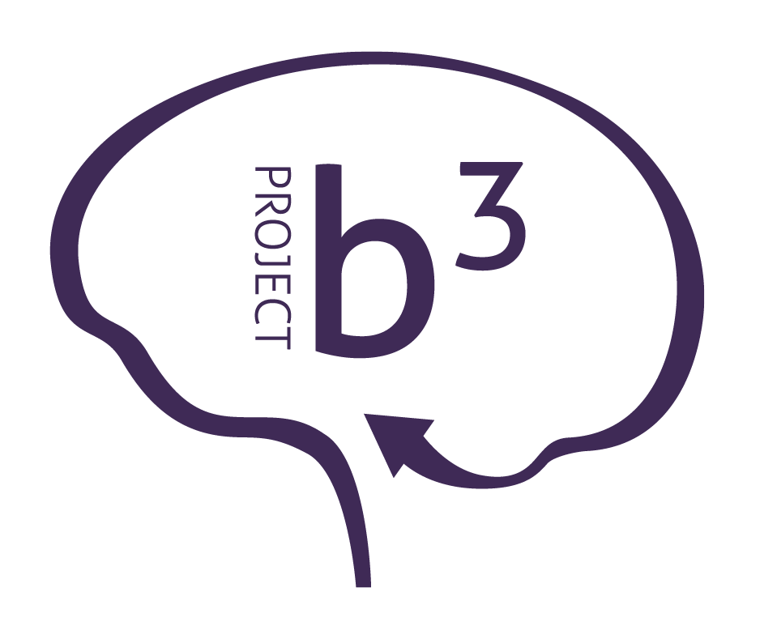
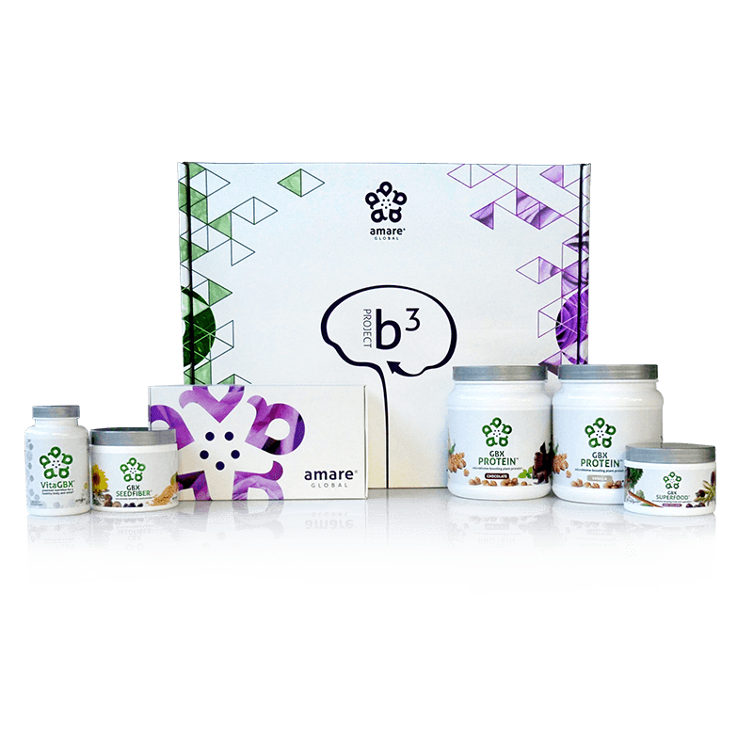
BODY.
BRAIN.
BIOME.
BODY. BRAIN. BIOME.
A fit body begins with mental wellness, and the key to a healthy brain is the gut microbiome. Body. Brain. Biome. Project b3. The holistic solution to a healthier well-being.
Item Code: Retail Price: Wholesale Price: Subscribe & Save:
P012-P017 $486.00 $305.95 / 210 PV $274.95 / 190 PV
*These statements have not been evaluated by the Food and Drug Administration. This product is not intended to diagnose, treat, cure, or prevent any disease.

Slide 2
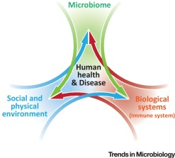
Biome
Body
Brain

Slide 3
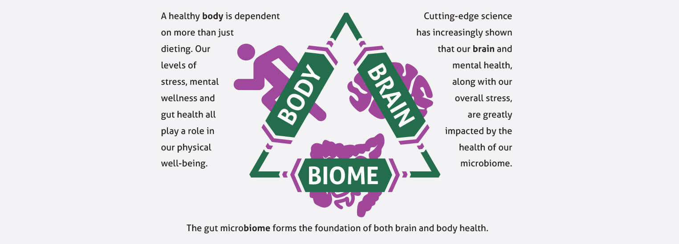
Project b³: BODY. BRAIN. BIOME.
Amare FundaMentals Pack (1), VitaGBX (1), GBX Protein (2), GBX SeedFiber (1), GBX SuperFood (1)

Slide 4
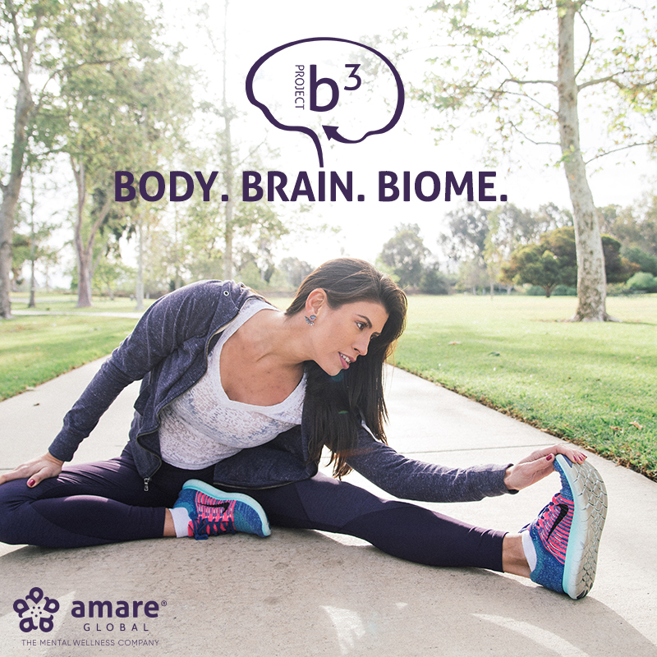
S.E.N.S.E. Program
Follow this step-by-step approach called S.E.N.S.E., which includes effective techniques and tips to create a healthier, happier you.
S – Supplementation
E – Exercise
N – Nutrition
S – Stress Management
E – Evaluation

Slide 5
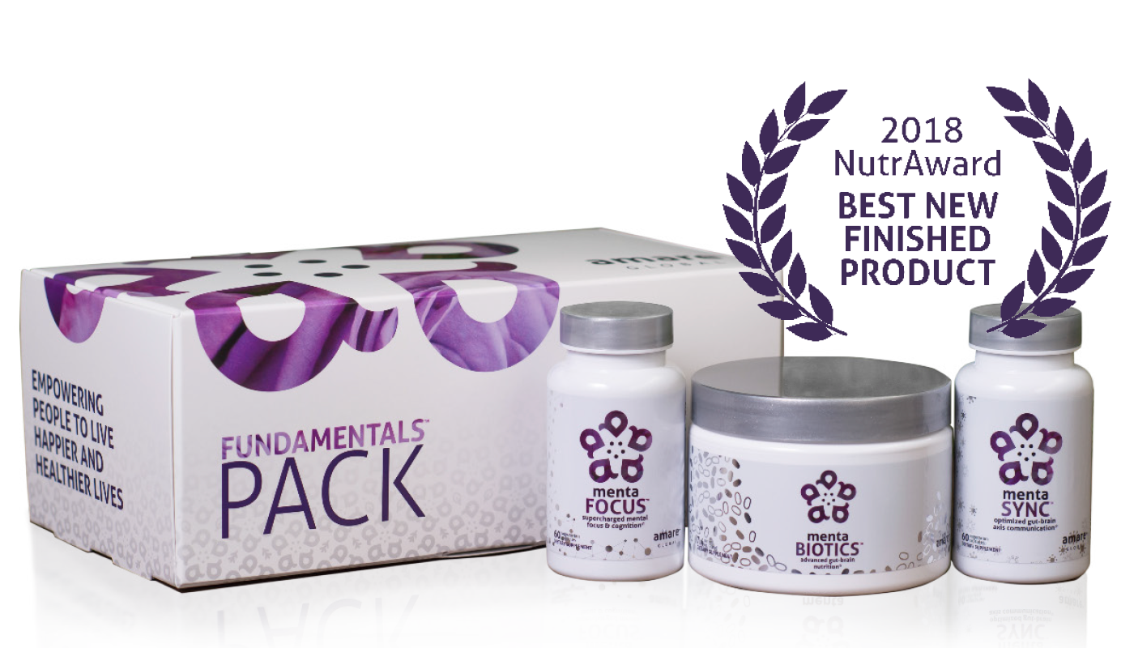
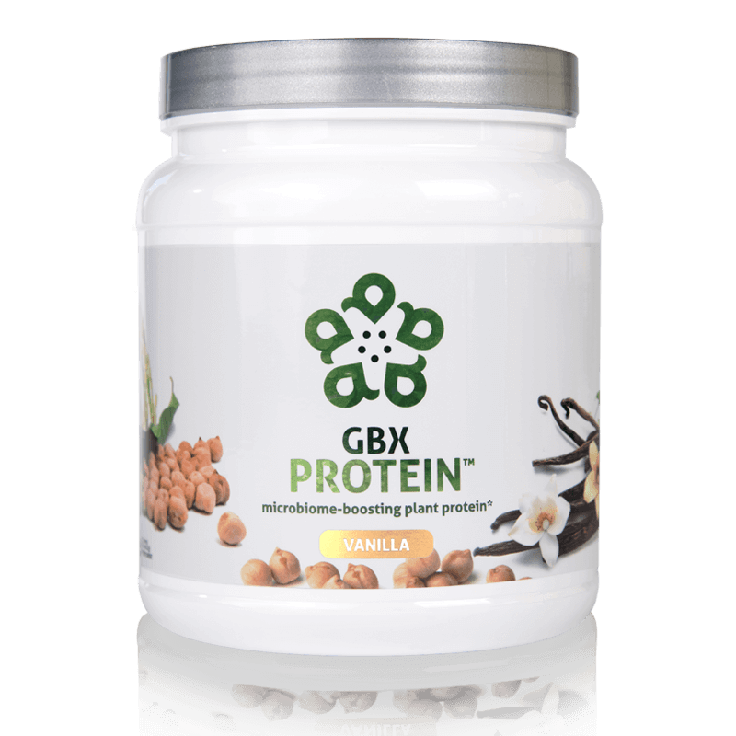
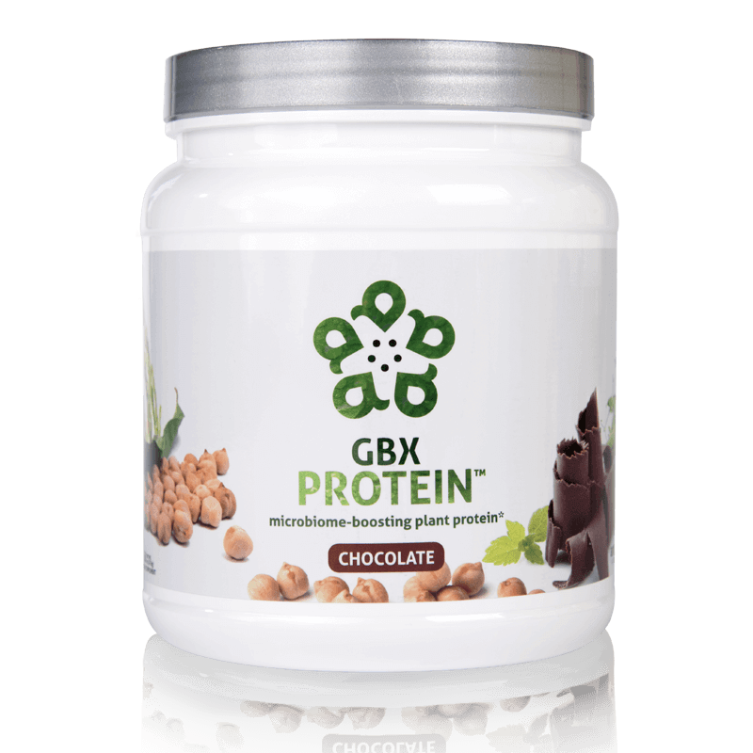
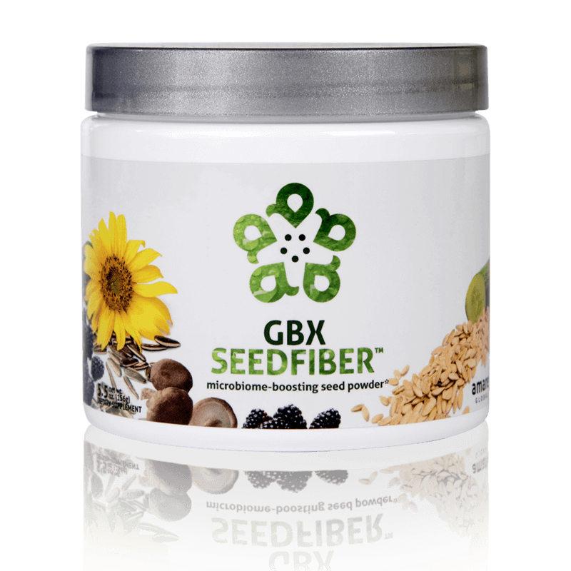
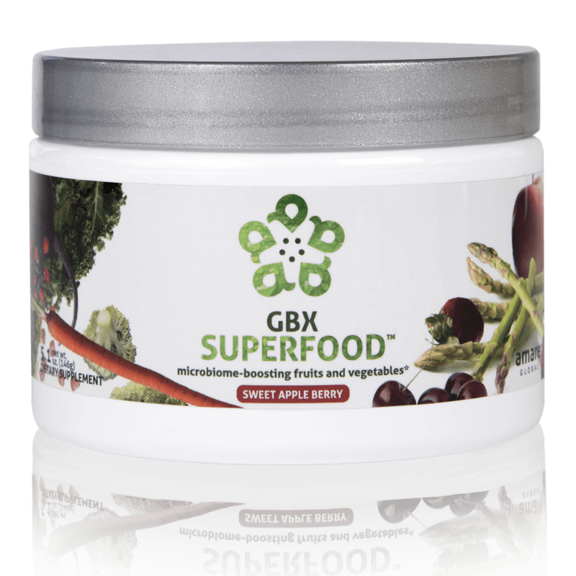
What’s in the Project b³ Pack?
Amare FundaMentals Pack (1), VitaGBX (1), GBX Protein (2),
GBX SeedFiber (1), GBX SuperFood (1)

Slide 6
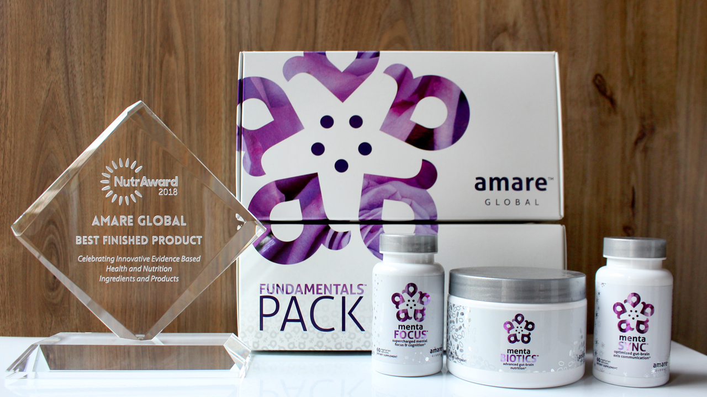
World’s First Award-Winning Gut-Brain Axis Nutrition System!
The NutrAward recognizes companies that are investing in rigorous and measurable scientific studies to prove the efficacy of their proprietary ingredients or technologies.
Submissions are judged on their merit in the following areas:
Viable product
Emerging category
Creative product concept
Distinct health application
Unique packaging
Matchless marketing

Slide 7
CLINICAL STUDY
The Amare FundaMentals Pack™ has been clinically proven to:

Slide 8
Portions of Data Presented at:
American College of Nutrition
November 2017 – Alexandria VA (“Outstanding Research” Award)
Experimental Biology
April 2018 – San Diego, CA
American College of Sports Medicine
May 2018 – Minneapolis, MN
Mental Health America – Fit for the Future Conference
June 2018 – Washington DC
Microbiome Movement – Gut Brain Axis
November 2018 – Boston, MA
American Mental Wellness Awareness Association
November 2018 – Hershey, PA
Medical, Nutrition, Biochemistry, Molecular Biology, Physiology, Psychology, Counselors, Policy…

Slide 9
MW3™ Probiotic Proprietary Blend
Our blend contains unique and specific probiotic strains targeted to enhance overall mental wellness.*
MW3 Probiotic Strains:
Lactobacillus rhamnosus R0011 — Reduces stress by lowering cortisol exposure and improves GABA neurotransmission*
Bifidobacterium longum R0175 — Enhances calmness by decreasing anxiety indices and improves cognitive function*
Lactobacillus helveticus R0052 — Improves mood by decreasing neuro-inflammation and increasing serotonin*
*These statements have not been evaluated by the Food and Drug Administration. This product is not intended to diagnose, treat, cure, or prevent any disease.

Slide 10
MW3™ Prebiotic Proprietary Blend
Our MW3 Prebiotic Proprietary Blend provides optimal gut support by feeding the specific mental wellness probiotic strains found in our MW3 Probiotic Proprietary Blend.*
MW3 Prebiotic Fibers:
IsoFiber™ (Iso-Malto-Oligosaccharides) — Contains a combination of naturally occurring prebiotic plant fibers that are clinically shown to improve the growth of specific probiotic strains featured in Kids FundaMentals™ and now MentaBiotics™ Sugar Free!
Bimuno® (Galacto-Oligo-Saccharides) — Resets and increases friendly gut bacteria, maintains immune health, controls inflammation in the body and supports microbiome balance. Is highly effective and a natural way of increasing preferred bacteria in the gut. Plays an important role in feeding Bifidobacteria probiotic strains.*
SunFiber® (Galactomannan Fiber) — Helps improve the growth and vitality of beneficial bacteria, including Bifidobacteria and Lactobacillus.*
*These statements have not been evaluated by the Food and Drug Administration. This product is not intended to diagnose, treat, cure, or prevent any disease.

Slide 11
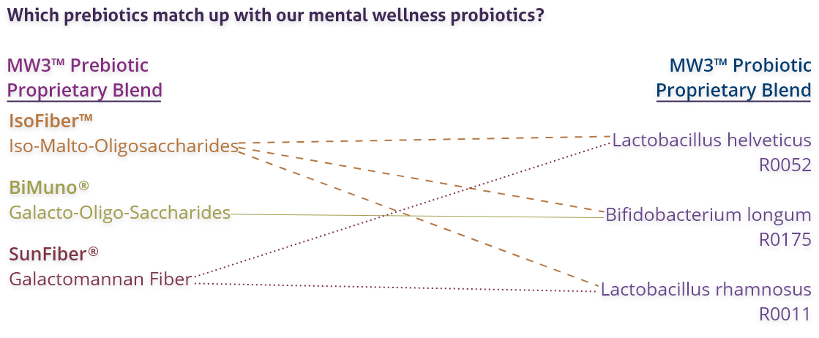
MW3™ Prebiotic/Probiotic Proprietary Blend
*These statements have not been evaluated by the Food and Drug Administration. This product is not intended to diagnose, treat, cure, or prevent any disease.

Slide 12
premium nutrition for a healthy body and mind*
Contains a Bright Mind Blend which helps improve concentration, attention, and alertness*
Combines 50+ vitamins, minerals, amino acids, and phytonutrients to deliver micronutrient nutrition for a well-balanced body and mind*
Contains our Amare GBX+ Proprietary Blend that enhances optimal functionality of the gut-brain axis*
*These statements have not been evaluated by the Food and Drug Administration. This product is not intended to diagnose, treat, cure, or prevent any disease.

Slide 13
Microbiome-Boosting Nutrition*
GBX FOODS
™
Vegan /
All Natural*
Non-GMO and Gluten Free*
Sugar Free*
Soy and Dairy Free*
No Preservatives, Artificial Colors, Flavors and Sweeteners*
*These statements have not been evaluated by the Food and Drug Administration. This product is not intended to diagnose, treat, cure, or prevent any disease.

Slide 14
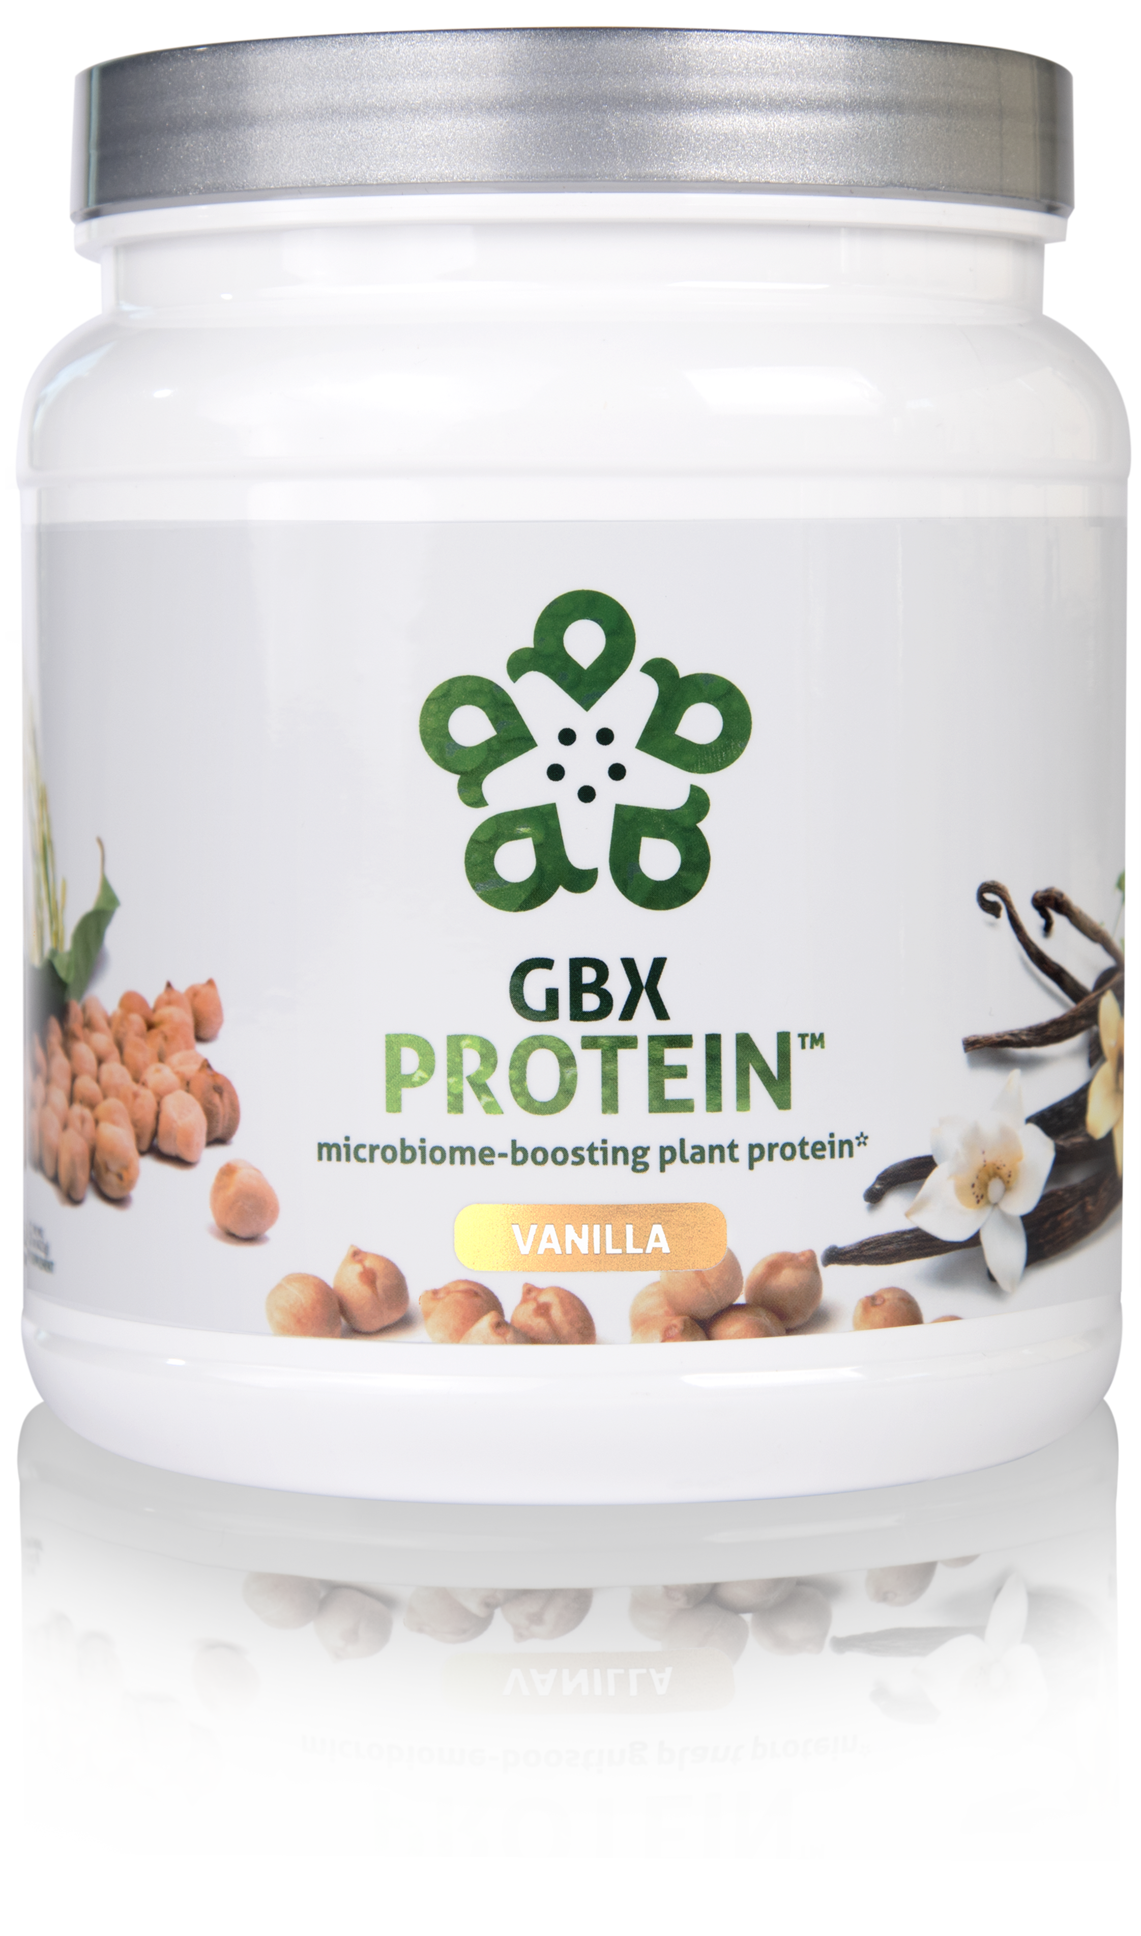
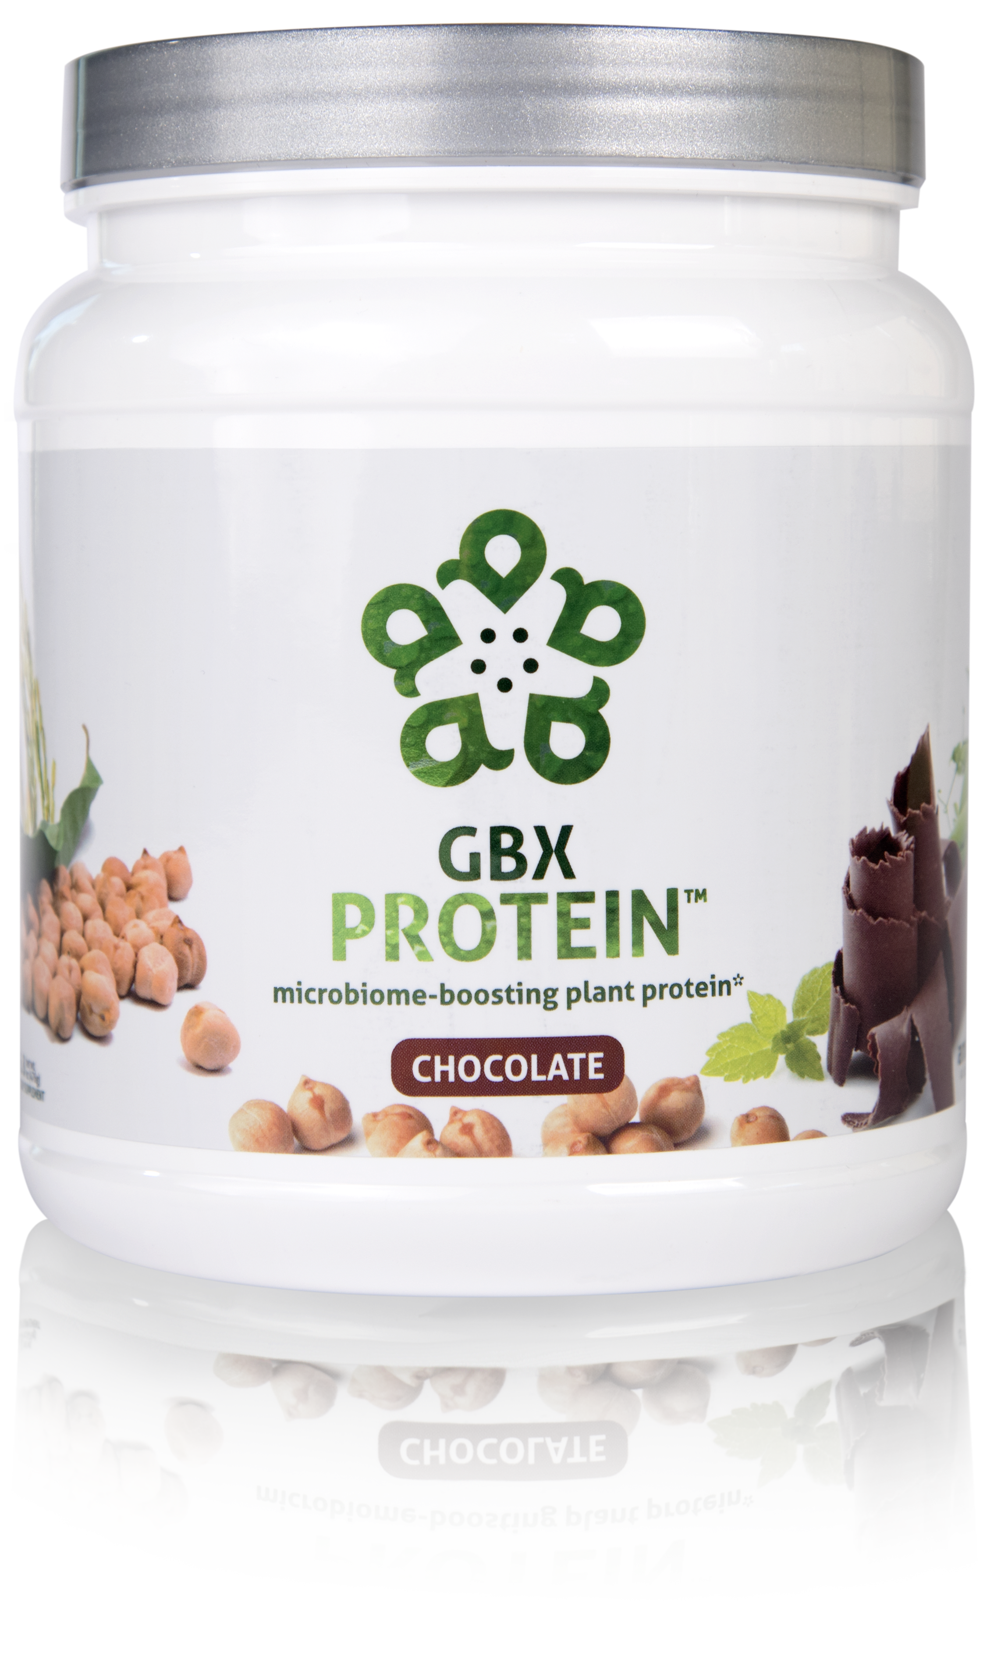
HELPS CONTROL APPETITE AND SUPPORTS MUSCLE MASS*
17 GRAMS OF ULTRA-PURE, PLANT-BASED PROTEIN*
NOURISHES GOOD GUT BACTERIA*
microbiome-boosting plant protein*
GBX Protein™ delivers 17 grams of pure plant protein. This unique chickpea, brown rice, and pea protein blend nourishes good bacteria in the gut and improves microbiome balance, while controlling appetite and supporting muscle mass. Fully-loaded with only functional ingredients, this potent formula supports the gut microbiome, helping fuel a healthy lifestyle.*
Item Code (Vanilla):
Item Code (Chocolate): Retail Price: Wholesale Price: Subscribe & Save:
S015
S016 $54.00 $39.95 / 26 PV $35.95 / 22 PV
*These statements have not been evaluated by the Food and Drug Administration. This product is not intended to diagnose, treat, cure, or prevent any disease.

Slide 15
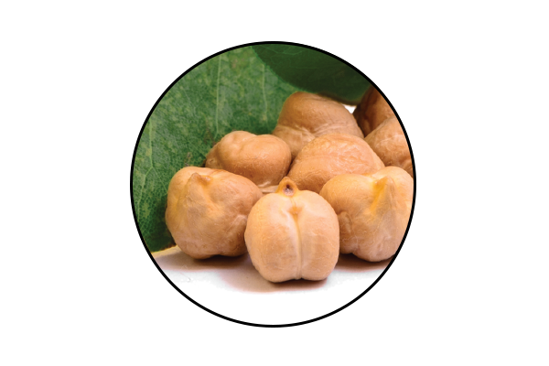
GBX Protein KEY INGREDIENTS
™
Artesa® Chickpea Protein
Premium, sustainably sourced chickpeas from Western Canada and North America*
Unique microbiome-boosting phytonutrients*
Smooth flavor and taste
*These statements have not been evaluated by the Food and Drug Administration. This product is not intended to diagnose, treat, cure, or prevent any disease.

Slide 16
GBX Protein KEY INGREDIENTS
™
Artesa® Chickpea Protein
An extraordinary, plant-based protein that is 96% absorbed by the human body, which is amongst the highest Protein Digestibility Corrected Amino Acid Score (PDACAAS) scores at 0.80 in the WORLD of plants!
Also acts as a prebiotic fiber that helps with gut integrity, bacteria diversification and gastric motility.
Incredible organoleptic profile compared to ALL other protein types out there.
*These statements have not been evaluated by the Food and Drug Administration. This product is not intended to diagnose, treat, cure, or prevent any disease.

Slide 18
Notes:
WHY ARE CHICKPEA PLANT PROTEINS SIGNIFICANT TO US? WHY A PLANT PROTEIN?
Chickpeas are an incredible source of plant protein. They provide nourishment in humans to ensure physical and cellular health/development.
Quality chickpeas are the next level of plant proteins, and are rich in fermentable fiber and phenolic compounds that help with gut junctions, mucosa and the microenvironment of your digestive tract!
This specifically formulated plant protein as a whole is the all-in-one protein that provides prebiotics that encourage healthy bacteria, physical health and cellular development — ultimately facilitating optimal mental wellness.

Slide 19
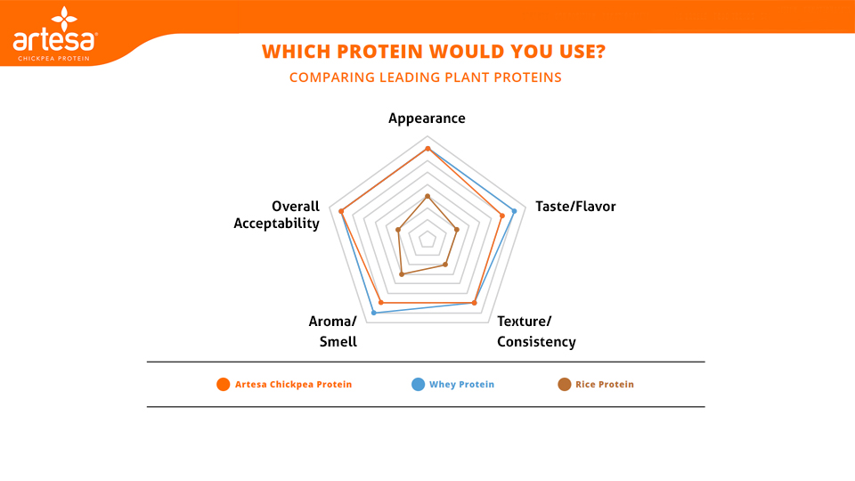

Slide 21
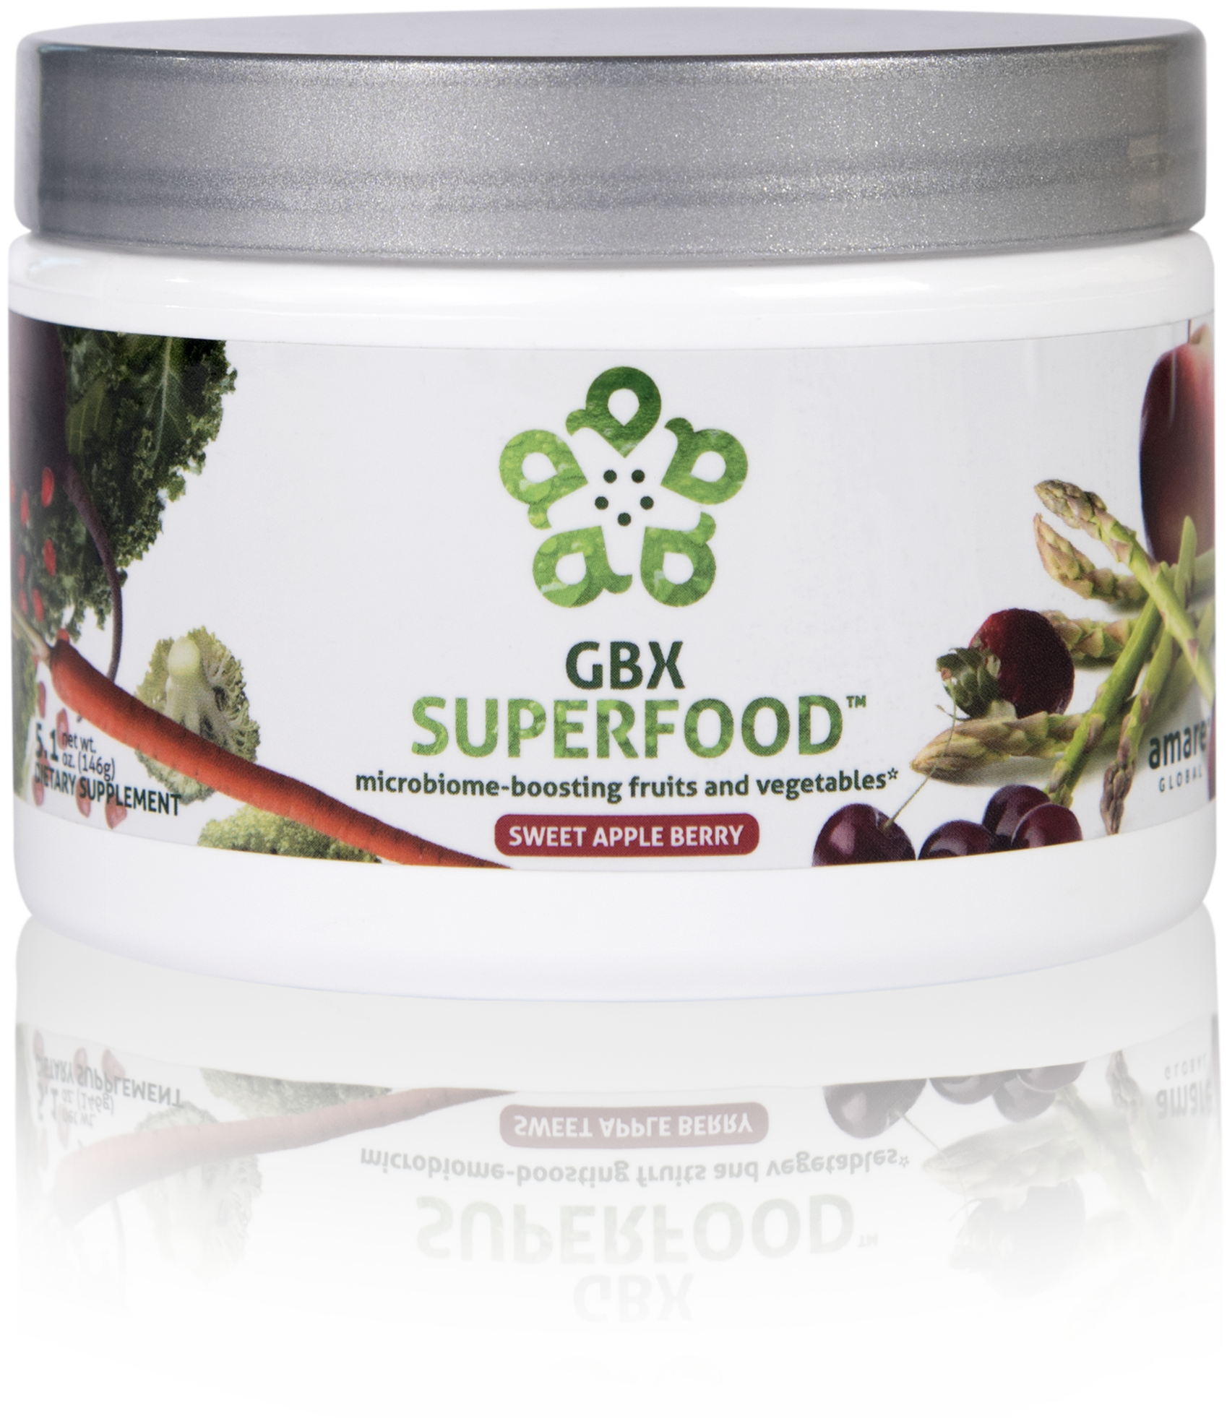
NUTRIENTS EQUIVALENT TO 3 SERVINGS OF FRUITS AND VEGETABLES*
NOURISHES GOOD GUT BACTERIA*
PROVIDES CELLULAR ANTI-STRESS BENEFITS*
microbiome-boosting fruits and vegetables*
GBX SuperFood™ provides the phytonutrient equivalent of three servings of fruits and vegetables per scoop. This phytobiotic-rich blend delivers cellular level anti-stress benefits and helps protect cells from a variety of different stressors, helping the brain and gut run at peak efficiency.*
Item Code: Retail Price: Wholesale Price: Subscribe & Save:
S018 $40.00 $29.95 / 21 PV $26.95 / 18 PV
*These statements have not been evaluated by the Food and Drug Administration. This product is not intended to diagnose, treat, cure, or prevent any disease.

Slide 22
microbiome-boosting fruits and vegetables*
Increases Heat Shock Protein expression*
Enhances internal cellular cleanup (autophagy)*
Stress resilience benefits that you can FEEL at the cellular level*
*These statements have not been evaluated by the Food and Drug Administration. This product is not intended to diagnose, treat, cure, or prevent any disease.

Slide 23
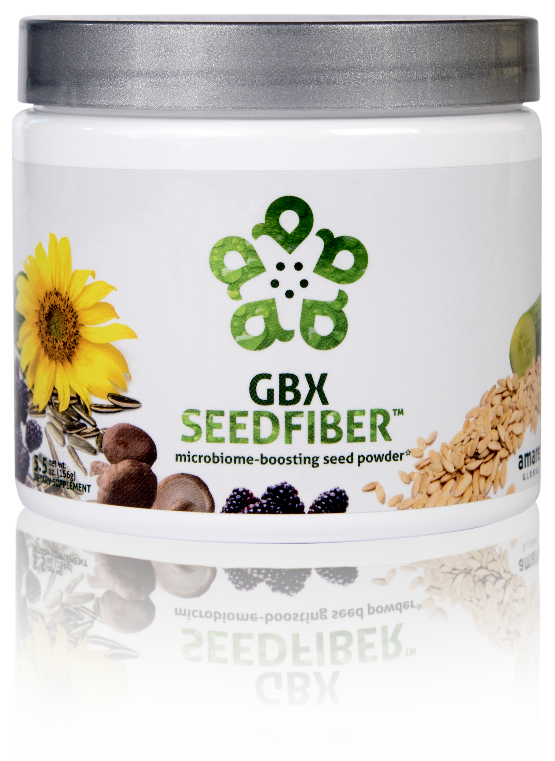
NEXT-GENERATION APPROACH TO OPTIMIZING GUT-BRAIN AXIS*
CONTAINS NATURAL MICROBIOME-BOOSTING FIBERS*
HELPS MANAGE FEELINGS OF STRESS, TENSION AND ANXIETY*
microbiome-boosting seed powder*
GBX SeedFiber™ is the next-generation approach to optimizing the gut-brain axis. This phytobiotic-rich formula contains seeds as sources of natural microbiome-boosting fibers, helping you feel fuller, longer. Featuring a cultured mushroom mycelia extract to support microRNA signaling between the microbiome and central nervous system, this unique blend helps manage feelings of stress, tension and anxiety.*
Item Code: Retail Price: Wholesale Price: Subscribe & Save:
S019 $50.00 $36.95 / 26 PV $32.95 / 21 PV
*These statements have not been evaluated by the Food and Drug Administration. This product is not intended to diagnose, treat, cure, or prevent any disease.

Slide 24
microbiome-boosting seed powder*
Optimizes gut-brain axis communication
Naturally supports microRNA signaling
Helps manage feelings of tension and anxiety*
*These statements have not been evaluated by the Food and Drug Administration. This product is not intended to diagnose, treat, cure, or prevent any disease.

Slide 25
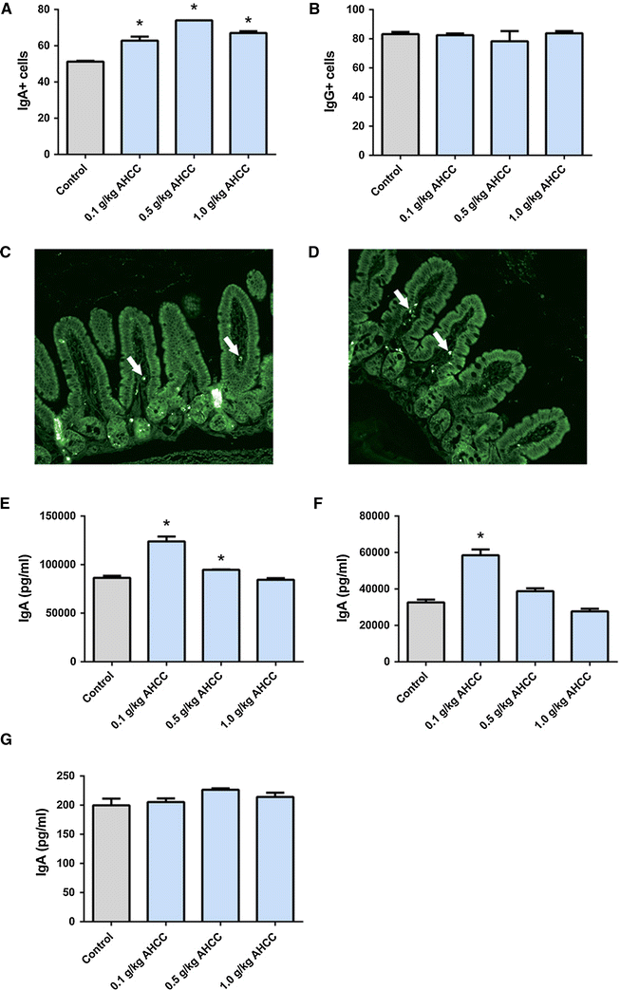
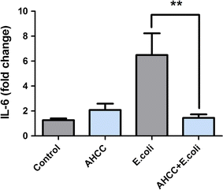
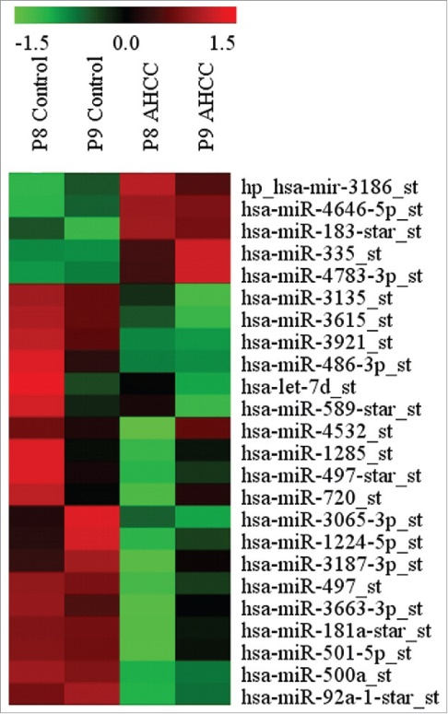
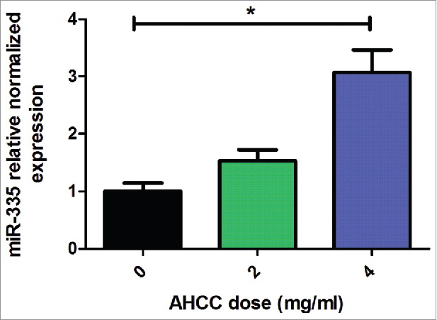
Roles of AHCC in Gut-Brain Axis
Anti-inflammatory/immune Homeostasis
Prebiotic (TLR2/4)
miRNAs
Mallet et al.,
European Journal of Nutrition 2015
Mallet et al.,
European Journal of Nutrition 2015
Graham et al., Cancer Biology and Therapy 2017

Slide 26
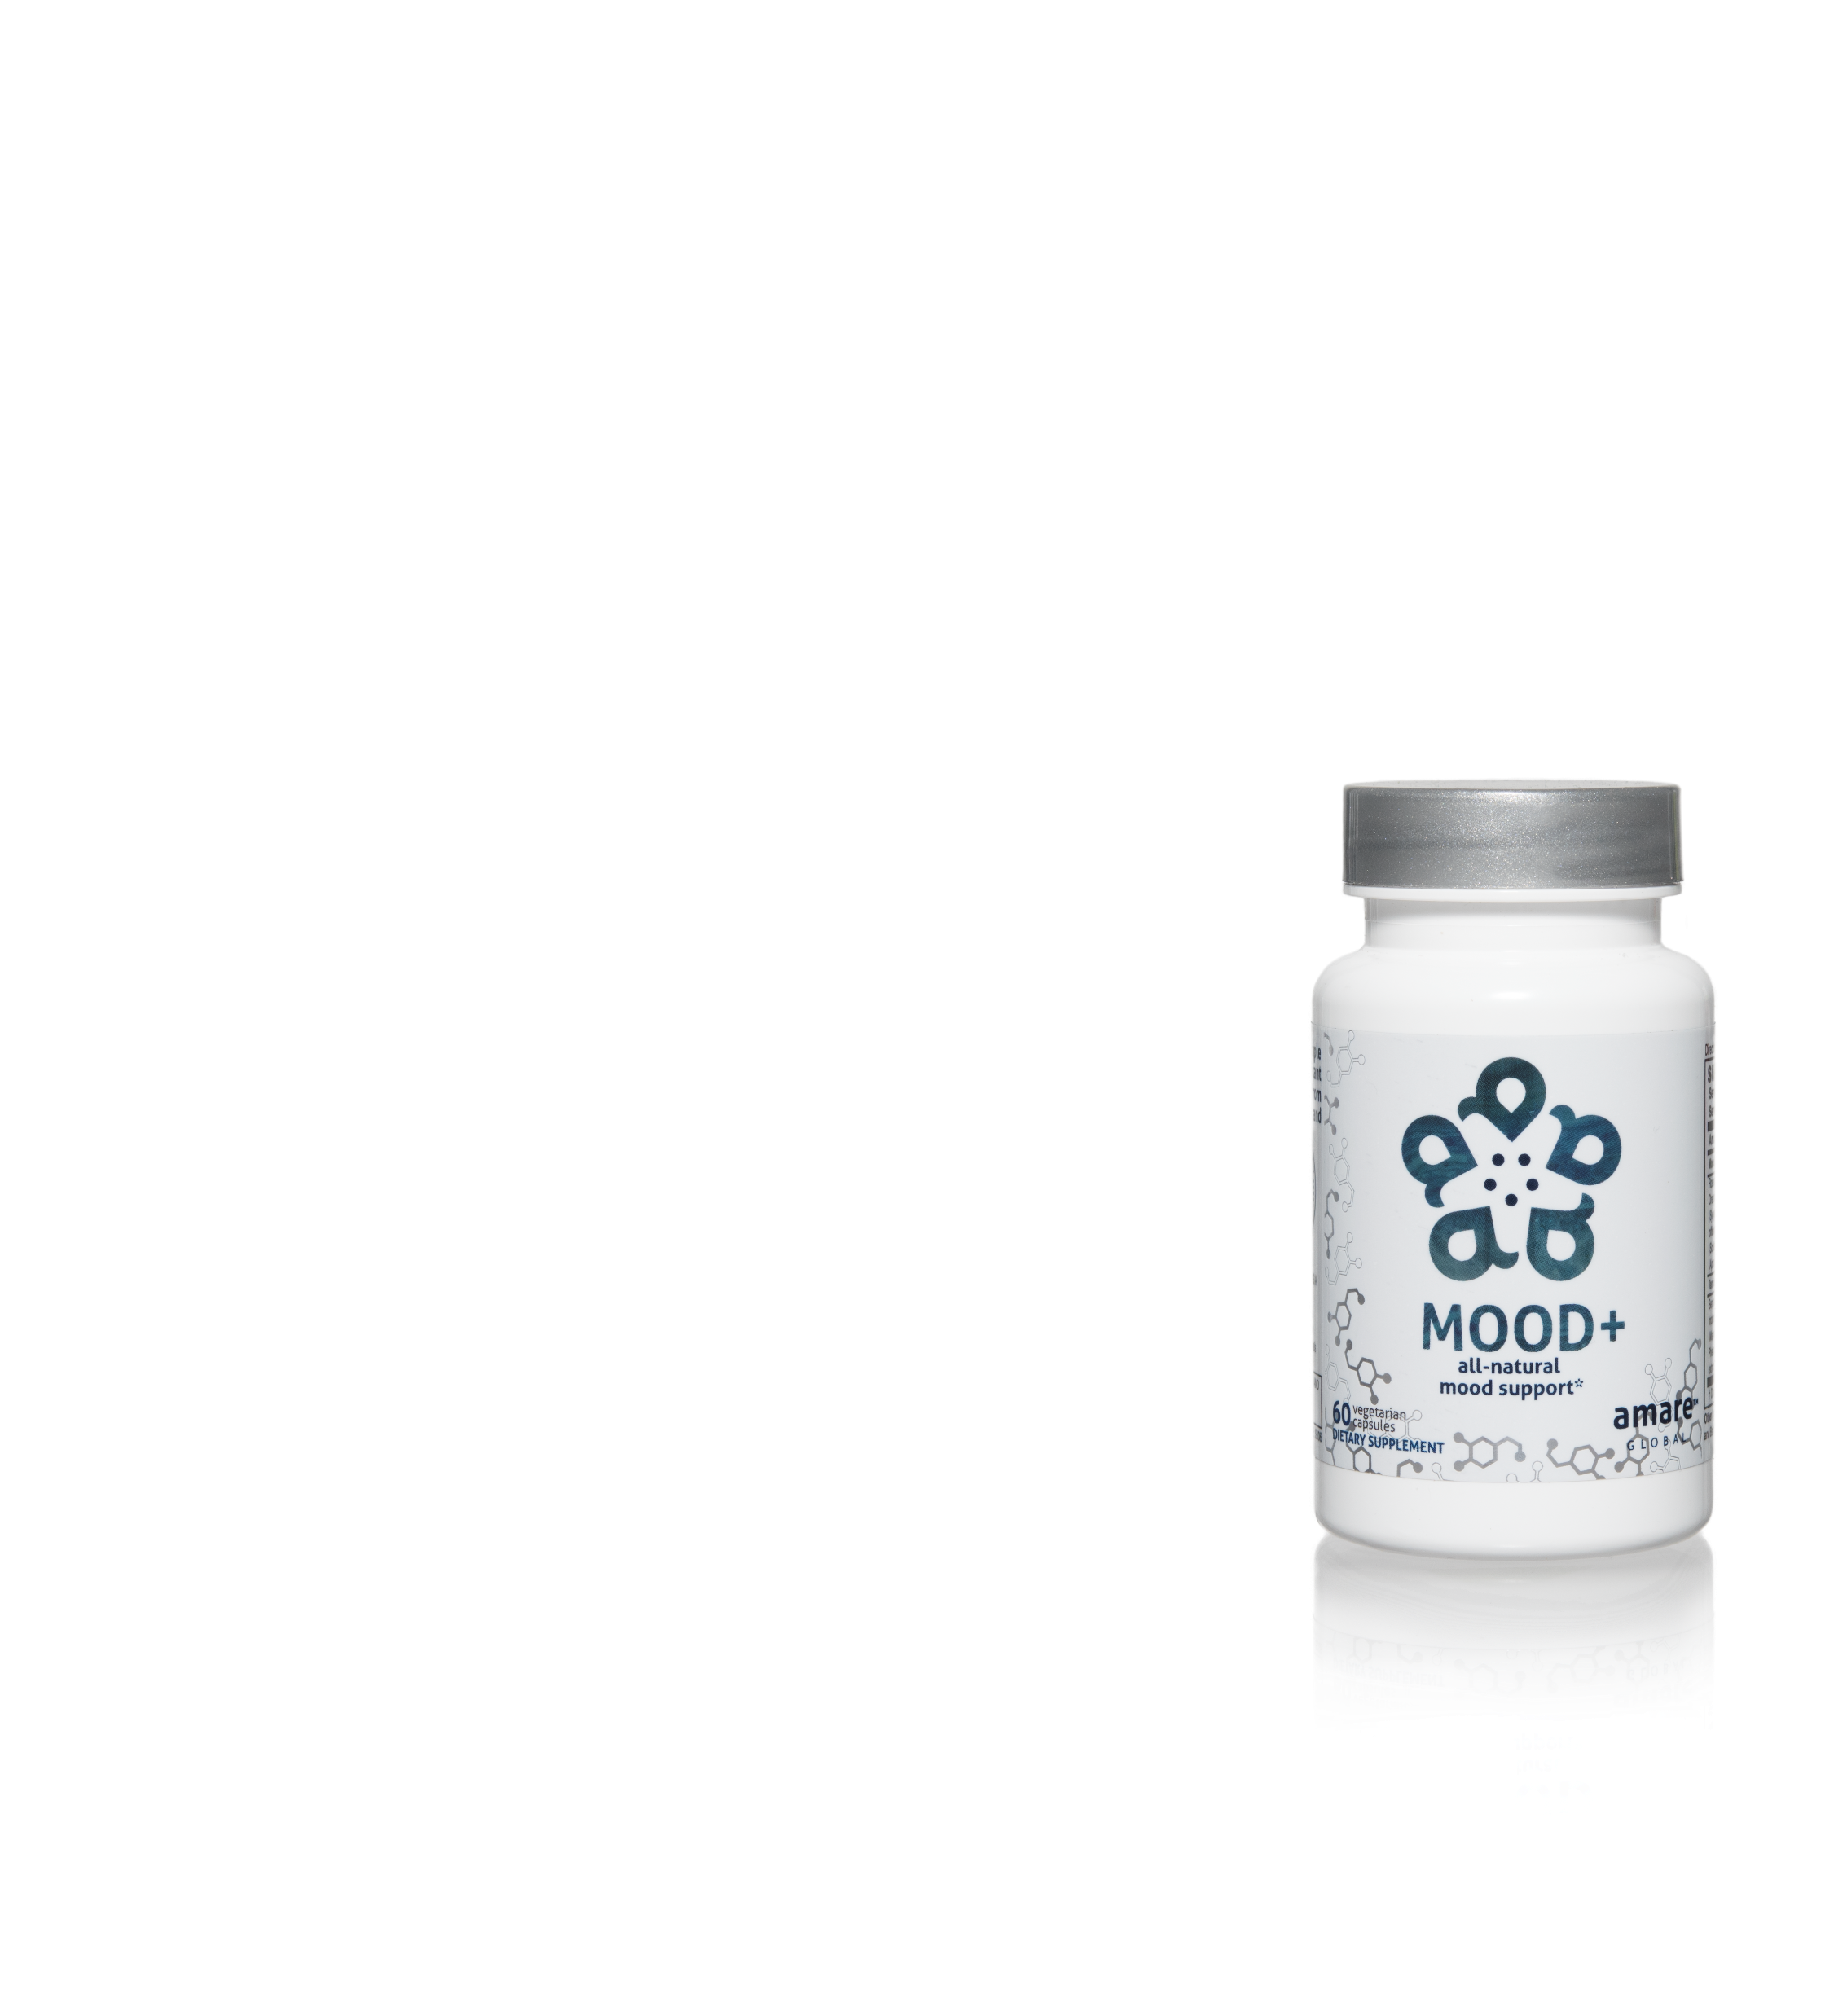
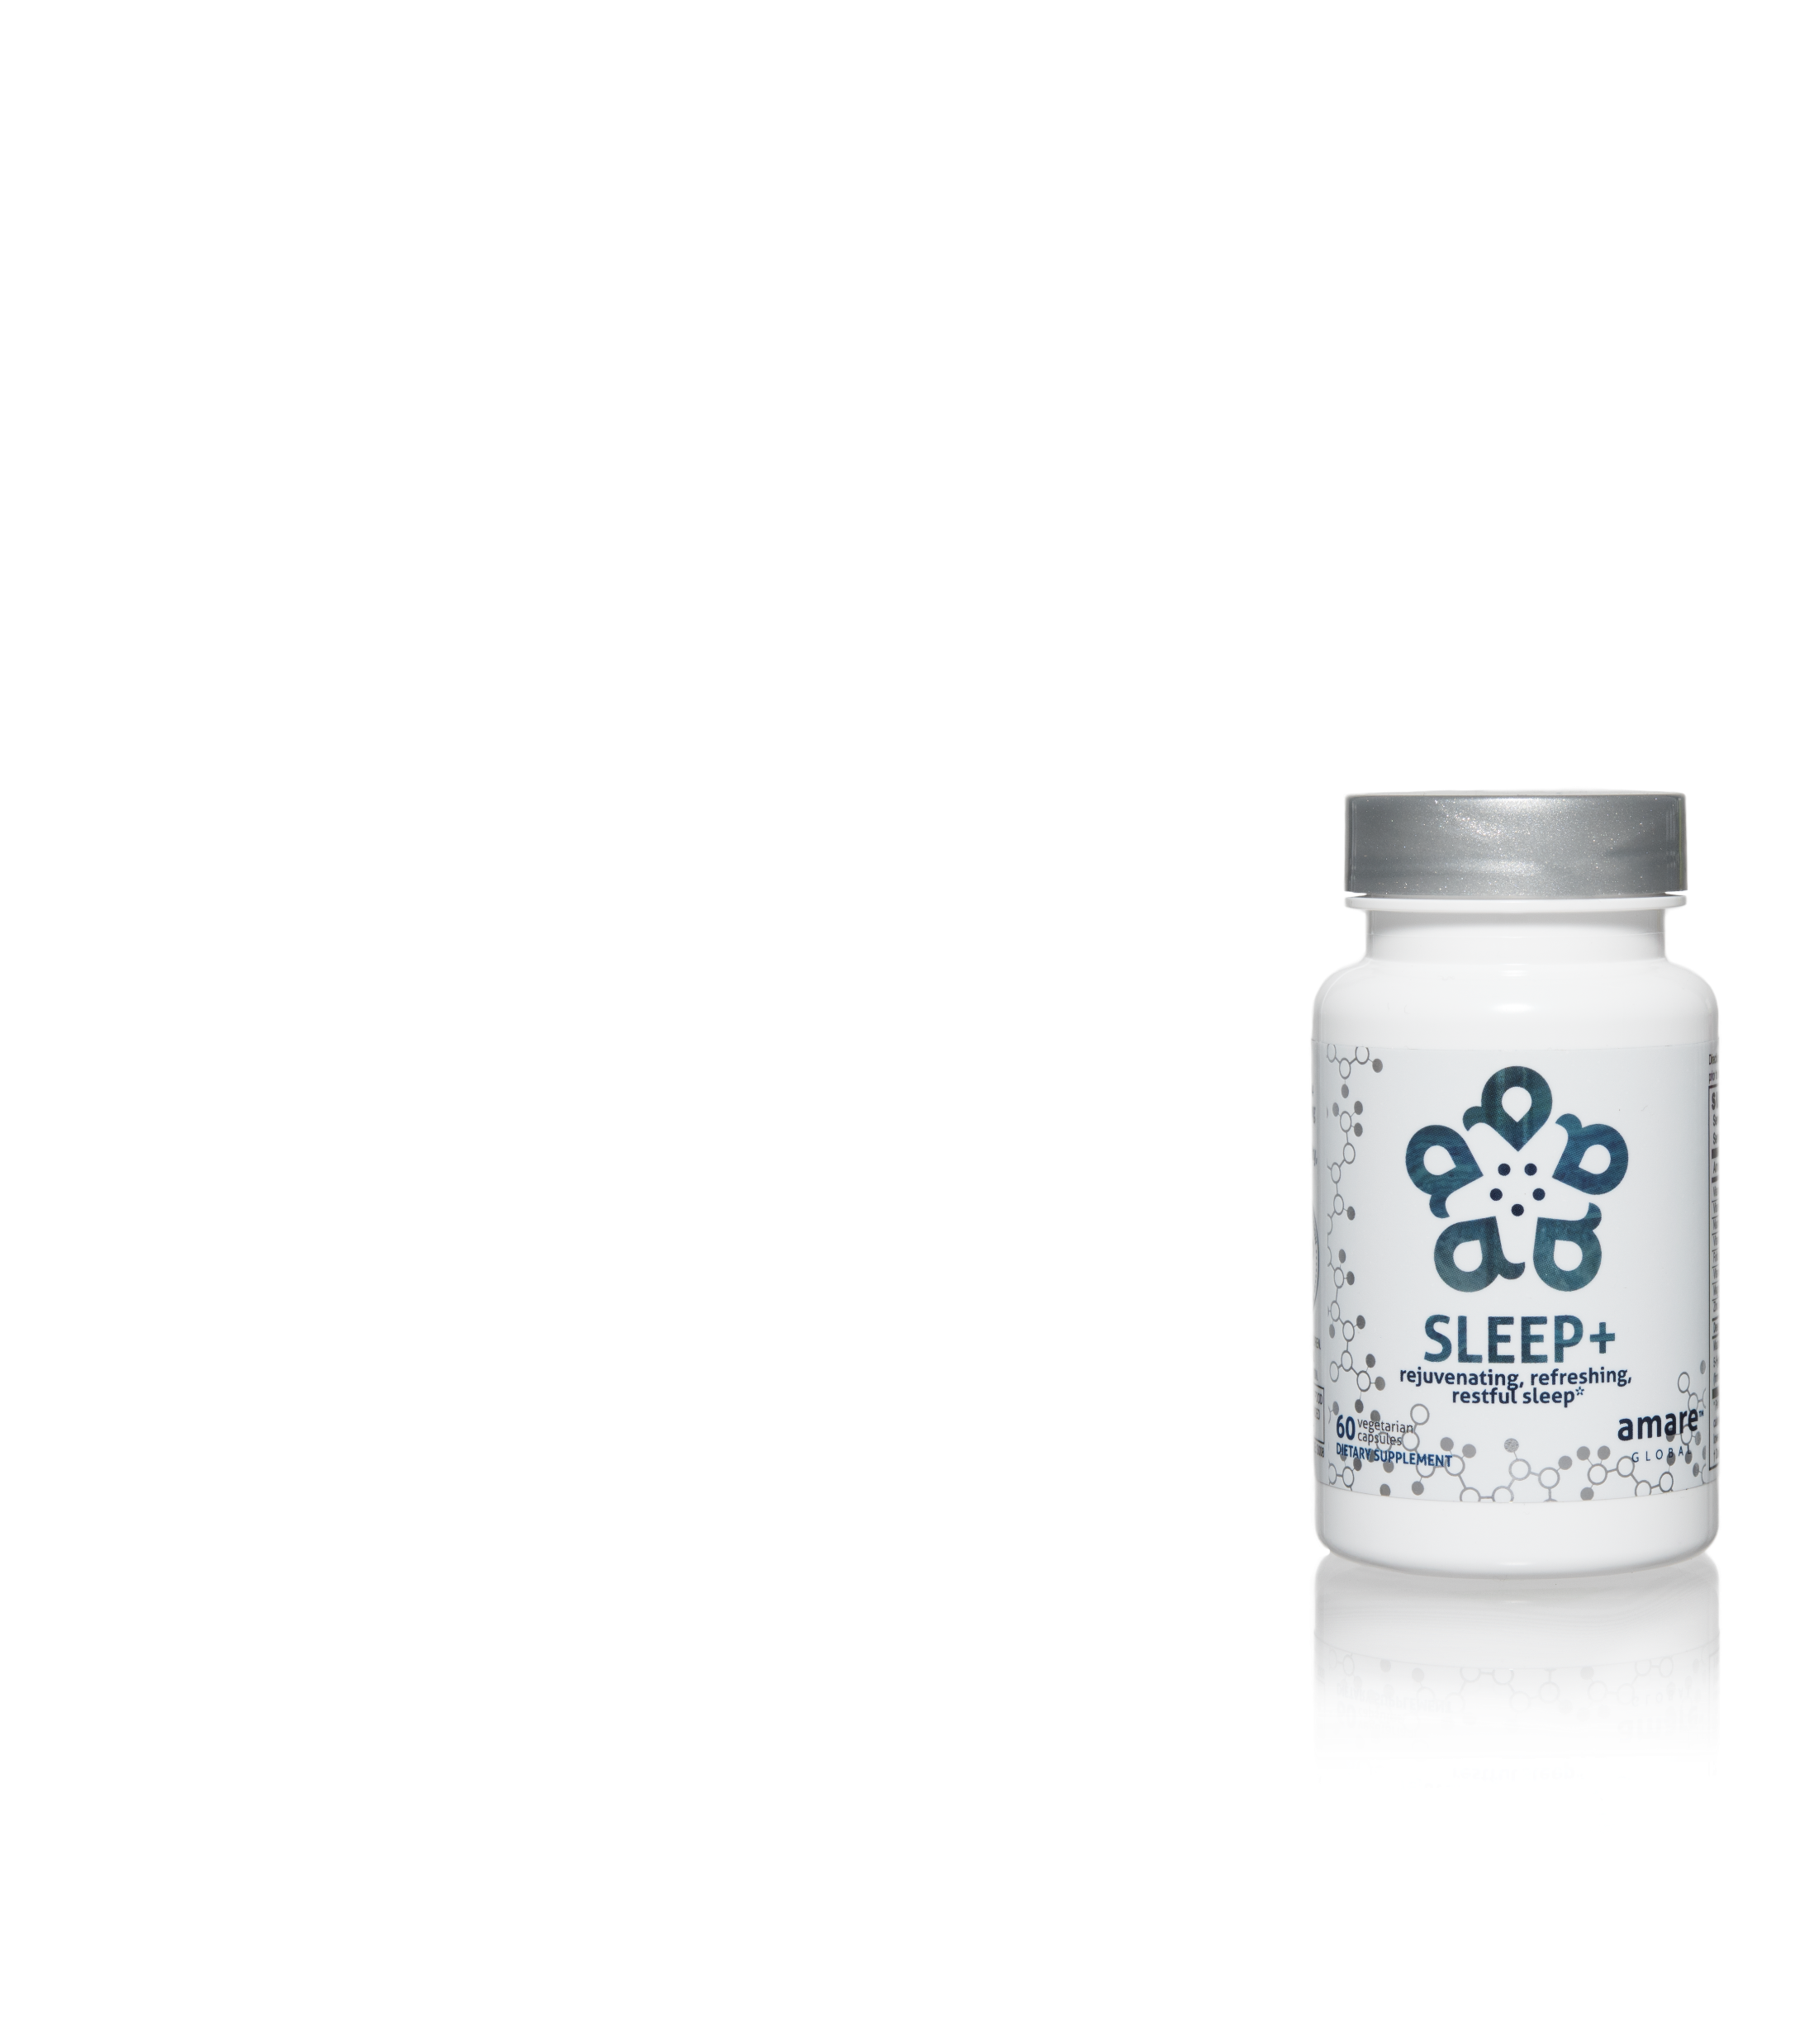
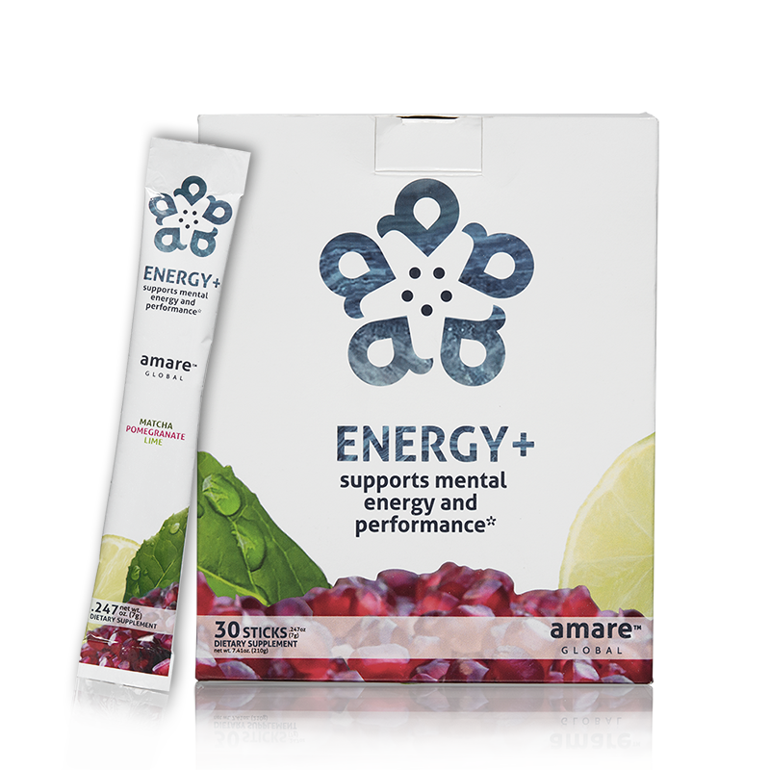
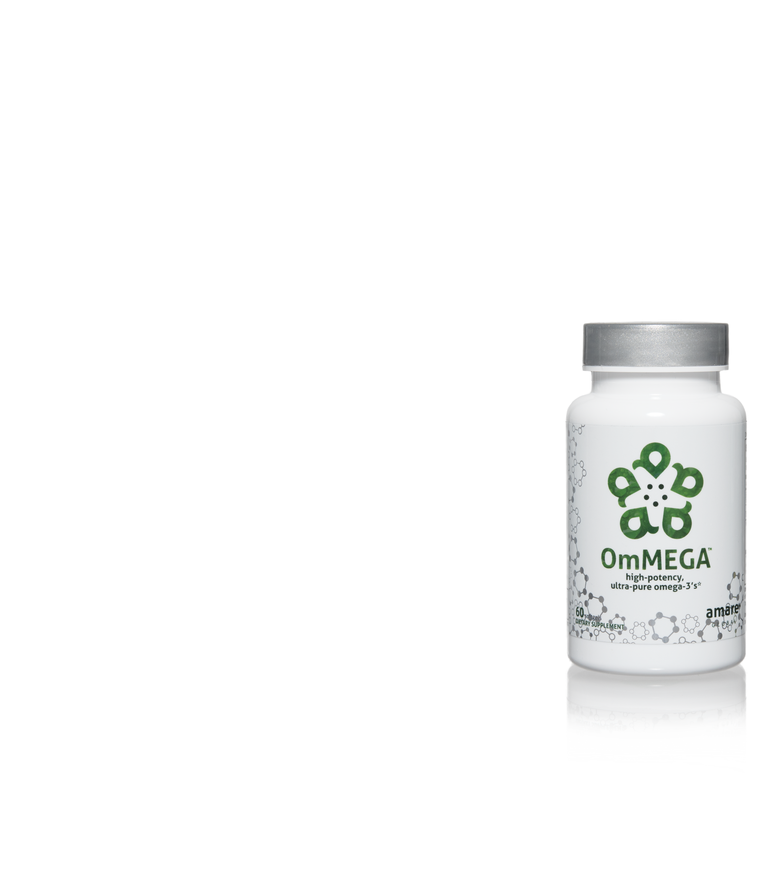
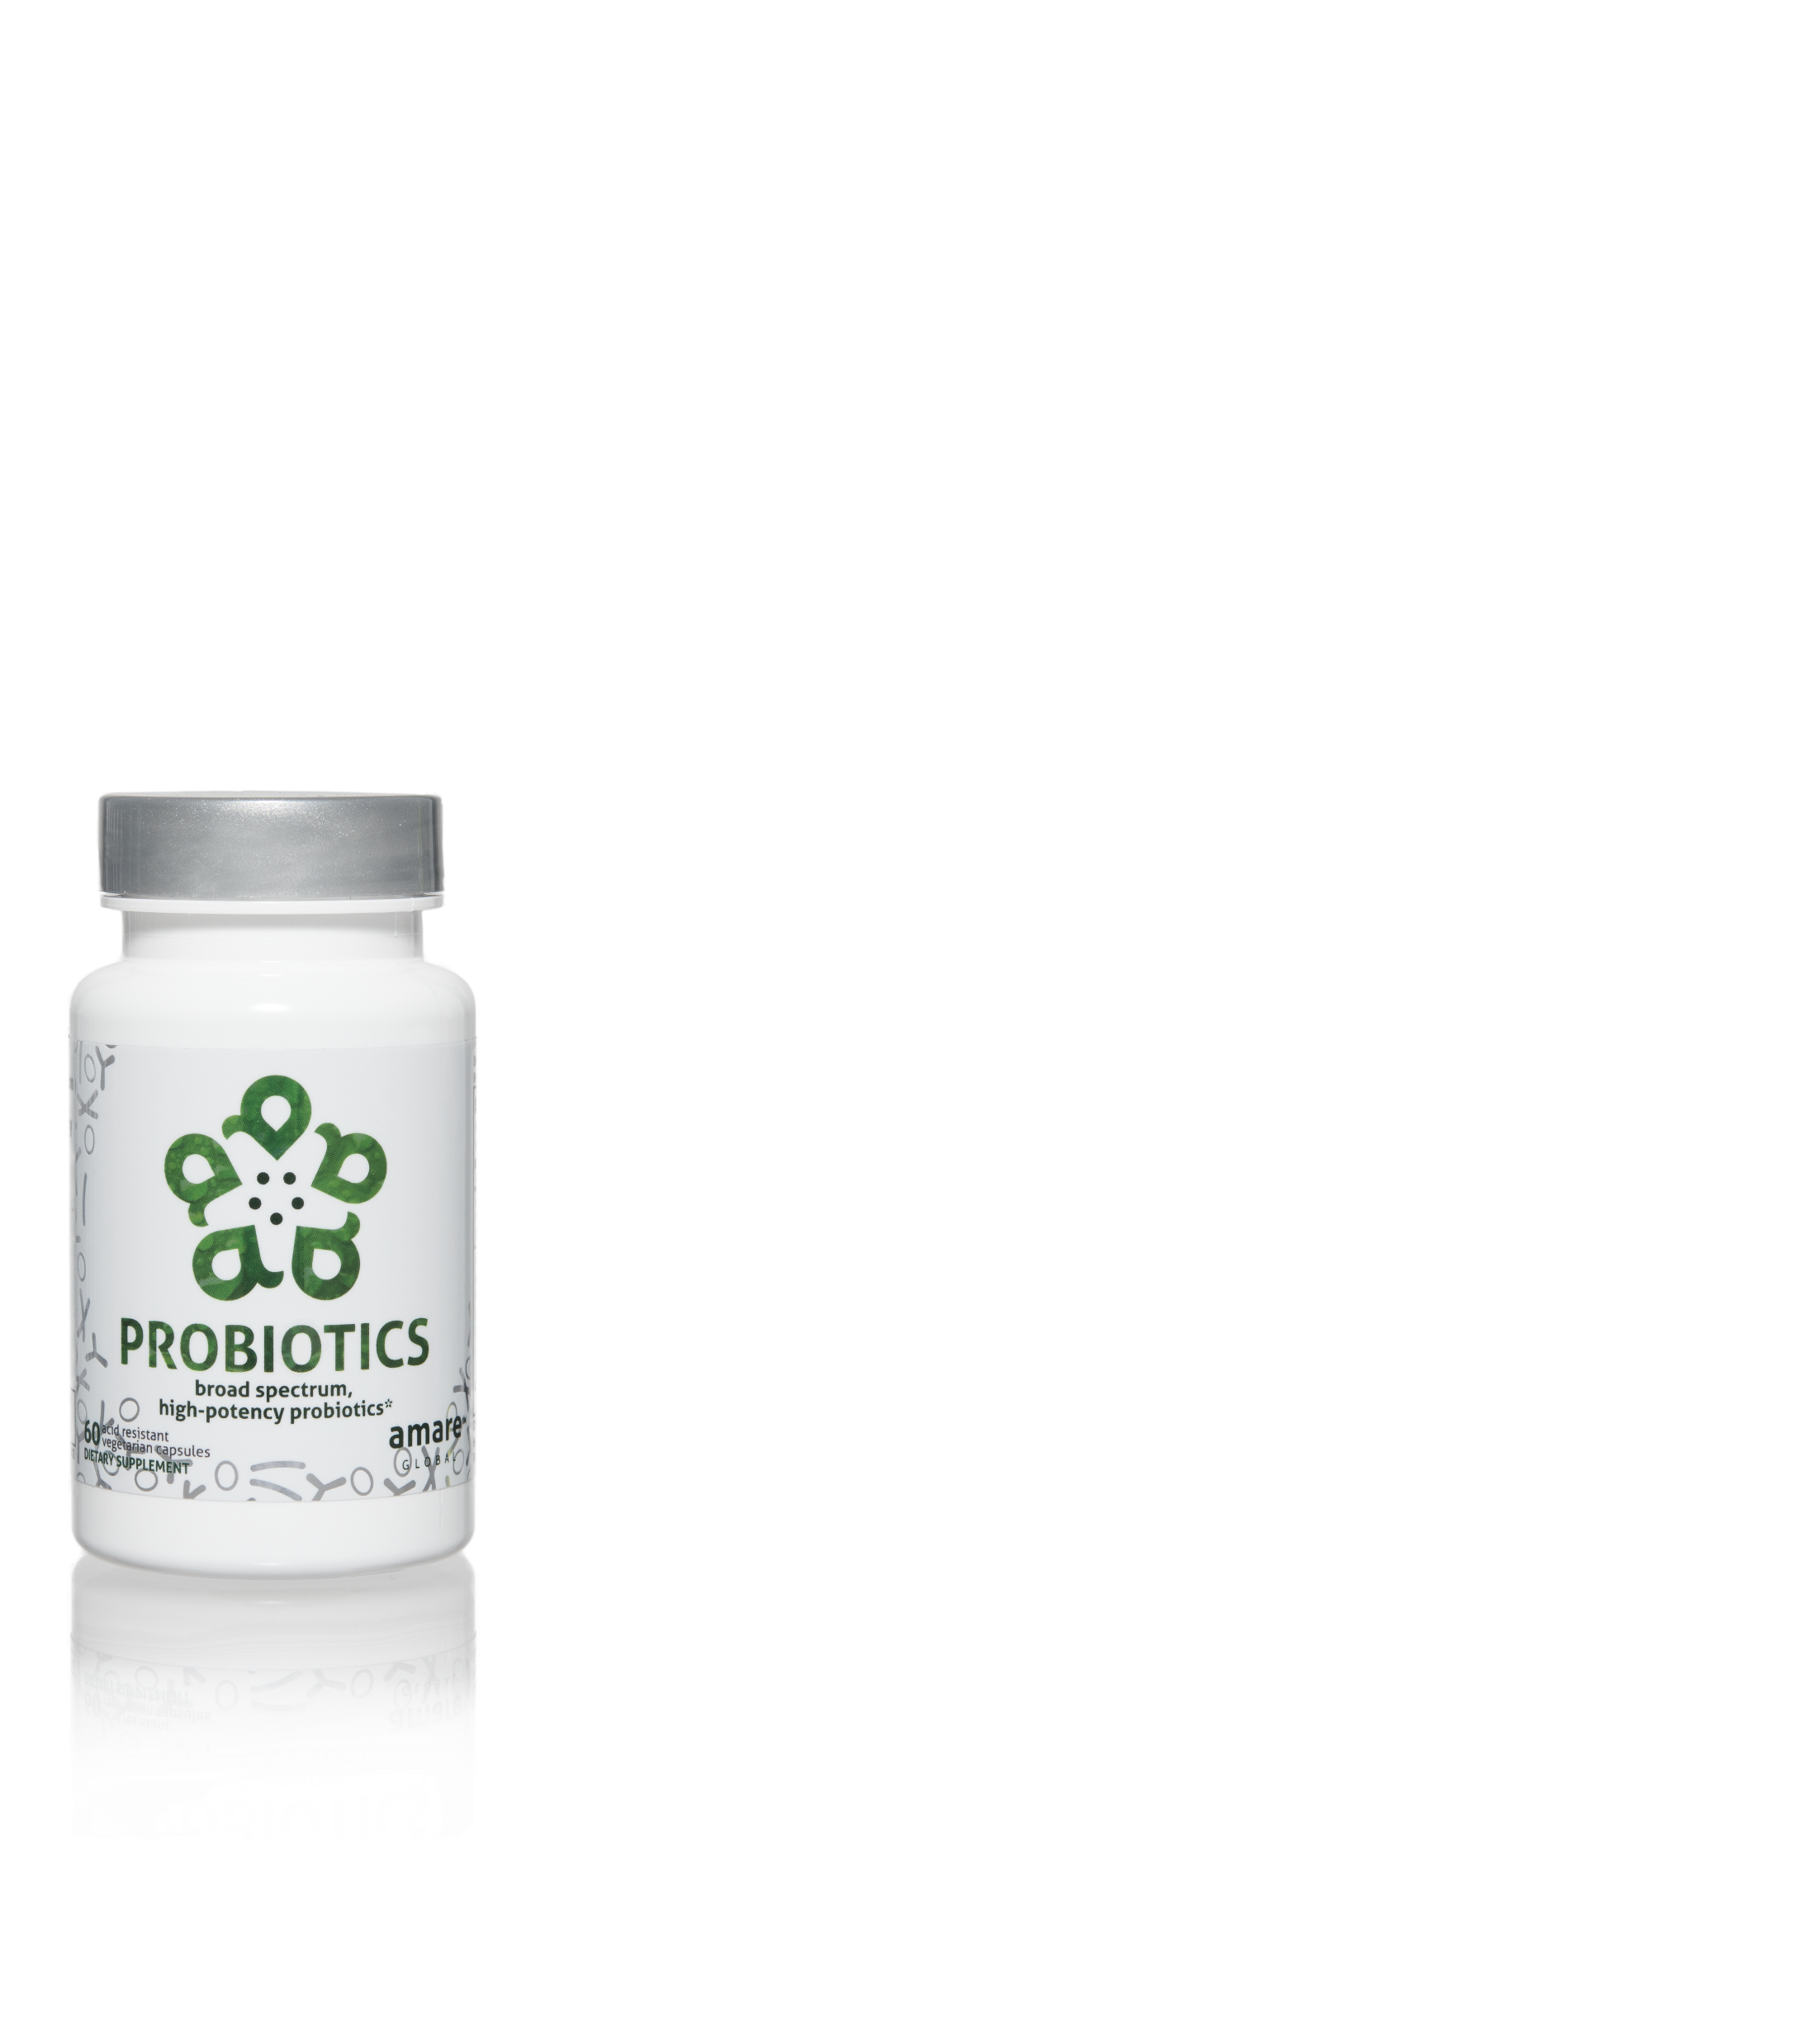
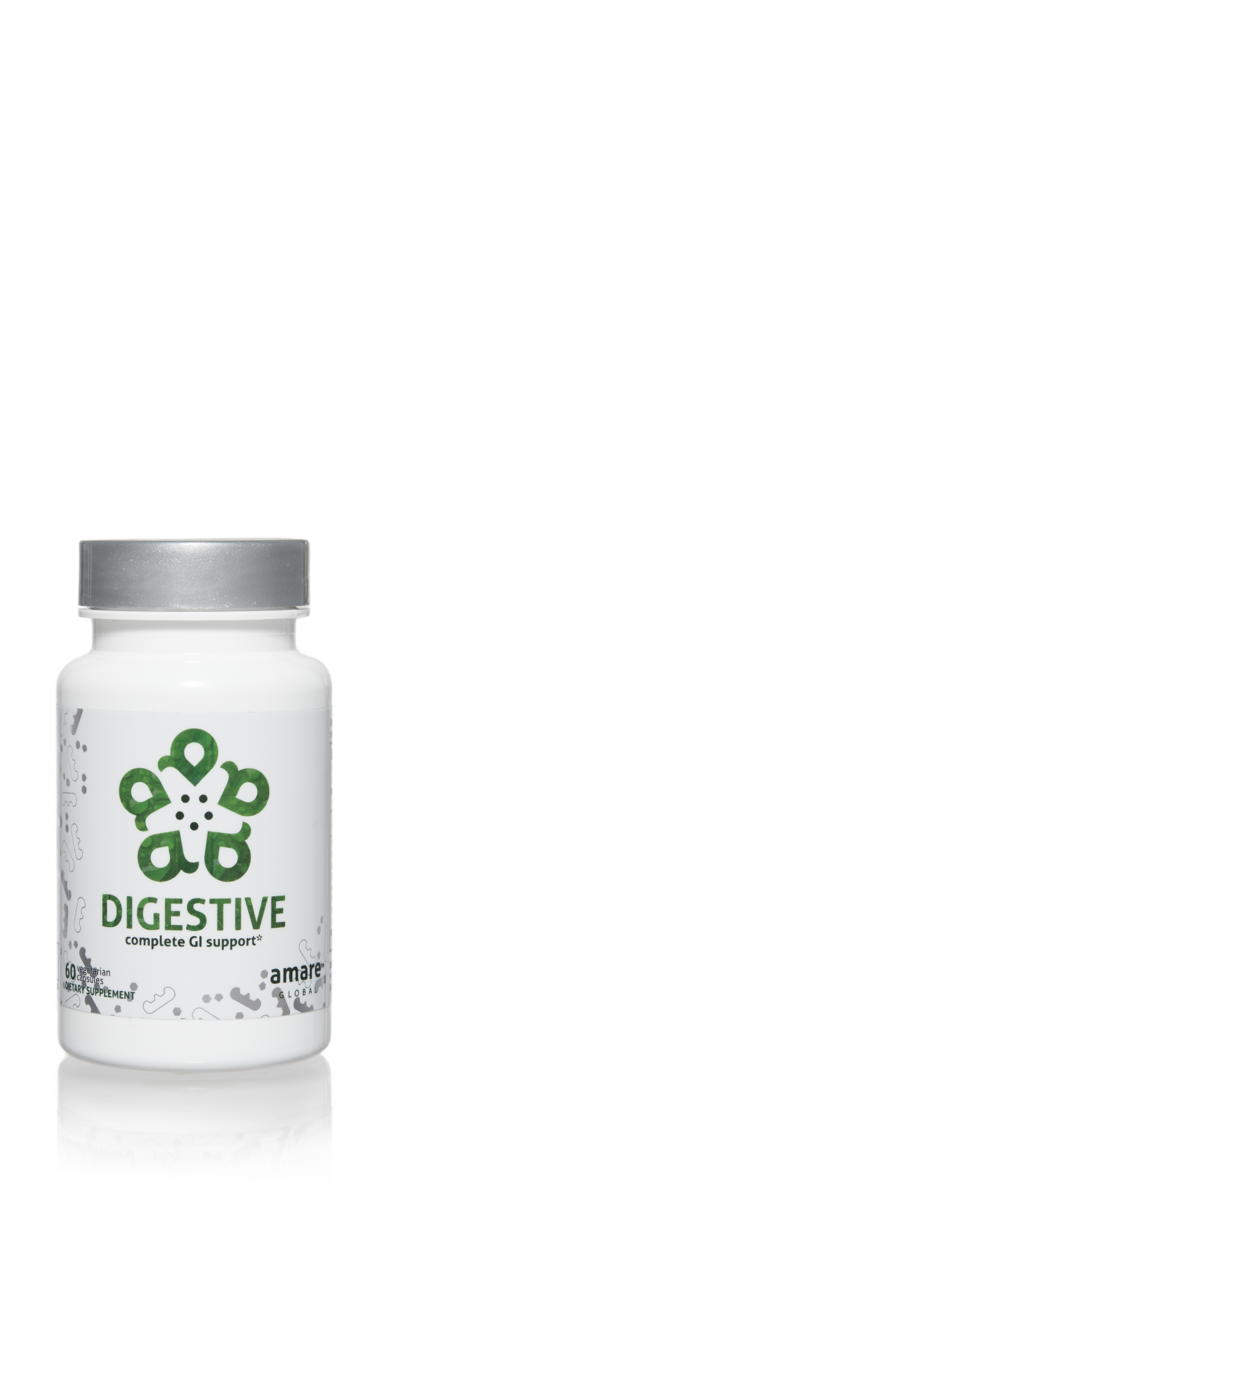
What’s NOT in the Project b³ Pack?
Highly Recommended:
Mood+
Sleep+
Energy+
Encouraged:
OmMega
Digestive
Probiotics

Slide 27
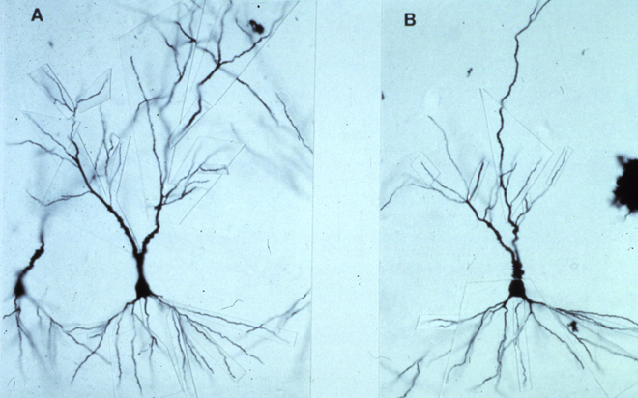
Neuronal Atrophy (dead brain cells)
Normal Stress / Normal Cortisol
Healthy, Large, Many Projections, Optimal Function
High Stress / High Cortisol
Small, Thin, Disrupted
Structural Damage, Poor Function

Slide 28
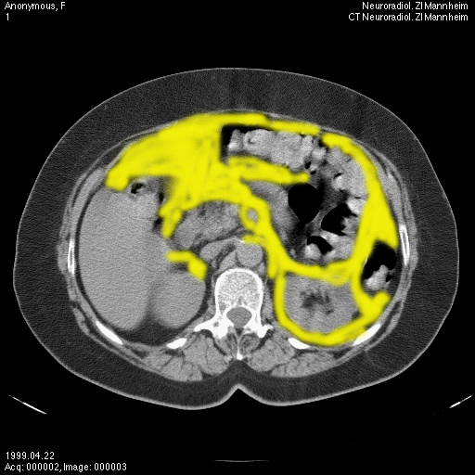
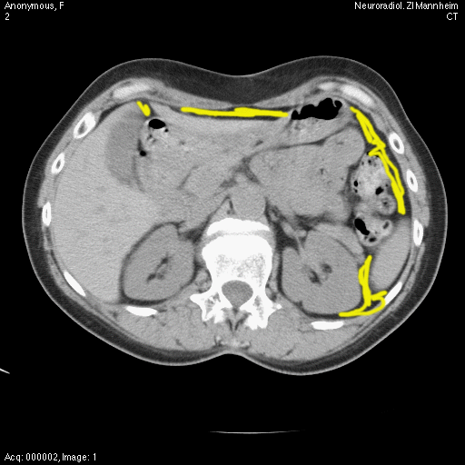
Abdominal Fat Accumulation
High Stress / High Cortisol
Normal Stress / Normal Cortisol

Slide 29
Eight-Week Survey Results
95% of people experienced an increase in their level of understanding about proper supplementation, exercise, nutrition, and sleep.
87% of individuals stated that Project b3 has helped improve mood, reduce stress, and/or increase motivation.
85% of people said the program was easy to incorporate into their daily routine
85% of people noticed an improvement in their physical health, fitness, and overall wellness.
4 out of 5 people said that Project b3 helped them control food cravings and reduce stress eating and that they feel better and better as time passed with Project b3 (better at week 4 than week 2; better at week 8 than week 4)
9 out of 10 people report after 8 weeks on Project b3 that they plan to continue with the products and program.

Slide 30
What are people saying about Project b³?
“Learned a lot and would like to keep going!”
“The program really delivered. Much better control over cravings, improved mood over-all, very noticeable reduction in belly fat. I still have a way to go considering where I started from but am very excited to see where I am at in another 4 weeks or so.”
“My entire life has changed!”
“I feel like everyone needs to learn about this. It is exactly what we need instead of the crazy diets we all have tried. This made sense and was easy to follow.”

Slide 31
Project b³ Testimonial
“I've been studying nutrition and have worked as a health coach for well over a decade and thought I knew a lot about gut health. But Project b3 took things to a whole new level! This program not only expanded my knowledge about the gut brain connection and microbiome and its impact on all areas of your health, it also equipped me with new ideas for food, fitness, sleep and stress management. I feel more energized, clear-headed and empowered. As a health professional, I’m so excited to share this program with everyone I know and see the ripple effect spread.”
-Jen M.

Slide 32
Project b³ Testimonial
“My appetite has definitely changed. I don't want as much food, nor do I want it as often. It is amazing!”
-Courtney B.

Slide 33
Project b³ Testimonial
“Project b3 is an incredible way to pave the road to ANY personal transformation. For me, I started before New Year’s. You know, that ONE day we decide to elevate everything in our life and set new goals with basically no ‘how to plan’ or prepping…The process strengthened my habits and gave me a renewed commitment to improving my brain, body and biome — not to mention a few more friends! The group inspired me to continue on this health journey. It was empowering not imprisoning, and I’m glad I jumped in and started! If you’re waiting for that “perfect time,” your wait is over. Welcome to Project b3, my friends!”
- Kim S.

Slide 34
THE THREE THINGS YOU SHOULD KNOW ABOUT MENTAL WELLNESS
How you feel is not just in your head — it’s also in your gut.
Our “second brain” includes the microbiome and plays a major role in mental wellness.
You can now DO something NATURALLY to improve your mental wellness.
WHERE ARE YOU ON THE MENTAL WELLNESS CONTINUUM? (Circle your current number)
1
2
3
4
5
6
7
8
9
10
DISEASE STATUS
“TYPICAL”
OPTIMIZED
Depression
Anxiety
Diabetes
Obesity
Heart Disease
Autoimmune
Arthritis
Fibromyalgia
CFS
Dementia
ADD / ADHD
Alzheimer’s
Fatigue
Tension
Sad
Brain Fog
Headaches
Acne
Eczema
Congestion
URTI’s
Joint Pain
Muscle Pain
Bloated
Chubby
Energetic
Calmness
Happy
Sharp
Creative
Clear Skin
Rarely Sick
Flexible
Lean
Strong
Resilient
RED
ORANGE
YELLOW
GREEN
BLUE
INDIGO
VIOLET

