Slide 1
MENTAL WELLNESS

Slide 2
GRIM REALITY
Americans spend over $100 billion annually on “feel better” products, from painkillers and anti-depressants to alternative and complementary therapies
100 million Americans suffer from chronic pain – this is one of the top reasons for the $100 billion expenditure
350 million people globally are affected by depression each year – another major reason for the $100 billion expenditure
90% of adolescents have a depressive disorder before the age of 18
Notes:
Americans spend over $100 billion annually on “feel better” products, from painkillers and anti-depressants to alternative and complementary therapies
Nearly 100 million Americans suffer from occasional aches and pains – and is one of the most common reasons that people look to complementary and alternative medicine (CAM) for non-pharmaceutical options
Globally, more than 350 million people are affected by feelings of depression each year
Nearly 90% of adolescents struggle with feelings of depression and anxiety before the age of 18
Globally, more than 800,000 people die by suicide every year – around one person every 40 seconds. In the United States, more than 40,000 Americans commit suicide each year – that’s more than 100 suicides per day
Every year, more than 24 million people, some as young as 12 years old, receive treatment for illicit drug or alcohol abuse
Approximately 1 in 5 new mothers in the U.S. have postpartum depression each year
The World Health Organization calls stress “the health epidemic of the 21st century” with more than 350 million people affected around the world
More than 80% of the nation’s 20 million college students feel “exhausted and overwhelmed by stress” - and more than one-third feel “depressed” to the point of dysfunction

Slide 3
GRIM REALITY
800,000 people die of suicide each year – that’s over 2000 suicides per day
24 million people, some as young as 12 years old, received treatment for illicit drug or alcohol abuse in 2016
1 in 5 new mothers in the U.S. report postpartum depression each year
The World Health Organization calls stress “the health epidemic of the 21st century”
85% of the nation’s 20 million college students reported feeling overwhelmed by stress - and more than 35% reported feeling “depressed” to the point of dysfunction
Notes:
Shawn’s verbiage:
Americans spend over $100 billion annually on “feel better” products, from painkillers and anti-depressants to alternative and complementary therapies
Nearly 100 million Americans suffer from occasional aches and pains – and is one of the most common reasons that people look to complementary and alternative medicine (CAM) for non-pharmaceutical options
Globally, more than 350 million people are affected by feelings of depression each year
Nearly 90% of adolescents struggle with feelings of depression and anxiety before the age of 18
Globally, more than 800,000 people die by suicide every year – around one person every 40 seconds. In the United States, more than 40,000 Americans commit suicide each year – that’s more than 100 suicides per day
Every year, more than 24 million people, some as young as 12 years old, receive treatment for illicit drug or alcohol abuse
Approximately 1 in 5 new mothers in the U.S. have postpartum depression each year
The World Health Organization calls stress “the health epidemic of the 21st century” with more than 350 million people affected around the world
More than 80% of the nation’s 20 million college students feel “exhausted and overwhelmed by stress” - and more than one-third feel “depressed” to the point of dysfunction
SOURCES:
Grim Reality Statistics
Americans spend over $100 billion annually on “feel better” products, from painkillers and anti-depressants to alternative and complementary therapies
Centers for Disease Control and Prevention (CDC) https://www.cdc.gov/nchs/data/hus/hus13.pdf;
Journal of the American Medical Association (JAMA) Trends in Prescription Drug Use Among Adults in the United States From 1999-2012 http://jamanetwork.com/journals/jama/fullarticle/2467552; National Survey on Drug Use and Health https://nsduhweb.rti.org/respweb/homepage.cfm; National Center for Complementary and Integrative Medicine (NCCIM) https://nccih.nih.gov/news/press/cost-spending-06222016
Nearly 100 million Americans suffer from occasional aches and pains – and is one of the most common reasons that people look to complementary and alternative medicine (CAM) for non-pharmaceutical options
National Institutes of Health (NIH), National Center for Complementary and Integrative Medicine (NCCIM), National Health Interview Survey (NHIS) https://nccih.nih.gov/news/press/08112015; Washington Post https://www.washingtonpost.com/news/to-your-health/wp/2015/08/11/nih-more-than-1-in-10-american-adults-experience-chronic-pain/?utm_term=.4dd603a1f016
Globally, more than 350 million people are affected by feelings of depression each year
National Institute for Mental Health (NIMH) https://www.nimh.nih.gov/health/publications/depression/index.shtml; Healthline http://www.healthline.com/health/depression/facts-statistics-infographic; National Alliance on Mental Illness (NAMI) https://www.nami.org
Nearly 90% of adolescents struggle with feelings of depression and anxiety before the age of 18
Depression in Children and Teens, WebMD http://www.webmd.com/depression/tc/depression-in-childhood-and-adolescence-topic-overview#1; National Institute of Mental Health (NIMH) https://www.nimh.nih.gov/health/statistics/prevalence/any-disorder-among-children.shtml
Globally, more than 800,000 people die by suicide every year – around one person every 40 seconds. In the United States, more than 40,000 Americans commit suicide each year – that’s more than 100 suicides per day.
Centers for Disease Control & Prevention, National Center for Health Statistics, Increase in Suicide in the United States, 1999–2014, NCHS Data Brief No. 241, April 2016; New York Times https://www.nytimes.com/2016/04/22/health/us-suicide-rate-surges-to-a-30-year-high.html?_r=0; World Health Organization (WHO) http://www.who.int/mediacentre/news/releases/2014/suicide-prevention-report/en/
Every year, more than 24 million people, some as young as 12 years old, receive treatment for illicit drug or alcohol abuse
National Institutes of Health (NIH); National Institute on Drug Abuse (NIDA) https://www.drugabuse.gov/related-topics/trends-statistics; Substance Abuse and Mental Health Services Administration’s (SAMHSA’s) National Survey on Drug Use and Health https://www.drugabuse.gov/publications/drugfacts/treatment-statistics
Approximately 1 in 5 new mothers in the U.S. have postpartum depression each year
Centers for Disease Control and Prevention https://www.cdc.gov/reproductivehealth/depression/index.htm; Postpartum Progress http://postpartumprogress.org/the-facts-about-postpartum-depression/; American Psychological Association (APA) http://www.apa.org/pi/women/resources/reports/postpartum-depression.aspx
The World Health Organization calls stress “the health epidemic of the 21st century” with more than 350 million people affected around the world
World Health Organization (WHO) http://www.who.int/mediacentre/factsheets/fs369/en/; http://www.who.int/mediacentre/factsheets/fs396/en/; Business News Daily http://www.businessnewsdaily.com/2267-workplace-stress-health-epidemic-perventable-employee-assistance-programs.html; Stress: Concepts, Cognition, Emotion, and Behavior http://scitechconnect.elsevier.com/stress-health-epidemic-21st-century/; WHO World Mental Health http://www.who.int/mental_health/world-mental-health-day/2016/en/
More than 80% of the nation’s 20 million college students feel “exhausted and overwhelmed by stress” - and more than one-third feel “depressed” to the point of dysfunction
American College Health Association http://www.acha.org/ACHA/Resources/Topics/MentalHealth.aspx; American Psychological Association (APA) http://www.apa.org/monitor/2014/09/cover-pressure.aspx;

Slide 4
THE THREE THINGS YOU SHOULD KNOW ABOUT MENTAL WELLNESS
How you feel is not just in your head — it’s also in your gut.
Our “second brain” includes the microbiome and plays a major role in mental wellness.
You can now DO something NATURALLY to improve your mental wellness.
WHERE ARE YOU ON THE MENTAL WELLNESS CONTINUUM? (Circle your current number)
1
2
3
4
5
6
7
8
9
10
DISEASE STATUS
“TYPICAL”
OPTIMIZED
Depression
Anxiety
Diabetes
Obesity
Heart Disease
Autoimmune
Arthritis
Fibromyalgia
CFS
Dementia
ADD / ADHD
Alzheimer’s
Fatigue
Tension
Sad
Brain Fog
Headaches
Acne
Eczema
Congestion
URTI’s
Joint Pain
Muscle Pain
Bloated
Chubby
Energetic
Calmness
Happy
Sharp
Creative
Clear Skin
Rarely Sick
Flexible
Lean
Strong
Resilient
RED
ORANGE
YELLOW
GREEN
BLUE
INDIGO
VIOLET

Slide 5
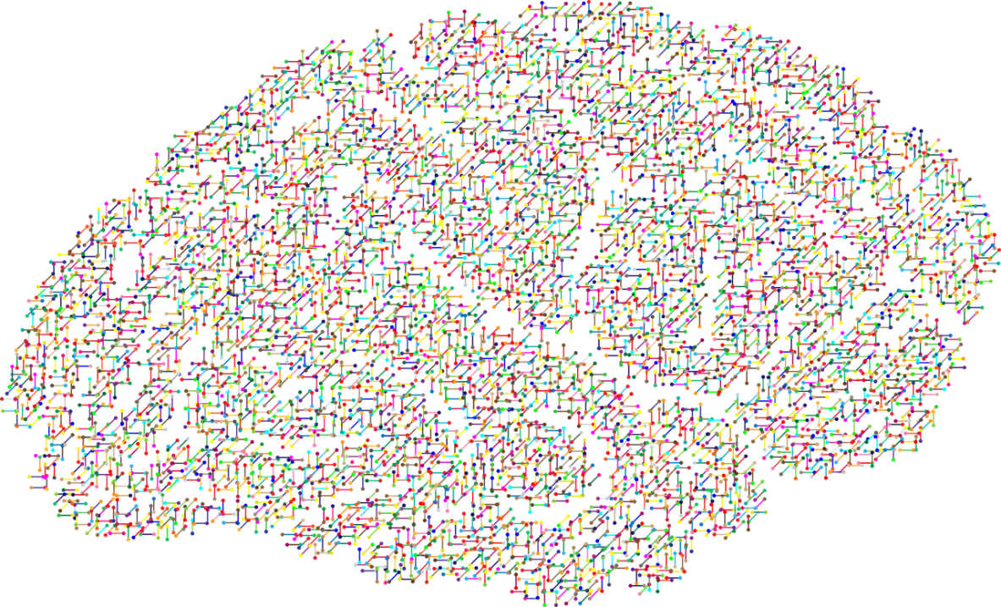
The NEW Science of Mental Wellness
Science has forever focused on the BRAIN as the primary source to addressing mental wellness problems & answers.
We’ve been relying highly on antidepressants and other forms of serotonin reuptake inhibitors (SSRIs) to resolve these issues.
BUT IS THIS THE RIGHT SOLUTON?

Slide 6
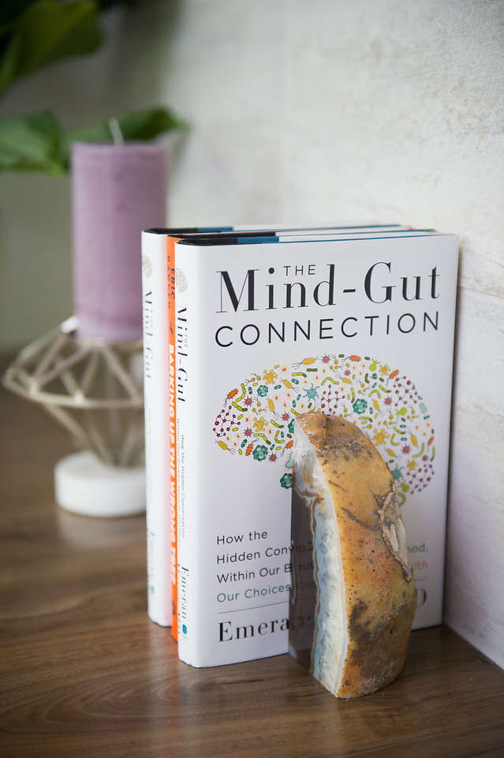
RECENT SCIENTIFIC DISCOVERIES
Science now tells us that we actually have a SECOND BRAIN!
There has been a massive scientific shift towards the MICROBIOME, also known as our gut and second brain, as being the source to addressing mental wellness issues.

Slide 7
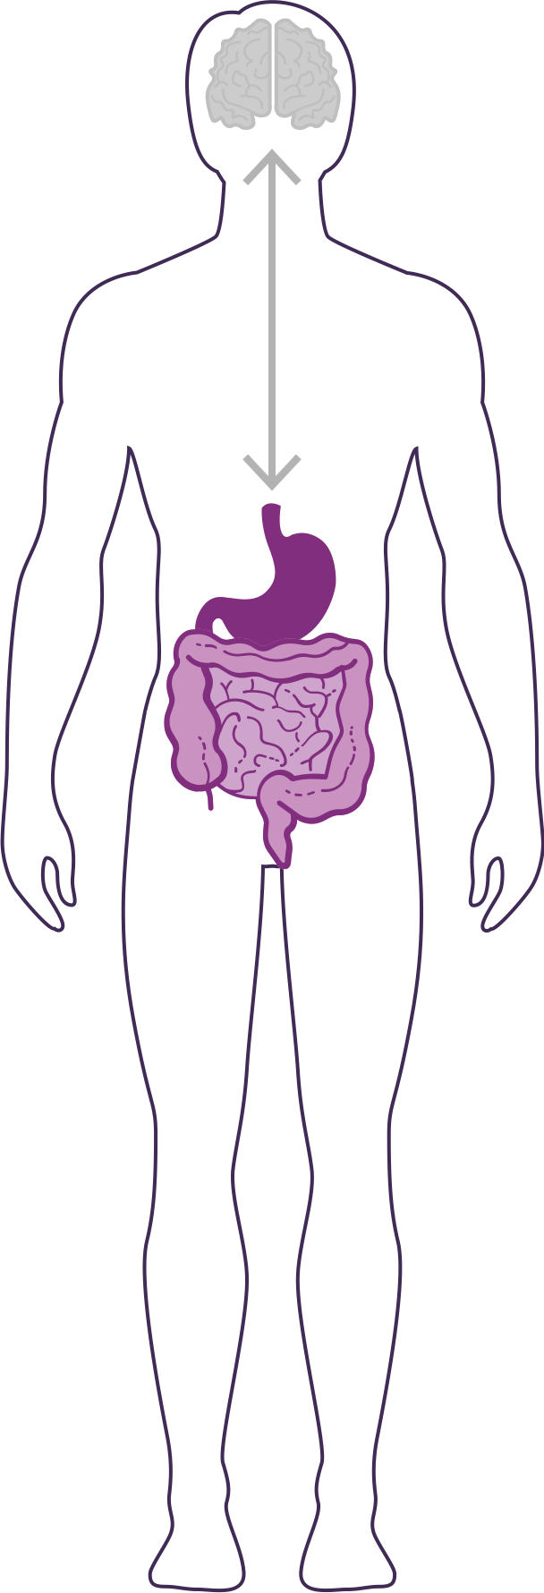
DID YOU KNOW?
90% of the cells in your body are non-human
Human genes = ~23,000
Bacterial genes= ~20 million
(~1,000x MORE than human genes)
The microbiome is an ecological community of trillions of bacteria living symbiotically in/on our body
“2nd Brain” = 3-4 lbs (approximately the same size as our 1st brain)
YOUR GUT IS CONSIDERED YOUR SECOND BRAIN

Slide 8
HOW IMPORTANT IS YOUR MICROBIOME?
Communicates with the brain to regulate health, weight, immune function, digestive function, mood, and overall mental health.
What we put in our bodies affects the microbiome, which in turn affects our mind and other crucial bodily systems
The microbiome plays an important role in the way you feel mentally & physically.
IN BALANCE
Feeling Great
OUT OF BALANCE
This explains why you have those “GUT FEELINGS”
Feeling fatigue, sad, tense, hungry, heavy, bloated, confused, stiff/sore

Slide 9
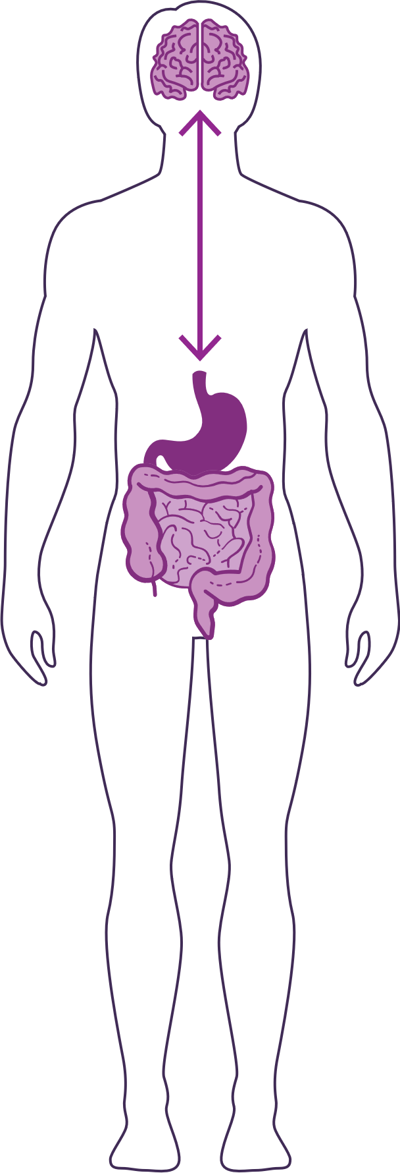
HOW DO YOUR “TWO BRAINS” COMMUNICATE?
Our “two brains” communicate through a highly extensive, multi-directional network, known as the gut-brain axis or what we refer to as the GBX.
THE NETWORK CONSISTS OF:
“wires” – nerves
“chemicals” – neurotransmitters/hormones
“cells” – immune system
The GBX connects our
nervous system (brain)
immune system (axis)
and gastrointestinal system (gut)
with a vast array of cellular and biochemical messengers throughout the entire body, which include the microbiome, hormones, cytokines, and neurotransmitters.

Slide 11
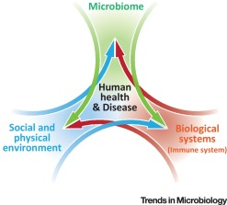
Biome
Body
Brain

Slide 12
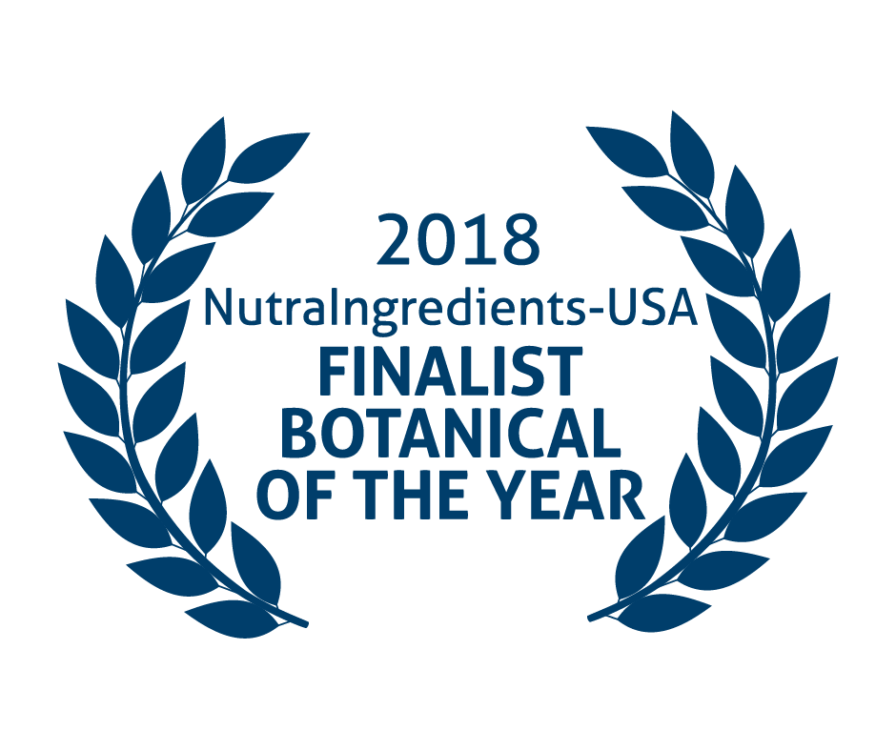
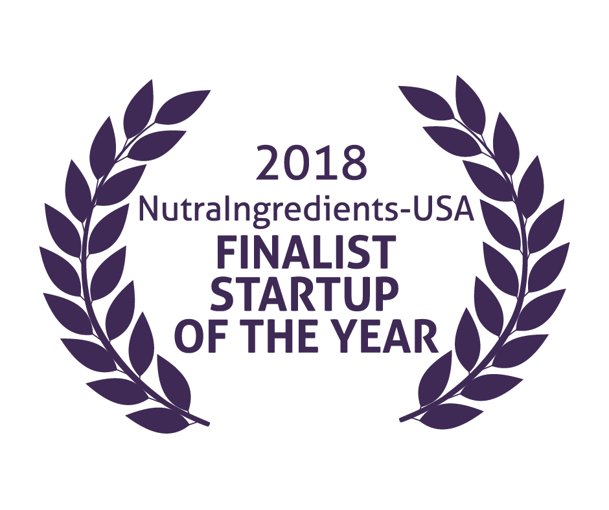
Mood+
Amare Global

Slide 13
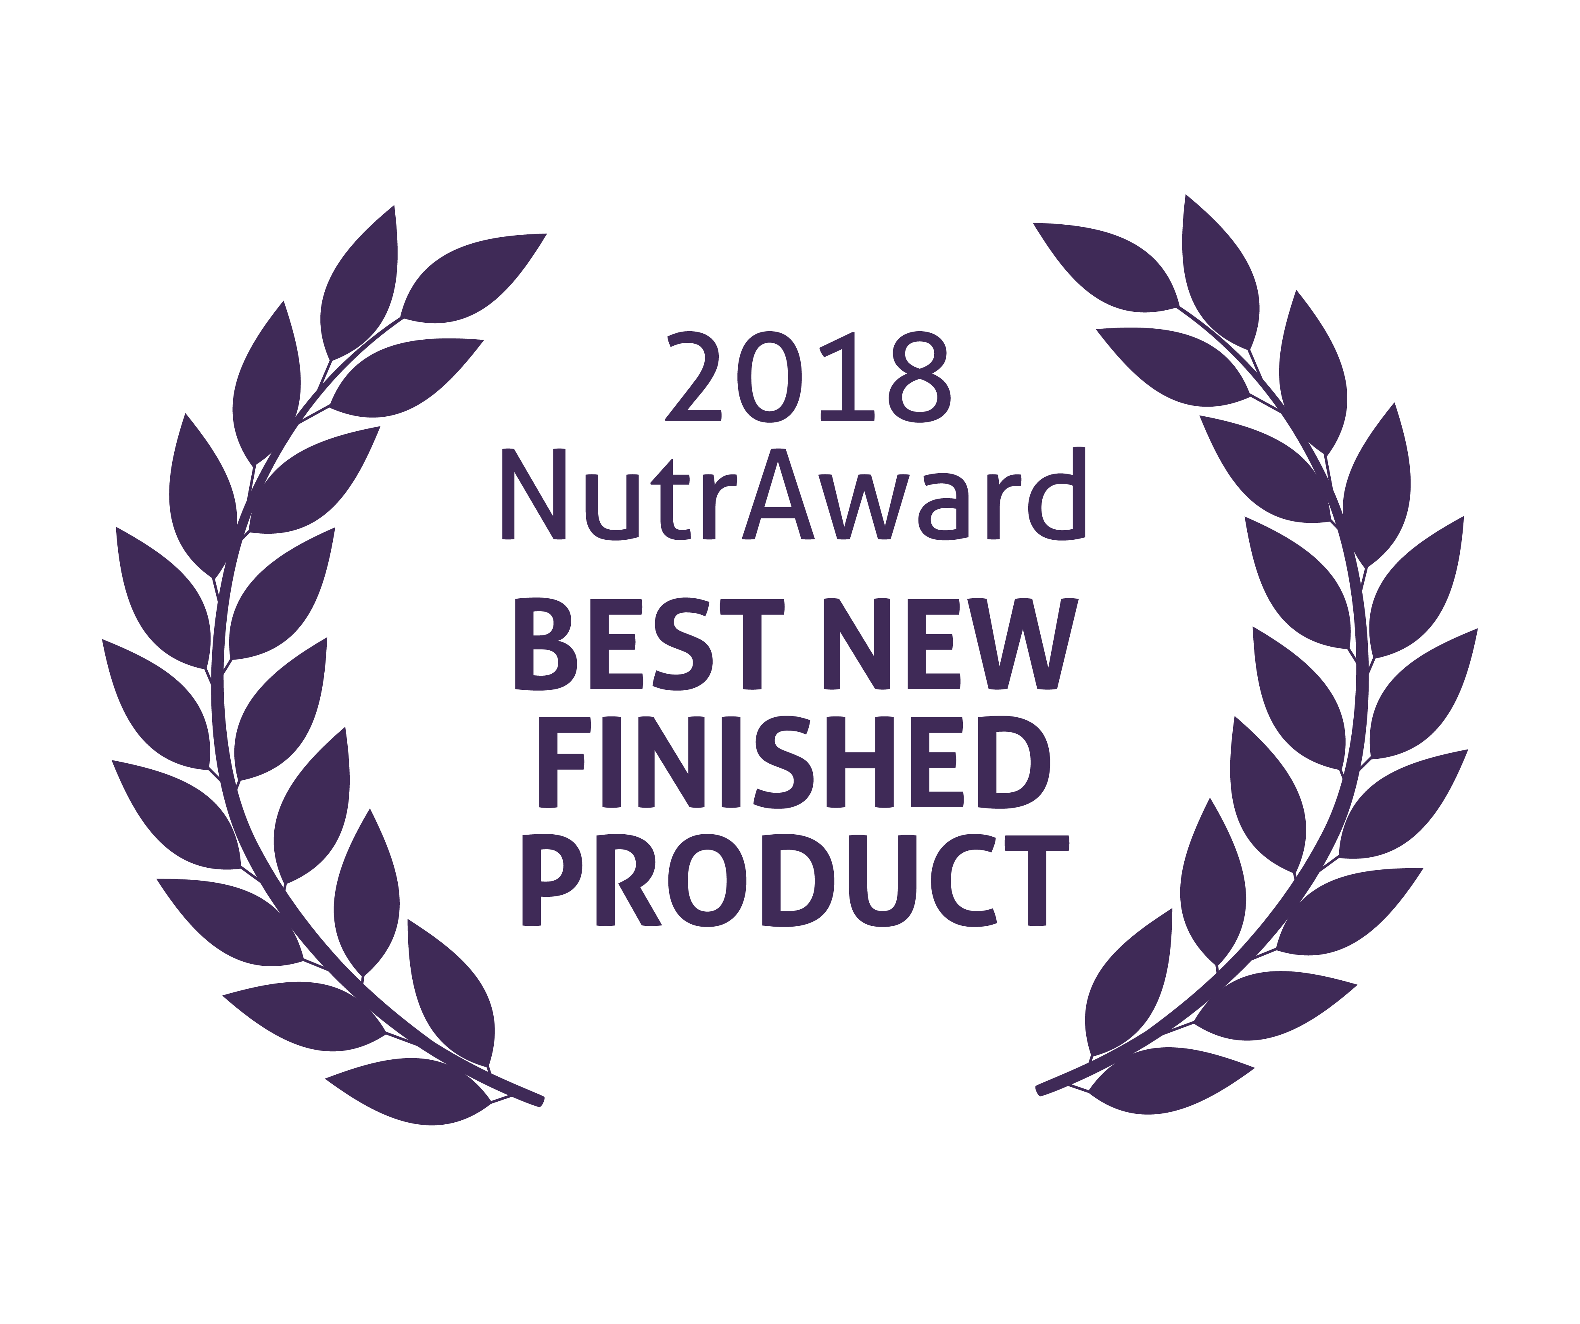
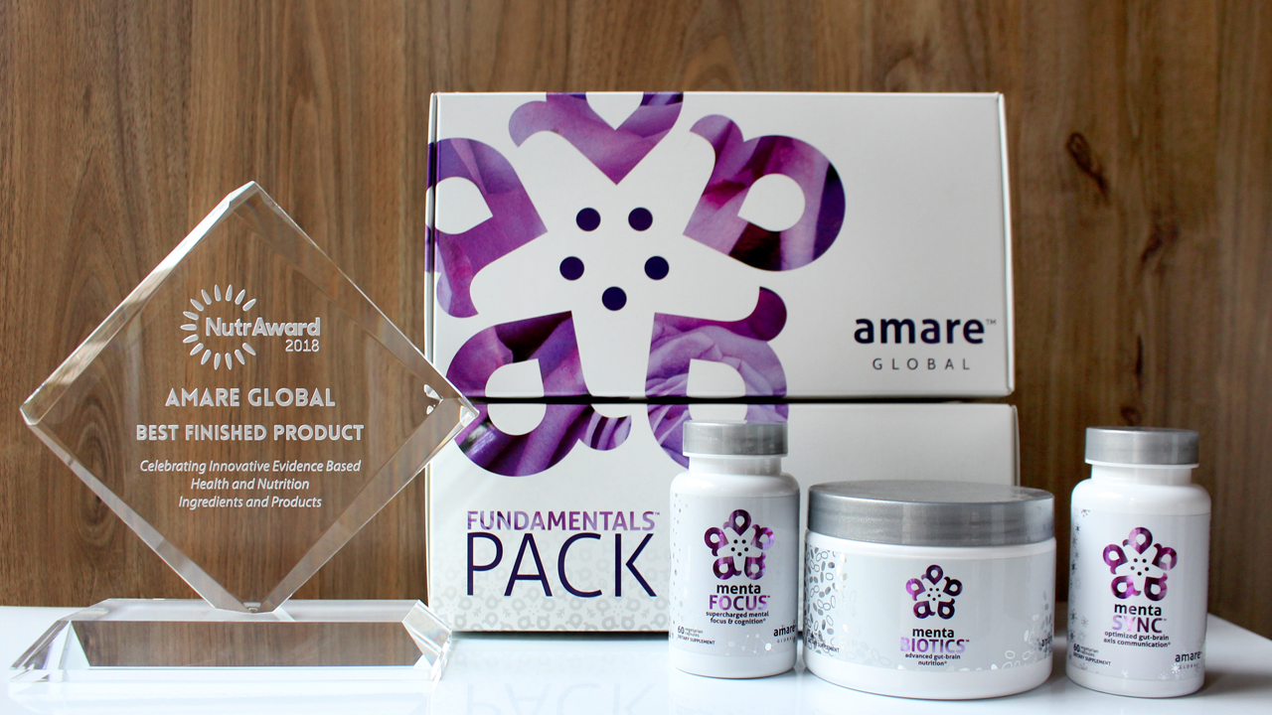
World’s First Award-Winning Gut-Brain Axis Nutrition System!
The NutrAward recognizes companies that are investing in rigorous and measurable scientific studies to prove the efficacy of their proprietary ingredients or technologies.
Submissions are judged on their merit in the following areas:
Viable product
Emerging category
Creative product concept
Distinct health application
Unique packaging
Matchless marketing

Slide 14
CLINICAL STUDY
The Amare FundaMentals Pack™ has been clinically proven to:

Slide 15
Portions of Data Presented at:
American College of Nutrition
November 2017 – Alexandria VA (“Outstanding Research” Award)
Experimental Biology
April 2018 – San Diego, CA
American College of Sports Medicine
May 2018 – Minneapolis, MN
Mental Health America – Fit for the Future Conference
June 2018 – Washington DC
Microbiome Movement – Gut Brain Axis
November 2018 – Boston, MA
American Mental Wellness Awareness Association
November 2018 – Hershey, PA
Medical, Nutrition, Biochemistry, Molecular Biology, Physiology, Psychology, Counselors, Policy…

Slide 16
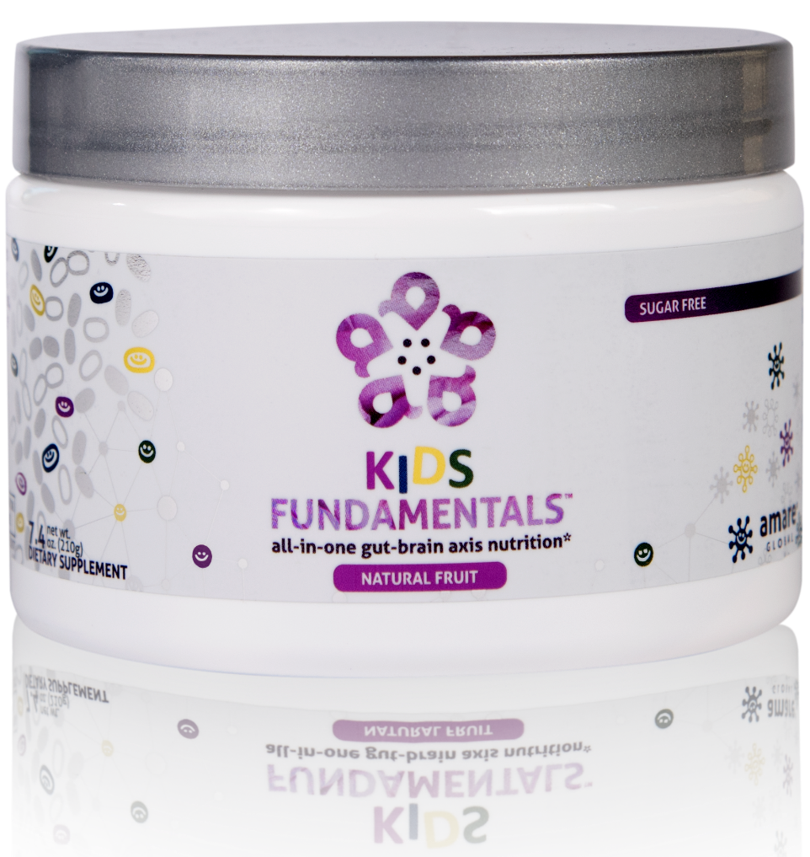
INGREDIENTS SHOWN TO IMPROVE MENTAL WELLNESS*
SUPPORTS ENTIRE GUT-BRAIN AXIS*
EASY-TO-DIGEST FORMULA
all-in-one gut-brain axis nutrition for kids & teens*
Kids FundaMentals™ is an all-in-one product that supports the entire gut-brain axis (GBX) of growing kids and teens. Featuring nutrients scientifically shown to improve mental wellness, this easy-to-digest formula is perfect for kids and teens of all ages.*
Item Code: Retail Price: Wholesale Price: Subscribe & Save:
S017 $90.00 $66.95 / 56 PV $59.95 / 50 PV
*These statements have not been evaluated by the Food and Drug Administration. This product is not intended to diagnose, treat, cure, or prevent any disease.
Notes:
Add callouts

Slide 17
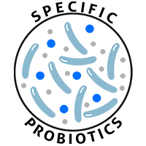
Kids FundaMentals MW3™ Probiotic Proprietary Blend
™
Our blend contains unique and specific probiotic strains targeted to enhance overall mental wellness.*
MW3 Probiotic Strains:
Lactobacillus rhamnosus R0011 — Reduces stress by lowering cortisol exposure and improves GABA neurotransmission*
Bifidobacterium longum R0175 — Enhances calmness by decreasing anxiety indices and improves cognitive function*
Lactobacillus helveticus R0052 — Improves mood by decreasing neuro-inflammation and increasing serotonin*
*These statements have not been evaluated by the Food and Drug Administration. This product is not intended to diagnose, treat, cure, or prevent any disease.

Slide 18
Kids FundaMentals MW3™ Prebiotic Proprietary Blend
™
Our MW3 Prebiotic Proprietary Blend provides optimal gut support by feeding the specific mental wellness probiotic strains found in our MW3 Probiotic Proprietary Blend.*
MW3 Prebiotic Fibers:
IsoFiber™ (Iso-Malto-Oligosaccharides) — Contains a combination of naturally occurring prebiotic plant fibers that are clinically shown to improve the growth of specific probiotic strains featured in Kids FundaMentals™ and now MentaBiotics™ Sugar Free!
Bimuno® (Galacto-Oligo-Saccharides) — Resets and increases friendly gut bacteria, maintains immune health, controls inflammation in the body and supports microbiome balance. Is highly effective and a natural way of increasing preferred bacteria in the gut. Plays an important role in feeding Bifidobacteria probiotic strains.*
SunFiber® (Galactomannan Fiber) — Helps improve the growth and vitality of beneficial bacteria, including Bifidobacteria and Lactobacillus.*
*These statements have not been evaluated by the Food and Drug Administration. This product is not intended to diagnose, treat, cure, or prevent any disease.

Slide 19
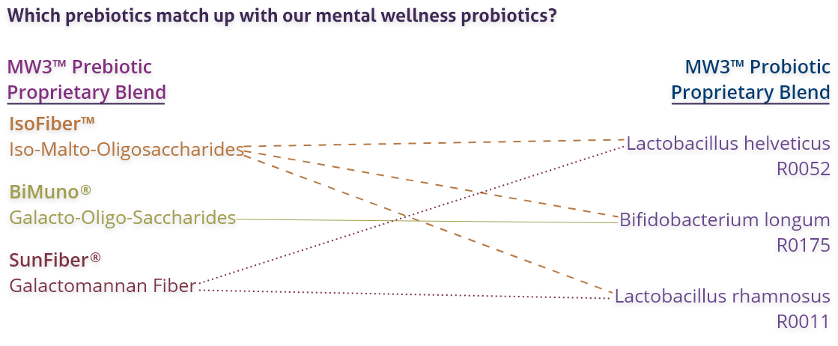
Kids FundaMentals MW3™ Prebiotic/Probiotic Proprietary Blend
™
*These statements have not been evaluated by the Food and Drug Administration. This product is not intended to diagnose, treat, cure, or prevent any disease.

Slide 20
Why is Fundamentals Different?
World’s 1st comprehensive/holistic GBX System
Addresses each level of GBX balance
Microbiome modulation
Gut integrity
Immune priming
Inflammatory balance
Neurotransmitter signaling
Specific probiotic strains for depression/anxiety/stress
Specific prebiotics fibers for stress/resilience
Patent-pending phytonutrients for GBX support
Scientifically-supported formula
6 peer-reviewed presentations

Slide 21
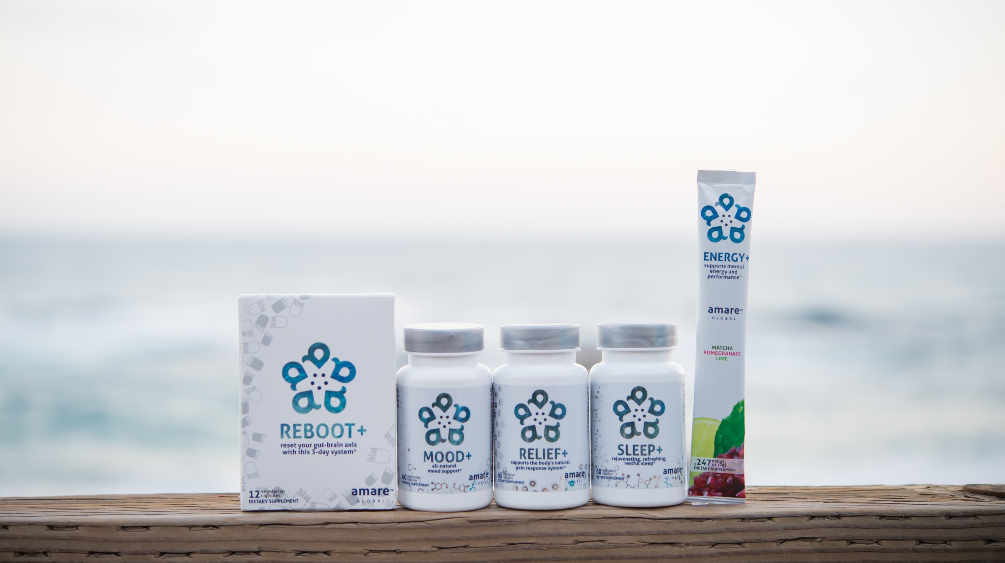
All-Natural Support Solutions for Energy, Mood, Pain, and Sleep*
MENTATHERAPEUTICS
™
*These statements have not been evaluated by the Food and Drug Administration. This product is not intended to diagnose, treat, cure, or prevent any disease.

Slide 22
Why is Reboot+ Different?
Worldwide exclusive on Sebatin
Patented blend of Poria/Myristica/Astragalus
Improves liver detoxification

Slide 23
Why is Mood+ Different?
Finalist for Botanical of the Year
Most comprehensive herbal blend for mood support
Venetron (Rafuma) – Depression
Zembrin (Kanna) – Stress Resilience
Sensoril (Ashwagandha) – Tension
Relora (Magnolia) - Anxiety

Slide 24
Why is Relief+ Different?
Worldwide exclusive on Meriva/Casperome combination
Fast-acting Meriva (30x-better-absorbed turmeric)
Blocks the inflammation/pain NOW
Long-lasting Casperome (30x-better-absorbed boswellia)
Inhibits the inflammation/pain LATER

Slide 25
Why is Sleep+ Different?
Worldwide exclusive on patented corn-grass extract
Research-supported Maizinol (30x potency corn grass)
Improves Serotonin signaling (depression/anxiety)
Improves Melatonin signaling Casperome (sleep quality)
40% more time in Deep Sleep (body recovery)
40% more time in REM Sleep (brain rejuvenation)

Slide 26
Why is Energy+ Different?
Patent-pending GBX proprietary blend
3-tiered energy
Physical Energy (motivation)
Mental Energy (focus)
Mental Awareness (presence/connectedness/engagement)

Slide 27
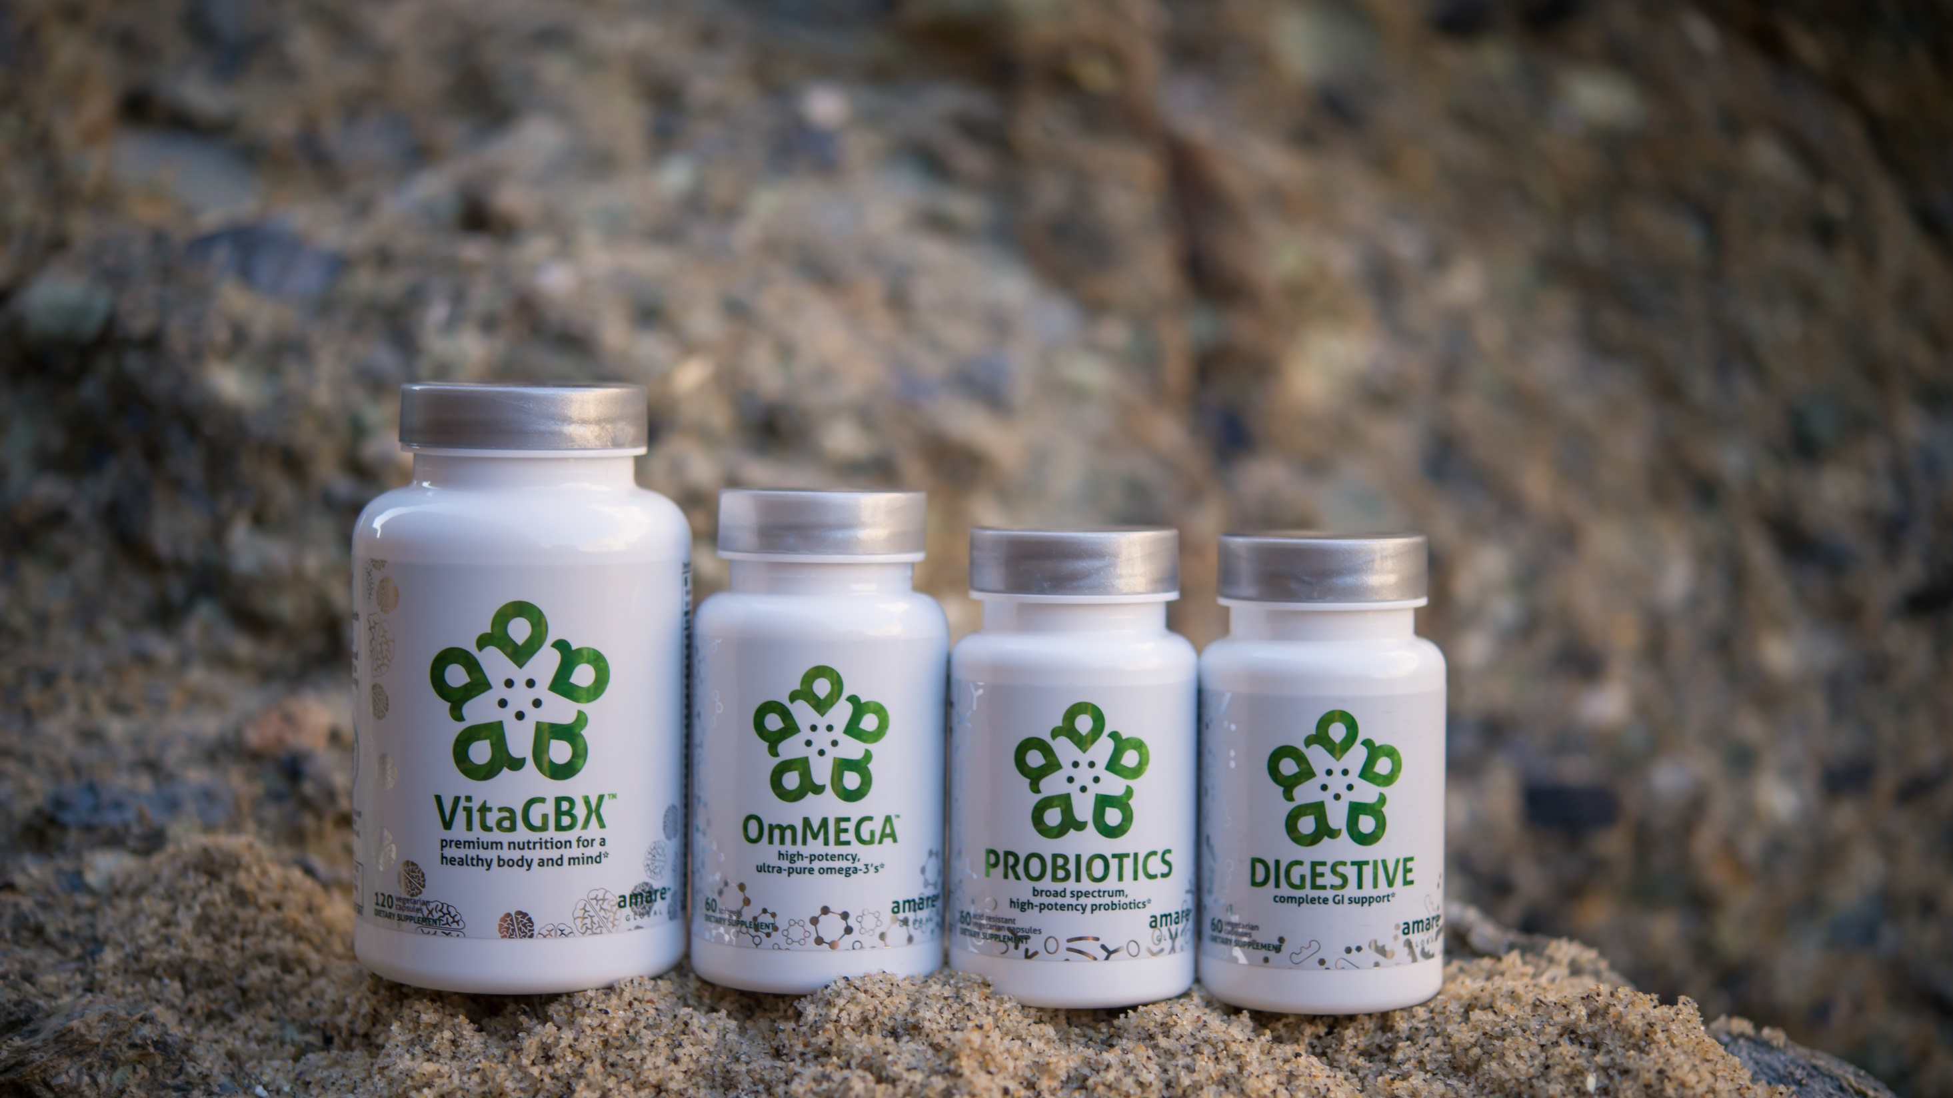
Pure & Potent Daily Essential Nutrients*
MENTAESSENTIALS
™
*These statements have not been evaluated by the Food and Drug Administration. This product is not intended to diagnose, treat, cure, or prevent any disease.

Slide 28
Why is VitaGBX Different?
Patent-pending GBX proprietary blend
Bioavailable forms of vitamins/minerals/phytonutrients
Nourishes Body & Mind
Modulates numerous CDRs (cellular-defense responses)
Nrf2 (antioxidant)
NfKb (inflamamtion)
SIRT (cellular aging)
MTOR (metabolism)
HSP (autophagy = cellular cleanup)

Slide 29
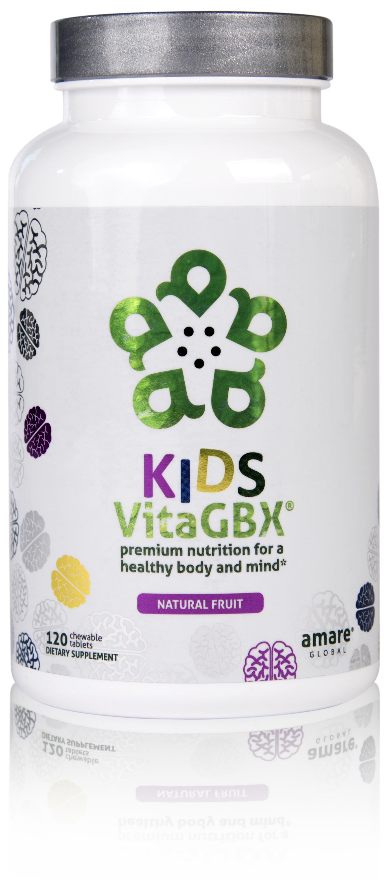
CONTAINS BENEFICIAL VITAMINS AND MINERALS
CONTAINS MORE THAN 50 NUTRIENTS*
PERFECT FOR KIDS AND TEENS OF ALL AGES*
premium nutrition for a healthy body and mind*
Kids VitaGBX® is a comprehensive multivitamin for kids and teens that combines more than 50 vitamins, minerals, amino acids, and phytonutrients. Packed with pure nutrients kids need as they grow and develop, our easy-to-digest chewable tablets feature both our Bright Mind Proprietary Blend (for mind support) and Amare GBX+ Proprietary Blend (for gut-brain axis support) to empower a well-balanced body and mind. Features a delicious, fruity flavor — perfect for kids and teens of all ages.*
Item Code: Retail Price: Wholesale Price: Subscribe & Save:
S020 $48.00 $35.95 / 25 PV $31.95 / 22 PV
*These statements have not been evaluated by the Food and Drug Administration. This product is not intended to diagnose, treat, cure, or prevent any disease.

Slide 30
Why is OmMega Different?
High-potency/purity fish oil
70% omega-3 extract
Typical = 30% omega-3

Slide 31
Why is Probiotics Different?
Bifidobacterium bifidum (Bb-06)
Maintains microflora balance by producing lactic acid and acetic acid to compete with “bad” bacteria (Staph. aureus, E. coli, Camplylobacter jejuni, etc).
Bifidobacterium longum (Bl-05)
Highly resistant to low pH and bile salts and is well-suited to the intestinal environment to help reduce inflammation. Helps reduce gastrointestinal discomfort caused by stress.
Lactobacillus acidophilus (La-14)
Ferments carbohydrates to lactic acid, which competes with “bad” bacteria for adhesion spaces on the intestinal mucosa. Increases mineral bioavailability (incl copper, magnesium, calcium, and manganese).
Lactobacillus casei (LC-11)
Wide range of benefits for improved digestion, reduced cholesterol, modulation of inflammation/allergies.
Lactobacillus rhamnosus (Lr-32)
Promotes general GI health and function – especially beneficial to prevent/treat occasional diarrhea and constipation after probiotic treatment.

Slide 32
Why is Digestive Different?
Digestive enzymes work on all macronutrients
Carbs/Fats/Proteins
Digestive enzymes work in all parts of GI tract
Upper (stomach) / Middle (small intestine) / Lower (colon)
Patented digestive performance blend (ProDigest)
Motility enhancer – moves food thru GI tract at proper speed
Improves GI pH – restores “environment” healthy microbiome

Slide 33
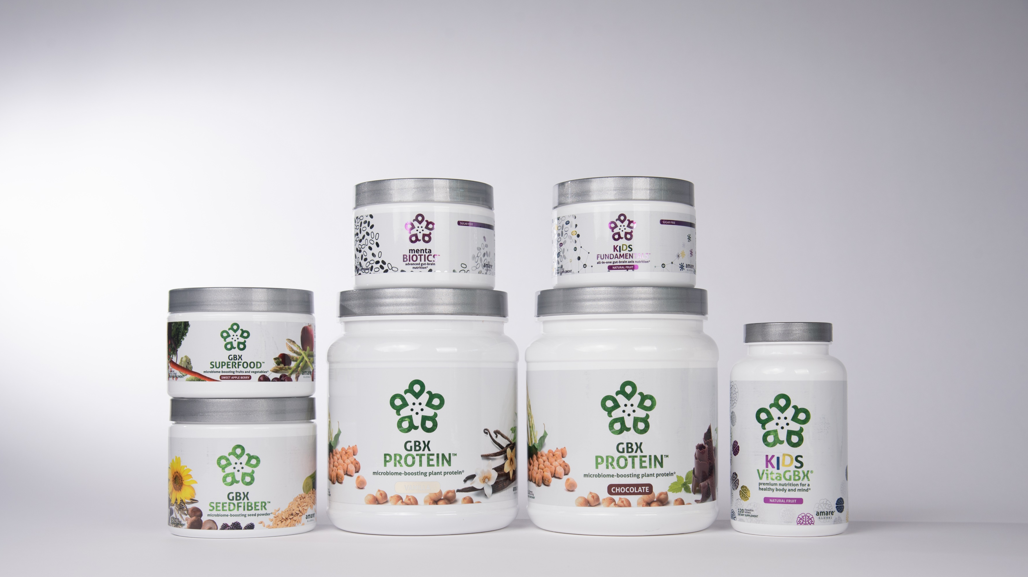
INTRODUCING NEW AMARE PRODUCTS

Slide 34
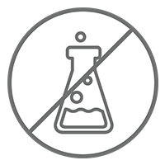
Microbiome-Boosting Nutrition*
GBX FOODS
™
Vegan /
All Natural*
Non-GMO and Gluten Free*
Sugar Free*
Soy and Dairy Free*
No Preservatives, Artificial Colors, Flavors and Sweeteners*
*These statements have not been evaluated by the Food and Drug Administration. This product is not intended to diagnose, treat, cure, or prevent any disease.

Slide 35
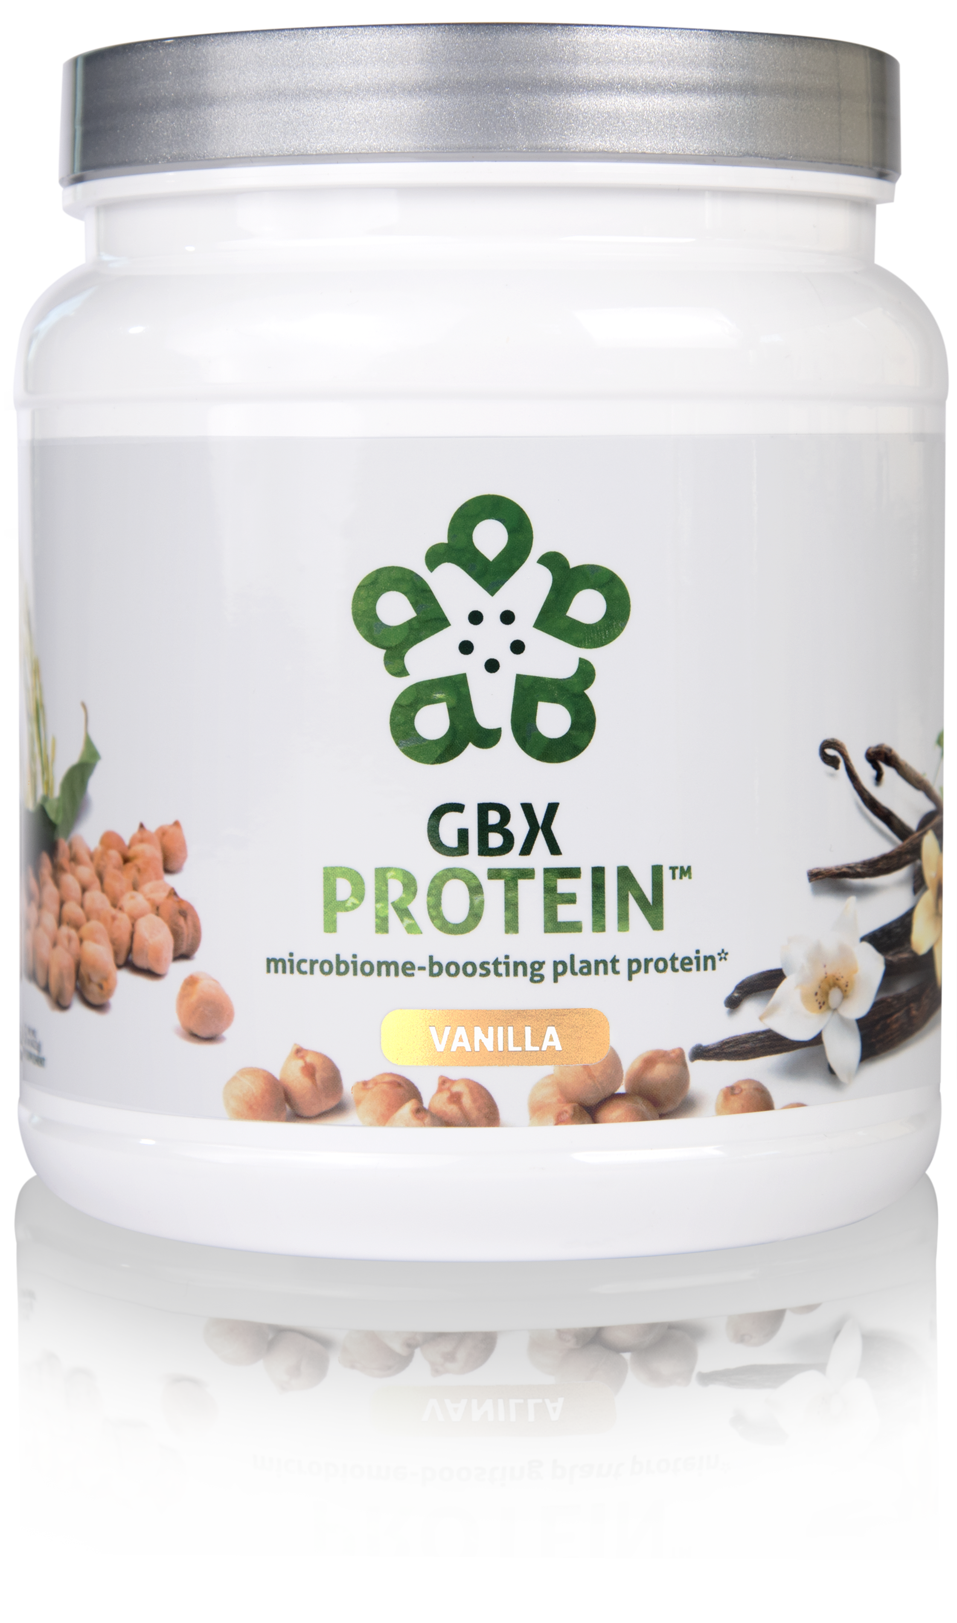
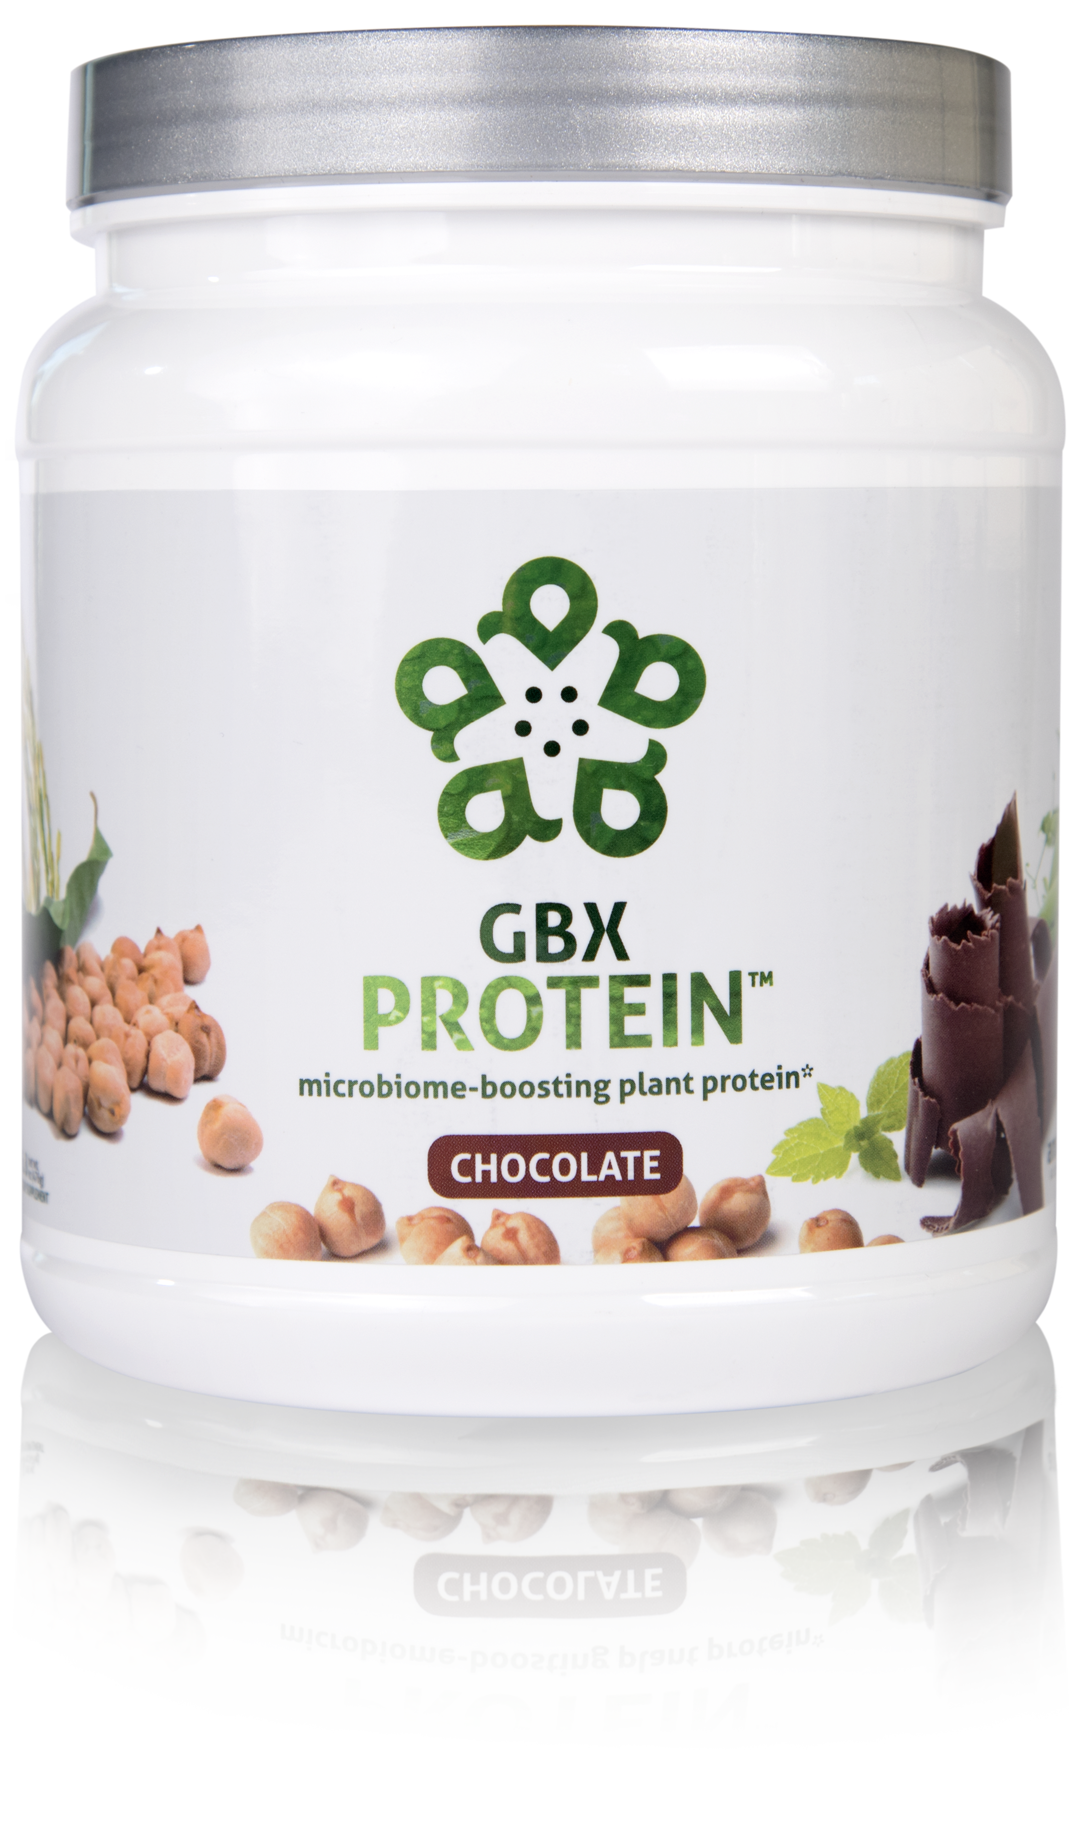
HELPS CONTROL APPETITE AND SUPPORTS MUSCLE MASS*
17 GRAMS OF ULTRA-PURE, PLANT-BASED PROTEIN*
NOURISHES GOOD GUT BACTERIA*
microbiome-boosting plant protein*
GBX Protein™ delivers 17 grams of pure plant protein. This unique chickpea, brown rice, and pea protein blend nourishes good bacteria in the gut and improves microbiome balance, while controlling appetite and supporting muscle mass. Fully-loaded with only functional ingredients, this potent formula supports the gut microbiome, helping fuel a healthy lifestyle.*
Item Code (Vanilla):
Item Code (Chocolate): Retail Price: Wholesale Price: Subscribe & Save:
S015
S016 $54.00 $39.95 / 26 PV $35.95 / 22 PV
*These statements have not been evaluated by the Food and Drug Administration. This product is not intended to diagnose, treat, cure, or prevent any disease.

Slide 36
Why is GBX Protein Different?
Chickpea protein (Artesa)
Small/uniform particle size = creamy mouthfeel
Essential AA profile = muscle maintenance
Oligosaccharides = microbiome nourishment

Slide 37
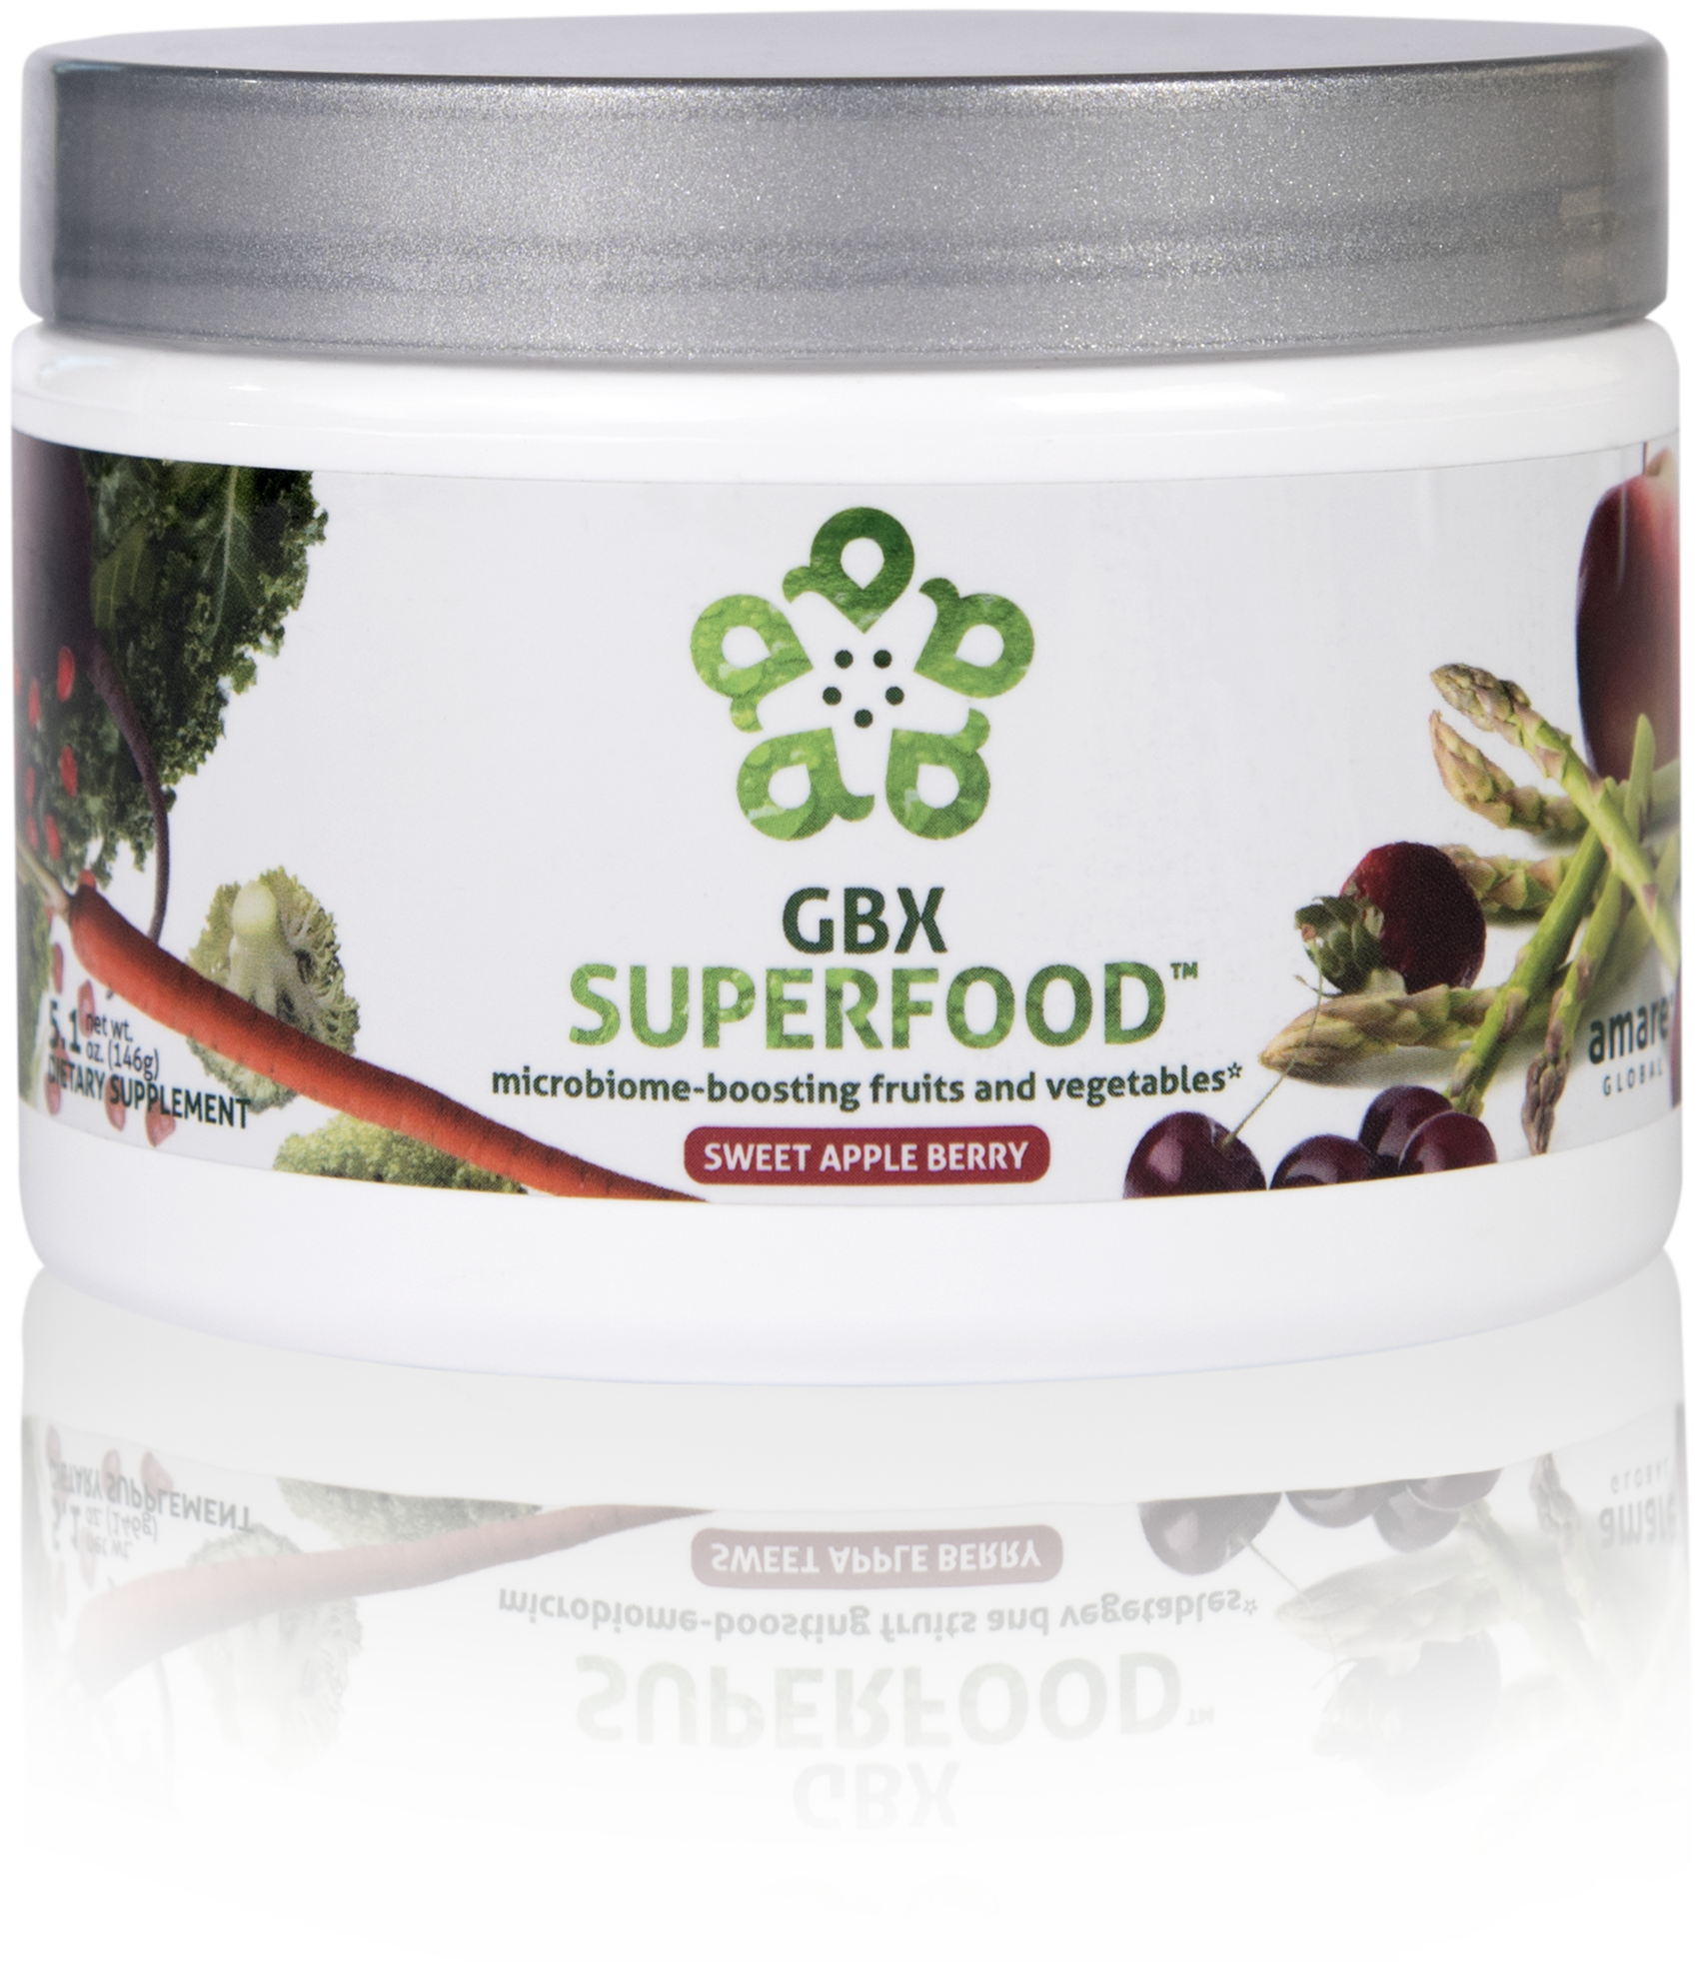
NUTRIENTS EQUIVALENT TO 3 SERVINGS OF FRUITS AND VEGETABLES*
NOURISHES GOOD GUT BACTERIA*
PROVIDES CELLULAR ANTI-STRESS BENEFITS*
microbiome-boosting fruits and vegetables*
GBX SuperFood™ provides the phytonutrient equivalent of three servings of fruits and vegetables per scoop. This phytobiotic-rich blend delivers cellular level anti-stress benefits and helps protect cells from a variety of different stressors, helping the brain and gut run at peak efficiency.*
Item Code: Retail Price: Wholesale Price: Subscribe & Save:
S018 $40.00 $29.95 / 21 PV $26.95 / 18 PV
*These statements have not been evaluated by the Food and Drug Administration. This product is not intended to diagnose, treat, cure, or prevent any disease.

Slide 38
Why is GBX Superfood Different?
3-servings of fruits/vegetables
Nourishes microbiome (Isofiber)
Improves gut integrity
Increases heat shock proteins (cellular protaction)
Stimulates autophagy (cellular cleanup)
Induces stress resilience and reduces tension (feel it)

Slide 39
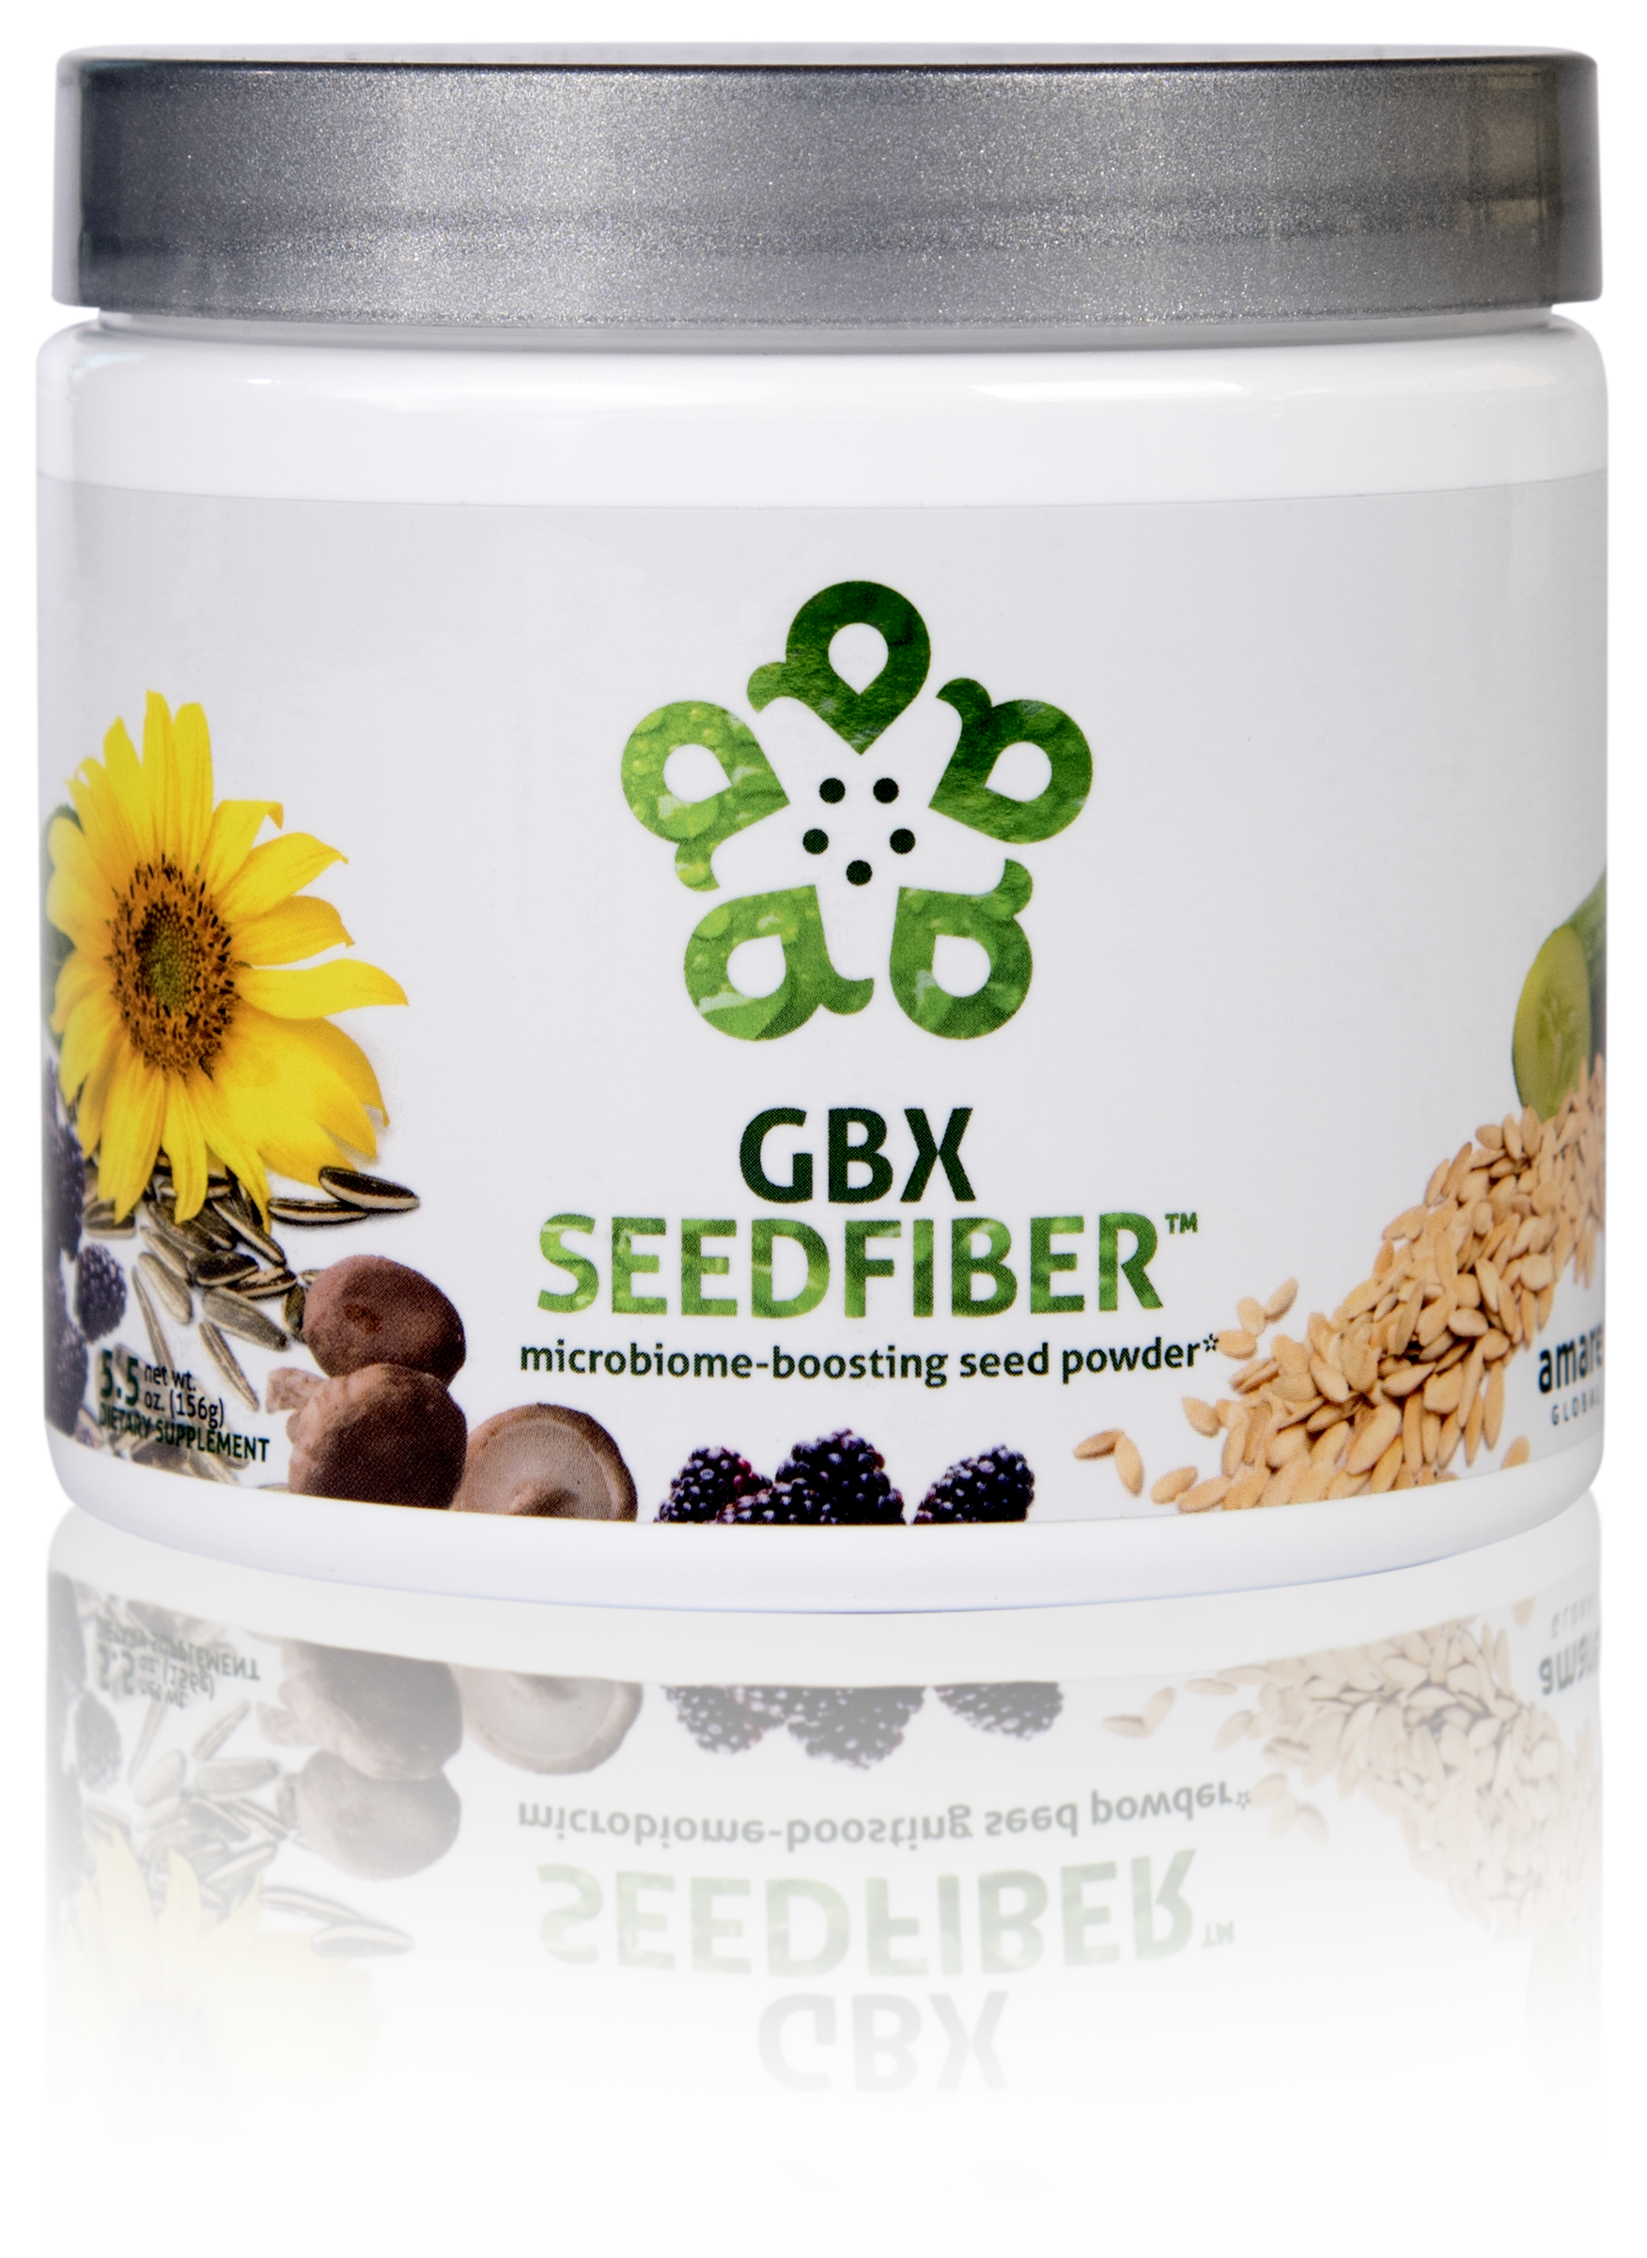
NEXT-GENERATION APPROACH TO OPTIMIZING GUT-BRAIN AXIS*
CONTAINS NATURAL MICROBIOME-BOOSTING FIBERS*
HELPS MANAGE FEELINGS OF STRESS, TENSION AND ANXIETY*
microbiome-boosting seed powder*
GBX SeedFiber™ is the next-generation approach to optimizing the gut-brain axis. This phytobiotic-rich formula contains seeds as sources of natural microbiome-boosting fibers, helping you feel fuller, longer. Featuring a cultured mushroom mycelia extract to support microRNA signaling between the microbiome and central nervous system, this unique blend helps manage feelings of stress, tension and anxiety.*
Item Code: Retail Price: Wholesale Price: Subscribe & Save:
S019 $50.00 $36.95 / 26 PV $32.95 / 21 PV
*These statements have not been evaluated by the Food and Drug Administration. This product is not intended to diagnose, treat, cure, or prevent any disease.

Slide 40
Why is GBX Superfood Different?
Delivers fiber/phytonutrients (cold-pressed seed hulls)
Nourishes microbiome
Improves gut integrity
Stimulates microRNA signaling (gene expression)
Enhances anti-anxiety signaling (feel it)

Slide 41
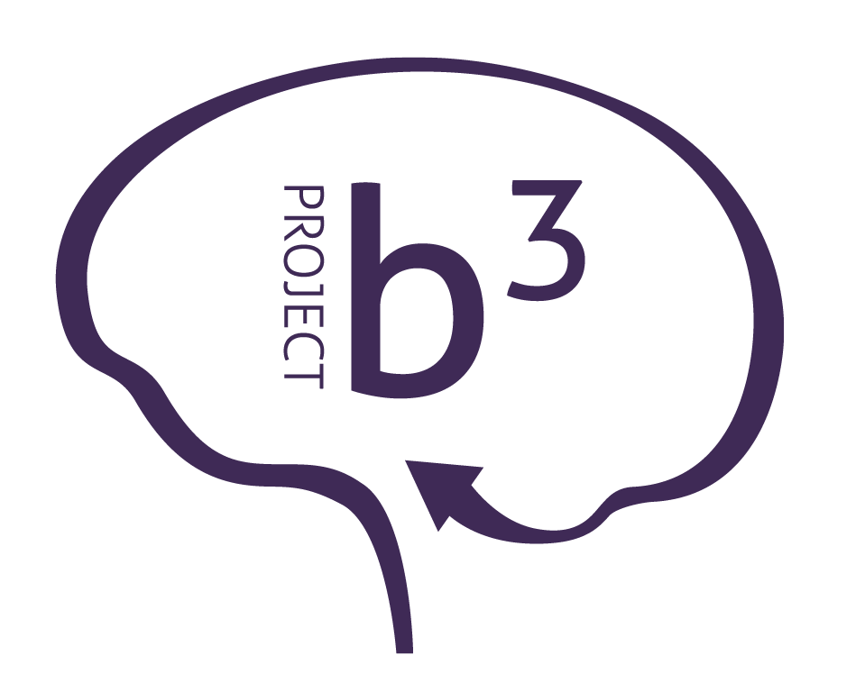
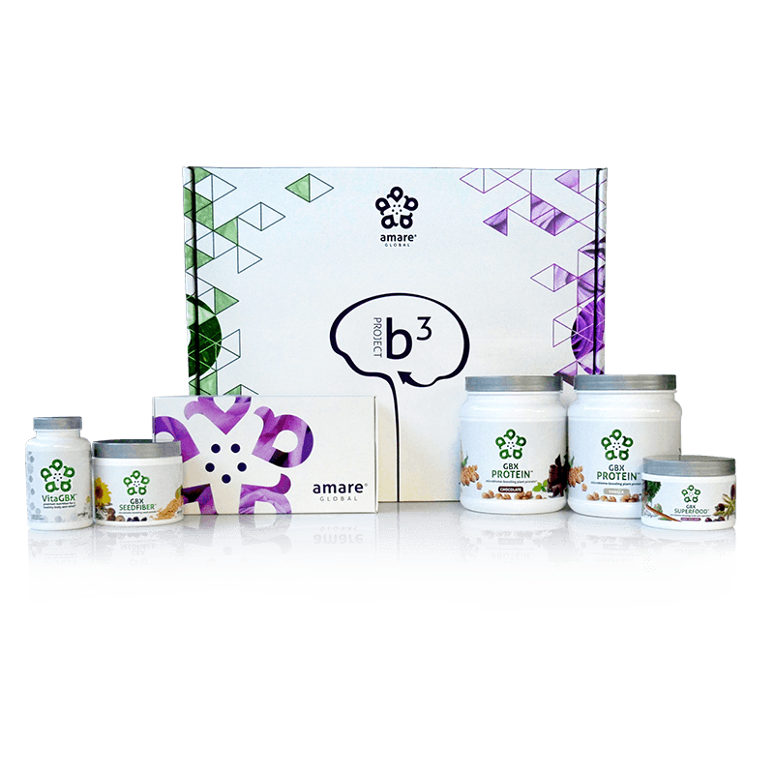
BODY.
BRAIN.
BIOME.
BODY. BRAIN. BIOME.
A fit body begins with mental wellness, and the key to a healthy brain is the gut microbiome. Body. Brain. Biome. Project b3. The holistic solution to a healthier well-being.
Item Code: Retail Price: Wholesale Price: Subscribe & Save:
P012-P017 $486.00 $305.95 / 210 PV $274.95 / 190 PV
*These statements have not been evaluated by the Food and Drug Administration. This product is not intended to diagnose, treat, cure, or prevent any disease.

Slide 42
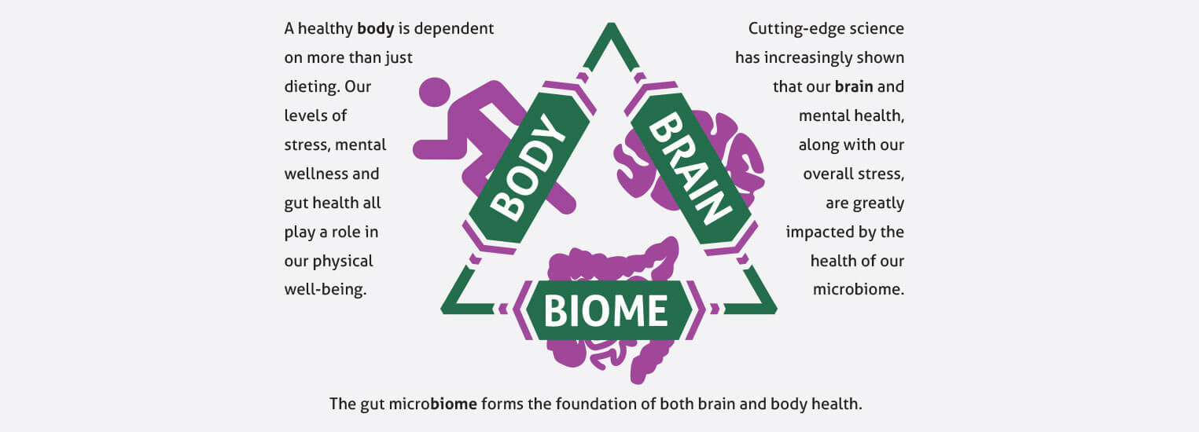
Project b³: BODY. BRAIN. BIOME.
Amare FundaMentals Pack (1), VitaGBX (1), GBX Protein (2), GBX SeedFiber (1), GBX SuperFood (1)

Slide 43
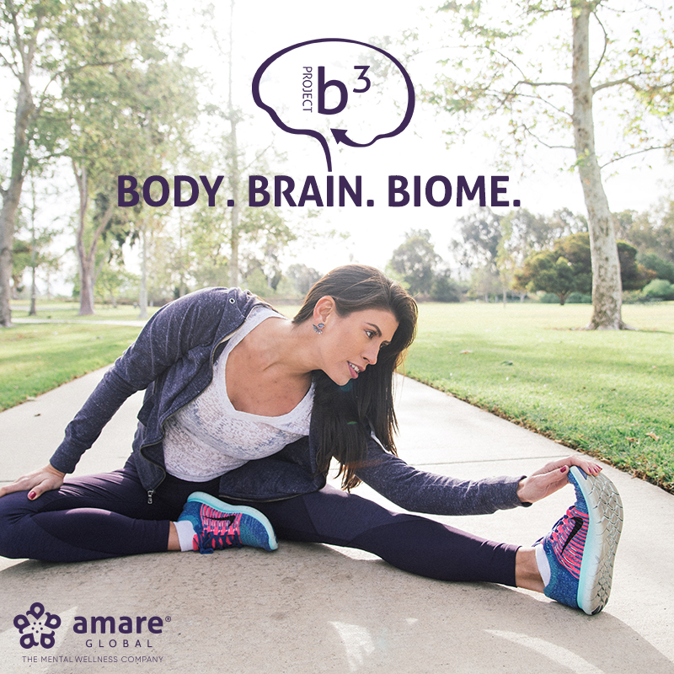
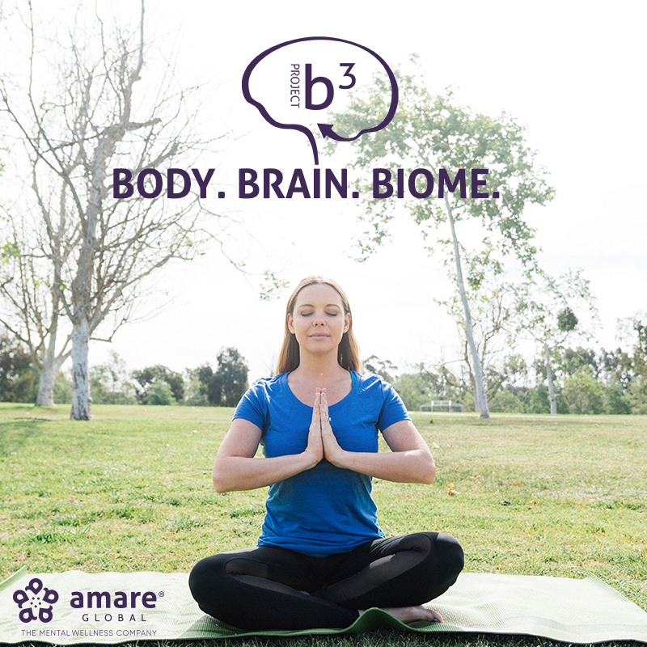
S.E.N.S.E. Program
Follow this step-by-step approach called S.E.N.S.E., which includes effective techniques and tips to create a healthier, happier you.
S – Supplementation
E – Exercise
N – Nutrition
S – Stress Management
E – Evaluation

Slide 44
Eight-Week Survey Results
95% of people experienced an increase in their level of understanding about proper supplementation, exercise, nutrition, and sleep.
87% of individuals stated that Project b3 has helped improve mood, reduce stress, and/or increase motivation.
85% of people said the program was easy to incorporate into their daily routine
85% of people noticed an improvement in their physical health, fitness, and overall wellness.
4 out of 5 people said that Project b3 helped them control food cravings and reduce stress eating and that they feel better and better as time passed with Project b3 (better at week 4 than week 2; better at week 8 than week 4)
9 out of 10 people report after 8 weeks on Project b3 that they plan to continue with the products and program.

Slide 45
THE THREE THINGS YOU SHOULD KNOW ABOUT MENTAL WELLNESS
How you feel is not just in your head — it’s also in your gut.
Our “second brain” includes the microbiome and plays a major role in mental wellness.
You can now DO something NATURALLY to improve your mental wellness.
WHERE ARE YOU ON THE MENTAL WELLNESS CONTINUUM? (Circle your current number)
1
2
3
4
5
6
7
8
9
10
DISEASE STATUS
“TYPICAL”
OPTIMIZED
Depression
Anxiety
Diabetes
Obesity
Heart Disease
Autoimmune
Arthritis
Fibromyalgia
CFS
Dementia
ADD / ADHD
Alzheimer’s
Fatigue
Tension
Sad
Brain Fog
Headaches
Acne
Eczema
Congestion
URTI’s
Joint Pain
Muscle Pain
Bloated
Chubby
Energetic
Calmness
Happy
Sharp
Creative
Clear Skin
Rarely Sick
Flexible
Lean
Strong
Resilient
RED
ORANGE
YELLOW
GREEN
BLUE
INDIGO
VIOLET

