Slide 1
Project B3 PILOT
Brain / Body
Shawn Talbott, PhD

Slide 2
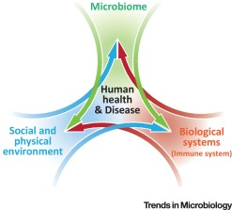
Biome
Body
Brain

Slide 3
Problem
Weight Loss is a “Body” Issue…
  Calories in / out
  Poor diet
  Appetite / cravings / “willpower”
  Metabolism / metabolic rate
  Hormones
  Genetics
NO – actually a “Brain-Body-Biome” issue
  Just as mental wellness issues are not ”just brain” issues – they are “gut-brain” issues (which are modifiable with natural approaches)

Slide 7
Solution
Restore balance across Brain-Body-Biome Axis
  Microbiome
  Gut integrity
  Immune system
  Inflammation
  Neurotransmitters
Mood, Stress, Tension, Energy, Vigor (motivation)
SENSE = stress/sleep, exercise, nutrition, supplements, evaluation

Slide 8
What Benefits Should I Expect?
Improve Gut Health
Balance Microbiome
Optimize Gut-Brain-Axis Function
Reduce Stress
Improve Vigor
Boost Energy
Maximize Sleep Quality
Sharpen Mental Clarity
Enhance Skin Tone
Reduced Cravings
Improve Body Composition = Fat/Lean

Slide 9
What to DO? (simple)
Daily
  Fundamentals (Mentabiotics, MentaFocus, MentaSync)
  VitaGBX (breakfast & dinner)
  GBX Shake/Smoothie (Protein, SuperFood, SeedFiber) – breakfast/lunch?
  Eat REAL Food! (Helping Hand)
  Project B3 FB Group (check-in)
Weekly
  HIIT – 3x
  Weights – 2x
  Project B3 Seminar (education/reinforcement)

Slide 10
Interval Training
Alternates between high intensity and low intensity exercise
Warm-up (5min)
1 minute high / 1 minute low intensity
2 minutes high / 2 minutes low intensity
3 minutes high / 3 minutes low intensity
2 minutes high / 2 minutes low intensity
1 minute high / 1 minute low intensity
Cool-down (5min)
18 minutes of Interval Training (28min total)

Slide 11

Strength Training
Builds lean muscle mass, which increases BMR
Tones and defines the muscles
Improves posture
Helps maintain bone mineral density

Slide 13
Project B3 Topic Schedule
Nov 1 (week 0) = Overview
Nov 8 (week 1) = Reboot/Biome
Nov 15 (week 2) = Body/Brain
Nov 22 (week 3) = OFF – Thanksgiving
Nov 29 (week 4) = Stress / Sleep
Dec 6 (week 5) = Exercise
Dec 13 (week 6) = Nutrition
Dec 20 (week 7) = Supplementation
Dec 27 (week 8) = Evaluation
Jan 3 = start 2019 RIGHT!

Slide 14
Weekly Education (Zoom & FB Live)
Thursdays at 6:00 PM Pacific Time
https://zoom.us/j/762420707
iPhone one-tap :
US: +16699006833,,762420707# or +16468769923,,762420707#
Or Telephone:
US: +1 669 900 6833 or +1 646 876 9923
Webinar ID: 762 420 707

Slide 15
Sharing / Support
Resources section of Amare.com
  https://amareassets.blob.core.windows.net/webassets/resources/recipes/Reboot_Recipes.pdf
Posting new smoothies recipes and tips at…
  ShawnTalbott.com
  ProjectB3 Private Facebook Group
  https://www.facebook.com/groups/2205006613102128/

Slide 16
What to DO? (simple)
Daily
  Fundamentals (Mentabiotics, MentaFocus, MentaSync)
  VitaGBX (breakfast & dinner)
  GBX Shake/Smoothie (Protein, SuperFood, SeedFiber) – breakfast/lunch?
  Eat REAL Food! (Helping Hand)
  Project B3 FB Group (check-in)
Weekly
  HIIT – 3x
  Weights – 2x
  Project B3 Seminar (education/reinforcement)

Slide 17
Recommended “Core” Products
Reboot+
FundaMentals (MentaBiotics, MentaFocus, MentaSync)
GBX Protein (1-2)
GBX SuperFood (1-2)
GBX SeedFiber (1-2)
VitaGBX
Optional (but highly recommended)
    Mood+
    Sleep+
    Energy+
Optional (but encouraged)
                OmMega (optional)
                Digestive (optional)
                Probiotics (optional)

Slide 18

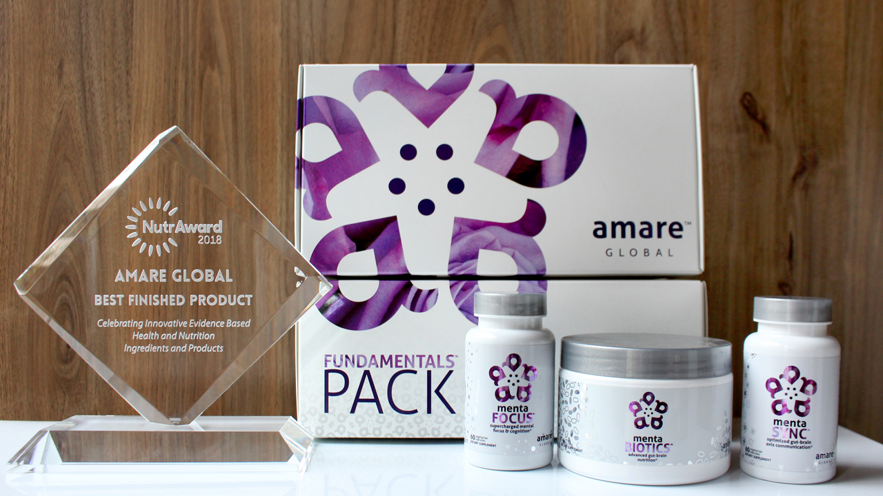
World’s First Award-Winning
Gut-Brain Axis Nutrition System!
The NutrAward recognizes companies that are investing in rigorous and measurable scientific studies to prove the efficacy of their proprietary ingredients or technologies.
Submissions are judged on their merit in the following areas:
Viable product
Emerging category
Creative product concept
Distinct health application
Unique packaging
Matchless marketing

Slide 19



Microbiome-Boosting Nutrition*
REBOOT with GBX FOODS
™
Benefits:
No more wasting time grocery shopping.
Saves you money!
Takes the hassle out of planning for your Reboot.
Convenient — products sent to straight to your door step.
Provides the microbiome-boosting nutrition you need every day.
Quick, easy, delicious products.
*These statements have not been evaluated by the Food and Drug Administration. This product is not intended to diagnose, treat, cure, or prevent any disease.

Slide 20
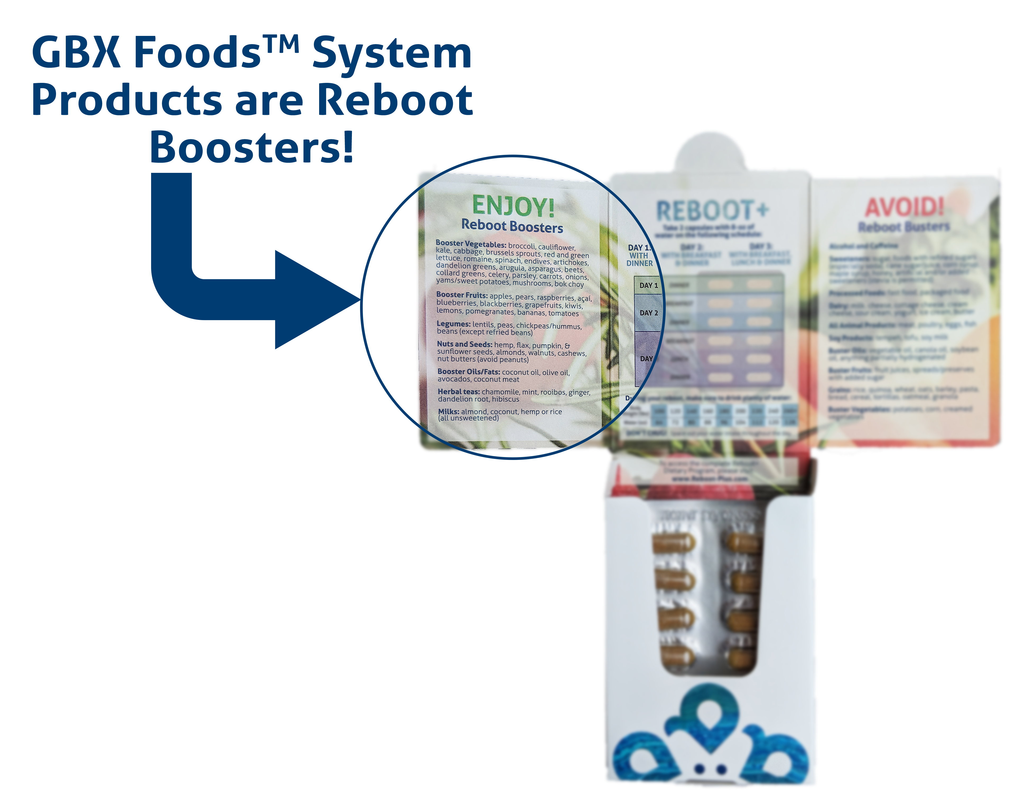
Microbiome-Boosting Nutrition*
GBX FOODS ARE REBOOT-FRIENDLY
™
*These statements have not been evaluated by the Food and Drug Administration. This product is not intended to diagnose, treat, cure, or prevent any disease.

Slide 21
What to DO? (simple)
Daily
  Fundamentals (Mentabiotics, MentaFocus, MentaSync)
  VitaGBX (breakfast & dinner)
  GBX Shake/Smoothie (Protein, SuperFood, SeedFiber) – breakfast/lunch?
  Eat REAL Food! (Helping Hand)
  Project B3 FB Group (check-in)
Weekly
  HIIT – 3x
  Weights – 2x
  Project B3 Seminar (education/reinforcement)

Slide 22
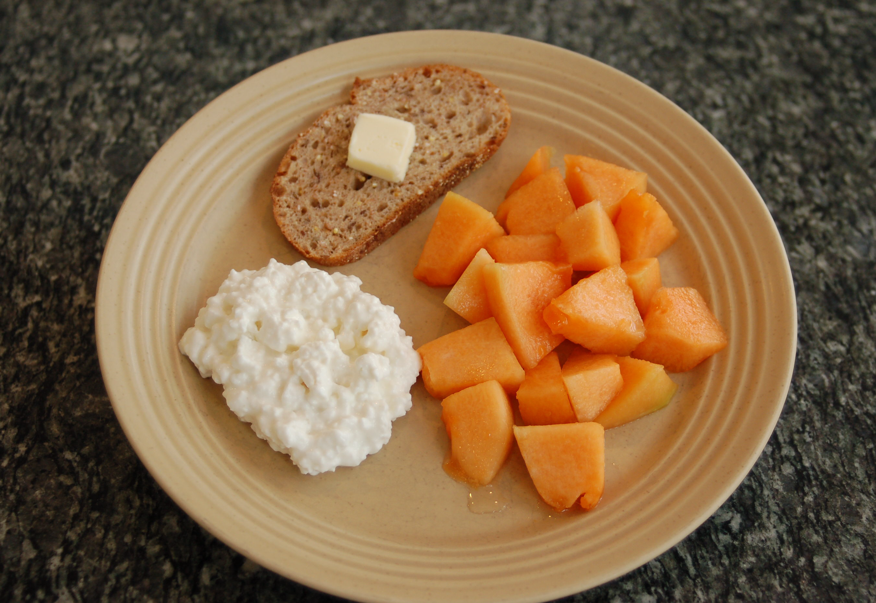
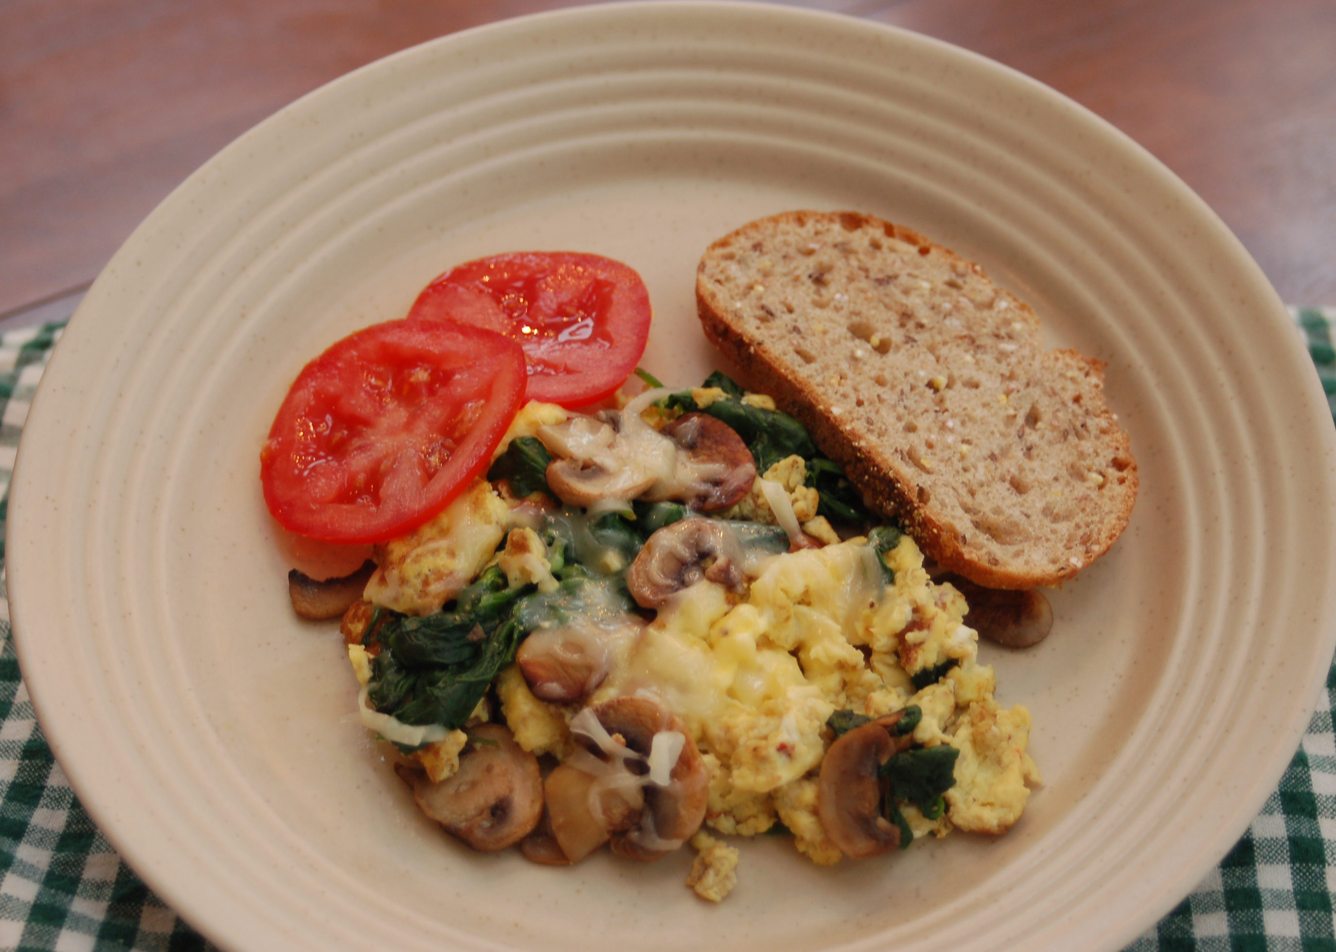
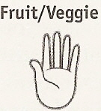
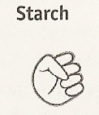


Breakfast
Tomato, Spinach, Mushrooms
Whole-wheat Bread
Egg
Swiss Cheese

Slide 23
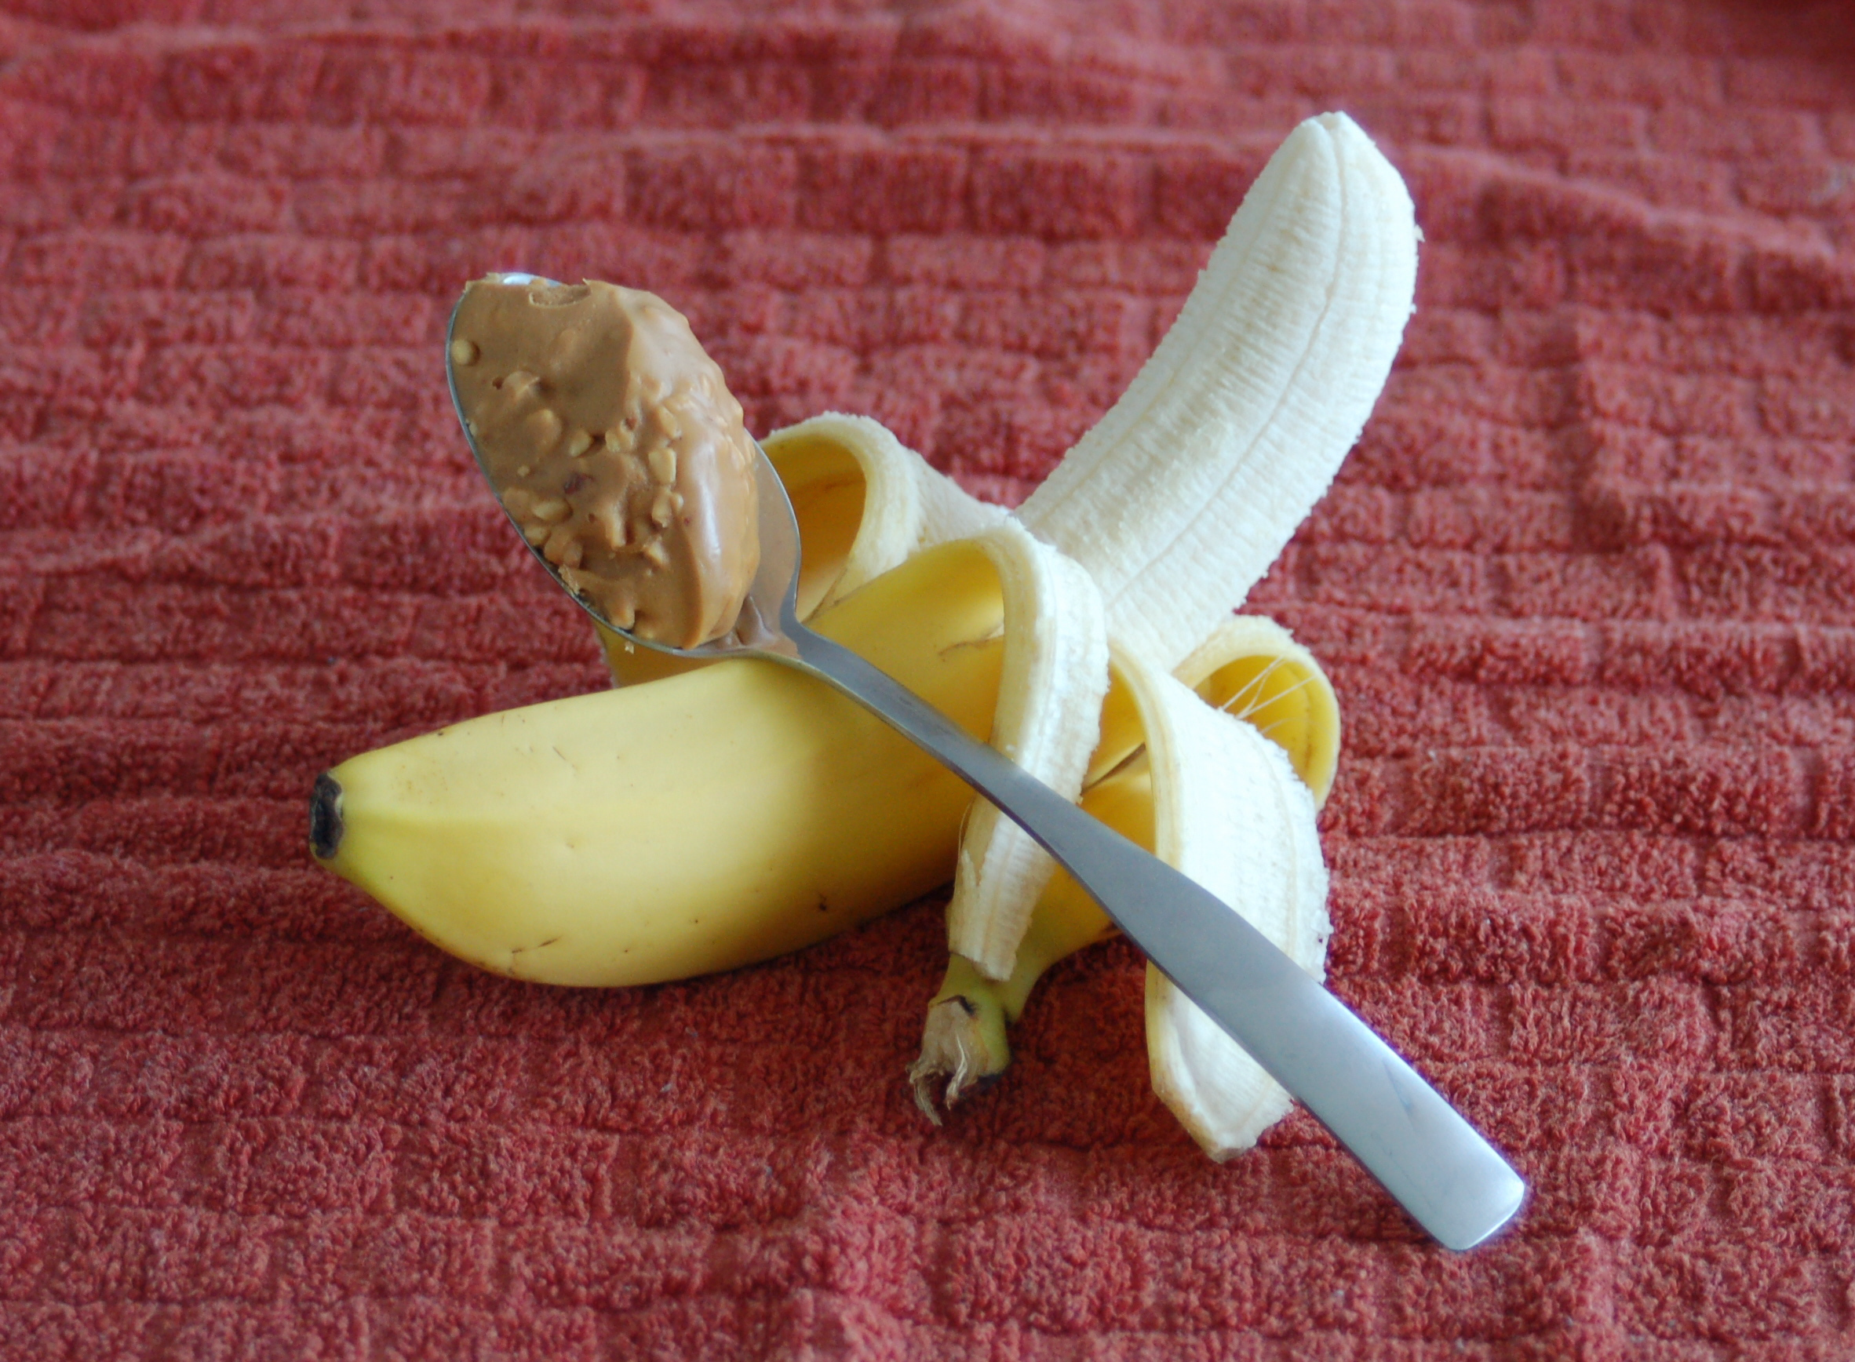
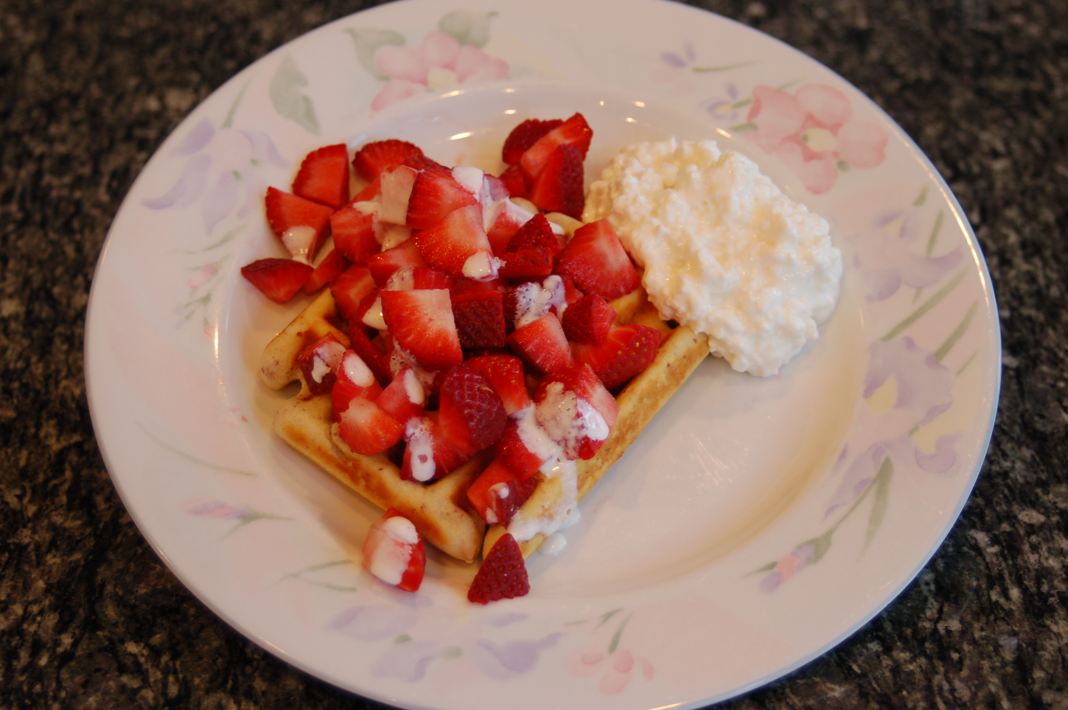
Breakfast
Strawberries
Whole Wheat Waffle
Cottage Cheese
Cream

Slide 24

Breakfast
Cantaloupe
Whole Wheat Toast
Cottage Cheese
Butter

Slide 25
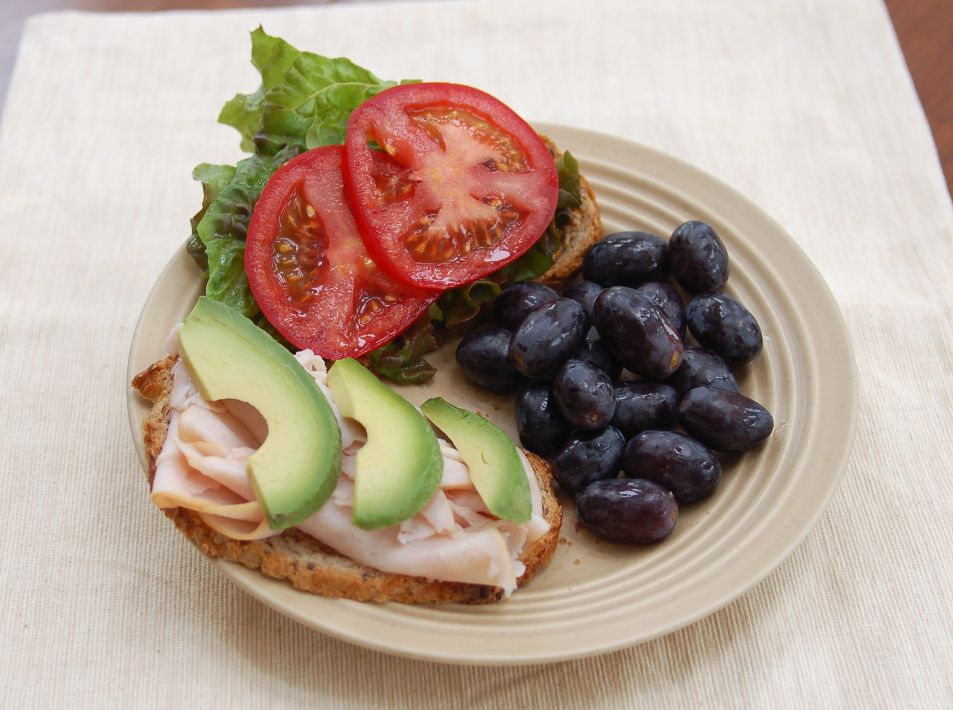
Lunch
Grapes, Lettuce, Tomato
Whole Wheat Bread
Turkey
Avocado

Slide 26
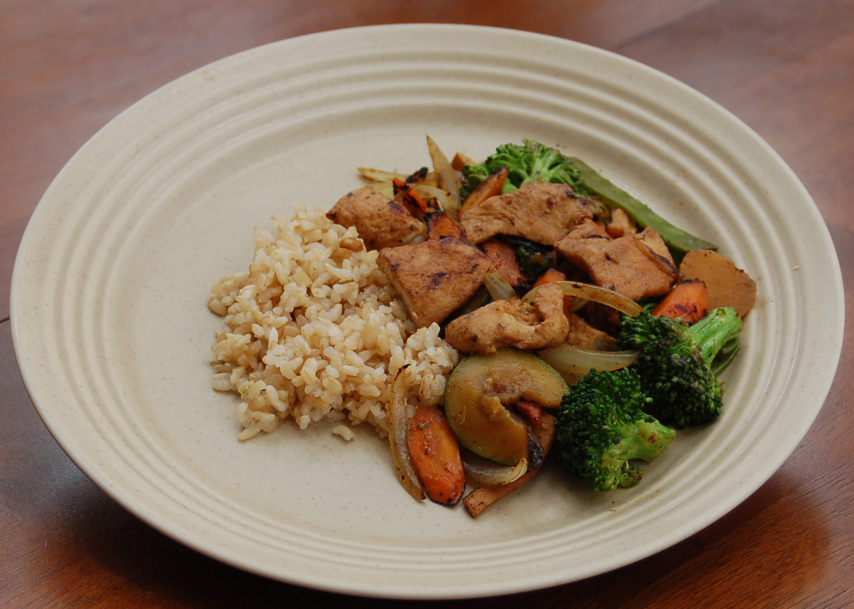
Lunch
Carrots, Onions, Zucchini, Broccoli
Brown Rice
Chicken
Olive oil for Cooking

Slide 27
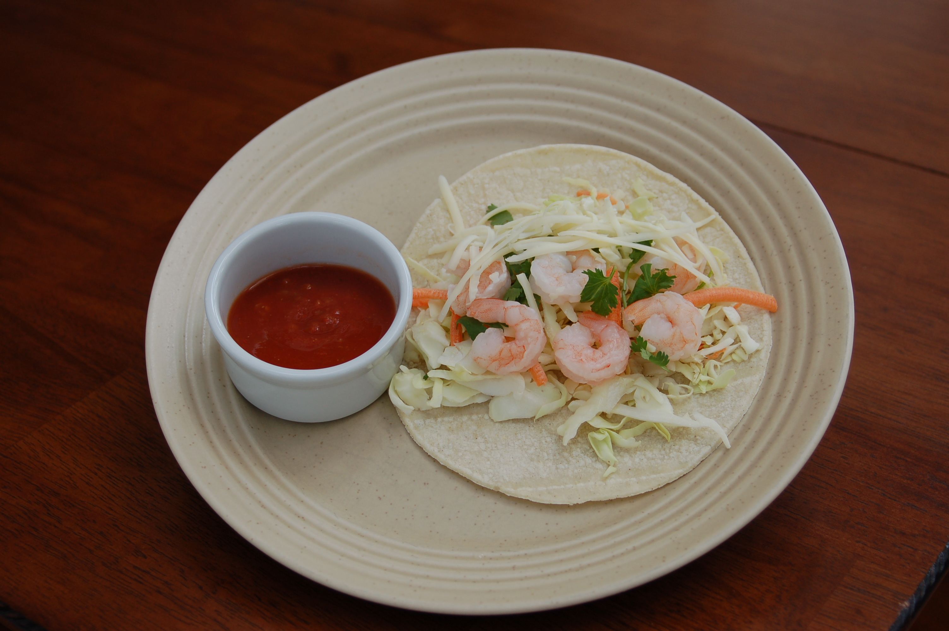
Lunch
Cabbage mix, Salsa
Corn Tortilla
Shrimp
Cheese

Slide 28
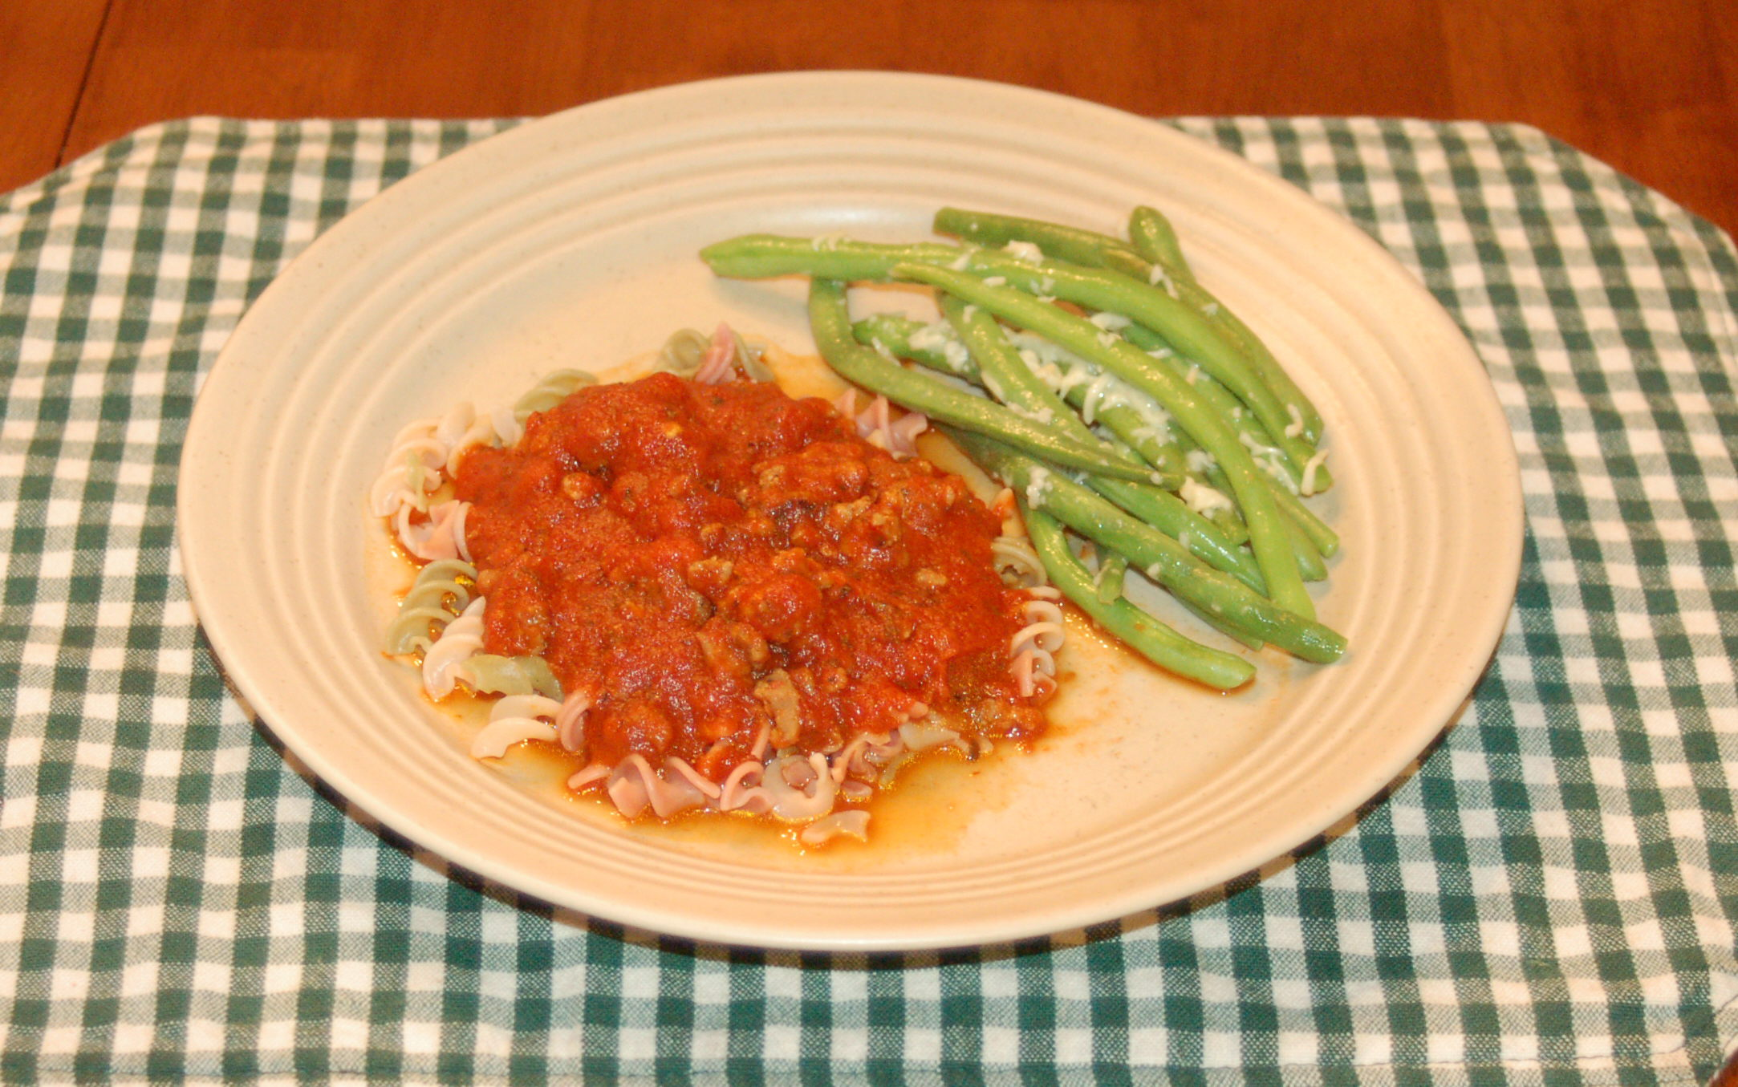
Lunch
Green Beans, Marinara
Whole Wheat Pasta
Lean Turkey Sausage
Parmesan Cheese

Slide 29
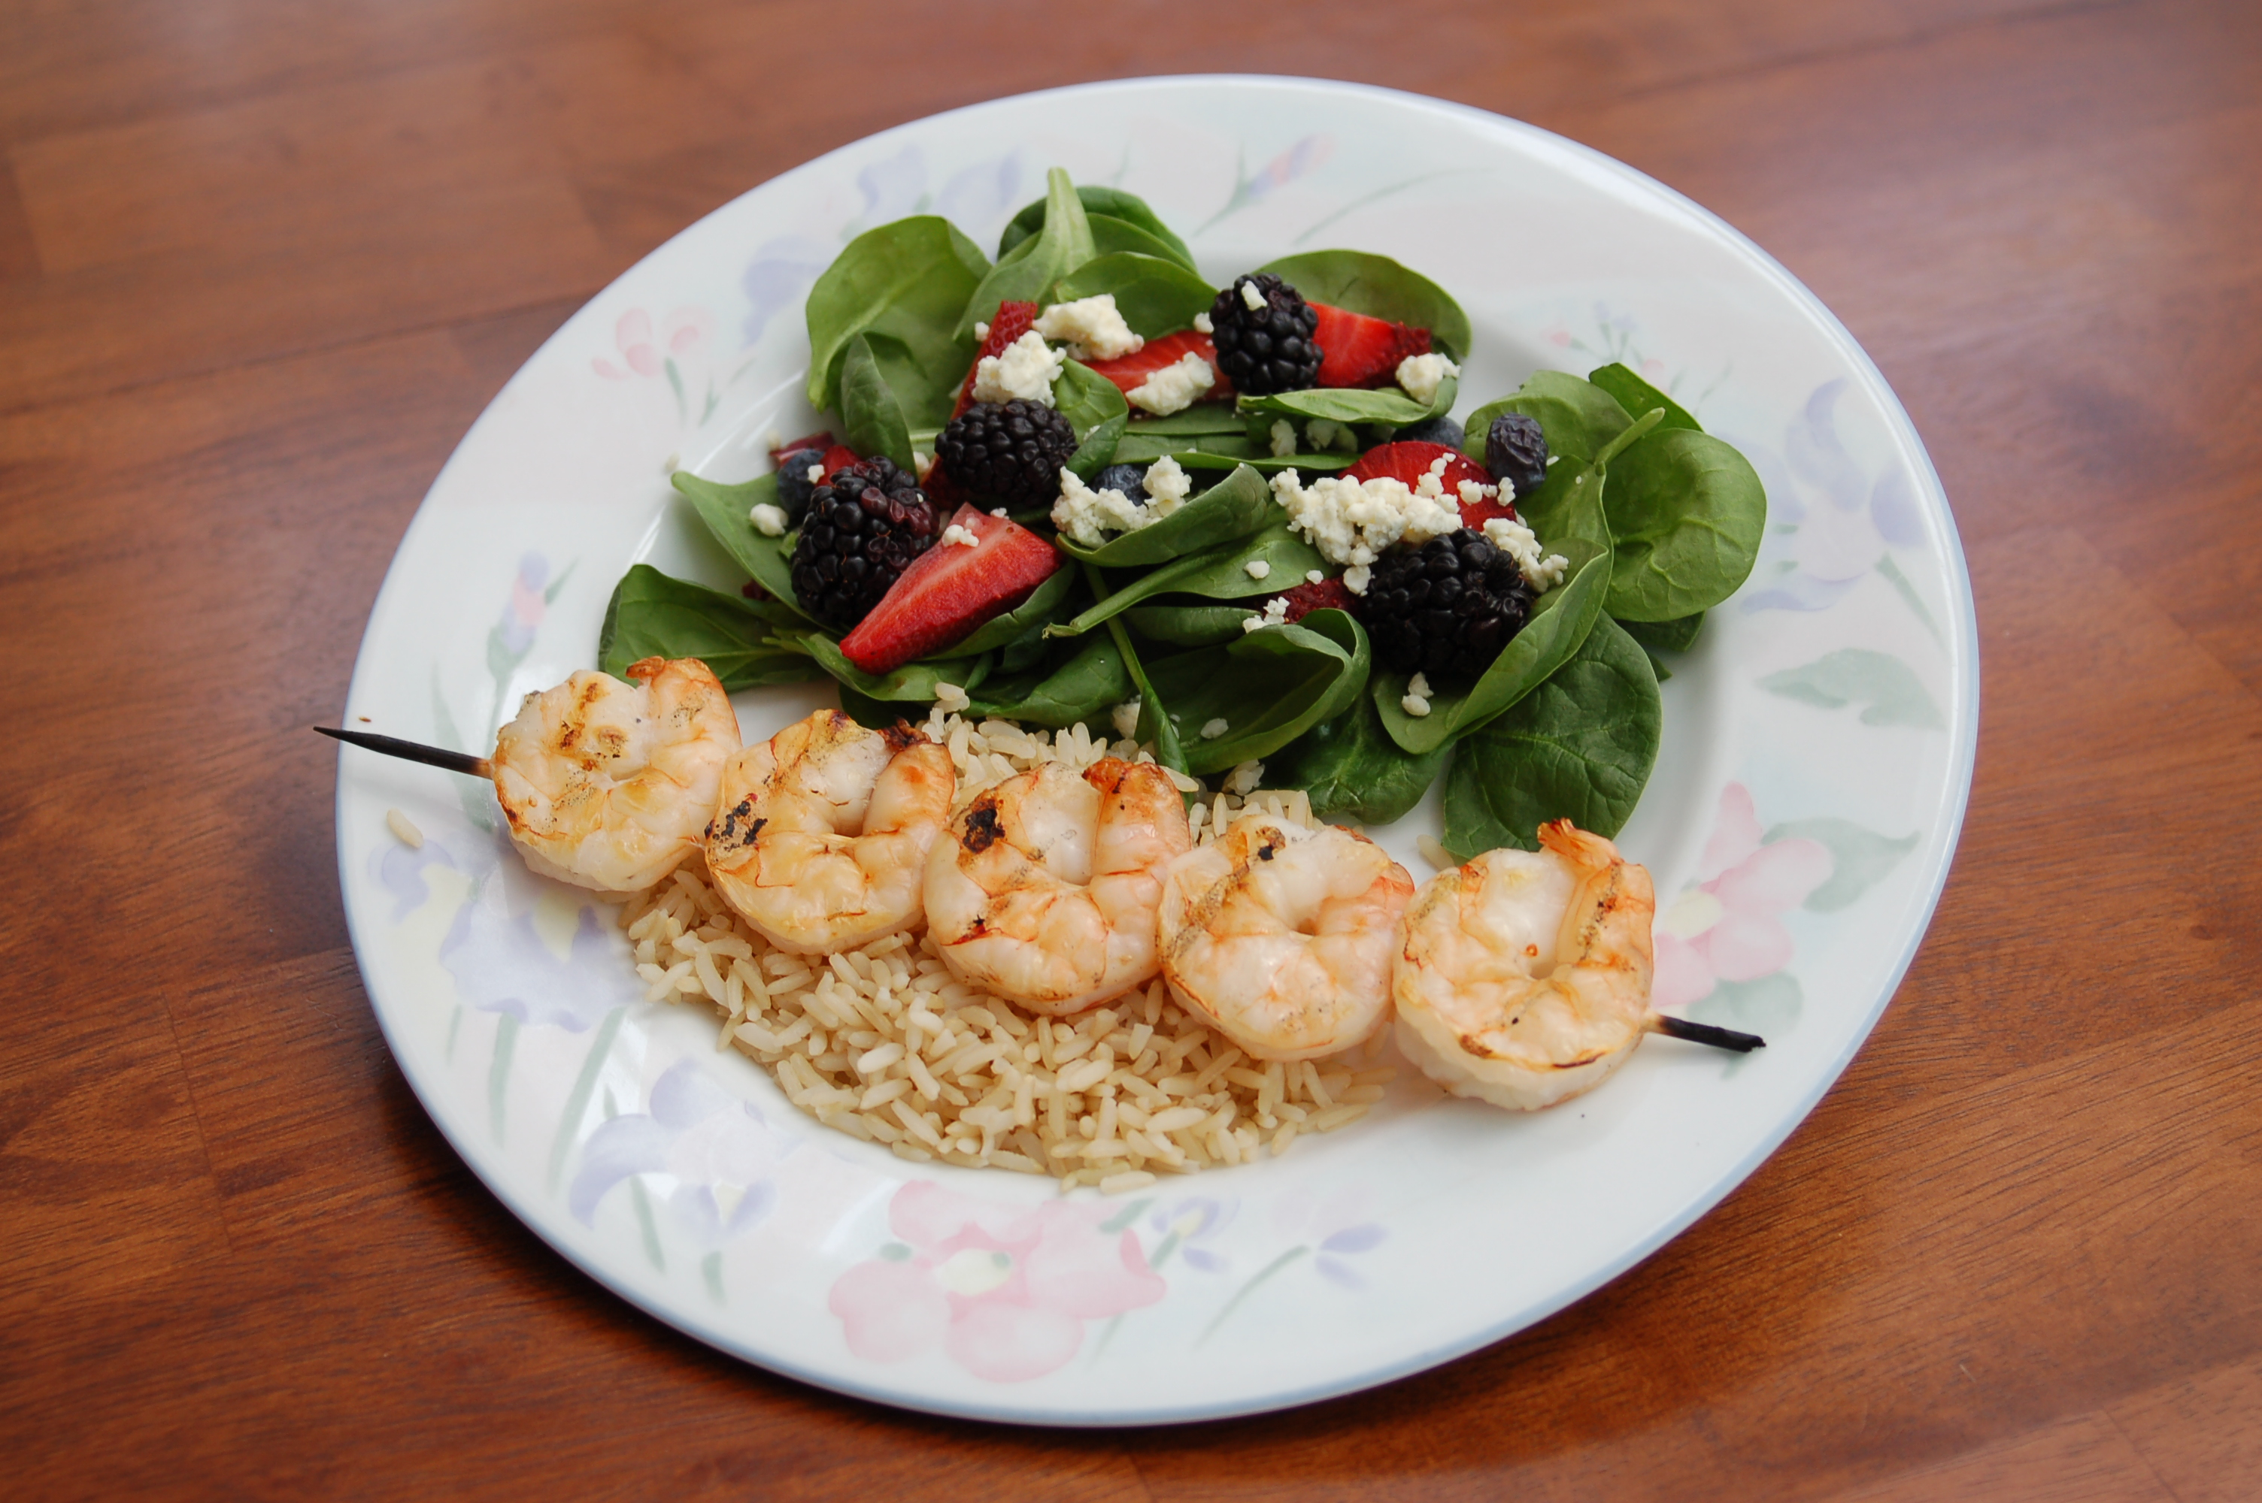
Dinner
Spinach, Berries
Brown Rice
Shrimp
Blue Cheese

Slide 30
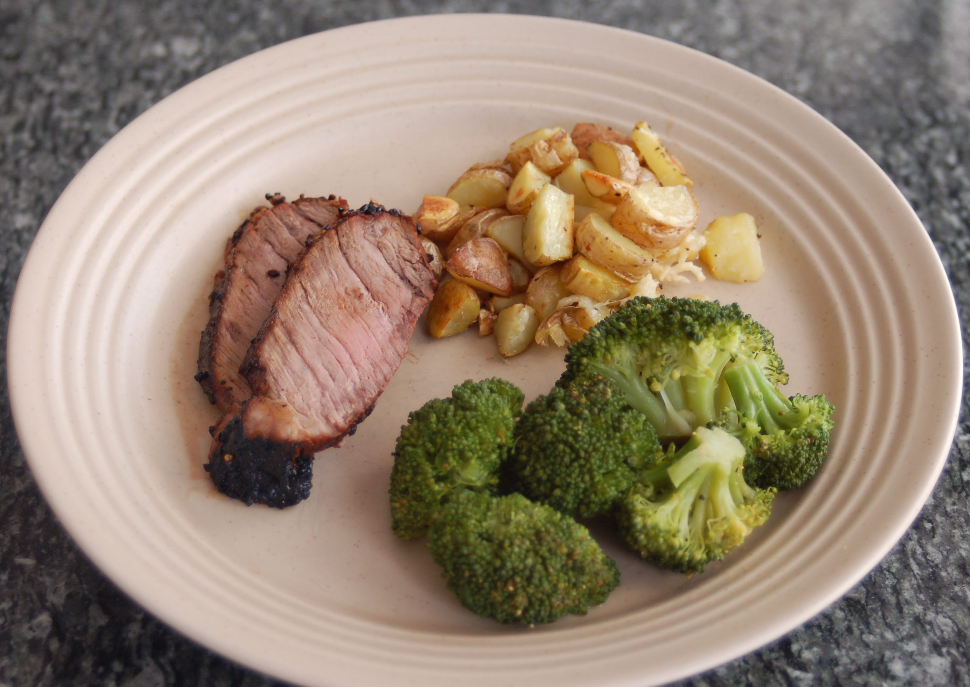
Dinner
Broccoli
Garlic Roasted Potatoes
Lean Beef
Olive Oil for Roasting Potatoes

Slide 31
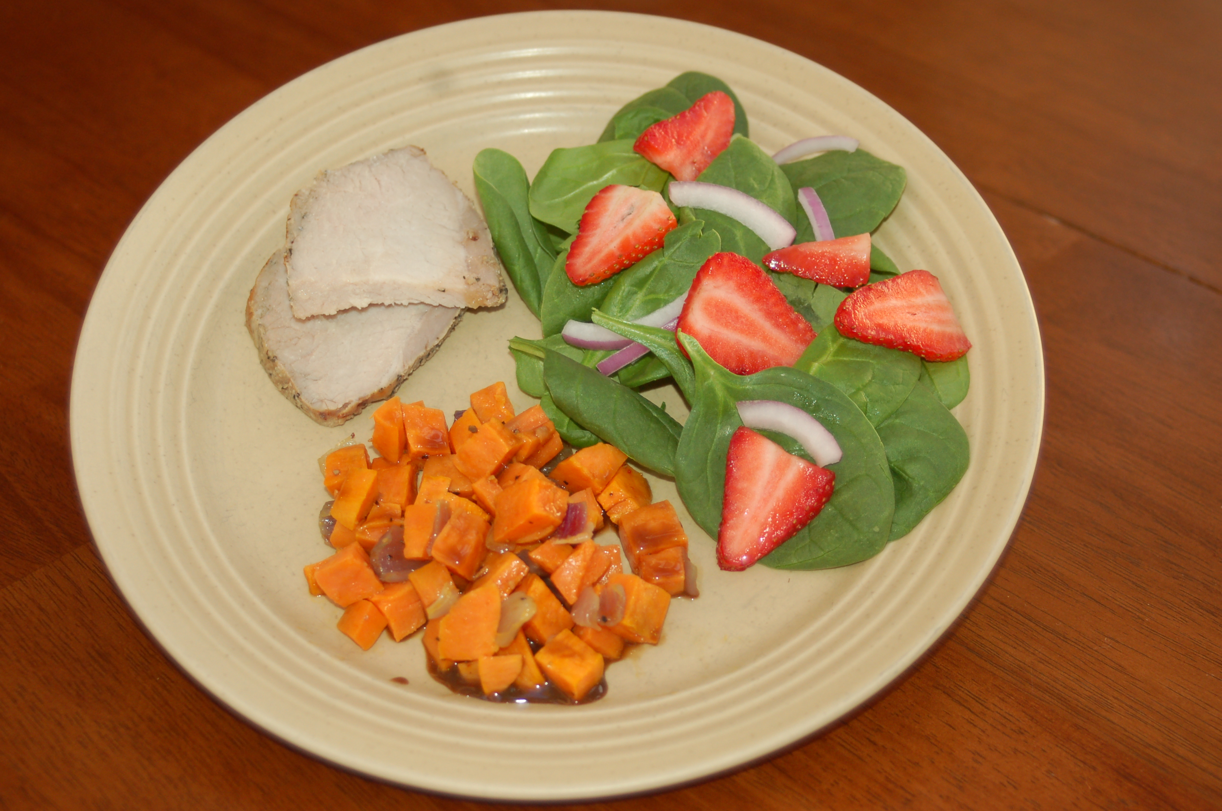
Dinner
Spinach, Strawberry, Onion
Roasted Sweet Potatoes
Lean Pork Tenderloin
Olive Oil for Roasting Potatoes

Slide 32
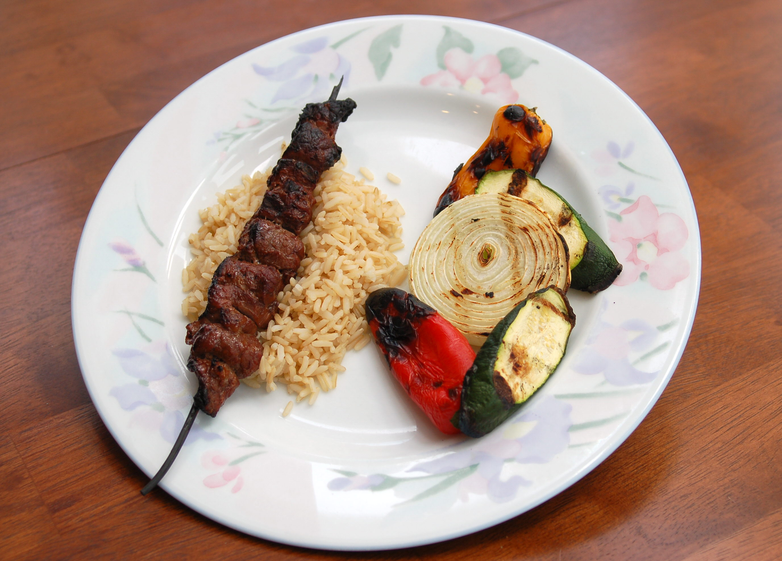
Dinner
Onion, Zucchini, SweetPepper
Brown Rice
Lean Beef
Olive Oil on Vegetables

Slide 33
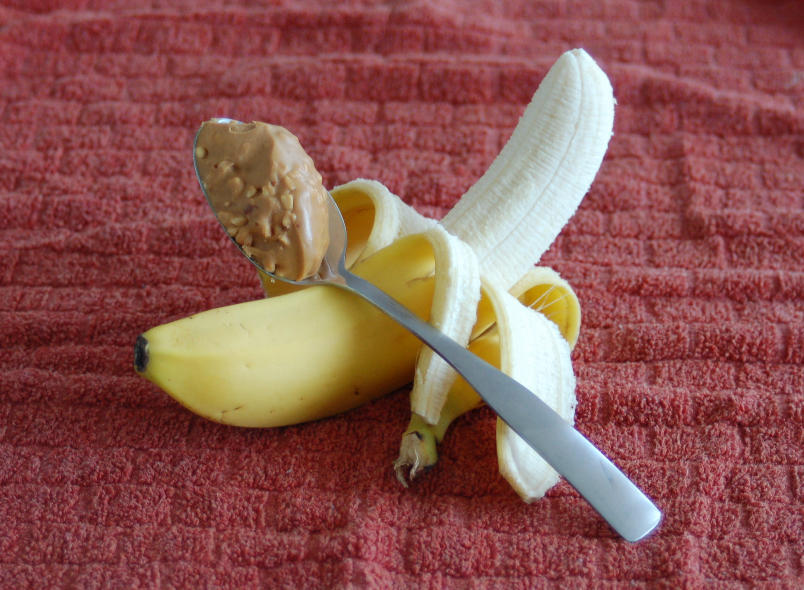
Snack
Banana
N/A
N/A
Peanut Butter

Slide 34
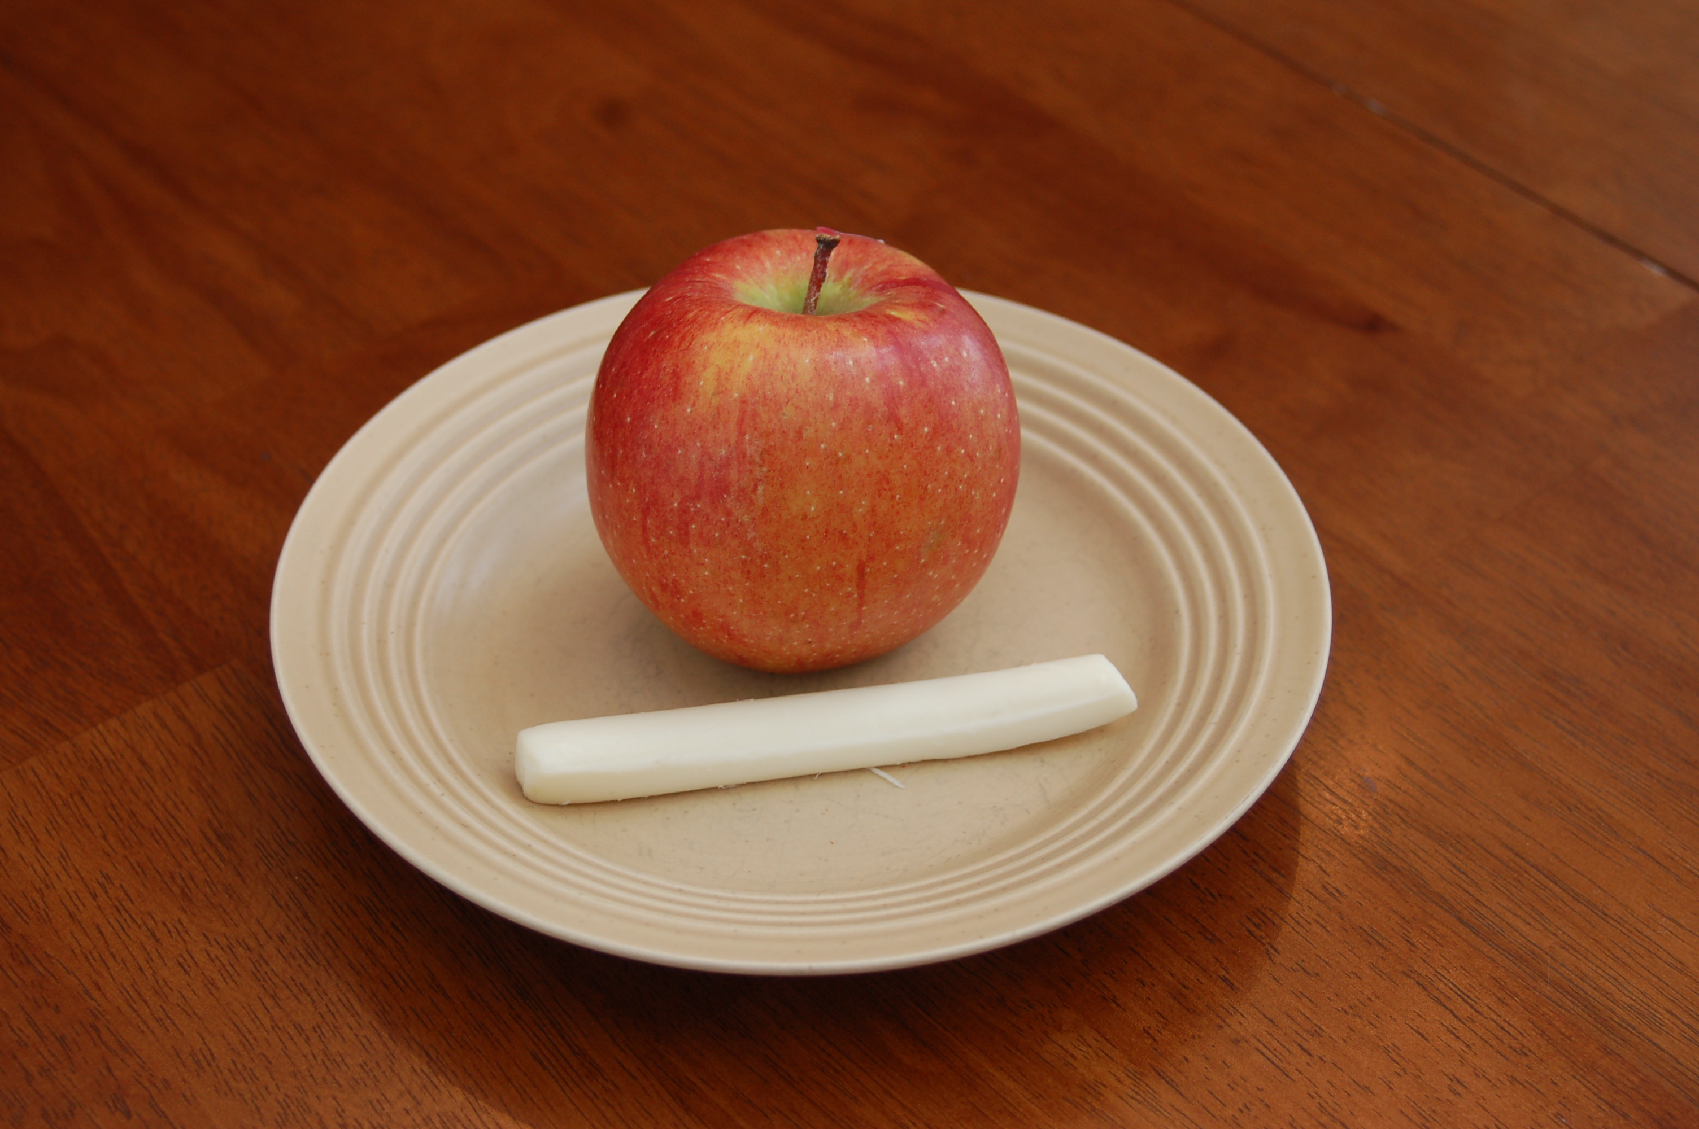
Snack
Apple
N/A
N/A
String Cheese

Slide 35
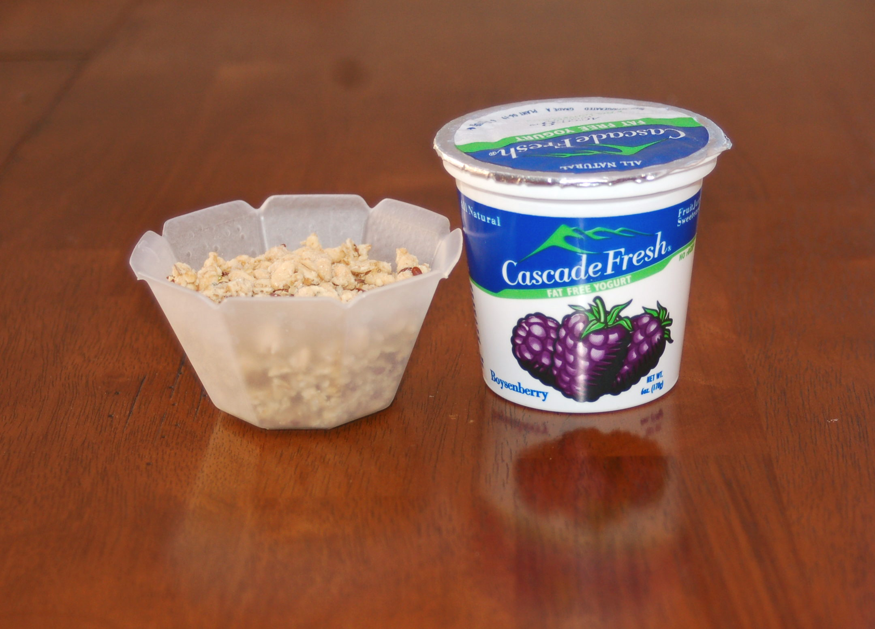
Snack
N/A
Granola
Yogurt
N/A

Slide 36
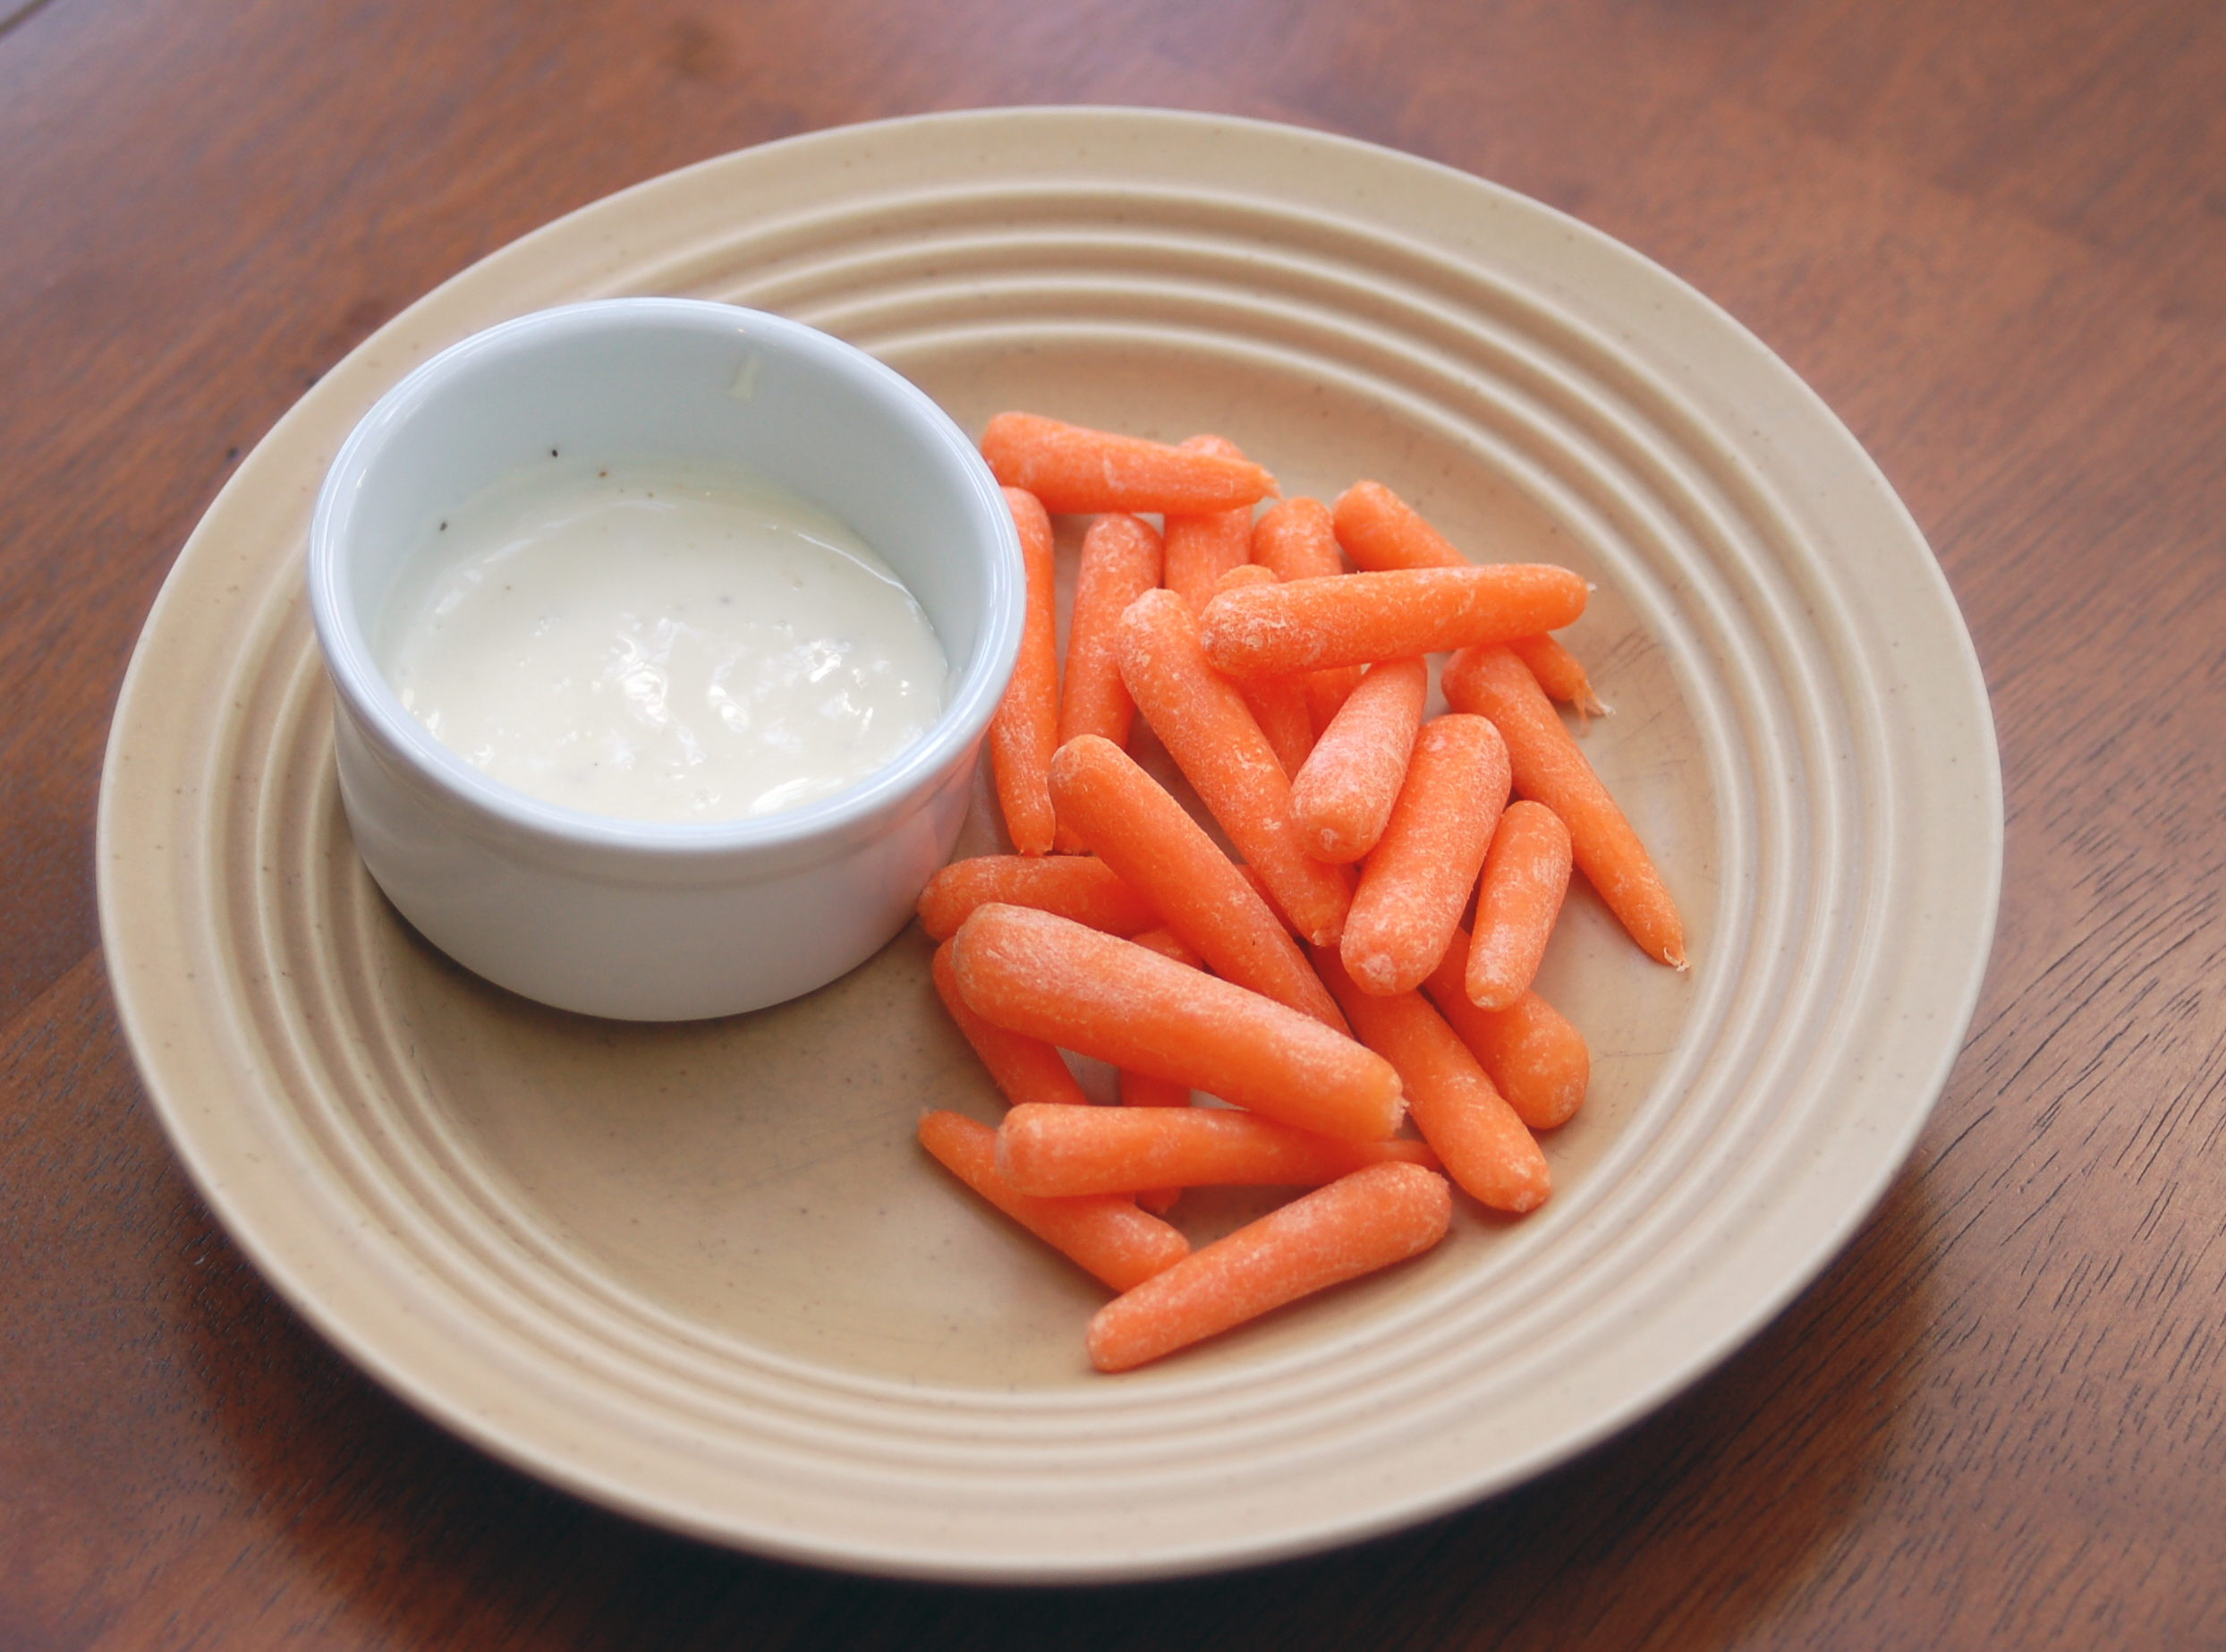
Snack
Carrots
N/A
N/A
Vegetable Dip

Slide 37
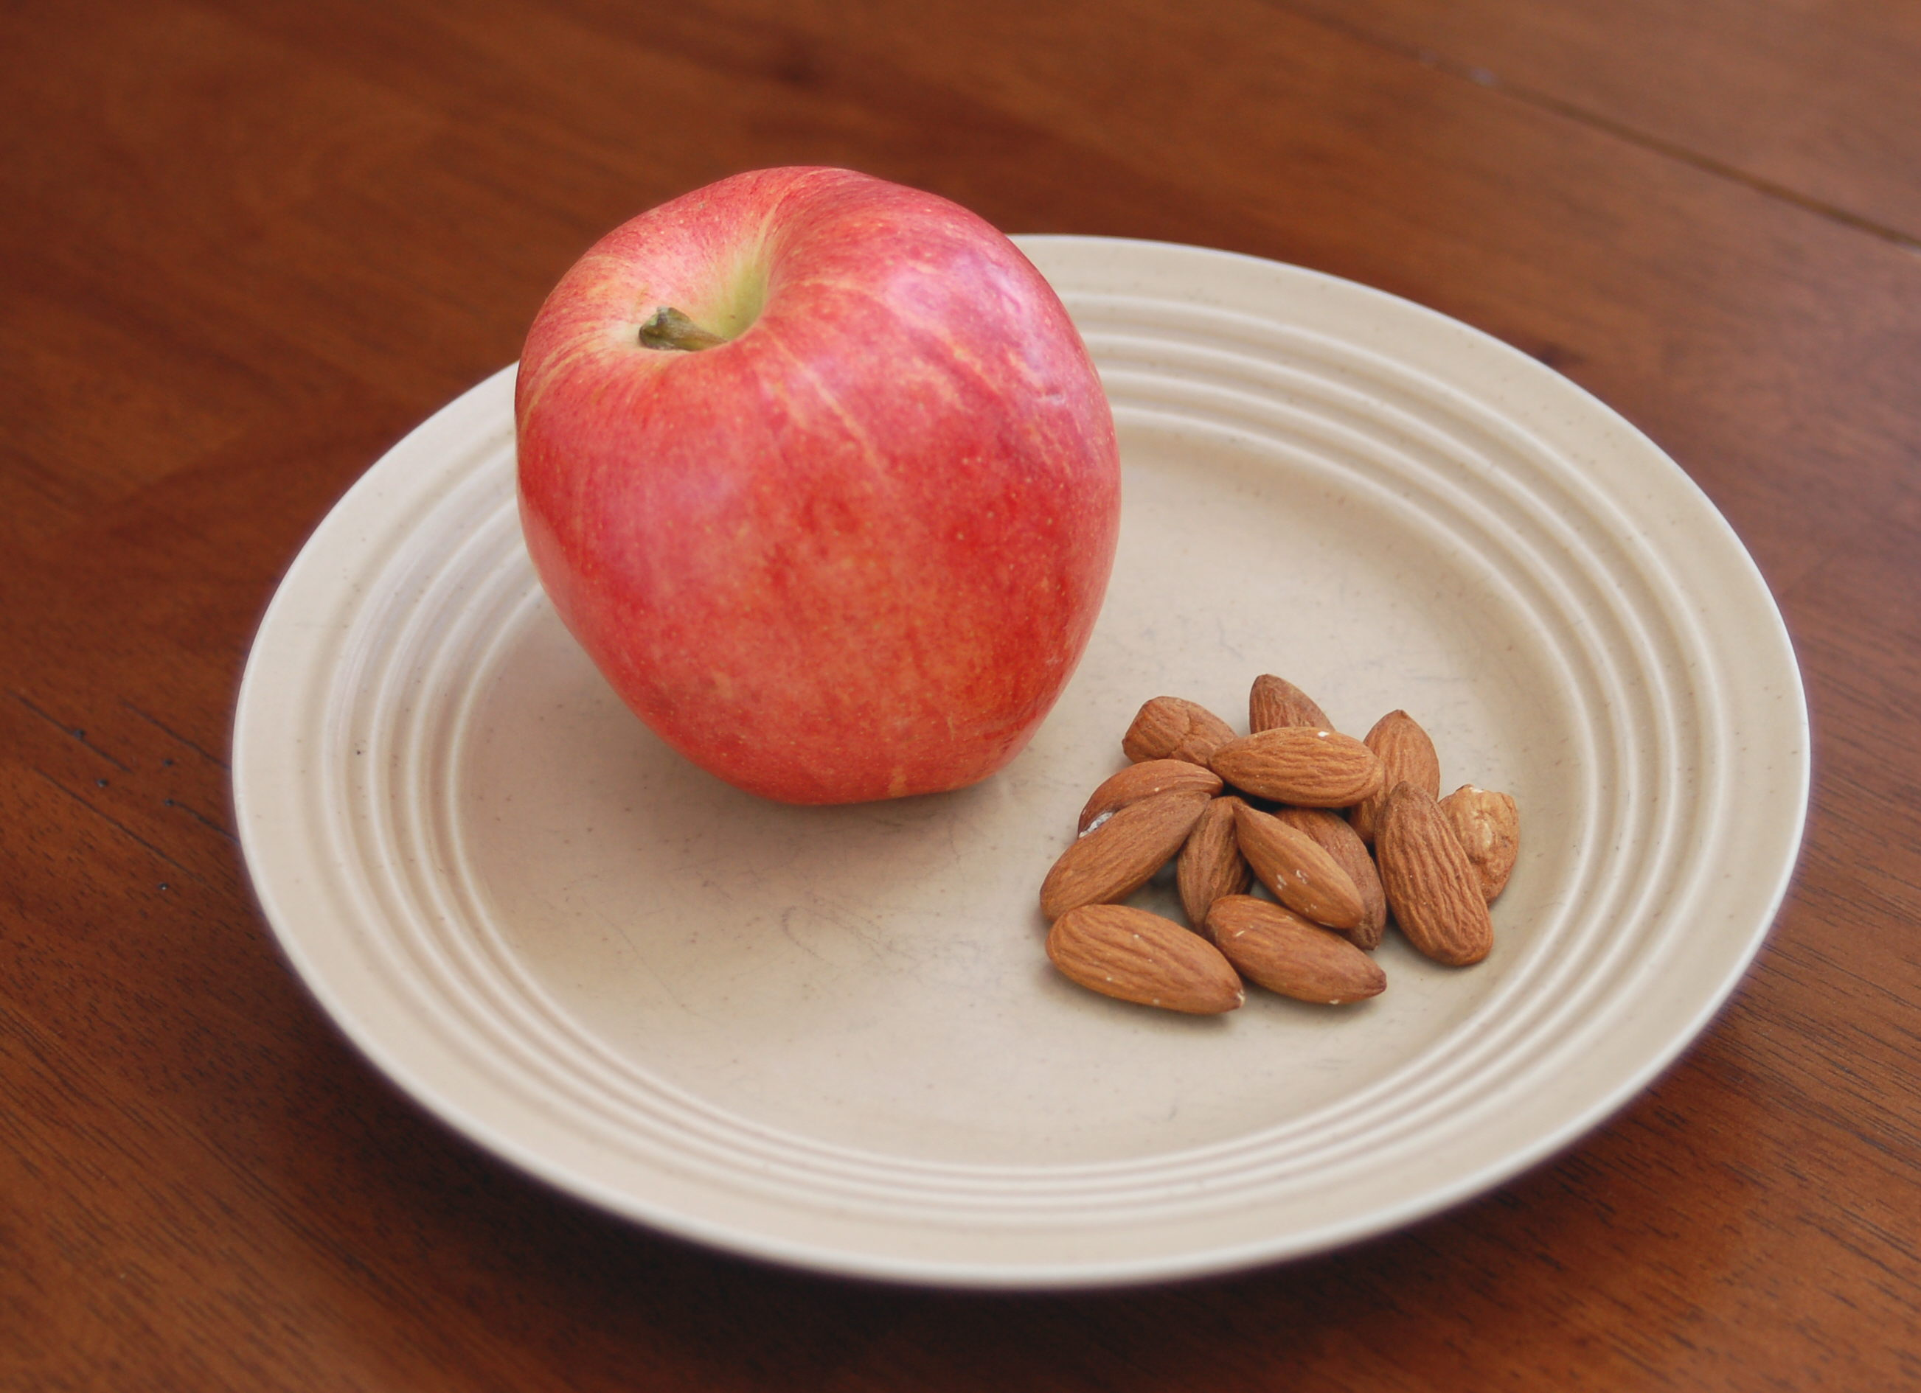
Snack
Apple
N/A
N/A
Almonds

Slide 38
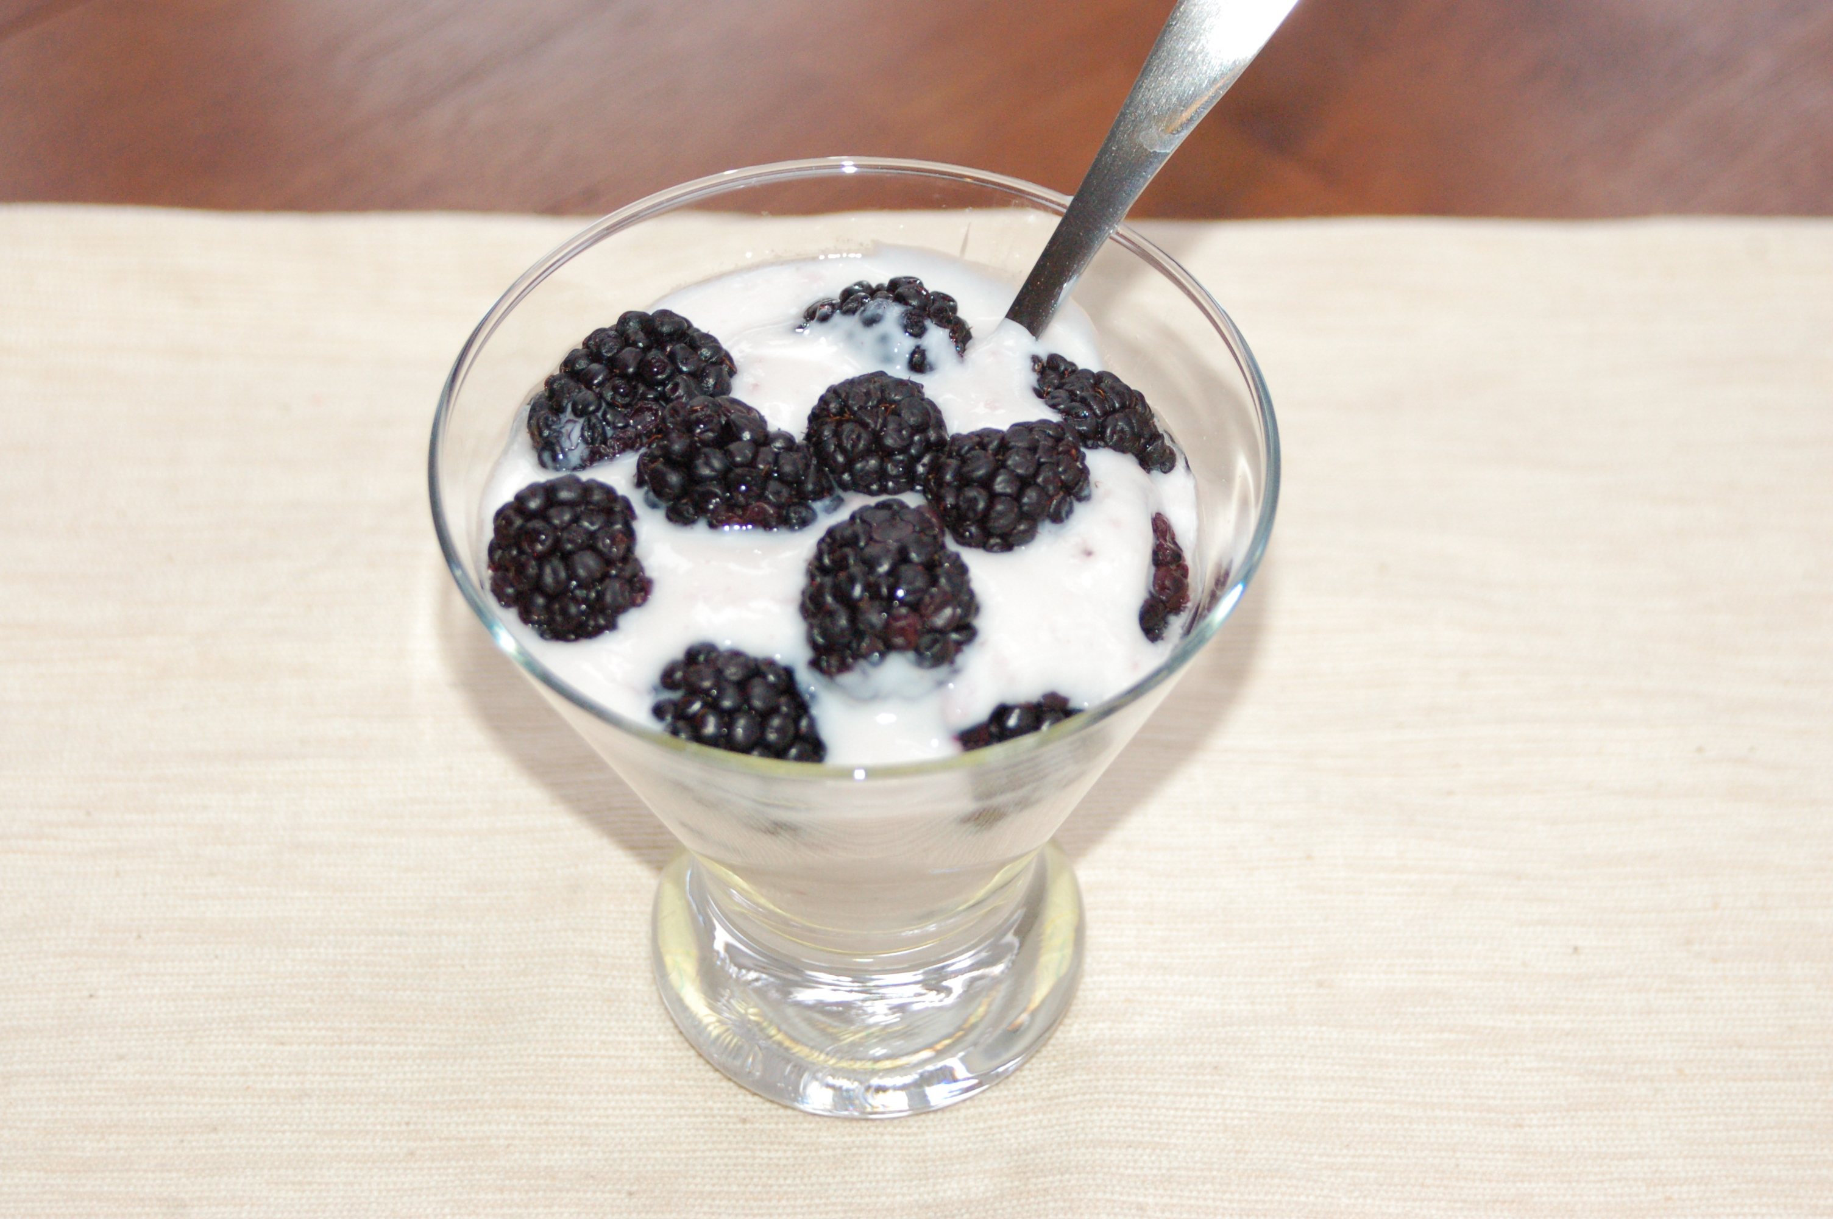
Snack
Blackberries
N/A
Yogurt
N/A

Slide 39
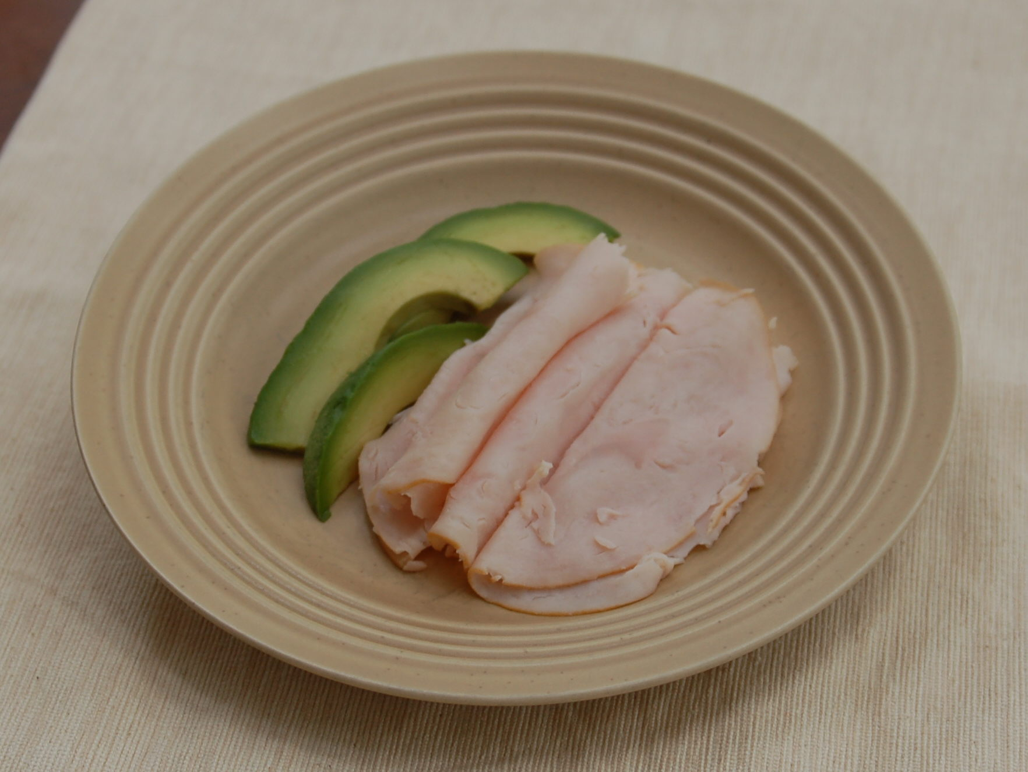
Snack
N/A
N/A
Turkey
Avocado

Slide 40
What to DO? (simple)
Daily
  Fundamentals (Mentabiotics, MentaFocus, MentaSync)
  VitaGBX (breakfast & dinner)
  GBX Shake/Smoothie (Protein, SuperFood, SeedFiber) – breakfast/lunch?
  Eat REAL Food! (Helping Hand)
  Project B3 FB Group (check-in)
Weekly
  HIIT – 3x
  Weights – 2x
  Project B3 Seminar (education/reinforcement)

Slide 41
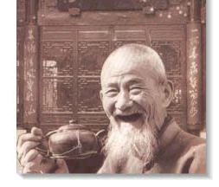
GOOD
HEALTH!

