Slide 1
Project B3 PILOT
Diet Quality
Shawn Talbott, PhD

Slide 2
Topic Schedule
Nov 1 (week 0) = Overview
Nov 8 (week 1) = Reboot/Biome
Nov 15 (week 2) = Body/Brain
Nov 22 (week 3) = OFF – Thanksgiving
Nov 29 (week 4) = Stress / Sleep
Dec 6 (week 5) = Exercise
Dec 13 (week 6) = Nutrition
Dec 20 (week 7) = Supplementation
Dec 27 (week 8) = Evaluation
Jan 3 = start 2019 RIGHT!

Slide 3
National Weight Control Registry
Database of 3,000+ “successful losers”
  30lb. weight loss maintained for 1+ years (avg. = 66lbs)
  60-80 min/day of physical activity
  1500-1800 calories/day
Get a buddy!
  Participating with friends = 33% more weight loss and 2-3x better maintenance (versus solo dieters)
  E-mail correspondence = doubles your weight loss

Slide 4
Interval Training
One approach to increasing caloric expenditure:
Alternates between high intensity and low intensity exercise
Warm-up
1 minute high / 1 minute low intensity
2 minutes high / 2 minutes low intensity
3 minutes high / 3 minutes low intensity
2 minutes high / 2 minutes low intensity
1 minute high / 1 minute low intensity
Cool-down
18 minutes of Interval Training

Slide 5
Enhancing Thermogenesis with Diet
Control Cortisol
  Too much cortisol accelerates muscle loss
  Muscle loss = reduced thermogenic capacity
Balance Blood Sugar
  Fluctuations in blood sugar (high or low) inhibits fat metabolism
  Higher fat metabolism (versus carb metabolism) is associated with higher overall thermogenesis
Improve Thyroid Efficiency
  Improved overall metabolism & thermogenic potential (create more heat)

Slide 6
What do “high thermogenic” people eat?
Balanced diet that provides ~1500 calories/day
  Range = 1300-1800 calories
  Carbohydrates (~200 grams/d from whole grains, fruits & veggies)
  Protein (~70 grams/d from lean sources such as chicken and fish)
  Fat (~40 grams/d from seeds, nuts, olive oil & canola oil)
  Sound familiar?
  Similar to NWCR (avg 66lbs lost and kept off for 5+ years)
  Similar to “Helping Hand” approach

Slide 11
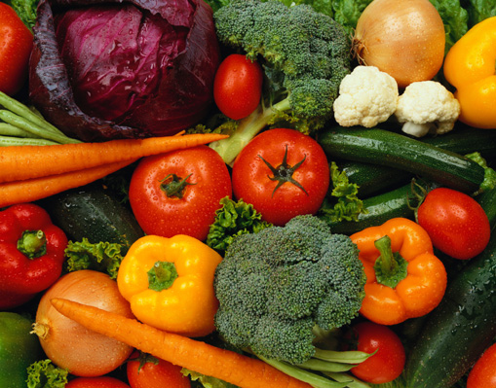

Balanced Nutrition
Protein for lean muscle maintenance
Carbohydrate for energy & metabolism
Fat for flavor & satiety
Fiber for digestion & satiety

Slide 12
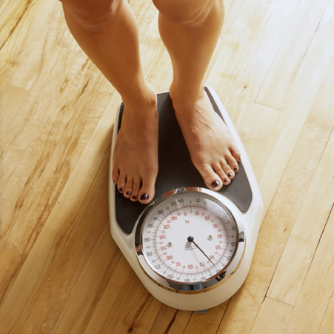
Quality - What to Eat?
Step 1 - Consider carbohydrates
Step 2 - Provide protein
Step 3 - Finish with Fat

Slide 13
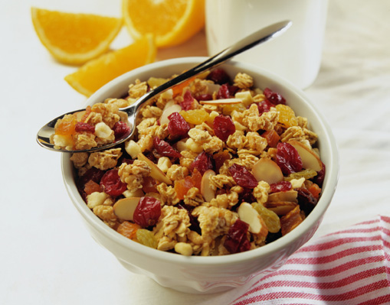
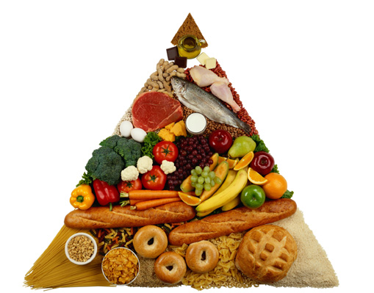
Carbs
General rule = foods that are in their “whole”(unprocessed, natural) state are better
Whole Apple > Applesauce > Apple juice
Whole fruits/veggies to “balance” other protein foods such
Always look for “whole grain flour” when selecting grains (“wheat flour” indicates highly refined grains)
No labels? Choose darker, thicker, chewier breads over “white & soft & fluffy” breads

Slide 14
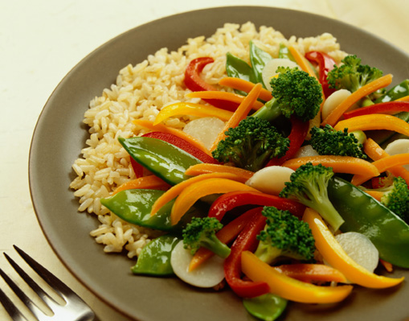
Proteins
General rule = any form of protein can be used to “balance” a refined carbohydrate
Protein and carbs are the “yin and yang” of nutrition - they must be consumed together
A bagel for breakfast is not “bad” - but it has a poor glycemic-index until you add some protein (smoked salmon, eggs, nut butter, etc)
Some foods can masquerade as protein - such as bacon, sausage, hot dogs, etc. - and need to be treated as added fat

Slide 15
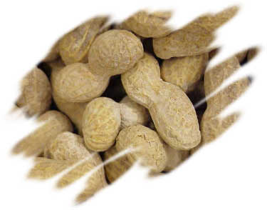
Fats
General rule = a small amount of added fat at each meal is a “metabolic regulator”
Pat of butter, dash of olive oil, square of cheese, handful of nuts
Slows the rise in blood sugar
Appetite control + fat-burning

Slide 16
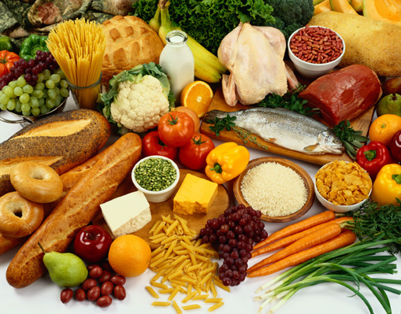
How to get more fiber?
25 gram target
Processed foods
2 bowls Total cereal
1 Sara Lee Honey Wheat Bagel
2 cups (4 servings) white rice
48 (3 servings) Wheat Thins
1/4 box (2 servings) spaghetti
1/2 can Campbell’s Chunky Vegetable Soup
Whole foods
1 pear
2 apples
1/2 cup chili beans
3 slices whole-grain bread

Slide 17
Breakfast example (1)

Slide 18
Breakfast example (2)

Slide 19
Adult Lunch example (1)

Slide 20
Adult Lunch example (2)

Slide 21
Kids Lunch example

Slide 22
Dinner example (1)

Slide 23
Two food “additives” to avoid
High fructose corn syrup
26% increase in HFCS consumption
  1970 = 64 grams/day
  1997 = 81 grams/day (100g + for teenagers)
Fructose is metabolized differently
Disrupted cortisol metabolism in fat cells (more fat storage)
Insulin resistance
Increased appetite (reduced leptin levels)
Body does not “register” fructose calories…

Slide 24
Two food “additives” to avoid
Hydrogenated oils (“trans-” fatty acids)
Liquid vegetable oils, chemically modifed with hydrogen, to become more solid at room temperature (Crisco)
Increase LDL cholesterol
Reduce HDL cholesterol
Increase cortisol levels (more fat storage)
Inhibit insulin function (higher blood sugar)
Increase inflammation (cortisol/fat/tissue damage)
Good news = eating more “whole” foods and fewer “processed” foods will automatically reduce your trans-fat intake

Slide 25
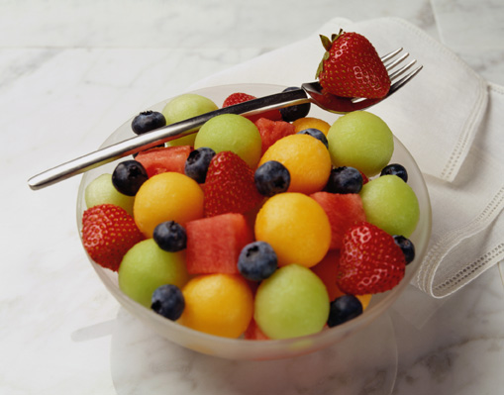
Timing - When to eat?
7AM = Snack (before leaving for work/school)
9AM = Breakfast (at work if need be)
Noon = Snack (+ Exercise if possible)
2PM = Lunch
5PM = Snack (before leaving work, on the way home)
7PM = Dinner
10PM = Snack (if you have exercised)
  *Each snack “lasts” for ~2 hours
  *Each meal “lasts” for ~3 hours
  *Snacks act as “bridges” to each meal

Slide 26
Recommended “Core” Products
Reboot+
FundaMentals (MentaBiotics, MentaFocus, MentaSync)
GBX Protein (1-2)
GBX SuperFood (1-2)
GBX SeedFiber (1-2)
VitaGBX
Optional (but highly recommended)
    Mood+
    Sleep+
    Energy+
Optional (but encouraged)
                OmMega (optional)
                Digestive (optional)
                Probiotics (optional)

Slide 27
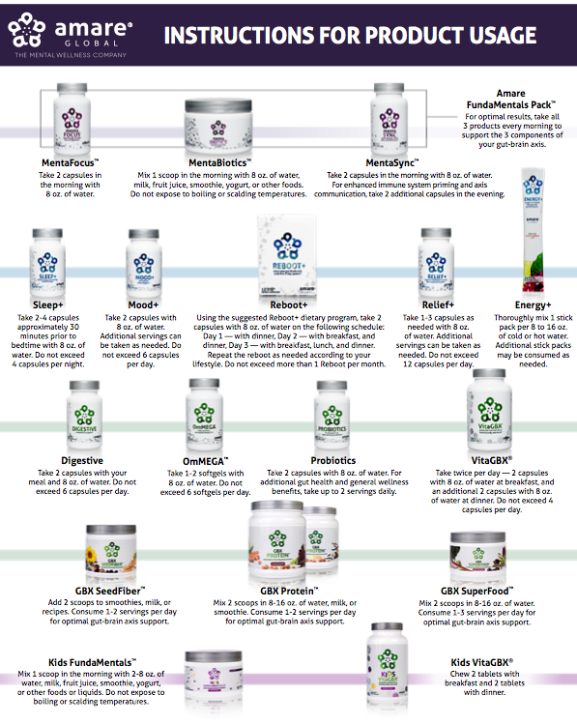
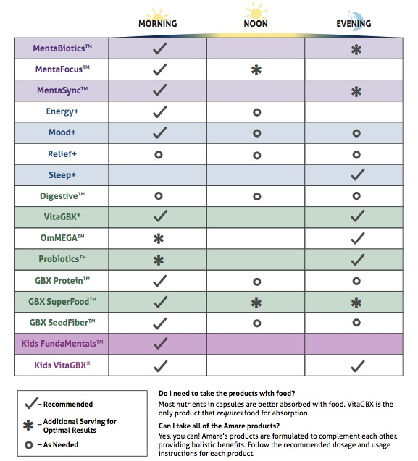

Slide 28



REMOVES WASTE & TOXINS
3-DAY PROGRAM
NATURAL CLEANSING
reset your gut-brain axis
with this 3-day system*
A synergistic blend of natural cleansing herbs and phytonutrients to assist the body’s own detoxification process – specifically formulated to reboot your gut-brain axis in 3-days.*
Item Code:
Retail Price:
Wholesale Price:
Subscribe & Save:
S004
$34.00
$24.95 / 21 PV
$21.95 / 19 PV
*These statements have not been evaluated by the Food and Drug Administration. This product is not intended to diagnose, treat, cure, or prevent any disease.

Slide 29

REBOOT+
KEY BENEFITS & FEATURES
Prepares the body’s gut microbiome for optimized mental wellness*
Provides a natural cleanse and supports a healthy digestive system*
Helps to remove built-up waste and toxins from the body*
Supports natural cleansing and filtering functions of the liver, kidneys, and colon*
Partners with and optimizes the body’s natural detoxification process*
*These statements have not been evaluated by the Food and Drug Administration. This product is not intended to diagnose, treat, cure, or prevent any disease.

Slide 30




reset your gut-brain axis
with this 3-day system*
Prevents liver damage 2-3x better than other popular detox supplements*
Resets/reboots gut microbiome balance*
Partners with and optimizes the body’s natural detoxification process*
*These statements have not been evaluated by the Food and Drug Administration. This product is not intended to diagnose, treat, cure, or prevent any disease.
Notes:
Morita T, Jinno K, Kawagishi H, Arimoto Y, Sμganuma H, Inakuma T, et al. Hepatoprotective Effect of Myristicin from Nutmeg (Myristica fragrans) on Lipopolysaccharide / D-Galactosamine- Induced Liver Injury. J Agric Food Chem. 2003; 51:1560–5.
Liu W, Gao FF, Li Q, Lv JW, Wang Y, Hu PC, Xiang QM, Wei L. Protective effect of astragalus polysaccharides on liver injury induced by several different chemotherapeutics in mice. Asian Pac J Cancer Prev. 2014; 15(23):10413-20.
Park YH, Son IH, Kim B, Lyu YS, Moon HI, Kang HW: Poria cocos water extract (PCW) protects PC12 neuronal cells from beta-amyloid-induced cell death throμgh antioxidant and antiapoptotic functions. Pharmazie 2009, 64:760–764.
Pu X, Fan W, Yu S, Li Y, Ma X, Liu L, Ren J, Zhang W. Polysaccharides from Angelica and Astragalus exert hepatoprotective effects against carbon-tetrachloride-induced intoxication in mice. Can J Physiol Pharmacol. 2015; 93(1):39-43.
Ren S, Zhang H, Mu Y, Sun M, Liu P. Pharmacological effects of Astragaloside IV: a literature review. J Tradit Chin Med. 2013; 33(3):413-6.
Ríos JL. Chemical constituents and pharmacological properties of Poria cocos. Planta Med. 2011; 77(7):681-91.

Slide 31
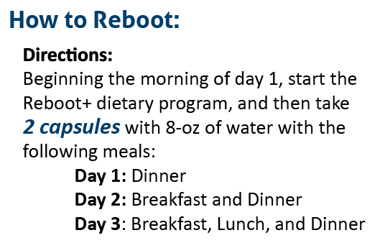
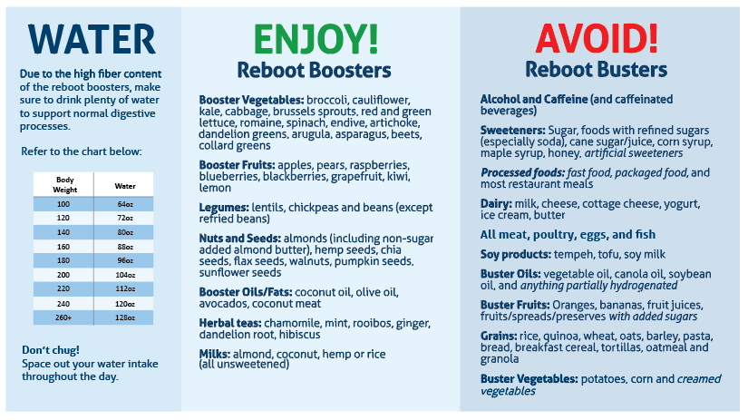
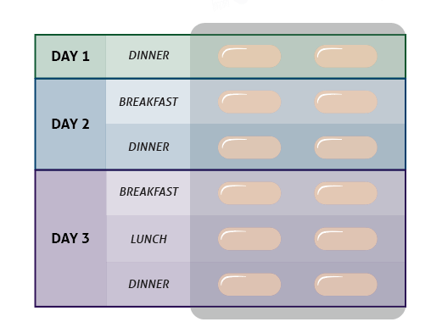
REBOOT+
DIETARY SUGGESTIONS
Notes:
Sources:
Letenneur et al. 2007, American Journal of Epidemiology 165: 1364.

Slide 32
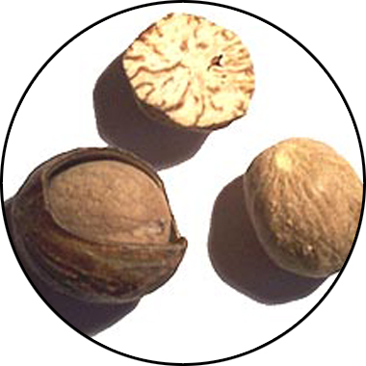
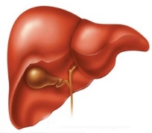
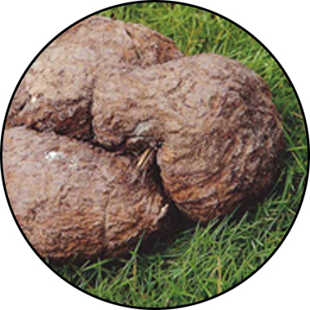
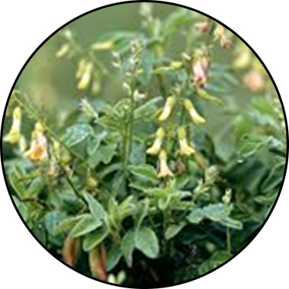
REBOOT+
KEY INGREDIENTS
Sebatin
Synergistic Effects of Sebatin™
™
Anti-inflammatory
Antioxidant
Hepatoprotective
Poria
lanostane triterpene acids
Panchyman (1,3-β-D-glucan)
Inhibition of iNOS & TNF-α production
Myristica
Phenylpropanoids
Induction of glutathion
S-transferase
Astragalus
Saponins & Polysacharin
Increase tissue SOD and GSH
Free radical scavenging
*These statements have not been evaluated by the Food and Drug Administration. This product is not intended to diagnose, treat, cure, or prevent any disease.
Notes:
Sources:
Letenneur et al. 2007, American Journal of Epidemiology 165: 1364.

Slide 33
REBOOT+
KEY INGREDIENTS
Sebatin
Outperforms Other
Liver Protection Agents
™
ALT % Inhibition
ALT % Inhibition
*These statements have not been evaluated by the Food and Drug Administration. This product is not intended to diagnose, treat, cure, or prevent any disease.
Notes:
Confidential Unigen Technical Development Tech Pack

Slide 34


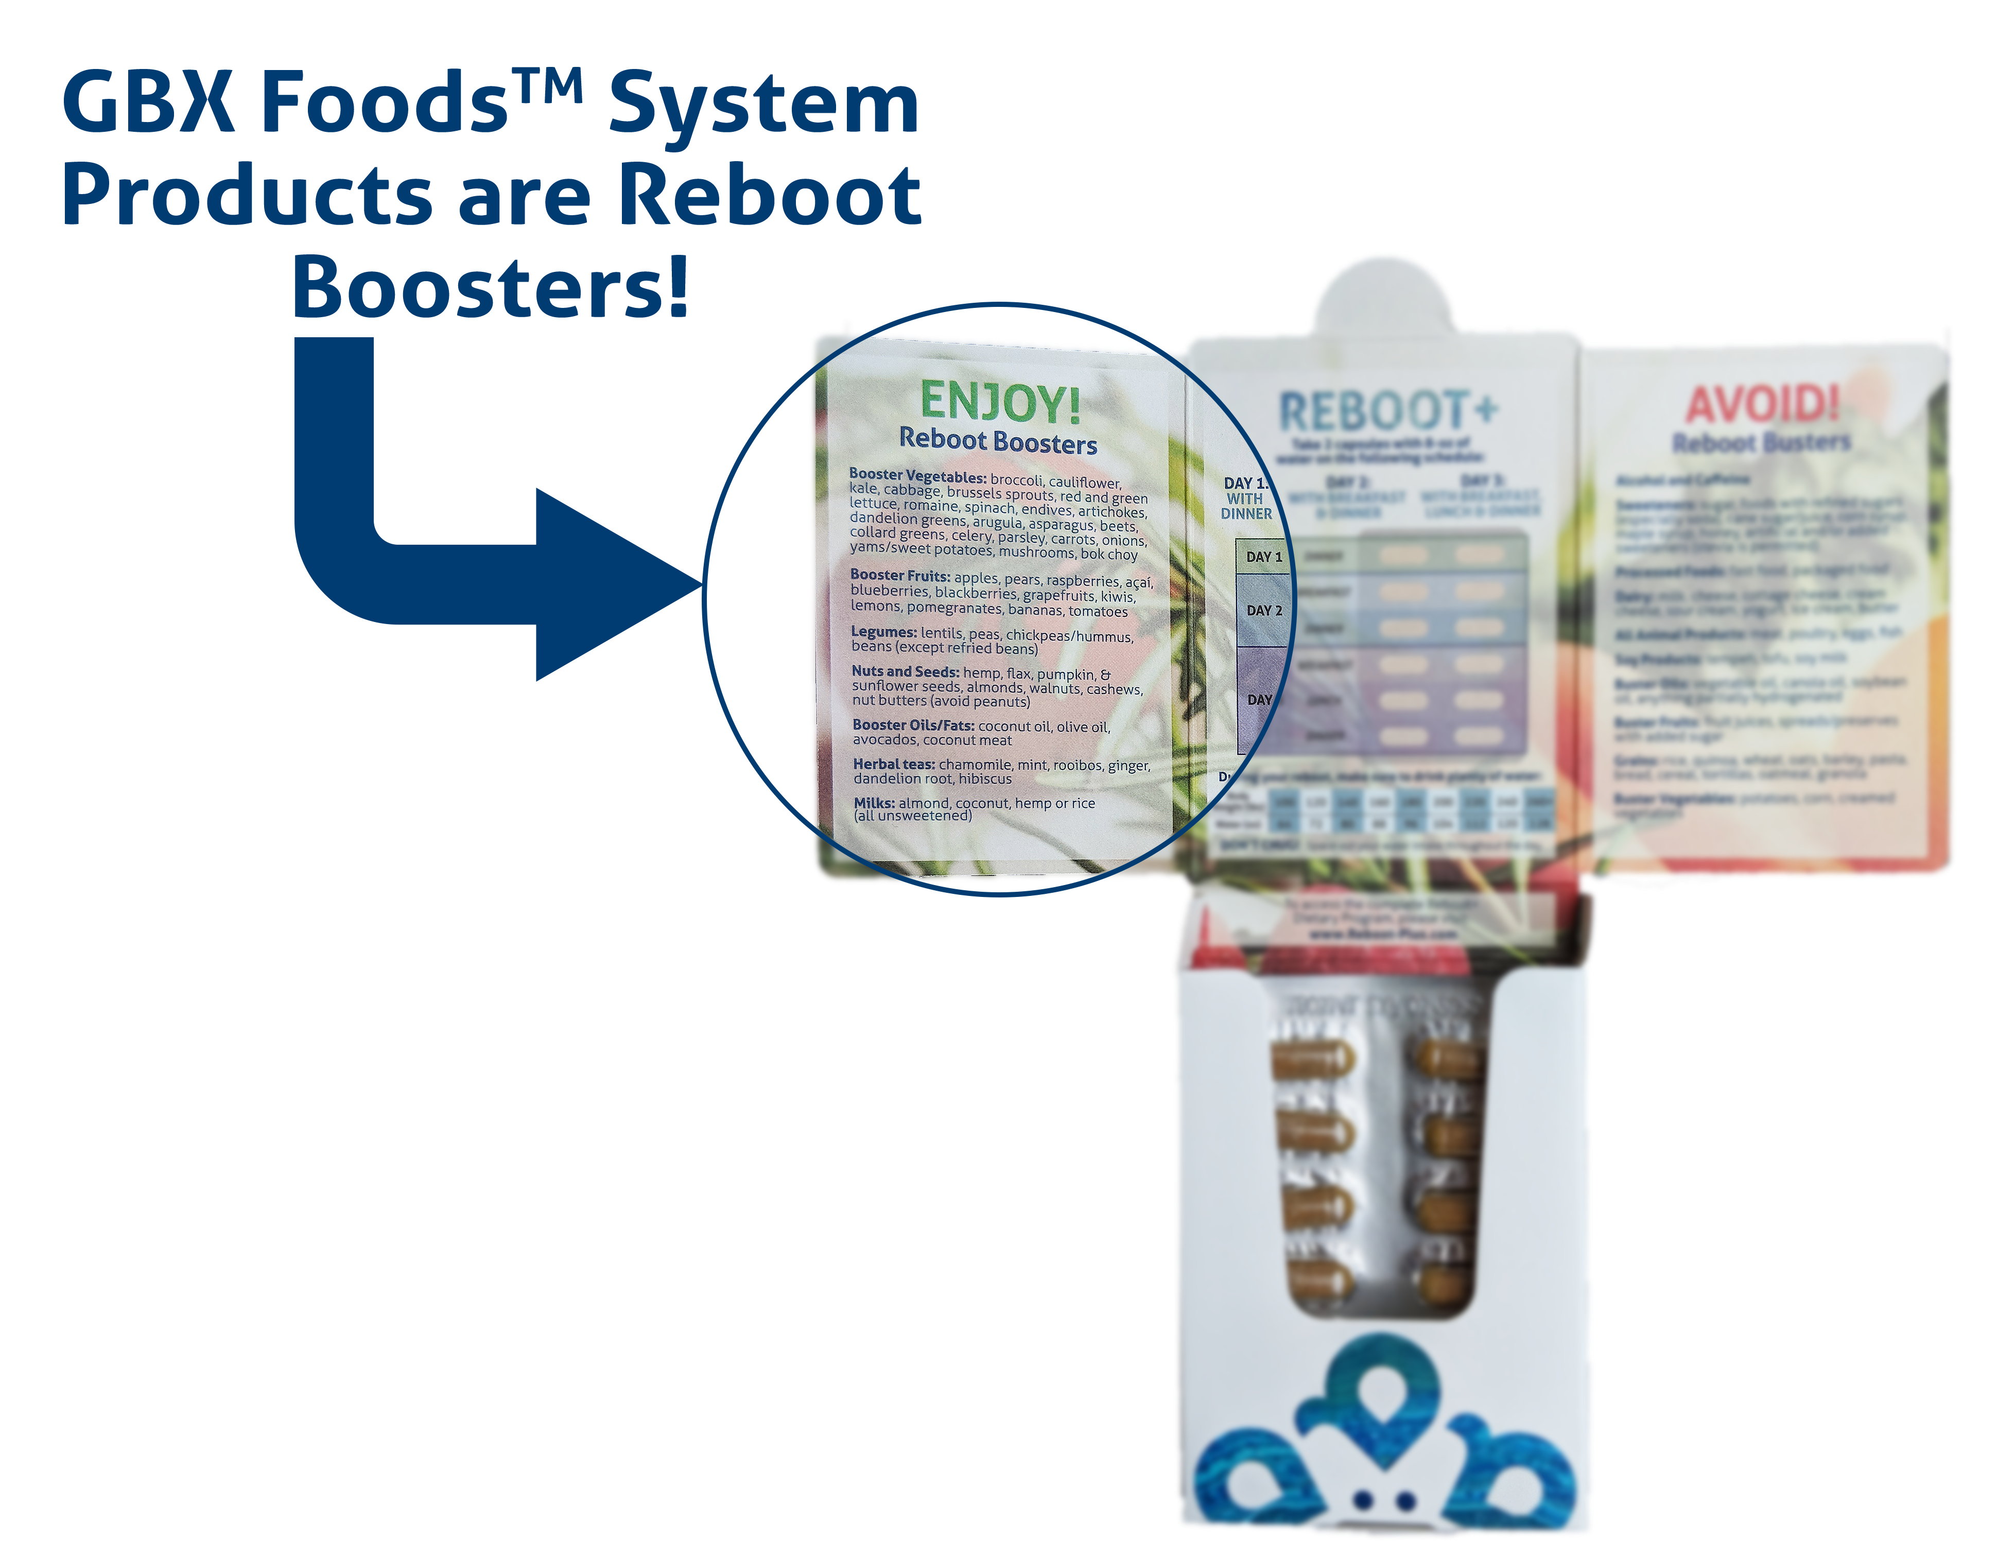

Microbiome-Boosting Nutrition*
GBX FOODS ARE REBOOT-FRIENDLY
™
*These statements have not been evaluated by the Food and Drug Administration. This product is not intended to diagnose, treat, cure, or prevent any disease.

Slide 35
Microbiome-Boosting Nutrition*
REBOOT with GBX FOODS
™
Benefits:
No more wasting time grocery shopping.
Saves you money!
Takes the hassle out of planning for your Reboot.
Convenient — products sent to straight to your door step.
Provides the microbiome-boosting nutrition you need every day.
Quick, easy, delicious products.
*These statements have not been evaluated by the Food and Drug Administration. This product is not intended to diagnose, treat, cure, or prevent any disease.

Slide 36
What to DO?
Friday – Reboot Day 1
Saturday – Reboot Day 2
Sunday – Reboot Day 3
Monday – Start Fundamentals
  +1 GBX Smoothie/day
  + HIIT exercise 3x/week
  SLEEP!

Slide 37
Recipe Ideas & Smoothies!
Resources section of Amare.com
  https://amareassets.blob.core.windows.net/webassets/resources/recipes/Reboot_Recipes.pdf
Posting new smoothies recipes in FB Group & ShawnTalbott.com

Slide 38
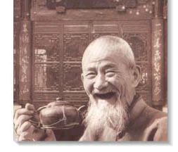
Good Health!

