Slide 1
Project B3 PILOT
Nutrition
Shawn Talbott, PhD

Slide 2
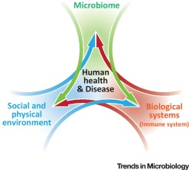

Biome
Body
Brain
THE MENTAL WELLNESS COMPANY

Slide 3
Topic Schedule
Nov 1 (week 0) = Overview
Nov 8 (week 1) = Reboot/Biome
Nov 15 (week 2) = Body/Brain
Nov 22 (week 3) = OFF – Thanksgiving
Nov 29 (week 4) = Stress / Sleep
Dec 6 (week 5) = Exercise
Dec 13 (week 6) = Nutrition
Dec 20 (week 7) = Supplementation
Dec 27 (week 8) = Evaluation
Jan 3 = start 2019 RIGHT!

Slide 4
Best Diet?
Researchers from Tufts University studied 160 overweight subjects
  Average 220 lbs.
  30-80 lbs. to lose
      40 = Atkins (low carb/high fat)
      40 = Ornish (very low fat, <10%)
      40 = Weight Watchers (moderate fat/carb/protein)
      40 = Zone (40% carb/30% protein/30% fat)

Slide 5
Tufts Study
All diets worked about the same…
At 2 months = 22% had given up…
At 1 year:
  WW & Zone = 35% dropped out
  Atkins / Ornish = 50% dropped out
Stay on diet for a year = 10-12lbs weight loss
Drop in heart disease risk = 5-15%
  LDL cholesterol drop: HDL rise:
  Atkins = -8.6% 15%
  Zone = -6.7% 15%
  WW = -7.7% 18.5%
  Ornish = -16.7% 2.2%

Slide 6
Glycemic Index?
refers to the degree by which the food increases blood-sugar levels
white bread (69) / grapefruit (26)
high GI will rapidly increase blood-sugar levels
low GI will have a less pronounced effect on blood-sugar levels
GI Influencers:
cooking methods (longer cooking increases GI of pasta, rice, etc.)
processing levels (smaller particle sizes increase the GI of flours, other grains)
content of fiber, fat, and protein in the overall meal (all tend to reduce the GI)
ripeness of fruit (riper = a lower GI)
physical form of the food (applesauce = 25% higher GI than whole apple)
proportion of different carbohydrate types in a single food (rice can have different levels of amylose—a slowly digested carb—versus amylopectin—a rapidly digested carb)
shape of the food (68 for macaroni / 45 for spaghetti / 68 for thick linguine / 87 for thin linguini)
processing methods (“more” processed increase blood-sugar levels faster)
preparation methods (amount of heat/water used in cooking, time of cooking, size into which the food particles are chopped prior to cooking)…
American Diabetes Association, American Heart Association, American Dietetics Association do not recommend using GI values

Slide 7
Eat right, exercise, and still gain weight - Why?
Habit Change in Obesity Risk
Eat 1+ midday snack -39%
Eat dinner as biggest meal +6%
Wait 3+ hrs to eat breakfast +43%
Eat 1/3+ of meals out +69%
Go to bed “hungry” (3+ hrs after last eating) +101%
Eat breakfast out +137%
Not eating breakfast at all +450%
University of Massachusetts - Survey of 500 men & women

Slide 8
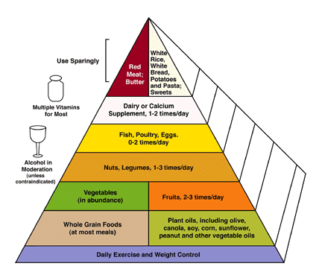
Research-Supported benefits for:
Heart disease
Cancer
Alzheimer’s/Dementia
Depression
Obesity / Diabetes

Slide 9
National Weight Control Registry
Database of 3,000+ “successful losers”
  30lb. weight loss maintained for 1+ years (avg. = 66lbs)
  60-80 min/day of physical activity
  1500-1800 calories/day
Get a buddy!
  Participating with friends = 33% more weight loss and 2-3x better maintenance (versus solo dieters)
  E-mail correspondence = doubles your weight loss (JAMA, April 2003)

Slide 10


How effective is exercise for weight control?
Exercise needed to promote negative energy balance
  A LOT! (more than most of us do).
  Taco Bell Burrito = 5 mile run
  12 Hershey kisses = 30 min Lap swimming
  6 Oreos = 30 min brisk walking
  Researchers at the U Virginia have determined 250,00 crunches needed to burn 1 pound of fat.
    (100 crunches per day……………….…for 7 years!)
  Duke University study = 30m/d brisk walking needed to PREVENT weight gain
    no exercise = 2.5lbs gain in 8 months
    jog 17 mile /week = 10lbs fat loss (in 8 months)
    Average is 1lb fat gain/yr from age 25-55y
  Moral = exercise alone stinks for weight loss
You MUST cut calories from the diet

Slide 16
Thyroid support
Hypothyroid – no energy, trouble concentrating, weight gain, increased appetite, dry skin/hair – the list goes on…
TSH (thyroid stimulating hormone from pituitary)
Thyroid gland produces T4 > converted (deiodination) in peripheral tissues into “active” T3
  Too little TSH > thyroid can’t make enough T4
    Not enough T4 > nothing to convert into active T3
  Plenty of T4, but some problem with the conversion process
    Cortisol can inhibit the conversion of T4 to T3
Micronutrients (Iodine, Tyrosine, Selenium, Zinc, Vit E, tocotrienols, Omega3…)
  iodine is stored in thyroid to combine with tyrosine in T4 synthesis
  Selenium & Zinc – cofactors for 5’-deiodinase
Gut Support (Leaky Gut)
  Improve gut integrity, reduce gut inflammation, prevent endotoxemia, prime immune system

Slide 17
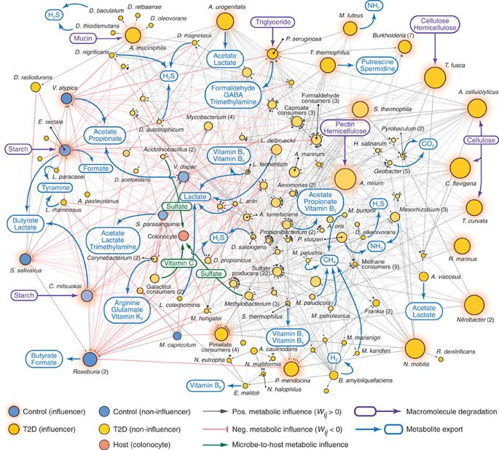

Slide 18
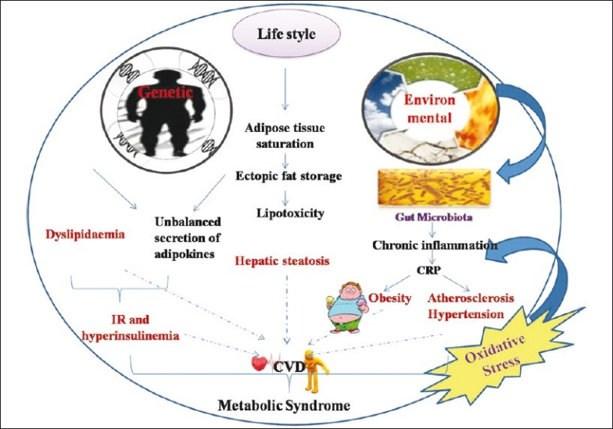

Slide 19
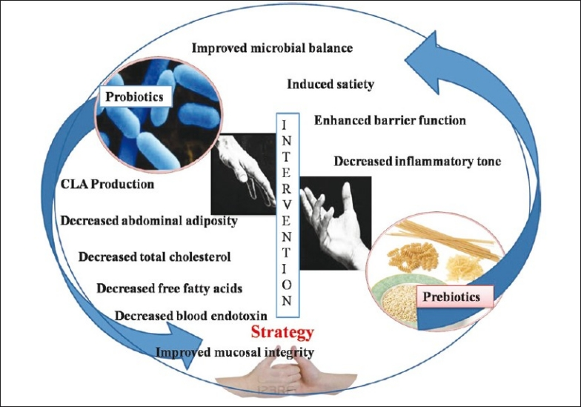

Slide 20
Fight Stress with Fish
Omega-3 fatty acids
Numerous studies 1-7g fish oil daily for 3 weeks = reduced stress reactivity
Salmon/Mackerel/Sardines/Trout (3.5 ounce serving) = 1-2g of Omega 3s
  OmMega = 1.3g per 2 softgels

Slide 21
An Apple a Day to Keep the Weight Away
Japanese scientists = rats fed apple polyphenols for 3 weeks lost 27% more fat than rats on standard diet...
Wales researchers = breakfast cereal daily = lower levels of cortisol
Harvard = diet analysis of 27,000 men over 8 years = adding 1 serving of whole grain reduced weight by 2.5 pounds (blood sugar control)

Slide 22
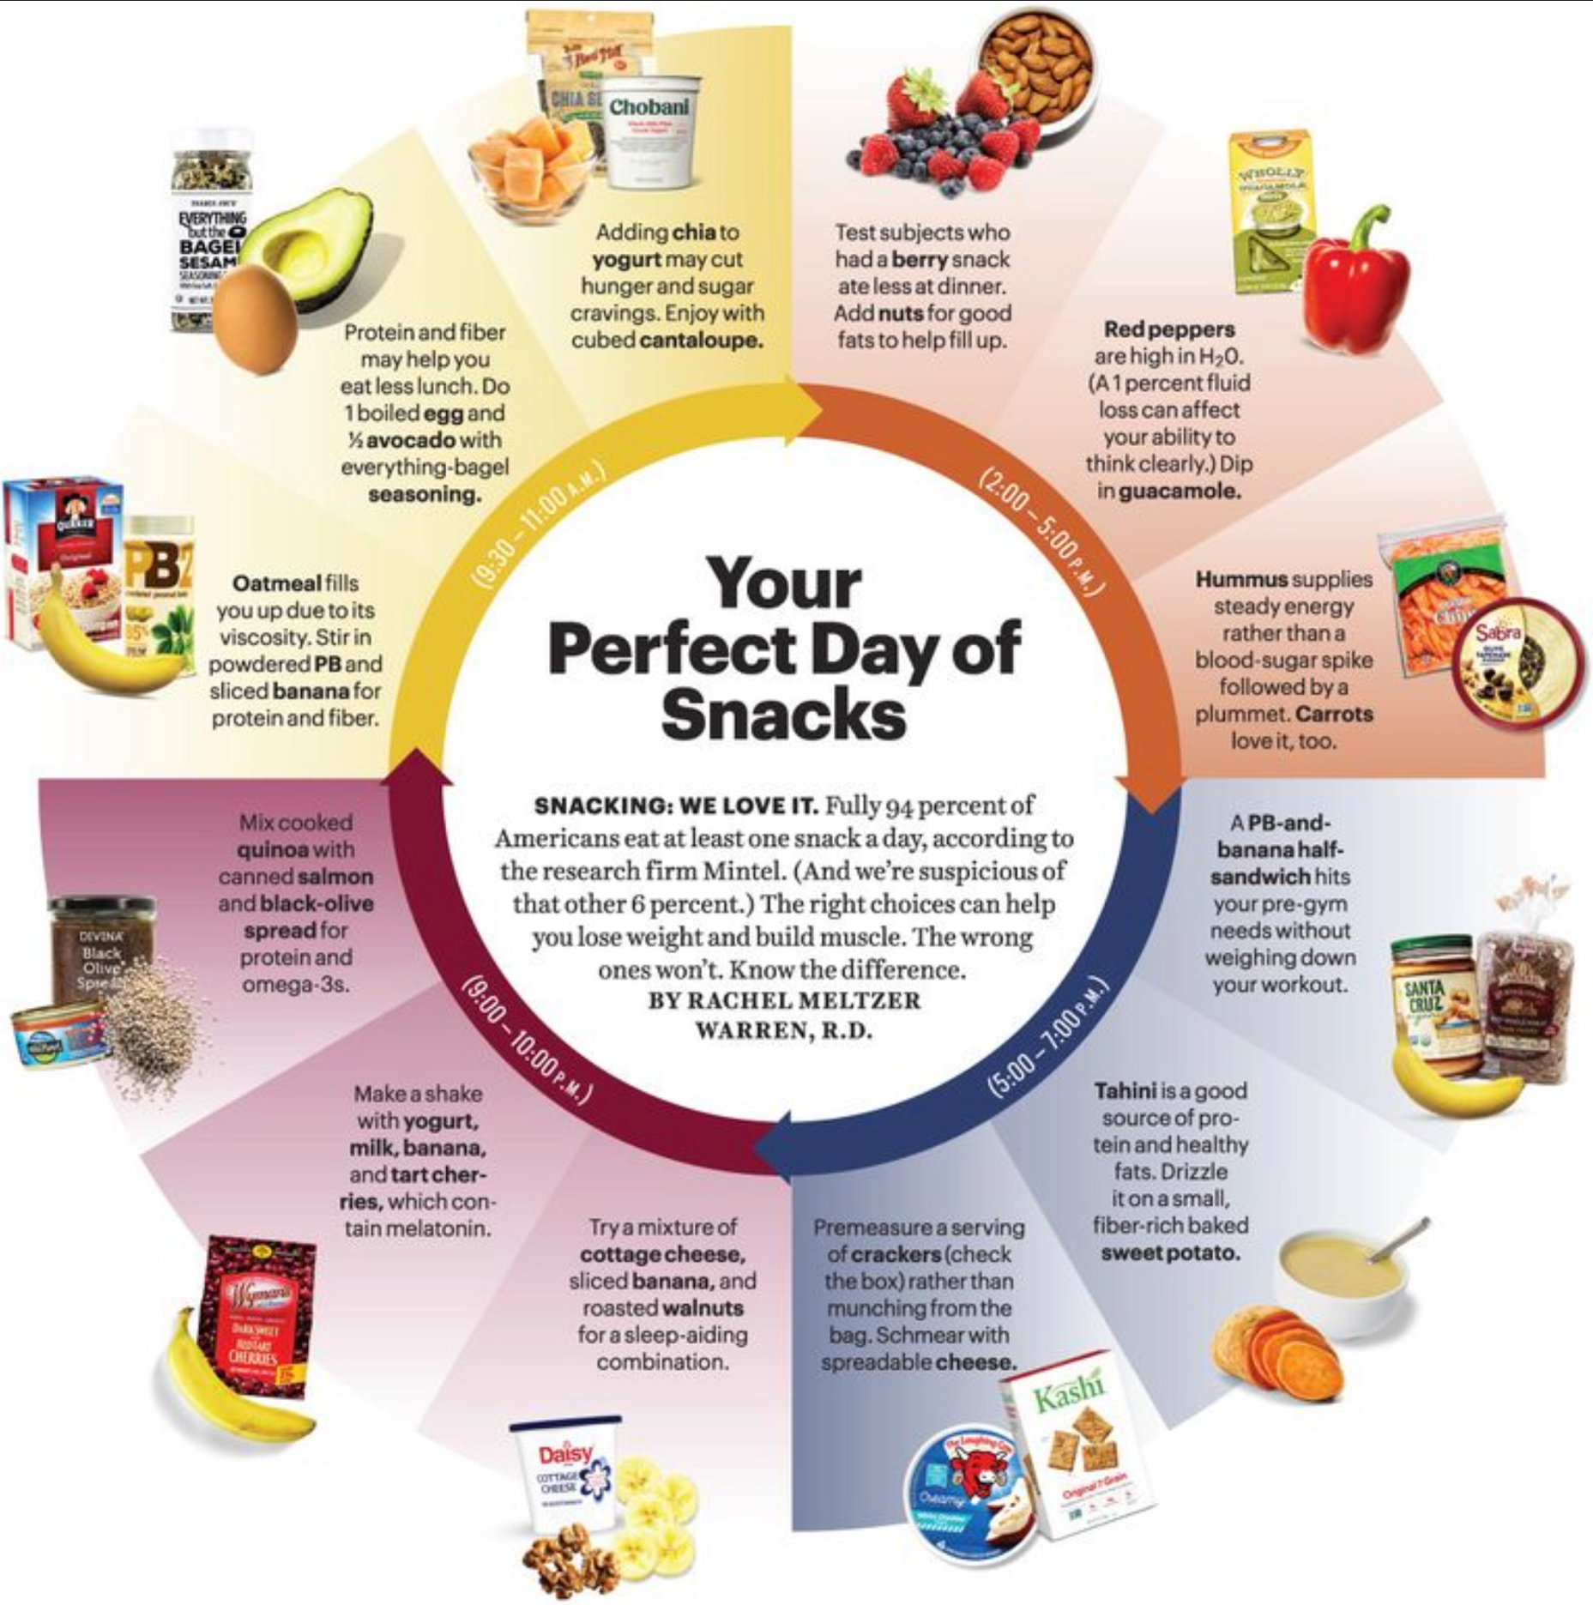

Slide 23
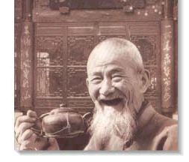
Eat!

