Slide 1
Food for Thought – Nutritional Psychology & the Role of Nutrition in Mental Wellness
Shawn Talbott, PhD, CNS, LDN, FACSM, FAIS, FACN
Chief Science Officer, Amare Global

Slide 2
Outline
1. Nutrition plays well-known effects on "physical health and wellness" - including cardiovascular, musculoskeletal, and cellular.
2. Less well-known are the effects of nutrition on "mental" health and wellness - including depression, anxiety, pain, and burnout.
3. The emerging field of "Nutritional Psychology" describes the biochemical/physiological basis for the behavioral/psychological effects of nutrition and lifestyle choices to impact mental wellness.
4. This presentation will describe research-supported nutrition modalities to positively influence mental wellness - including pre/probiotics, plant polyphenols (“phytobiotics”), essential fatty acids, and traditional herbal therapies.

Slide 3


Slide 4


Slide 5
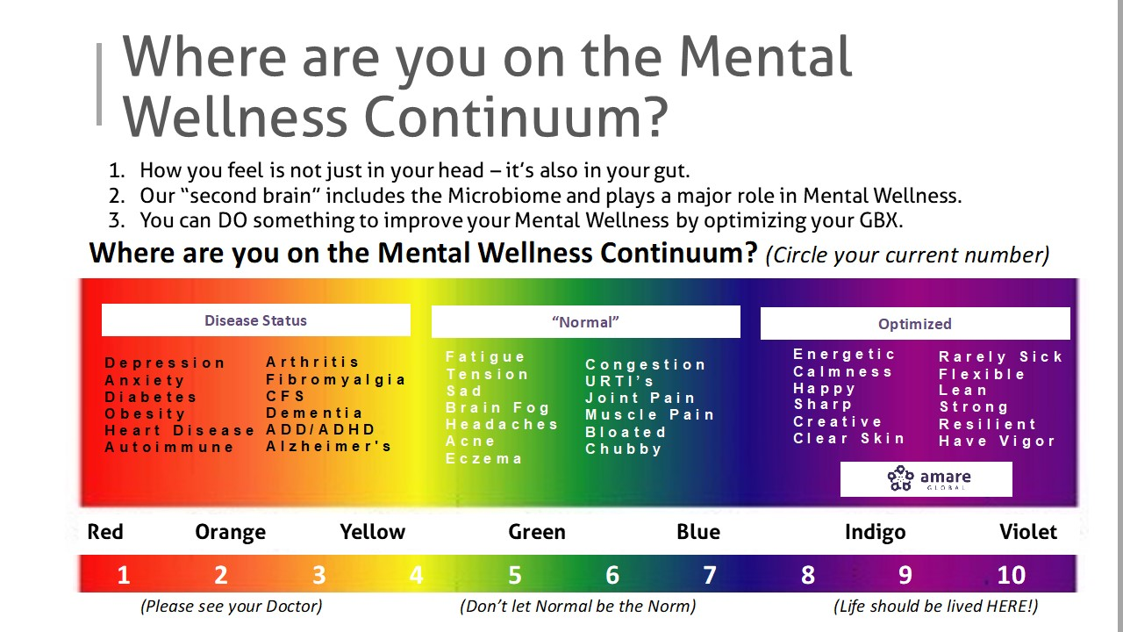

Slide 6
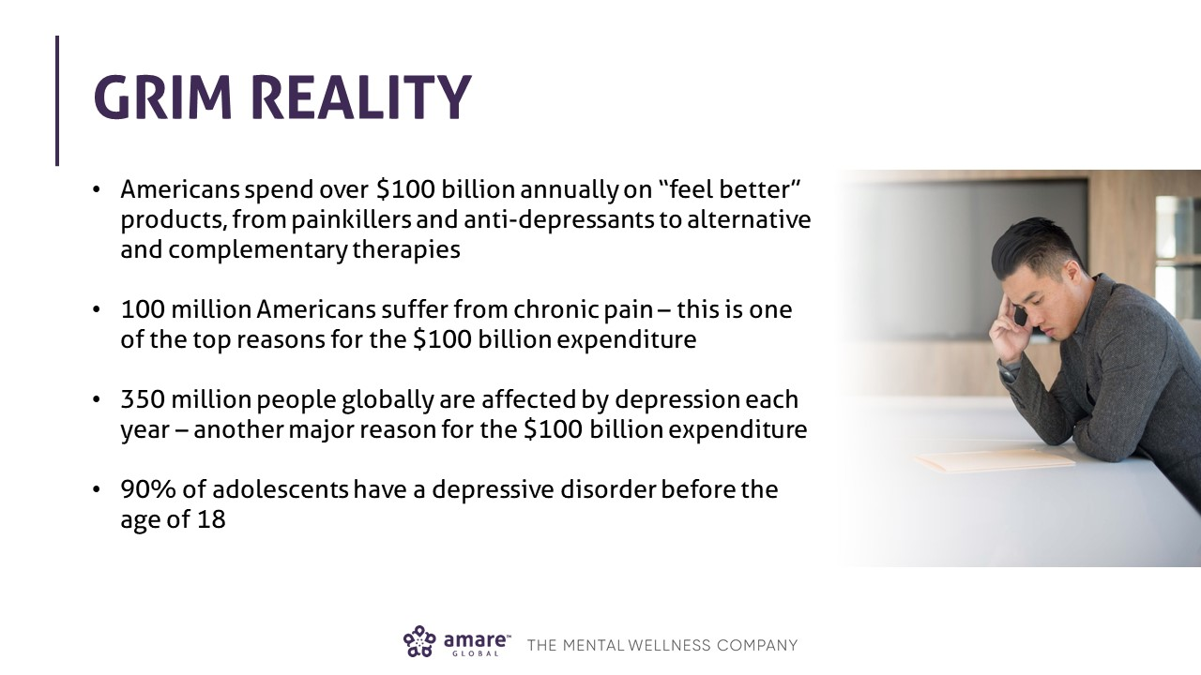

Slide 7
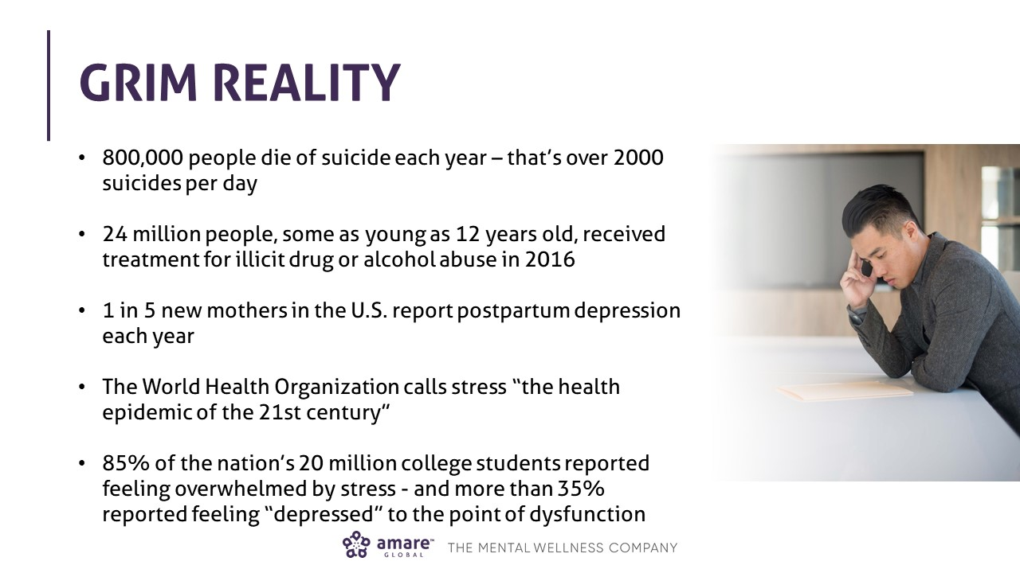

Slide 10
Multi-Factorial Problem
Microbiome
Depression
Anxiety
Stress
Brain Fog
Fatigue
Pain
Tension
Irritability
Burnout
Stressors
Neurotransmitters
Thoughts
Immune System
Inflammation

Slide 11
Multi-Factorial Solution
Emotional
Self-Love/Compassion
Gratitude
Social Connection
Happiness
Energy
Motivation
Flexibility
Relaxation
Calmness
Clarity
Vigor
Professional
Financial
Work-Life Balance
Goals
Physical
GBX Diet
Exercise
Yoga
Personal
Who am I?
What do I want?
Hobbies
Psychological
Relaxation
Mindfulness
Aromatherapy
Spiritual
Why?
Inspiration
Meaning/Purpose

Slide 12
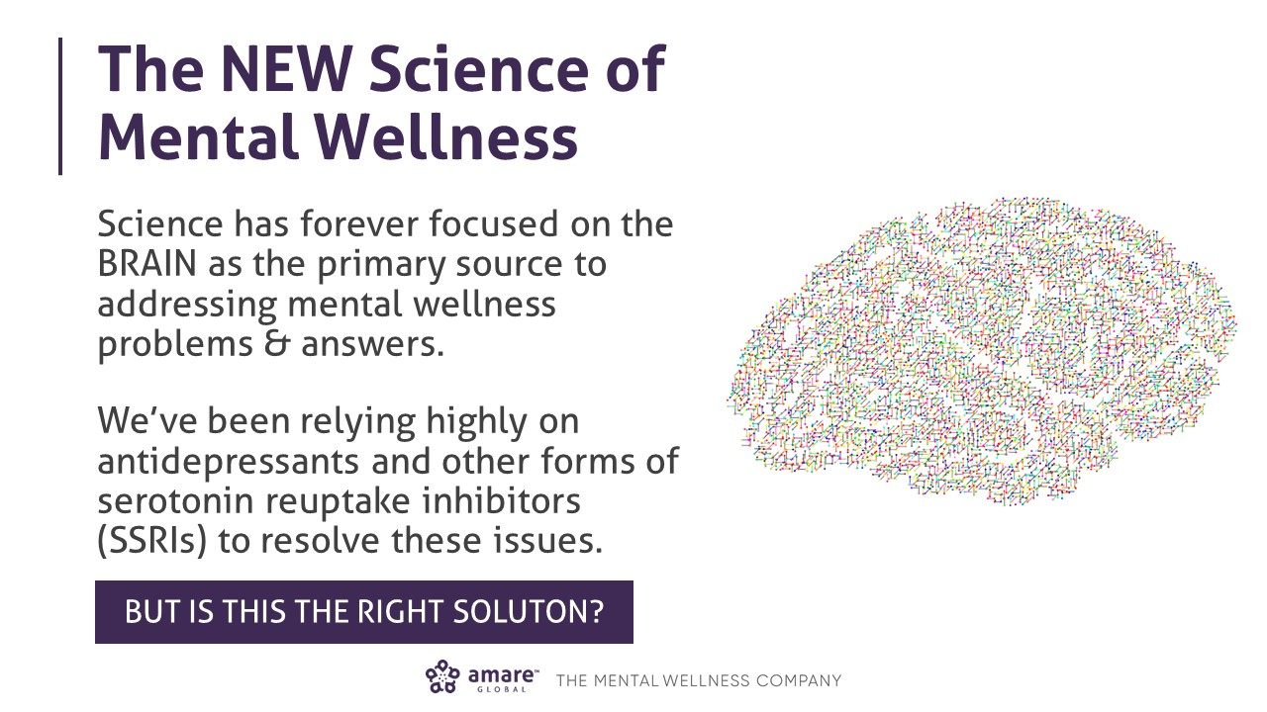

Slide 13
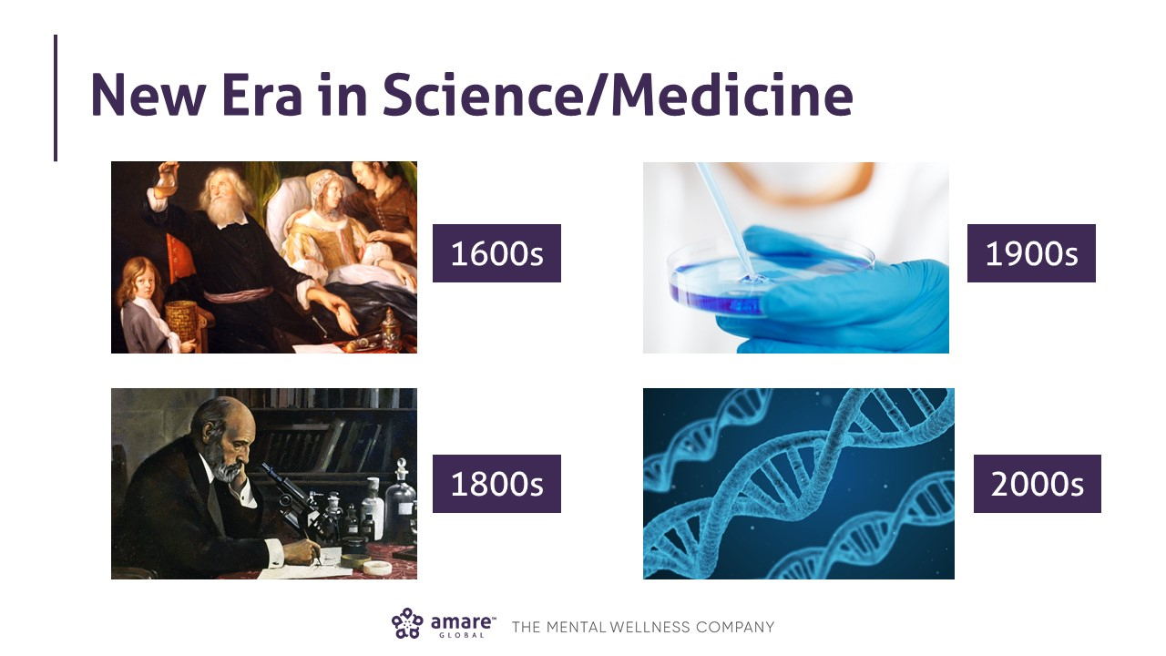

Slide 14
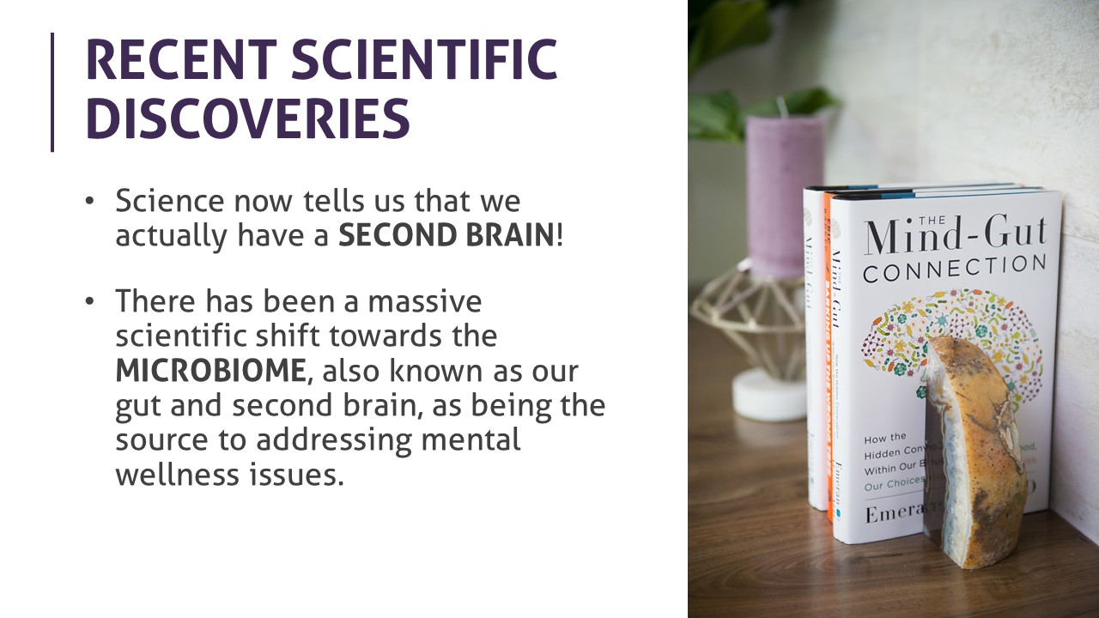

Slide 15
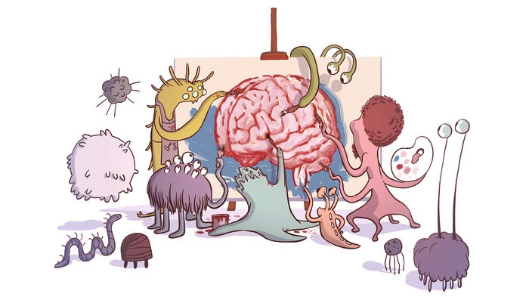

Slide 16
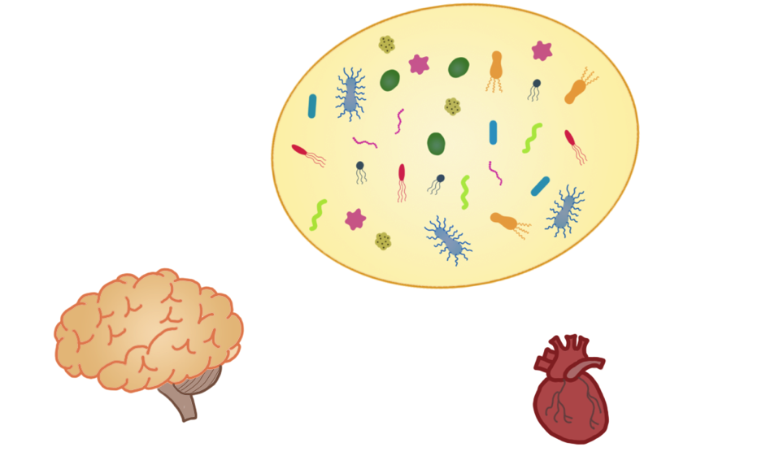
The Forgotten Organ
Microbiota:
100 trillion cells
~0.9 kg – 2.7 kg
Heart:
~0.3 kg
Brain:
100 billion cells
~1.2 kg
Courtesy from E. Hsiao

Slide 17
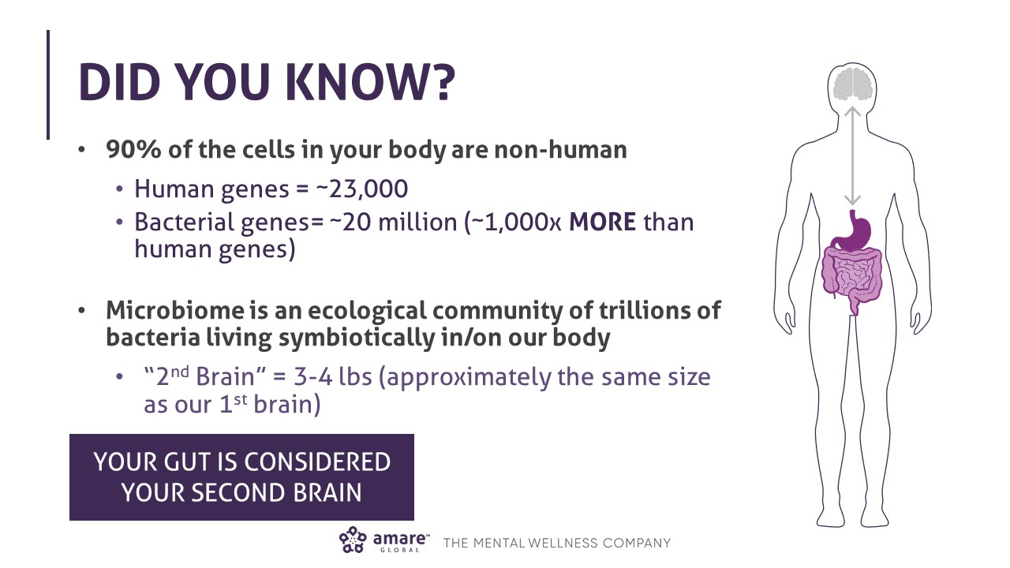

Slide 18
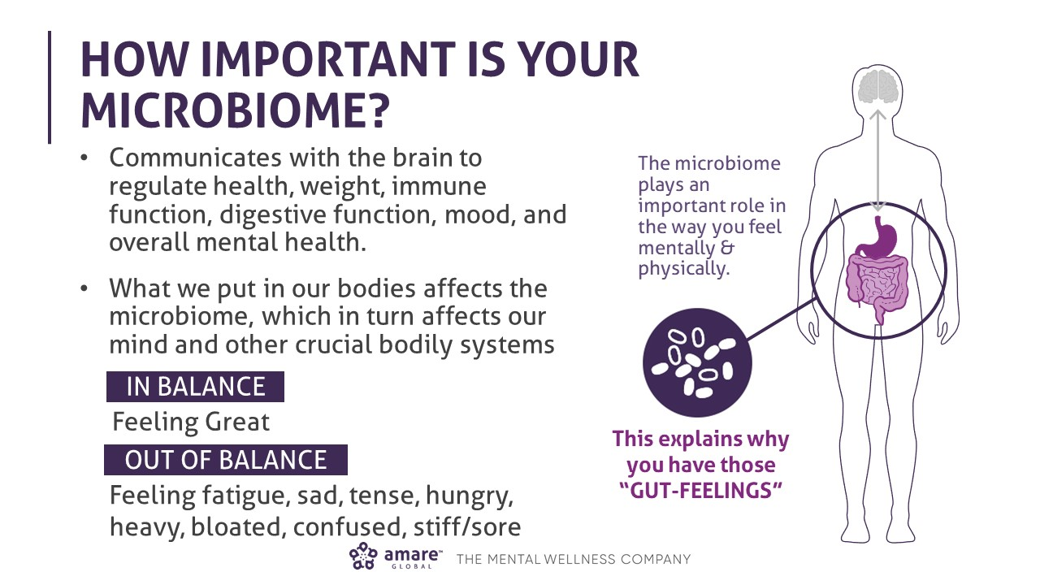

Slide 19
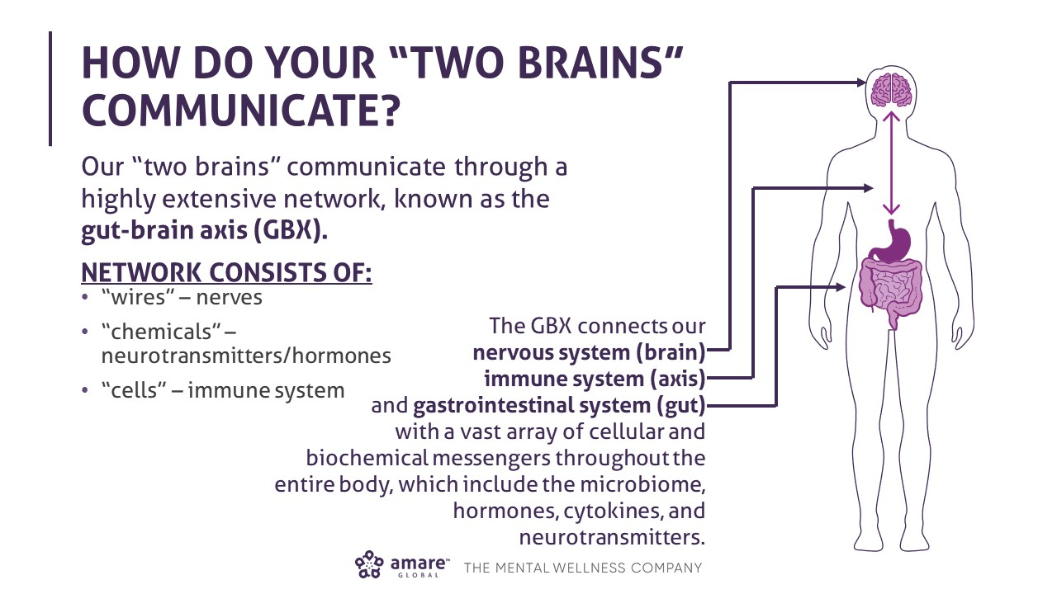

Slide 20
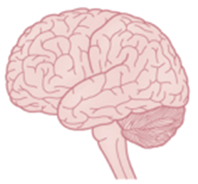
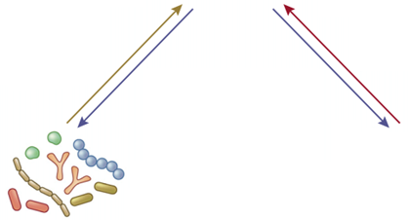
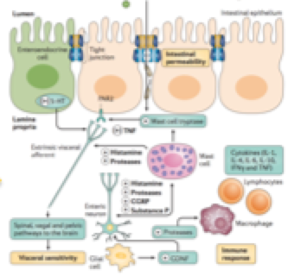
Brain connectome
Stress reactivity
Mood
Sleep
Visceral sensitivity
Microbe-derived
molecules
Neuroactive molecules
Neuronal signals
Central nervous system
Gut derived molecules
Neuronal
Immune
Neuroendocrine
ANS modulation
Motility
Secretion
Permeability
Microbiome
Microbe-derived molecules
Gut microbiota
Gut connectome
Immune
Neuronal
Neuroendocrine
Modified from Fung, Hsiao et al, Nature Neuroscience 2017

Slide 21
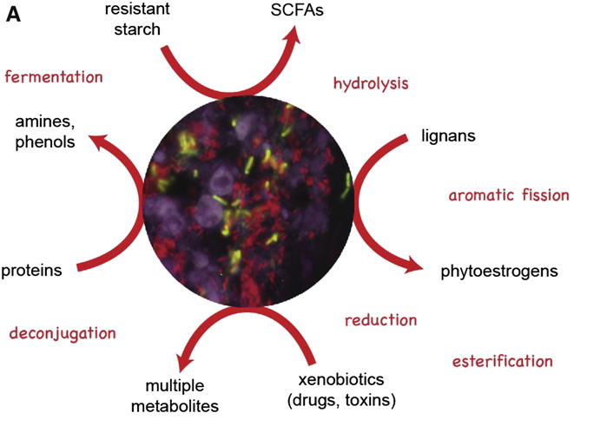
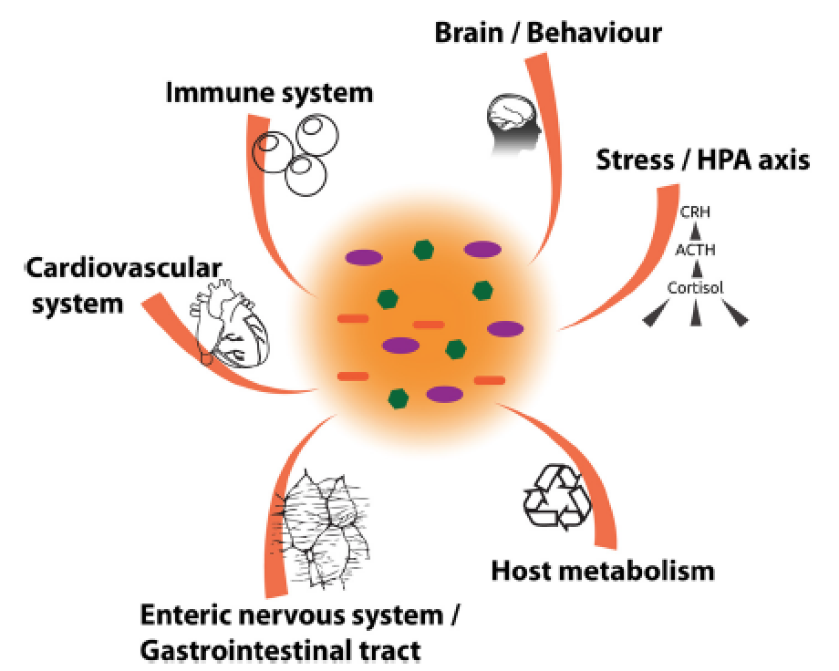
What Gut Microbes Do Most of the Time
What they produce
With whom they communicate
Baeckhed et al, 2012

Slide 22
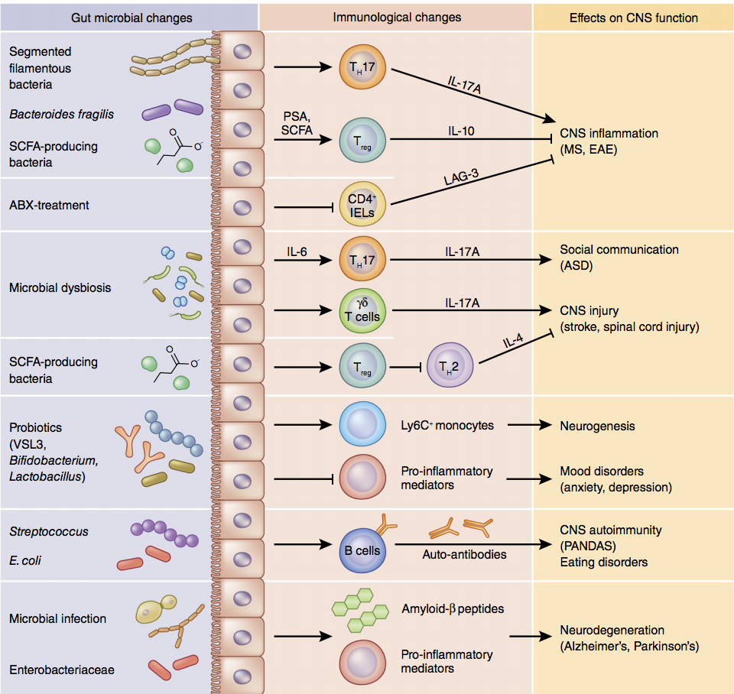
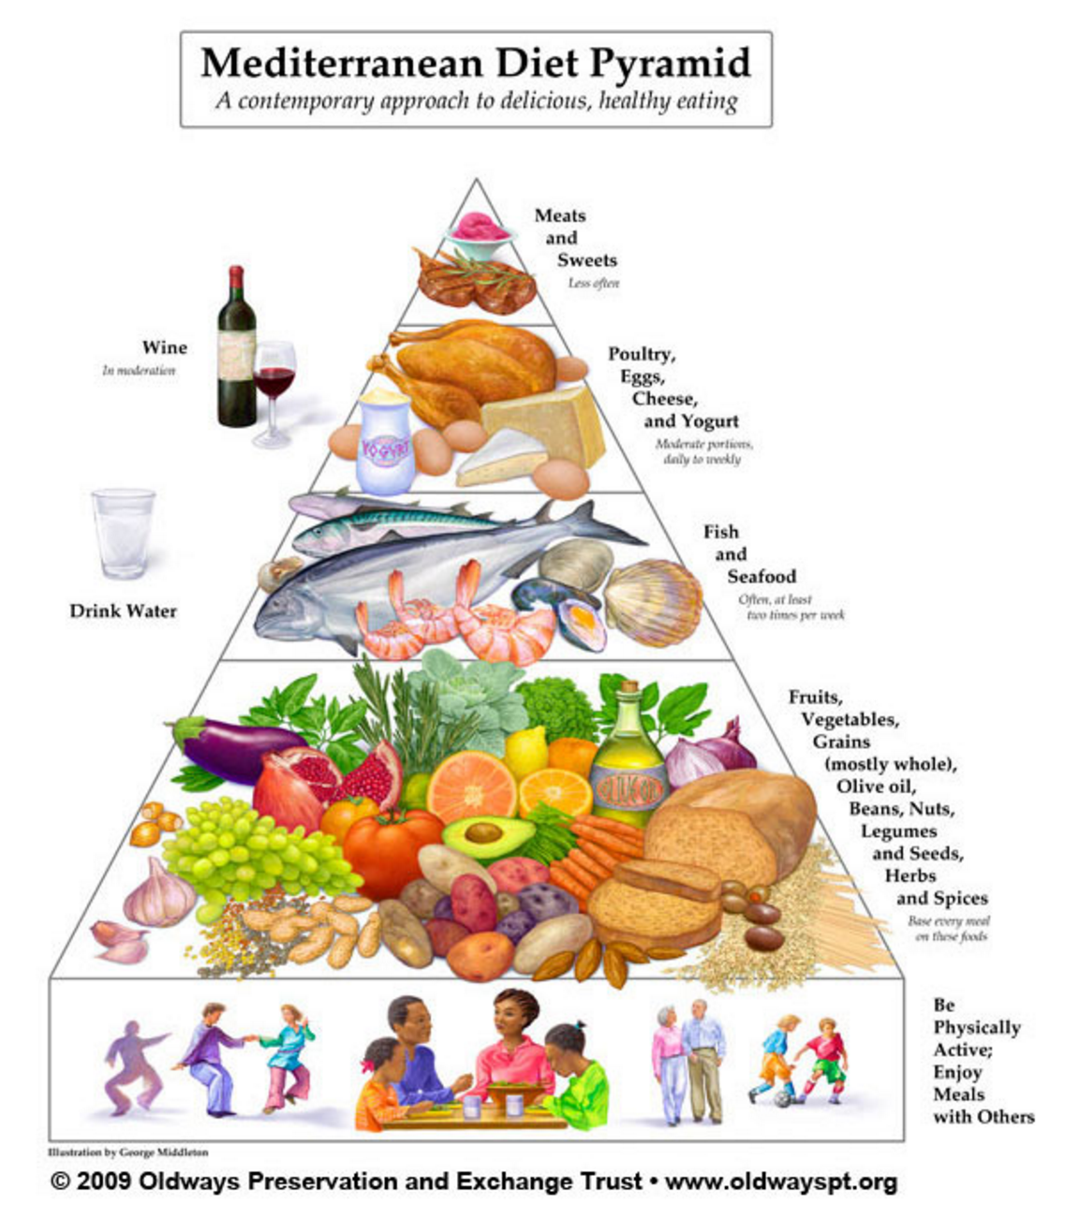
Modulation of BGM Interactions by Food and the Brain
Modified from Fung, Hsiao et al, Nature Neuroscience 2017

Slide 23


Stress-Induced Brain Gut Microbiome Interactions
Psychosocial Stress
Anxiety
Fear
Anger
Sadness
Pain
Diarrhea
Pain
Discomfort
Modified from Nature Reviews 2016

Slide 24
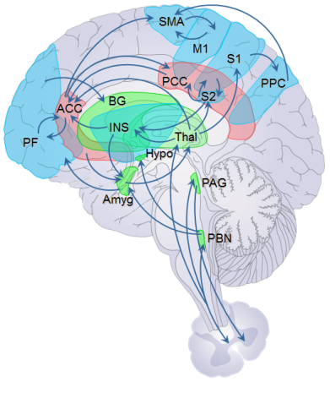
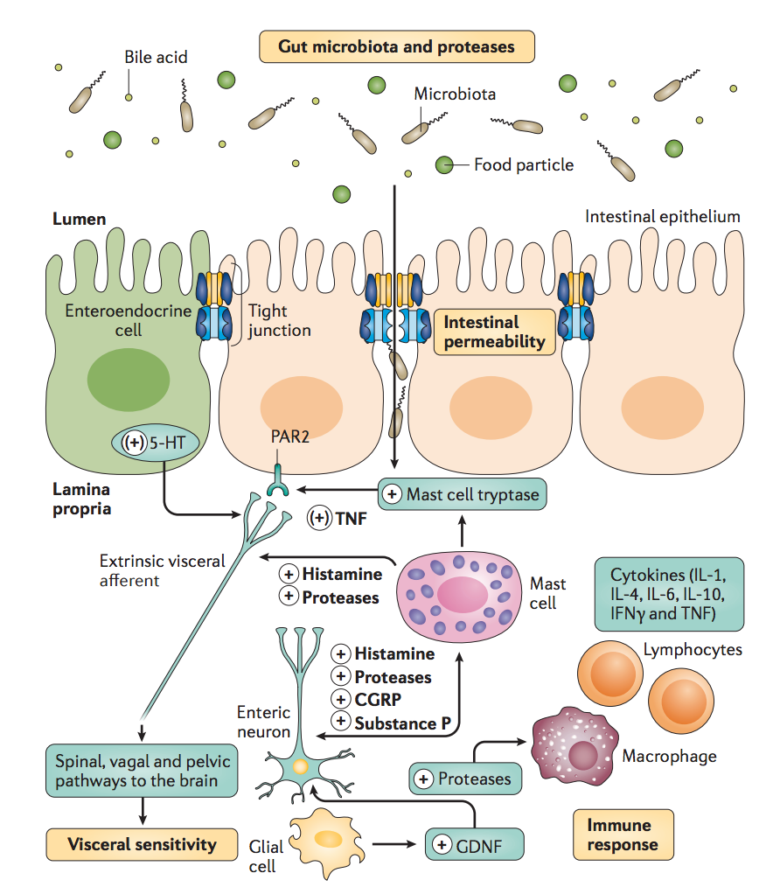
Stress-Induced Brain Gut Microbiome Interactions
Psychosocial Stress
Anxiety
Fear
Anger
Sadness
Pain
Modified from Nature Reviews 2016

Slide 25
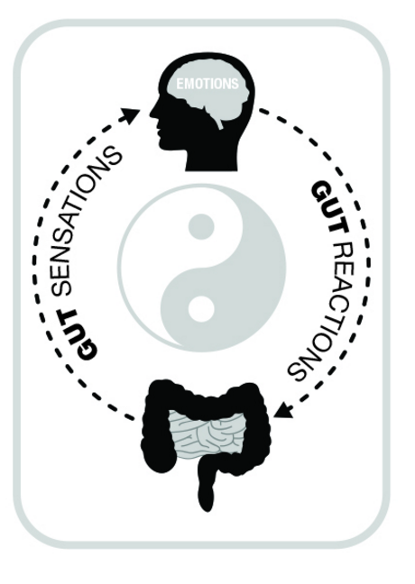
The Mind Body Concept of Emotions
Anxiety
Fear
Anger
Sadness
Pain
Belly discomfort, Belly pain
Diarrhea, Constipation
Modified from Nature Reviews 2016

Slide 26
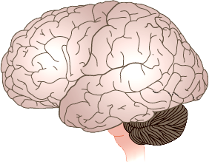
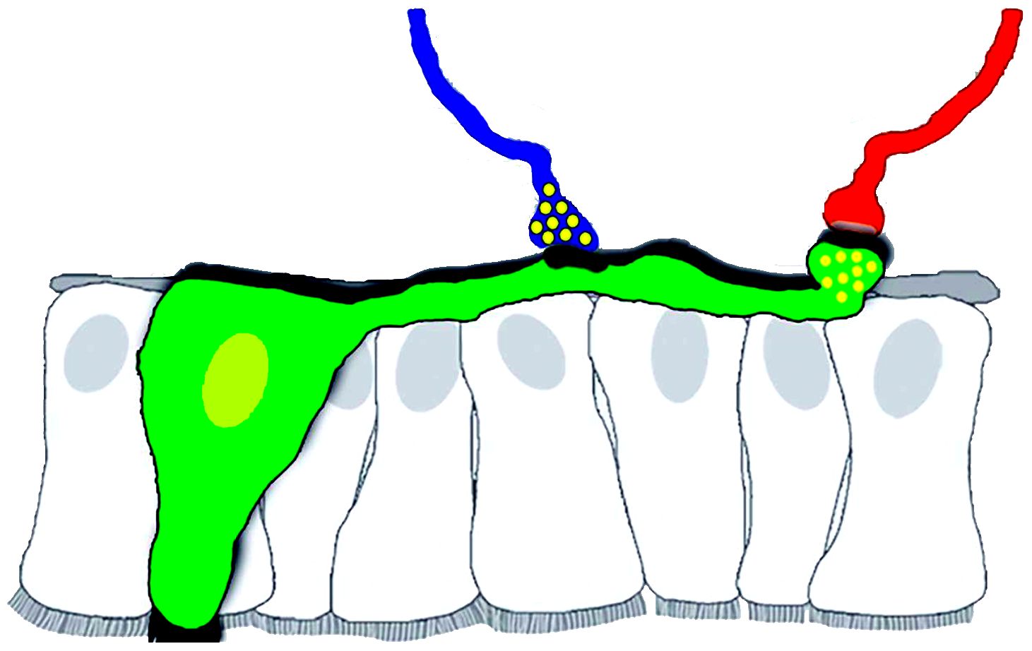
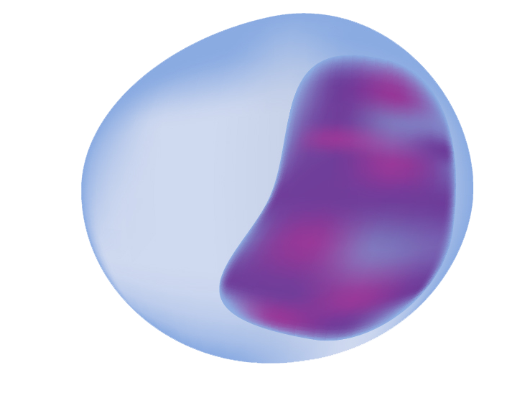
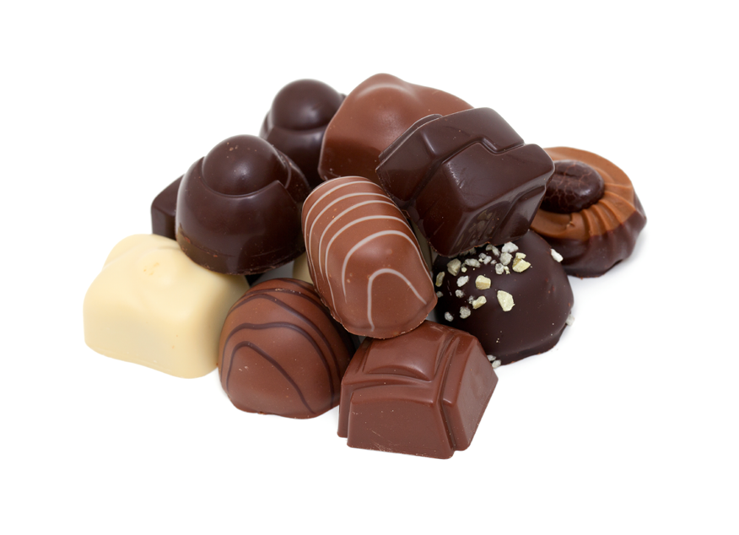
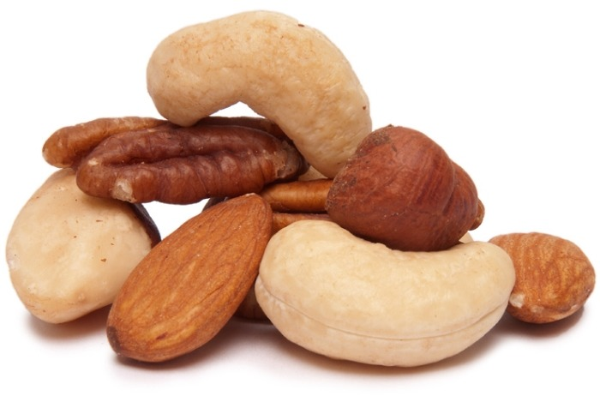
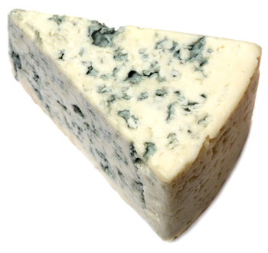
The Role of the Gut Microbiome
In Serotonin to Brain Signaling
TPH
5HT
Chocolate, Nuts,
Blue Cheese,
Plant and Animal Protein
5HT
SCFA, 2º Bile Acids
Jano, Hsiao et al. Cell 2015;
Bohorquez et al, JCI 2015
Dietary Tryptophan
Spore Forming Clostridiales

Slide 27



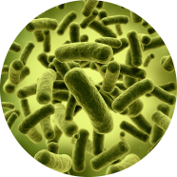
Timid
“Introvert”
Outgoing
“Extrovert”
Timid
“Introvert”
Normal gut microbes
Germ-free
Transplanted

Slide 28
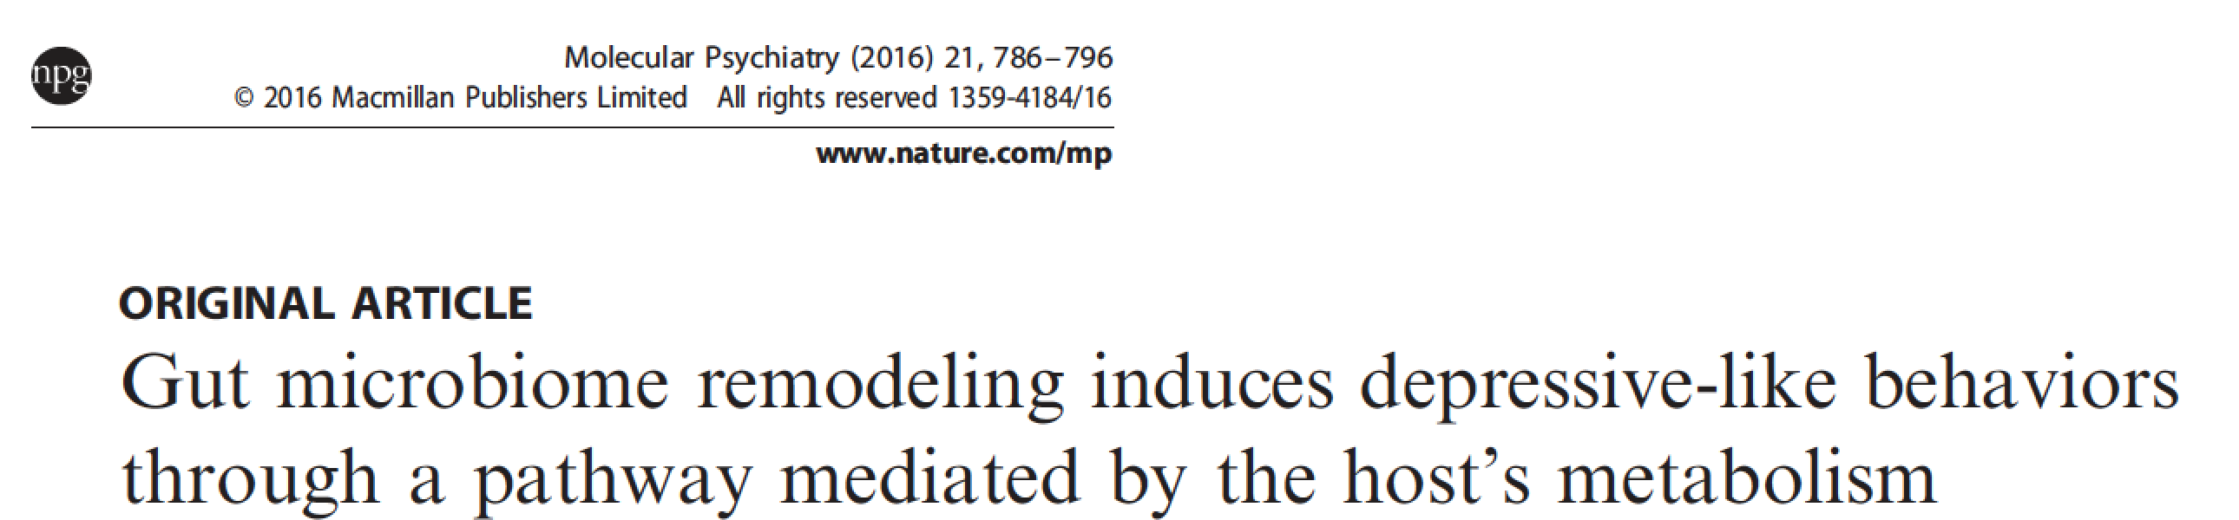
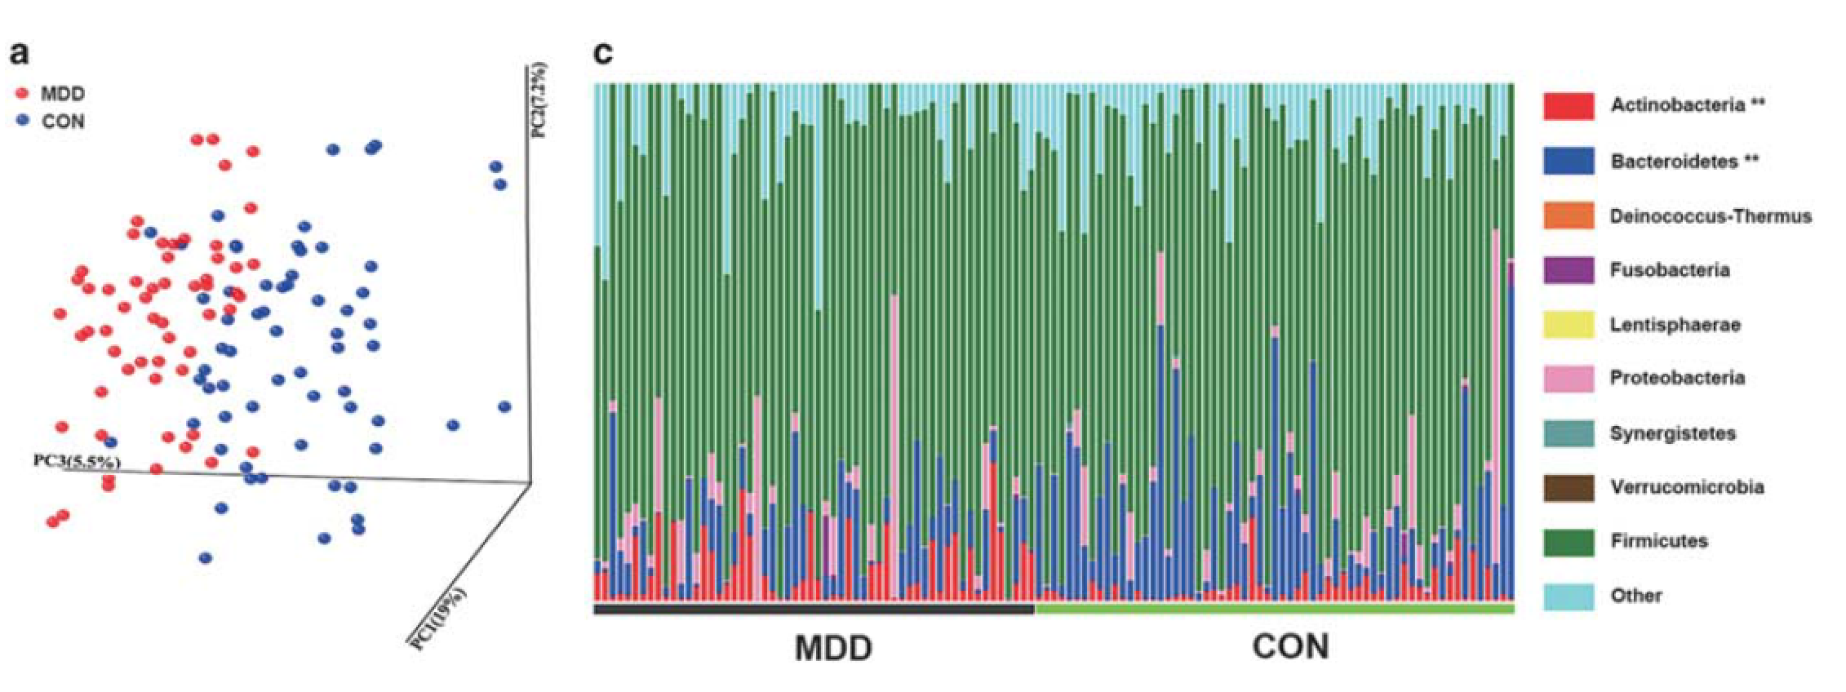
Depression
Zheng P et al, 2016

Slide 29

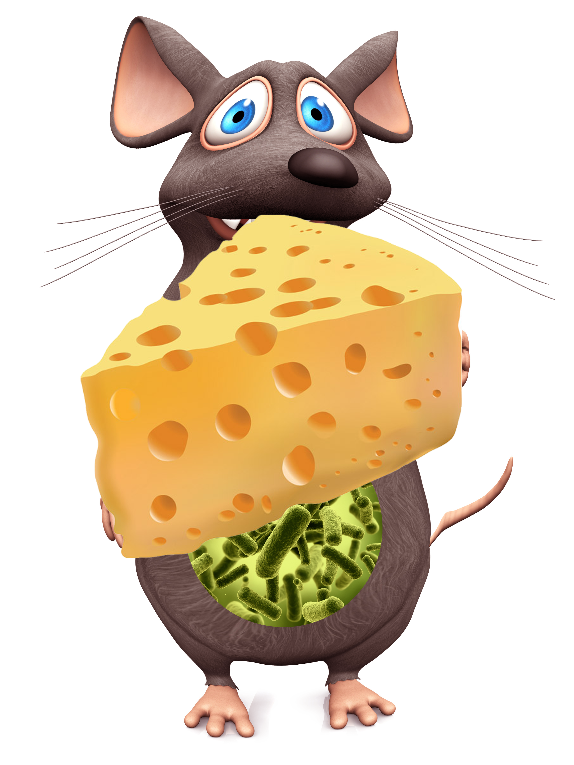

Obese
Overeating
Lean
Obese
Overeating
Obesogenic microbiota
Germ-free
Obesogenic microbiota
Notes:
Please make sure that on the two mouse ppts, the mice and the headings are in exactly the same position

Slide 30
Gut-Based Decision Making
Rational decision making:
Slow, linear, objective, weighing multiple options (+/- lists), advice from others, evaluating data
Gut-based decision making:
Rapid, intuitive, subjective, deeply personal,
The “secret author of many of the choices and judgements [we]… make.” Daniel Kahneman

Slide 31
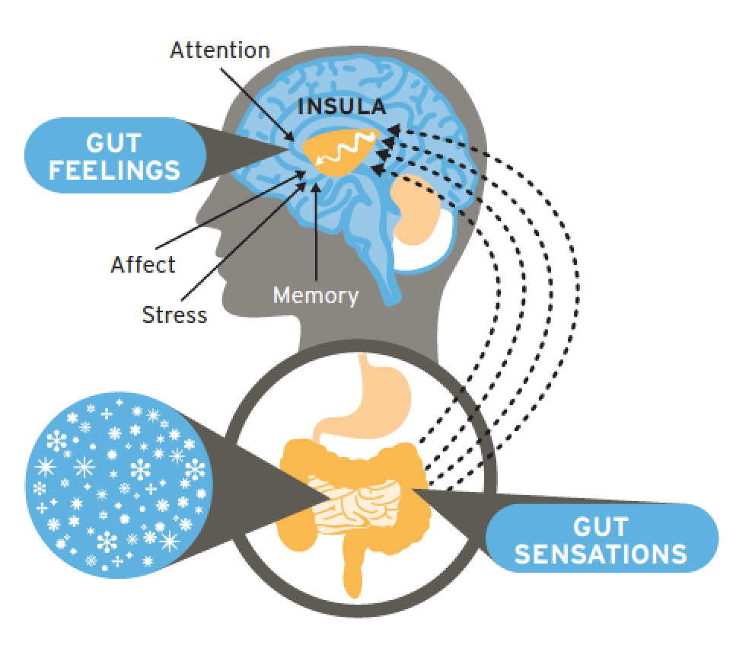
Decisions
Notes:
Gut feelings and gut based decisions

Slide 32



Antibiotic Consumption by the Numbers
>73 billion doses worldwide yearly
258 million courses (833/1000) in USA (2010):
2.7 courses by age 2; 10.9 courses by age 10
Ccourtesy from M. Blaser

Slide 33
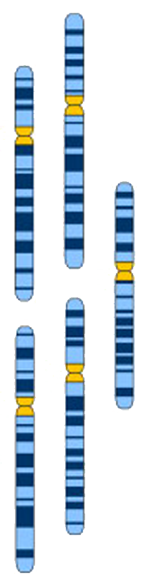
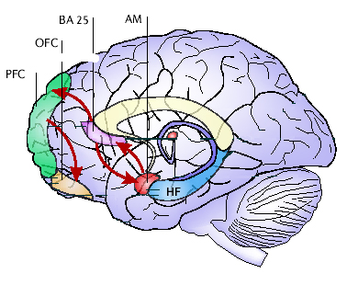


Putative Role of Gut Microbial Metabolites in Brain Development and in Activity of Brain Circuits
Multiple perinatal factors
Early Adverse Life Events
Allostatic Load
Diet
Clinical
Phenotype
Sex
Resilience
Motivation
Drive
Saliency
Brain Disorder
Stress
Race
Viruses?
Gut microbial metabolites

Slide 34
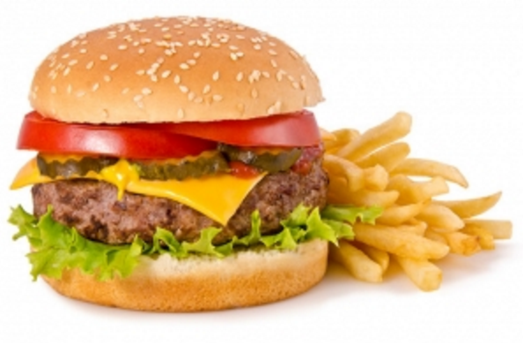
The Standard American Diet (SAD)
Salt
Sugar
Animal Fat
Processed food
Non caloric sweeteners
Emulsifiers

Slide 35
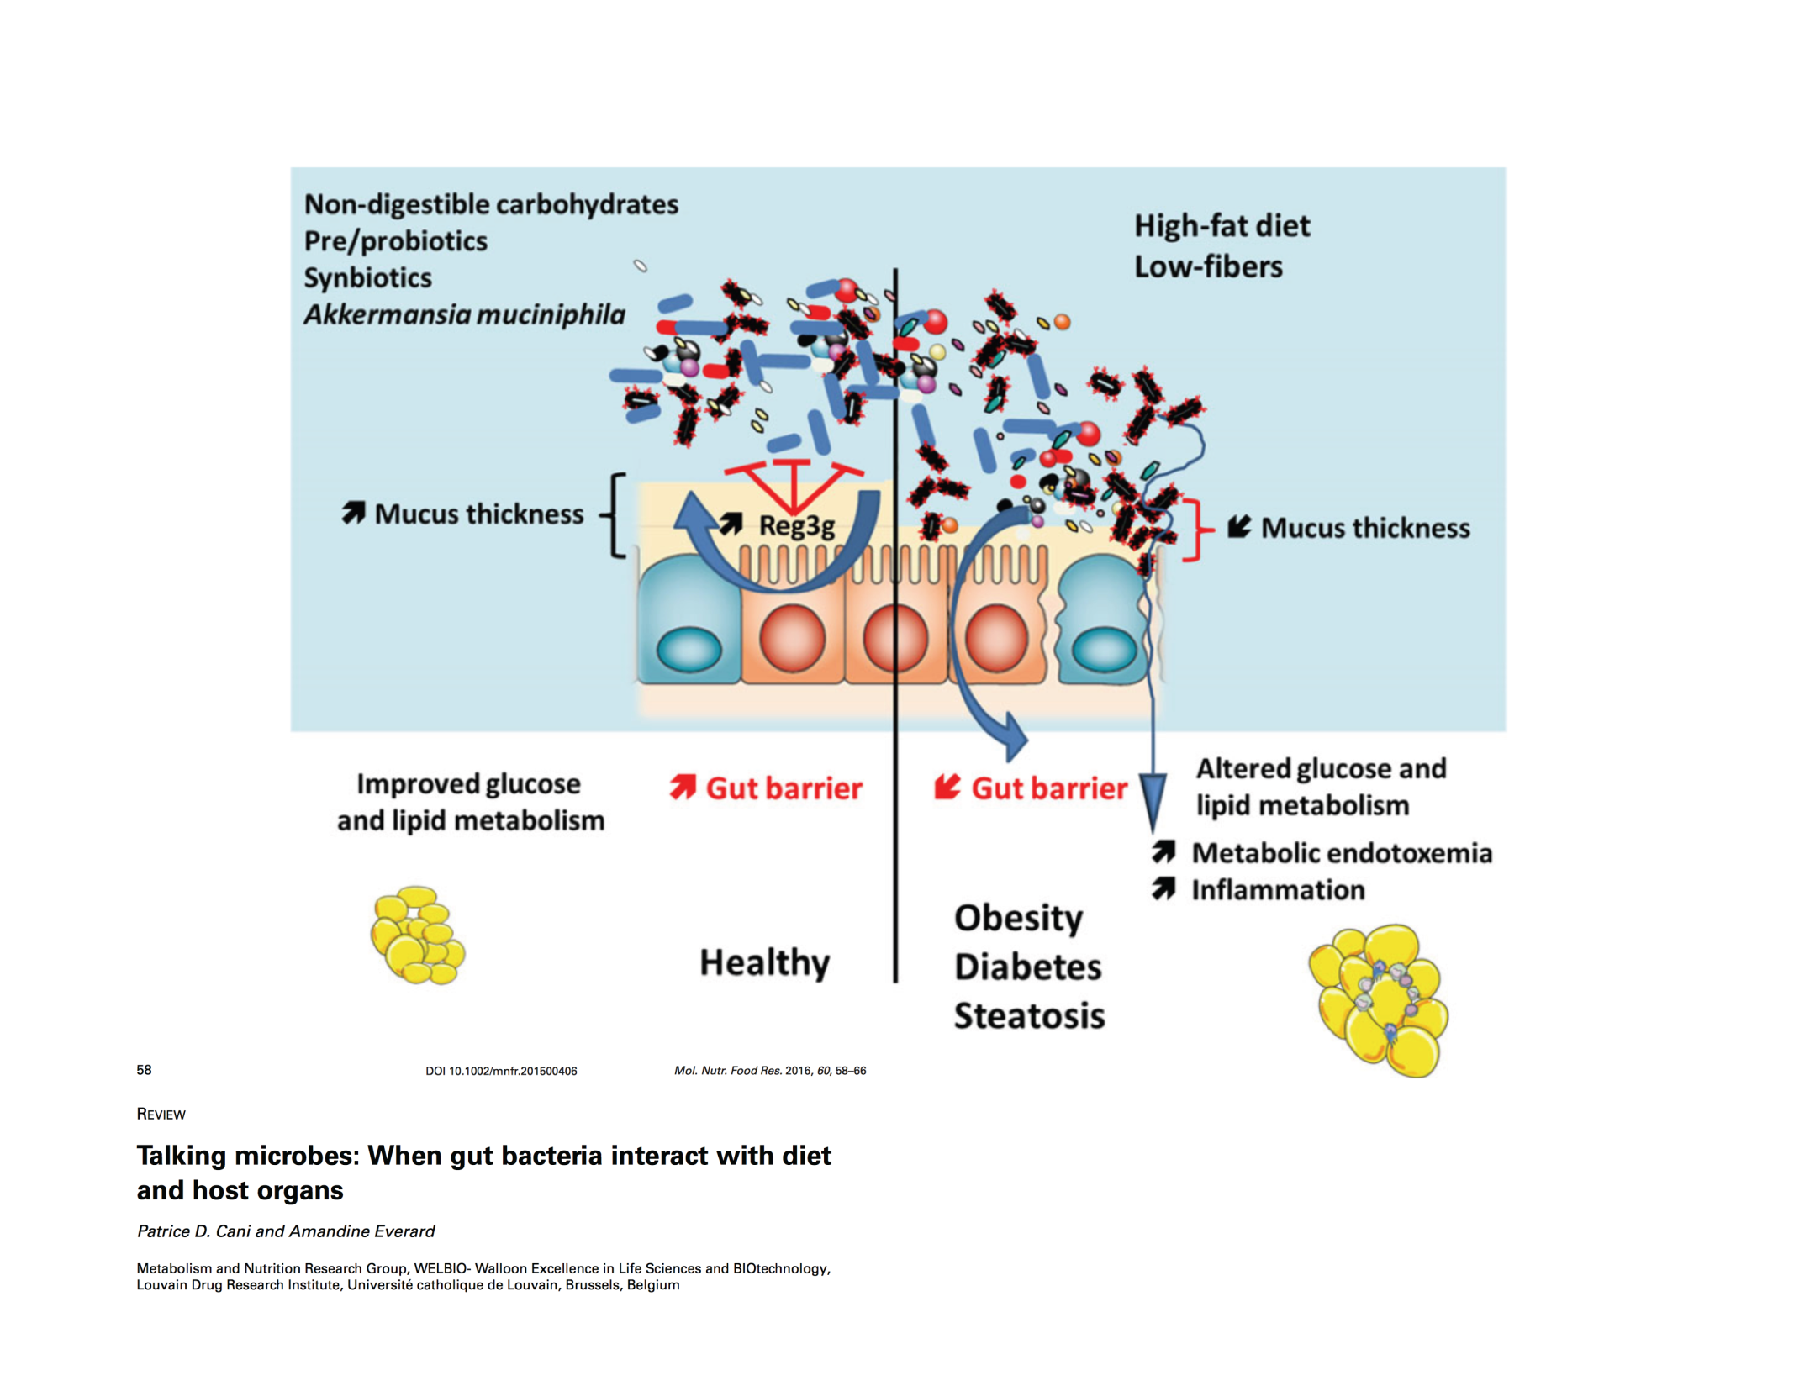
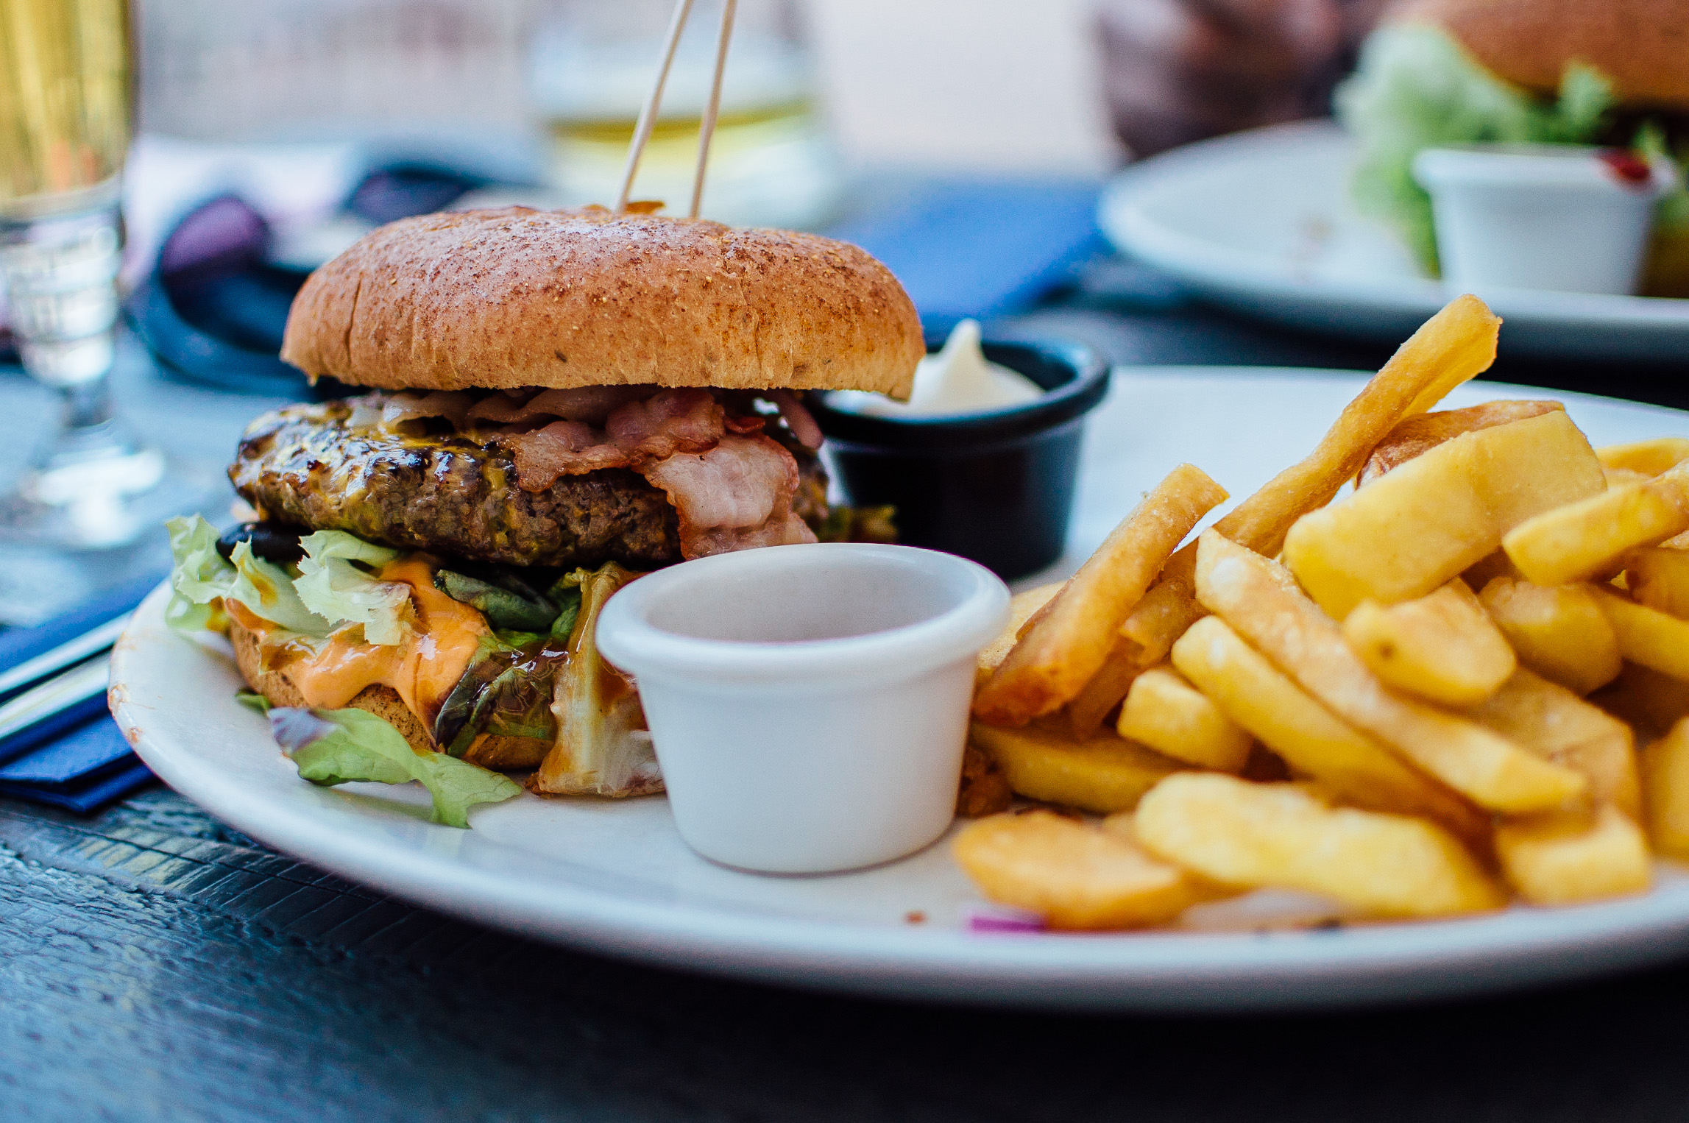
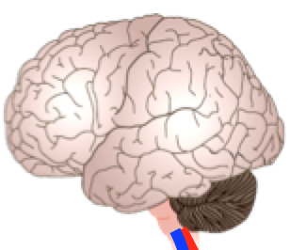
Diet induced Microbiome Perturbations Can Result in Local and Systemic Immune Activation
Depression?
Anxiety?
Food sensitivities?

Slide 36
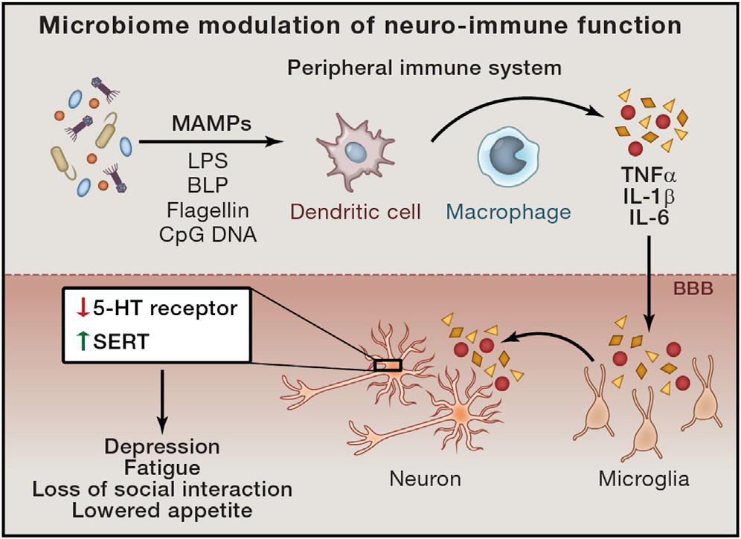
The Inflammed Brain: Microbiota-related Signaling to the Central Immune System
Depression
Obesity
Neurodegenerative diseases
Chronic pain
Chronic inflammation
Modified from Sampson & Mazmanian, 2015

Slide 37
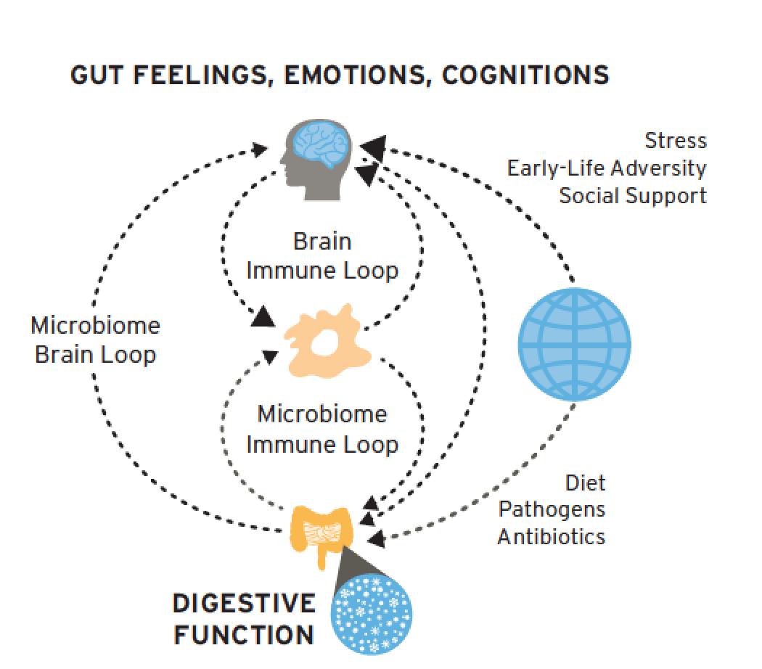

Slide 38
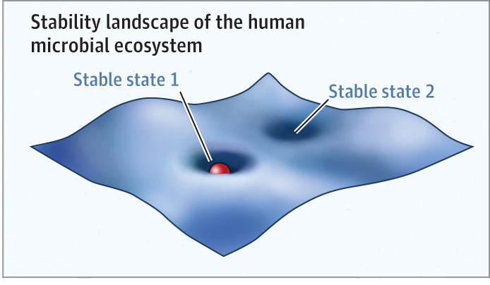
The New Ecological View of Health and Disease
Genetics
Environment
Life style
Early life experiences
Social connectedness
Diet
Mind
Modified from Relman, JAMA 2015

Slide 39
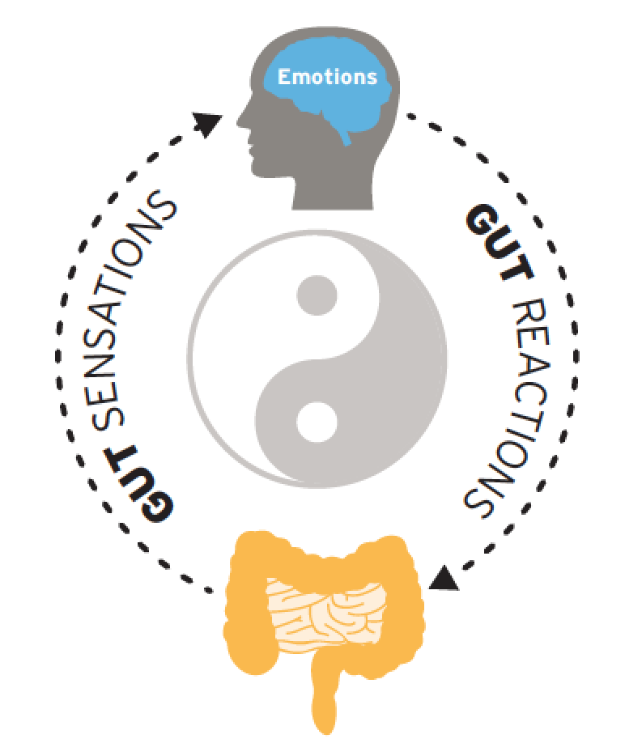

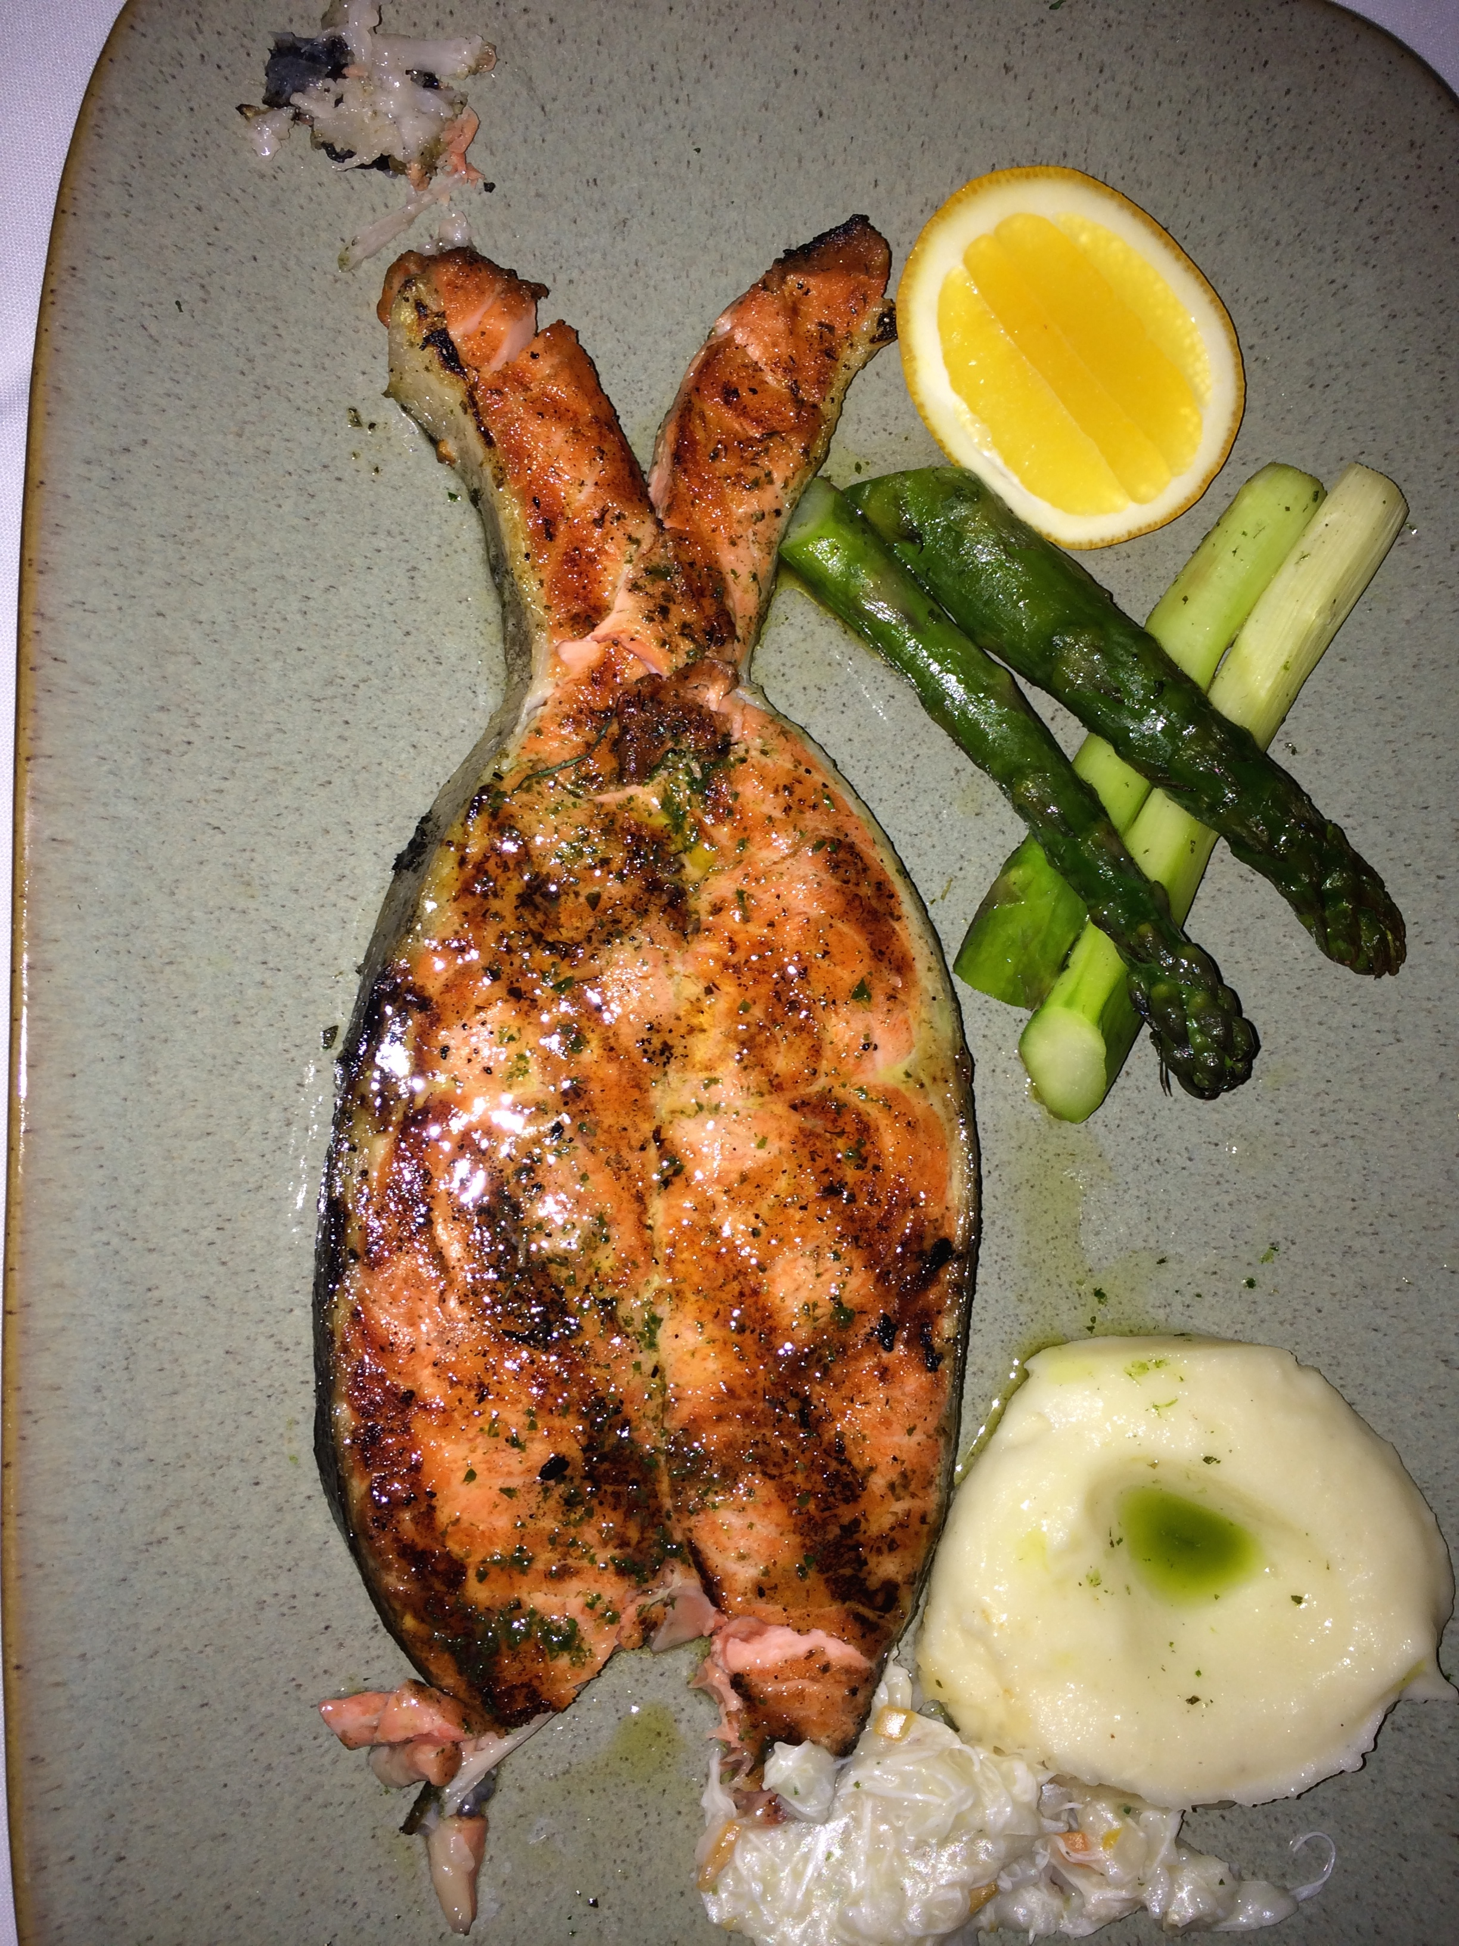
Optimal Health
“Complete physical, mental, emotional, spiritual and social well being”

Slide 40
The Mediterranean Diet Pyramid

Slide 41
Well Documented Health Benefits of the Mediterranean Diet
  Cardiovascular disease
  Cancer
  Metabolic syndrome
  Brain structure and function
  Cognitive impairment (Alzheimer’s)
  Depression
Estruch et al, NEJM 2013

Slide 42
Why is a Mediterranean Type Diet Good for Your Health?
Good for your gut microbes:
  High ratio of plant to animal based foods
  High ratio of plant based (unsaturated fats) to animal based fats
  Anti inflammatory effects on the gut, brain and body
High concentration of antioxidants and polyphenols produced by plants for their own protection (olive oil, red wine, roots, leaves) which require the gut microbiota to digest
Social interactions

Slide 43


Slide 44
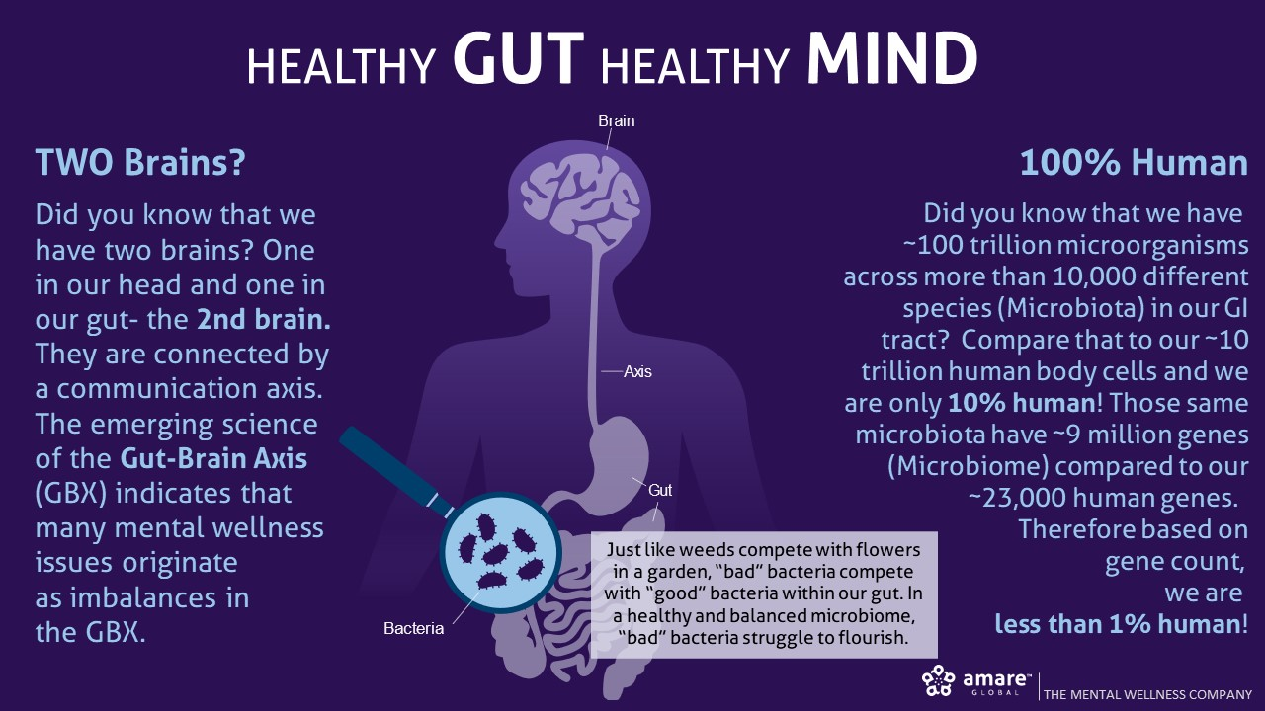

Slide 45
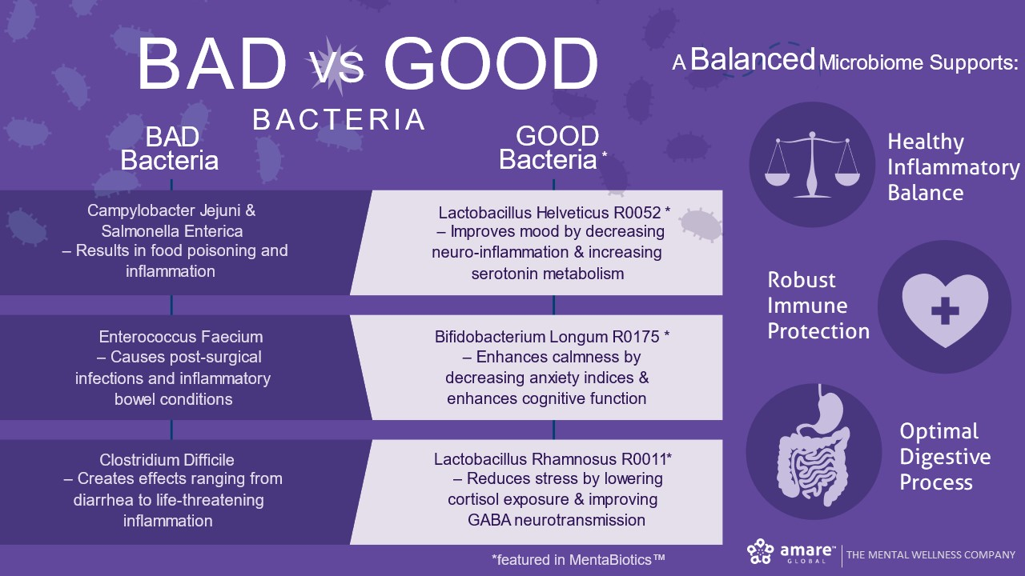

Slide 46
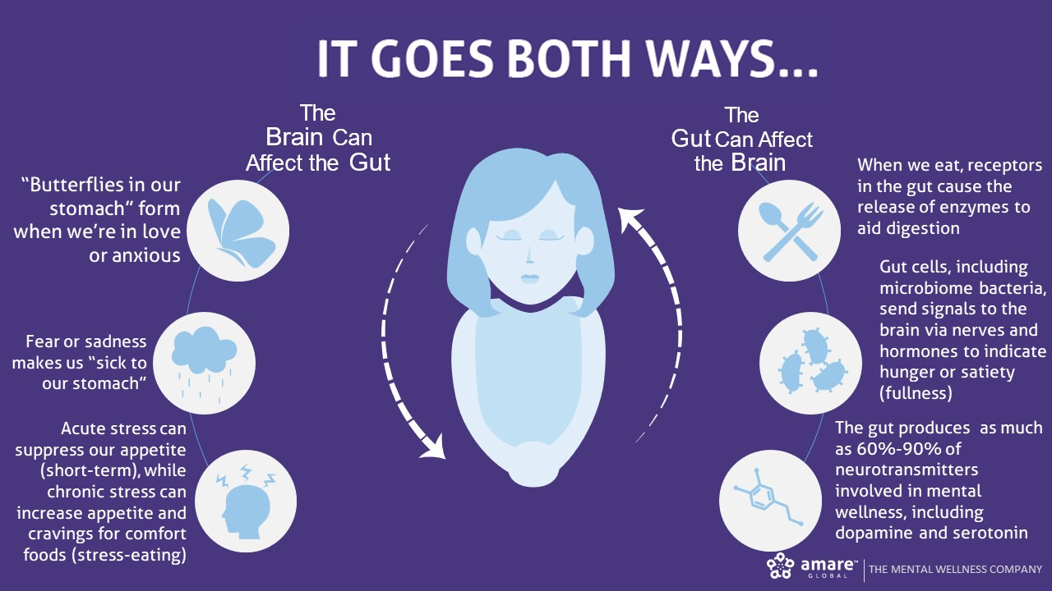

Slide 47
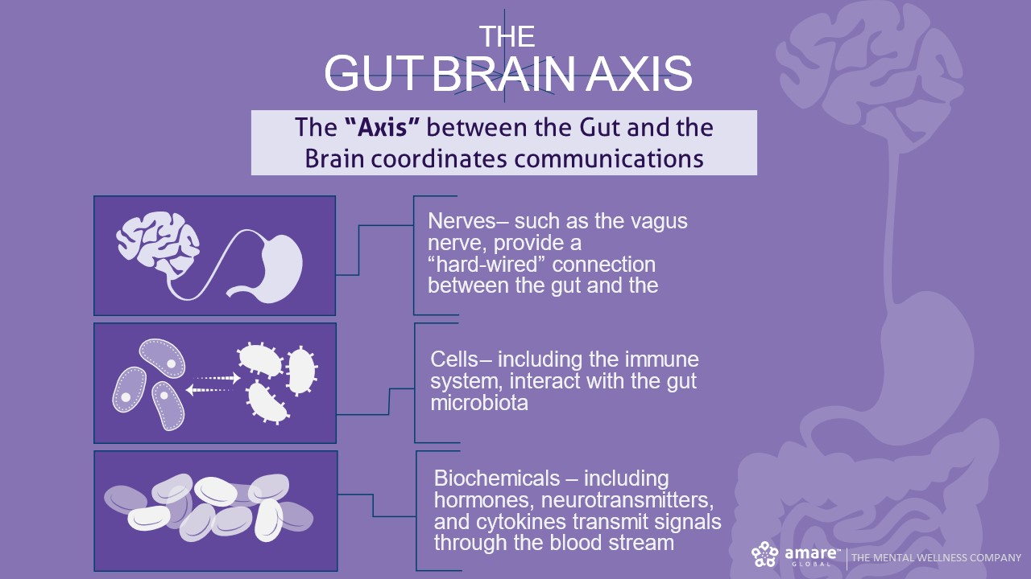

Slide 48
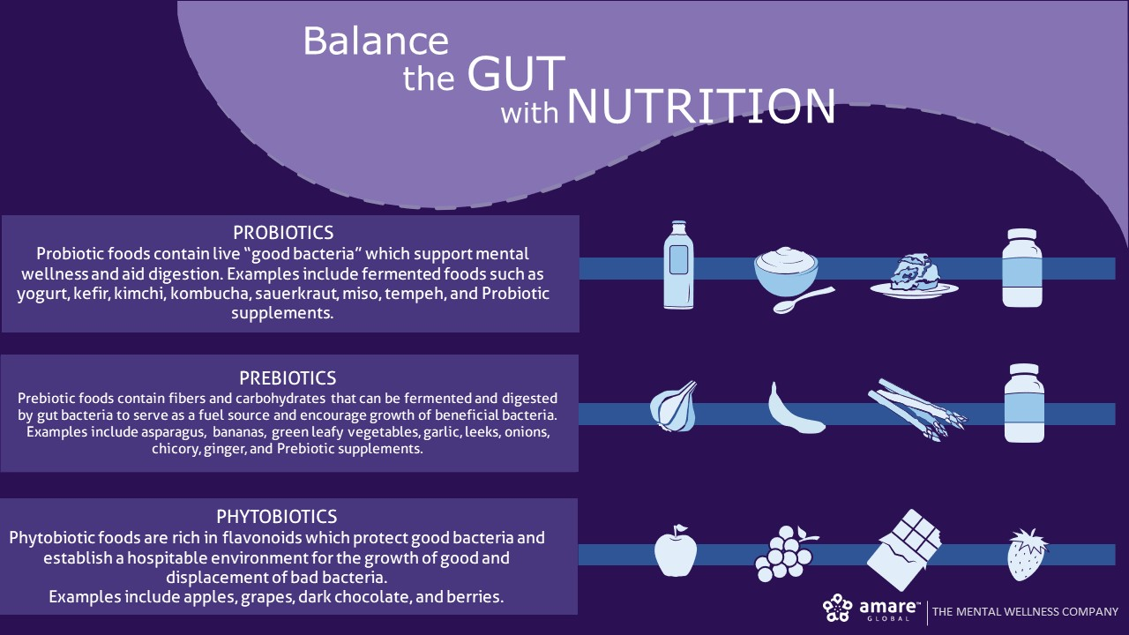

Slide 49
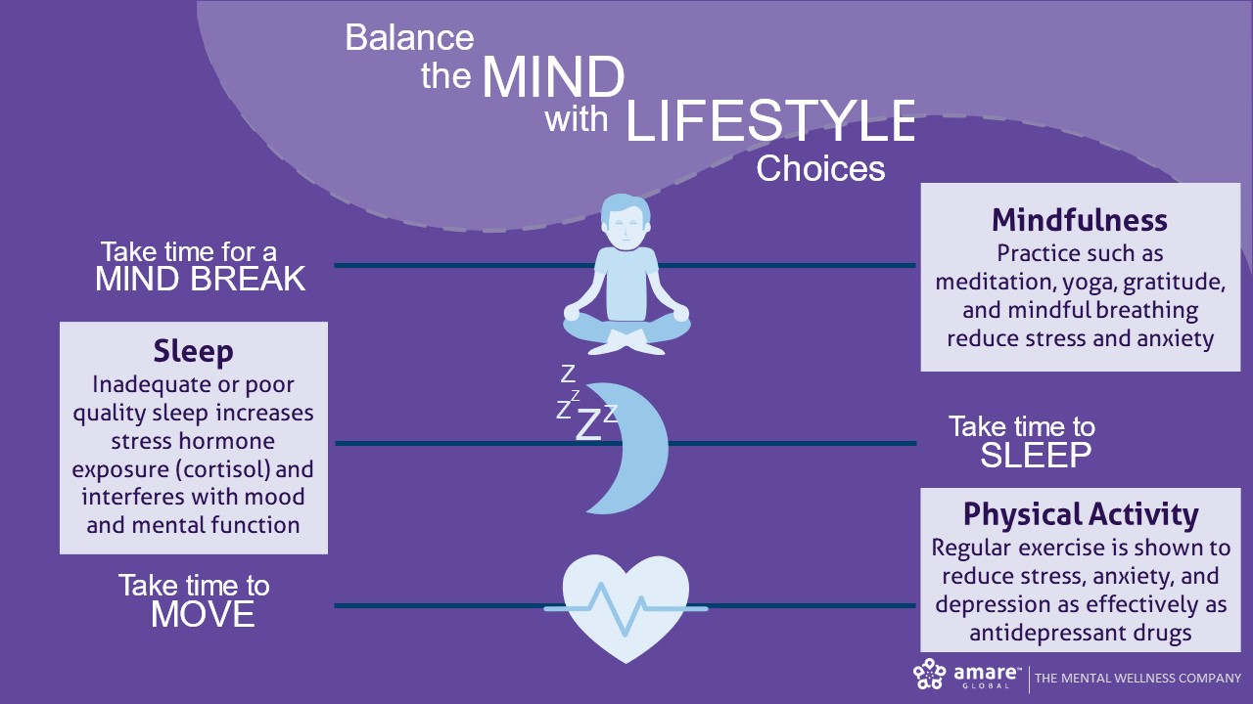

Slide 50
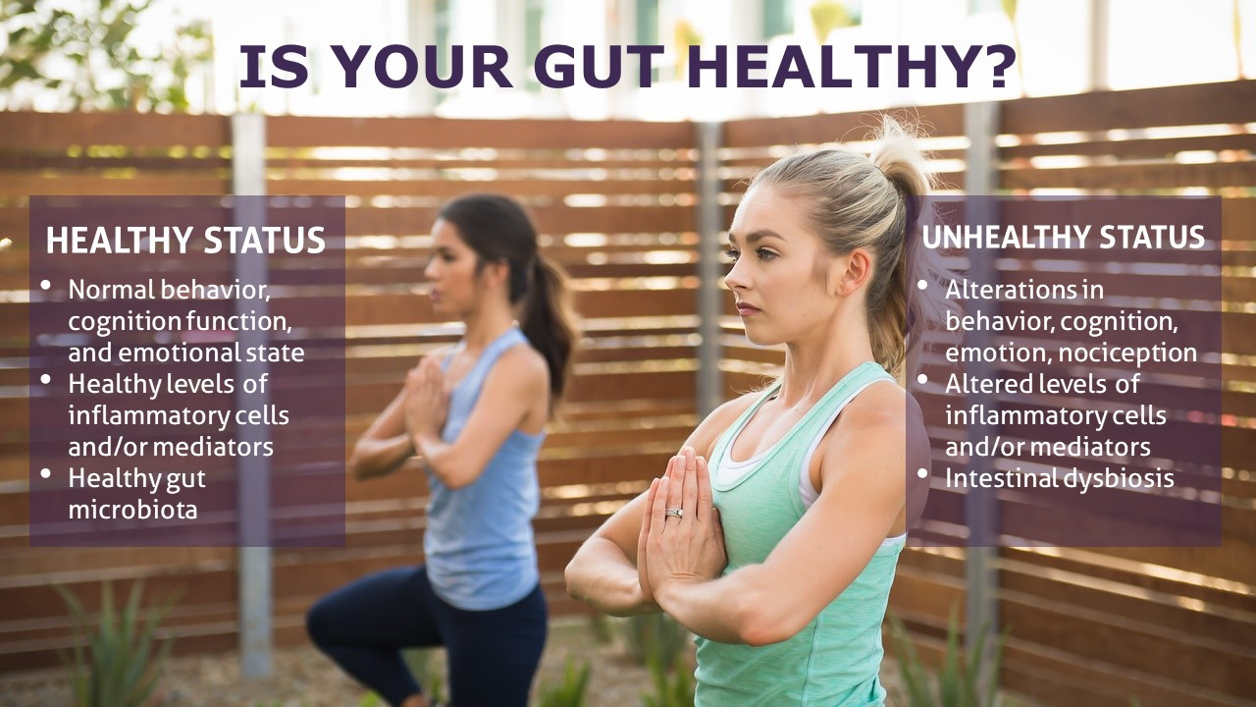

Slide 51


Slide 52


Slide 53

CLINICAL STUDY
The Amare FundaMentals Pack has been clinically proven to:

Slide 54


Slide 56


Slide 57


Slide 58


Slide 59


Slide 60
My own “Mental Wellness Diet” (MWdiet for short) is a super-charged version of the Mediterranean diet that addresses the 3 primary anti-depression factors:
Brain Nutrients (Vitamin B6, Omega-3 fats, Flavonoids, Tocotrienols)
Inflammation
Microbiome
DocTalbott’s MWdiet Shopping List
Fresh Fruits & Vegetables
Unlimited amounts – choose brighter options grown as close to home as possible
Spinach
Kale
Cabbage
Sweet potatoes
Tomatoes
Onions
Leeks
Garlic
Asparagus
Artichokes
Peas (frozen is OK)
Bananas
Berries (frozen is OK)
Pomegranates
Apples
Grapes (including red wine, in moderation)
Beans & Legumes (canned is OK)
Black beans
Kidney beans
Garbanzo (Chickpeas)
Lentils
Healthy Fats
Extra Virgin Olive Oil
Nuts – Cashews, Walnuts, Almonds, Macadamias, Pistachios
Avocados
Whole Grains
Oats/Oatmeal
Whole Grain Pasta
Quinoa
Brown Rice
Dairy, Cheese, and Fermented Foods
Greek Yogurt, Icelandic Skyr, or other yogurt (look for lower sugar and higher fat content)
Whole Organic Milk
Kefir
Kombucha (fermented tea)
Cheeses of your choice (in moderation)
Sauerkraut (and other fermented veggies such as cucumbers/pickles, beets, carrots, turnips)
Proteins
Salmon
Chicken
Eggs
Shrimp (frozen is OK)
Lean Pork
Lean Beef (in moderation)
Herbs & Spices
Turmeric
Ginger
Basil
Rosemary
Oregano
Clove
Sage
Cayenne
Parsley
Thyme
Saffron
Cumin
Coriander
Paprika
Cinnamon
Allspice
Nutmeg

