Slide 1

The Mental Wellness Company®
March 17, 2020
Amare.com
ShawnTalbott.com
YouTube.com
Notes:
Welcome! We are excited to introduce you to Amare®, The Mental Wellness Company®.

Slide 2

20+ years developing nutritional products.
Fellow of the American College of Nutrition, the American College of Sports Medicine, and the American Institute of Stress.
Author of two academic textbooks, an award-winning documentary film, and several best-selling books
Featured guest on the “Dr. Oz Show,” “Ask Dr. Nandi,” The TED stage, and the White House.
Served as a nutrition educator for elite-level athletes.
Diplomate of the International Olympic Committee’s (IOC) Sports Nutrition program.
Dr. Shawn Talbott
Amare’s Chief Science Officer
PhD, CNS, LDN, FACSM, FAIS, FACN
Notes:
Amare’s Chief Science Officer, Dr. Shawn Talbott
Scientist + Accomplished Athlete (Triathlons/Iron Man medal winner!)
20+ years developing products in the nutrition space
Fellow of the American College of Nutrition, the American College of Sports Medicine, and the American Institute of Stress.
Author of two academic textbooks, an award-winning documentary film, and several best-selling books
Featured guest on the “Dr. Oz Show,” “Ask Dr. Nandi,” The TED stage, and the White House.
Served as a nutrition educator for elite-level athletes.
Diplomate of the International Olympic Committee’s (IOC) Sports Nutrition program.

Slide 3
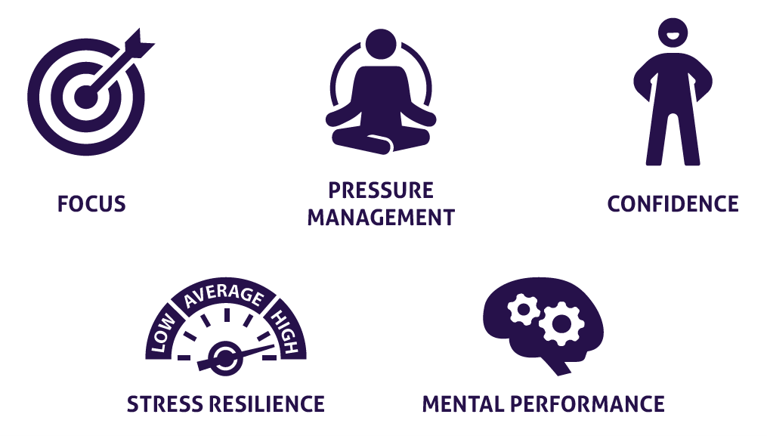


What is Mental Wellness?
Notes:
Mental WELLNESS, not mental ILLNESS!
Focus
Pressure Management
Confidence
Stress Resilience
Mental Performance
Physical Performance

Slide 4
The Mental Wellness Continuum
How you feel is not just in your head — it’s also in your gut and heart.
You can now DO something NATURALLY to improve your mental wellness.
WHERE ARE YOU ON THE MENTAL WELLNESS CONTINUUM?
1
2
3
4
5
6
7
8
9
10
DISEASE STATUS
“NORMAL”
OPTIMIZED
Depression
Anxiety
Diabetes
Obesity
Heart Disease
Autoimmune
Arthritis
Fibromyalgia
CFS
Dementia
ADD / ADHD
Alzheimer’s
Fatigue
Tension
Sad
Brain Fog
Headaches
Acne
Eczema
Congestion
URTIs
Joint Pain
Muscle Pain
Bloated
Chubby
Energetic
Calmness
Happy
Sharp
Creative
Clear Skin
Rarely Sick
Flexible
Lean
Strong
Resilient
RED
ORANGE
YELLOW
GREEN
BLUE
INDIGO
VIOLET
Notes:
Wherever you are today on the mental wellness continuum, you can ”move to the right”

Slide 5
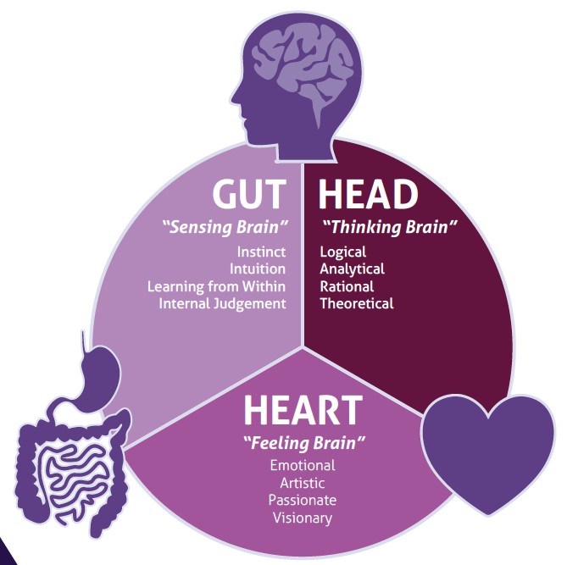
Targeting Mental Wellness Through the
BODY’S THREE BRAINS
Science now tells us that we actually have SECOND & THIRD BRAINS in our gut and heart!
Notes:
Amare targets mental wellness through the body’s THREE brains! Each of these brains contain immense amounts of neurons that can receive and send signals to other areas of the body.
Gut – “Sensing Brain” – gut feelings, instinct, intution, learning from within, internal judgment
Head – “Thinking Brain” – logical, analytical, rational, theoretical
Heart – “Feeling Brain” – Emotional, Artistic, Visionary
Gut feelings and trusting your heart are more than just turns of phrase – science now tells us that the microbes in our gut and the electrical signals from our heart are read by the brain and can dramatically influence our mood and behavior as well as our mental and physical health.

Slide 6
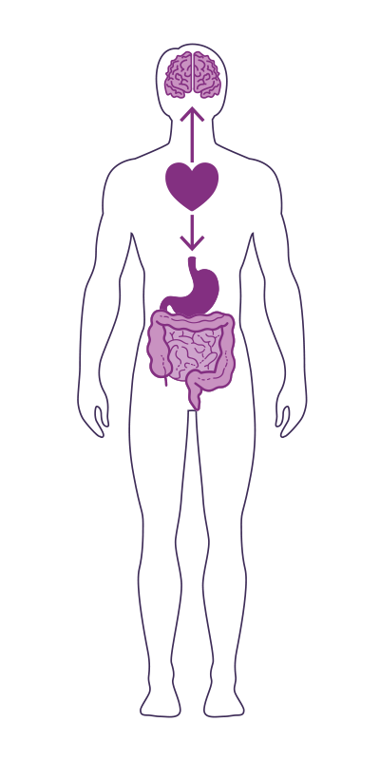
The
GUT-BRAIN-HEART AXIS
Studies have now shown that the heart is the body’s third brain, containing approximately 40,000 neurons that can sense, feel, learn, and remember.
Similar to the gut-brain axis, the heart and brain are also closely connected via the heart-brain axis.
The heart sends messages to the brain about what it needs, how the body feels and more.
Nervous system (brain)
Cardiovascular system (heart)
Immune system (axis)
Gastrointestinal system (gut)
Notes:
Our three brains communicate through a highly extensive, multi-directional network, known as the gut-brain-heart axis.
THE NETWORK CONSISTS OF:
“wires” — nerves
“chemicals” — neurotransmitters/hormones
“cells” — immune system
The Gut-Brain-Heart Axis connects our nervous system (brain), cardiovascular system (heart), immune system (axis), and gastrointestinal system (gut) with a vast array of cellular and biochemical messengers throughout the entire body, which include the microbiome, hormones, cytokines, and neurotransmitters.

Slide 7
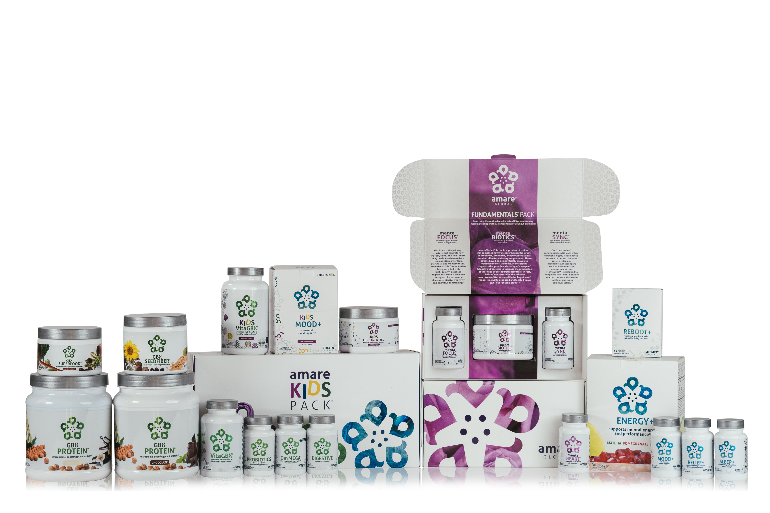

AMARE IS THE ONLY COMPANY DOING WHAT WE’RE DOING!
UNIQUE PRODUCTS
Notes:
No other company is developing a comprehensive lineup of products for mental wellness through the microbiome and gut-brain axis!
We launched with TWELVE of them in 2017! Now we have TWENTY TWO unique products!
We will continue to lead the way!

Slide 8
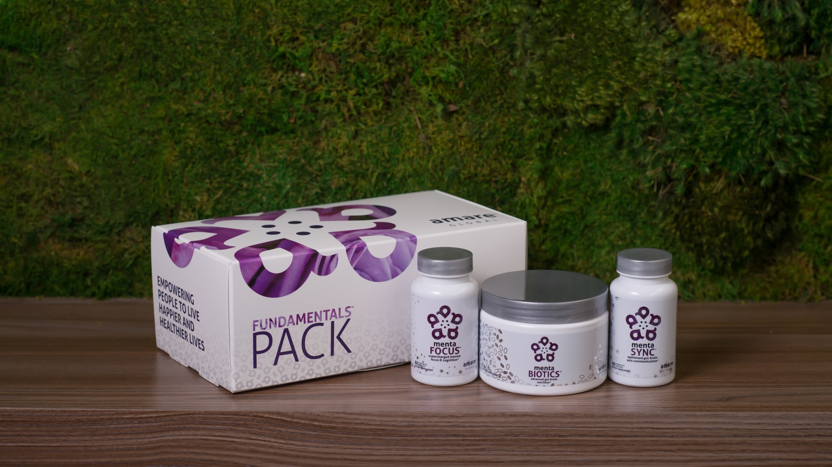

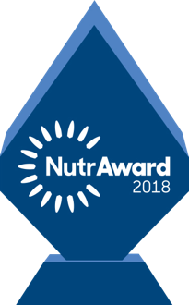
World’s First Award-Winning Gut-Brain Axis Nutrition System
Amare FundaMentals Pack
®
2018 NutrAward Winner for
“BEST NEW FINISHED PRODUCT”
Item Code:
Retail Price:
Wholesale Price:
Subscribe & Save:
P001
$234.00
$149.95 / 120 PV
$134.95 / 108 PV
*These statements have not been evaluated by the Food and Drug Administration. This product is not intended to diagnose, treat, cure, or prevent any disease.
Notes:
Our original flagship pack to uniquely address the gut-brain-axis with the world’s first comprehensive nutrition system to address each component of the gut-brain axis!
Award Winning - 2018 NutrAward winner for “Best New Finished Product” – this is like the Academy Awards of Nutritional products, selected from hundreds of companies that submitted for the award. Judged by industry experts, and presented at the country’s largest expo/convention for natural products with nearly 100,000 attendees!
Includes:
MentaBiotics (for the gut)
MentaFocus (for the brain)
MentaSync (for the axis)
Save money compared to buying the products individually! (10% savings)

Slide 9
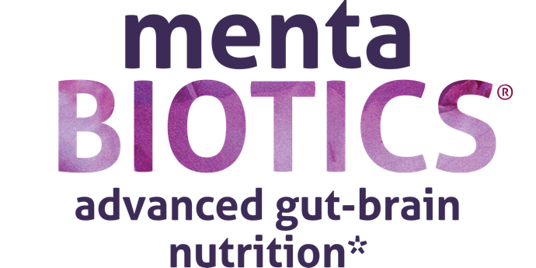

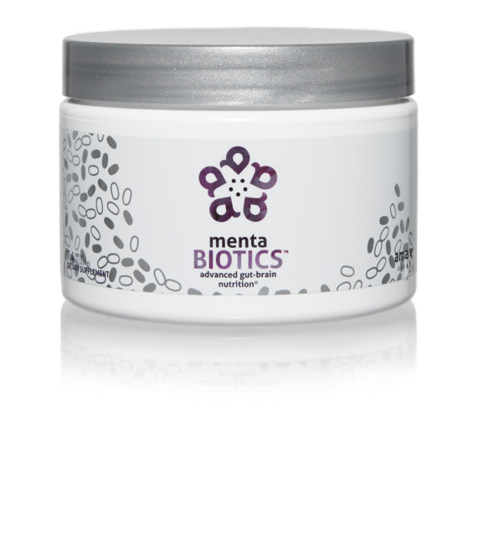
AMARE’S FLAGSHIP PRODUCT
SUPPORTS FEEL-GOOD NEUROTRANS-MITTERS
INCREASES GOOD BACTERIA
The most comprehensive combination of unique strains of probiotics, prebiotics and phytobiotics that have been scientifically shown to improve mental wellness.*
Item Code:
Retail Price:
Wholesale Price:
Subscribe & Save:
S001
$100.00
$74.95 / 65 PV
$66.95 / 58 PV
Also available in
SUGAR FREE
*These statements have not been evaluated by the Food and Drug Administration. This product is not intended to diagnose, treat, cure, or prevent any disease.
Notes:
MentaBiotics (for the gut) – advanced gut-brain nutrition.
The most comprehensive combination of unique strains of probiotics, prebiotics and phytobiotics that have been scientifically shown to improve mental wellness.*
- It’s like 4 products in one!
Amare’s flagship product
Supports feel-good neurotransmitters
Increases good bacteria, which lead to good mood, confidence, and stress resilience.

Slide 10
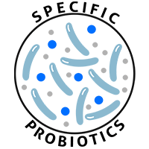
MENTABIOTICS SUGAR FREE
MW3™ Probiotic Proprietary Blend
™
Our blend contains unique and specific probiotic strains targeted to enhance overall mental wellness.*
MW3 Probiotic Strains:
Lactobacillus rhamnosus R0011 — Reduces stress by lowering cortisol exposure and improves GABA neurotransmission*
Bifidobacterium longum R0175 — Enhances calmness by decreasing anxiety indices and improves cognitive function*
Lactobacillus helveticus R0052 — Improves mood by decreasing neuro-inflammation and increasing serotonin*
*These statements have not been evaluated by the Food and Drug Administration. This product is not intended to diagnose, treat, cure, or prevent any disease.

Slide 11
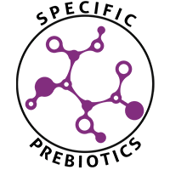
MENTABIOTICS SUGAR FREE
MW3™ Prebiotic Proprietary Blend
™
Our MW3 Prebiotic Proprietary Blend provides optimal gut support by feeding the specific mental wellness probiotic strains found in our MW3 Probiotic Proprietary Blend.*
MW3 Prebiotic Fibers:
IsoFiber™ (Iso-Malto-Oligosaccharides) — Contains a combination of naturally occurring prebiotic plant fibers that are clinically shown to improve the growth of specific probiotic strains featured in Kids FundaMentals™ and now MentaBiotics™ Sugar Free!
Bimuno® (Galacto-Oligo-Saccharides) — Resets and increases friendly gut bacteria, maintains immune health, controls inflammation in the body and supports microbiome balance. Is highly effective and a natural way of increasing preferred bacteria in the gut. Plays an important role in feeding Bifidobacteria probiotic strains.*
SunFiber® (Galactomannan Fiber) — Helps improve the growth and vitality of beneficial bacteria, including Bifidobacteria and Lactobacillus.*
*These statements have not been evaluated by the Food and Drug Administration. This product is not intended to diagnose, treat, cure, or prevent any disease.

Slide 12
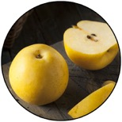
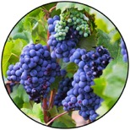
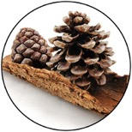
GBX+ Proprietary Blend…
Patent Pending and Exclusive to Amare
Applephenon: Asian Apple Fruit extract
Supports gut health, immune function, & inflammatory balance*
Enovita: French Grape Seed extract
Enhances blood flow, cardiovascular tone, & cellular defenses*
Enzogenol: New Zealand Pine Bark extract
Improves neurotransmitter balance, mental focus, & psychological vigor*
*These statements have not been evaluated by the Food and Drug Administration. This product is not intended to diagnose, treat, cure, or prevent any disease.
Notes:
Shawn: Slide: For Your Gut...: The Probiotic Strain Matters pg.26 -- Part of the reason why this product is so effective, is because we've looked at the research to guide our formulation. One of the very important ways that weve done that is the probiotic strains that we have chosen have already been specifically evaluated for their effects on different mental wellness parameters. This is very important distinction as you go out to talk to people about these products, that probiotics are hot right now, its one of the very important health trends that’s going on. But, the benefits of a probiotic are very very strain dependent. If I just said to you, "Everyone go out and buy some probiotics", and you went to the grocery store to look for probiotics, that would be like me saying, "Go out and get some vitamins." You wouldn’t know what vitamin I was talking about. Did he mean vitamin D or A? Or did he mean Vitamin C or B? All these vitamins do all different things inside the body, its exactly the same with these probiotic strains. So you can see the benefits here, Lactobacillus rhamnosus R0011, that tells us that specific strain does this, it lowers cortisol exposure which is a stress hormone. It increases a neurotransmitter called GABA which is associated with relaxing. Bifidobacterium longum R0175 reduces anxiety and improves cognitive function. Lactobacillus helveticus R0052 decreases neuroinflammation and increases serotonin, so its going to help you with your mood. You know, those benefits are specific to those strains, not to probiotics in general. In our separate probiotic formula, we have different strains that are more associated with more general wellness benefits, diarrhea, constipation, gastro intestinal function, immune system function, inflammation in a different way than your getting here with neural inflammation. In the future, we'll be selecting probiotic strains that are good for the heart-brain axis that is going to compound some of the benefits that we are seeing with this gut-brain axis. It’s a very very exciting area of science, but it’s also very strain-dependent.
There are over 10,000 different species of bacteria in our gut, but there are millions of strains comprising billions of bacteria overall.
Amare’s strains of bacteria are unique and have specific functions around mental wellness.

Slide 13
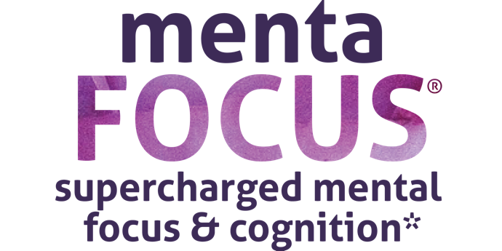
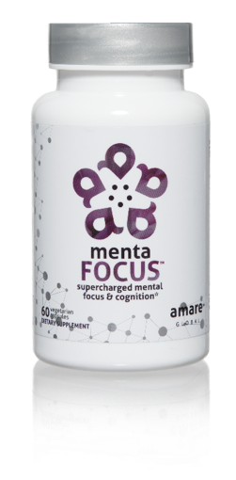
AMPLIFIES ATTENTION & ALERTNESS
ENHANCES BRAIN ACTIVATION
PROMOTES CLARITY COGNITION CREATIVITY
Supercharge your brain with key phytonutrients clinically shown to support focus, mental sharpness, clarity, creativity, and cognitive functioning.*
Item Code:
Retail Price:
Wholesale Price:
Subscribe & Save:
S002
$60.00
$44.95 / 39 PV
$39.95 / 35 PV
*These statements have not been evaluated by the Food and Drug Administration. This product is not intended to diagnose, treat, cure, or prevent any disease.
Notes:
MentaFocus (for the brain) – supercharged mental focus & cognition
Supercharge your brain with key phytonutrients clinically shown to support focus, mental sharpness, clarity, creativity, and cognitive functioning.*
Amplified attention & alertness
Enhances brain activation
Promotes clarity, cognition, and creativity

Slide 14
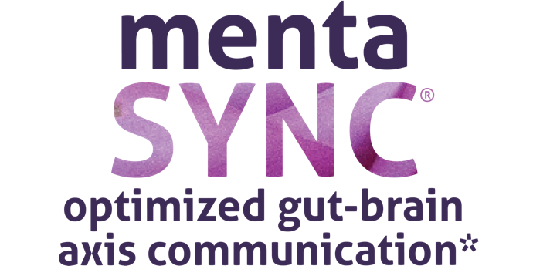
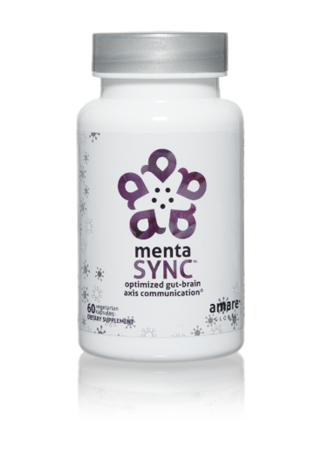
IMPROVES
GUT-BRAIN COMMUNICATION
BALANCES SIGNALING BETWEEN CELLS
ENHANCES
BIO-CHEMICAL COMMUNICATION
Optimize the communication sync of chemical messengers between your brain and your gut with the clinically studied key ingredients in MentaSync.*
Item Code:
Retail Price:
Wholesale Price:
Subscribe & Save:
S003
$74.00
$54.95 / 47 PV
$48.95 / 42 PV
*These statements have not been evaluated by the Food and Drug Administration. This product is not intended to diagnose, treat, cure, or prevent any disease.
Notes:
MentaSync (for the axis) – optimized gut-brain axis communication
Optimize the communication sync of chemical messengers between your brain and your gut with the clinically studied key ingredients in MentaSync.*
Improves gut-brain communication
Balances signaling between cells
Enhances bio-chemical communication
Supports the immune system, a primary pathway in the gut-brain axis.

Slide 15
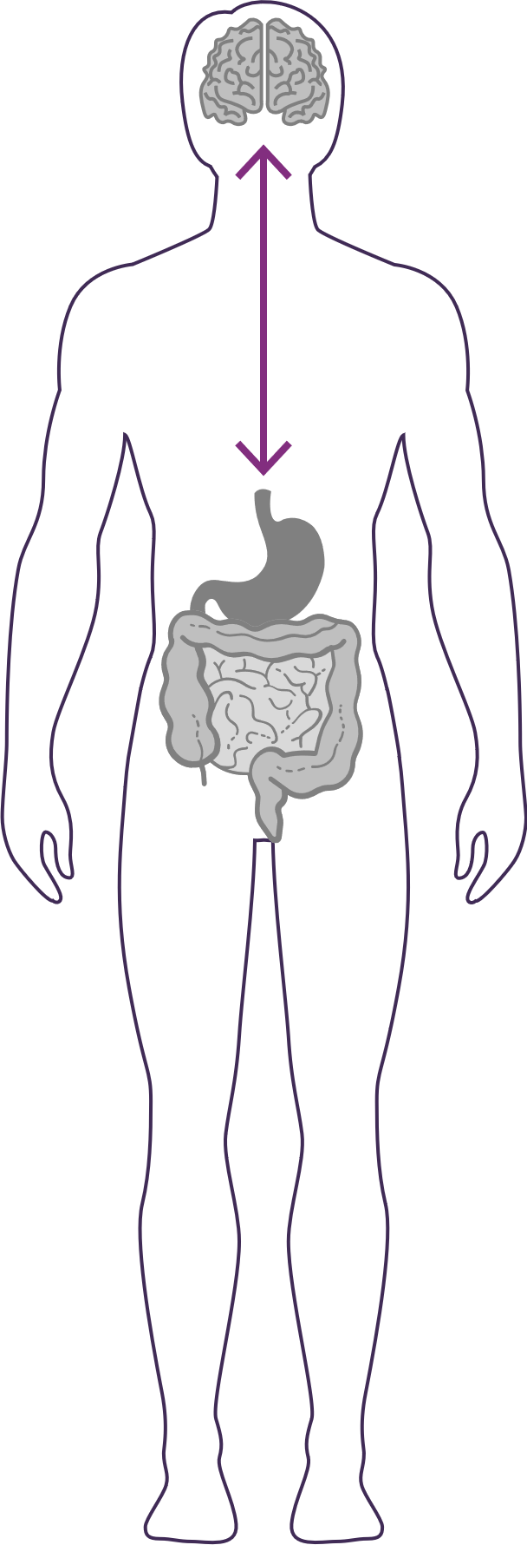

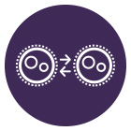
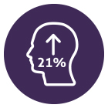
GUT – BRAIN - AXIS
The gut and brain are connected by a link known as the “axis,” which is an important component of the gut-brain axis system. It is the primary connection between our two brains and is greatly responsible for our overall well-being.
Balances normal signaling between cells of the gut, brain and immune system.*‡
Enhances GBX (gut-brain axis) signaling and gut barrier function via alpha-glucans, beta-glucans, SCFAs (butyrate) and zinc-carnosine*‡
Increases psychological vigor by 21%*‡
*These statements have not been evaluated by the Food and Drug Administration. This product is not intended to diagnose, treat, cure, or prevent any disease.
‡BASED ON KEY INGREDIENTS CLINICAL STUDIES

Slide 16
Immune System
“7th Sense”
Brain-Immune Connection

Slide 17

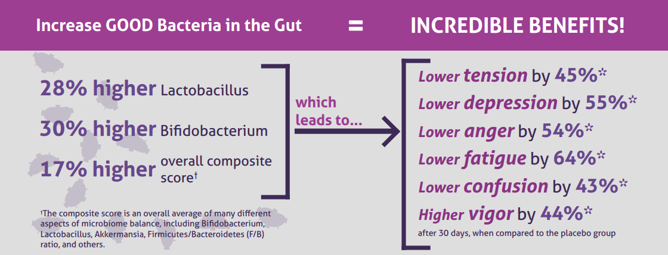
CLINICAL STUDY
The Amare FundaMentals Pack has been clinically proven to:

Slide 18
Why is FundaMentals Different?
World’s 1st comprehensive/holistic GBX system
  Addresses each level of GBX balance
  Microbiome modulation
  Gut integrity
  Immune priming
  Inflammatory balance
  Neurotransmitter signaling
Specific probiotic strains for depression/anxiety/stress
Specific prebiotics fibers for stress/resilience
Patent-pending phytonutrients for GBX support
Scientifically-supported formula
  More than a dozen peer-reviewed scientific presentations and publications*
  *Effect of Coordinated Probiotic/Prebiotic/Phytobiotic Supplementation on Microbiome Balance and Psychological Mood State in Healthy Stressed Adults
  Functional Foods in Health & Disease Journal
  FFHD: Online ISSN:2160-3855
  Vol 9, No 4 (2019)
  https://www.ffhdj.com/index.php/ffhd/article/view/599/

Slide 19
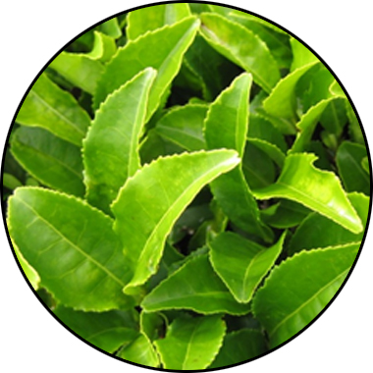
MENTABIOTICS
KEY INGREDIENTS
®
Suntheanine
Increases alpha waves
“Relaxed alertness”
*These statements have not been evaluated by the Food and Drug Administration. This product is not intended to diagnose, treat, cure, or prevent any disease.

Slide 20
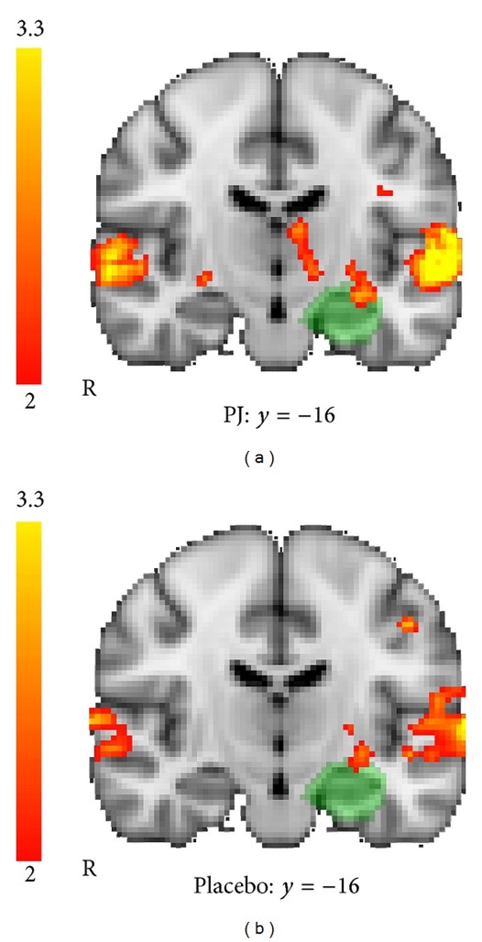
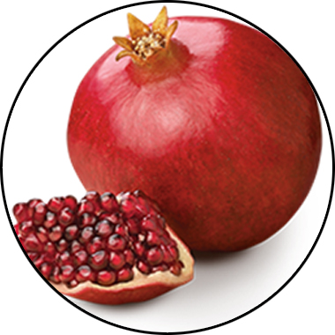
MENTAFOCUS
KEY INGREDIENTS
®
POMx
Enhances brain activation
*These statements have not been evaluated by the Food and Drug Administration. This product is not intended to diagnose, treat, cure, or prevent any disease.

Slide 21
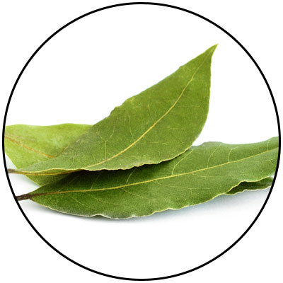
ENERGY+
KEY INGREDIENTS
Guayusa
Amazonian awareness enhancer
*These statements have not been evaluated by the Food and Drug Administration. This product is not intended to diagnose, treat, cure, or prevent any disease.
Notes:
Amazonian Hunters call guayusa the “Night Watchman” because it sharpens their awareness and gives them energy when heading into the jungle at night to hunt. Guayusa's effect is usually experienced as a bright and focused energy thanks to healthy synergistic compounds that help balance the naturally occurring caffeine.

Slide 22
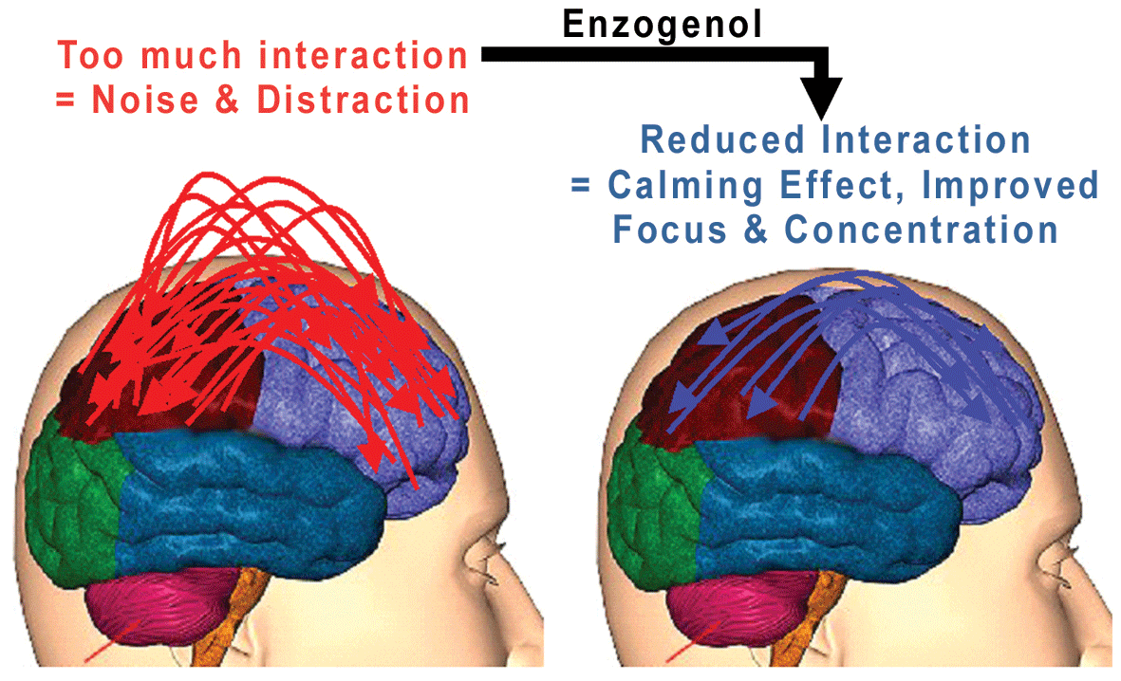
ENERGY+
KEY INGREDIENTS
Enzogenol®
Calms “monkey mind”
*These statements have not been evaluated by the Food and Drug Administration. This product is not intended to diagnose, treat, cure, or prevent any disease.

Slide 23
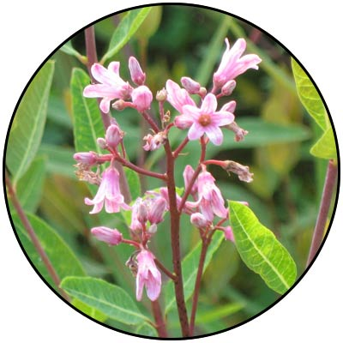
MOOD+
KEY INGREDIENTS
Venetron® (Rafuma)
Depression
*These statements have not been evaluated by the Food and Drug Administration. This product is not intended to diagnose, treat, cure, or prevent any disease.

Slide 24
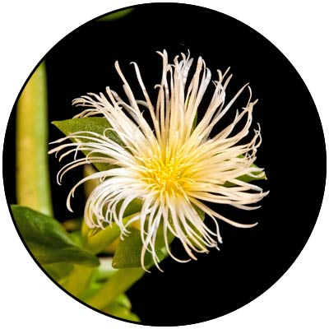
MOOD+
KEY INGREDIENTS
Zembrin® (Kanna)
Depression
*These statements have not been evaluated by the Food and Drug Administration. This product is not intended to diagnose, treat, cure, or prevent any disease.

Slide 25
fMRI Study Results Show Reduced Stress Response
MOOD+
KEY INGREDIENTS
Zembrin® can help in the
management of stress in
everyday life
A single dose of Zembrin® attenuates
reactivity within the part of the brain
(amygdala) that responds to threat/stress
*These statements have not been evaluated by the Food and Drug Administration. This product is not intended to diagnose, treat, cure, or prevent any disease.
Notes:
Terburg et al. Acute Effects of Sceletium tortuosum (Zembrin), a Dual
5-HT Reuptake and PDE4 Inhibitor, in the Human Amygdala and its Connection to the Hypothalamus. Neuropsychopharmacology (2013), 1–9.

Slide 26
Cognitive Set Flexibility
MOOD+
KEY INGREDIENTS
Cognitive Flexibility
Ability to shift attention between two or more tasks and the ability to adapt to rapidly changing directions and intelligently utilize the information.
Necessary for decision-making, impulse control and strategy formation.
CNS VitalSign® has been used for testing neurocognitive function by over 5,000 clinicians in 52 countries.
*These statements have not been evaluated by the Food and Drug Administration. This product is not intended to diagnose, treat, cure, or prevent any disease.
Notes:
Chiu et al. Proof-of-Concept Randomized Controlled Study of Cognition Effects of the Proprietary Extract Sceletium tortuosum (Zembrin) Targeting Phosphodiesterase-4 in Cognitively Healthy Subjects: Implications for Alzheimer’s Dementia. Evidence-Based Complementary and Alternative Medicine Volume 2014, Article ID 682014

Slide 27
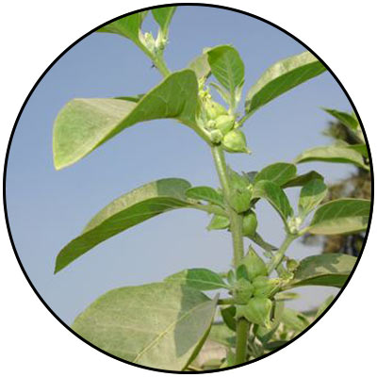
MOOD+
KEY INGREDIENTS
Sensoril® (Ashwagandha)
Anxiety
*These statements have not been evaluated by the Food and Drug Administration. This product is not intended to diagnose, treat, cure, or prevent any disease.
Notes:
Auddy et al. A Standardized Withania Somnifera Extract Significantly Reduces Stress-Related Parameters in Chronically Stressed Humans: A Double-Blind, Randomized, Placebo-Controlled Study. Journal of the American Nutraceutical Association Vol.11,No.1, 2008 pp50-56.

Slide 28
MOOD+
KEY INGREDIENTS
Sensoril® (Ashwagandha)
Anxiety
*These statements have not been evaluated by the Food and Drug Administration. This product is not intended to diagnose, treat, cure, or prevent any disease.
Notes:
Auddy et al. A Standardized Withania Somnifera Extract Significantly Reduces Stress-Related Parameters in Chronically Stressed Humans: A Double-Blind, Randomized, Placebo-Controlled Study. Journal of the American Nutraceutical Association Vol.11,No.1, 2008 pp50-56.

Slide 29
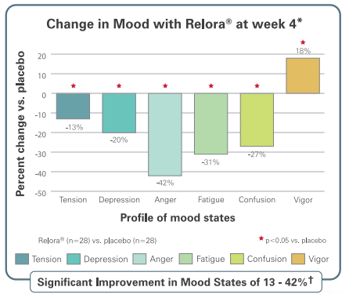
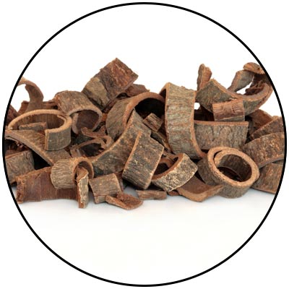
MOOD+
KEY INGREDIENTS
Relora®
(Magnolia & Phellodendron)
Anxiety
*These statements have not been evaluated by the Food and Drug Administration. This product is not intended to diagnose, treat, cure, or prevent any disease.
Notes:
Talbott et al. Effect of Magnolia officinalis and Phellodendron amurense (Relora®) on cortisol and psychological mood state in moderately stressed subjects. Journal of the International Society of Sports Nutrition 2013, 10:37
Garrison et al. Effect of a proprietary Magnolia and Phellodendron extract on weight management: a pilot, double-blind, placebo-controlled clinical trial. Altern Ther Health Med. 2006;12(1):50-54.
Kalman et al. Effect of a proprietary Magnolia and Phellodendron extract on stress levels in healthy women: a pilot, double-blind, placebo-controlled clinical trial. Nutrition Journal 2008, 7:11

Slide 30
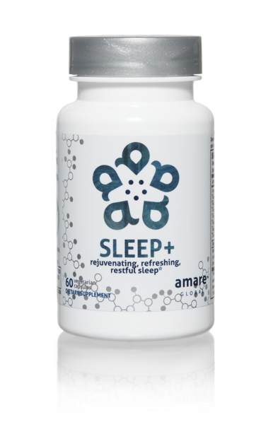
Why is Sleep+ Different?
Worldwide exclusive on patented corn-grass extract
  Research-supported MaizinolTM (30x potency corn grass)
  Improves Serotonin signaling (depression/anxiety)
  Improves Melatonin signaling (sleep quality)
    40% more time in Deep Sleep (body recovery)
    40% more time in REM Sleep (brain rejuvenation)

Slide 31





microbiome-boosting fruits and vegetables*
Increases heat shock protein expression*
Enhances internal cellular cleanup (autophagy)*
Stress resilience benefits that you can FEEL at the cellular level*
*These statements have not been evaluated by the Food and Drug Administration. This product is not intended to diagnose, treat, cure, or prevent any disease.

Slide 32

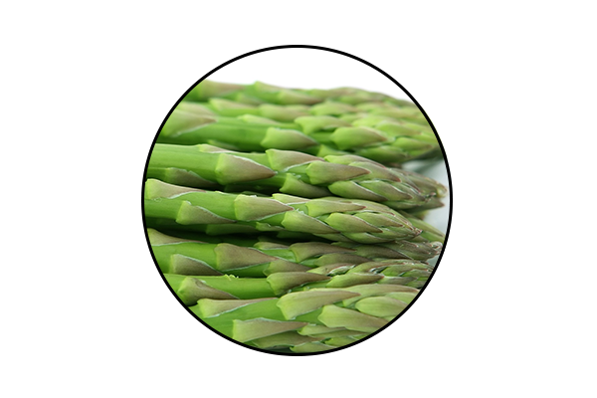
GBX SUPERFOOD
KEY INGREDIENTS:
™
Anti-Stress Phytobiotic Proprietary Blend
ETAS™: Enzyme-Treated Japanese Asparagus
Supports mood and cognitive function*
Protects neuronal cells*
Induces the production of natural anti-stress molecules called Heat Shock Proteins*
*These statements have not been evaluated by the Food and Drug Administration. This product is not intended to diagnose, treat, cure, or prevent any disease.
Notes:
ETAS™: Enzyme-Treated Japanese Asparagus
Uniquely sourced from Japan
Has been used for > 5,000 years
Derived from the lower stalk portion of asparagus stalks, where the most phytonutrients are found.
Rich in hydroxymethylfurfural derivatives, which is a necessary compound that induces HSP70 microRNA expression.
ETAS™: Mechanism of Action
What is HSP70? Heat Shock Proteins
ETAS works by increasing the production of HSP70: an intracellular protein produced naturally by the body when it encounters a stressor, such as extreme heat.
Clinical Studies have shown ETAS induces a significant production of HSP70 microRNA expression activities that helps with biological activities such as cellular protection, cellular repair, reduced cell death, blood flow, cellular stress, anti inflammatory activity, sleep, mood, energy, and antioxidant activity.
ETAS™: Mechanism of Action
Why is HSP70 production important?
As we age, the Heat Shock Protein production to stressors decrease with age.
ETAS helps preserve and maintain the appropriate HSP70 expression to promote brain health, stress response and cognitive performance as we age!
HSP70 has a number of beneficial, physiological effects in the body, including reduced cell death, anti-inflammatory activity and antioxidant activity.
There is no reason why you shouldn’t feel 25, when you’re 50!

Slide 33

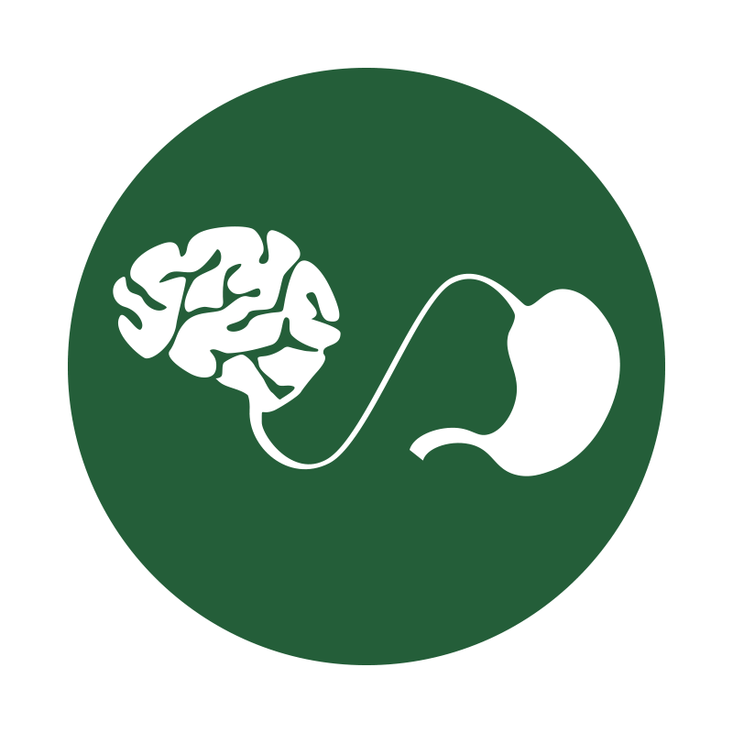

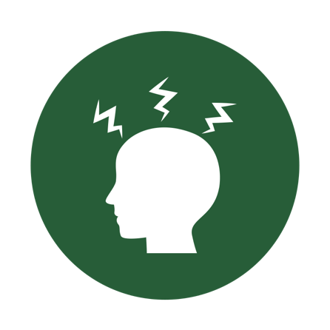
microbiome-boosting seed powder*
Optimizes gut-brain axis communication*
Naturally supports microRNA signaling*
Helps manage feelings of tension and anxiety*
*These statements have not been evaluated by the Food and Drug Administration. This product is not intended to diagnose, treat, cure, or prevent any disease.

Slide 34
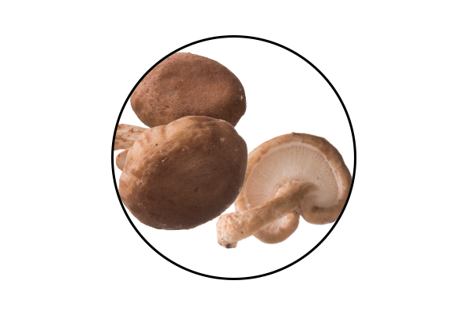
GBX SEEDFIBER
KEY INGREDIENTS:
™
AHCC®: Active Hexose Correlated Compound
Cultured mushroom mycelia extract
Effective for immune support*
Rich in alpha-glucans*
Supports microRNA signaling between the microbiome and the central nervous system*
*These statements have not been evaluated by the Food and Drug Administration. This product is not intended to diagnose, treat, cure, or prevent any disease.
Notes:
AHCC®: Active Hexose Correlated Compound
Is a compound of cultured, mushroom mycelia extract that is rich in alpha-glucans.
It is uniquely sourced in Japan, at the highest quality standards.
Known as the #1 supplement in Japan for immune function for over 25 years.
AHCC®:
Extracted through a special lipid culturing process that delivers an extract that has superior bio-absorption and efficacy.
AHCC contains a partially acylated alpha glucan 1,4 that is known to have positive effects on immune cell production, intestinal immunity, T cell activity, cytokine production, antioxidant effects, and microRNA signaling from the microbiome to the central nervous system.
AHCC helps reduce the production of glucocorticoids in the cases of stress. This manifests in improved mood and energy.
AHCC is beneficial for gut health, in which it reduces intestinal inflammation to favor the development of a healthy gut microflora specific to the strains we use in our Probiotics and MentaBiotics™ (more Bifidobacterium, less Clostridium).
Helps improves gut integrity by providing protection from Candida, Pseudomonas and other detrimental bacteria types.
Facilitating and building a responsive immune system allows our body to repair, rebuild and maintain itself at a cellular level, allowing the most efficient communication between your microbiome and your central nervous system.

Slide 35
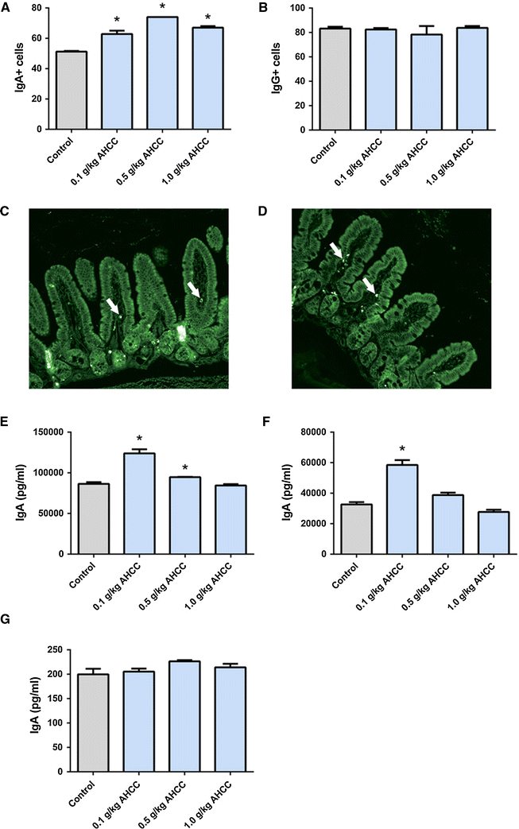
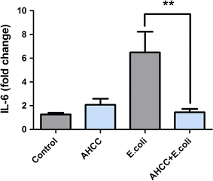
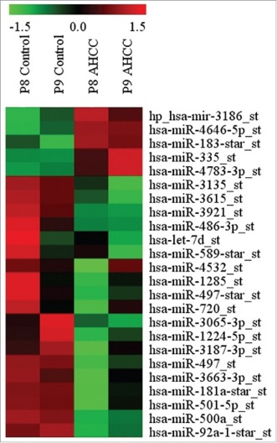
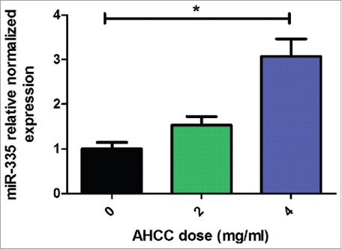

Roles of AHCC in the Gut-Brain Axis
Anti-inflammatory/immune Homeostasis
Prebiotic (TLR2/4)
miRNAs
Mallet et al.,
European Journal of Nutrition 2015
Mallet et al.,
European Journal of Nutrition 2015
Graham et al., Cancer Biology and Therapy 2017

Slide 37

Kids Mood+
Focus, Attention, Mood, Listening, Tension, Irritation
School work, Math, Reading, Writing, Social Relationships
-29%
-18%

Slide 38
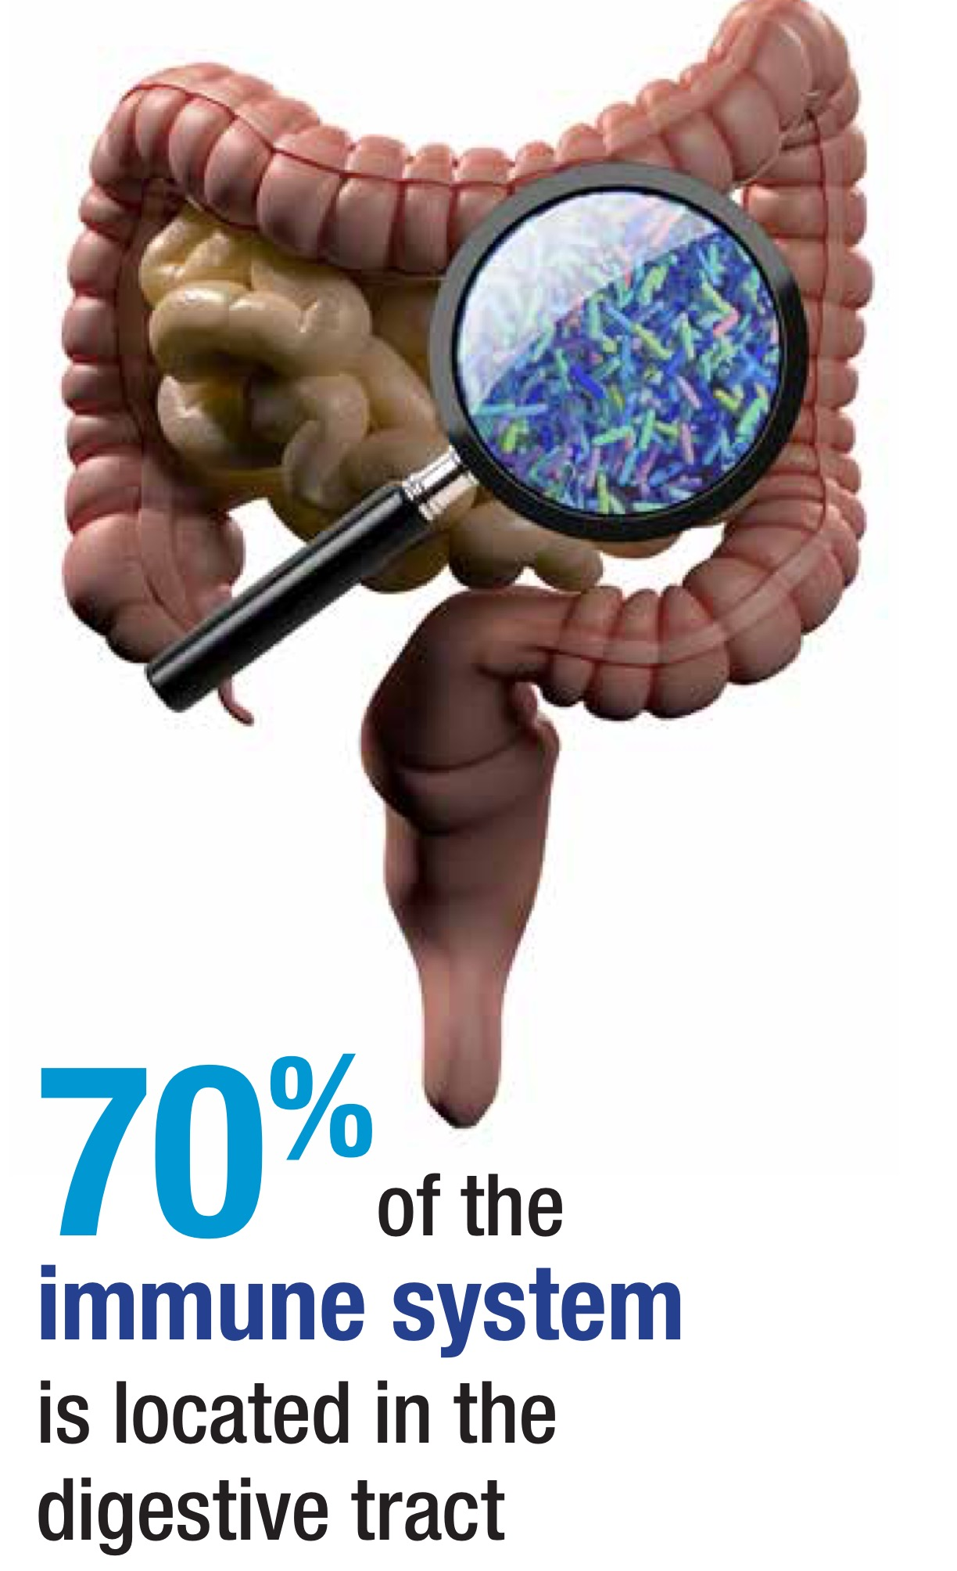

Slide 40

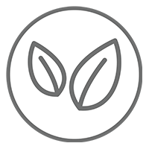



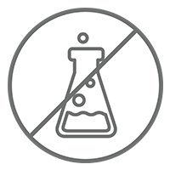
Daily Essential Nutrients For Healthy Kids & Teens*
Amare Kids
™
TM
Vegan /
All Natural*
Non-GMO and Gluten Free*
Sugar Free*
No Preservatives, Artificial Colors, Flavors and Sweeteners*
*These statements have not been evaluated by the Food and Drug Administration. This product is not intended to diagnose, treat, cure, or prevent any disease.
*These statements have not been evaluated by the Food and Drug Administration. This product is not intended to diagnose, treat, cure, or prevent any disease.

Slide 41

Amare Kids Pack
TM
The first comprehensive mental wellness pack for kids and teens, the Amare Kids Pack is formulated to support full mind and body nutrition.*
Item Code:
Retail Price:
Wholesale Price:
Subscribe & Save:
P018
$198.00
$131.95 / 95 PV
$117.95 / 85 PV

Slide 42
MentaEssentials
Amare Kids
GBX Foods
MentaTherapeutics
™
FundaMentals
™
™
™
™
Notes:
No other company is developing a comprehensive lineup of products for mental wellness through the microbiome and gut-brain axis!
We launched with TWELVE of them! Now we have TWENTY TWO unique products!
We will continue to lead the way!

Slide 43


