Slide 1


Slide 2
THE THREE THINGS YOU SHOULD KNOW ABOUT
MENTAL WELLNESS
How you feel is not just in your head – it’s also in your gut.
Our “second brain” includes the Microbiome and plays a major role in mental wellness.
You can now DO something NATURALLY to improve your mental wellness.
WHERE ARE YOU ON THE MENTAL WELLNESS CONTINUUM? (Circle your current number)
1
2
3
4
5
6
7
8
9
10
DISEASE STATUS
“NORMAL”
OPTIMIZED
Depression
Anxiety
Diabetes
Obesity
Heart Disease
Autoimmune
Arthritis
Fibromyalgia
CFS
Dementia
ADD / ADHD
Alzheimer’s
Fatigue
Tension
Sad
Brain Fog
Headaches
Acne
Eczema
Congestion
URTI’s
Joint Pain
Muscle Pain
Bloated
Chubby
Energetic
Calmness
Happy
Sharp
Creative
Clear Skin
Rarely Sick
Flexible
Lean
Strong
Resilient
RED
ORANGE
YELLOW
GREEN
BLUE
INDIGO
VIOLET

Slide 3

GRIM REALITY
Americans spend over $100 billion annually on “feel better” products, from painkillers and anti-depressants to alternative and complementary therapies
100 million Americans suffer from chronic pain – this is one of the top reasons for the $100 billion expenditure
350 million people globally are affected by depression each year – another major reason for the $100 billion expenditure
90% of adolescents have a depressive disorder before the age of 18
Notes:
Americans spend over $100 billion annually on “feel better” products, from painkillers and anti-depressants to alternative and complementary therapies
Nearly 100 million Americans suffer from occasional aches and pains – and is one of the most common reasons that people look to complementary and alternative medicine (CAM) for non-pharmaceutical options
Globally, more than 350 million people are affected by feelings of depression each year
Nearly 90% of adolescents struggle with feelings of depression and anxiety before the age of 18
Globally, more than 800,000 people die by suicide every year – around one person every 40 seconds. In the United States, more than 40,000 Americans commit suicide each year – that’s more than 100 suicides per day
Every year, more than 24 million people, some as young as 12 years old, receive treatment for illicit drug or alcohol abuse
Approximately 1 in 5 new mothers in the U.S. have postpartum depression each year
The World Health Organization calls stress “the health epidemic of the 21st century” with more than 350 million people affected around the world
More than 80% of the nation’s 20 million college students feel “exhausted and overwhelmed by stress” - and more than one-third feel “depressed” to the point of dysfunction

Slide 4
GRIM REALITY
800,000 people die of suicide each year – that’s over 2000 suicides per day
24 million people, some as young as 12 years old, received treatment for illicit drug or alcohol abuse in 2016
1 in 5 new mothers in the U.S. report postpartum depression each year
The World Health Organization calls stress “the health epidemic of the 21st century”
85% of the nation’s 20 million college students reported feeling overwhelmed by stress - and more than 35% reported feeling “depressed” to the point of dysfunction
Notes:
Shawn’s verbiage:
Americans spend over $100 billion annually on “feel better” products, from painkillers and anti-depressants to alternative and complementary therapies
Nearly 100 million Americans suffer from occasional aches and pains – and is one of the most common reasons that people look to complementary and alternative medicine (CAM) for non-pharmaceutical options
Globally, more than 350 million people are affected by feelings of depression each year
Nearly 90% of adolescents struggle with feelings of depression and anxiety before the age of 18
Globally, more than 800,000 people die by suicide every year – around one person every 40 seconds. In the United States, more than 40,000 Americans commit suicide each year – that’s more than 100 suicides per day
Every year, more than 24 million people, some as young as 12 years old, receive treatment for illicit drug or alcohol abuse
Approximately 1 in 5 new mothers in the U.S. have postpartum depression each year
The World Health Organization calls stress “the health epidemic of the 21st century” with more than 350 million people affected around the world
More than 80% of the nation’s 20 million college students feel “exhausted and overwhelmed by stress” - and more than one-third feel “depressed” to the point of dysfunction
SOURCES:
Grim Reality Statistics
Americans spend over $100 billion annually on “feel better” products, from painkillers and anti-depressants to alternative and complementary therapies
Centers for Disease Control and Prevention (CDC) https://www.cdc.gov/nchs/data/hus/hus13.pdf;
Journal of the American Medical Association (JAMA) Trends in Prescription Drug Use Among Adults in the United States From 1999-2012 http://jamanetwork.com/journals/jama/fullarticle/2467552; National Survey on Drug Use and Health https://nsduhweb.rti.org/respweb/homepage.cfm; National Center for Complementary and Integrative Medicine (NCCIM) https://nccih.nih.gov/news/press/cost-spending-06222016
Nearly 100 million Americans suffer from occasional aches and pains – and is one of the most common reasons that people look to complementary and alternative medicine (CAM) for non-pharmaceutical options
National Institutes of Health (NIH), National Center for Complementary and Integrative Medicine (NCCIM), National Health Interview Survey (NHIS) https://nccih.nih.gov/news/press/08112015; Washington Post https://www.washingtonpost.com/news/to-your-health/wp/2015/08/11/nih-more-than-1-in-10-american-adults-experience-chronic-pain/?utm_term=.4dd603a1f016
Globally, more than 350 million people are affected by feelings of depression each year
National Institute for Mental Health (NIMH) https://www.nimh.nih.gov/health/publications/depression/index.shtml; Healthline http://www.healthline.com/health/depression/facts-statistics-infographic; National Alliance on Mental Illness (NAMI) https://www.nami.org
Nearly 90% of adolescents struggle with feelings of depression and anxiety before the age of 18
Depression in Children and Teens, WebMD http://www.webmd.com/depression/tc/depression-in-childhood-and-adolescence-topic-overview#1; National Institute of Mental Health (NIMH) https://www.nimh.nih.gov/health/statistics/prevalence/any-disorder-among-children.shtml
Globally, more than 800,000 people die by suicide every year – around one person every 40 seconds. In the United States, more than 40,000 Americans commit suicide each year – that’s more than 100 suicides per day.
Centers for Disease Control & Prevention, National Center for Health Statistics, Increase in Suicide in the United States, 1999–2014, NCHS Data Brief No. 241, April 2016; New York Times https://www.nytimes.com/2016/04/22/health/us-suicide-rate-surges-to-a-30-year-high.html?_r=0; World Health Organization (WHO) http://www.who.int/mediacentre/news/releases/2014/suicide-prevention-report/en/
Every year, more than 24 million people, some as young as 12 years old, receive treatment for illicit drug or alcohol abuse
National Institutes of Health (NIH); National Institute on Drug Abuse (NIDA) https://www.drugabuse.gov/related-topics/trends-statistics; Substance Abuse and Mental Health Services Administration’s (SAMHSA’s) National Survey on Drug Use and Health https://www.drugabuse.gov/publications/drugfacts/treatment-statistics
Approximately 1 in 5 new mothers in the U.S. have postpartum depression each year
Centers for Disease Control and Prevention https://www.cdc.gov/reproductivehealth/depression/index.htm; Postpartum Progress http://postpartumprogress.org/the-facts-about-postpartum-depression/; American Psychological Association (APA) http://www.apa.org/pi/women/resources/reports/postpartum-depression.aspx
The World Health Organization calls stress “the health epidemic of the 21st century” with more than 350 million people affected around the world
World Health Organization (WHO) http://www.who.int/mediacentre/factsheets/fs369/en/; http://www.who.int/mediacentre/factsheets/fs396/en/; Business News Daily http://www.businessnewsdaily.com/2267-workplace-stress-health-epidemic-perventable-employee-assistance-programs.html; Stress: Concepts, Cognition, Emotion, and Behavior http://scitechconnect.elsevier.com/stress-health-epidemic-21st-century/; WHO World Mental Health http://www.who.int/mental_health/world-mental-health-day/2016/en/
More than 80% of the nation’s 20 million college students feel “exhausted and overwhelmed by stress” - and more than one-third feel “depressed” to the point of dysfunction
American College Health Association http://www.acha.org/ACHA/Resources/Topics/MentalHealth.aspx; American Psychological Association (APA) http://www.apa.org/monitor/2014/09/cover-pressure.aspx;

Slide 5















$100B+

Slide 7
Yerkes-Dodson Curve of Human Performance

Slide 12
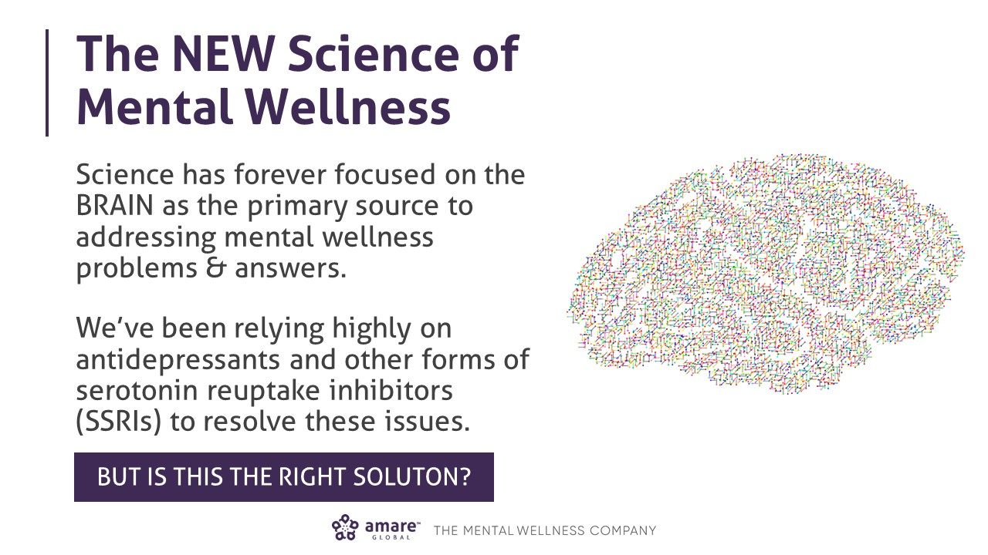

Slide 13
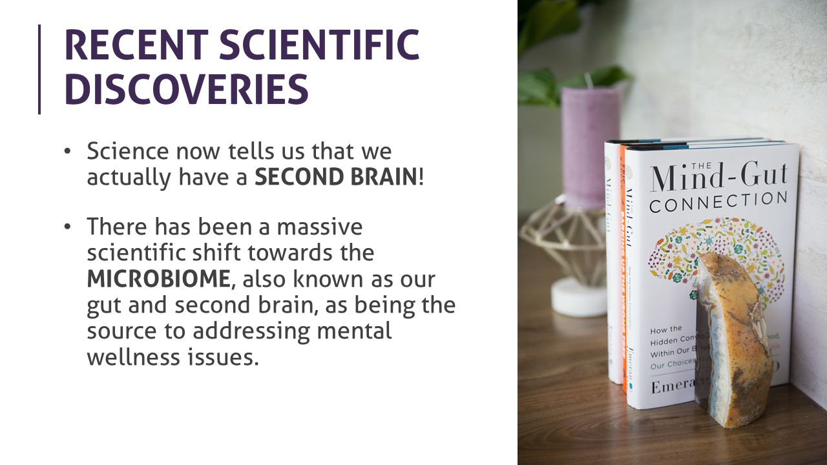

Slide 14
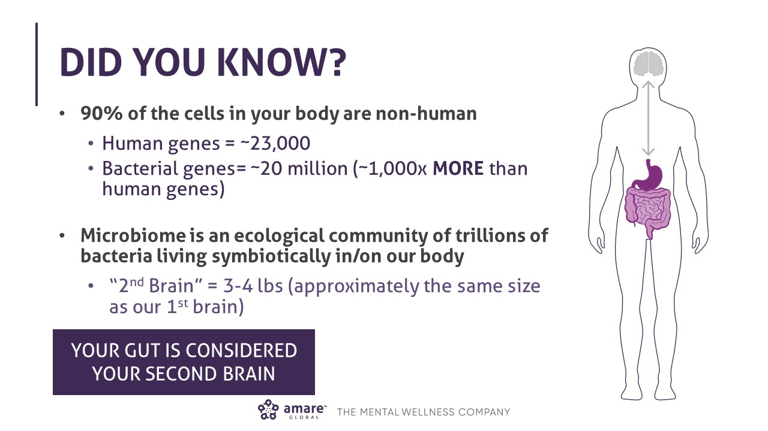

Slide 15
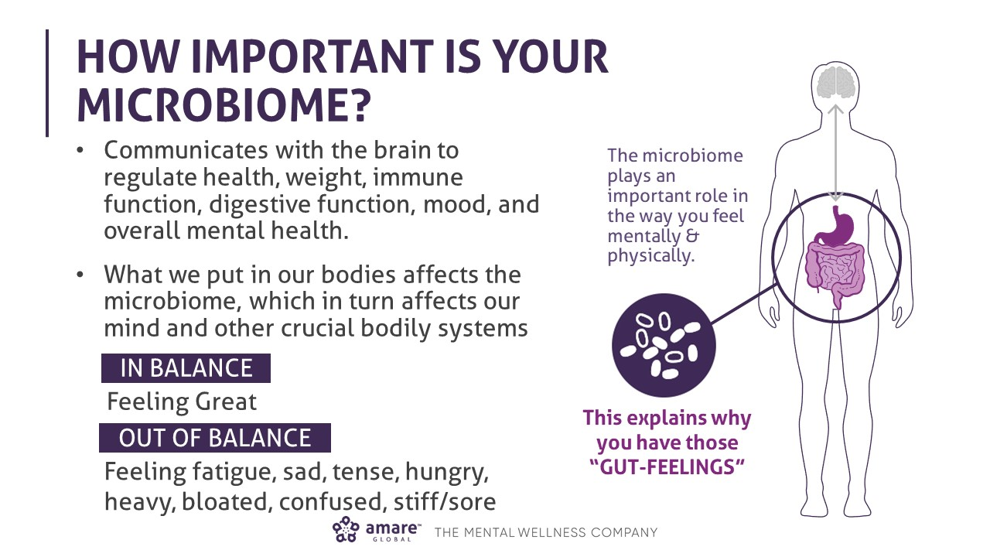

Slide 16
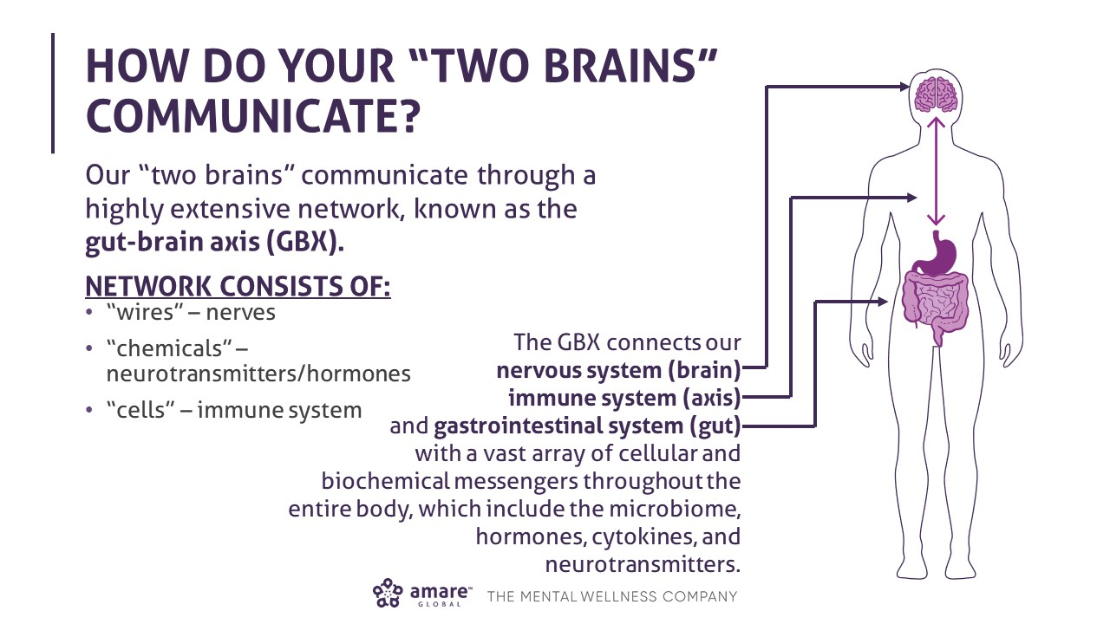

Slide 17

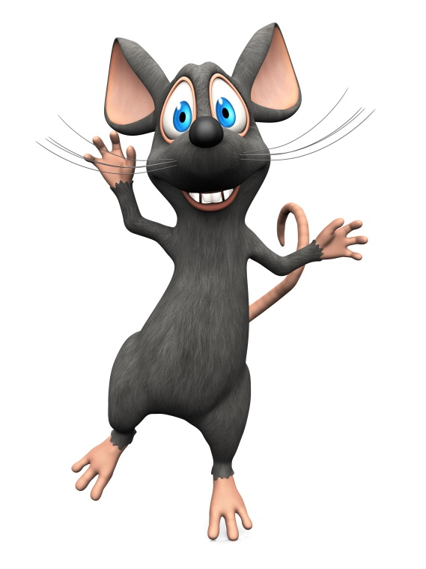
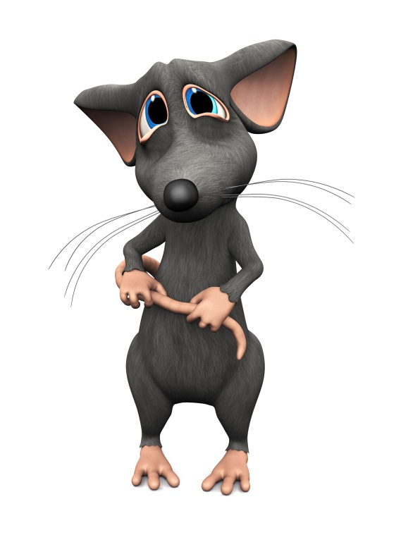
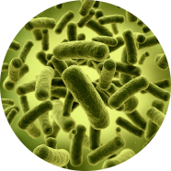
Timid
“Introvert”
Outgoing
“Extrovert”
Timid
“Introvert”
Normal gut microbes
Germ-free
Transplanted

Slide 18
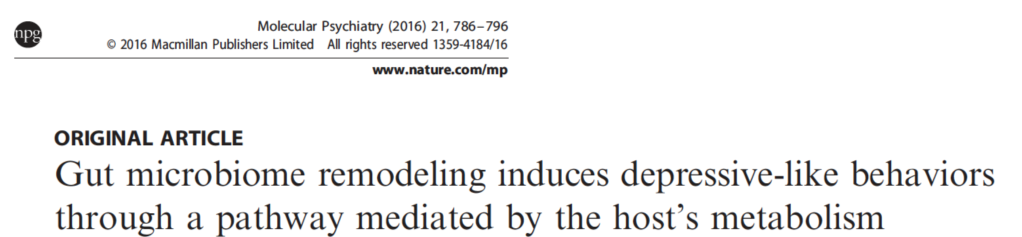
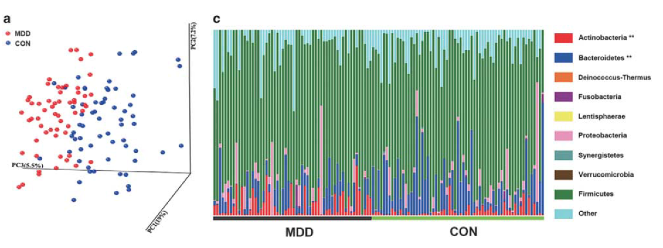
Depression
Zheng P et al, 2016

Slide 19
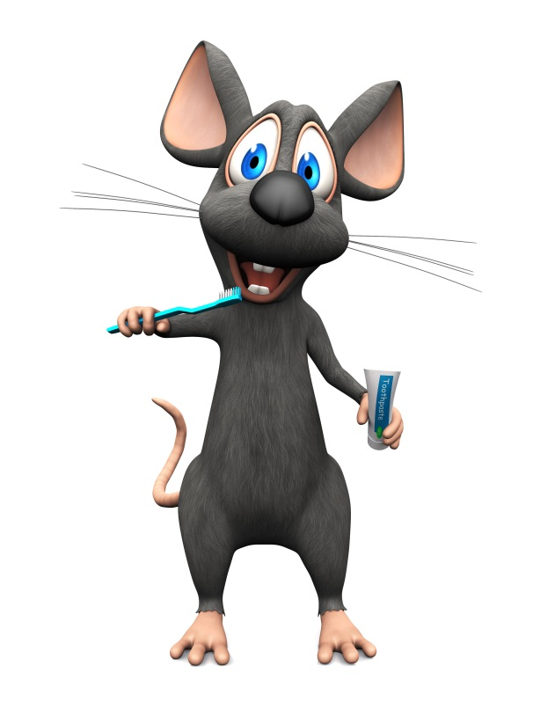
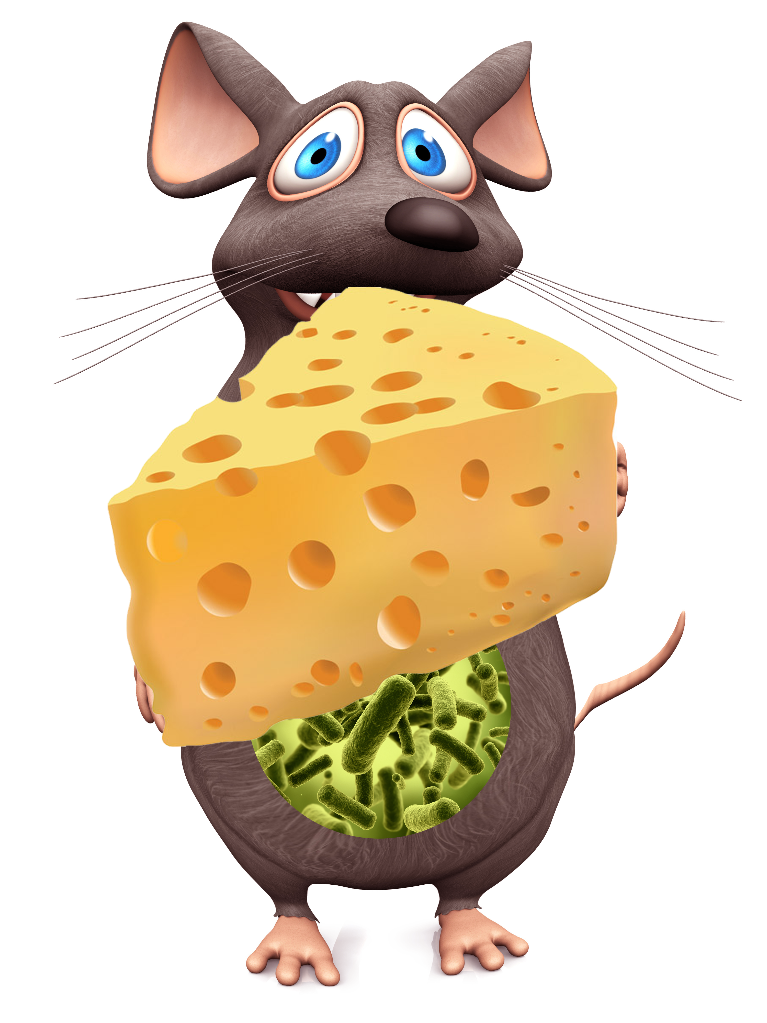
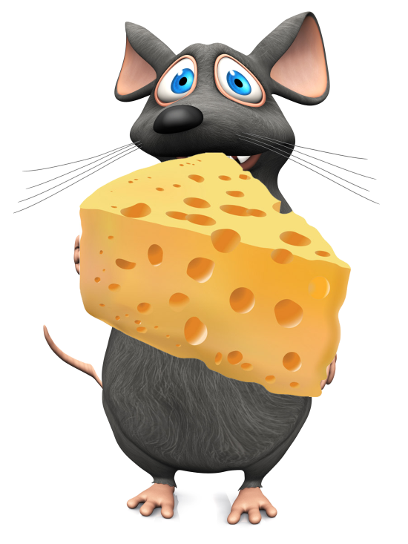
Obese
Overeating
Lean
Obese
Overeating
Obesogenic microbiota
Germ-free
Obesogenic microbiota
Notes:
Please make sure that on the two mouse ppts, the mice and the headings are in exactly the same position

Slide 20
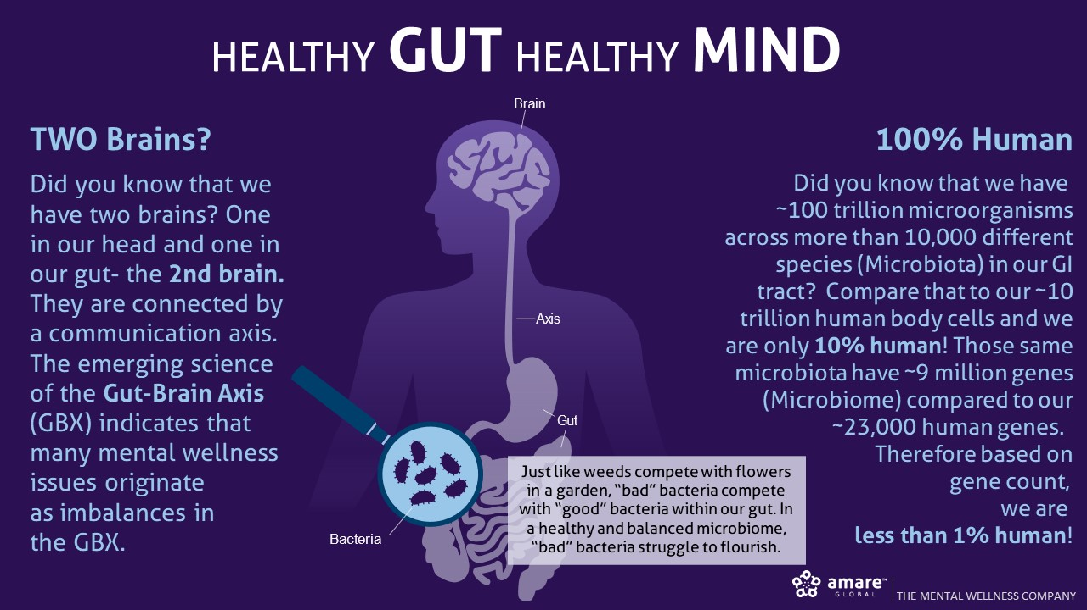

Slide 21
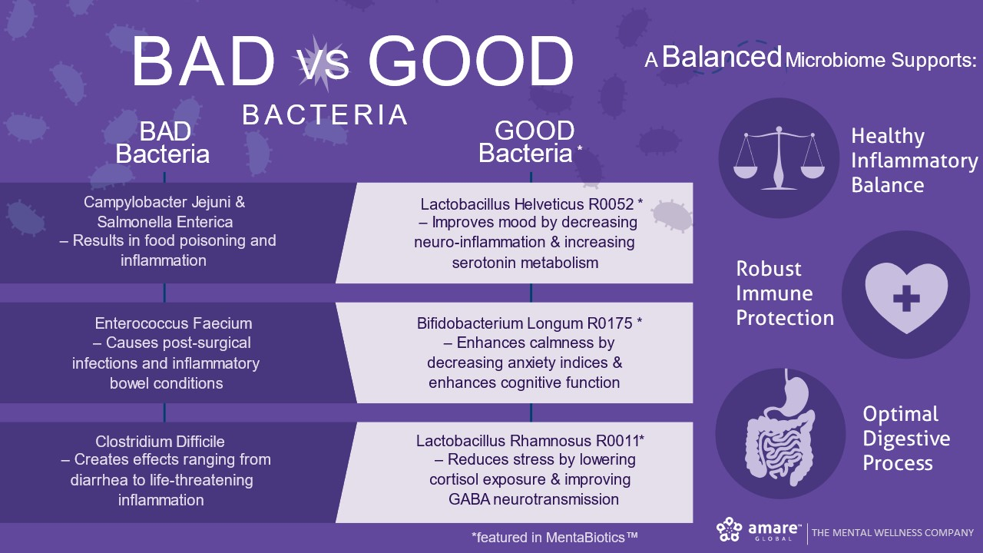

Slide 22
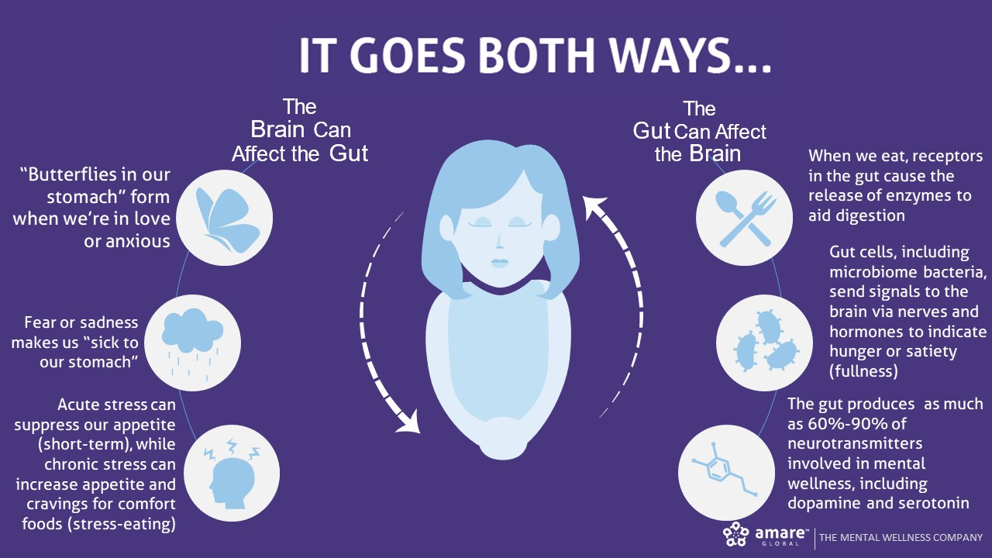

Slide 23
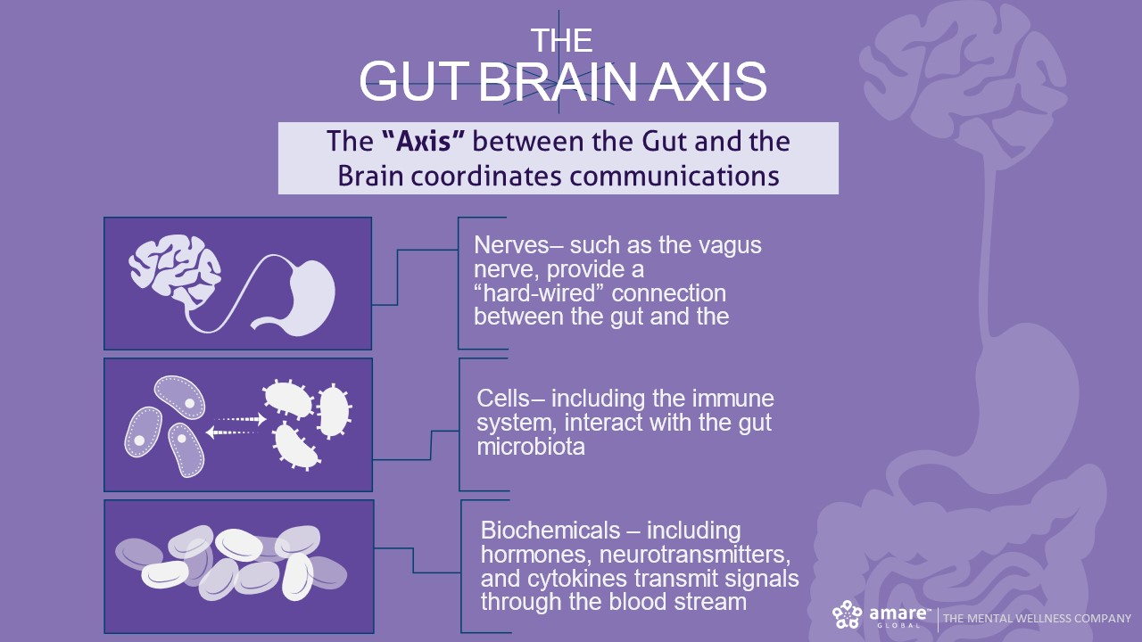

Slide 24
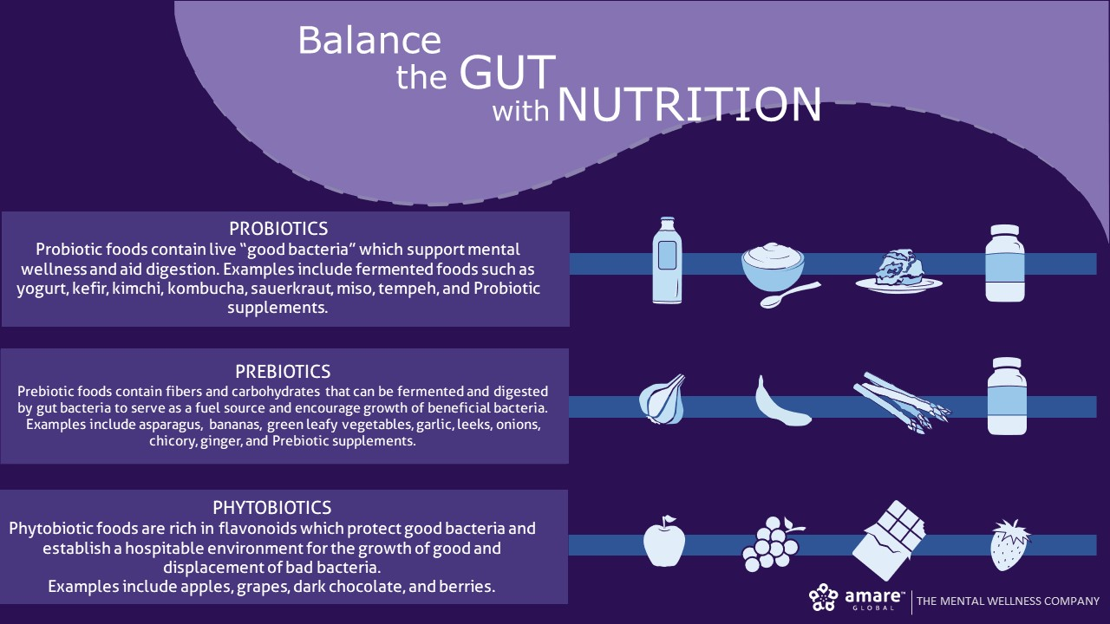

Slide 25
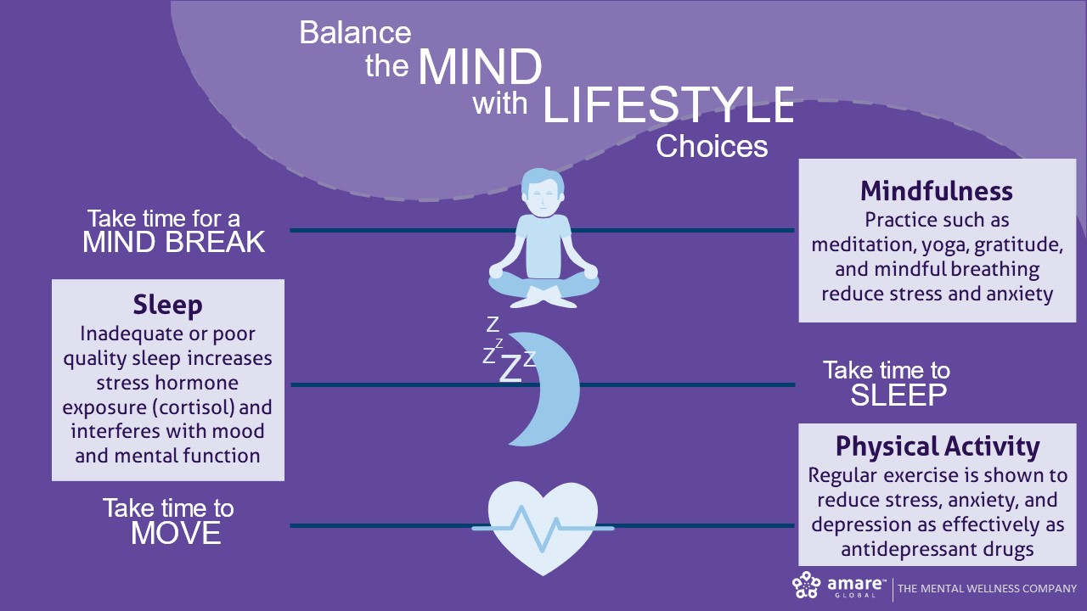

Slide 26


Slide 27
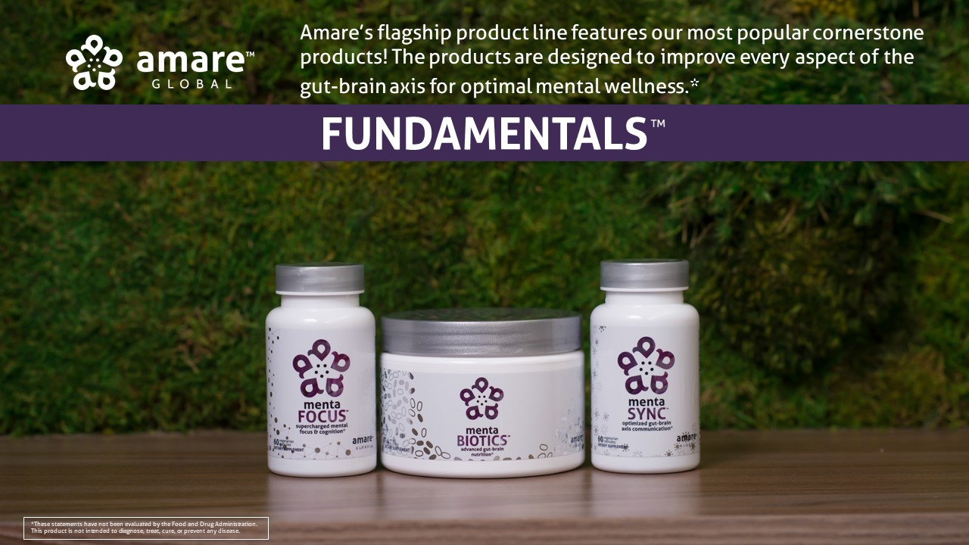

Slide 28
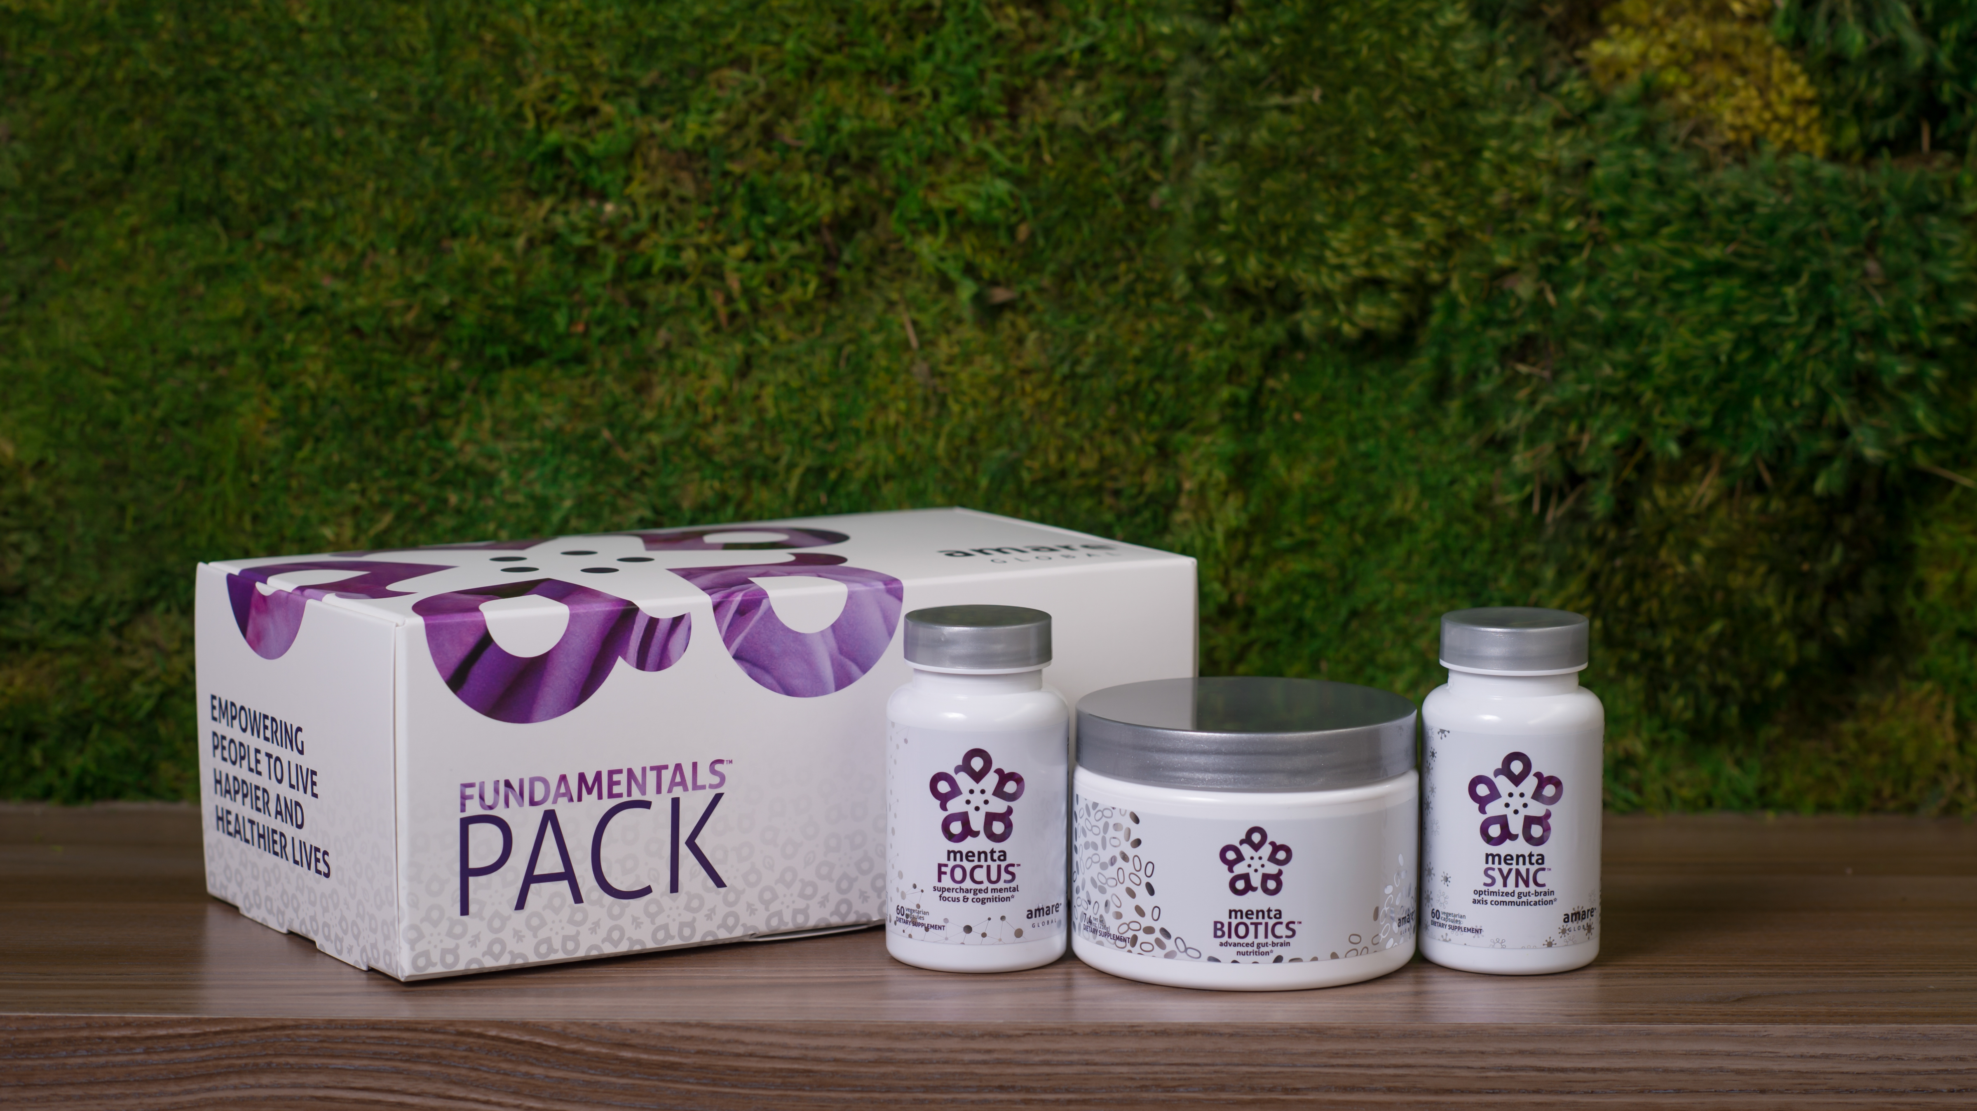

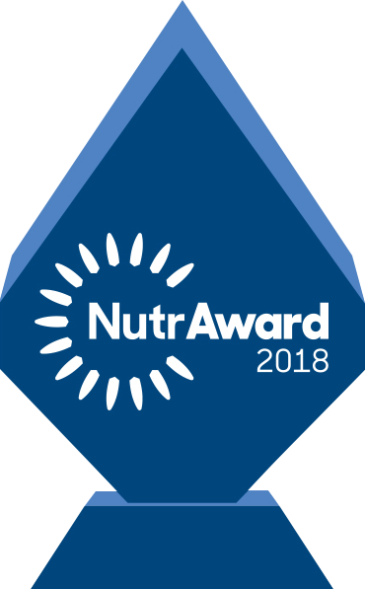
The World’s First Award-Winning Gut-Brain Axis
Nutrition System
AMARE FUNDAMENTALS PACK
™
2018 NutrAward Winner for
“BEST NEW FINISHED PRODUCT”
*These statements have not been evaluated by the Food and Drug Administration. This product is not intended to diagnose, treat, cure, or prevent any disease.

Slide 29
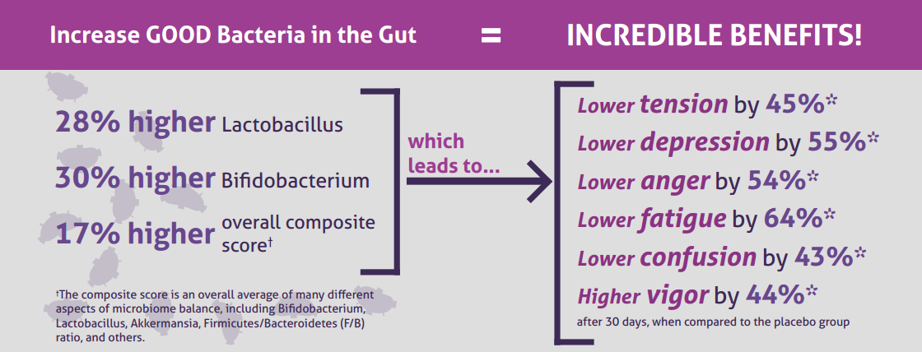
CLINICAL STUDY
The Amare FundaMentals Pack has been clinically proven to:

Slide 30
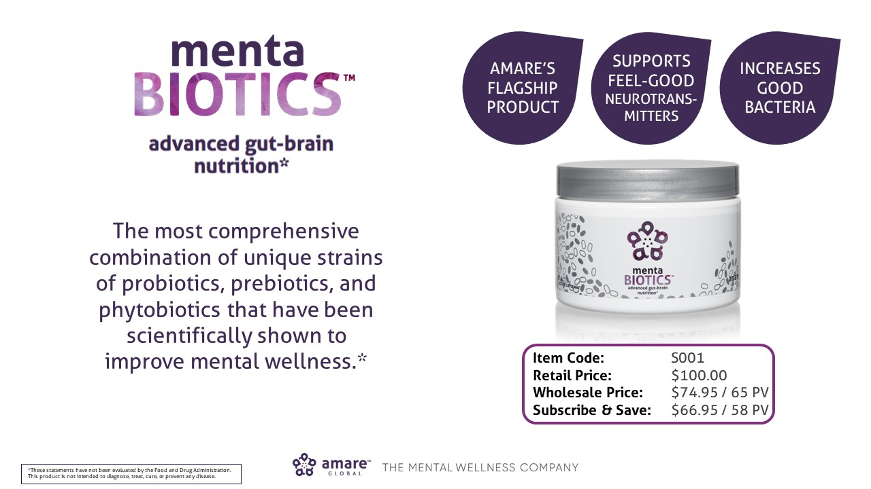

Slide 31
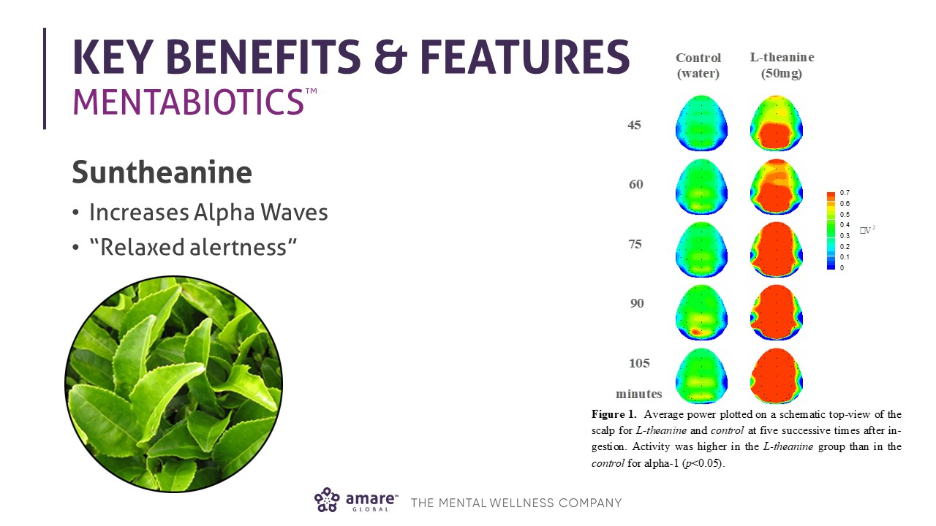

Slide 32
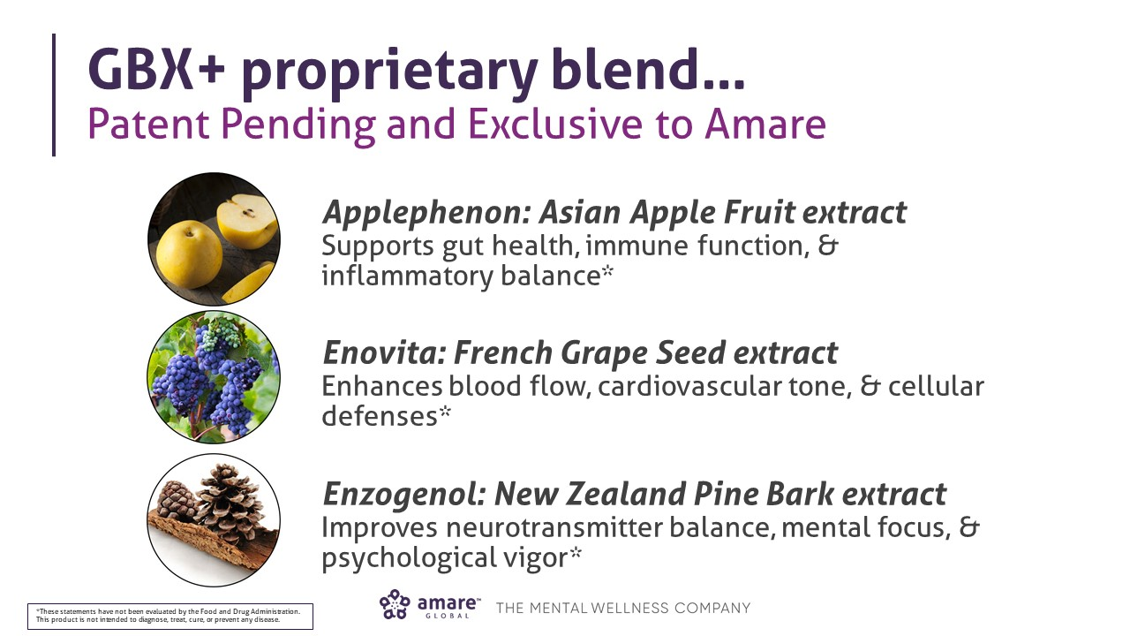

Slide 33
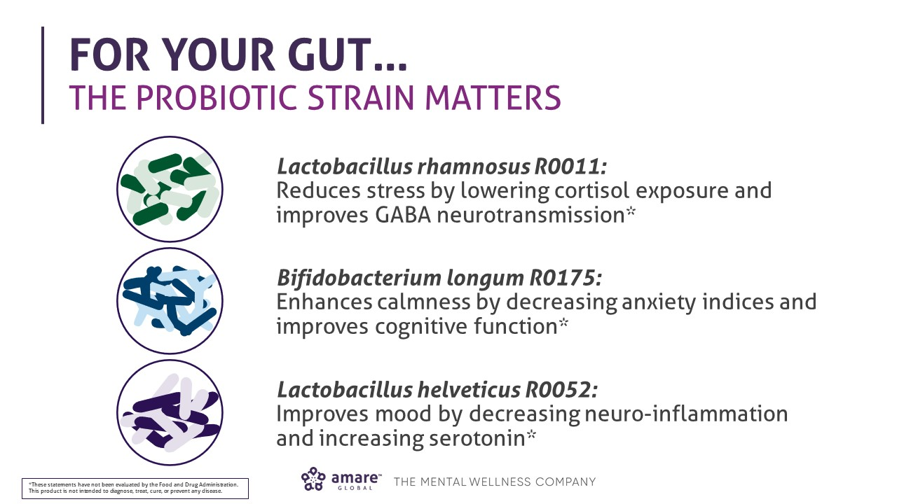

Slide 34
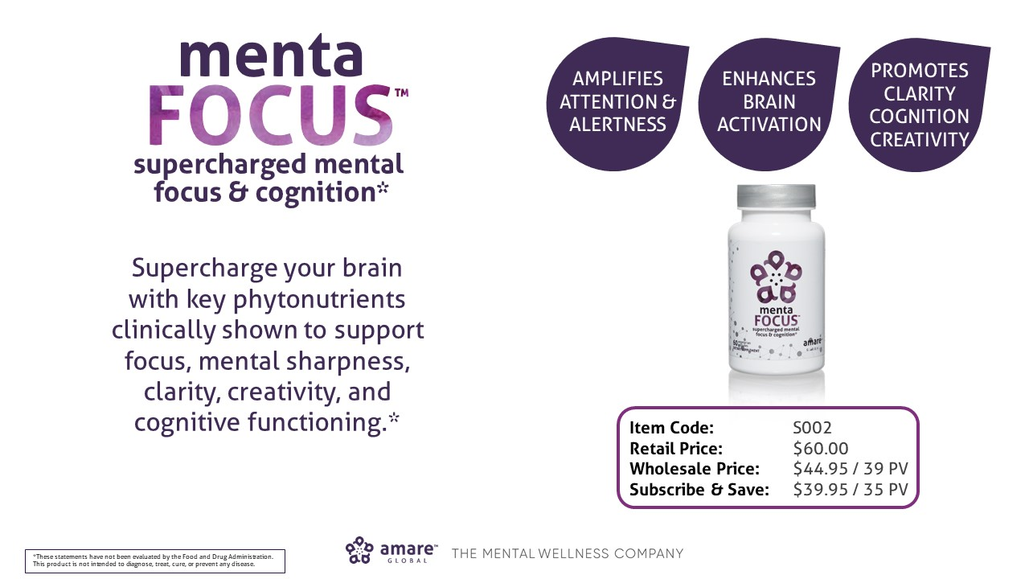

Slide 35
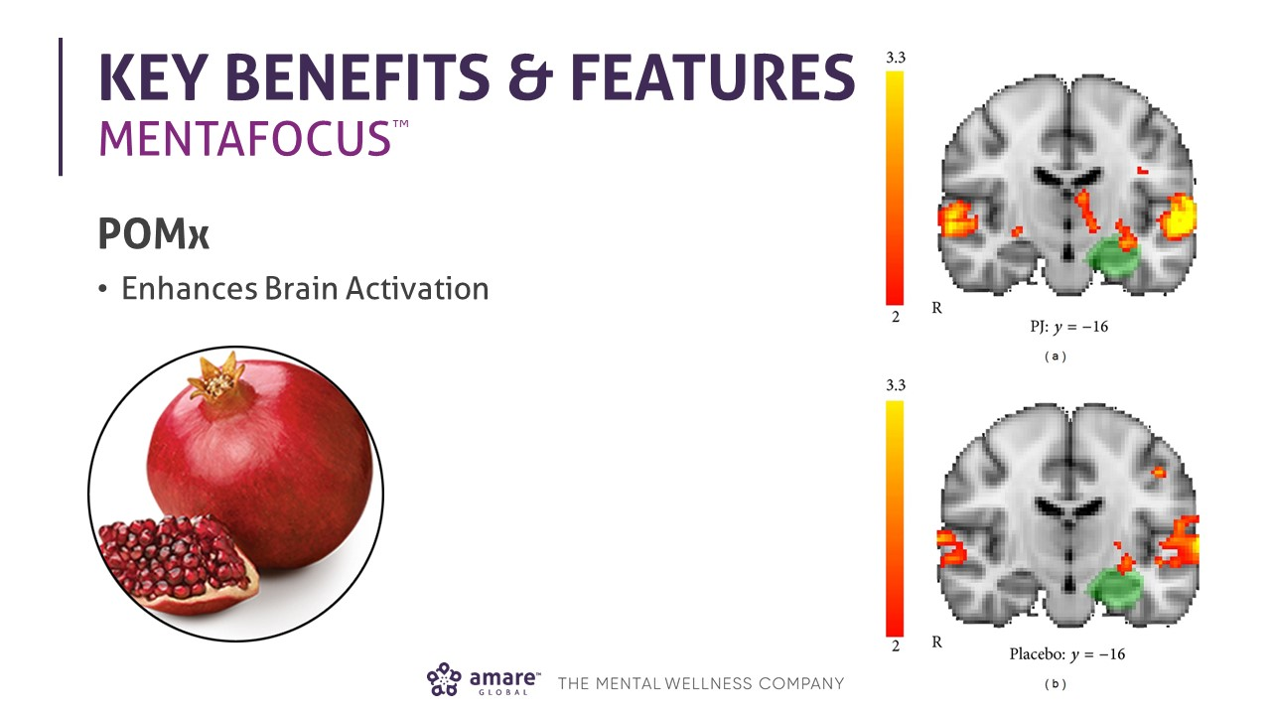

Slide 36
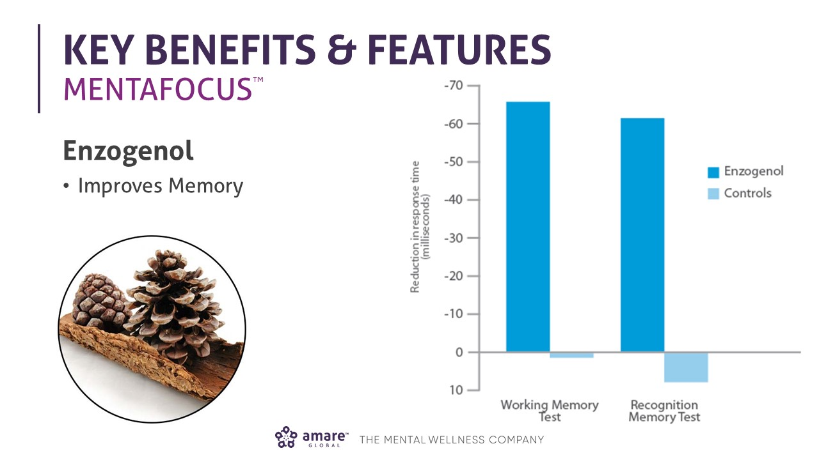

Slide 37
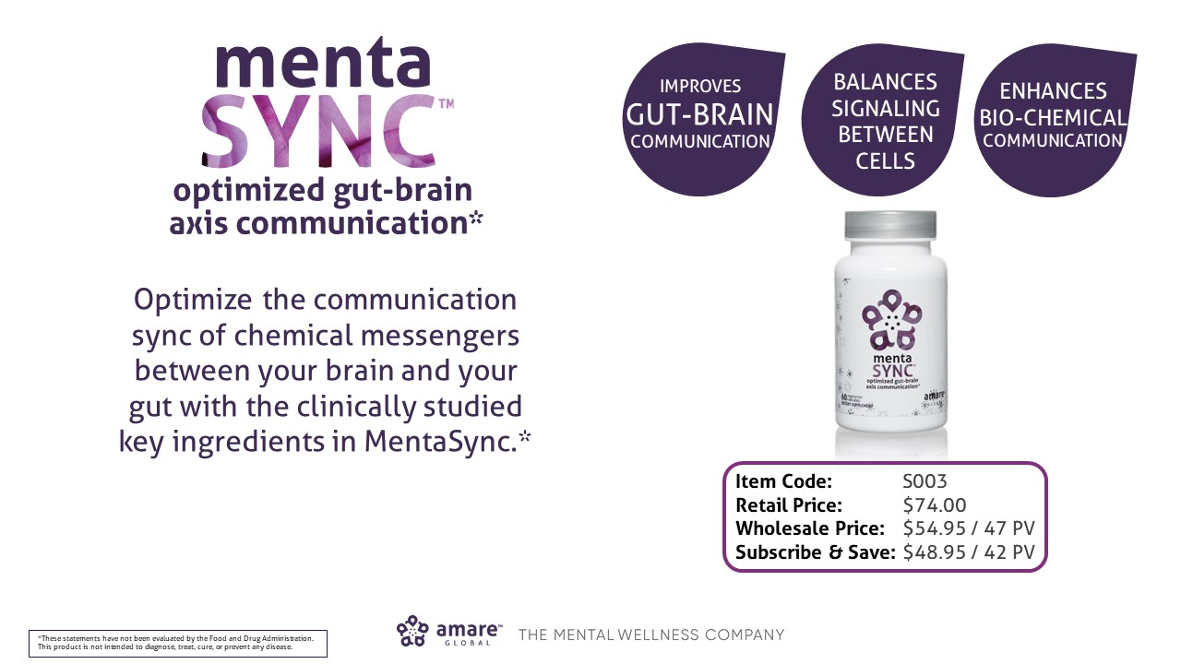

Slide 38
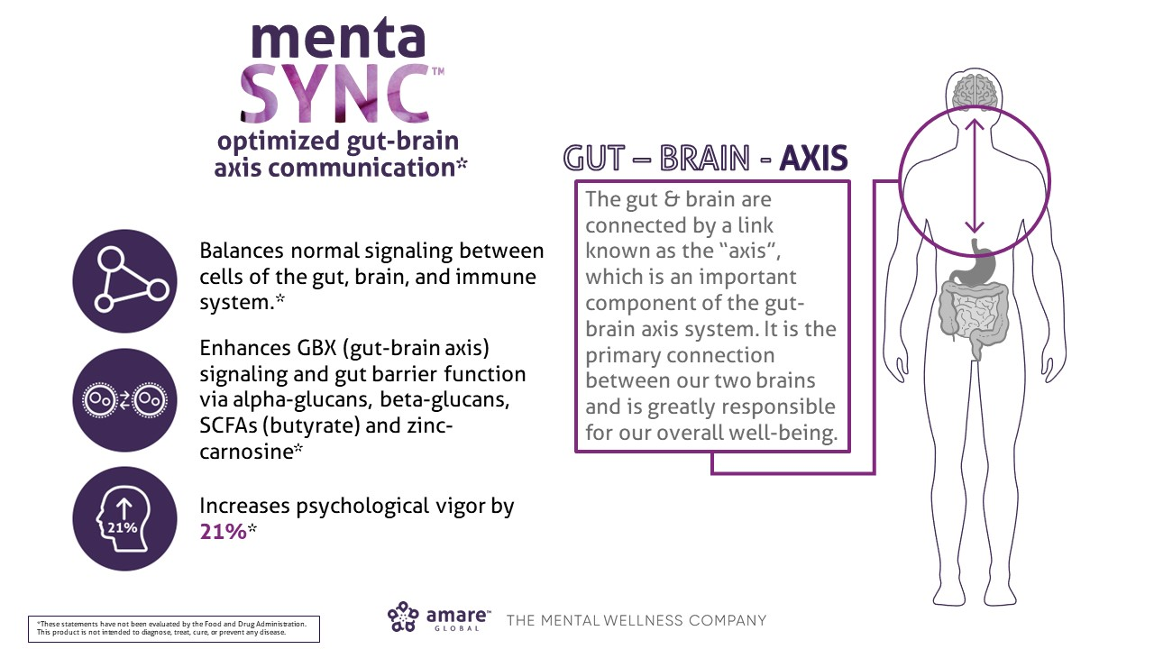

Slide 39
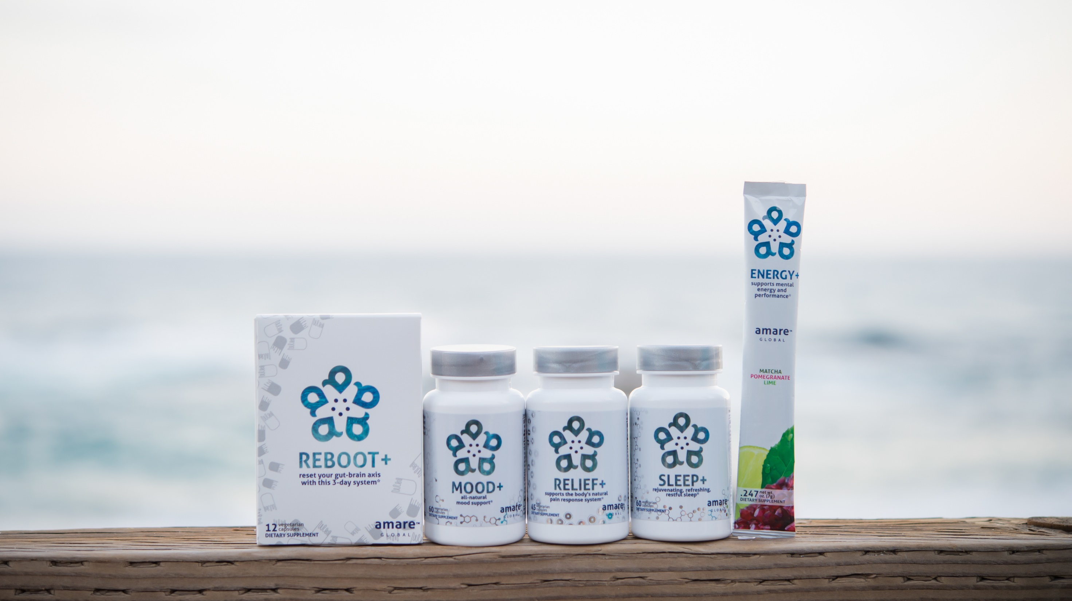
All-Natural Support Solutions for Energy, Mood, Pain, and Sleep*
MENTATHERAPEUTICS
™
*These statements have not been evaluated by the Food and Drug Administration. This product is not intended to diagnose, treat, cure, or prevent any disease.

Slide 40
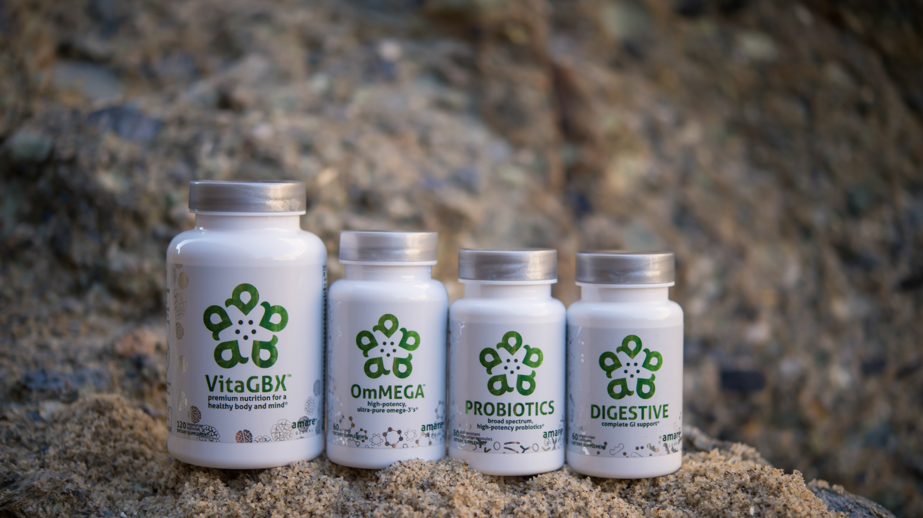
Pure & Potent Daily Essential Nutrients*
MENTAESSENTIALS
™
*These statements have not been evaluated by the Food and Drug Administration. This product is not intended to diagnose, treat, cure, or prevent any disease.

Slide 41
THE THREE THINGS YOU SHOULD KNOW ABOUT
MENTAL WELLNESS
How you feel is not just in your head – it’s also in your gut.
Our “second brain” includes the Microbiome and plays a major role in mental wellness.
You can now DO something NATURALLY to improve your mental wellness.
WHERE ARE YOU ON THE MENTAL WELLNESS CONTINUUM? (Circle your current number)
1
2
3
4
5
6
7
8
9
10
DISEASE STATUS
“NORMAL”
OPTIMIZED
Depression
Anxiety
Diabetes
Obesity
Heart Disease
Autoimmune
Arthritis
Fibromyalgia
CFS
Dementia
ADD / ADHD
Alzheimer’s
Fatigue
Tension
Sad
Brain Fog
Headaches
Acne
Eczema
Congestion
URTI’s
Joint Pain
Muscle Pain
Bloated
Chubby
Energetic
Calmness
Happy
Sharp
Creative
Clear Skin
Rarely Sick
Flexible
Lean
Strong
Resilient
RED
ORANGE
YELLOW
GREEN
BLUE
INDIGO
VIOLET

