Slide 1
Fundamentals Pack
Clinical Trial Deep Dive
June 7, 2018

Slide 2
THE THREE THINGS YOU SHOULD KNOW ABOUT
MENTAL WELLNESS
How you feel is not just in your head – it’s also in your gut.
Our “second brain” includes the Microbiome and plays a major role in mental wellness.
You can now DO something NATURALLY to improve your mental wellness.
WHERE ARE YOU ON THE MENTAL WELLNESS CONTINUUM? (Circle your current number)
1
2
3
4
5
6
7
8
9
10
DISEASE STATUS
“NORMAL”
OPTIMIZED
Depression
Anxiety
Diabetes
Obesity
Heart Disease
Autoimmune
Arthritis
Fibromyalgia
CFS
Dementia
ADD / ADHD
Alzheimer’s
Fatigue
Tension
Sad
Brain Fog
Headaches
Acne
Eczema
Congestion
URTI’s
Joint Pain
Muscle Pain
Bloated
Chubby
Energetic
Calmness
Happy
Sharp
Creative
Clear Skin
Rarely Sick
Flexible
Lean
Strong
Resilient
RED
ORANGE
YELLOW
GREEN
BLUE
INDIGO
VIOLET

Slide 3

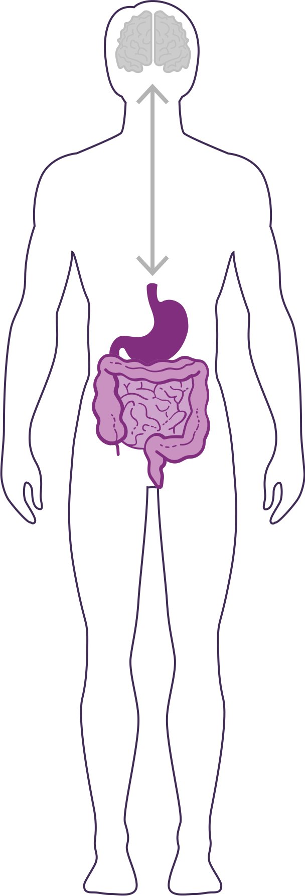




GUT – BRAIN - AXIS
The growth and vitality of healthy beneficial bacteria in the gut is a key component to overall well-being.
60% Decrease in irritability scores*
55% Decrease in anxiety scores*
50% Decrease in depression scores*
49% Reduction in overall distress*
70% Increase in “good” bacteria*
Improves overall mood by increasing positive mood by 211% and decreasing negative mood by 105%*
*These statements have not been evaluated by the Food and Drug Administration. This product is not intended to diagnose, treat, cure, or prevent any disease.
Notes:
Shawn: Slide: MentaBiotics pg.24 -- That first set of bullet points, all of those decreases. These are psychological scores, right? Very well validated ways of measuring how people are feeling. You can see significant reduction in stress and depression scores, anxiety scores, and irritability scores. The reason that people are feeling so much better, is because of the change in the balance between good bacteria and bad bacteria. The good bacteria going up by a factor of about 70%, the bad bacteria going down by about 30%, and the change in that ratio is really enabling more of the feel good signals and less of the feel bad signals. If we look at it in a little bit of a different way, that last one on the bottom, overall mood is going up by 211% and negative mood is going down by 105%. These kinds of statistics that have been found in human trials, show us that if we normalize what's happening in the second brain, in this gut microbiome, its going to be transmitted throughout the rest of the body.
PRO-Biotic Benefits
49%-60% decrease in stress, anxiety, depression scores
PRE-Biotic Benefits
Increases “good” bacteria count (+70% Bifidobacterium) and reduces “bad” bacteria (-29% Clostridium)
Increases GI “signalling” molecules (+52% SCFAs – short chain fatty acids)
Improves overall mood (+211% positive and -105% negative mood state)
PHYTO-Biotic Benefits
Reduces both gastro- and neuro-inflammation
Improves intestinal barrier function and blood/brain barrier function
Digestive Performance Benefits
34% reduction in fullness & bloating
Sources:

Slide 4
Portions of Data Presented at:
American College of Nutrition Annual Scientific Conference
  November 2017 – Alexandria VA (“Outstanding Research” Award)
Experimental Biology Annual Scientific Conference
  April 2018 – San Diego
American College of Sports Medicine Annual Scientific Conference
  May 2018 - Minneapolis
Mental Health America – Fit for the Future Conference
  June 2018 – Washington DC
Medical, Nutrition, Biochemistry, Molecular Biology, Physiology, Psychology, Policy…

Slide 5
Background
Background: Interest in and knowledge of the gut microbiome has increased exponentially in the past decade. This once overlooked component of the gastrointestinal tract is now implicated in multiple aspects of human health, including mental wellness (e.g. depression, anxiety, stress), metabolic (e.g. diabetes, obesity), neurologic (e.g. Alzheimer’s, Parkinson’s, Autism Spectrum Disorder), gastrointestinal (e.g. irritable bowel syndrome, Crohn’s), and immunologic (e.g. inflammation, cancer), among others.

Slide 6
Purpose/Objectives
Purpose/Objectives: Previous research has demonstrated the “strain specificity” of probiotic therapy – elucidating that targeted health benefits are related to the specific strain of bacteria (e.g. Lactobacillus helveticus R0052 for serotonin/depression; Bifidobacterium longum R0175 for GABA/anxiety; Lactobacillus rhamnosus R0011 for cortisol/stress). Similarly, probiotic bacteria demonstrate different growth trajectories based on availability of preferred fiber substrates (e.g. prebiotics) and phytonutrients such as flavonoids/polyphenols (e.g. phytobiotics). Thus, our objective was two-fold: to determine the change in microbiome ecology/balance; and to assess the change in psychological mood state (e.g. depression/anxiety/vigor) following a coordinated pro-/pre-/phyto-biotic supplementation regimen.

Slide 7
Methods
Methods: Thirty-two healthy subjects screened for “moderate” levels of psychological stress were randomly assigned to 30-days of Supplement (Amare Fundamentals containing specific strains of probiotic bacteria, prebiotic fibers, and phytobiotic plant extracts, N=21) or look-alike Placebo (N=11). Microbiome balance was assessed in fecal samples using a PCR-based analysis (BiomeTracker) that has previously compared favorably to 16S sequencing (ACN 2017) for abundance quantification for major phyla/families of bacteria. Psychological mood state parameters were assessed using the validated Profile of Mood States survey (POMS) to generate scores for Global Mood State, and six sub-scales (Depression, Tension, Fatigue, Anger, Confusion, and Vigor).

Slide 8
Results
Results: Following 30-days of supplementation, there was a significant increase in populations of “good” bacteria in the Supplement group (+28% Lactobacillus; +30% Bifidobacterium) and overall composite score (+17%) versus Placebo (p<0.05). Psychological indices were significantly improved in the Supplement group for both positive (+25% Global Mood; +25% Vigor) and negative (-60% Depression; -54% Tension; -52% Fatigue; -42% Confusion; -39% Anger) mood state parameters versus Placebo (p<0.05).

Slide 9
Conclusions
Conclusions: The World Health Organization has identified mental wellness issues as the leading contributor to global health burden – highlighting the urgency to develop lifestyle interventions to effectively manage depression, anxiety, and stress. These results demonstrate the close relationship between microbiome balance and psychological parameters – and the utility of targeted supplementation to positively influence the gut-brain-axis for improved mental wellness.

Slide 15
Notes:
Following 30-days of supplementation with Amare’s FundaMentals Pack (Mentabiotics, MentaFocus, and MentaSync), the FundaMentals group showed significant improvements (compared to Placebo) in populations of “good” gut bacteria and overall microbiome balance, as well as significantly better psychological mood states.

Slide 16
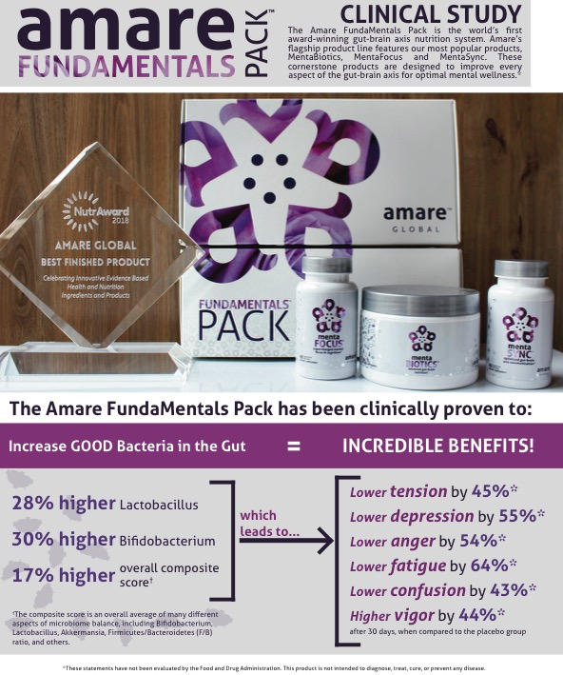
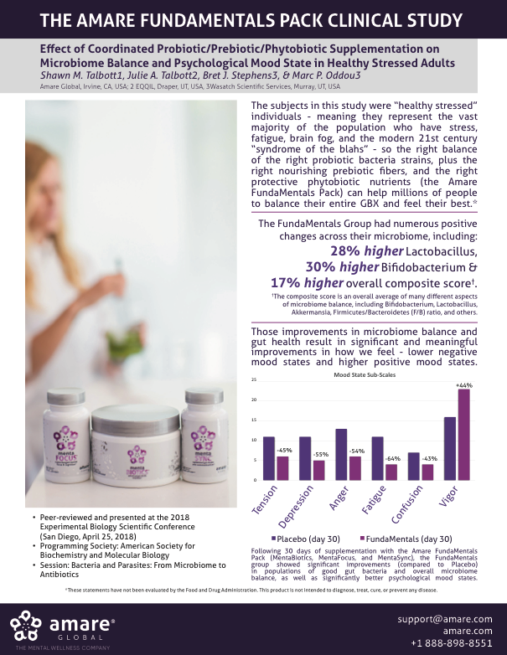

Slide 17
Clinical Study - Technical

