Slide 1
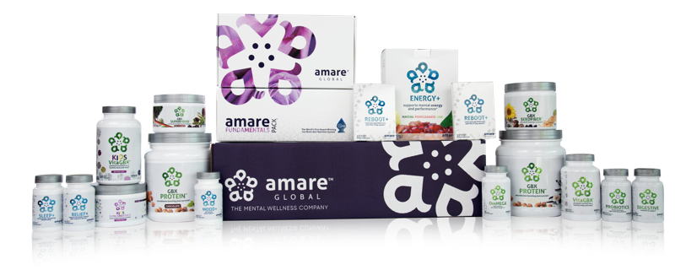
PRODUCT
PRESENTATION

Slide 2


MENTAL WELLNESS

Slide 3


Slide 4
APA Stats
more than half of all women (51%) and men (43%) in the United States experience heightened stress during the holidays – enough stress to put them at increased risk for physical and mental health effects
Cited as “multiple stressors” in the APA research are lack of time (69%), lack of money (69%), and pressure to give or get gifts (51%)
In addition, men and women who experience elevated levels of stress, rate their psychological and physical health lower than those who are not experiencing stress – and are more likely to experience a range of health ailments and symptoms such as sadness (59%), sleep problems (56%), and lack of energy (55%).
“reduce my stress levels” is second only to “lose some weight” among the most popular New Year resolutions.

Slide 5








Mindfulness
Practice such as
meditation, yoga, gratitude, and mindful breathing reduce stress and anxiety
Take time for a
MINDFUL MEDITATION
Sleep
Inadequate or poor quality sleep increases stress hormone exposure (cortisol) and interferes with mood and mental function
Take time to
SLEEP
Physical Activity
Regular exercise is shown to reduce stress, anxiety and depression as effectively as antidepressant drugs
Take time to
MOVE

Slide 6
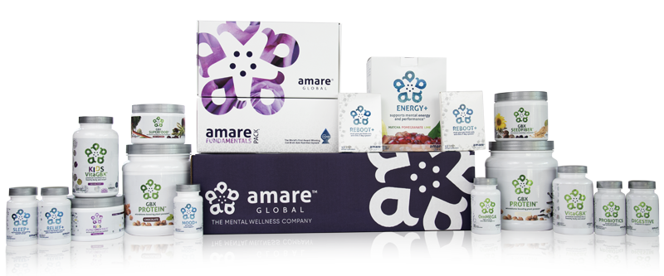
INTRODUCING AMARE GLOBAL PRODUCTS

Slide 7
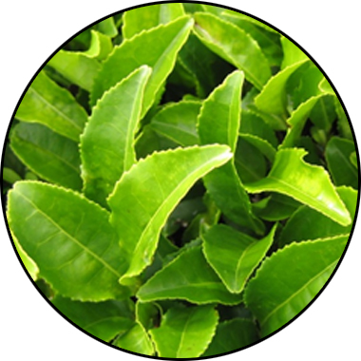
MENTABIOTICS
KEY INGREDIENTS
®
Suntheanine
Increases alpha waves
“Relaxed alertness”
*These statements have not been evaluated by the Food and Drug Administration. This product is not intended to diagnose, treat, cure, or prevent any disease.

Slide 8
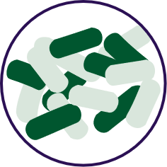


FOR YOUR GUT…
THE PROBIOTIC STRAIN MATTERS
Lactobacillus rhamnosus R0011:
Reduces stress by lowering cortisol exposure and improves GABA neurotransmission*
Stress
Bifidobacterium longum R0175:
Enhances calmness by decreasing anxiety indices and improves cognitive function*
Anxiety/
Cognition
Lactobacillus helveticus R0052:
Improves mood by decreasing neuro-inflammation and increasing serotonin*
Mood
*These statements have not been evaluated by the Food and Drug Administration. This product is not intended to diagnose, treat, cure, or prevent any disease.

Slide 9

MENTABIOTICS SUGAR FREE
MW3TM Prebiotic Proprietary Blend
®
Our MW3 Prebiotic Proprietary Blend provides optimal gut support by feeding the specific mental wellness probiotic strains found in our MW3 Probiotic Proprietary Blend.*
MW3 Prebiotic Fibers:
IsoFiber™ (Iso-Malto-Oligosaccharides) — Contains a combination of naturally occurring prebiotic plant fibers that are clinically shown to improve the growth of specific probiotic strains featured in Kids FundaMentals™ and now MentaBiotics® Sugar Free!
Bimuno® (Galacto-Oligo-Saccharides) — Resets and increases friendly gut bacteria, maintains immune health, controls inflammation in the body and supports microbiome balance. Is highly effective and a natural way of increasing preferred bacteria in the gut. Plays an important role in feeding Bifidobacteria probiotic strains.*
SunFiber® (Galactomannan Fiber) — Helps improve the growth and vitality of beneficial bacteria, including Bifidobacteria and Lactobacillus.*
SUGAR FREE
*These statements have not been evaluated by the Food and Drug Administration. This product is not intended to diagnose, treat, cure, or prevent any disease.

Slide 10
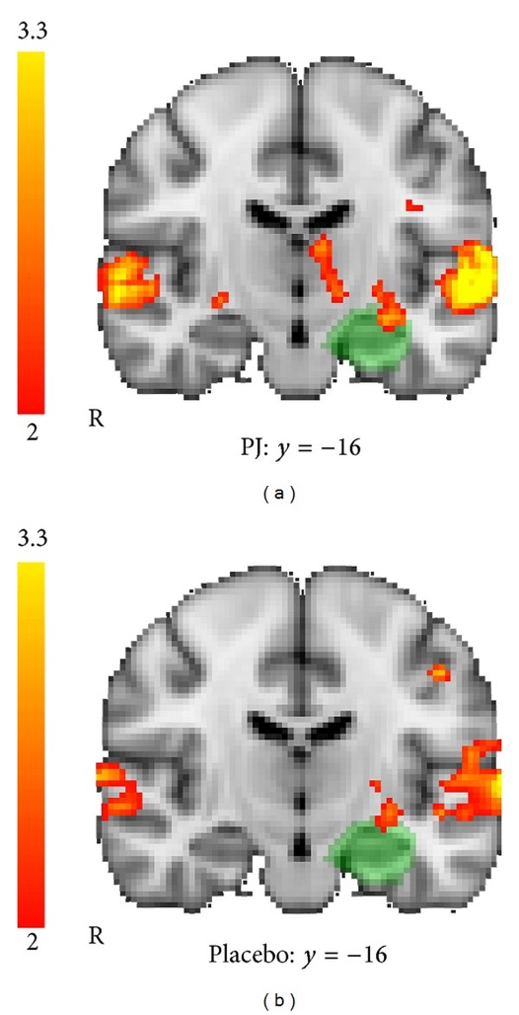
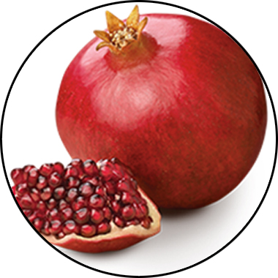
MENTAFOCUS
KEY INGREDIENTS
®
POMx
Enhances brain activation
*These statements have not been evaluated by the Food and Drug Administration. This product is not intended to diagnose, treat, cure, or prevent any disease.

Slide 11
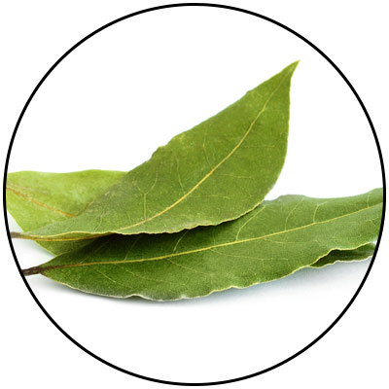
ENERGY+
KEY INGREDIENTS
Guayusa
Amazonian awareness enhancer
*These statements have not been evaluated by the Food and Drug Administration. This product is not intended to diagnose, treat, cure, or prevent any disease.
Notes:
Amazonian Hunters call guayusa the “Night Watchman” because it sharpens their awareness and gives them energy when heading into the jungle at night to hunt. Guayusa's effect is usually experienced as a bright and focused energy thanks to healthy synergistic compounds that help balance the naturally occurring caffeine.

Slide 12
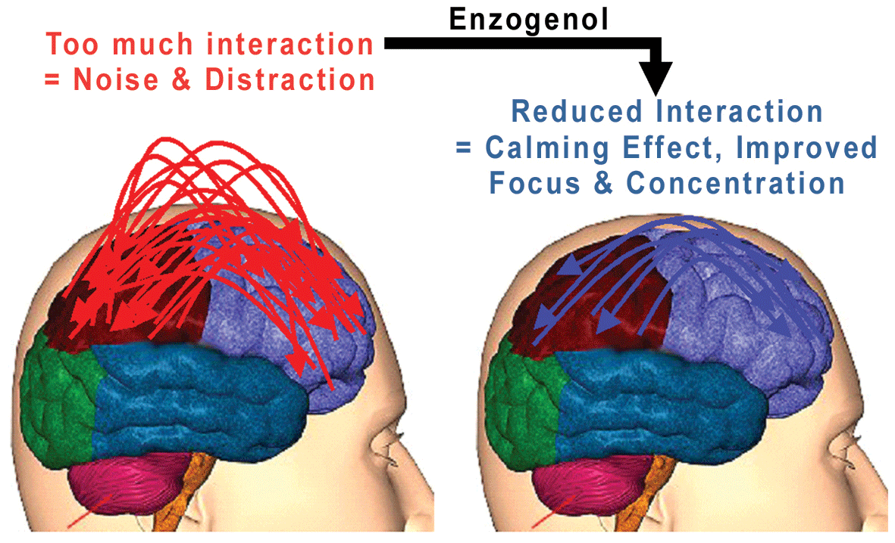
ENERGY+
KEY INGREDIENTS
Enzogenol®
Calms “monkey mind”
*These statements have not been evaluated by the Food and Drug Administration. This product is not intended to diagnose, treat, cure, or prevent any disease.

Slide 13
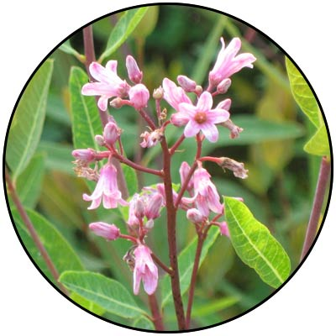
MOOD+
KEY INGREDIENTS
Venetron® (Rafuma)
Depression
*These statements have not been evaluated by the Food and Drug Administration. This product is not intended to diagnose, treat, cure, or prevent any disease.

Slide 14
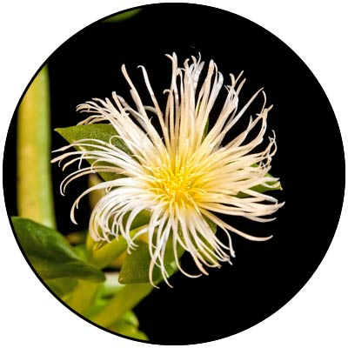
MOOD+
KEY INGREDIENTS
Zembrin® (Kanna)
Depression
*These statements have not been evaluated by the Food and Drug Administration. This product is not intended to diagnose, treat, cure, or prevent any disease.

Slide 15
Stress Reduction & Mood Enhancement
MOOD+
KEY INGREDIENTS
HAM-D SCORE
‘Global-Standard’ to assess severity of depression and response to therapy in clinical research
RESULTS
Reduction of stress and improvement of mood manifested through:
Statistically significant improved quality of sleep
Less fatigue
Enhanced work performance
Enhanced interest in daily activities
Less irritability, worry and insecurity
*These statements have not been evaluated by the Food and Drug Administration. This product is not intended to diagnose, treat, cure, or prevent any disease.
Notes:
Chiu et al. Proof-of-Concept Randomized Controlled Study of Cognition Effects of the Proprietary Extract Sceletium tortuosum (Zembrin) Targeting Phosphodiesterase-4 in Cognitively Healthy Subjects: Implications for Alzheimer’s Dementia. Evidence-Based Complementary and Alternative Medicine Volume 2014, Article ID 682014

Slide 16
fMRI Study Results Show Reduced Stress Response
MOOD+
KEY INGREDIENTS
Zembrin® can help in the
management of stress in
everyday life
A single dose of Zembrin® attenuates
reactivity within the part of the brain
(amygdala) that responds to threat/stress
*These statements have not been evaluated by the Food and Drug Administration. This product is not intended to diagnose, treat, cure, or prevent any disease.
Notes:
Terburg et al. Acute Effects of Sceletium tortuosum (Zembrin), a Dual
5-HT Reuptake and PDE4 Inhibitor, in the Human Amygdala and its Connection to the Hypothalamus. Neuropsychopharmacology (2013), 1–9.

Slide 17
Cognitive Set Flexibility
MOOD+
KEY INGREDIENTS
Cognitive Flexibility
Ability to shift attention between two or more tasks and the ability to adapt to rapidly changing directions and intelligently utilize the information.
Necessary for decision-making, impulse control and strategy formation.
CNS VitalSign® has been used for testing neurocognitive function by over 5,000 clinicians in 52 countries.
*These statements have not been evaluated by the Food and Drug Administration. This product is not intended to diagnose, treat, cure, or prevent any disease.
Notes:
Chiu et al. Proof-of-Concept Randomized Controlled Study of Cognition Effects of the Proprietary Extract Sceletium tortuosum (Zembrin) Targeting Phosphodiesterase-4 in Cognitively Healthy Subjects: Implications for Alzheimer’s Dementia. Evidence-Based Complementary and Alternative Medicine Volume 2014, Article ID 682014

Slide 18
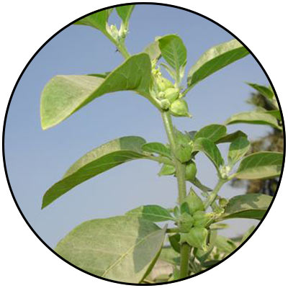
MOOD+
KEY INGREDIENTS
Sensoril® (Ashwagandha)
Anxiety
*These statements have not been evaluated by the Food and Drug Administration. This product is not intended to diagnose, treat, cure, or prevent any disease.
Notes:
Auddy et al. A Standardized Withania Somnifera Extract Significantly Reduces Stress-Related Parameters in Chronically Stressed Humans: A Double-Blind, Randomized, Placebo-Controlled Study. Journal of the American Nutraceutical Association Vol.11,No.1, 2008 pp50-56.

Slide 19
MOOD+
KEY INGREDIENTS
Sensoril® (Ashwagandha)
Anxiety
*These statements have not been evaluated by the Food and Drug Administration. This product is not intended to diagnose, treat, cure, or prevent any disease.
Notes:
Auddy et al. A Standardized Withania Somnifera Extract Significantly Reduces Stress-Related Parameters in Chronically Stressed Humans: A Double-Blind, Randomized, Placebo-Controlled Study. Journal of the American Nutraceutical Association Vol.11,No.1, 2008 pp50-56.

Slide 20
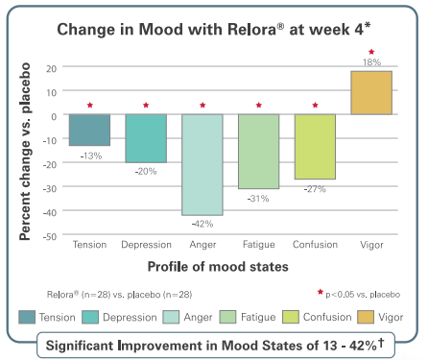
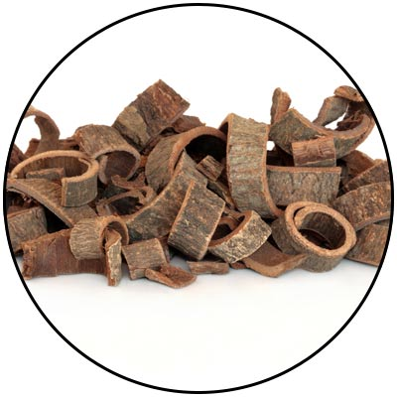
MOOD+
KEY INGREDIENTS
Relora®
(Magnolia & Phellodendron)
Anxiety
*These statements have not been evaluated by the Food and Drug Administration. This product is not intended to diagnose, treat, cure, or prevent any disease.
Notes:
Talbott et al. Effect of Magnolia officinalis and Phellodendron amurense (Relora®) on cortisol and psychological mood state in moderately stressed subjects. Journal of the International Society of Sports Nutrition 2013, 10:37
Garrison et al. Effect of a proprietary Magnolia and Phellodendron extract on weight management: a pilot, double-blind, placebo-controlled clinical trial. Altern Ther Health Med. 2006;12(1):50-54.
Kalman et al. Effect of a proprietary Magnolia and Phellodendron extract on stress levels in healthy women: a pilot, double-blind, placebo-controlled clinical trial. Nutrition Journal 2008, 7:11

Slide 21
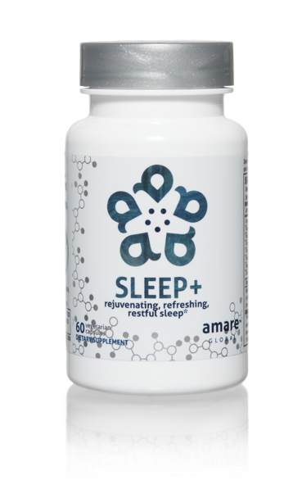
Why is Sleep+ Different?
Worldwide exclusive on patented corn-grass extract
  Research-supported MaizinolTM (30x potency corn grass)
  Improves Serotonin signaling (depression/anxiety)
  Improves Melatonin signaling (sleep quality)
    40% more time in Deep Sleep (body recovery)
    40% more time in REM Sleep (brain rejuvenation)

Slide 22





microbiome-boosting fruits and vegetables*
Increases heat shock protein expression*
Enhances internal cellular cleanup (autophagy)*
Stress resilience benefits that you can FEEL at the cellular level*
*These statements have not been evaluated by the Food and Drug Administration. This product is not intended to diagnose, treat, cure, or prevent any disease.

Slide 23

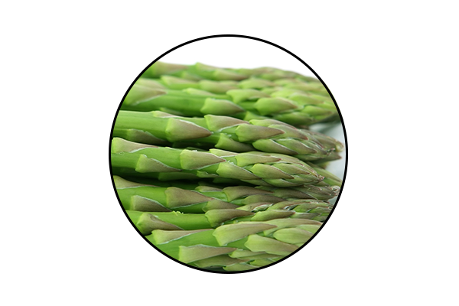
GBX SUPERFOOD
KEY INGREDIENTS:
™
Anti-Stress Phytobiotic Proprietary Blend
ETAS™: Enzyme-Treated Japanese Asparagus
Supports mood and cognitive function*
Protects neuronal cells*
Induces the production of natural anti-stress molecules called Heat Shock Proteins*
*These statements have not been evaluated by the Food and Drug Administration. This product is not intended to diagnose, treat, cure, or prevent any disease.
Notes:
ETAS™: Enzyme-Treated Japanese Asparagus
Uniquely sourced from Japan
Has been used for > 5,000 years
Derived from the lower stalk portion of asparagus stalks, where the most phytonutrients are found.
Rich in hydroxymethylfurfural derivatives, which is a necessary compound that induces HSP70 microRNA expression.
ETAS™: Mechanism of Action
What is HSP70? Heat Shock Proteins
ETAS works by increasing the production of HSP70: an intracellular protein produced naturally by the body when it encounters a stressor, such as extreme heat.
Clinical Studies have shown ETAS induces a significant production of HSP70 microRNA expression activities that helps with biological activities such as cellular protection, cellular repair, reduced cell death, blood flow, cellular stress, anti inflammatory activity, sleep, mood, energy, and antioxidant activity.
ETAS™: Mechanism of Action
Why is HSP70 production important?
As we age, the Heat Shock Protein production to stressors decrease with age.
ETAS helps preserve and maintain the appropriate HSP70 expression to promote brain health, stress response and cognitive performance as we age!
HSP70 has a number of beneficial, physiological effects in the body, including reduced cell death, anti-inflammatory activity and antioxidant activity.
There is no reason why you shouldn’t feel 25, when you’re 50!

Slide 24

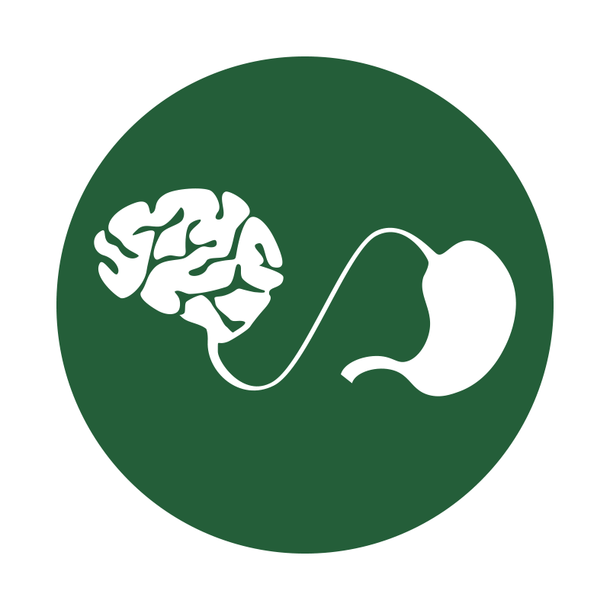

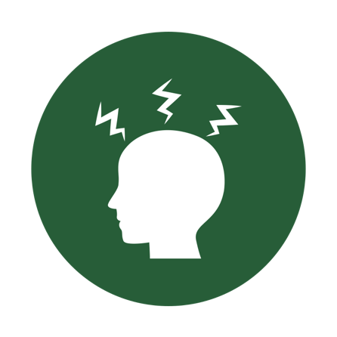
microbiome-boosting seed powder*
Optimizes gut-brain axis communication*
Naturally supports microRNA signaling*
Helps manage feelings of tension and anxiety*
*These statements have not been evaluated by the Food and Drug Administration. This product is not intended to diagnose, treat, cure, or prevent any disease.

Slide 25
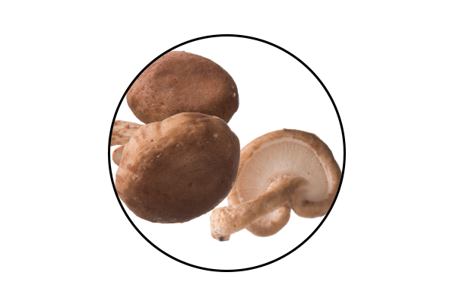
GBX SEEDFIBER
KEY INGREDIENTS:
™
AHCC®: Active Hexose Correlated Compound
Cultured mushroom mycelia extract
Effective for immune support*
Rich in alpha-glucans*
Supports microRNA signaling between the microbiome and the central nervous system*
*These statements have not been evaluated by the Food and Drug Administration. This product is not intended to diagnose, treat, cure, or prevent any disease.
Notes:
AHCC®: Active Hexose Correlated Compound
Is a compound of cultured, mushroom mycelia extract that is rich in alpha-glucans.
It is uniquely sourced in Japan, at the highest quality standards.
Known as the #1 supplement in Japan for immune function for over 25 years.
AHCC®:
Extracted through a special lipid culturing process that delivers an extract that has superior bio-absorption and efficacy.
AHCC contains a partially acylated alpha glucan 1,4 that is known to have positive effects on immune cell production, intestinal immunity, T cell activity, cytokine production, antioxidant effects, and microRNA signaling from the microbiome to the central nervous system.
AHCC helps reduce the production of glucocorticoids in the cases of stress. This manifests in improved mood and energy.
AHCC is beneficial for gut health, in which it reduces intestinal inflammation to favor the development of a healthy gut microflora specific to the strains we use in our Probiotics and MentaBiotics™ (more Bifidobacterium, less Clostridium).
Helps improves gut integrity by providing protection from Candida, Pseudomonas and other detrimental bacteria types.
Facilitating and building a responsive immune system allows our body to repair, rebuild and maintain itself at a cellular level, allowing the most efficient communication between your microbiome and your central nervous system.

Slide 26
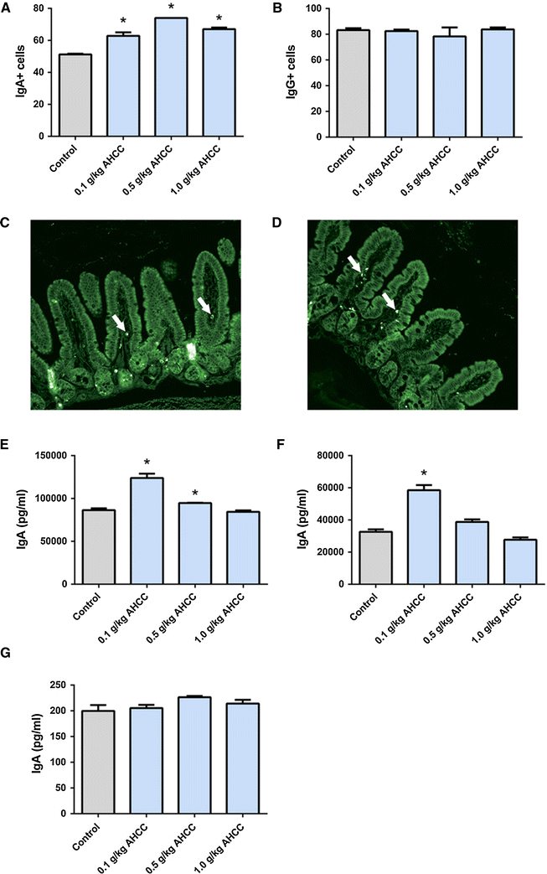
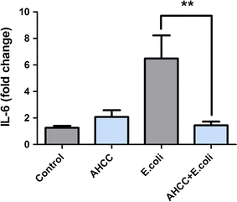
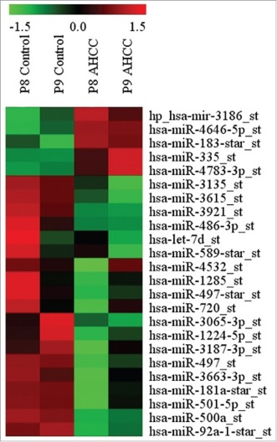
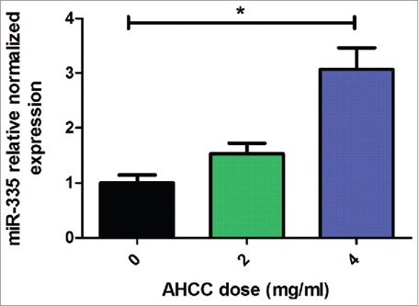

Roles of AHCC in the Gut-Brain Axis
Anti-inflammatory/immune Homeostasis
Prebiotic (TLR2/4)
miRNAs
Mallet et al.,
European Journal of Nutrition 2015
Mallet et al.,
European Journal of Nutrition 2015
Graham et al., Cancer Biology and Therapy 2017

Slide 28

Kids Mood+
Focus, Attention, Mood, Listening, Tension, Irritation
School work, Math, Reading, Writing, Social Relationships
-29%
-18%

