Slide 1
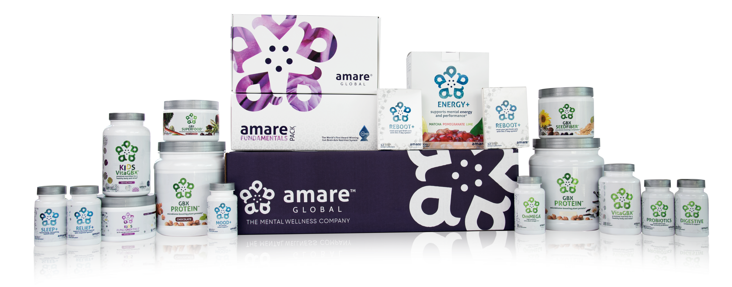
PRODUCT
PRESENTATION

Slide 2
OUR MISSION…
is to create a holistic mental wellness platform that connects a purpose-driven community of passionate people.

Slide 3


MENTAL WELLNESS

Slide 4

Grim Reality
Americans spend over $100 billion annually on “feel better” products, from painkillers and anti-depressants to alternative and complementary therapies.
Nearly 100 million Americans suffer from occasional aches and pains — and is one of the most common reasons that people look to complementary and alternative medicine (CAM) for non-pharmaceutical options.
Globally, more than 350 million people are affected by feelings of depression each year.
More than 80% of the nation’s 20 million college students feel “exhausted and overwhelmed by stress” — and more than one-third feel “depressed” to the point of dysfunction.

Slide 5
Grim Reality
800,000 people die of suicide each year — that’s more
than 2,000 suicides per day.
24 million people, some as young as 12 years old, received treatment for illicit drug or alcohol abuse in 2016.
1 in 5 new mothers in the US report postpartum depression each year.
The World Health Organization (WHO) calls stress “the health epidemic of the 21st century.”
85% of the nation’s 20 million college students reported feeling overwhelmed by stress, and more than 35% reported feeling “depressed” to the point of dysfunction.

Slide 6

1 TRILLION DOLLARS
“Cultural change” is emerging in the global attitude toward stress and mental health
Over the next 10-20 years there will be no bigger focus in the natural nutrition or pharmaceutical industries, than brain health and mental wellness
A massive scientific shift
TIMING IS EVERYTHING!

Slide 7
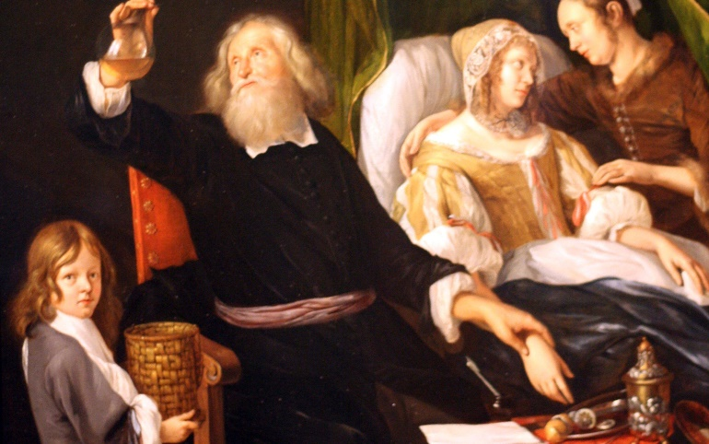

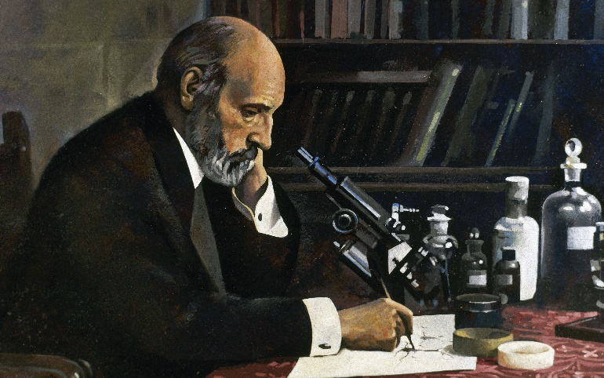

New Era in Science/Medicine
1600s
1900s
1800s
2000s

Slide 8
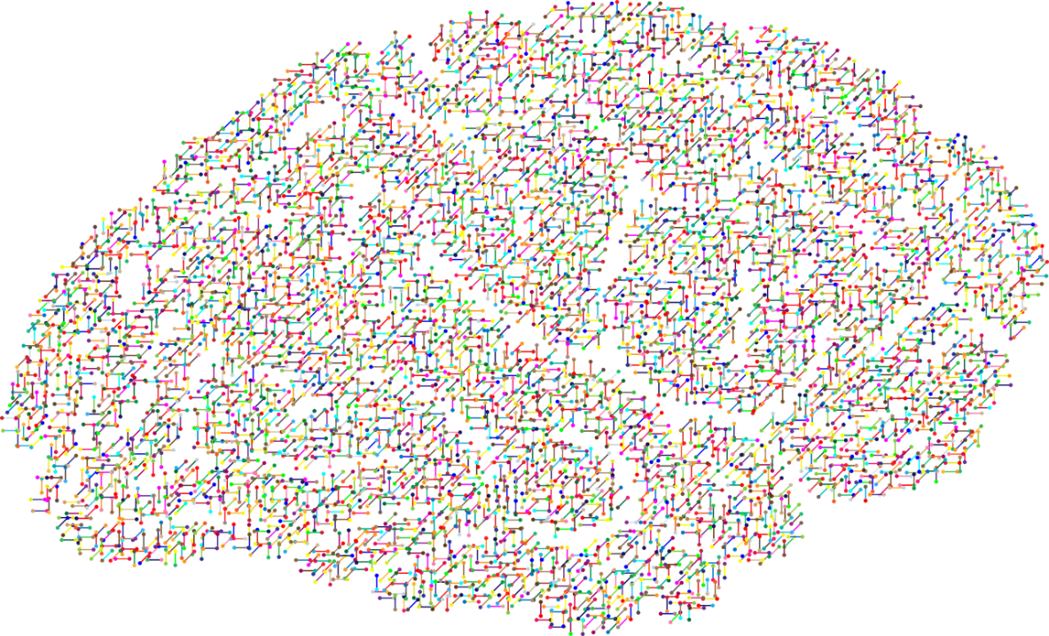
The NEW Science of
Mental Wellness
Science has forever focused on the BRAIN as the primary source to addressing mental wellness problems and answers.
We’ve been relying highly on antidepressants and other forms of serotonin reuptake inhibitors (SSRIs) to resolve these issues.
BUT IS THIS THE RIGHT SOLUTON?

Slide 9

RECENT SCIENTIFIC
DISCOVERIES
Science now tells us that we actually have a SECOND BRAIN!
There has been a massive scientific shift towards the MICROBIOME, also known as our gut and second brain, as being the source to addressing mental wellness issues.

Slide 10
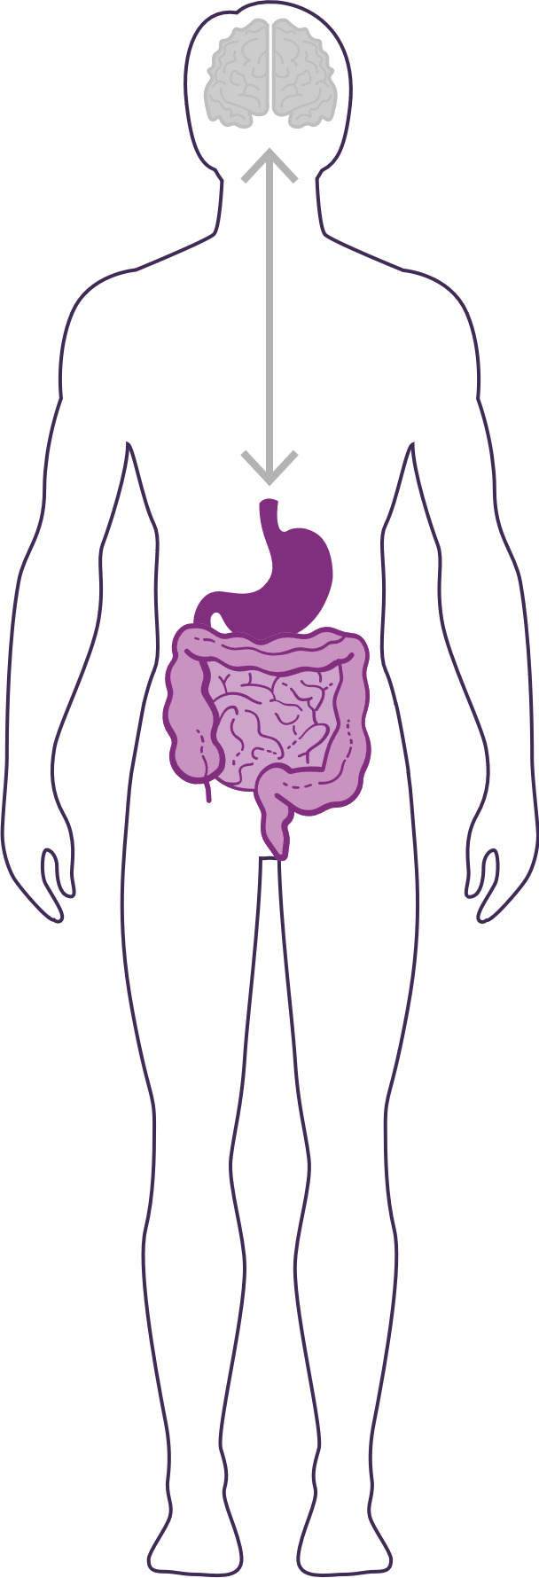
DID YOU KNOW?
90% of the cells in your body are non-human
  Human genes = ~23,000
  Bacterial genes= ~20 million
  (~1,000x MORE than human genes)
The microbiome is an ecological community of trillions of bacteria living symbiotically in/on our body
  “2nd Brain” = 3-4 lbs (approximately the same size as our 1st brain)
YOUR GUT IS CONSIDERED YOUR SECOND BRAIN

Slide 11
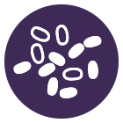
HOW IMPORTANT IS YOUR
MICROBIOME?
Communicates with the brain to regulate health, weight, immune function, digestive function, mood, and overall mental health.
What we put in our bodies affects the microbiome, which in turn affects our mind and other crucial bodily systems.
The microbiome plays an important role in the way you feel mentally and physically.
IN BALANCE
Feeling great
OUT OF BALANCE
This explains why you have those “GUT FEELINGS”
Feeling fatigue, sad, tense, hungry, heavy, bloated, confused, stiff/sore

Slide 12
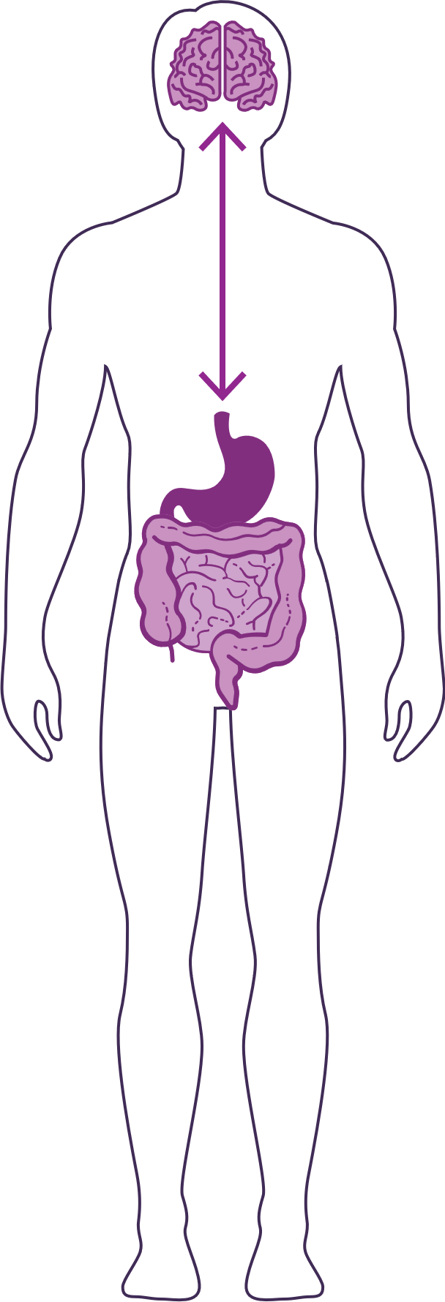
HOW DO YOUR “TWO BRAINS”
COMMUNICATE?
Our “two brains” communicate through a highly extensive, multi-directional network, known as the gut-brain axis or what we refer to as the GBX.
THE NETWORK CONSISTS OF:
“wires” — nerves
“chemicals” — neurotransmitters/hormones
“cells” — immune system
The GBX connects our
nervous system (brain)
immune system (axis)
and gastrointestinal system (gut)
with a vast array of cellular and biochemical messengers throughout the entire body, which include the microbiome, hormones, cytokines, and neurotransmitters.

Slide 13


Slide 14
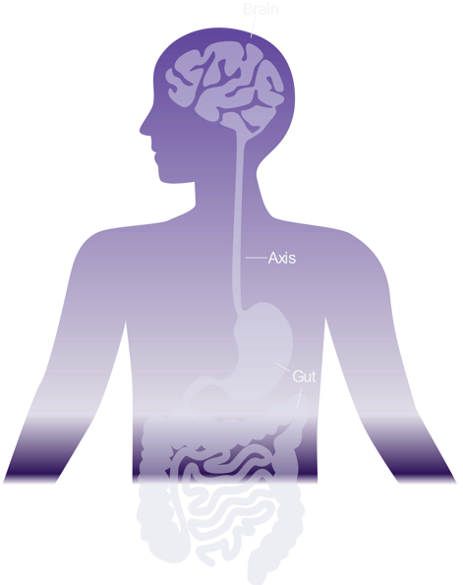



HEALTHY GUT HEALTHY MIND
TWO Brains?
Did you know that we have two brains? One in our head and one in our gut — the 2nd brain. They are connected by a communication axis.
The emerging science
of the gut-brain axis
(GBX) indicates that
many mental wellness
issues originate
as imbalances in
the GBX.
100% Human
Did you know that we have
~100 trillion microorganisms across more than 10,000 different species (Microbiota) in our GI tract? Compare that to
our ~10 trillion human body cells and we are only 10% human! Those same microbiota have ~9 million genes (Microbiome) compared to our
~23,000 human genes. Therefore, based on
gene count,
we are
less than 1% human!
Just like weeds compete with flowers in a garden, “bad” bacteria compete with “good” bacteria within our gut. In a healthy and balanced microbiome, “bad” bacteria struggle to flourish.

Slide 15
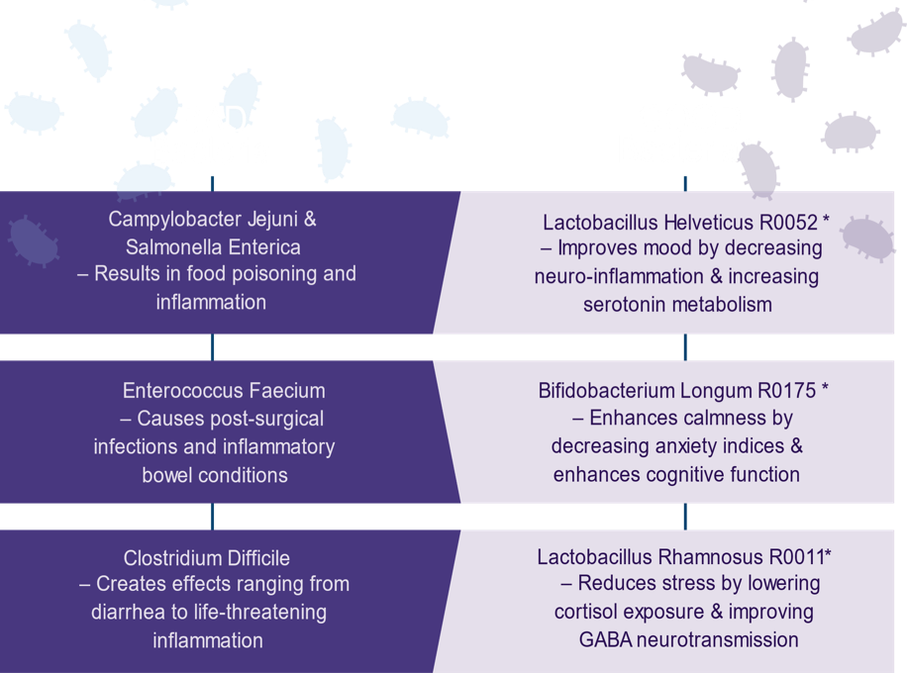




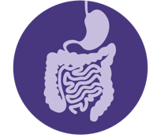
Healthy Inflammatory Balance
Robust Immune Protection
Optimal Digestive Process
*featured in MentaBiotics®

Slide 16








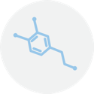
IT GOES BOTH WAYS…
“Butterflies in our stomach” form when we’re in love or anxious
When we eat, receptors in the gut cause the release of enzymes to aid digestion
Gut cells, including microbiome bacteria, send signals to the brain via nerves and hormones to indicate hunger or satiety (fullness)
Fear or sadness makes us “sick to our stomach”
Acute stress can suppress our appetite (short-term), while chronic stress can increase appetite and cravings for comfort foods (stress-eating)
The gut produces as much as 60%-90% of neurotransmitters involved in mental wellness, including dopamine and serotonin

Slide 17




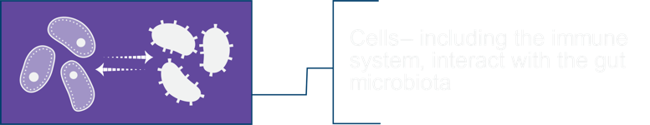
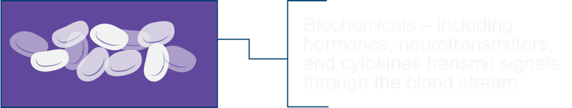
The “Axis” between the Gut and the
Brain coordinates communications

Slide 18

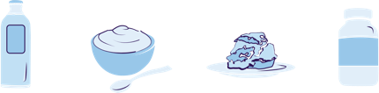
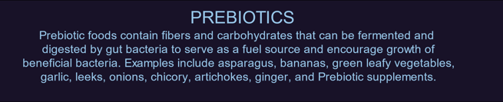


Balance
the GUT
with NUTRITION
PROBIOTICS
Probiotic foods contain live “good bacteria” which support mental wellness and aid digestion. Examples include fermented foods such as yogurt, kefir, kimchi, kombucha, sauerkraut, miso, tempeh, and probiotic supplements.
PREBIOTICS
Prebiotic foods contain fibers and carbohydrates that can be fermented and digested by gut bacteria to serve as a fuel source and encourage growth of beneficial bacteria. Examples include asparagus, bananas, green leafy vegetables, garlic, leeks, onions, chicory, ginger, and prebiotic supplements.
PHYTOBIOTICS
Phytobiotic foods are rich in flavonoids which protect good bacteria and establish a hospitable environment for the growth of good and displacement of bad bacteria.
Examples include apples, grapes, dark chocolate, and berries.

Slide 19







Mindfulness
Practice such as
meditation, yoga, gratitude, and mindful breathing reduce stress and anxiety
Take time for a
MINDFUL MEDITATION
Sleep
Inadequate or poor quality sleep increases stress hormone exposure (cortisol) and interferes with mood and mental function
Take time to
SLEEP
Physical Activity
Regular exercise is shown to reduce stress, anxiety and depression as effectively as antidepressant drugs
Take time to
MOVE

Slide 20

IS YOUR GUT HEALTHY?
HEALTHY
STATUS
UNHEALTHY
STATUS
Normal behavior, cognition function and emotional state
Healthy levels of inflammatory cells and/or mediators
Healthy gut microbiota
Alterations in behavior, cognition, emotion and nociception
Altered levels of inflammatory cells and/or mediators
Intestinal dysbiosis

Slide 21
THE THREE THINGS YOU SHOULD KNOW ABOUT
MENTAL WELLNESS
How you feel is not just in your head — it’s also in your gut.
Our “second brain” includes the microbiome and plays a major role in mental wellness.
You can now DO something NATURALLY to improve your mental wellness.
WHERE ARE YOU ON THE MENTAL WELLNESS CONTINUUM? (Circle your current number)
1
2
3
4
5
6
7
8
9
10
DISEASE STATUS
“NORMAL”
OPTIMIZED
Depression
Anxiety
Diabetes
Obesity
Heart Disease
Autoimmune
Arthritis
Fibromyalgia
CFS
Dementia
ADD / ADHD
Alzheimer’s
Fatigue
Tension
Sad
Brain Fog
Headaches
Acne
Eczema
Congestion
URTIs
Joint Pain
Muscle Pain
Bloated
Chubby
Energetic
Calmness
Happy
Sharp
Creative
Clear Skin
Rarely Sick
Flexible
Lean
Strong
Resilient
RED
ORANGE
YELLOW
GREEN
BLUE
INDIGO
VIOLET

Slide 22
20+ years of experience developing nutritional products.
Fellow of the American College of Nutrition, the American College of Sports Medicine, and the American Institute of Stress.
Author of two academic textbooks, an award-winning documentary film, and several best-selling books that have been translated into multiple languages.
Featured guest on the “Dr. Oz Show,” “Ask Dr. Nandi,” The TED stage and the White House.
Served as a nutrition educator for elite-level athletes.
Diplomate of the International Olympic Committee’s (IOC) Sports Nutrition program.
Dr. Shawn Talbott
Amare’s Chief Science Officer
PhD, CNS, LDN, FACSM, FAIS, FACN

Slide 23





Scientific Advisory Board
Shawn Talbott
PhD, CNS, LDN, FACSM, FAIS, FACN
Chief Science Officer
Tamara Tifft
L.Ac., OMM
Scientific Advisory Board Member
Kerry Hughes
M.Sc.
Scientific Advisory Board Member
Emeran Mayer
MD, PhD
Scientific Advisory Board Member
Trish Henrie-Barrus
PhD
Scientific Advisory Board Member

Slide 24
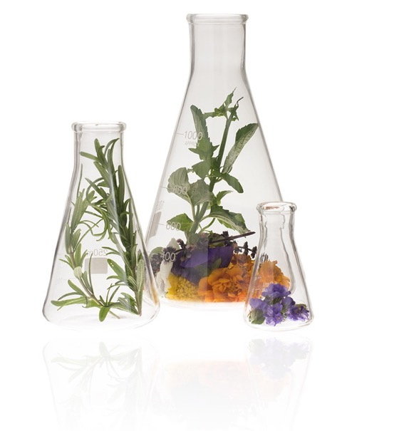
Amare Quality
Control
ANCIENT WISDOM
MODERN INNOVATION
ANALYTICAL VERIFICATION
RESEARCH PROVEN
ETHICAL SOURCING
from the 5,000-year-old practice of traditional Chinese medicine and Ayurveda
using bio-psycho-neuro-immunology to create new proprietary formulas
of our safe, pure, potent and traceable all-natural, standardized active compounds
claims, substantiation and studies that prove our products work
of exotic ingredients through our global supply chain of sustainability-focused partners

Slide 25
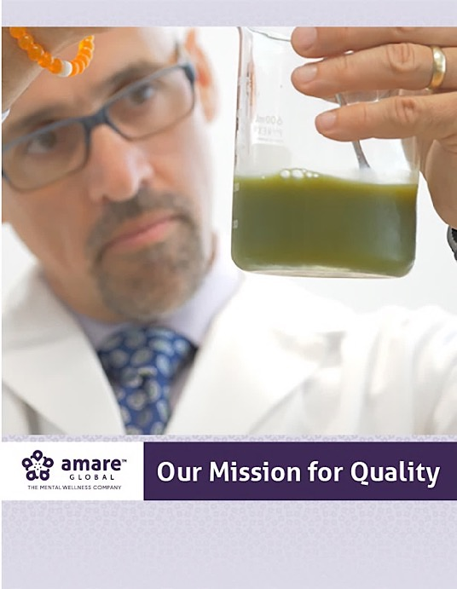
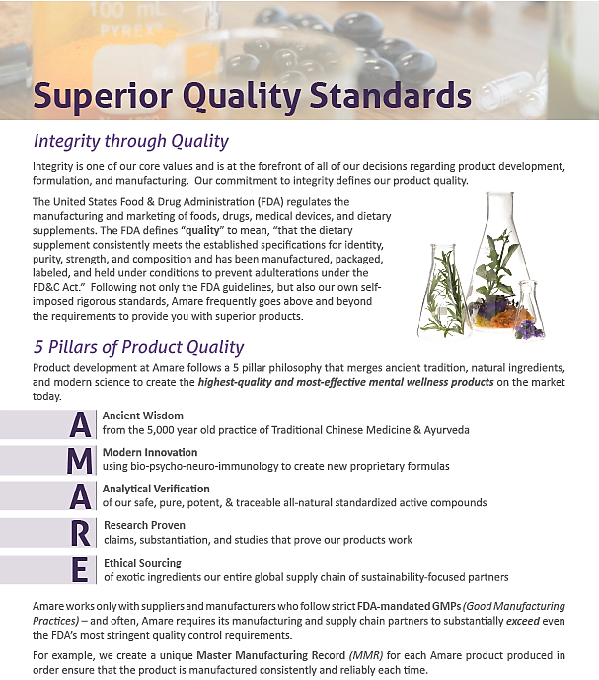

Slide 26
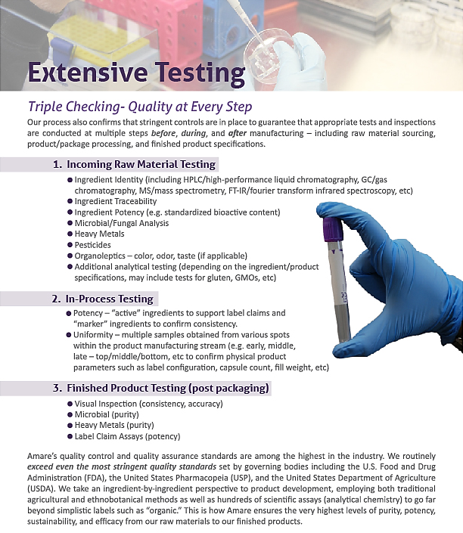
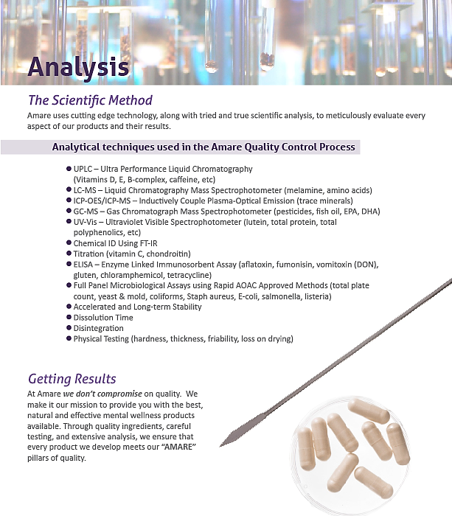

Slide 27
INTRODUCING AMARE GLOBAL PRODUCTS

Slide 28
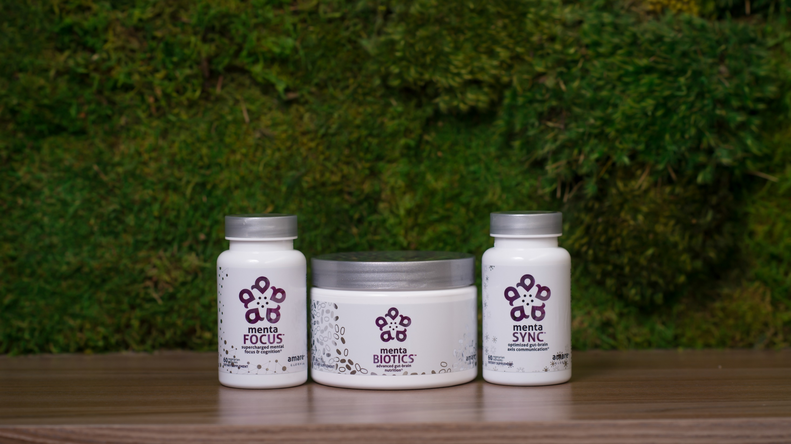

Amare’s flagship product line features our most popular cornerstone products! The products are designed to improve every aspect of the gut-brain axis for optimal mental wellness.*
FUNDAMENTALS
*These statements have not been evaluated by the Food and Drug Administration. This product is not intended to diagnose, treat, cure, or prevent any disease.

Slide 29
Why is FundaMentals Different?
World’s 1st comprehensive/holistic GBX system
  Addresses each level of GBX balance
  Microbiome modulation
  Gut integrity
  Immune priming
  Inflammatory balance
  Neurotransmitter signaling
Specific probiotic strains for depression/anxiety/stress
Specific prebiotics fibers for stress/resilience
Patent-pending phytonutrients for GBX support
Scientifically-supported formula
  7 peer-reviewed scientific presentations and publications*
  *Effect of Coordinated Probiotic/Prebiotic/Phytobiotic Supplementation on Microbiome Balance and Psychological Mood State in Healthy Stressed Adults
  Functional Foods in Health & Disease Journal
  FFHD: Online ISSN:2160-3855
  Vol 9, No 4 (2019)
  https://www.ffhdj.com/index.php/ffhd/article/view/599/

Slide 30
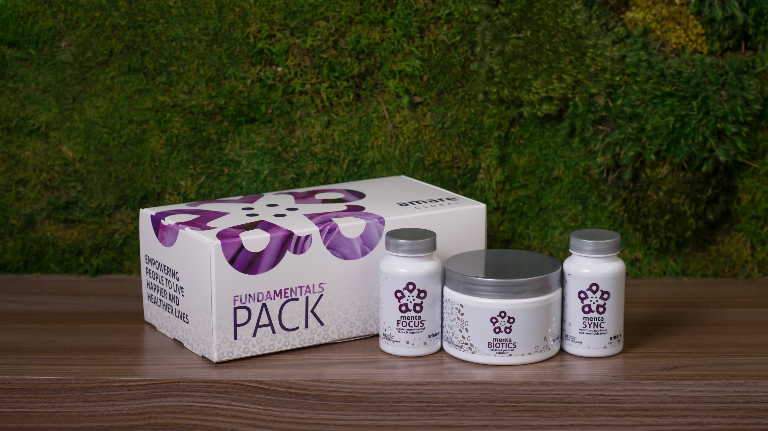
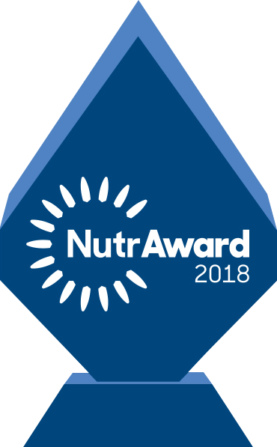
The World’s First Award-Winning Gut-Brain Axis
Nutrition System
AMARE FUNDAMENTALS PACK
®
2018 NutrAward Winner for
“BEST NEW FINISHED PRODUCT”
*These statements have not been evaluated by the Food and Drug Administration. This product is not intended to diagnose, treat, cure, or prevent any disease.

Slide 31

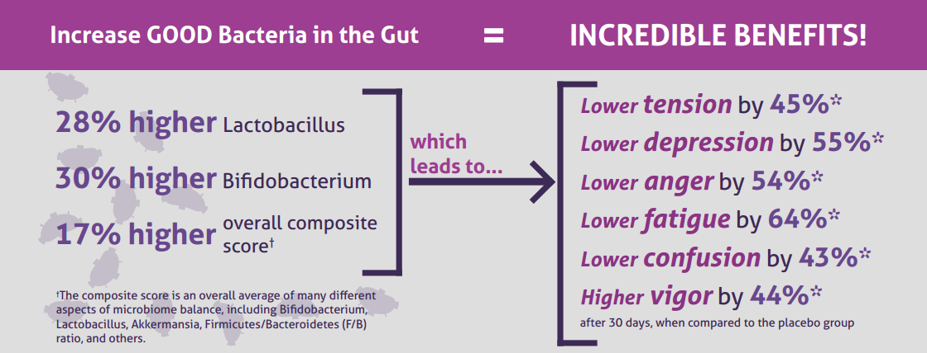
CLINICAL STUDY
The Amare FundaMentals Pack has been clinically proven to:

Slide 32
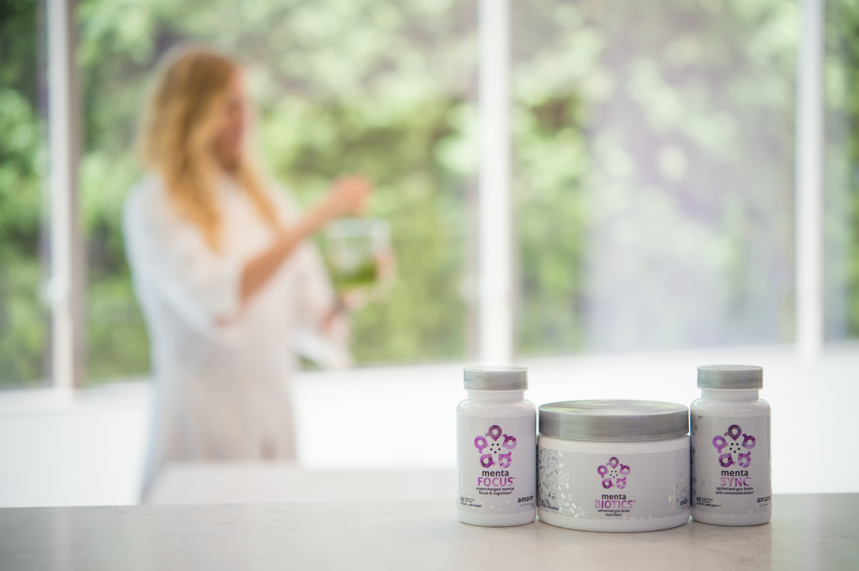
CLINICAL STUDY
The subjects in this study were “healthy stressed” individuals — meaning they represent the vast majority of the population who have stress, fatigue, brain fog, and the modern 21st century “syndrome of the blahs.”

Slide 33
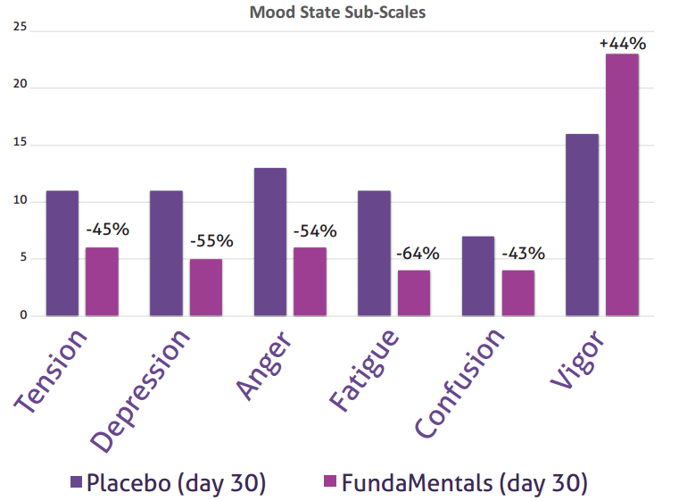
CLINICAL STUDY
Following 30 days of supplementation with the Amare FundaMentals Pack (MentaBiotics, MentaFocus and MentaSync), the FundaMentals group showed significant improvements (compared to Placebo) in populations of good gut bacteria and overall microbiome balance, as well as significantly better psychological mood states.

Slide 34
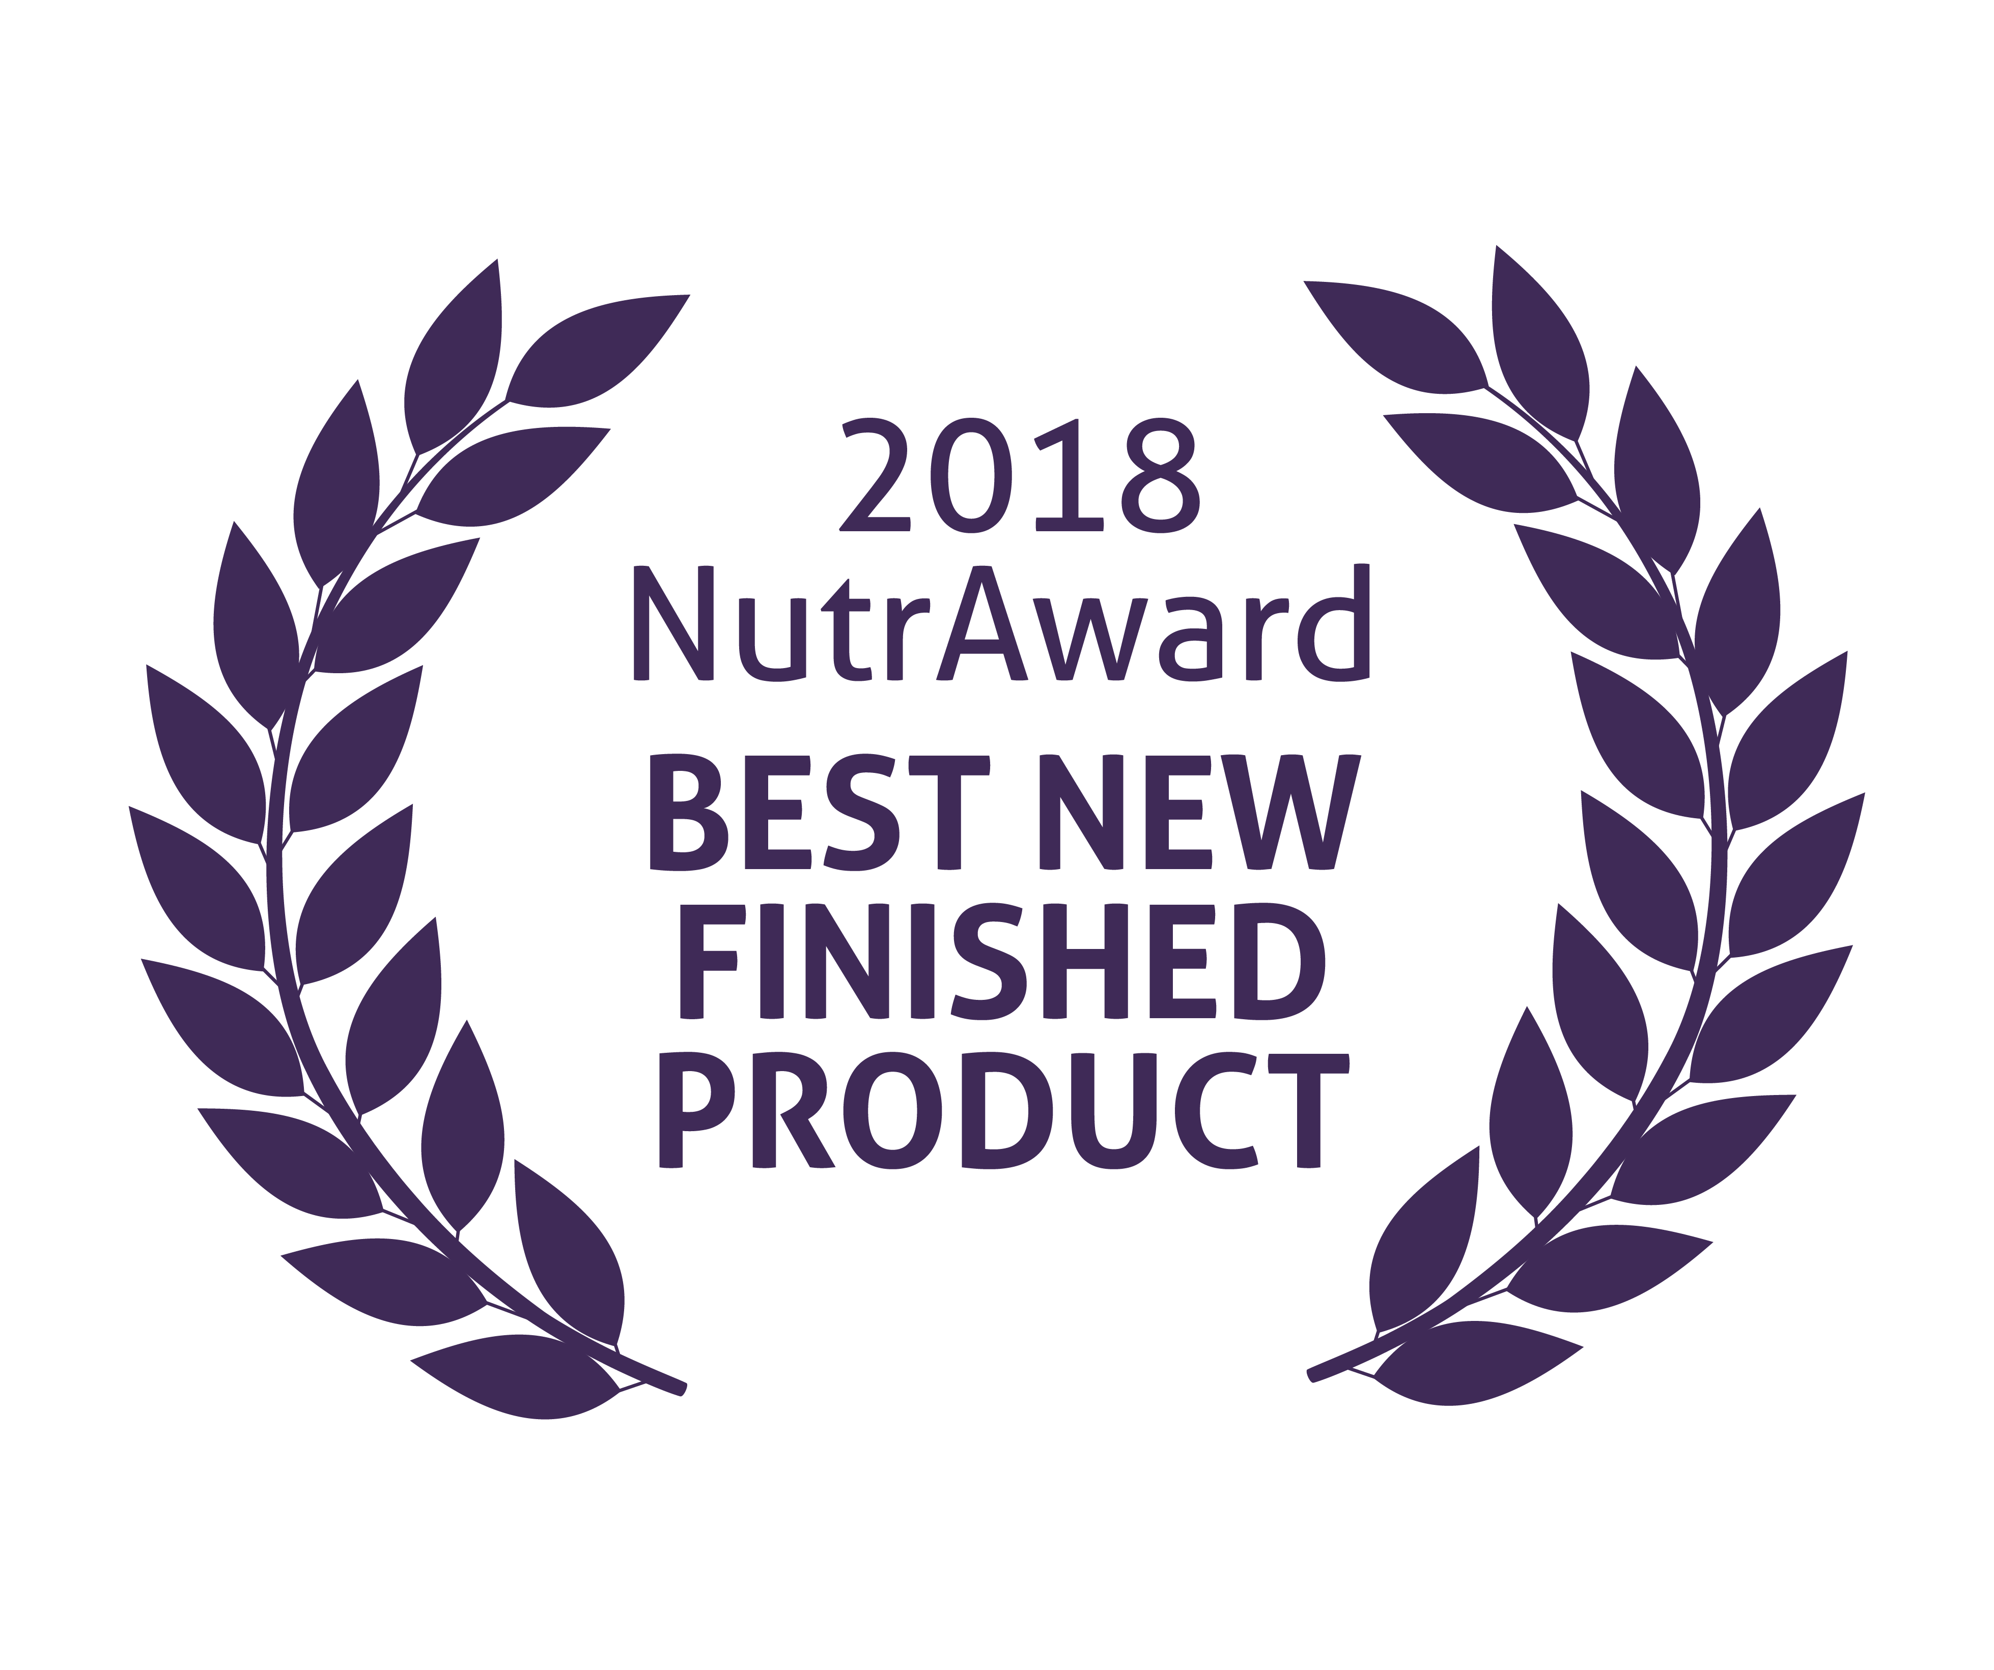
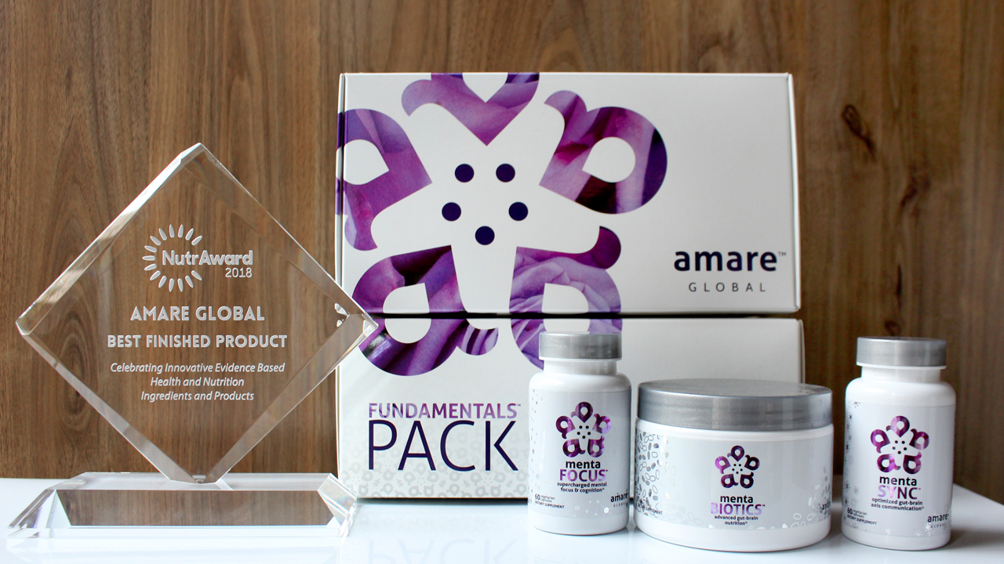
World’s First Award-Winning
Gut-Brain Axis Nutrition System!
The NutrAward recognizes companies that are investing in rigorous and measurable scientific studies to prove the efficacy of their proprietary ingredients or technologies.
Submissions are judged on their merit in the following areas:
Viable product
Emerging category
Creative product concept
Distinct health application
Unique packaging
Matchless marketing

Slide 35
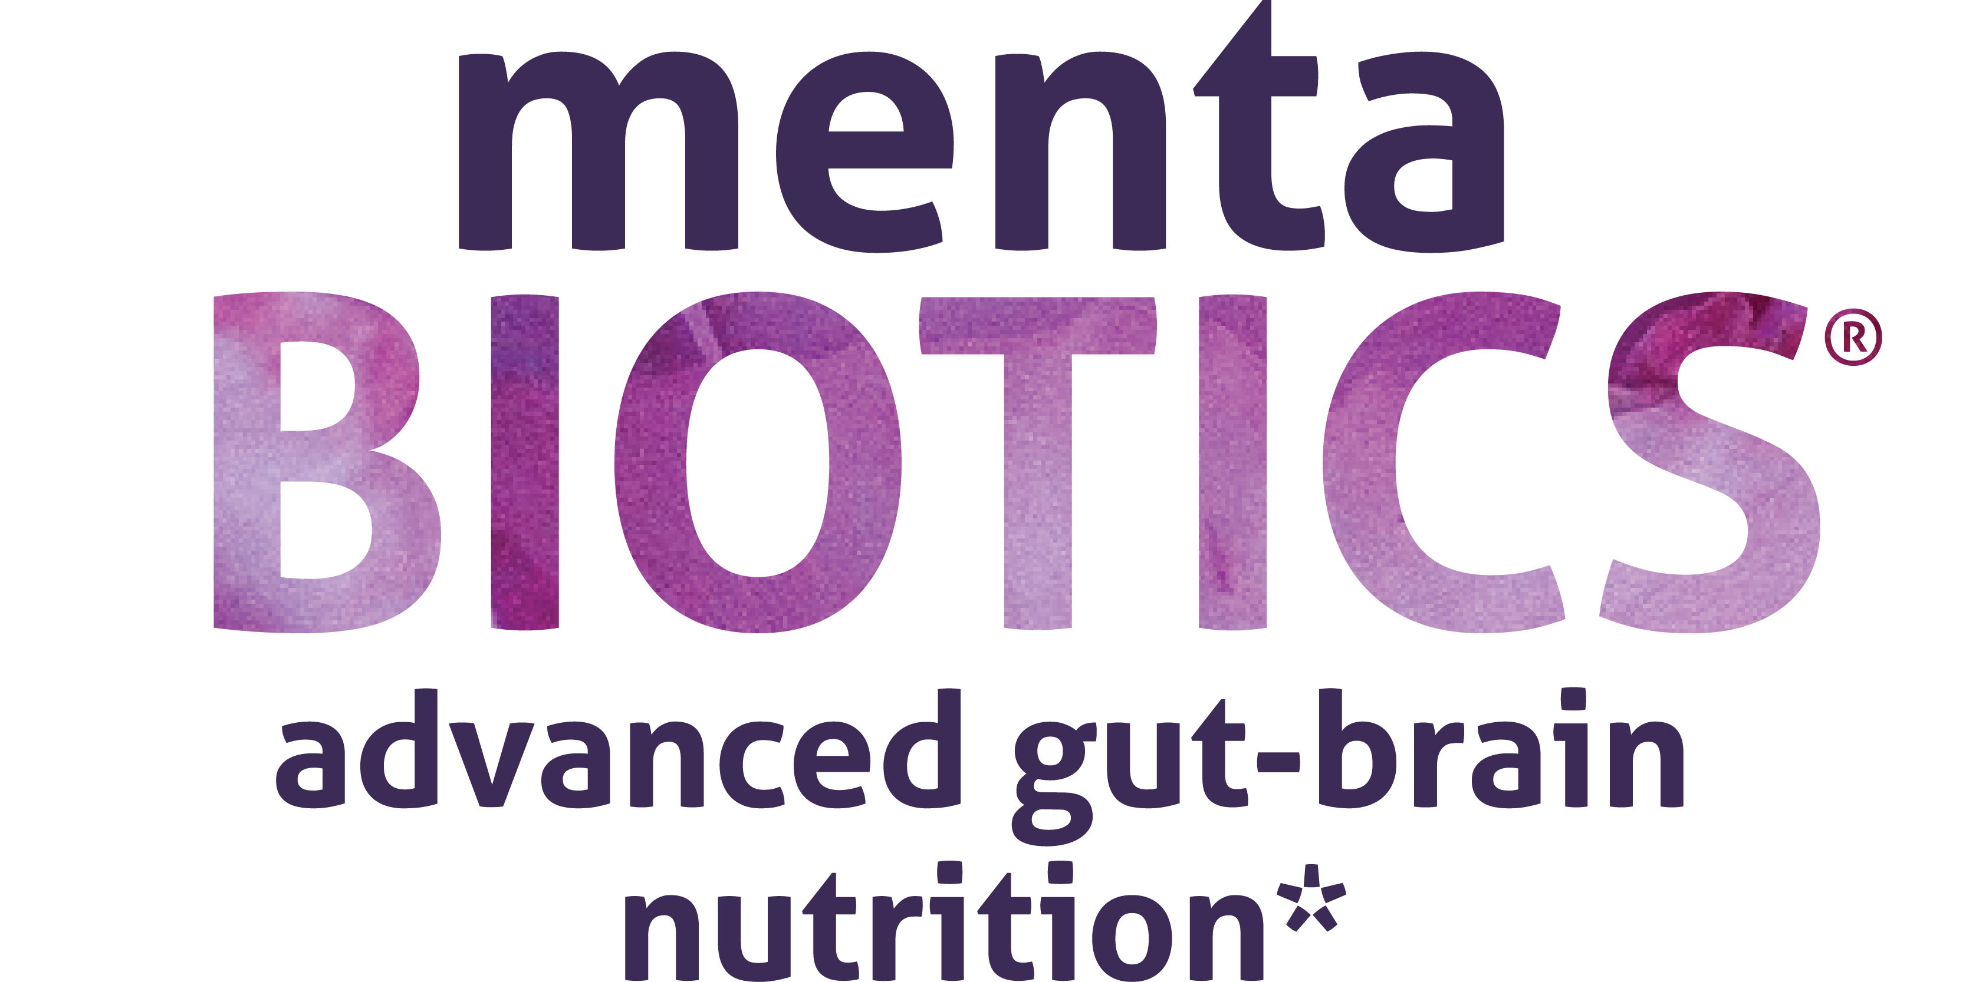

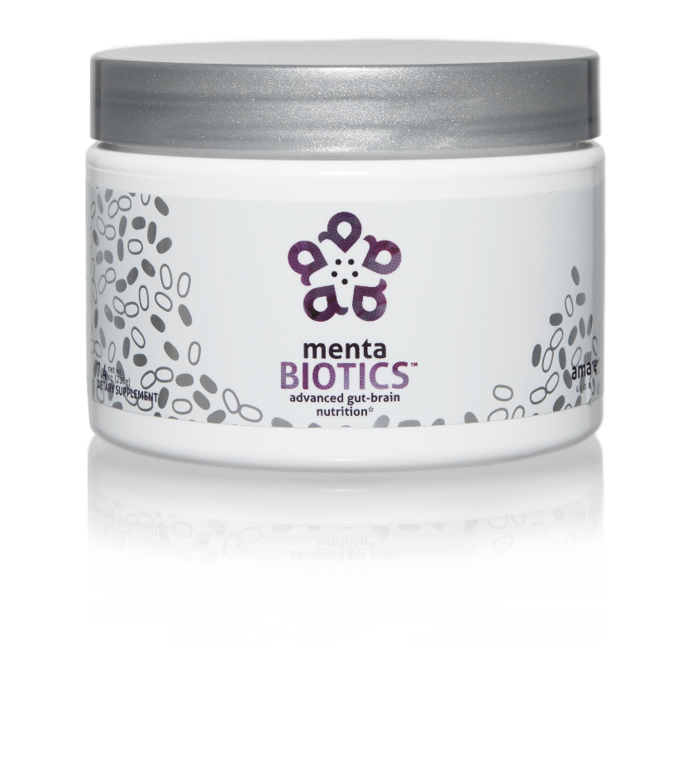
AMARE’S FLAGSHIP PRODUCT
SUPPORTS FEEL-GOOD NEUROTRANS-MITTERS
INCREASES GOOD BACTERIA
The most comprehensive combination of unique strains of probiotics, prebiotics and phytobiotics that have been scientifically shown to improve mental wellness.*
Item Code:
Retail Price:
Wholesale Price:
Subscribe & Save:
S001
$100.00
$74.95 / 65 PV
$66.95 / 58 PV
*These statements have not been evaluated by the Food and Drug Administration. This product is not intended to diagnose, treat, cure, or prevent any disease.

Slide 36

MENTABIOTICS
KEY BENEFITS & FEATURES
®
Improves aspects of mental wellness by populating the microbiome system with specific strains of probiotics and prebiotics*
Supports the growth and vitality of a range of beneficial gut bacteria*
Helps normalize gut, immune and brain function*
Reduces stress and promotes a positive mood*
Ingredients proven to improve mood and reduce tension in human clinical trials*
*These statements have not been evaluated by the Food and Drug Administration. This product is not intended to diagnose, treat, cure, or prevent any disease.

Slide 37


GUT – BRAIN - AXIS
The growth and vitality of healthy beneficial bacteria in the gut is a key component to overall well-being.
60% Decrease in irritability scores*‡
55% Decrease in anxiety scores*‡
50% Decrease in depression scores*‡
49% Reduction in overall distress*‡
70% Increase in “good” bacteria*‡
Improves overall mood by increasing positive mood and decreasing negative mood*‡
*These statements have not been evaluated by the Food and Drug Administration. This product is not intended to diagnose, treat, cure, or prevent any disease.
‡BASED ON KEY INGREDIENTS CLINICAL STUDIES

Slide 38
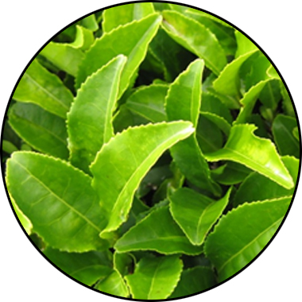
MENTABIOTICS
KEY INGREDIENTS
®
Suntheanine
Increases alpha waves
“Relaxed alertness”
*These statements have not been evaluated by the Food and Drug Administration. This product is not intended to diagnose, treat, cure, or prevent any disease.

Slide 39
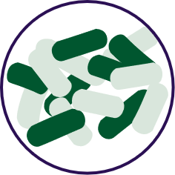


FOR YOUR GUT…
THE PROBIOTIC STRAIN MATTERS
Lactobacillus rhamnosus R0011:
Reduces stress by lowering cortisol exposure and improves GABA neurotransmission*
Stress
Bifidobacterium longum R0175:
Enhances calmness by decreasing anxiety indices and improves cognitive function*
Anxiety/
Cognition
Lactobacillus helveticus R0052:
Improves mood by decreasing neuro-inflammation and increasing serotonin*
Mood
*These statements have not been evaluated by the Food and Drug Administration. This product is not intended to diagnose, treat, cure, or prevent any disease.

Slide 40
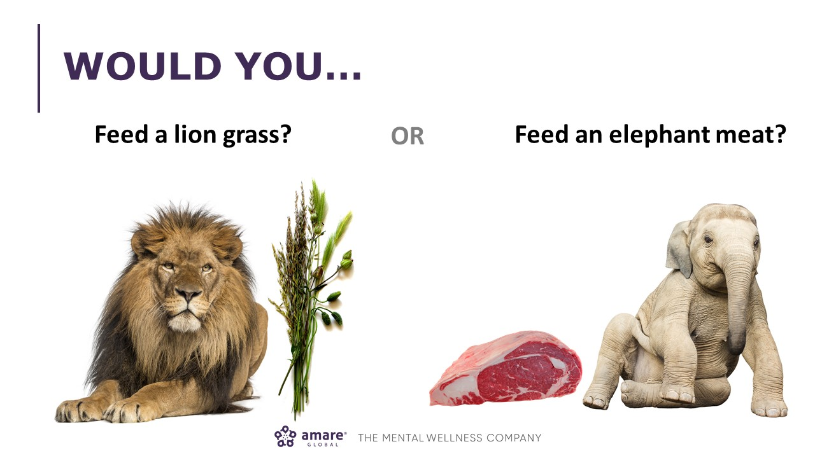

Slide 41


Slide 42


Prebiotic Proprietary Blend…
Supports the growth of preferred bacteria
These prebiotics support the growth and vitality of a range of beneficial gut bacteria, particularly Lactobacillus and Bifidobacterium species (featured in MentaBiotics®).
Bimuno® GOS (Galacto-Oligo-Saccharides)
Resets and increases friendly gut bacteria, maintains immune health, controls inflammation in the body, supports your microbiome balance, highly effective and natural way of increasing preferred bacteria in your gut.*
SunFiber®, Galactomannan Fiber — a.k.a. PHGG (partially hydrolyzed guar gum)
Helps improve the growth and vitality of beneficial bacteria, including Bifidobacteria and Lactobacillus.*
*These statements have not been evaluated by the Food and Drug Administration. This product is not intended to diagnose, treat, cure, or prevent any disease.

Slide 43
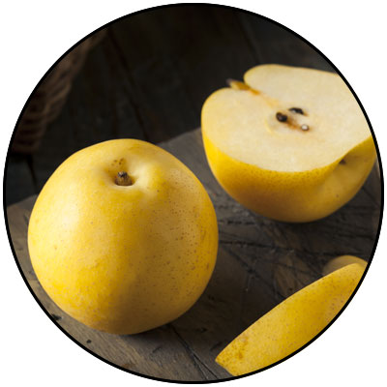
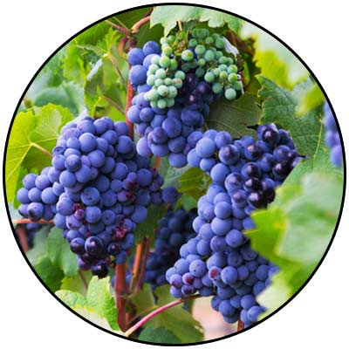
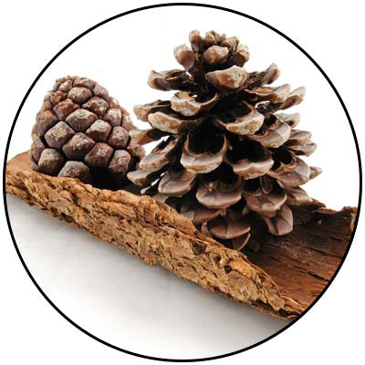
GBX+ Proprietary Blend…
Patent Pending and Exclusive to Amare
Applephenon®: Asian Apple Fruit Extract
Supports gut health, immune function and inflammatory balance*
Enovita®: French Grape Seed Extract
Enhances blood flow, cardiovascular tone and cellular defenses*
Enzogenol®: New Zealand Pine Bark Extract
Improves neurotransmitter balance, mental focus and psychological vigor*
*These statements have not been evaluated by the Food and Drug Administration. This product is not intended to diagnose, treat, cure, or prevent any disease.

Slide 44
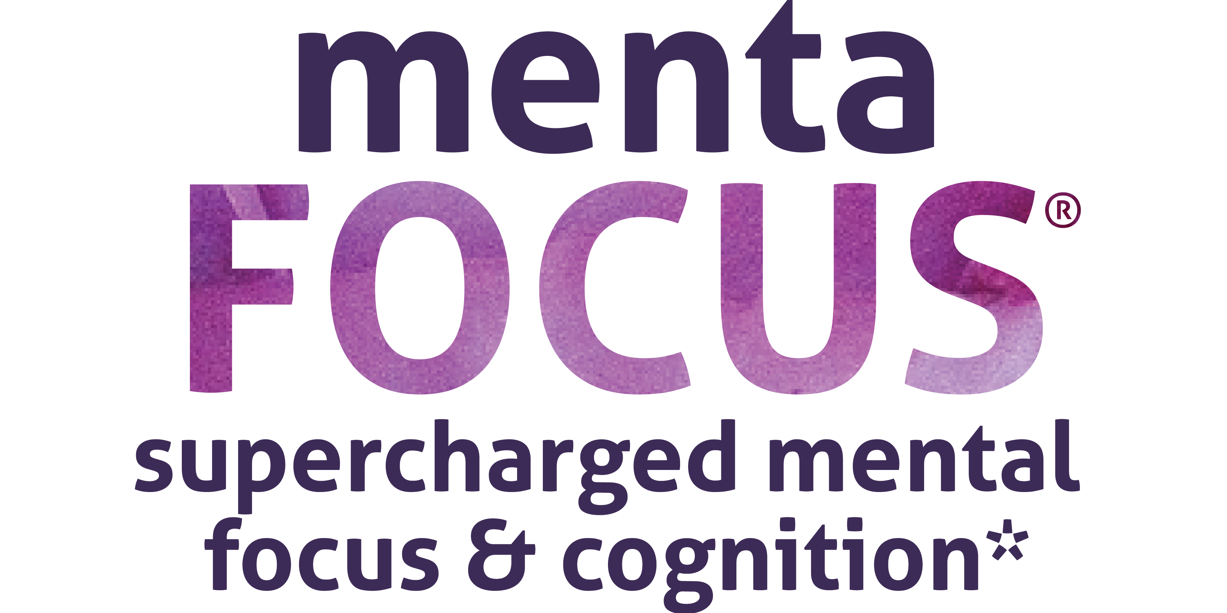
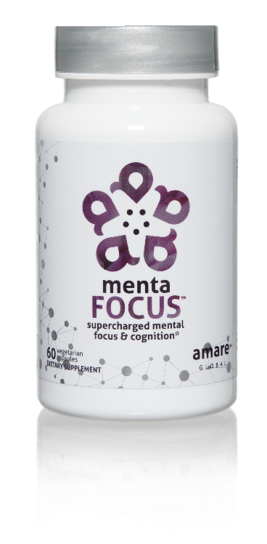
AMPLIFIES ATTENTION & ALERTNESS
ENHANCES BRAIN ACTIVATION
PROMOTES CLARITY COGNITION CREATIVITY
Supercharge your brain with key phytonutrients clinically shown to support focus, mental sharpness, clarity, creativity, and cognitive functioning.*
Item Code:
Retail Price:
Wholesale Price:
Subscribe & Save:
S002
$60.00
$44.95 / 39 PV
$39.95 / 35 PV
*These statements have not been evaluated by the Food and Drug Administration. This product is not intended to diagnose, treat, cure, or prevent any disease.

Slide 45

MENTAFOCUS
KEY BENEFITS & FEATURES
®
Enhances clarity, cognition
and creativity*
Increases short-term and
long-term memory*
Empowers and sustains a sense of
mental focus*
Improves concentration, attention
and alertness*
All-natural and stimulant-free*
Promotes stress reduction*
*These statements have not been evaluated by the Food and Drug Administration. This product is not intended to diagnose, treat, cure, or prevent any disease.

Slide 46
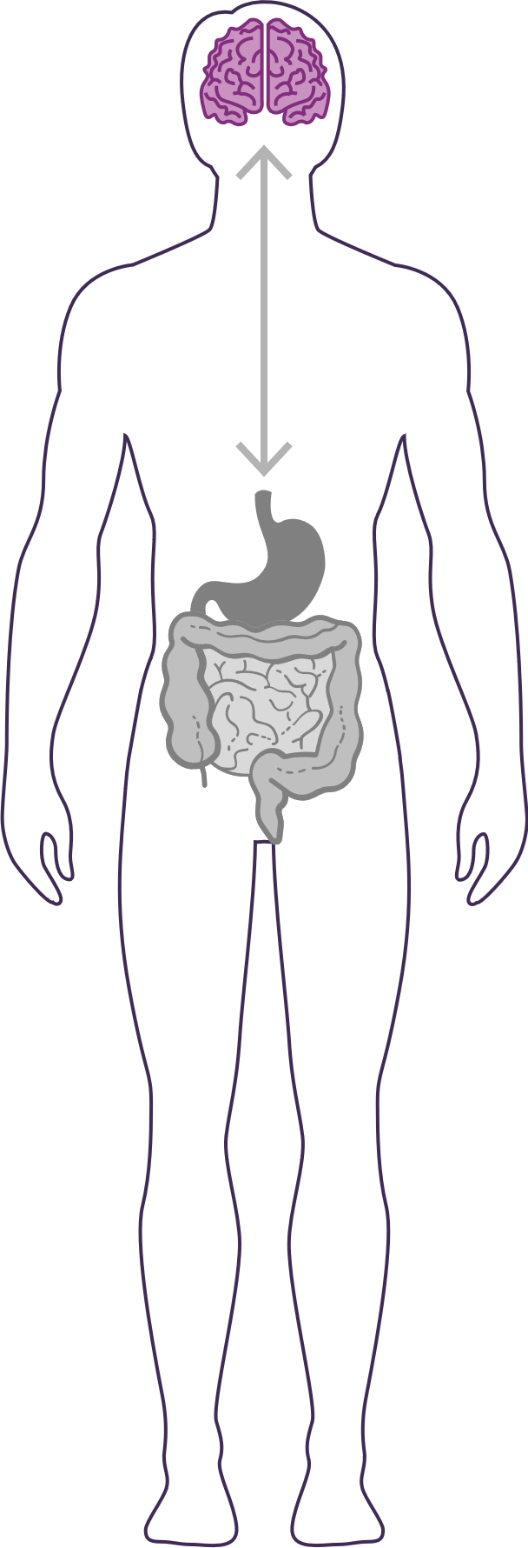


GUT – BRAIN - AXIS
The brain is an extremely complex and powerful system. Fuel it with the right nutrients for enhanced mental focus and cognitive function.
Restores “youthful” brain function*‡
Increases short-term and long-term memory by increasing visual and verbal recall by 28%*‡
Improves both working memory and recognition memory and reduces functional brain age by 12 years*‡
*These statements have not been evaluated by the Food and Drug Administration. This product is not intended to diagnose, treat, cure, or prevent any disease.
‡BASED ON KEY INGREDIENTS CLINICAL STUDIES

Slide 47
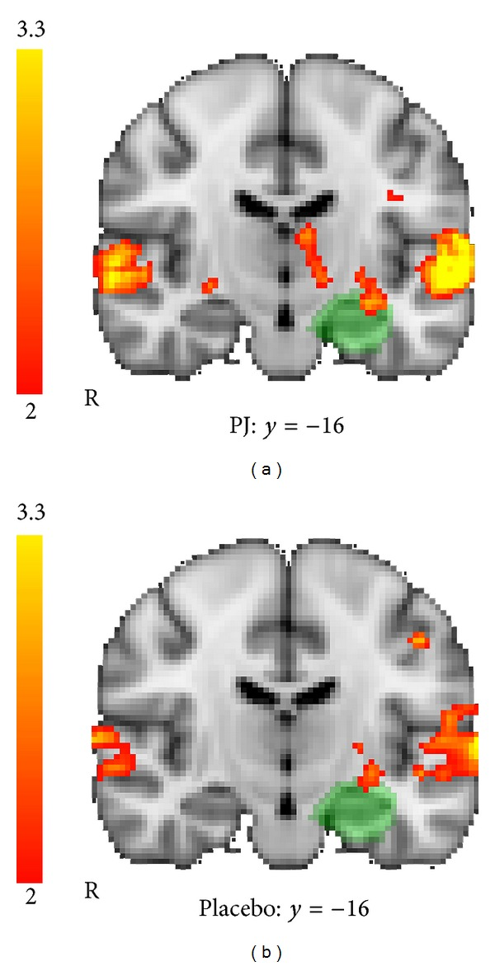
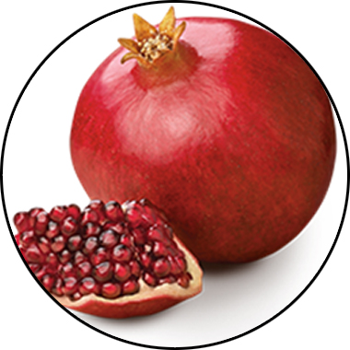
MENTAFOCUS
KEY INGREDIENTS
®
POMx
Enhances brain activation
*These statements have not been evaluated by the Food and Drug Administration. This product is not intended to diagnose, treat, cure, or prevent any disease.

Slide 48
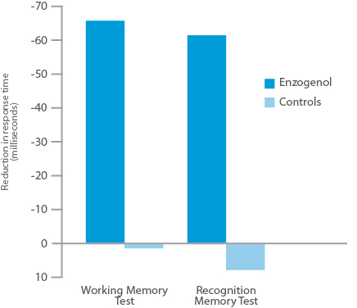
MENTAFOCUS
KEY INGREDIENTS
®
Enzogenol®
Improves memory
*These statements have not been evaluated by the Food and Drug Administration. This product is not intended to diagnose, treat, cure, or prevent any disease.

Slide 49
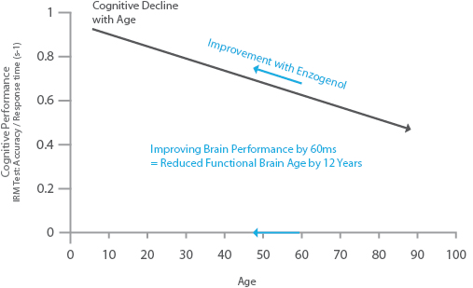
MENTAFOCUS
KEY INGREDIENTS
®
Enzogenol®
Restores
“youthful” brain function
*These statements have not been evaluated by the Food and Drug Administration. This product is not intended to diagnose, treat, cure, or prevent any disease.

Slide 50
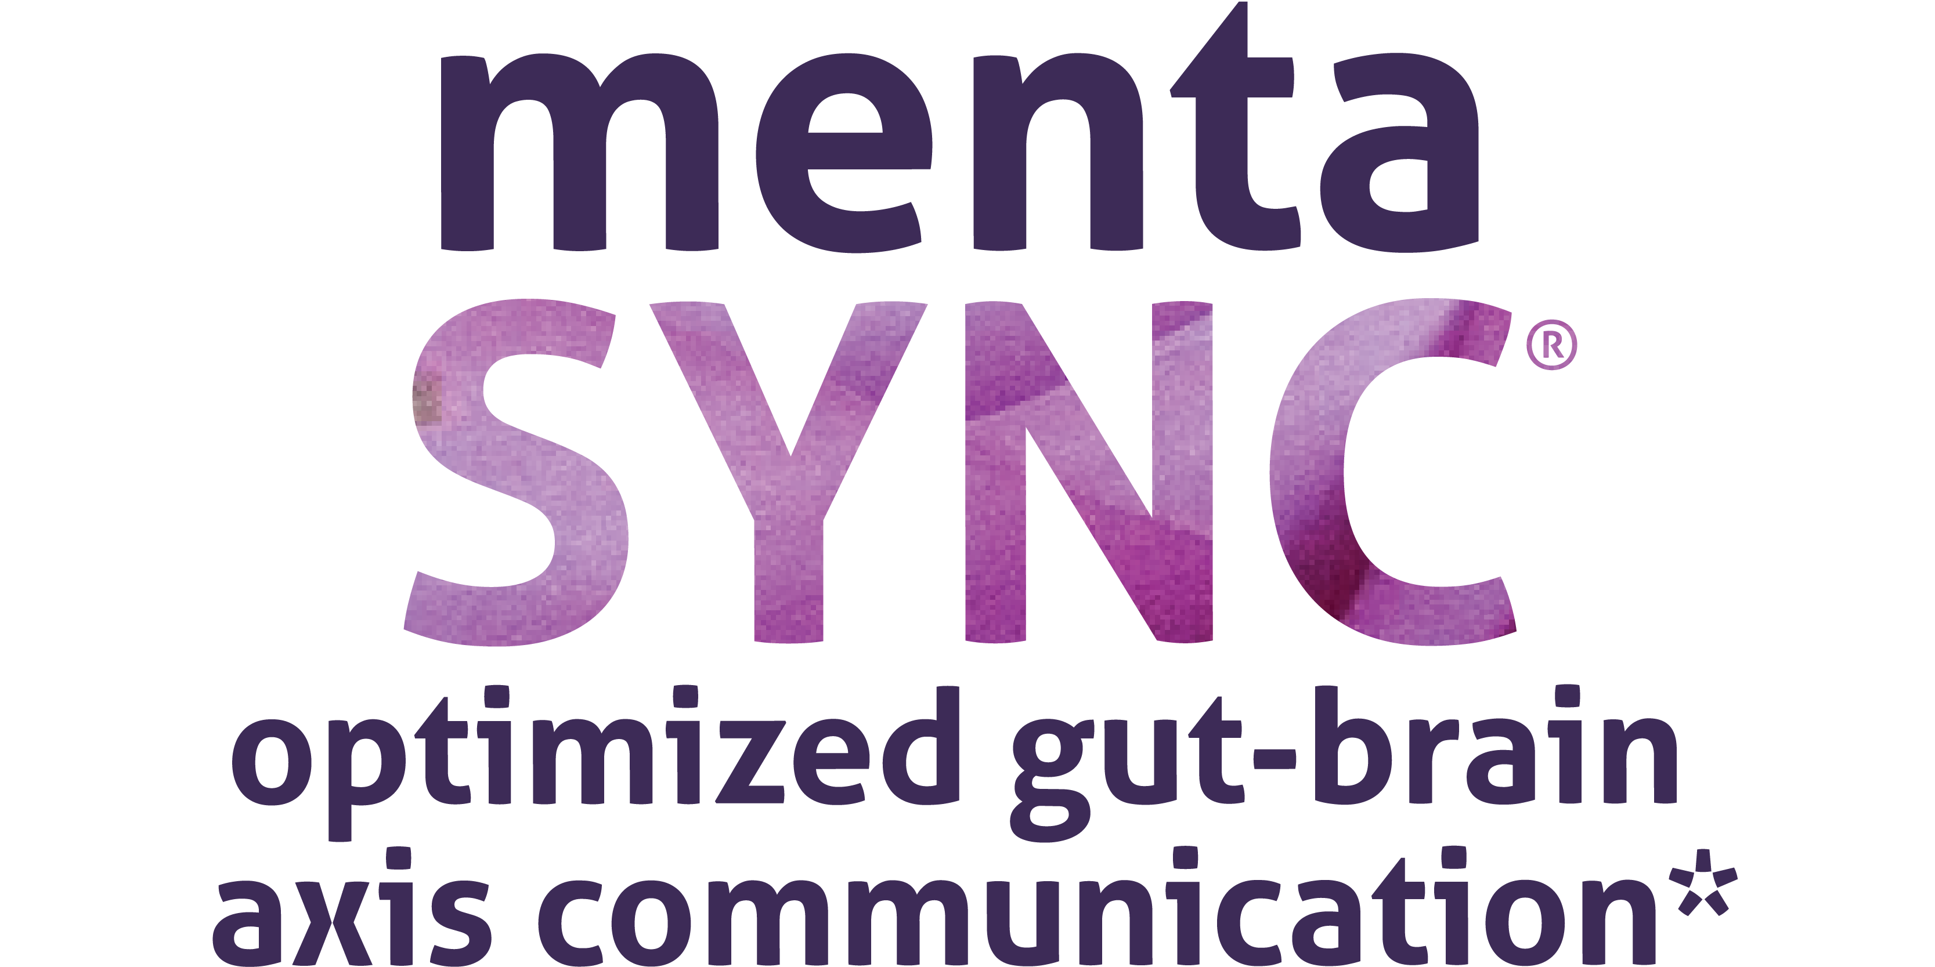
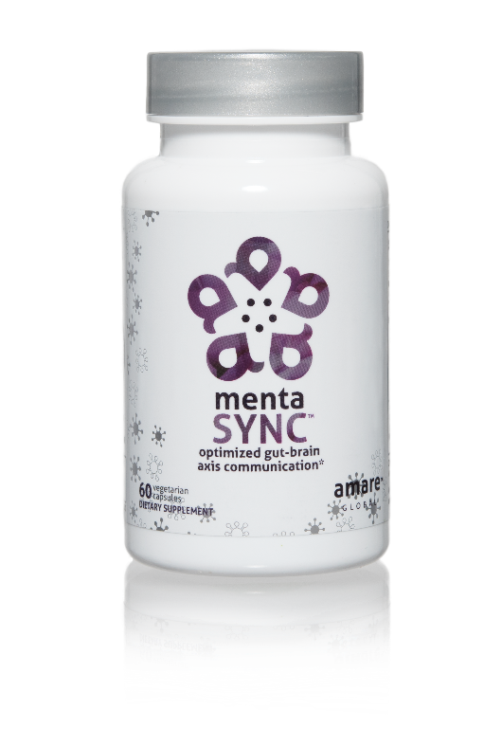
IMPROVES
GUT-BRAIN COMMUNICATION
BALANCES SIGNALING BETWEEN CELLS
ENHANCES
BIO-CHEMICAL COMMUNICATION
Optimize the communication sync of chemical messengers between your brain and your gut with the clinically studied key ingredients in MentaSync.*
Item Code:
Retail Price:
Wholesale Price:
Subscribe & Save:
S003
$74.00
$54.95 / 47 PV
$48.95 / 42 PV
*These statements have not been evaluated by the Food and Drug Administration. This product is not intended to diagnose, treat, cure, or prevent any disease.

Slide 51

MENTASYNC
KEY BENEFITS & FEATURES
®
Optimizes the communication of the gut-brain axis*
Balances normal signaling between cells of the gut, brain and immune system*
Improves psychological vigor (physical energy, mental acuity and emotional well-being)*
Supports healthy aging*
Optimizes nervous system functioning*
Enhances immune activity*
*These statements have not been evaluated by the Food and Drug Administration. This product is not intended to diagnose, treat, cure, or prevent any disease.

Slide 52
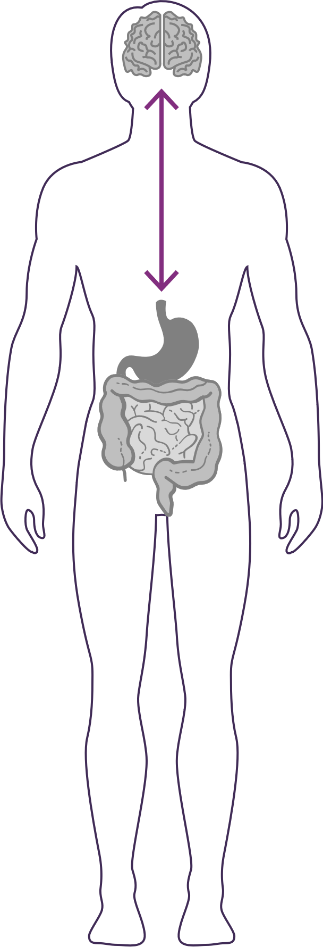


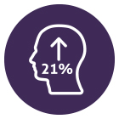
GUT – BRAIN - AXIS
The gut and brain are connected by a link known as the “axis,” which is an important component of the gut-brain axis system. It is the primary connection between our two brains and is greatly responsible for our overall well-being.
Balances normal signaling between cells of the gut, brain and immune system.*‡
Enhances GBX (gut-brain axis) signaling and gut barrier function via alpha-glucans, beta-glucans, SCFAs (butyrate) and zinc-carnosine*‡
Increases psychological vigor by 21%*‡
*These statements have not been evaluated by the Food and Drug Administration. This product is not intended to diagnose, treat, cure, or prevent any disease.
‡BASED ON KEY INGREDIENTS CLINICAL STUDIES

Slide 53
World’s First Award-Winning Gut-Brain Axis Nutrition System
AMARE FUNDAMENTALS PACK
®
2018 NutrAward Winner for
“BEST NEW FINISHED PRODUCT”
Item Code:
Retail Price:
Wholesale Price:
Subscribe & Save:
P001
$234.00
$149.95 / 120 PV
$134.95 / 108 PV
*These statements have not been evaluated by the Food and Drug Administration. This product is not intended to diagnose, treat, cure, or prevent any disease.

Slide 54
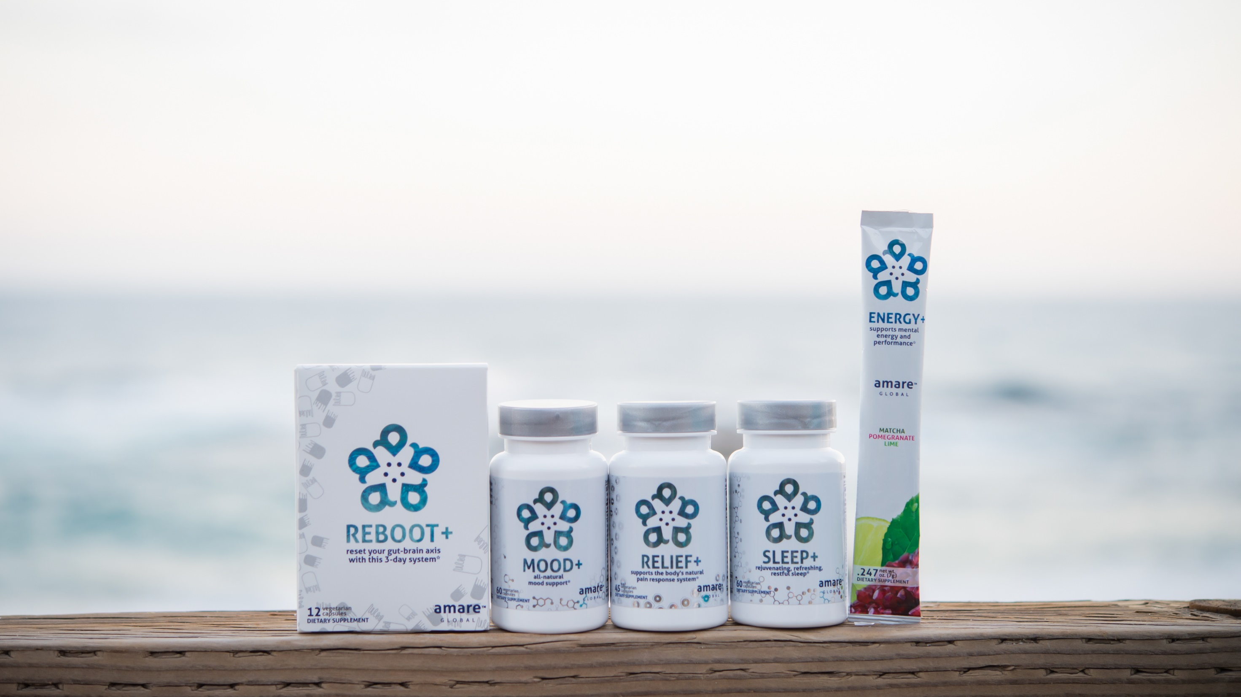
All-Natural Support Solutions for Energy, Mood, Pain, and Sleep*
MENTATHERAPEUTICS
™
*These statements have not been evaluated by the Food and Drug Administration. This product is not intended to diagnose, treat, cure, or prevent any disease.

Slide 55


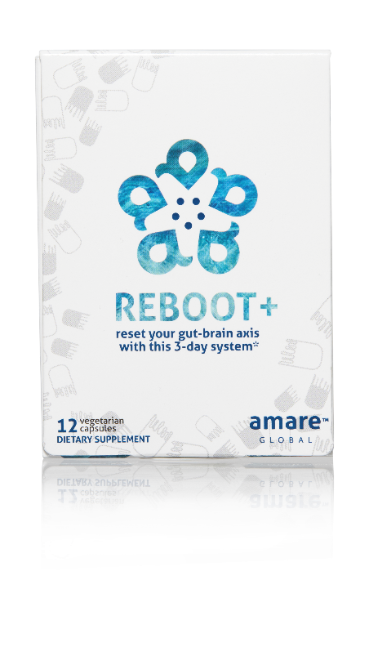
REMOVES WASTE & TOXINS
3-DAY PROGRAM
NATURAL CLEANSING
reset your gut-brain axis
with this 3-day system*
A synergistic blend of natural cleansing herbs and phytonutrients to assist the body’s own detoxification process — specifically formulated to reboot your
gut-brain axis in three days.*
Item Code:
Retail Price:
Wholesale Price:
Subscribe & Save:
S004
$34.00
$24.95 / 21 PV
$21.95 / 19 PV
*These statements have not been evaluated by the Food and Drug Administration. This product is not intended to diagnose, treat, cure, or prevent any disease.

Slide 56
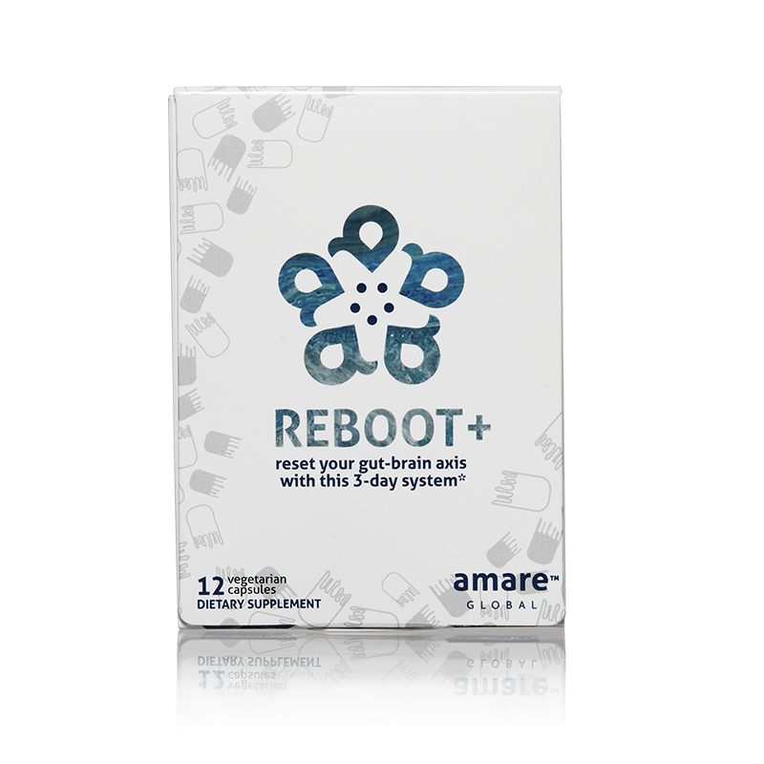
Why is Reboot+ Different?
Worldwide exclusive on SebatinTM
  Patented blend of Poria/Myristica/Astragalus
  Improves liver detoxification

Slide 57
REBOOT+
KEY BENEFITS & FEATURES
Prepares the body’s gut microbiome for optimized mental wellness*
Provides a natural cleanse and supports a healthy digestive system*
Helps to remove built-up waste and toxins from the body*
Supports natural cleansing and filtering functions of the liver, kidneys and colon*
Partners with and optimizes the body’s natural detoxification process*
*These statements have not been evaluated by the Food and Drug Administration. This product is not intended to diagnose, treat, cure, or prevent any disease.

Slide 58



reset your gut-brain axis
with this 3-day system*
Prevents liver damage 2-3x better than other popular detox supplements*
Resets/reboots gut microbiome balance*
Partners with and optimizes the body’s natural detoxification process*
*These statements have not been evaluated by the Food and Drug Administration. This product is not intended to diagnose, treat, cure, or prevent any disease.

Slide 59



REBOOT+
DIETARY SUGGESTIONS

Slide 60




REBOOT+
KEY INGREDIENTS
Sebatin
Synergistic effects of Sebatin™
™
Anti-inflammatory
Antioxidant
Hepatoprotective
Poria
lanostane triterpene acids
Panchyman (1,3-β-D-glucan)
Inhibition of iNOS & TNF-α production
Myristica
Phenylpropanoids
Induction of glutathion
S-transferase
Astragalus
Saponins & Polysacharin
Increase tissue SOD and GSH
Free radical scavenging
*These statements have not been evaluated by the Food and Drug Administration. This product is not intended to diagnose, treat, cure, or prevent any disease.

Slide 61
REBOOT+
KEY INGREDIENTS
Sebatin
Outperforms other liver protection agents
™
ALT % Inhibition
ALT % Inhibition
*These statements have not been evaluated by the Food and Drug Administration. This product is not intended to diagnose, treat, cure, or prevent any disease.

Slide 62


LONG-LASTING STAMINA
ALL-NATURAL
NO SYNTHETICS
MENTAL
ENERGY
supports mental energy and
performance*
A next-generation mental energy product that delivers rapid improvements in brain and physical performance, without the jitters or crash you might get from many high-stimulant or high-sugar energy drinks.*
Item Code:
Retail Price:
Wholesale Price:
Subscribe & Save:
S005
$60.00
$44.95 / 36 PV
$39.95 / 32 PV
*These statements have not been evaluated by the Food and Drug Administration. This product is not intended to diagnose, treat, cure, or prevent any disease.

Slide 63

Why is Energy+ Different?
Patent-pending GBX proprietary blend
Three-tiered energy
  Physical Energy (motivation)
  Mental Energy (focus)
  Mental Awareness (presence/connectedness/engagement)

Slide 64


ENERGY+
KEY BENEFITS & FEATURES
Increases energy levels and endurance*
Improves brain performance*
Rapid improvements in mental acuity and alertness*
Long-lasting stamina without the jitters or crash*
Helps to regulate epinephrine production*
Sip throughout the day for maximum mental energy benefits*
*These statements have not been evaluated by the Food and Drug Administration. This product is not intended to diagnose, treat, cure, or prevent any disease.

Slide 65



supports mental energy and
performance*
Rapid improvements in mental energy, acuity and alertness*
Increases energy levels and endurance*
Provides energy without the jitters or crash from other high-stimulant or high-sugar energy drinks*
*These statements have not been evaluated by the Food and Drug Administration. This product is not intended to diagnose, treat, cure, or prevent any disease.

Slide 66

ENERGY+
KEY INGREDIENTS
Guayusa
Amazonian awareness enhancer
*These statements have not been evaluated by the Food and Drug Administration. This product is not intended to diagnose, treat, cure, or prevent any disease.
Notes:
Amazonian Hunters call guayusa the “Night Watchman” because it sharpens their awareness and gives them energy when heading into the jungle at night to hunt. Guayusa's effect is usually experienced as a bright and focused energy thanks to healthy synergistic compounds that help balance the naturally occurring caffeine.

Slide 67

ENERGY+
KEY INGREDIENTS
Enzogenol®
Calms “monkey mind”
*These statements have not been evaluated by the Food and Drug Administration. This product is not intended to diagnose, treat, cure, or prevent any disease.

Slide 68


MOOD ELEVATING
PROMOTES RELAXATION
TENSION REDUCING
all-natural
mood support*
The key ingredients in Mood+ have multiple scientific studies that show significant benefits for mood support such as relief from anxious feelings, sadness, restlessness, and overall
stress relief.*
Item Code:
Retail Price:
Wholesale Price:
Subscribe & Save:
S006
$80.00
$59.95 / 52 PV
$53.95 / 46 PV
*These statements have not been evaluated by the Food and Drug Administration. This product is not intended to diagnose, treat, cure, or prevent any disease.

Slide 69

Why is Mood+ Different?
Finalist for Botanical of the Year
Most comprehensive herbal blend for mood support
  Venetron (Rafuma) — Depression
  Zembrin (Kanna) — Stress Resilience
  Sensoril (Ashwagandha) — Tension
  Relora (Magnolia) — Anxiety

Slide 70

MOOD+
KEY BENEFITS & FEATURES
Enhances feelings of well-being and supports a healthy, positive mood*
Promotes a calming, relaxing state of mind*
Reduces feelings of negativity and stress*
Lessens occasional anxiousness and feelings of sadness*
Increases motivation and drive*
Supports natural serotonin and dopamine production for enhanced mood benefits*
*These statements have not been evaluated by the Food and Drug Administration. This product is not intended to diagnose, treat, cure, or prevent any disease.

Slide 71



all-natural
mood support*
Decrease in feelings of anger*
Decrease in feelings of sadness*
Reduction of stress-related symptoms*
*These statements have not been evaluated by the Food and Drug Administration. This product is not intended to diagnose, treat, cure, or prevent any disease.

Slide 72

MOOD+
KEY INGREDIENTS
Venetron® (Rafuma)
Depression
*These statements have not been evaluated by the Food and Drug Administration. This product is not intended to diagnose, treat, cure, or prevent any disease.

Slide 73

MOOD+
KEY INGREDIENTS
Zembrin® (Kanna)
Depression
*These statements have not been evaluated by the Food and Drug Administration. This product is not intended to diagnose, treat, cure, or prevent any disease.

Slide 74
Stress Reduction & Mood Enhancement
MOOD+
KEY INGREDIENTS
HAM-D SCORE
‘Global-Standard’ to assess severity of depression and response to therapy in clinical research
RESULTS
Reduction of stress and improvement of mood manifested through:
Statistically significant improved quality of sleep
Less fatigue
Enhanced work performance
Enhanced interest in daily activities
Less irritability, worry and insecurity
*These statements have not been evaluated by the Food and Drug Administration. This product is not intended to diagnose, treat, cure, or prevent any disease.
Notes:
Chiu et al. Proof-of-Concept Randomized Controlled Study of Cognition Effects of the Proprietary Extract Sceletium tortuosum (Zembrin) Targeting Phosphodiesterase-4 in Cognitively Healthy Subjects: Implications for Alzheimer’s Dementia. Evidence-Based Complementary and Alternative Medicine Volume 2014, Article ID 682014

Slide 75
fMRI Study Results Show Reduced Stress Response
MOOD+
KEY INGREDIENTS
Zembrin® can help in the
management of stress in
everyday life
A single dose of Zembrin® attenuates
reactivity within the part of the brain
(amygdala) that responds to threat/stress
*These statements have not been evaluated by the Food and Drug Administration. This product is not intended to diagnose, treat, cure, or prevent any disease.
Notes:
Terburg et al. Acute Effects of Sceletium tortuosum (Zembrin), a Dual
5-HT Reuptake and PDE4 Inhibitor, in the Human Amygdala and its Connection to the Hypothalamus. Neuropsychopharmacology (2013), 1–9.

Slide 76
Cognitive Set Flexibility
MOOD+
KEY INGREDIENTS
Cognitive Flexibility
Ability to shift attention between two or more tasks and the ability to adapt to rapidly changing directions and intelligently utilize the information.
Necessary for decision-making, impulse control and strategy formation.
CNS VitalSign® has been used for testing neurocognitive function by over 5,000 clinicians in 52 countries.
*These statements have not been evaluated by the Food and Drug Administration. This product is not intended to diagnose, treat, cure, or prevent any disease.
Notes:
Chiu et al. Proof-of-Concept Randomized Controlled Study of Cognition Effects of the Proprietary Extract Sceletium tortuosum (Zembrin) Targeting Phosphodiesterase-4 in Cognitively Healthy Subjects: Implications for Alzheimer’s Dementia. Evidence-Based Complementary and Alternative Medicine Volume 2014, Article ID 682014

Slide 77

MOOD+
KEY INGREDIENTS
Sensoril® (Ashwagandha)
Anxiety
*These statements have not been evaluated by the Food and Drug Administration. This product is not intended to diagnose, treat, cure, or prevent any disease.
Notes:
Auddy et al. A Standardized Withania Somnifera Extract Significantly Reduces Stress-Related Parameters in Chronically Stressed Humans: A Double-Blind, Randomized, Placebo-Controlled Study. Journal of the American Nutraceutical Association Vol.11,No.1, 2008 pp50-56.

Slide 78
MOOD+
KEY INGREDIENTS
Sensoril® (Ashwagandha)
Anxiety
*These statements have not been evaluated by the Food and Drug Administration. This product is not intended to diagnose, treat, cure, or prevent any disease.
Notes:
Auddy et al. A Standardized Withania Somnifera Extract Significantly Reduces Stress-Related Parameters in Chronically Stressed Humans: A Double-Blind, Randomized, Placebo-Controlled Study. Journal of the American Nutraceutical Association Vol.11,No.1, 2008 pp50-56.

Slide 79


MOOD+
KEY INGREDIENTS
Relora®
(Magnolia & Phellodendron)
Anxiety
*These statements have not been evaluated by the Food and Drug Administration. This product is not intended to diagnose, treat, cure, or prevent any disease.
Notes:
Talbott et al. Effect of Magnolia officinalis and Phellodendron amurense (Relora®) on cortisol and psychological mood state in moderately stressed subjects. Journal of the International Society of Sports Nutrition 2013, 10:37
Garrison et al. Effect of a proprietary Magnolia and Phellodendron extract on weight management: a pilot, double-blind, placebo-controlled clinical trial. Altern Ther Health Med. 2006;12(1):50-54.
Kalman et al. Effect of a proprietary Magnolia and Phellodendron extract on stress levels in healthy women: a pilot, double-blind, placebo-controlled clinical trial. Nutrition Journal 2008, 7:11

Slide 80




SOOTHE MINOR ACHES & DISCOMFORT
FAST-ACTING
LONG-LASTING
supports the body’s natural
pain response system*
The key ingredients in Relief+ have been scientifically shown to balance normal inflammatory function and support antioxidant levels to provide fast-acting and long-lasting relief from
occasional aches and pains.*
Item Code:
Retail Price:
Wholesale Price:
Subscribe & Save:
S007
$74.00
$54.95 / 47 PV
$48.95 / 42 PV
*These statements have not been evaluated by the Food and Drug Administration. This product is not intended to diagnose, treat, cure, or prevent any disease.

Slide 81

Why is Relief+ Different?
Worldwide exclusive on Meriva/Casperome combination
  Fast-acting Meriva (30x-better-absorbed turmeric)
    Blocks the inflammation/pain NOW
  Long-lasting Casperome (30x-better-absorbed boswellia)
    Inhibits the inflammation/pain LATER

Slide 82

RELIEF+
KEY BENEFITS & FEATURES
Fast-acting and long-lasting relief*
Soothes minor aches and discomfort*
Reduces the intensity of occasional aches and pains*
Provides relief to active athletes or people on the go*
Helps improve physical function in people with joint and tendon challenges*
*These statements have not been evaluated by the Food and Drug Administration. This product is not intended to diagnose, treat, cure, or prevent any disease.

Slide 83



supports the body’s natural
pain response system*
74% Decrease in osteomuscular pain*
53% Reduction in inflammation*
31% Decrease in cartilage damage*
Fast-acting relief*
Long-lasting relief*
Phytostome Technology: Superior absorption
Phytostome Technology:
Enhanced metabolism
*These statements have not been evaluated by the Food and Drug Administration. This product is not intended to diagnose, treat, cure, or prevent any disease.
Notes:
Marczylo, T.H., et al., Comparison of systemic availability of curcumin with that of curcumin formulated with phosphatidylcholine. Cancer Chemother Pharmacol, 2007. 60(2): p. 171-7.
Cuomo, J., et al., Comparative absorption of a standardized curcuminoid mixture and its lecithin formulation. J Nat Prod, 2011. 74(4): p. 664-9.
Di Pierro, F. et al. Comparative evaluation of the pain-relieving properties of a lecithinized formulation of curcumin (Meriva®), nimesulide, and acetaminophen. J. Pain Res. 2013, 6, 201-205.
Drobnic, F., et al., Reduction of delayed onset muscle soreness by a novel curcumin delivery system (Meriva®): a randomised, placebo-controlled trial. J Int Soc Sports Nutr, 2014. 11: p. 31.
Sciberras, J.N., et al., The effect of turmeric (Curcumin) supplementation on cytokine and inflammatory marker responses following 2 hours of endurance cycling. J Int Soc Sports Nutr, 2015. 12(1): p. 5.
Franceschi et al. A novel lecithin based delivery form of Boswellic acids (Casperome®) for the management of osteo-muscular pain:
a registry study in young rugby players. European Review for Medical and Pharmacological Sciences 2016; 20: 4156-4161.

Slide 84
RELIEF+
KEY INGREDIENTS
Meriva®
(Turmeric)
As effective as Tylenol
*These statements have not been evaluated by the Food and Drug Administration. This product is not intended to diagnose, treat, cure, or prevent any disease.
Notes:
Di Pierro, F. et al. Comparative evaluation of the pain-relieving properties of a lecithinized formulation of curcumin (Meriva®), nimesulide, and acetaminophen. J. Pain Res. 2013, 6, 201-205.

Slide 85

RELIEF+
KEY INGREDIENTS
Turmeric
Fast-acting
inflammatory balance
*These statements have not been evaluated by the Food and Drug Administration. This product is not intended to diagnose, treat, cure, or prevent any disease.
Notes:
-shows effects of curcumin (Meriva/turmeric) on wide range of inflammatory enzymes

Slide 86
RELIEF+
KEY INGREDIENTS
TRANSCRIPTION
FACTORS
NF-kb
STAT-3
PPAR-γ
C/EBP-α
↓
↓
↓
↓
ENZYMES
COX-2
MMP-9
5-LO
Caspase
topoisomerase I
topoisomerase II
HLE
KINASES
Akt
ERK1/2
p38 MAPK
IKKa/b
CDK-2
CDK-4
↓
↓
↑↓
↓
↓
Casperome®
^{(Boswellia)}
Long-lasting
inflammatory balance
↓
↓
↓
↓
↓
↓
Molecular Targets of Boswellic
Acids
RECEPTORS
AR
DR-4
DR-5
CXCR4
PDGFR
OTHERS
Cyclin D
Cyclin E
p21
P53
Rb
Bcl-2
Bcl-xL
Mcl-1
IAP-1
survivin
↓
↓
↓
↓
↓
↓
↓
↓
↓
↑↑
↓
↓
GROWTH
FACTORS
VEGF
PDGF
TF
↓
↓
↓
↓: Downregulation or Inhibition
↑: Upregulation or Activation
*These statements have not been evaluated by the Food and Drug Administration. This product is not intended to diagnose, treat, cure, or prevent any disease.
Notes:
-shows effects of boswellic acids (Casperome/boswellia) on wide range of different inflammatory enzymes)

Slide 87



FALL ASLEEP FASTER
STAY ASLEEP LONGER
IMPROVES SLEEP QUALITY
rejuvenating, refreshing,
restful sleep*
The key ingredients in Sleep+ have multiple scientific studies that show significant benefits including helping you fall asleep faster, stay asleep longer and experience higher quality plus more rejuvenating sleep.*
Item Code:
Retail Price:
Wholesale Price:
Subscribe & Save:
S008
$80.00
$59.95 / 52 PV
$53.95 / 46 PV
*These statements have not been evaluated by the Food and Drug Administration. This product is not intended to diagnose, treat, cure, or prevent any disease.

Slide 88

Why is Sleep+ Different?
Worldwide exclusive on patented corn-grass extract
  Research-supported MaizinolTM (30x potency corn grass)
  Improves Serotonin signaling (depression/anxiety)
  Improves Melatonin signaling (sleep quality)
    40% more time in Deep Sleep (body recovery)
    40% more time in REM Sleep (brain rejuvenation)

Slide 89

SLEEP+
KEY BENEFITS & FEATURES
Relieves occasional sleeplessness*
Provides a soothing and refreshing night’s sleep, without morning grogginess*
Improves quality of sleep and ease of falling asleep*
Encourages restful sleep, calms the nervous system and helps reduce stress*
Decreases the number of nighttime awakenings and sleepless nights*
*These statements have not been evaluated by the Food and Drug Administration. This product is not intended to diagnose, treat, cure, or prevent any disease.

Slide 90



rejuvenating, refreshing,
restful sleep*
Improvement in sleep efficiency*
Improvement in sleep quality*
Fall asleep faster by 33% and wake up fewer times each night by 30%*
*These statements have not been evaluated by the Food and Drug Administration. This product is not intended to diagnose, treat, cure, or prevent any disease.
Notes:
Talbott and Talbott: Effect of Monocot Grass Extract (MGE) on mood state and sleep patterns in moderately stress subjects. Journal of the International Society of Sports Nutrition 2013 10(Suppl 1):P26.

Slide 91

Pure & Potent Daily Essential Nutrients*
MENTAESSENTIALS
™
*These statements have not been evaluated by the Food and Drug Administration. This product is not intended to diagnose, treat, cure, or prevent any disease.

Slide 92



MULTIVITAMIN + MIND COMBO
FILLS GAPS IN DAILY NUTRITION
UNIQUE BRIGHT MIND BLEND
premium nutrition for a
healthy body and mind*
VitaGBX is a premium multivitamin that combines more than 50 vitamins, minerals, amino acids, and phytonutrients. It features both our Bright Mind Proprietary Blend (for mind support) and Amare GBX+ Proprietary Blend (for gut-brain axis support) to empower a well-balanced body and mind.*
Item Code:
Retail Price:
Wholesale Price:
Subscribe & Save:
S010
$54.00
$39.95 / 32 PV
$35.95 / 29 PV
*These statements have not been evaluated by the Food and Drug Administration. This product is not intended to diagnose, treat, cure, or prevent any disease.

Slide 93

Why is VitaGBX® Different?
Patent-pending GBX proprietary blend
Bioavailable forms of vitamins/minerals/phytonutrients
Nourishes body and mind
Modulates numerous CDRs (Cellular-Defense Responses)
  Nrf2 (antioxidant)
  NfKb (inflammation)
  SIRT (cellular aging)
  MTOR (metabolism)
  HSP (autophagy = cellular cleanup)

Slide 94

VitaGBX
KEY BENEFITS & FEATURES
®
Contains key nutrients that are essential for daily overall wellness*
Supports bone health with calcium, magnesium, zinc and vitamin D*
Supports healthy immune function*
Packed with free radical fighting antioxidants*
Proper physiological ingredient amounts —
no mega doses*
Balances body and mind via key nutrients often not consumed in your daily meals*
Improves concentration, attention and alertness*
Empowers and sustains a sense of mental focus*
*These statements have not been evaluated by the Food and Drug Administration. This product is not intended to diagnose, treat, cure, or prevent any disease.

Slide 95



premium nutrition for a
healthy body and mind*
Contains a Bright Mind Blend which helps improve concentration, attention and alertness*
Combines 50+ vitamins, minerals, amino acids, and phytonutrients to deliver micronutrient nutrition for a well-balanced body and mind*
Contains our Amare GBX+ Proprietary Blend that enhances optimal functionality of the
gut-brain axis*
*These statements have not been evaluated by the Food and Drug Administration. This product is not intended to diagnose, treat, cure, or prevent any disease.

Slide 96


SUPPORTS COGNITIVE HEALTH
HIGH-POTENCY
EPA + DHA
MERCURY FREE
FISH OIL
high-potency,
ultra-pure omega-3’s*
OmMEGA is a high-potency, ultra-pure marine oil concentrate that delivers high levels of the critical omega-3 fatty acids EPA and DHA.*
Item Code:
Retail Price:
Wholesale Price:
Subscribe & Save:
S011
$40.00
$29.95 / 24 PV
$26.95 / 22 PV
*These statements have not been evaluated by the Food and Drug Administration. This product is not intended to diagnose, treat, cure, or prevent any disease.

Slide 97

Why is OmMega™ Different?
High-potency/purity fish oil
70% omega-3 extract
  Typical = 30% omega-3

Slide 98

OmMEGA
KEY BENEFITS & FEATURES
™
Provides a healthy balance of all-natural,
pure omega-3 fatty acids*
Protects against lipid oxidation and supports healthy function of the brain*
Promotes healthy cardiovascular, nervous
and immune system function*
Supports memory and cognitive health*
Promotes normal memory, attention control, alertness, mental acuity, and positive mood*
Helps to regulate the body’s natural inflammatory response*
*These statements have not been evaluated by the Food and Drug Administration. This product is not intended to diagnose, treat, cure, or prevent any disease.

Slide 99



high-potency,
ultra-pure omega-3’s*
Contains ultra-pure and ultra-potent omega-3 content that is approx. 70% more omega-3 (EPA/DHA) than standard fish oils*
Promotes cardiovascular health*
Supports memory and cognitive functions, while promoting a healthy nervous system*
*These statements have not been evaluated by the Food and Drug Administration. This product is not intended to diagnose, treat, cure, or prevent any disease.

Slide 100




ACTIVATES HEALTHY DIGESTION
REDUCES BLOATING
& GAS
SUPPORTS ALL PARTS OF THE GI SYSTEM
complete GI support*
A comprehensive blend of digestive enzymes to support the process of digestion in the upper, middle and lower gastrointestinal system.*
Item Code:
Retail Price:
Wholesale Price:
Subscribe & Save:
S009
$40.00
$29.95 / 24 PV
$26.95 / 22 PV
*These statements have not been evaluated by the Food and Drug Administration. This product is not intended to diagnose, treat, cure, or prevent any disease.

Slide 101

Why is Digestive Different?
Digestive enzymes work on all macronutrients
  Carbs/Fats/Proteins
Digestive enzymes work in all parts of GI tract
  Upper (stomach)/Middle (small intestine)/Lower (colon)
Patented digestive performance blend (ProDigest)
  Motility enhancer — moves food through GI tract at proper speed
  Improves GI pH — restores “environment” healthy microbiome

Slide 102

DIGESTIVE
KEY BENEFITS & FEATURES
Delivers a balanced and comprehensive blend
of digestive enzymes to support normal
digestive processes*
Helps to digest many enzymes-deficient,
processed foods*
Speeds conversion of food nutrients to
cellular energy*
Promotes gastrointestinal comfort and
food tolerance*
Reduces feelings of discomfort and bloating
after eating a meal*
Decreases uncomfortable gas during digestion*
Supports healthy production of metabolic enzymes*
*These statements have not been evaluated by the Food and Drug Administration. This product is not intended to diagnose, treat, cure, or prevent any disease.

Slide 103



complete GI support*
Speeds conversion of food nutrients to cellular energy*
Reduction in overall digestive complaints*
Improvement in GI function*
*These statements have not been evaluated by the Food and Drug Administration. This product is not intended to diagnose, treat, cure, or prevent any disease.
Notes:
Giacosa et al. The Effect of Ginger (Zingiber officinalis) and
Artichoke (Cynara cardunculus) Extract Supplementation on Functional Dyspepsia: A Randomised, Double-Blind, and Placebo-Controlled Clinical Trial. Evidence-Based Complementary and Alternative Medicine Volume 2015, Article ID 915087
Lazzini et al. The effect of ginger (Zingiber officinalis) and artichoke (Cynara cardunculus) extract supplementation on gastric motility: a pilot randomized study in healthy volunteers. European Review for Medical and Pharmacological Sciences 2016; 20: 146-149

Slide 104


SUPPORTS GUT HEALTH
BROAD-SPECTRUM PROBIOTICS
HEALTHY MICROFLORA BALANCE
broad spectrum,
high-potency probiotics*
A high-potency, broad
spectrum formulation
of probiotics shown to
support gut health, immune function and normal
inflammatory balance.*
Item Code:
Retail Price:
Wholesale Price:
Subscribe & Save:
S0012
$40.00
$29.95 / 24 PV
$26.95 / 22 PV
*These statements have not been evaluated by the Food and Drug Administration. This product is not intended to diagnose, treat, cure, or prevent any disease.

Slide 105

Why is Probiotics Different?
Bifidobacterium bifidum (Bb-06)
Maintains microflora balance by producing lactic acid and acetic acid to compete with “bad” bacteria (Staph. aureus, E. coli, Camplylobacter jejuni, etc).
Bifidobacterium longum (Bl-05)
Highly resistant to low pH and bile salts and is well-suited to the intestinal environment to help reduce inflammation. Helps reduce gastrointestinal discomfort caused by stress.
Lactobacillus acidophilus (La-14)
Ferments carbohydrates to lactic acid, which competes with “bad” bacteria for adhesion spaces on the intestinal mucosa. Increases mineral bioavailability (incl copper, magnesium, calcium, and manganese).
Lactobacillus casei (LC-11)
Wide range of benefits for improved digestion, reduced cholesterol, modulation of inflammation/allergies.
Lactobacillus rhamnosus (Lr-32)
Promotes general GI health and function — especially beneficial to prevent/treat occasional diarrhea and constipation after probiotic treatment.

Slide 106

PROBIOTICS
KEY BENEFITS & FEATURES
Supports healthy functioning of the digestive and immune system*
Maintains healthy intestinal
microflora balance*
Helps support optimal metabolism
and absorption of food*
Supports normal inflammatory balance*
Promotes positive balance and proliferation of beneficial bacteria*
Helps nourish beneficial bacteria in
your gut*
*These statements have not been evaluated by the Food and Drug Administration. This product is not intended to diagnose, treat, cure, or prevent any disease.

Slide 107
Probiotic Strains
Bifidobacterium bifidum (Bb-06)
Maintains microflora balance by producing lactic acid and acetic acid to compete with “bad” bacteria (Staph. aureus, E. coli, Camplylobacter jejuni, etc).
Bifidobacterium longum (Bl-05)
Highly resistant to low pH and bile salts and is well-suited to the intestinal environment to help reduce inflammation. Helps reduce gastrointestinal discomfort caused by stress.
Lactobacillus acidophilus (La-14)
Ferments carbohydrates to lactic acid, which competes with “bad” bacteria for adhesion spaces on the intestinal mucosa. Increases mineral bioavailability (incl. copper, magnesium, calcium, and manganese).
Lactobacillus casei (LC-11)
Wide range of benefits for improved digestion, reduced cholesterol and modulation of inflammation/allergies.
Lactobacillus rhamnosus (Lr-32)
Promotes general GI health and function — especially beneficial to prevent/treat occasional diarrhea and constipation after probiotic treatment.
*These statements have not been evaluated by the Food and Drug Administration. This product is not intended to diagnose, treat, cure, or prevent any disease.

Slide 108



broad spectrum,
high-potency probiotics*
Includes acid-resistant capsules to ensure optimal colonization of the probiotics in the colon*
Contains over 10 billion CFUs of probiotics*
Packed with beneficial bacteria specifically to support optimal
metabolism of food*
*These statements have not been evaluated by the Food and Drug Administration. This product is not intended to diagnose, treat, cure, or prevent any disease.

Slide 109
THE THREE THINGS YOU SHOULD KNOW ABOUT
MENTAL WELLNESS
How you feel is not just in your head — it’s also in your gut.
Our “second brain” includes the microbiome and plays a major role in mental wellness.
You can now DO something NATURALLY to improve your mental wellness.
WHERE ARE YOU ON THE MENTAL WELLNESS CONTINUUM? (Circle your current number)
1
2
3
4
5
6
7
8
9
10
DISEASE STATUS
“NORMAL”
OPTIMIZED
Depression
Anxiety
Diabetes
Obesity
Heart Disease
Autoimmune
Arthritis
Fibromyalgia
CFS
Dementia
ADD / ADHD
Alzheimer’s
Fatigue
Tension
Sad
Brain Fog
Headaches
Acne
Eczema
Congestion
URTIs
Joint Pain
Muscle Pain
Bloated
Chubby
Energetic
Calmness
Happy
Sharp
Creative
Clear Skin
Rarely Sick
Flexible
Lean
Strong
Resilient
RED
ORANGE
YELLOW
GREEN
BLUE
INDIGO
VIOLET

Slide 110
Amare Global
17872 Gillette Ave #100 Irvine, CA 92614
amare.com
+1 888.898.8551

