Slide 2

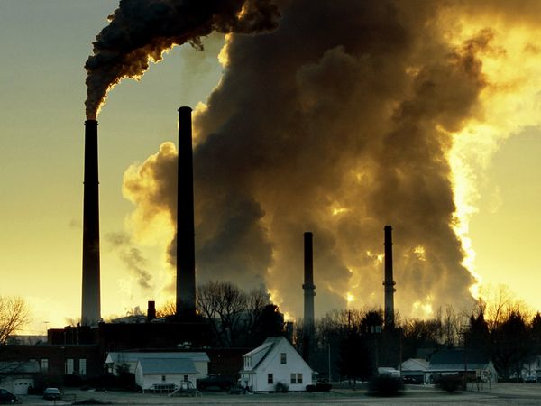

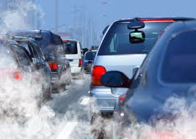
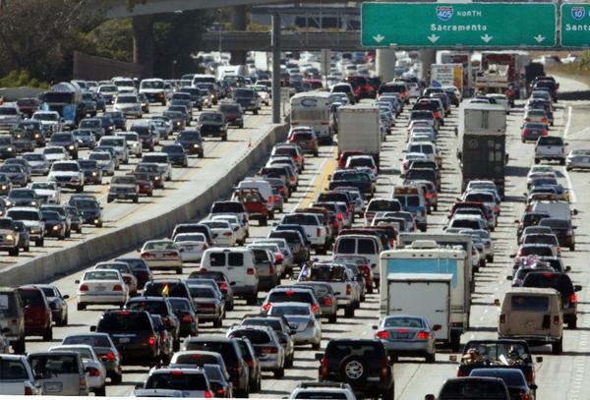


Slide 3
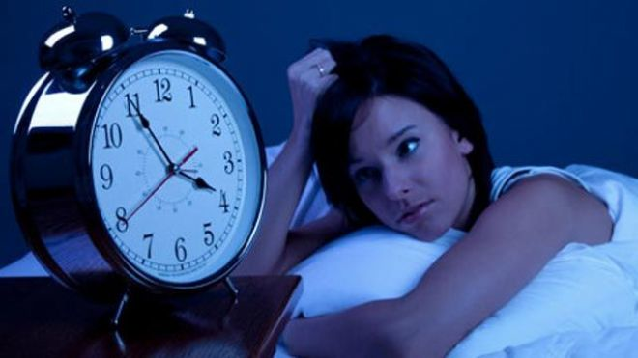
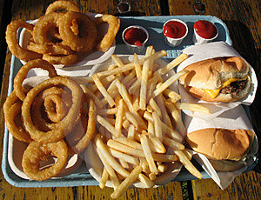
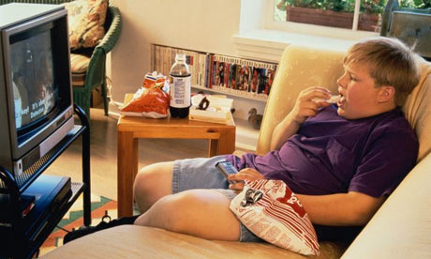
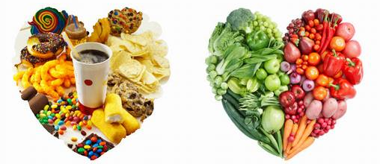

Slide 4
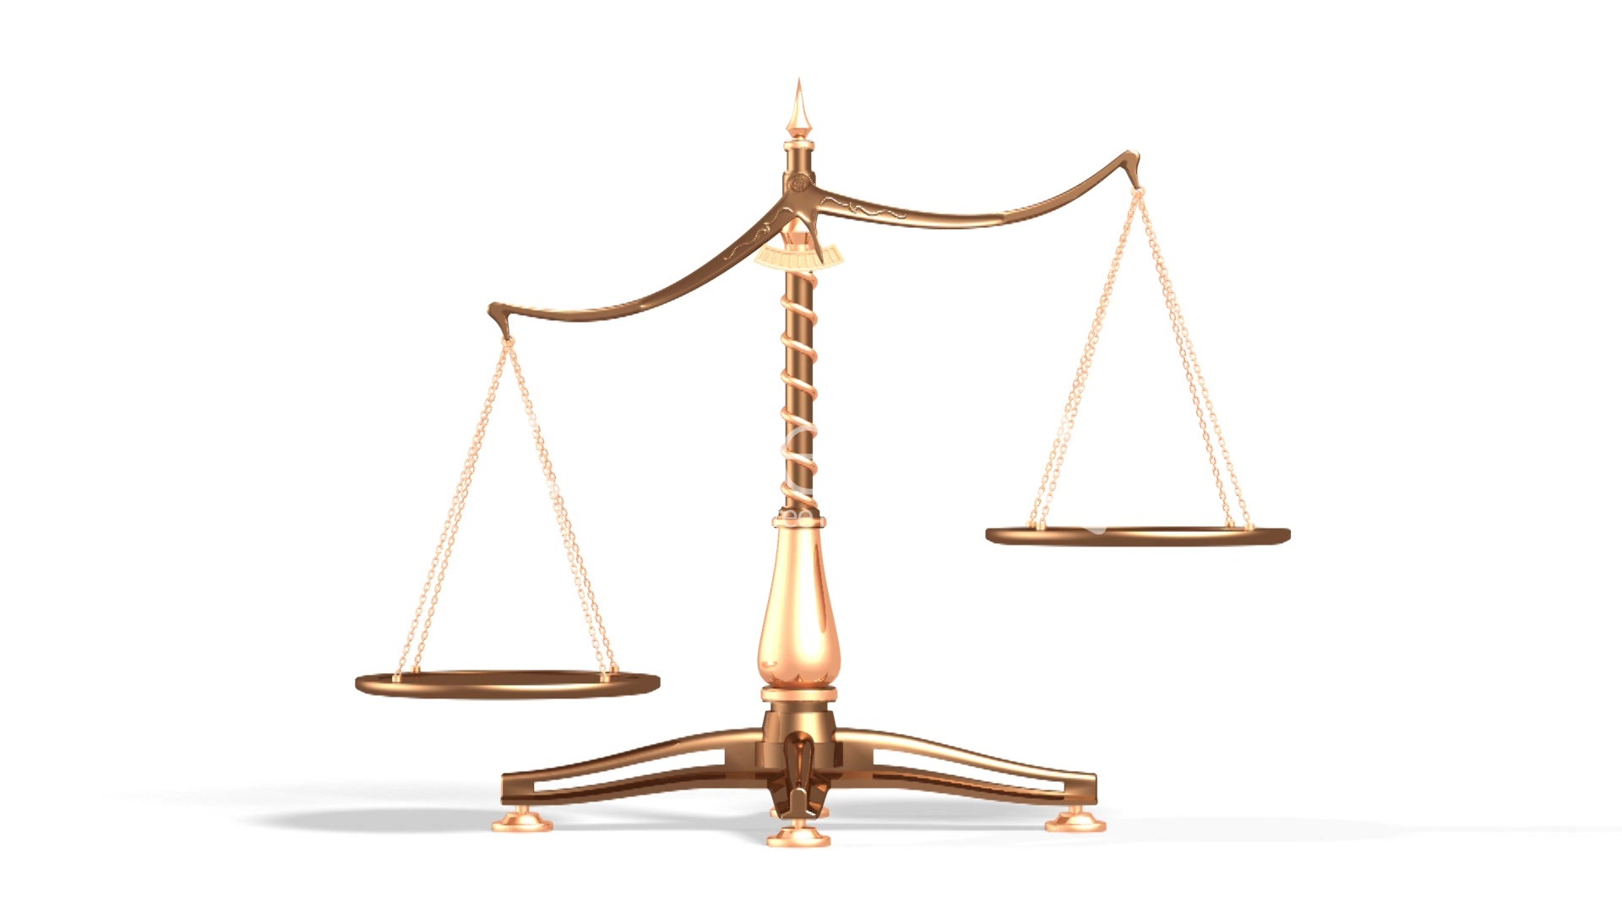
Notes:
Oxidants - Antioxidants
Enzymes – Hormones – Neurotransmitters
The reason that we Feel – or Look – or Perform at a certain level is because of our balance – or lack of balance

Slide 5
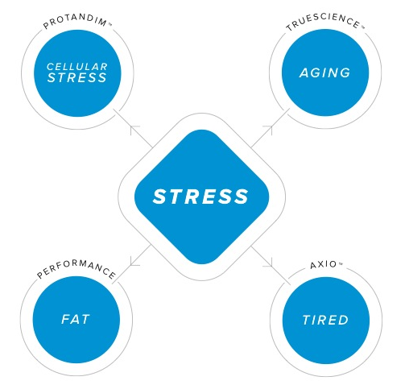
Best Future You
Notes:
Most of us have a word for this lack of balance - Stress

Slide 6




Slide 7
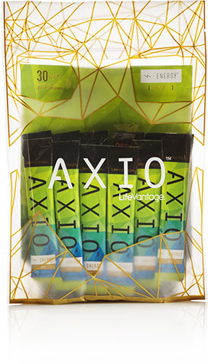
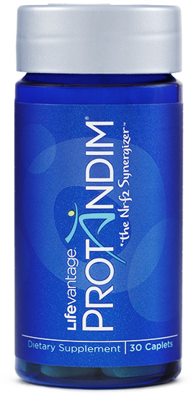
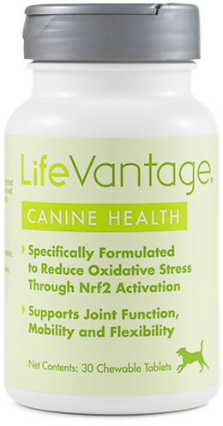
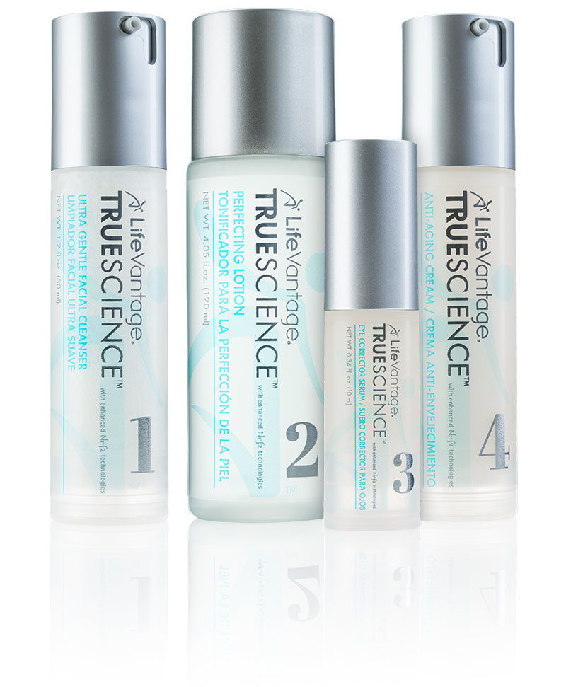
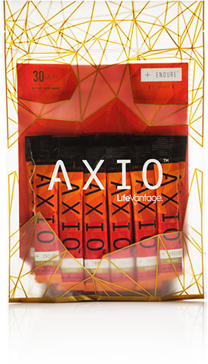

Slide 8
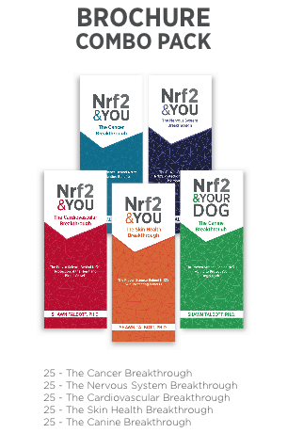

Slide 9
Scientific Advisory Board
Ethnobotany & Botanical Sciences
Michael J. Balick, PhD
Vice President for Botanical Science, The New York Botanical Garden
Immunology & Endocrinology
Jun Nishihira, MD, PhD
Professor, Dept of Medical Informatics, Hokkaido Information University
Brain Function / Psychiatry
Edward (Ned) Hallowell, MD
The Hallowell Center (Boston & NYC)
Veterinarian Medicine
Michael S. Davis, DVM PhD Dipl ACVIM, ACVSMR
Center for Veterinary Health Sciences, Oklahoma State University

Slide 10
Medical Advisory Board
Cardiology
Mark Gordon, MD (Chair) - Sioux Falls, SD
Chiropractic Medicine
Ed Weathersby, DC (Phoenix, AZ)
Dentistry
Gene Tynes, DDS (Great Falls, MT)
Family Medicine
Gene Delucia, DO (Tampa, FL)
Pathology
Svetlana Silverman, MD (Edmonton, Alberta, Canada)
Veterinary Medicine
Lee Seward, DVM (Eaton, CO)

Slide 11
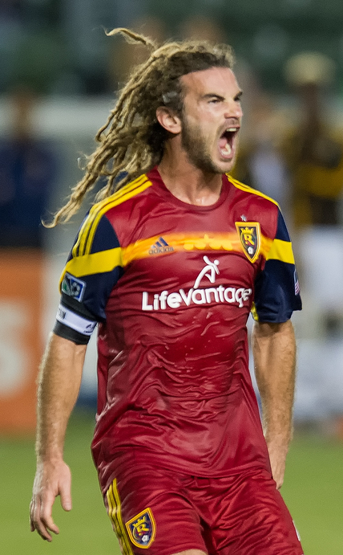
LifeVantage Sports Science Lab @ RSL
Gather data
Customize training
Monitor progress
Optimize performance
Protandim
Wicked Fast (pre/post)
Axio

Slide 12
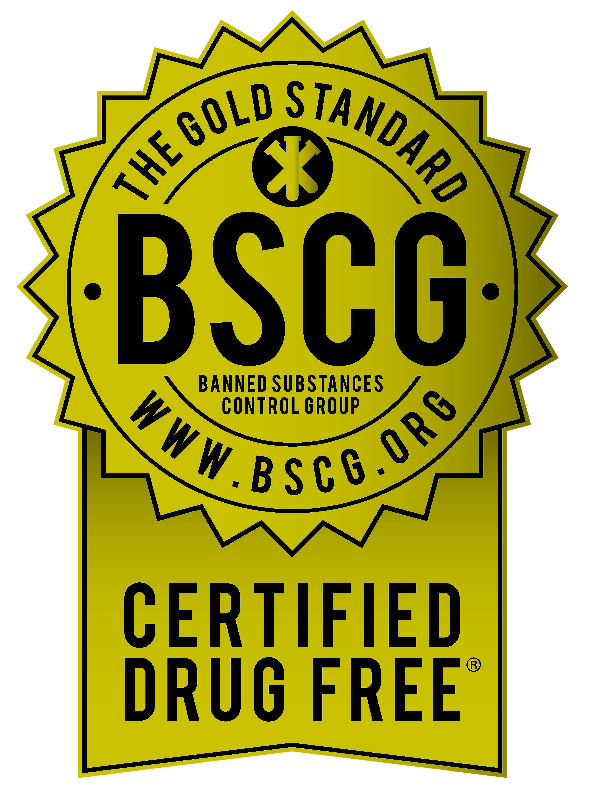
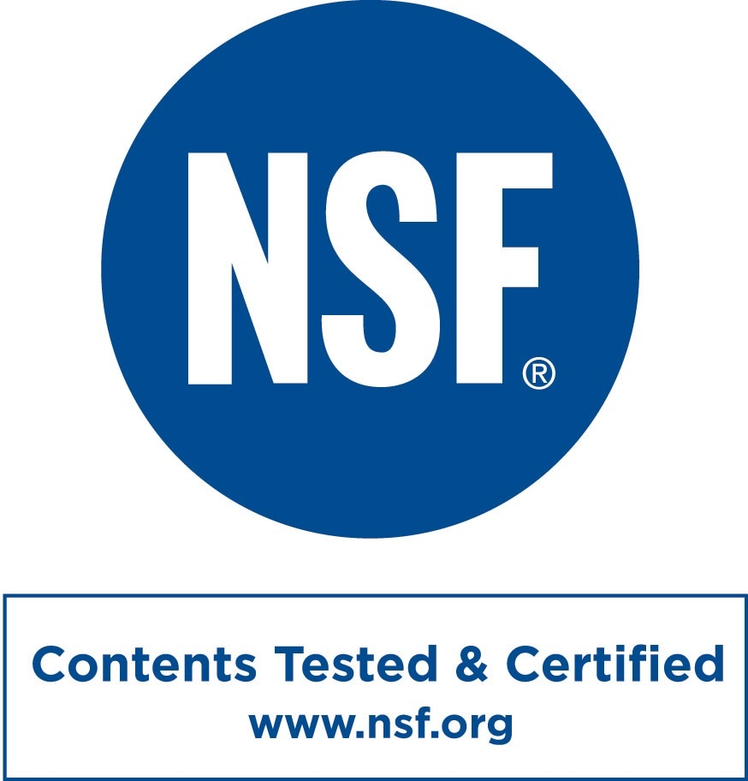

Slide 13

LifeVantage Lab Series
NEW Episode 1
  Product Overview w/Axio
NEW Webinars
  Bi-monthly science topics
  March 4

Slide 14
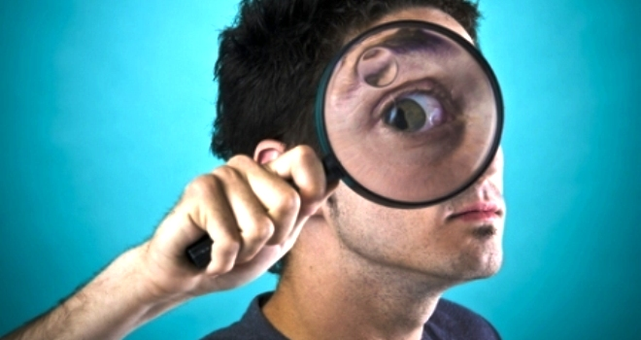
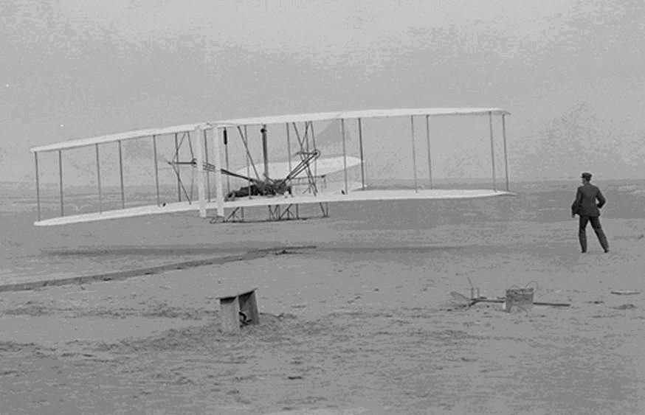
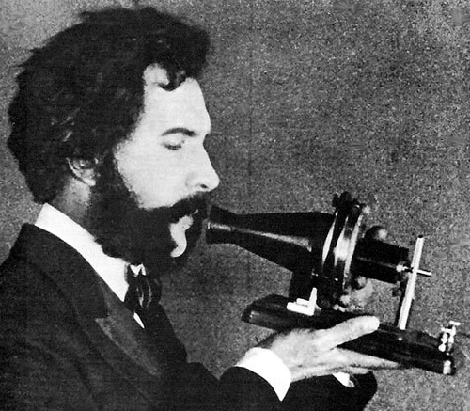
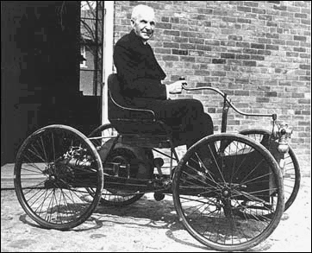

Notes:
Skeptics versus True Believers
Here's the thing about proving skeptics wrong: They don't care. They won't learn. They will stay skeptics. The ones who said the airplane would never fly ignored the success of the Wright Bros. and went on to become skeptical of something else.
Instead of working so hard to prove the skeptics wrong, it makes a lot more sense to delight the true believers.
They deserve it, after all, and they're the ones that are going to spread the word for you.

Slide 15
Stress / Balance is Hot
TEDxSandy – April 2014
The 431 Project – Sept 2014
ACLM – Oct 2014
A4M – Dec 2014
Biochemical Society – Jan 2015
Experimental Biology – March 2015
Philippine Heart Association – May 2015
NIH Healthy Aging Summit – July 2015
www.ShawnTalbott.com

Slide 16
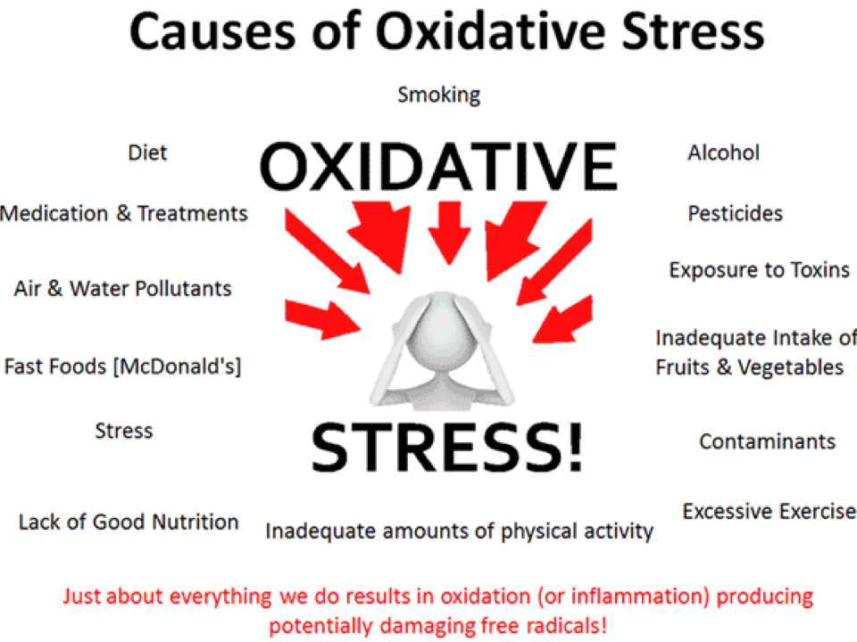

Slide 17
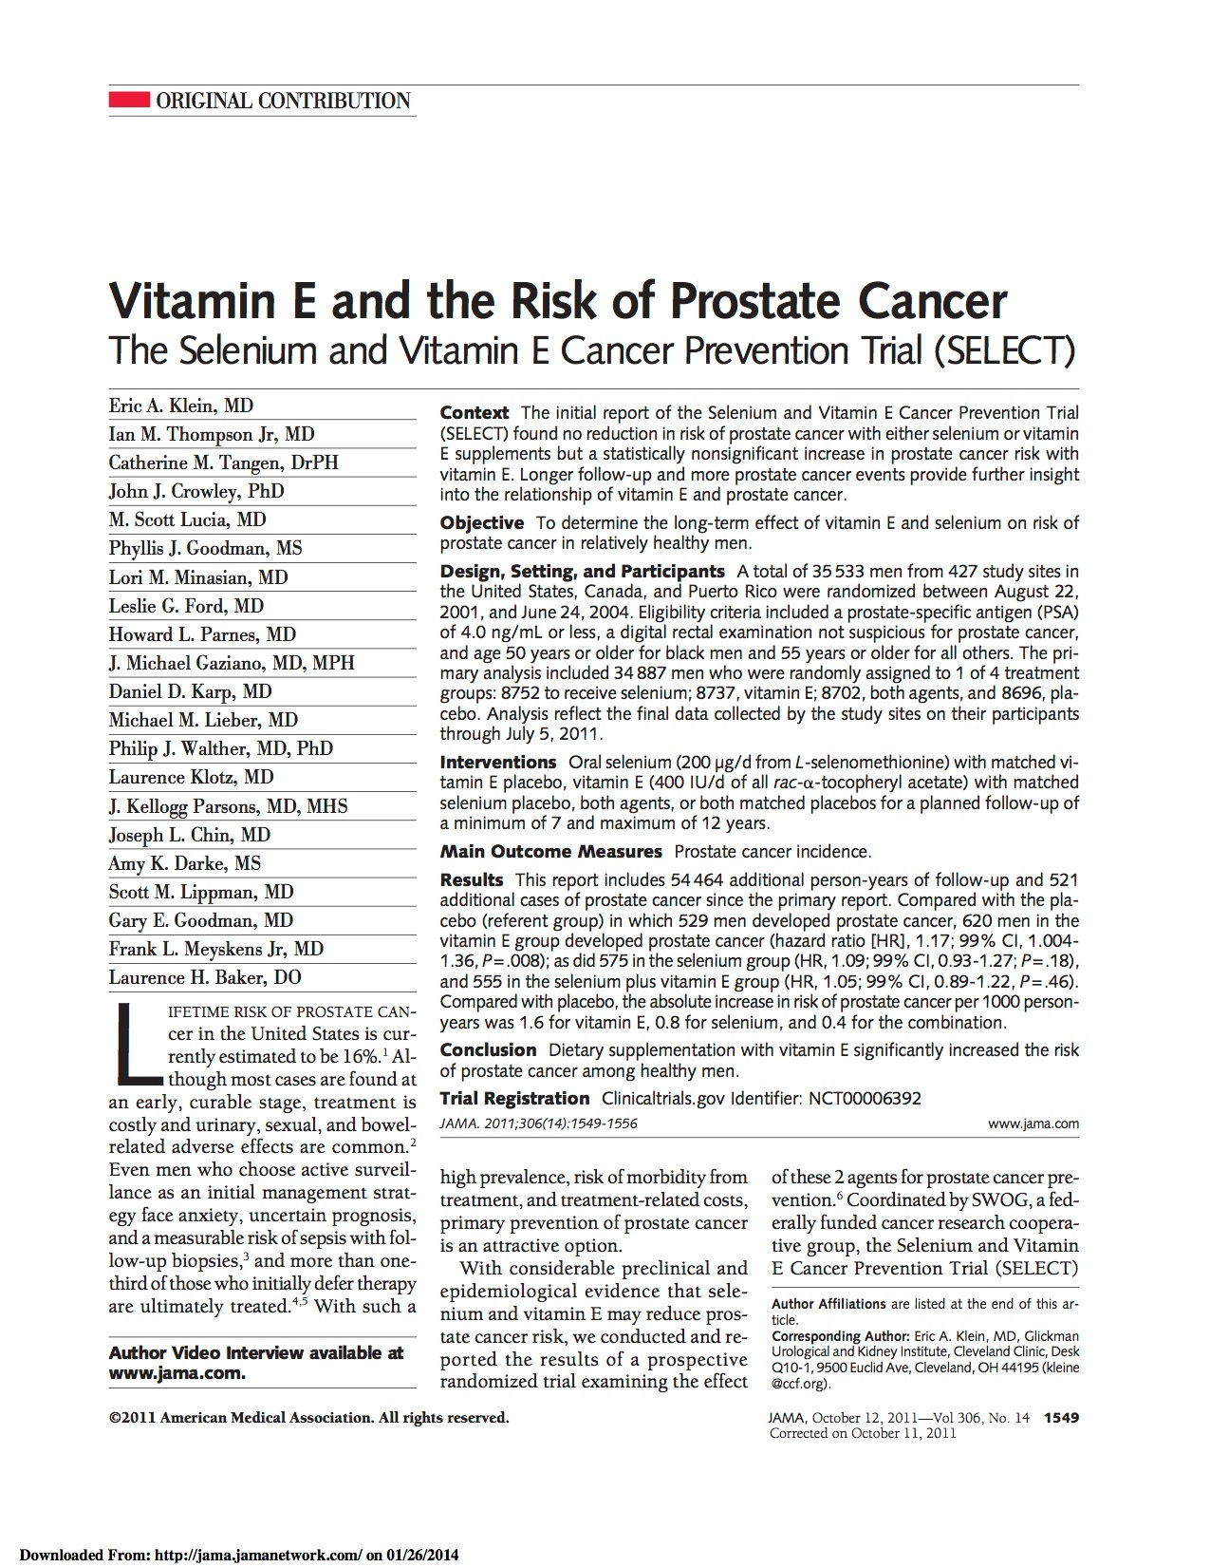
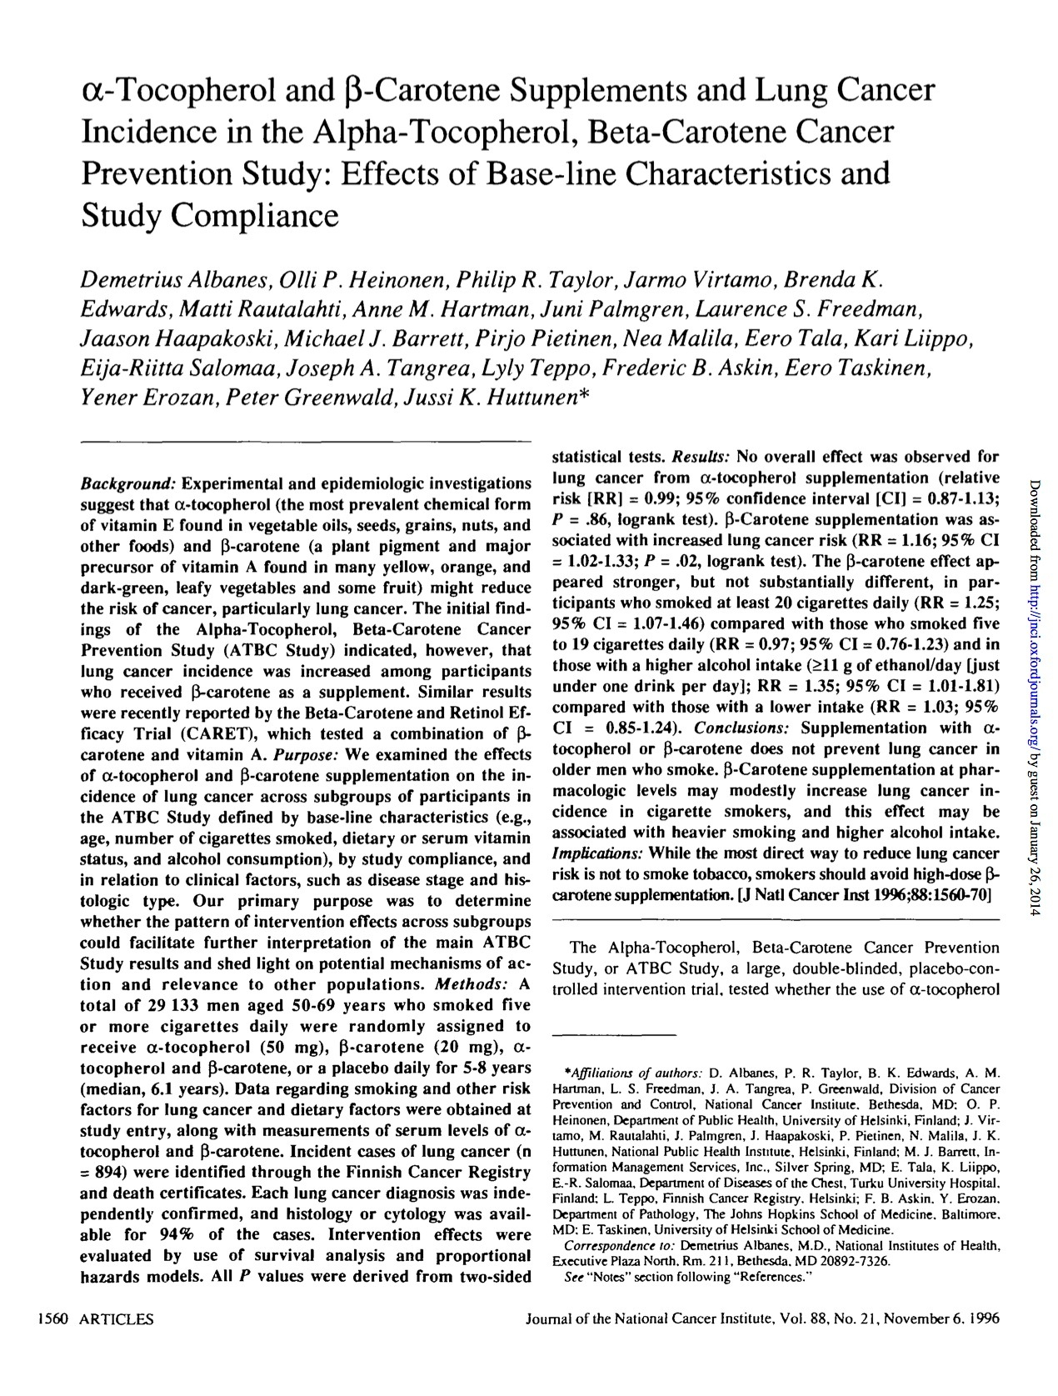
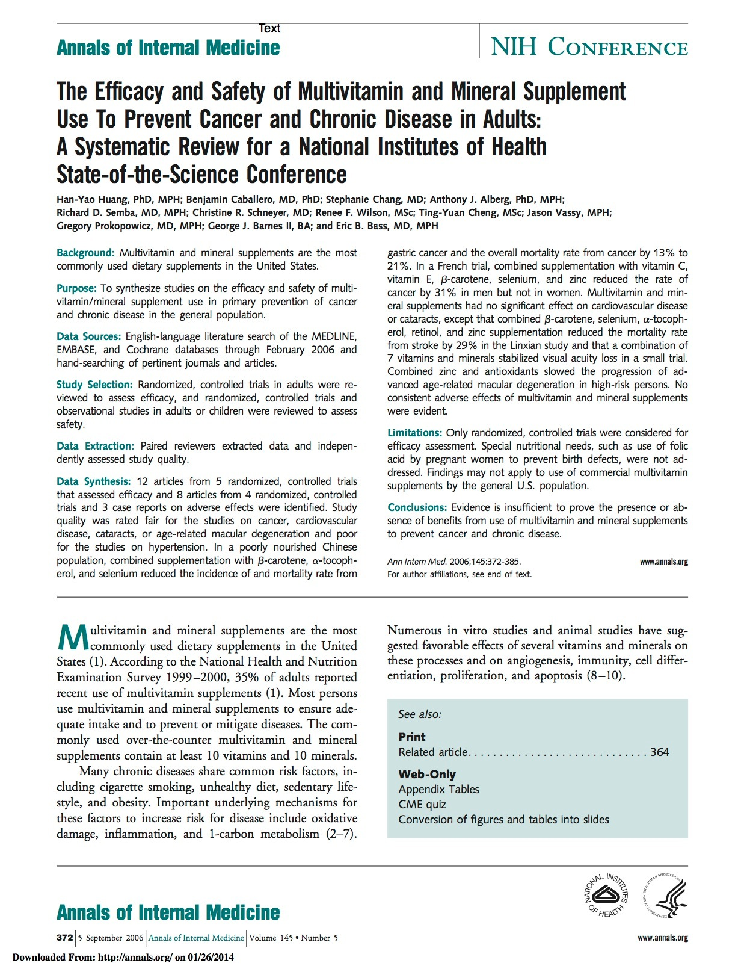
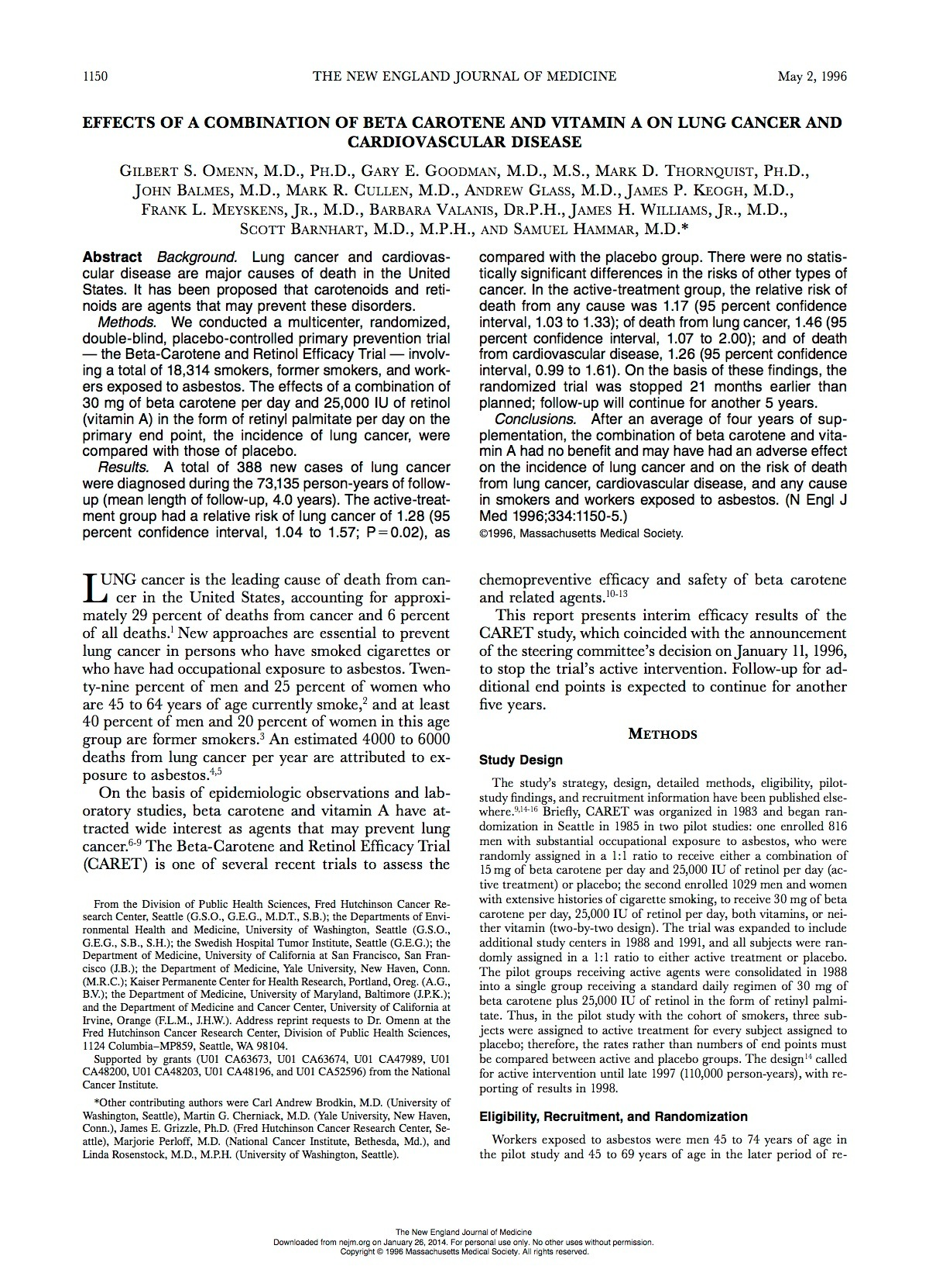
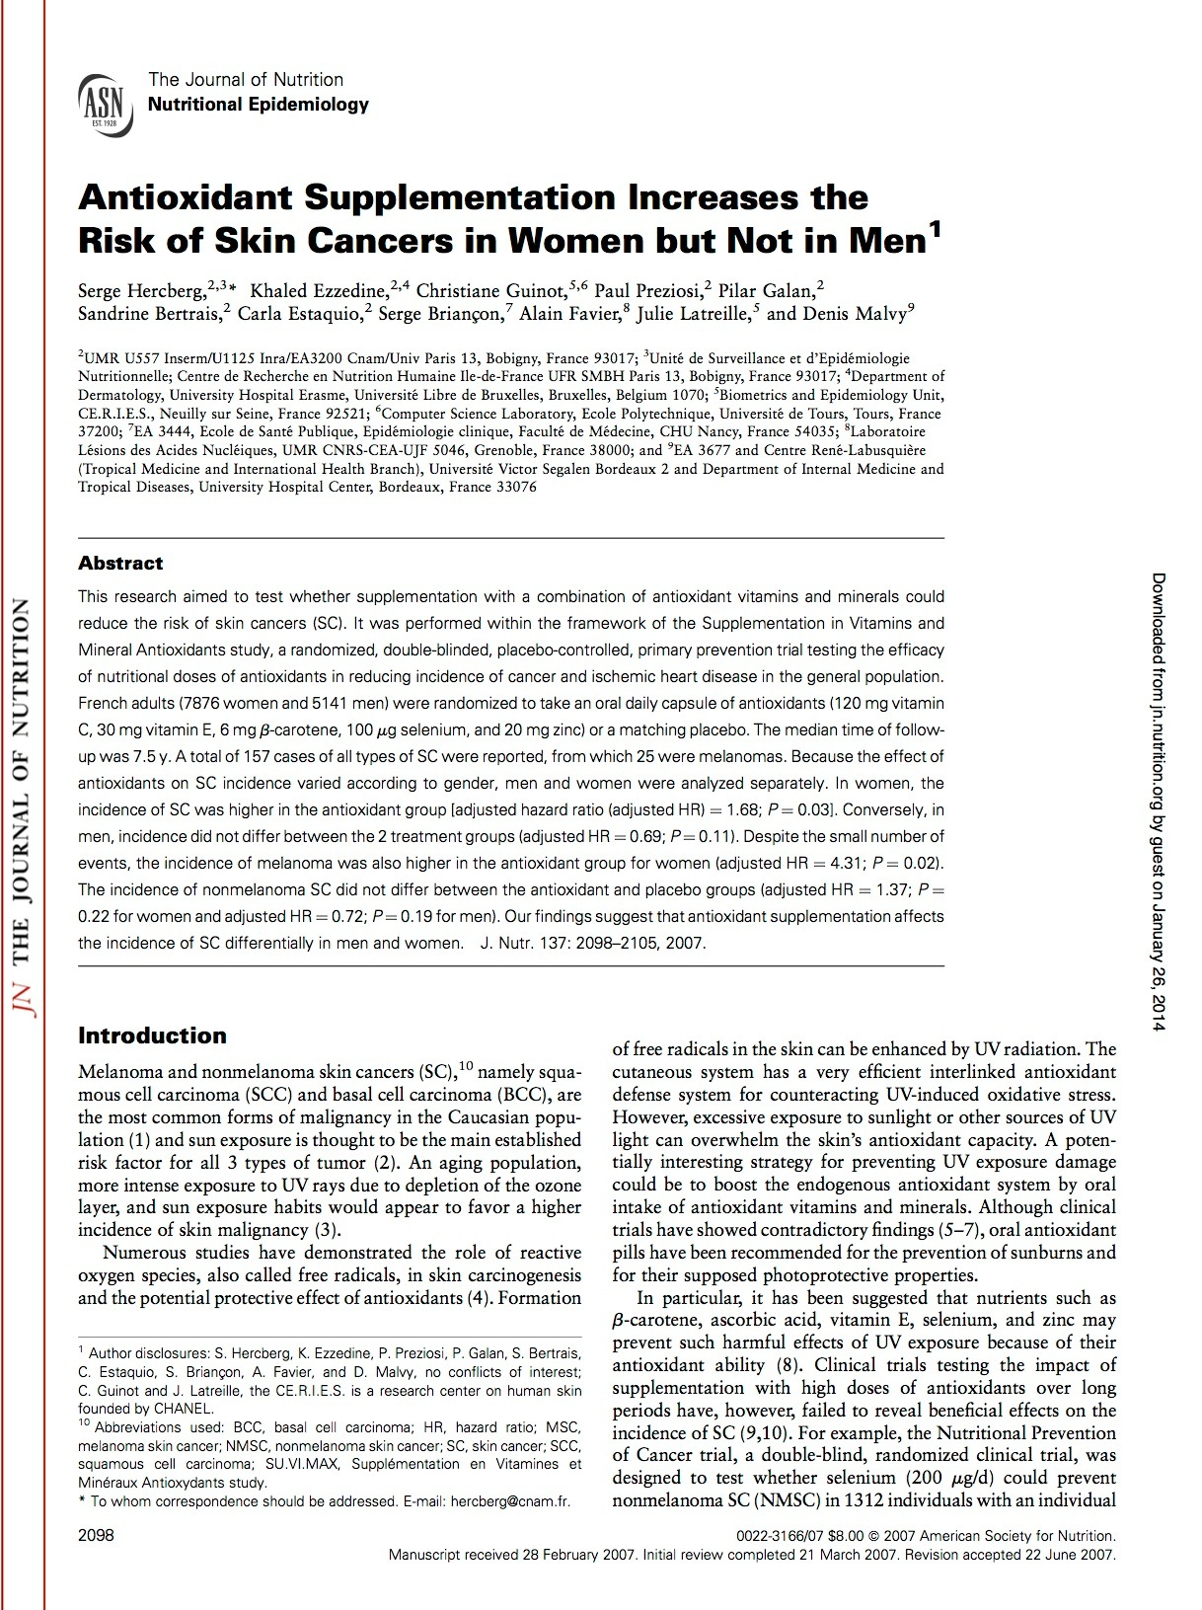
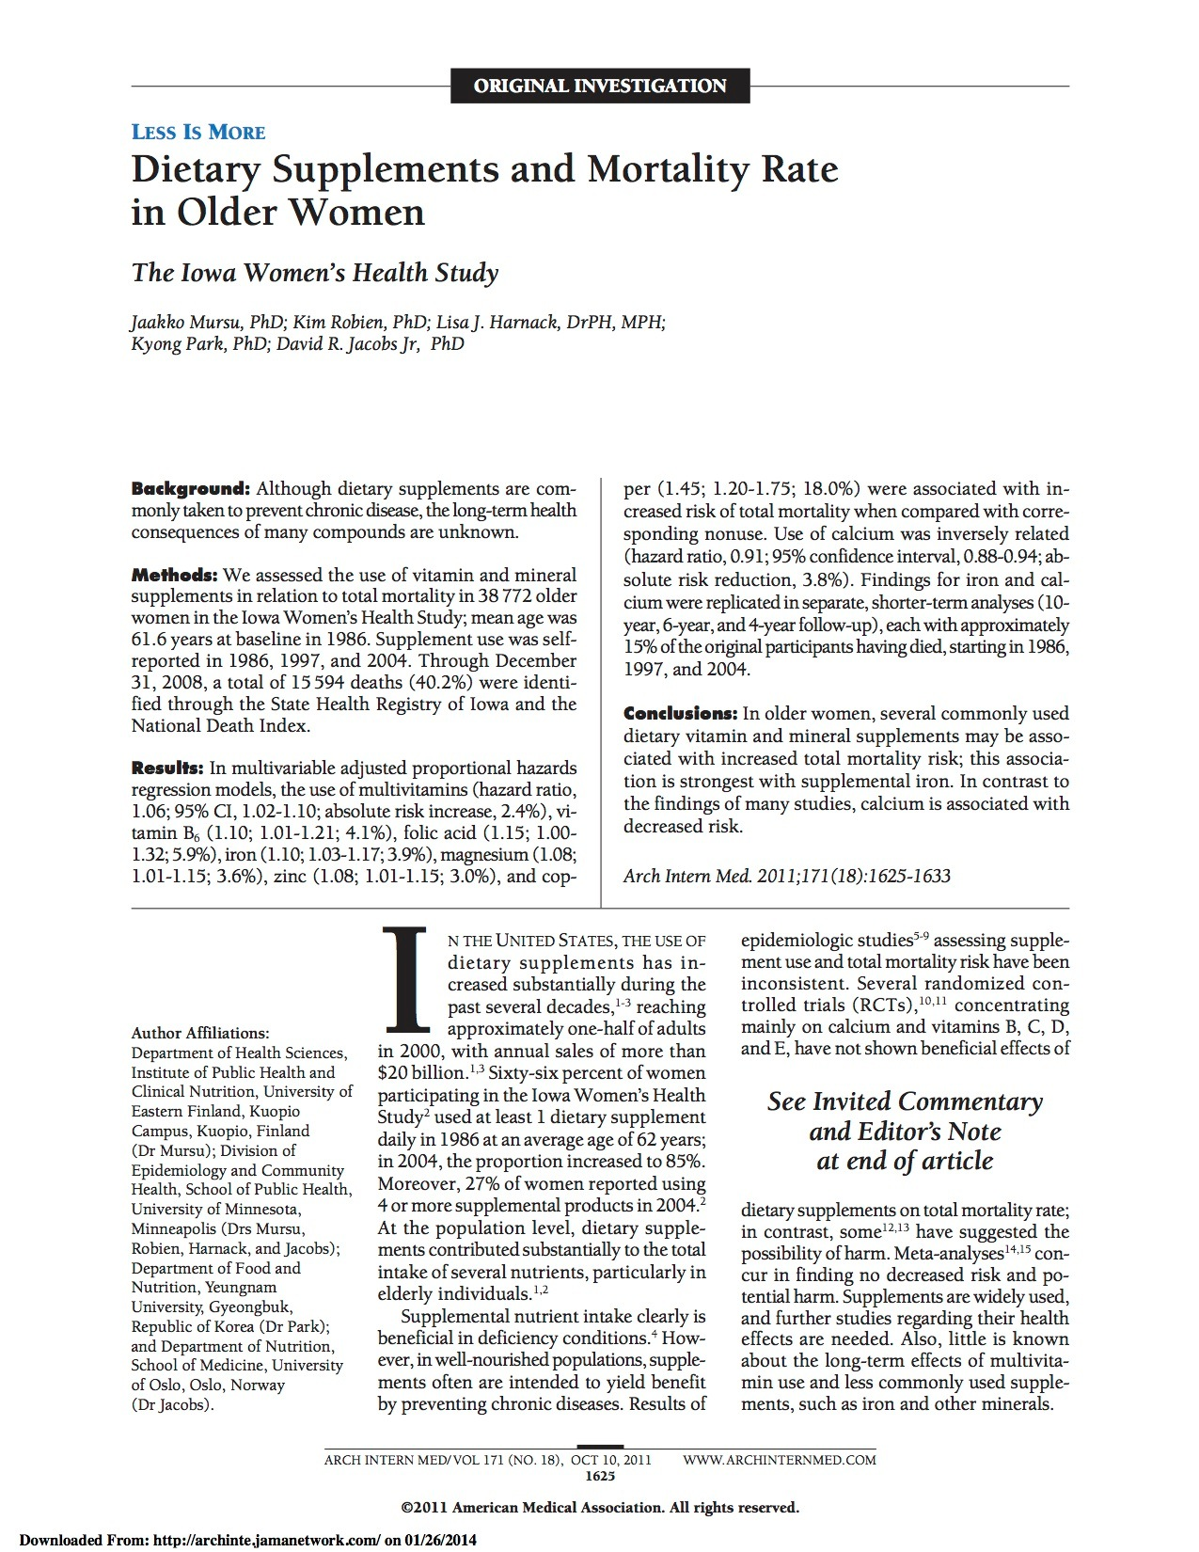
Notes:
Enough is enough: Stop wasting money on Vitamins and Mineral supplements (n=400,000 from 27 trials; Annals of Internal Med-2013)
Oral High-Dose Multivitamins and Minerals After Myocardial Infarction - did not significantly reduce cardiovascular events in patients after MI (Annals of Internal Med-2013).
Long-Term Multivitamin Supplementation, in male physicians (n= 5947) aged 65 years or older, did not provide cognitive benefits (Annals of Internal Med-2013).
Hennekens CH, et al. Lack of effect of long-term supplementation with beta-carotene on the incidence of malignant neoplasms and cardiovascular disease. N Engl J Med. 1996; 334:1145–49.
Albanes D, et al. Alpha-tocopherol and beta-carotene supplements and lung cancer incidence in the alpha-tocopherol, beta-carotene cancer prevention study: effects of base-line characteristics and study compliance. J Natl Cancer Inst. 1996; 88:1560-70.
Omenn GS, et al. Effects of a combination of beta-carotene and vitamin A on lung cancer and cardiovascular disease. N Engl J Med. 1996; 334:1150-55.
Hercberg S, et al. Antioxidant supplementation increases the risk of skin cancers in women but not in men. J Nutr. 2007; 137:2098-105.

Slide 18
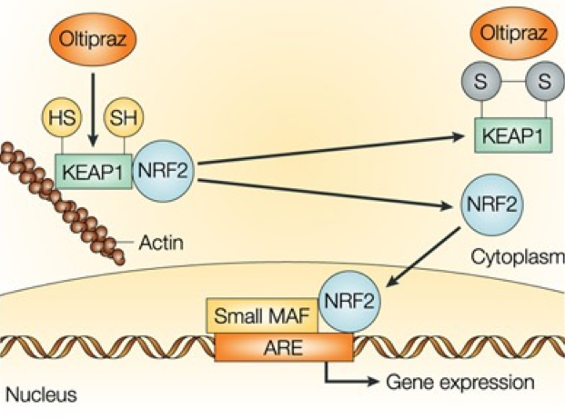
Nrf2 Activator
Nrf2 Activator

Slide 19
Don’t Take Antioxidants
Make Antioxidants!

Slide 20

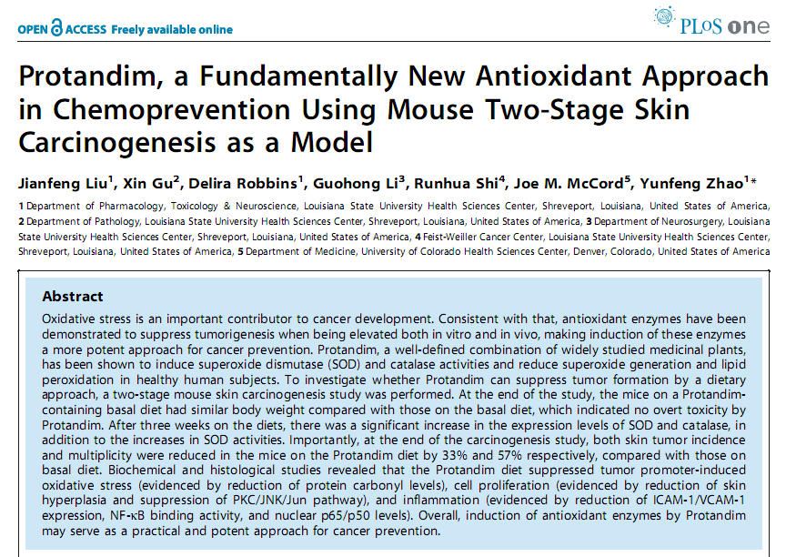
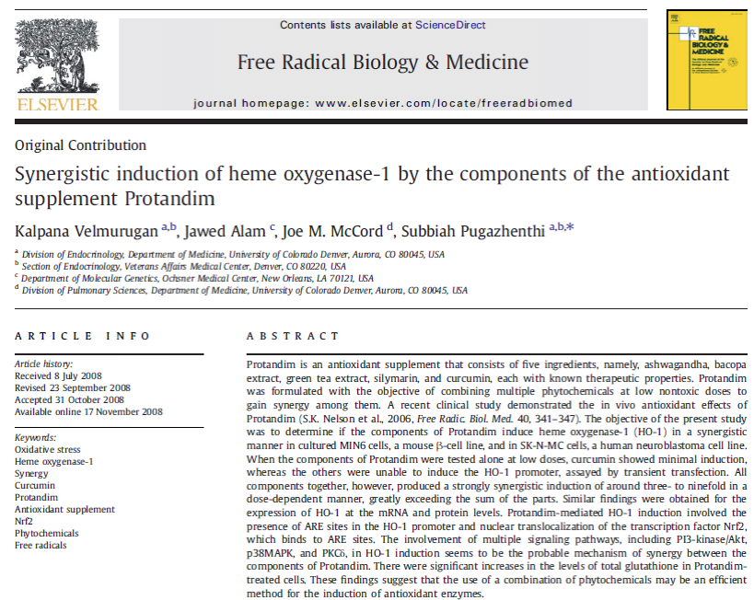
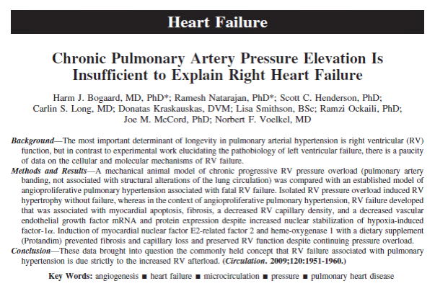
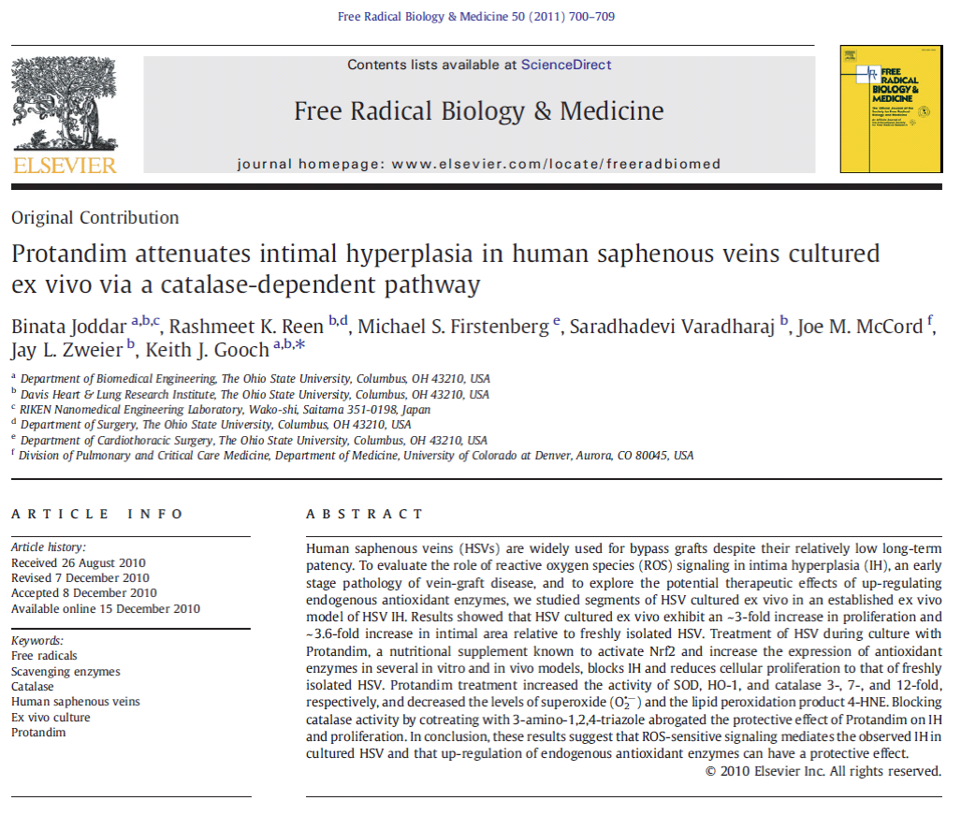
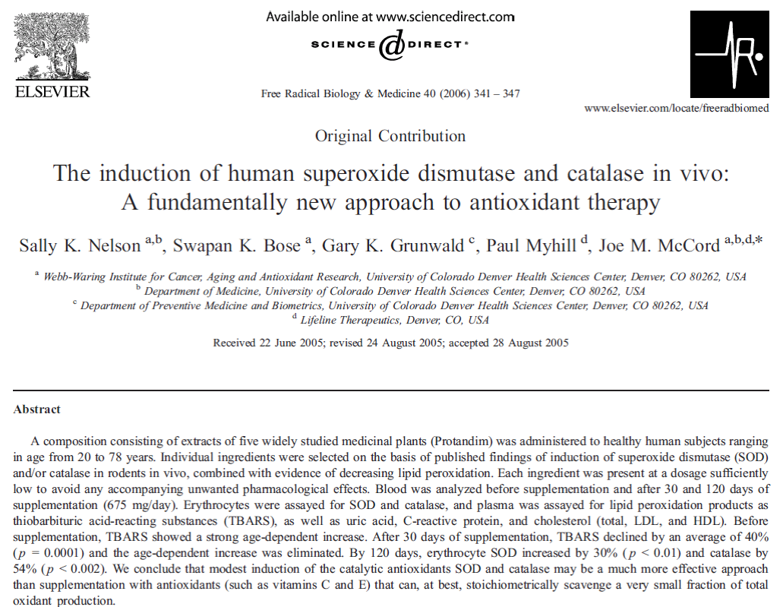
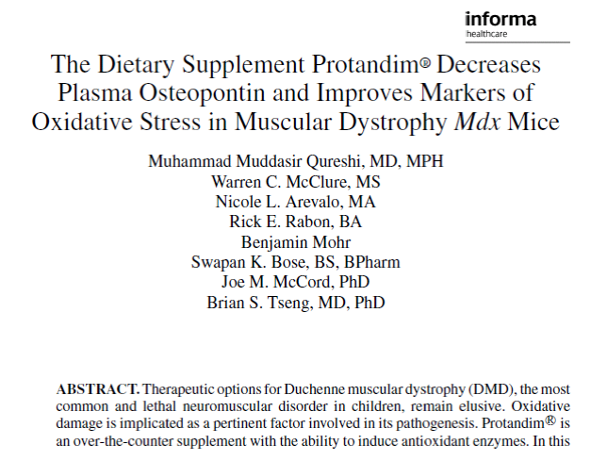
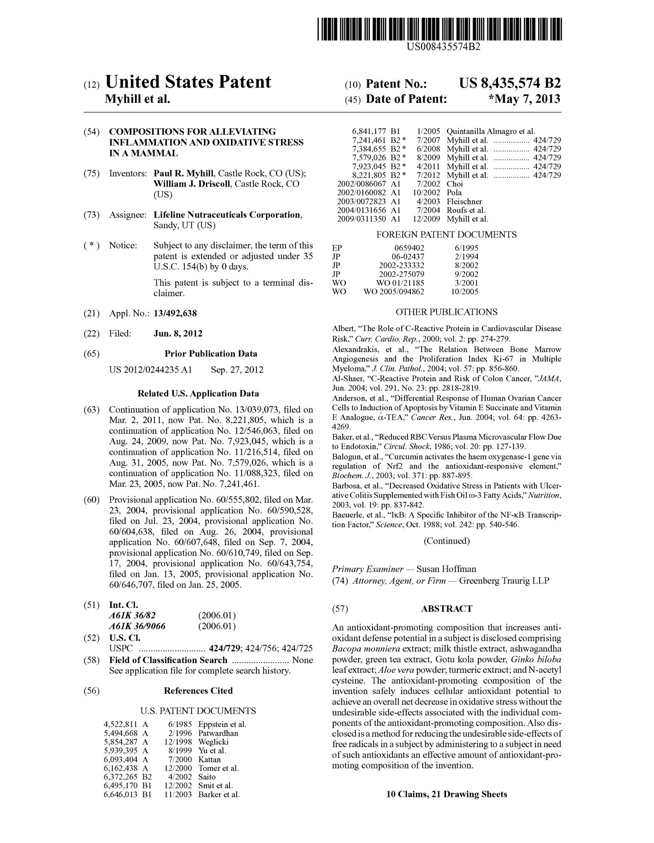
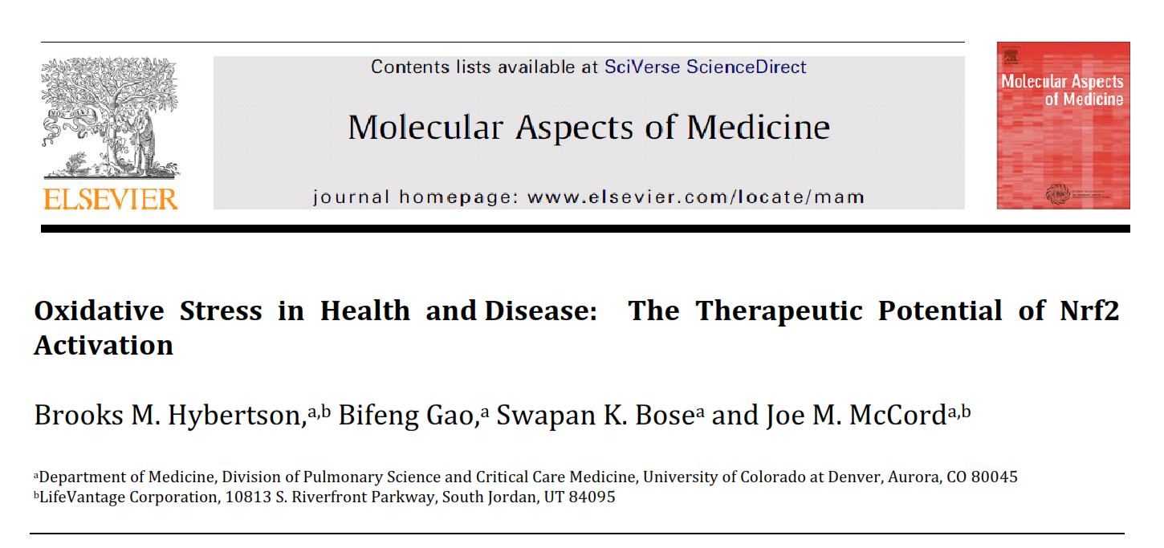
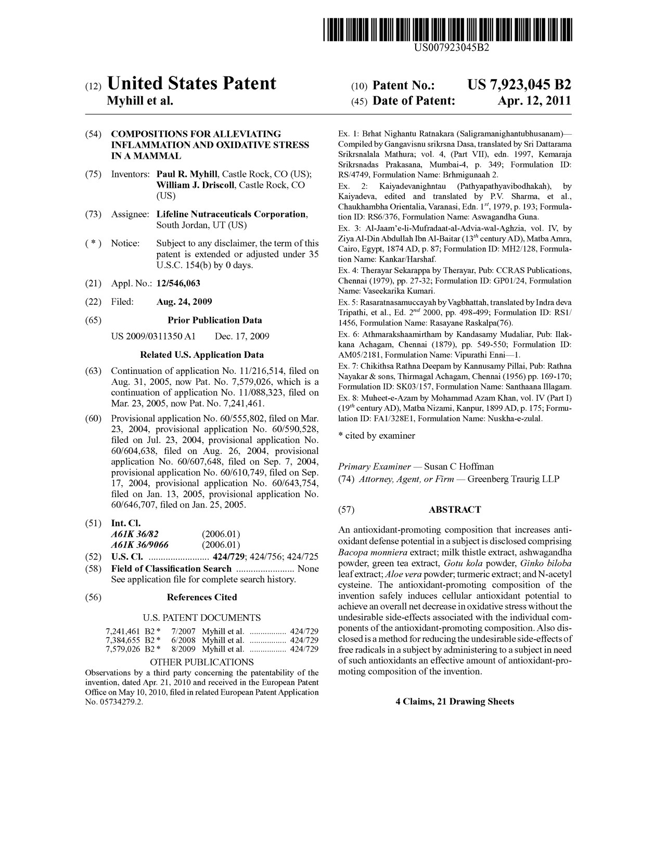
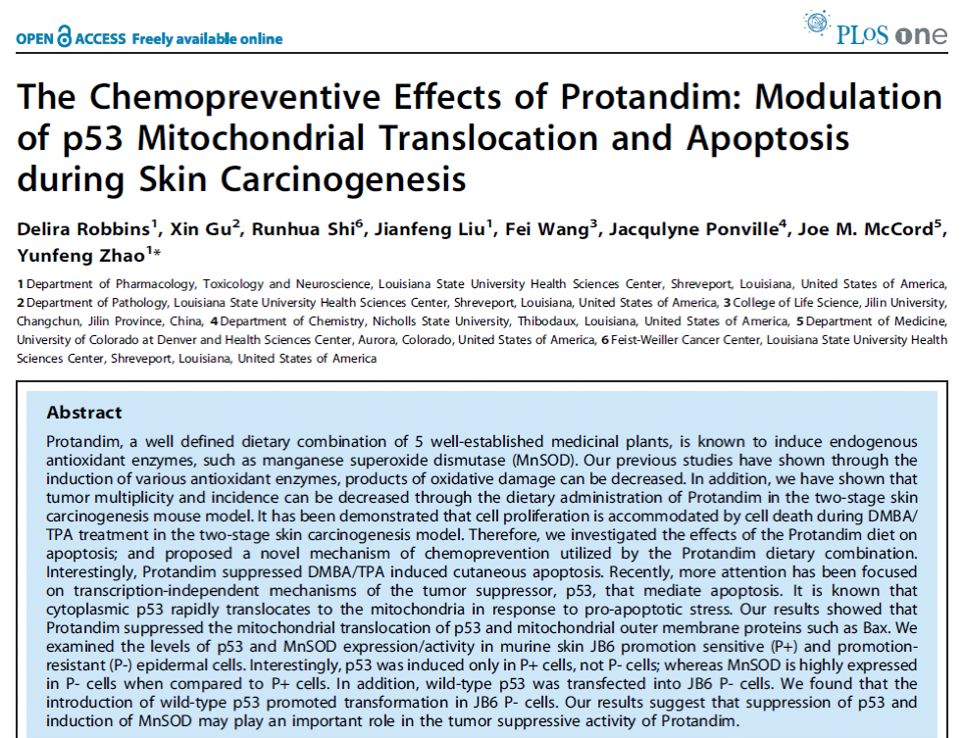
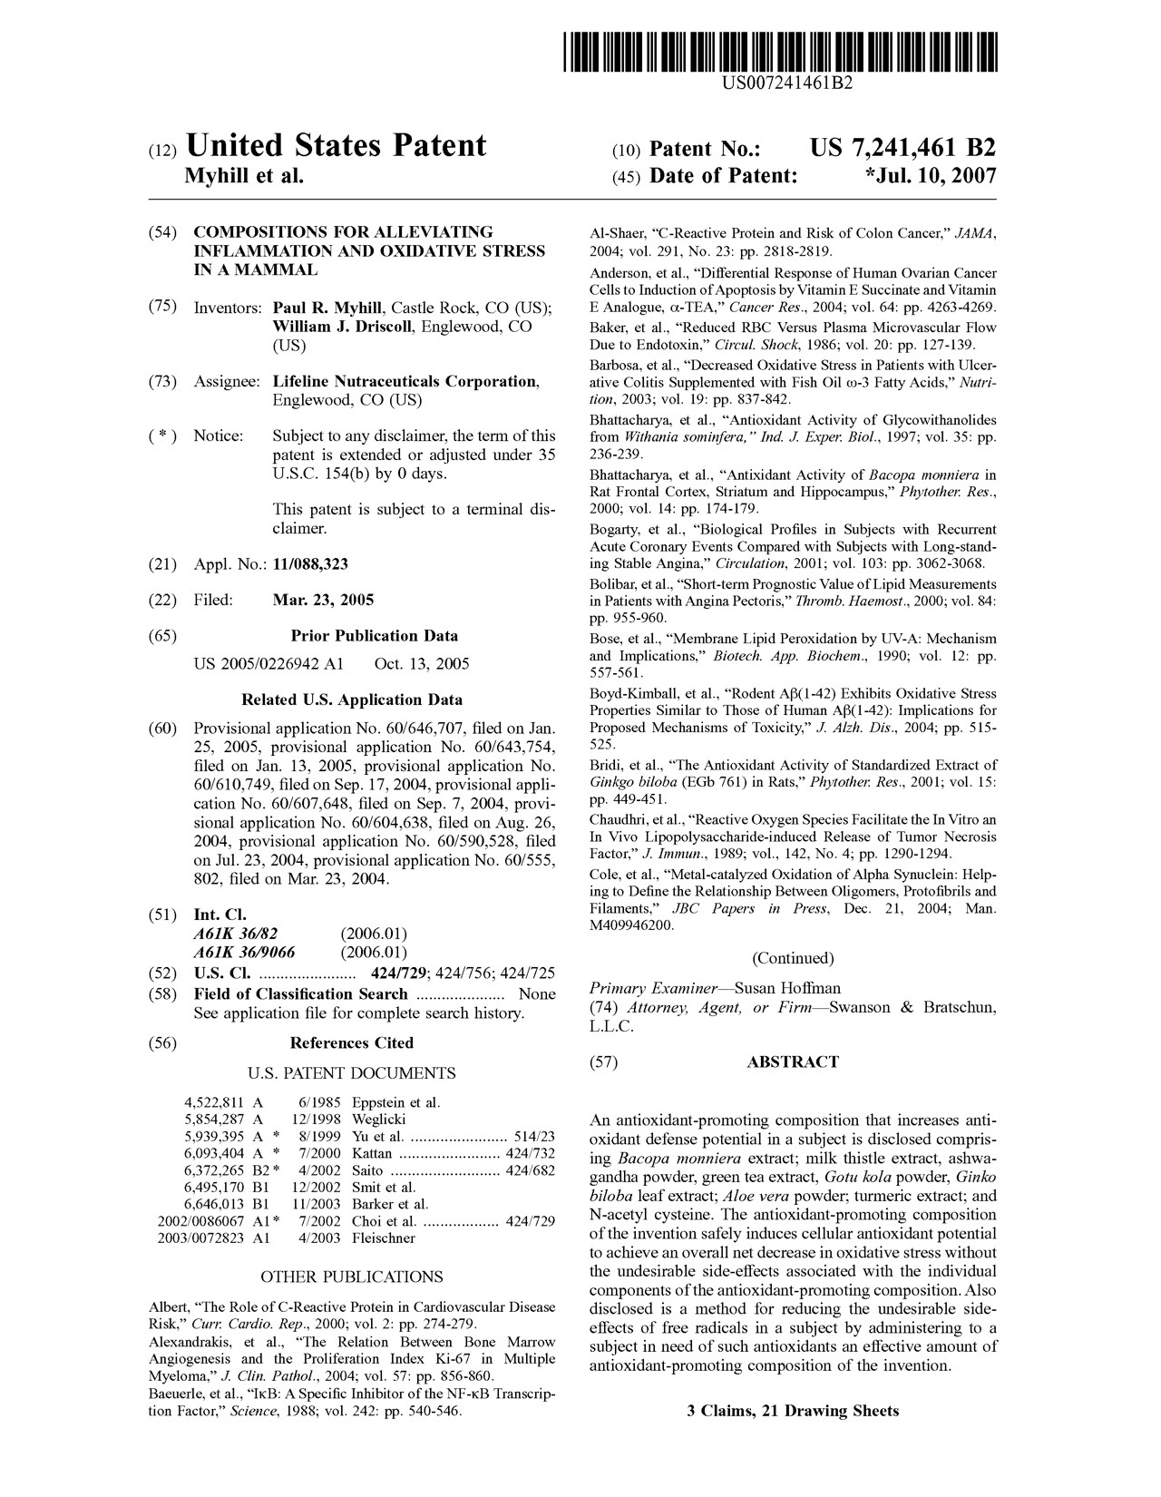

Slide 21
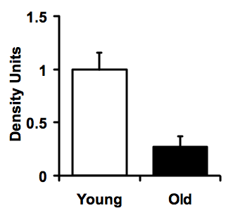
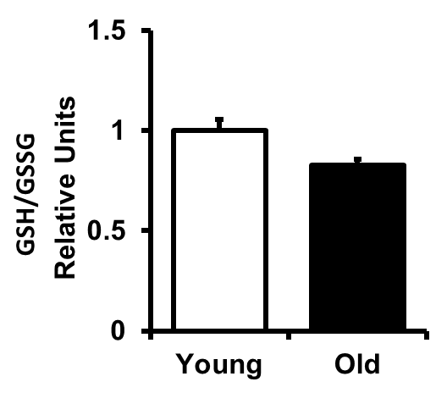
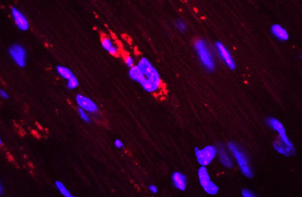
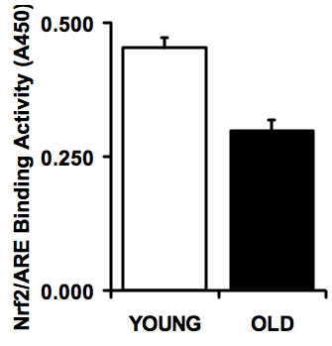
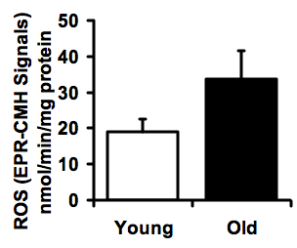
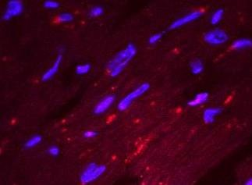
Nrf2 Declines with Age and Induces Oxidative Stress
Increased oxidative stress
WT (C57/Bl6) Mouse
YOUNG
OLD
p<0.05
NRF2
*
Lamin-B1
Nrf2
YOUNG
*
p<0.05
OLD

Slide 22
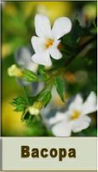
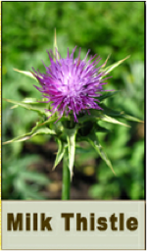
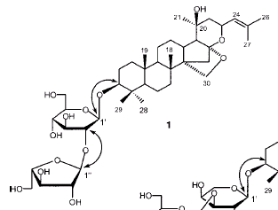






Nrf2 = a powerful “master regulator” of antioxidant enzymes and survival genes
Silymarin
Bacopa
HOCH₂
C
H
3
O
O
C
H
C
H
3
3
O
C
H
3
Withaferin A
Epigallocatechin gallate
EGCG
O
H
O
Curcumin

Slide 23


Slide 24
4
3.5
R
2
= 0.238
Before Supplementation
3
2.5
Oxidative Stress
TBARS (micromolar)
2
1.5
1
0.5
After Supplementation 30 d
R
2
= 0.003
0
0
20
40
60
80
100
AGE
After 30 days…
“Remarkably, this age-dependent increase in TBARS was almost completely abolished by Protandim treatment (Fig. 1D), with an overall average reduction of the oxidative stress marker by 40%.”

Slide 25

Nrf2 Staining Intensity 24 hours after UV Exposure
TrueScience™ Facial Cream results in more Nrf2 in skin, thus more protection!
Notes:
The next testing was to look at the amount of Nrf2 protein present in the skin also by Immunostaining. The untreated skin samples that were exposed to UVs at Day 5 showed less Nrf2 staining 24 hours later, at day 6. Applying the non-Nrf2 cream to the skin 2 twice a day for 5 days and exposing it to UV leads to a reduction also in the Nrf2 stain.
With the application of the new TS cream, after UV exposure the skin has a greater amount of Nrf2. Greater amount of Nrf2 implies greater protection
By immuno-staining the skin sample and looking at the amount of stain taken by Nrf2 protein by microscopy
Keep in mind that more stain (color) means more Nrf2 protein,
More Nrf2 is good because it implies more Protection

Slide 26

Less Thymine Dimers with TrueScience
TrueScience™ Facial Cream with Nrf2 protects the cell DNA!
Notes:
The day following the exposure to UV rays, we look at the surface that was occupied by thymine dimers that had been immunostained. For the skin samples that were left untreated, the surface with thymine dimers was 7.7%. The skin that had been treated with the non-Nrf2 cream showed an increase of 13% of the surface occupied by the dimers. More importantly the skin samples to which TrueScience facial cream had been applied had a 29% reduction in thymine dimers from the untreated or the non-nfr2 cream. This is significant because cellular DNA damage affects the cell ability to replicate properly and thus accelerates cellular aging.

Slide 27

TrueScience^{tm} Facial Cream with Advanced Nrf2 Technology has been shown to:
Boost skin protection from UV exposure by reducing DNA damage
Increase Nrf2 Protein amount, thus improve resistance to oxidative stress
Fight the signs of aging though all layers of the skin

Slide 28
TrueScience Shaving Study
27 subjects (13 African-Americans), 30-65y
7 day usage
  Ultra-Gentle Cleanser (shave)
  Perfecting Lotion (repair)
  Facial Cream (protect)
Measures Pre/Post (trained technician)

Slide 29
Shaving – Irritation
0 = None / 2-3 Mild / 4-5 Moderate / 8-9 Severe
#
#
*
*
*
*

Slide 30
Shaving – Barrier Function
TEWL – trans-epidermal water loss (higher = more damage)
5-12 Healthy / 13-16 Strained / 17+ Critical
#
#
*
*
*
*

Slide 31
Shaving - Results
Irritation Reduced 32%
Barrier Function Improved 28%
High Response rate (85%-100%)
Good for Guys! (Bulletproof Skin)

Slide 32






















$100B+
Notes:
we’re spending $100 billion every year because we don’t feel the way we want to feel…

Slide 33





Proanthocyanidin
DMAE
Quercetin
Catechin
L-Theanine

Slide 34
Axio Usage Survey

Slide 35
Axio Usage Survey

Slide 37
Nrf2 as a Convergence Point for Stress, Metabolic, and Longevity Signals

Slide 38

Notes:
The fork in the road presents two problems = Seeing it and Taking it
The good news is that there are far more people than ever pointing out the forks that are open to us. The "this" or "that" alternatives that each lead to success if we're gutsy enough to take one or the other.
Alas, taking the fork is even more difficult than seeing it.

Slide 39
Carpe Diem
Caveat Emptor
Notes:
One philosophy is caveat emptor. Let the Buyer Beware - Assume the worst. Assume you will be ignored or ripped off or disappointed. Your mileage may vary.
Another is carpe diem. Sieze the Day! Seize the moment to connect, to keep promises and most of all, to figure out how to look people in the eye or not promise you will
Inventing isn't the hard part. The ideas that change the world are changing the world because someone cared enough to stick it out, to cajole and lead and evolve. But even though the inventing isn't the hard part, it scares us away.
Before you tell yourself you have no right to succeed and certainly no right to change the world, remind yourself that the person before you had no right either, but did it anyway.

